Slide 1
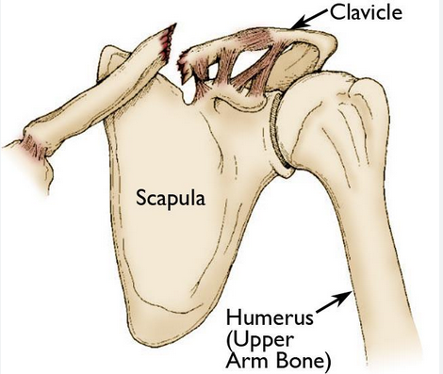
Clavicle Fracture
Mohsen Avandi
Semnan University

Slide 2
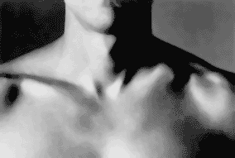
Clavicle Fracture
A clavicle fracture is a break in the clavicle bone (also called the collarbone).
The clavicle can fracture in three different places:
Middle third—the middle portion of the clavicle, which is the most common site for a clavicle fracture.
Distal third—the end of the clavicle connecting to the shoulder.
Medial third—the end of the clavicle connecting to the sternum.

Slide 3
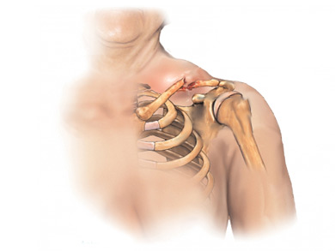
Clavicle Fracture
Causes
A clavicle fracture is caused by trauma to the clavicle bone. The trauma is usually caused by:
Direct blow to the clavicle
Falling on an outstretched arm
Newborn babies can break a clavicle passing through the birth canal

Slide 4
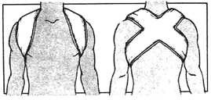
Symptoms
Symptoms include:
Pain, often severe
Sagging shoulder, down and forward
Inability to lift the arm because of pain
A lump or visible deformity over the fracture site
Tenderness and swelling of the affected area

Slide 5
Exercises
When your doctor decides you are ready, start shoulder range-of-motion and strengthening exercises. You may be referred to a physical therapist to assist you with these exercises. Do not return to sports activity until your clavicle is fully healed.

Slide 6
Healing Time
A child may heal as quickly as 3-4 weeks.
An adolescent may take 6-8 weeks to heal.
An adult who has stopped growing may require 8-10 weeks to heal.

Slide 7
Nonoperative Rehabilitation Of Clavicle Fractures

Slide 8
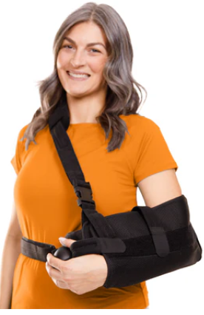
Phase I (weeks 0 to 6)
Protection
Sling immobilization at all times
Resting positions: lying supine with pillow support;
lying on the contralateral side with pillow support

Slide 9
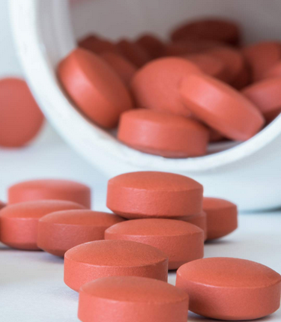
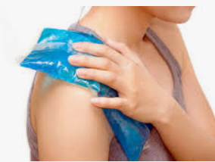
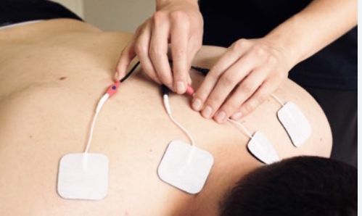
Phase I (weeks 0 to 6)
Management of Pain and Swelling
Oral pain medications
Cryotherapy
Transcutaneous electrical nerve stimulation (TENS)

Slide 10
Phase I (weeks 0 to 6)
Techniques for Progressive Increase in Range of Motion:
Initiate manual therapy techniques for IR and ER in the plane of the scapula.
Soft Tissue Techniques
Myofascial release for pectorals, trapezius
AROM wrist extension/flexion; pronation/supination;
elbow flexion/extension with arm at side; gripping exercises

Slide 11
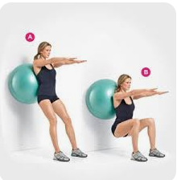
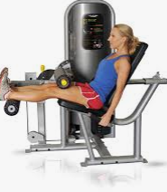
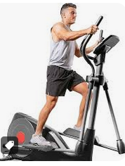
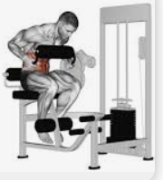
Phase I (weeks 0 to 6)
TBS
Can be incorporated early while wearing the sling
Stationary cycling and elliptical trainer
Lower abdominals; (seated machines)
Ball squats, seated LE machines for hamstrings, quads, and hip musculature

Slide 12
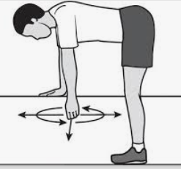
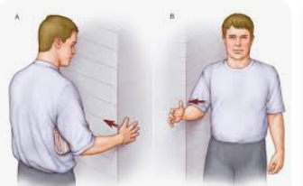
Phase I (weeks 0 to 6)
Activation of Primary Muscles Involved
Muscle activation of the primary muscles (pectorals, anterior deltoid, upper trapezius, SCM) is not indicated during this healing phase.
Submaximal rotator cuff isometrics in the plane of the scapula (PoS).

Slide 13
Phase I (weeks 0 to 6)

Slide 14
Phase I (weeks 0 to 6)
Milestones for Progression to the Next Phase
No pain at rest
Pain and swelling controlled
Radiographic evidence of union

Slide 15
Phase II (weeks 6 to 10)
Goals
Discontinue sling
Limit ROM to 90° abduction and forward flexion
Begin progressive ROM when signs of radiographic healing

Slide 16
Phase II (weeks 6 to 10)
Management of Pain and Swelling
Oral pain medications
Cryotherapy

Slide 17
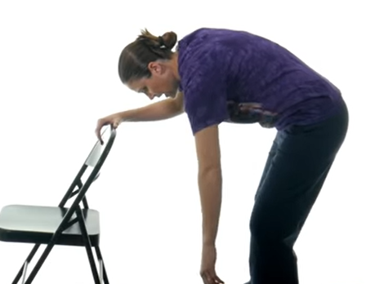
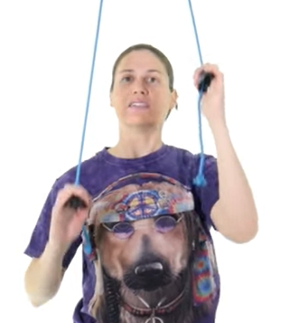
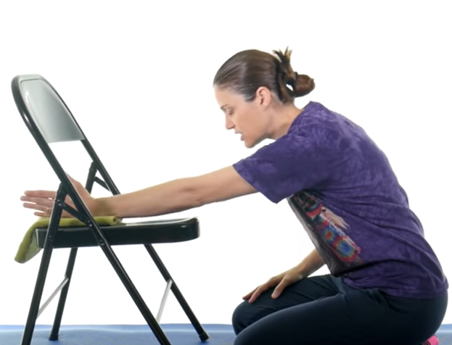
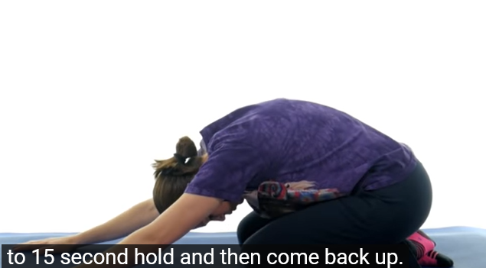
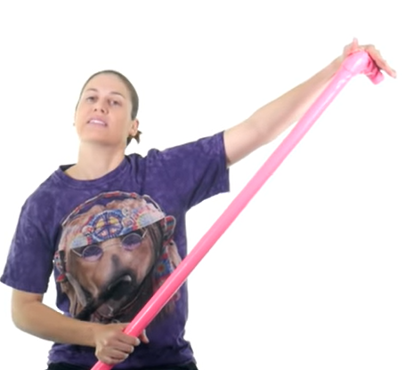
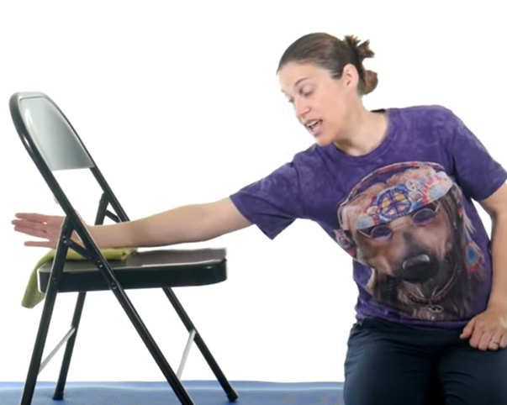
Phase II (weeks 6 to 10)
Manual Therapy Techniques
ROM exercises: passive-to-active assistive-ROM of shoulder flexion/abduction, ER at 90° abduction, IR, scapular mobility in side lying.
Soft Tissue Techniques
Therapeutic massage for the pectorals, subscapularis, posterior cuff, latissimus, trapezii.

Slide 18
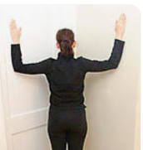
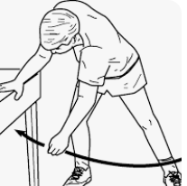
Phase II (weeks 6 to 10)
Stretching and Flexibility Techniques for the Musculotendinous Unit
Increase ER at 90° abduction with cane/stick
Can begin doorway or corner stretch for pectorals (major and minor).
Pendulum exercises

Slide 19
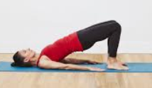
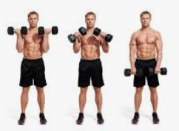
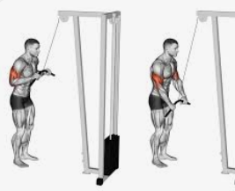
Phase II (weeks 6 to 10)
TBS
Stationary cycling, elliptical
Lower abdominals, bridging, gluteals
TAS
Avoid carrying heavy weights and traction forces with training program.
Perform pain-free exercise within the available ROM
such as biceps curls, triceps curls, scapular retraction, scapular protraction, extension.
Squats, RDLs, knee extension, knee flexion.
• Machines for hip abd/add, gluteals.

Slide 20
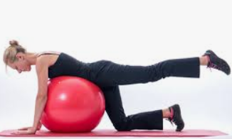
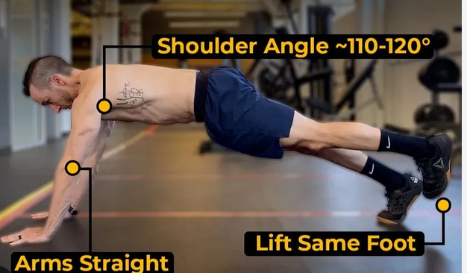
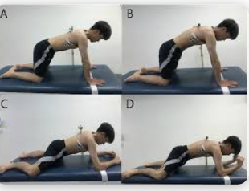
Phase II (weeks 6 to 10)
Open and Closed Kinetic Chain Exercises
Progressive strengthening of the scapular musculature such as rhomboids, serratus anterior, lower trapezius to begin to address force couple involved in shoulder flexion/abduction.
Rotator cuff strengthening
Hydrotherapy exercises

Slide 21
Phase II (weeks 6 to 10)

Slide 22
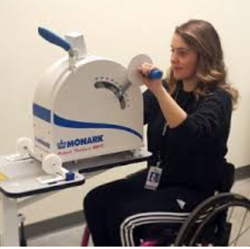
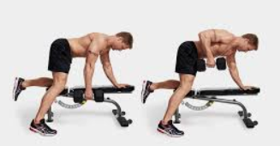
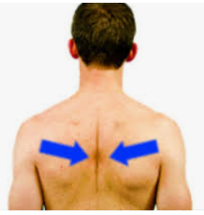
Phase III (weeks 10 to 14)
Perform pain-free exercise within the available ROM such as biceps curls, triceps curls, scapular retraction, scapular protraction, extension (dumbbell row).
• Upper body ergometry; use of arms in c-v equipment (row, elliptical, bicycle) progresses pain-free.

Slide 23
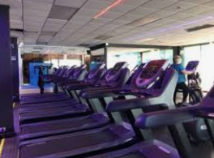
Phase III (weeks 10 to 14)
Pain should be controlled without medication
ROM exercises for flexion, abduction, ER at 90° abduction, IR.
Stationary cycling, elliptical, utilization of upper body with c-v equipment, pain-free.
Pushing activities such as wall push-ups

Slide 24
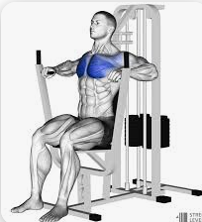
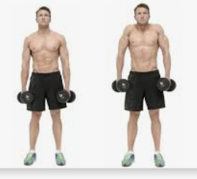
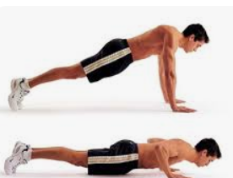
Phase IV (weeks 15 to 20)
Management of Pain and Swelling
Safe exercise progression
Monitor for swelling
Activation of Primary Muscles Involved
Chest press
Shrugs
Push-ups

Slide 25
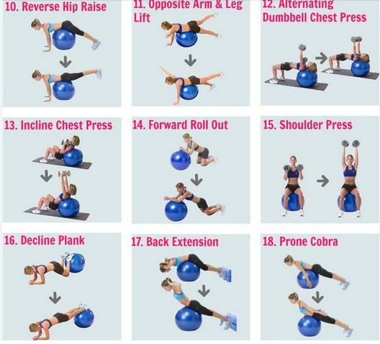
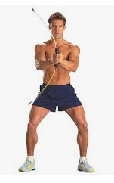
Phase IV (weeks 15 to 20)
Open and Closed Kinetic Chain Exercises
Progress to single arm ball stabilization
Pushup progression
Neuromuscular Dynamic Stability Exercises
Body blade
Ball stabilization exercises (single arm)
PNF diagonal patterns

Slide 26
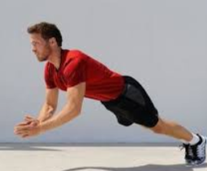
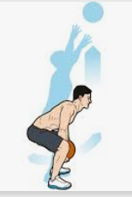
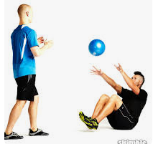
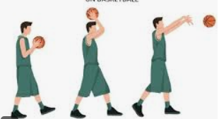
Phase IV (weeks 15 to 20)
Plyometrics
Activity-specific plyos
Ball tosses: chest pass, overhead pass
Functional Exercises
PNF diagonal pattern progressions

