Slide 1
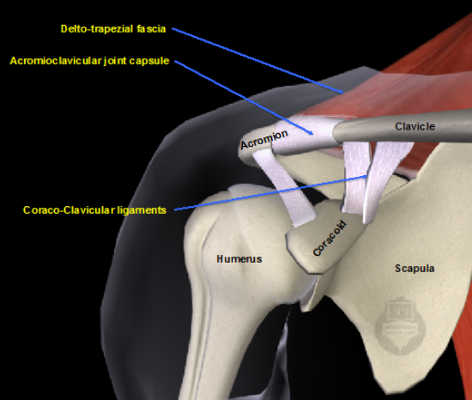
Acromioclavicular dislocation
Mohsen Avandi
Semnan University

Slide 2
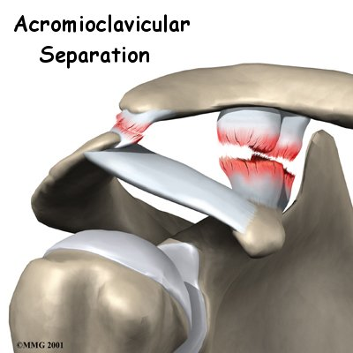
Acromioclavicular dislocation
Introduction:
A shoulder separation is a fairly common injury, especially in certain sports.
The AC joint is where the acromion and the clavicle meet. Ligaments hold these two bones together.

Slide 3
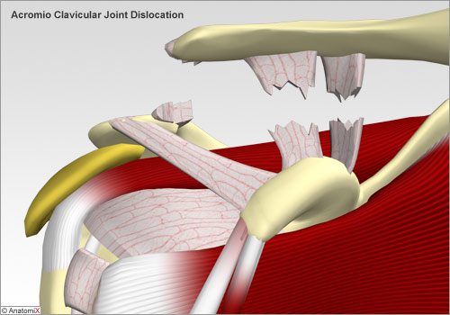
Causes
The most common cause of an AC joint separation is falling on the shoulder.
As the shoulder strikes the ground, the force from the fall pushes the scapula down.
The collarbone, because it is attached to the rib cage, cannot move enough to follow the motion of the scapula.
The result is that the ligaments around the AC joint begin to tear, separating (dislocating) the joint.

Slide 4
Symptoms
Symptoms range from mild tenderness felt over the joint after a ligament sprain to the intense pain of a complete separation.
Grade two and three separations can cause a considerable amount of swelling.
In grade three separations, you may feel a popping sensation due to shifting of the loose joint. Grade three separations usually cause a noticeable bump on the shoulder.

Slide 5
Acromioclavicular Joint Injuries
most common orthopedic injuries to the shoulder in the young athletic population.
9% or 12% of all injuries to the shoulder.
A majority of injuries affecting this joint occur in the first three decades of life (66%).
AC dislocation has been reported to be more common in males than females
(5 : 1 to 10 : 1).

Slide 6
Acromioclavicular Joint Injuries
AC dislocation is the most prevalent sports injury to participants in contact sports including hockey, rugby, and American football.
38.5% of shoulder injuries in athletes.

Slide 7
Classification of Injury/Pathological Findings
Type I Injury
AC ligament sprain
No displacement on radiographs
Type II Injury
AC ligament tear, CC ligaments intact
Lateral end of the clavicle superior in relation to acromion but not 100% displaced.

Slide 8
Classification of Injury/Pathological Findings
Type III Injury
AC and CC ligaments torn
100% displacement of the clavicle on radiographs.
Type IV Injury
Complete dislocation with posterior displacement of the distal clavicle into or through trapezius muscle.
Posteriorly displaced clavicle on axillary radiographs.

Slide 9
Classification of Injury/Pathological Findings

Slide 10
Classification of Injury/Pathological Findings

Slide 11
Classification of Injury/Pathological Findings

Slide 12
Classification of Injury/Pathological Findings

Slide 13
Physical Examination
Point tenderness
Deformity at the AC joint and is palpable and different from contralateral (uninjured) side.
Pain at AC joint with forward elevation greater than 140°.
Pain at joint with cross-arm adduction
Cross-arm adduction test performed with arm elevated to 90° and then adducted across the chest with the elbow bent at 90°

Slide 14
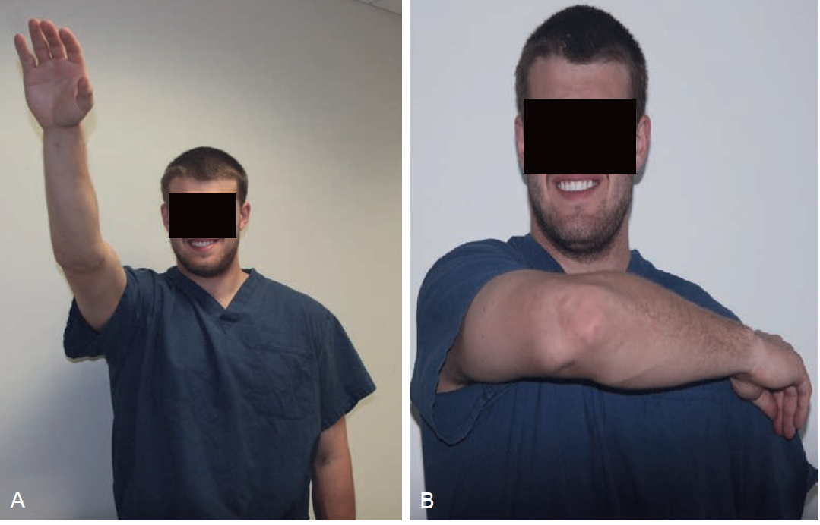
Physical Examination

Slide 15
Differential Diagnosis
O’Brien test
Radiographs
Shrug Test
Used to distinguish type III from type V injuries

Slide 16
Treatment
Type I and II (incomplete injuries) are typically treated nonoperatively
• Type IV, V, and VI (complete injuries) are typically treated operatively due to significance of morbidity
• Type III injuries remain the most controversial.
Current trends lean more towards initial nonoperative treatment

Slide 17
NONOPERATIVE REHABILITATION OF ACROMIOCLAVICULAR JOINT SPRAIN/SEPARATION

Slide 18
Phase I (48 hours to weeks 2)
Protection
Immobilization via a sling is used on as needed basis.
The amount of time immobilized will vary depending on the grade of injury.
Grade I separations typically require little to no sling use.
Grade II separations involve disruption of ligamentous tissue that may result in prolonged periods of pain associated with early phases of tissue healing. During this time, a sling may be required to avoid stress on the AC joint.

Slide 19
Phase I (48 hours to weeks 2)
Protection
The sling is discontinued following cessation of pain with the arm at the side and with self-care activities. Generally speaking, this time period does not exceed 1 week.
Grades III and V involve complete ligament rupture While sling use up to 4 weeks for these higher-grade AC separations.

Slide 20
Phase I (48 hours to weeks 2)
Protection
In all cases, immobilization is discontinued following the cessation of pain at rest with the arm at the side and with self-care activities.
Management of Pain and Swelling
Ice
Sling

Slide 21
Phase I (48 hours to weeks 2)

Slide 22
Phase I (48 hours to weeks 2)

Slide 23
Phase I (48 hours to weeks 2)

Slide 24
Phase I (48 hours to weeks 2)

Slide 25
Phase I (48 hours to weeks 2)

Slide 26
Phase I (48 hours to weeks 2)

Slide 27
Phase II (weeks 2 to 6)
Conditioning (bike or elliptical)
Non weight bearing upper extremity core stability (bridge, crunch, etc.)
Activation of Primary Muscles Involved
Isotonic strengthening exercises directed at restoring and maintaining adequate scapular retraction

Slide 28
Phase II (weeks 2 to 6)
Lower extremity exercise including shoulder dumps ,single leg trunk flexion bends, single leg balance, hip hike, squats.
Full active ROM (equal to the uninjured side with visual estimation) without pain.

Slide 29
Phase III (weeks 6 to 12)
Continued conditioning described in phase II.
Initiate upper extremity weight-bearing core stability exercise, e.g., plank, side plank (grades I and II may tolerate before or at 6 weeks).
Activation of Primary Muscles Involved
Isotonic exercises are progressed at this phase with continued emphasis on maintaining scapula retraction.

Slide 30
Phase III (weeks 6 to 12)
exercise tubing or cable resistance exercises are utilized to progress the strengthening program.
Strengthening targeted at the rotator cuff muscles (emphasis on ERs), biceps brachii, pectoralis major, and minor and scapular rotators.
PNF utilizing rubber tubing is introduced at this time.

Slide 31
Phase III (weeks 6 to 12)
Multilevel rows
Prone scapula exercises—Is, Ts and Ys (start with no weight and high repetitions to fatigue).
IR/ER (tubing/cable)
One-hand pushup on wall with light ball
Plyometrics
90-90 supine ball toss (Figure 7-13A)
Overhead supine ball toss (Figure 7-13B)
Medicine ball chest pass

Slide 32
Phase III (weeks 6 to 12)

Slide 33
Phase III (weeks 6 to 12)

Slide 34
Phase IV (weeks 12+)
Return to gym (grades I and II typically can start gym activity at or before 8 weeks).
Bench press at 50% or less than pre surgical
Overhead press at 50% or less than presurgical
Continue one hand ball pushup on wall.
Plyometrics
Two-handed medicine ball chest
pass, standing two-handed overhead chest pass, singlehand
90/90 ball toss to upright with rebounder.

Slide 35
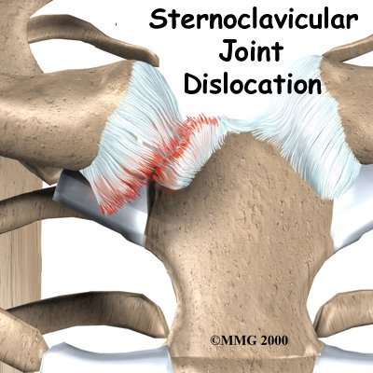
Sternoclavicular Joint Injury
The sternoclavicular (SC) joint is important because it helps support the shoulder. The SC joint links the bones of the arms and shoulder to the vertical skeleton.

Slide 36
Anatomy
Like most joints, the SC joint is made up of two bones covered with a material called articular cartilage.
The intra-articular disc ligament attaches to the first rib and divides the joint into two separate spaces. This ligament is very thick and fibrous.
The costoclavicular ligament is short and strong. It attaches underneath the clavicle to the first rib just below. It helps steady the SC joint during certain motions.

Slide 37
Anatomy
The interclavicular ligament supports the ends of both clavicle bones near the SC joint. It passes over the top of the sternum, connecting one clavicle to the other.
The capsular ligament reinforces the capsule that surrounds the SC joint. This ligament keeps the sternum end of the clavicle from pointing up as the other end of the clavicle drops down.

Slide 38
Causes
The SC joint is one of the least commonly dislocated joints in the body. Car accidents cause nearly half of all SC dislocations. Sports injuries cause about 20 percent. Falls and other types of accidents cause the rest. These sorts of traumatic injuries can also cause injuries to the physis in people under 25 years old.

Slide 39
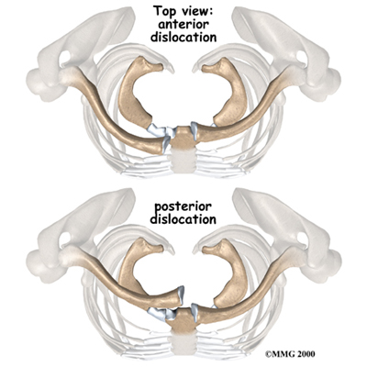
Causes
When the SC joint is dislocated, it is usually an anterior dislocation. This means that the clavicle is pushed forward, in front of the sternum. Dislocating in the opposite direction is less common because the ligaments on the back side of the joint are so strong.

Slide 40
Causes
Posterior dislocations can be very dangerous, because the area behind the sternum contains vital organs and tissues. The heart and its large vessels, the trachea, the esophagus, and lymph nodes can all be seriously damaged in a posterior dislocation of the SC joint.

Slide 41
Symptoms: Dislocation
You will know immediately if your SC joint has dislocated.
Dislocation causes severe pain that gets worse with any arm movements.
In anterior dislocation, the end of the clavicle juts out near the sternum. This causes a hard bump in the middle of the chest.
Posterior dislocations can cause difficulty breathing, shortness of breath, or a feeling of choking. Some patients have trouble swallowing or have a tight feeling in their throats.

Slide 42
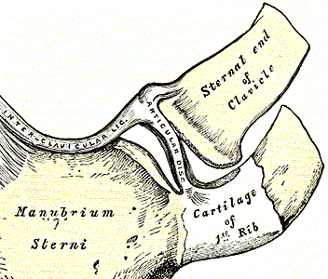
Sprains
Sometimes force may only sprain the SC joint. Mild sprains cause pain, but the joint is still stable. In moderate sprains, the joint becomes unstable.

Slide 43
Diagnosis
Nonsurgical Treatment Sprains :
A mild sprain usually gets better by resting the joint for two to three days. Ice packs can be placed on the sore joint for 15 minutes at a time during the first few days after the injury.
Moderate sprains may require some help to get the joint back into position. A figure-eight strap wraps around both shoulders to support the SC joint.

Slide 44
Nonsurgical Treatment Sprains :
Patients with a moderate sprain may need to wear this type of strap for four to six weeks. The strap protects the joint from another injury and lets the injured ligaments heal and become strong again.

Slide 45
Anterior Dislocation
Doctors have different ways of treating anterior dislocation. Some feel that surgery is needed when the dislocation is severe. Most doctors treat the anterior dislocation by letting it heal where it is or by performing a closed reduction.
Closed reduction involves pulling, pushing, and moving the clavicle until it pops back into joint.

Slide 46
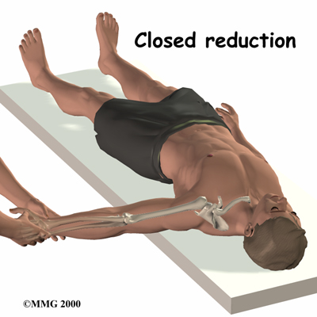
Posterior Dislocation
If your doctor suspects posterior dislocation, you will need to have a complete physical examination right away. A series of X-rays and CT scans will be needed.

Slide 47
Posterior Dislocation
Sometimes closed reduction for a posterior dislocation does not work, or SC joint problems become chronic. In these cases, adult patients may need surgery.
Surgery:
If nonsurgical measures fail to relieve your pain, you may need surgery.

Slide 48
NONOPERATIVE REHABILITATION OF STERNOCLAVICULAR JOINT SPRAINS

Slide 49
Symptoms
SC joint pathology produces localized pain over the joint surfaces and adjacent capsule.
swelling is usually visually evident
CT or
MRI scan

Slide 50
Phase I (weeks 0 to 4)
The SC joint pathology can be divided into those caused by trauma and those of insidious onset.
The acute sprain can be classified into grade I (mild), grade II (moderate) and grade III (severe).
A grade I SC joint sprain is symptom-limited with a fairly rapid return to activity based on resolution of symptoms within 7 to 10 days.

Slide 51
Phase I (weeks 0 to 4)
Protection
Grade I: 5 to 10 days in a sling
Grade II: 2 to 3 weeks using a sling for anterior instability and “figure of 8” brace for posterior instability.
Grade III: 3 to 4 weeks using a sling for anterior instability and “figure of 8” brace for posterior instability.

Slide 52
Phase I (weeks 0 to 4)
Management of Pain and Swelling
Ice, Ultrasound, Interferential Current Electrical Stimulation.
Techniques for Progressive Increase in Range of Motion
PROM flexion and scaption:
• 0° to 90° (week 1 to 2) to avoid excessive clavicular retraction, elevation, and posterior rotation on the thorax
• 0° to 180° (week 2 to 3)
• AAROM 0° to 90° flexion and scaption (week 2 to 3)
Pendulum exercises
• Active elbow and wrist ROM

Slide 53
Phase I (weeks 0 to 4)
Techniques to Increase Muscle Strength, Power, and Endurance
Week 2 to 3: Submaximal isometric flexion, abduction, IR, ER in neutral; progress to maximal isometric if pain-free
Week 2 to 3: Active scapular retraction and depression, scapular protraction, biceps curls, triceps extensions

Slide 54
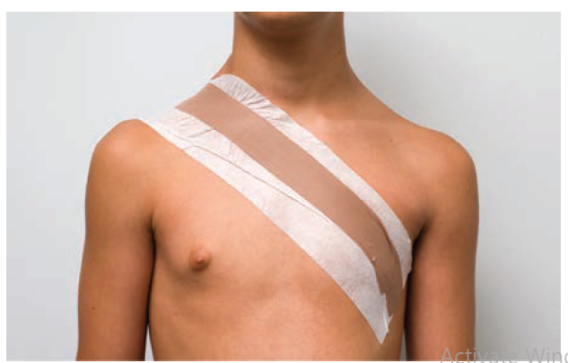
Phase II (weeks 4 to 8)
Protection
• Taping prn for anterior instability

Slide 55
Phase II (weeks 4 to 8)
Stretching and Flexibility Techniques for the Musculotendinous Unit
upper trapezius and
pectoralis muscles prn, and strengthening of middle
and lower trapezius, rhomboids and deep cervical flexor muscle groups.
Other Therapeutic Exercises
• TBS, Core, TLS as tolerated and recommended

Slide 56
Phase II (weeks 4 to 8)
Open and Closed Kinetic Chain Exercises
press-ups, wall pushup with a plus, table pushup, 4-point weight shifts, prone on
elbows, prone ball punches (Figure 7-20), standing ball punches with perturbations, modified pushups, partial ball walk-outs, full-walk-outs and full pushups.

Slide 57
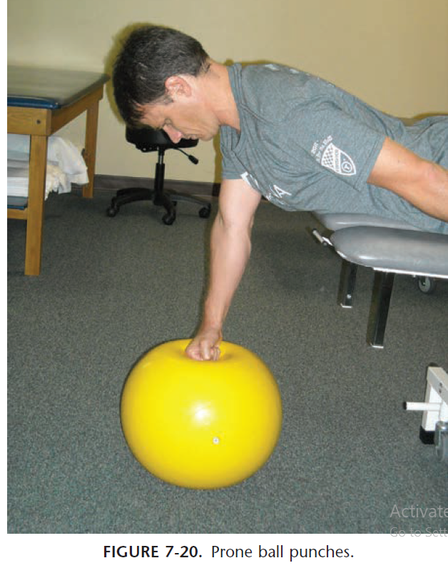
Phase II (weeks 4 to 8)
Open and Closed Kinetic Chain Exercises

Slide 58
Phase II (weeks 4 to 8)
Techniques to Increase Muscle Strength,
Power, and Endurance
Continue total arm strengthening, including bicep curls, triceps extensions.
Progress strengthening of scapular stabilizers, posterior cuff, and glenohumeral muscles.
• Prone rows
• Prone GH extension
• Supine protraction
• Horizontal abduction with external rotation
• Sidelying ER
• TheraBand IR/ER

Slide 59
Phase II (weeks 4 to 8)
Plyometrics
two-handed chest level toss, progress to an overhead throw, and then to a single arm 90/90.

Slide 60
Phase III (weeks 8 to 12)
Protection
• Taping prn for anterior instability
Management of Pain and Swelling
• Ice, Ultrasound, Interferential Current Electrical Stimulation prn.
Open and Closed Kinetic Chain Exercises
CKC pushup activity by incorporating an unstable surface, an elevated position (box pushups), or unilateral support.

Slide 61
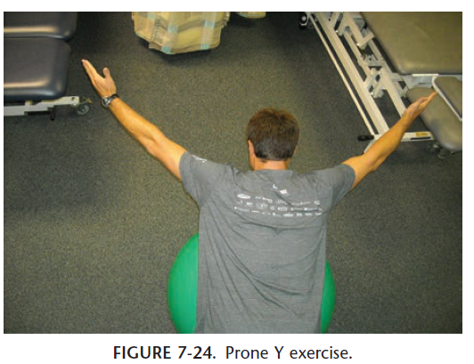
Phase III (weeks 8 to 12)

Slide 62
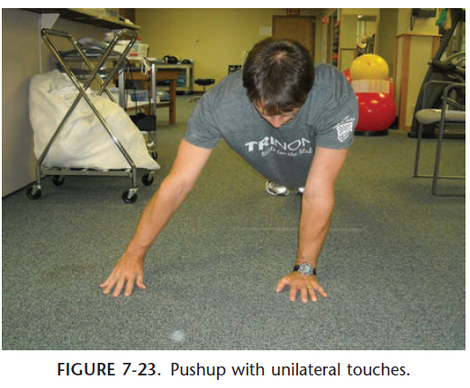
Phase III (weeks 8 to 12)

Slide 63
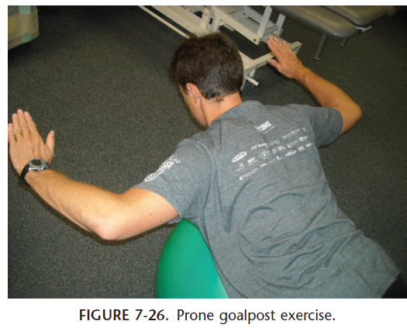
Phase III (weeks 8 to 12)

Slide 64
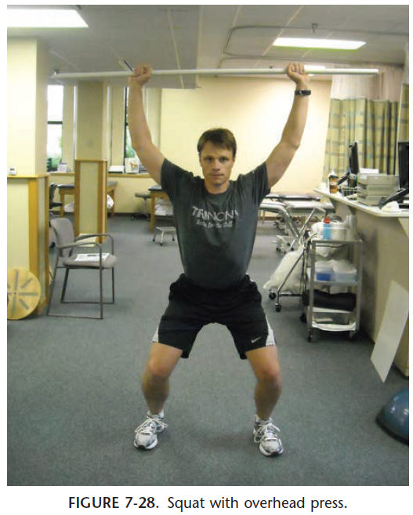
Phase III (weeks 8 to 12)

