Slide 1
Orthopedic Rehab of the Athlete
Bruce C. Reider
George J. Davies
Matthew T. Provencher

Slide 2
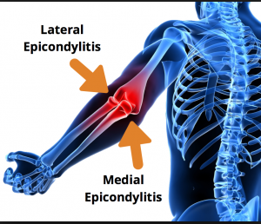
Epicondylitis
Chapter 9

Slide 3
Epidemiology
Age/ Sex:
35 to 50 years
Females and males
Sport:
Tennis
Golf
Occupations or hobbies with repetitive activities
1% to 3 % of population affected
Adults: 35 to 50 %
Elite: 11 to 13 %

Slide 4
Pathophysiology
Intrinsic Factors:
Proximal strength deficits at the scapula and GH joint
GH flexibility deficits
Poor weight shifting during backhand, late back swing
Increased wrist extension at ball impact
Poor general condition
Poor upper limb posture
Inadequate rest and recovery
Inadequate warm up

Slide 5
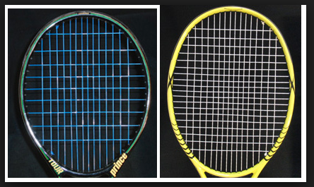
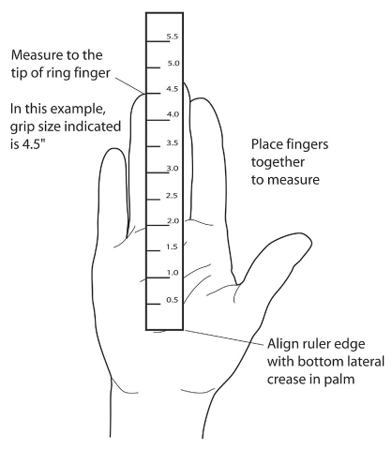
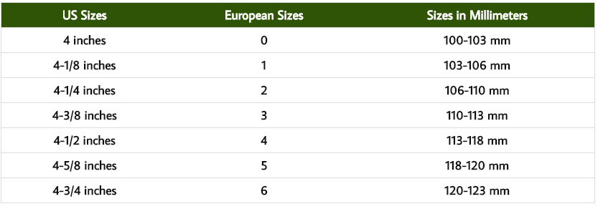
Pathophysiology
Extrinsic Factors:
Improper racquet grip size
How to Find Your Tennis Racquet Grip Size
Racquet string tension too high

Slide 6
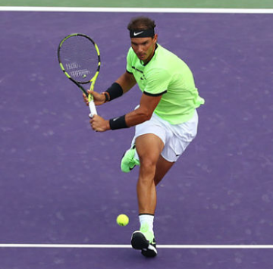
Pathophysiology
Extrinsic Factors:
Strings not resilient or soft enough
Improper handle size of racquet
Traumatic factors:
Repetitive micro trauma
Vascular compromise
High ECC and CON stresses on extensor tendon

Slide 7
Clinical presentation
History:
درد تدریجی در محل اوریجن تاندون اکستنسور
غالبا با حرکات بک هند و به ویژه در ورزشکاران مبتدی و تفریحی تنیس شایع است
سایر موارد بروز آسیب شامل فعالیت های شغلی مکرر، فعالیت کامپیوتری و حمل کوله است.
نشانه ها عمدتا بعد از فعالیت ورزشی و حتی فعالیت های روزمره نمایان می گردد
آرنج در موقع خواب و بیداری همراه با درد می گردد

Slide 8
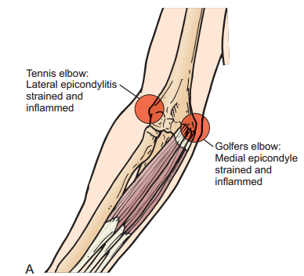
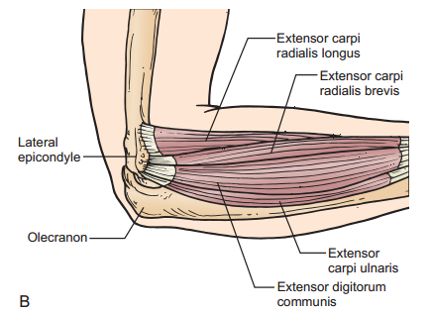
lateral and medial epicondyle of the elbow

Slide 9
Physical Examination
Abnormal Findings:
Loss of wrist flexion ROM
Tenderness to palpation of Extensor origin at lateral epicondyle
Localized edema
Grip weakness (both side, hand grip)
Pain with passive wrist flexion
Pain with resistive wrist extension

Slide 10
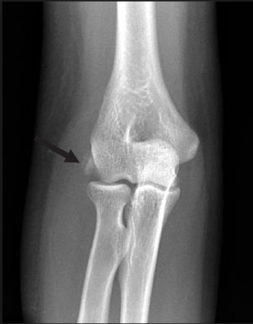
Physical Examination
Radiographs: tendinous calcific changes
MRI: tears of the extensor tendon, abnormal tendinous tissue

Slide 11
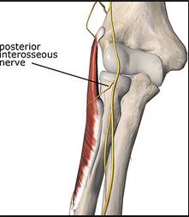
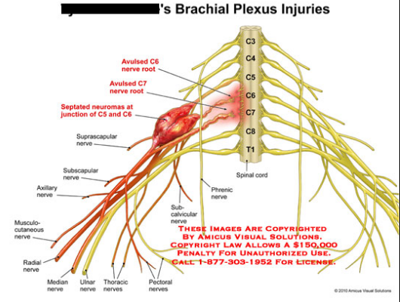
Differential Diagnosis
C6 to C7 nerve root compression
Posterior interosseous nerve syndrome
Lateral antebrachial cutaneous nerve irritation

Slide 12
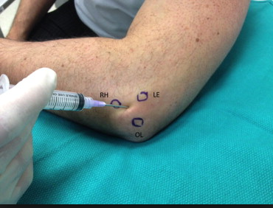
Treatment
Nonoperative management
Activity modification
Corticosteroid injection
Nonsteroidal anti-inflammatory drugs

Slide 13
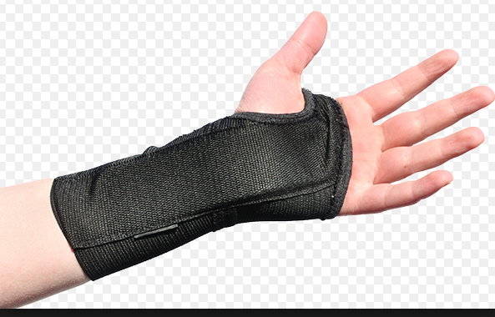
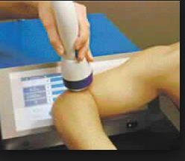
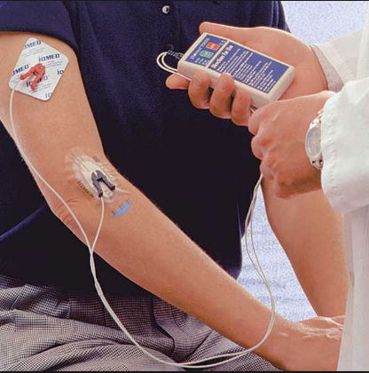
Nonoperative management
Bracing, wrist cockup splint
Shock-wave therapy
Physical therapy: strength, flexibility, ….
Cryotherapy, TENS, iontophoresis, ultrasound, low level laser
Improvement of sport mechanics
Plasma rich platelet injection

Slide 14
Surgical indications
Failure of injections
Associated intraarticular pathology
Failure of treatment for a 6 months

Slide 15
Phase I
Protection:
بریس مچ حتی در فعالیت های روزمره
اسپلینت مچ در موقع خواب برداشته شود. ممکن است باعث کوتاه شدن اکستنسورهای مچ گردد
تغییر فعالیت های روزمره
Pain and swelling management
Cryotherapy
Iontophoresis
TENS
Ultrasound
low level laser

Slide 16
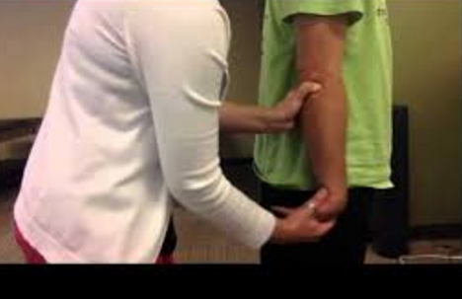
Phase I
Techniques for Progressive Increase in Range of Motion
Manual therapy techniques
Mills manipulation: Mill’s manipulation is a small-amplitude, high-velocity thrust performed at the end of elbow extension while the wrist and hand are held ﬂexed. Soft tissue techniques
It is the authors’ opinion that deep-tissue massage often exacerbates symptoms and has little therapeutic value

Slide 17
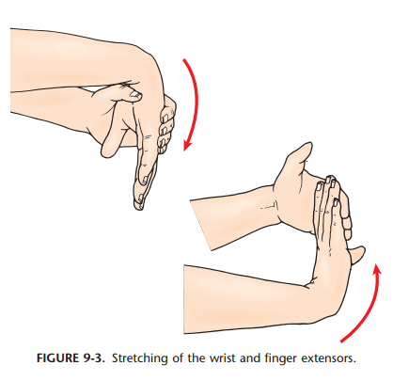
Phase I
Stretching/flexibility techniques for the musculo-tendinous unit
Wrist and fingers extensor
Pain free ROM

Slide 18
Phase I
Other therapeutic exercise
TAS
Scapula, deltoid, rotator cuff,
Biceps and triceps strength should be in a pain free, avoid full extension elbow
TLS without holding weights in hands
Open and Closed Kinetic Chain Exercises
This is contraindicated in phase I

Slide 19
Phase I
Milestones for Progression to the Next Phase
کاهش علائم حاد (درد، ادم و التهاب)
کسب ثبات و استابیلیتی در کمربند شانه ای و روتیتور کاف
کسب ROM طبیعی در فلکشن مچ

Slide 20
Phase II
Protection:
Counterforce bracing or wrist-cockup splint as needed
Pain and swelling management:
Cryotherapy
Iontophoresis
TENS
Ultrasound
low level laser

Slide 21
Phase II
Techniques for Progressive Increase in Range of Motion
Continue pain-free stretching of the wrist and finger extensors. Begin to address any shoulder ﬂexibility deficits.
Manual therapy techniques
Mills manipulation
Soft tissue techniques

Slide 22
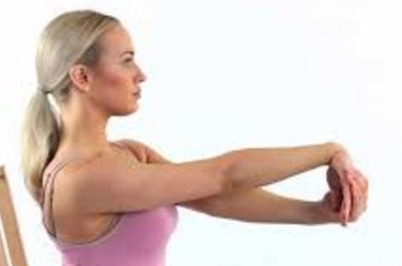
Phase II
Stretching/flexibility techniques for the musculo-tendinous unit
Wrist and fingers extensor
Pain free ROM

Slide 23
Phase II
Other Therapeutic Exercises Continue to progress general upper-extremity, multijoint exercises to normalize shoulder and scapula strength. For the tennis player, emphasize the scapula and posterior rotator cuff.
Continue biceps- and triceps-strengthening to include concentric and eccentric activity.
Initiate forearm-strengthening to include wrist ﬂexion.
Core and lower-extremity strengthening may be progressed, but the patient should still avoid holding heavy weights in the hands.

Slide 24
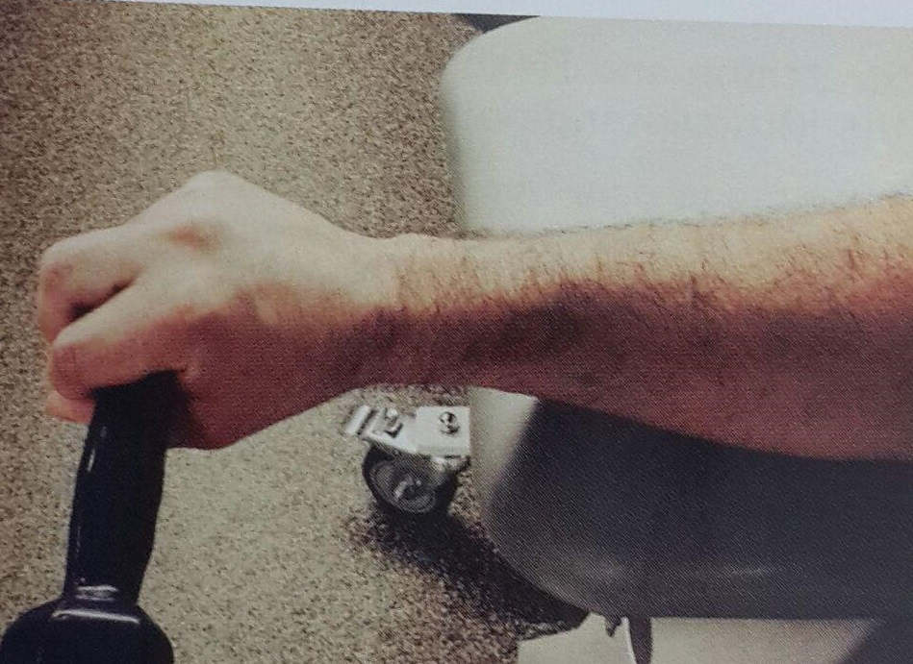
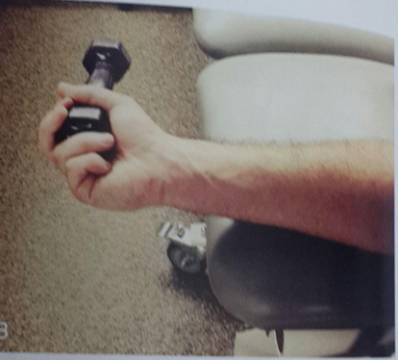
Phase II
Activation of Primary Muscles Involved
Wrist extension
Pronation
Supination

Slide 25
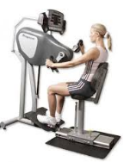
Phase II
Techniques to Increase Muscle Strength, Power, and Endurance
If proximal strength is adequate
Upper body ergometer

Slide 26
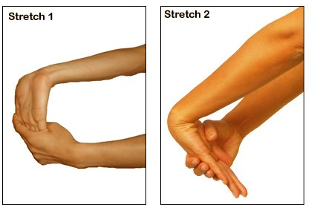
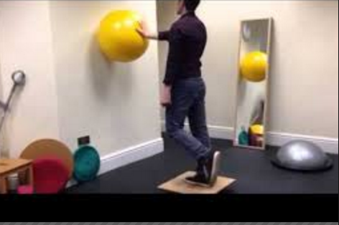
Phase II
Neuromuscular Dynamic Stability Exercises
Rhythmic stabilization
Functional exercise
PNF

Slide 27
Phase II
Milestones for Progression to the Next Phase
انعطاف پذیری طبیعی اندام فوقانی
قدرت طبیعی
حداقل درد در حین اکستنشن مچ

Slide 28
Phase III
Stretching/flexibility techniques for the musculo-tendinous unit
Wrist and fingers extensor
Overstretching of the wrist and finger extensors should be avoided.
Pain free ROM
Techniques to Increase Muscle Strength, Power, and Endurance
TLS, TAS, TAS
Sport specific exercise

Slide 29
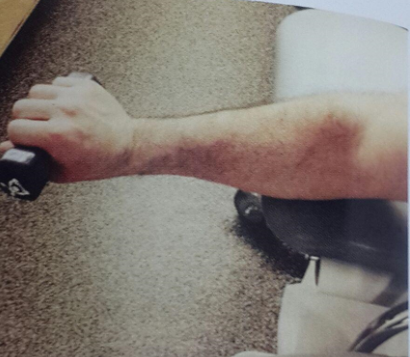
Phase III
Activation of Primary Muscles Involved
ECC wrist extesion

Slide 30
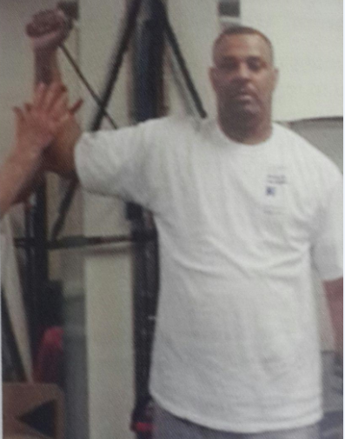
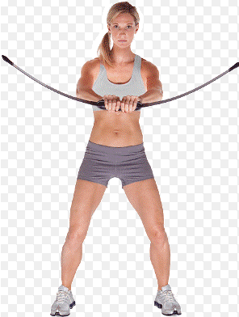
Phase III
Neuromuscular Dynamic Stability Exercises
Rhythmic stabilization
Body blade

Slide 31
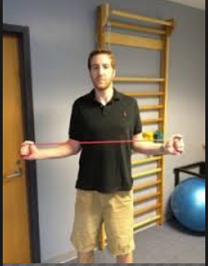
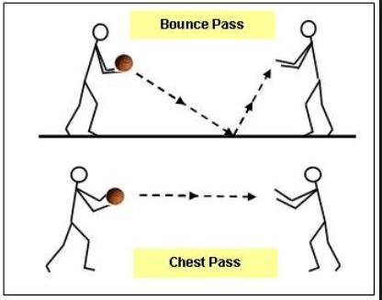
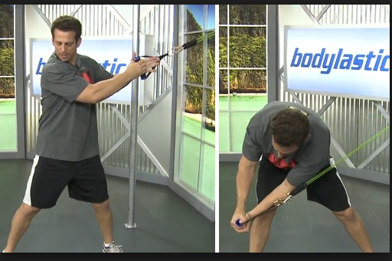
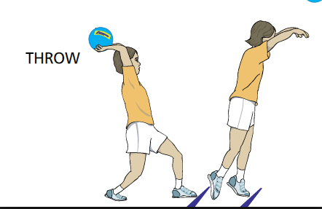
Phase III
Plyometrics
Two handed chest pass,
side to side wood chops,
over head soccer pass,
One handed external rotation
One handed backhand

Slide 32
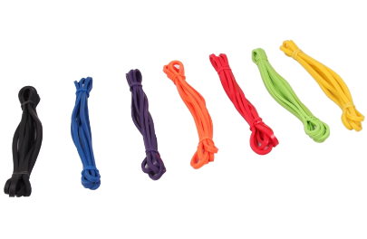
Phase III
Sport specific exercise
Resistive forehand and backhand exercise using elastic band

Slide 33
Phase IV
Management of Pain and Swelling
Cryotherapy should be utilized throughout the return
Stretching and Flexibility Techniques for the Musculotendinous Unit
Continue full upper-extremity ﬂexibility program.
Avoid overstretching the extensor tendons.
Stretching should always be pain-free.

Slide 34
Phase IV
Other Therapeutic Exercises
Continue a full upper-extremity strengthening program to include the scapula, shoulder, elbow, forearm, and wrist
Continue core stability with emphasis on trunk rotation and posture.
Continue full lower-extremity strengthening program with emphasis on closed-chain activities

Slide 35
Techniques to Increase Muscle Strength,Power, and Endurance
Isokinetics for wrist ﬂexion–extension and pronation–supination once a strength base has been established.
sport-specifc speeds and train for endurance
Plyometrics
Sport-Specifc Exercises
An interval tennis program
The program should entail a progression of volume and intensity.

Slide 36
Nonoperative Rehabilitation of Lateral Epicondylitis (Tennis Elbow)

Slide 37
Nonoperative Rehabilitation of Lateral Epicondylitis (Tennis Elbow)

Slide 38
Nonoperative Rehabilitation of Lateral Epicondylitis (Tennis Elbow)

Slide 39
Nonoperative Rehabilitation of Lateral Epicondylitis (Tennis Elbow)

Slide 40
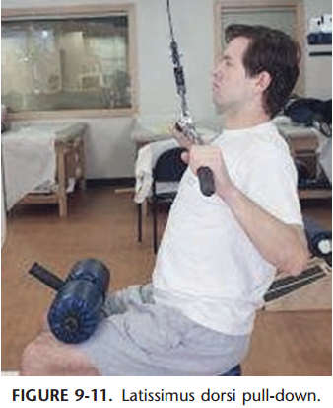

Slide 42
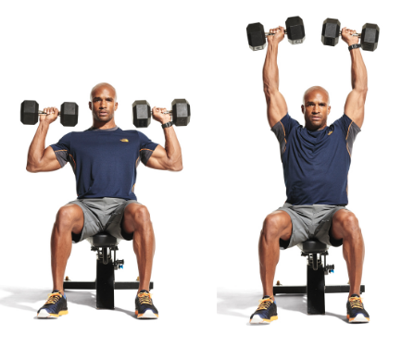
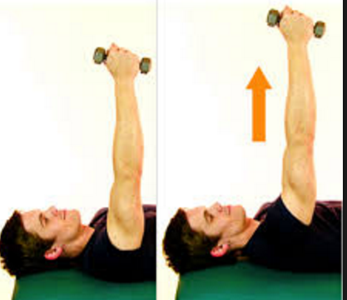
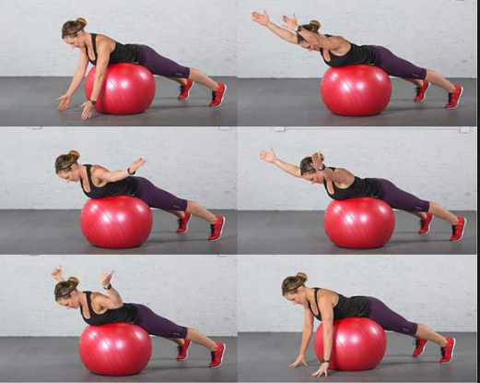
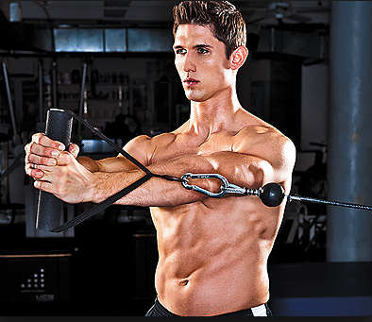
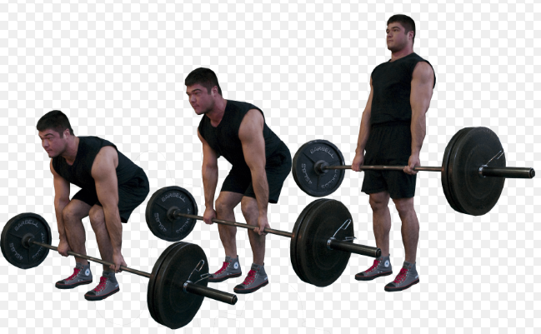
Application of Acute Training Variables
Specifc exercises used in the training • Clean and jerk • Clean • Squat • Dumbbell overhead press • Dead lift • Push press • Row • Lat pull-down • Pushup • Serratus punch • Chest ﬂy • Prone Y’s and T’s • Plank • Side plank • Palloff press

Slide 43
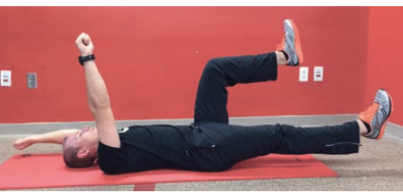
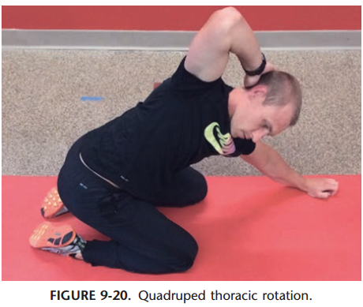
Application of Acute Training Variables
Stability chop and lift • Bridge • Dead bug (Figure 9-19) • Russian twist • Wrist extension and ﬂexion • Wrist pronation and supination • Shoulder external rotation • Shoulder internal rotation • Quadruped thoracic rotation (Figure 9-20) • Hip airplane • Wall slide stretch • Sleeper stretch

Slide 44
Application of Acute Training Variables

Slide 45
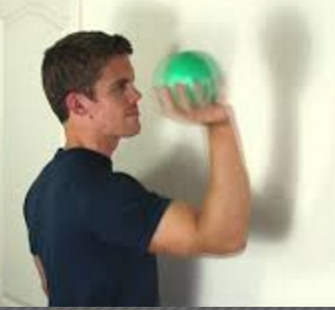
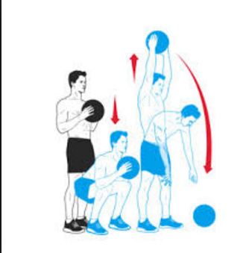
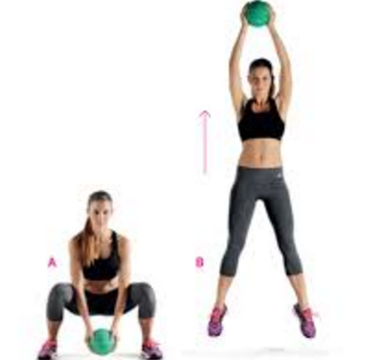
Application of Acute Training Variables
Lateral bounding progression • Box jumps • Medicine ball squat thrust • Medicine ball slam • Medicine ball rotational throw (Figure 9-21) • 90°/90° wall plyometrics • Straight-arm ball dribbling on wall • Medicine ball squat to rotational chest pass • Medicine ball sit-up overhead throw • Reaction/response training

Slide 46
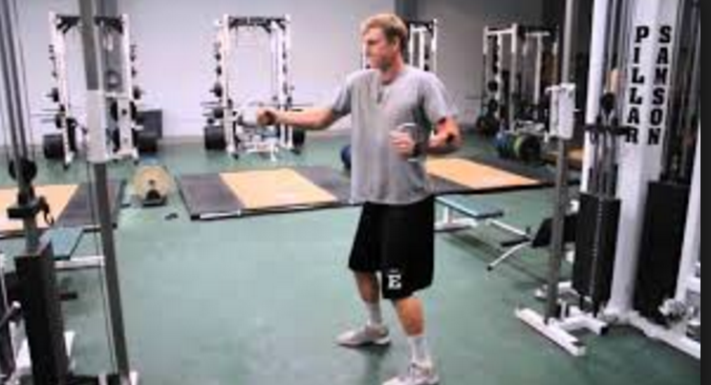
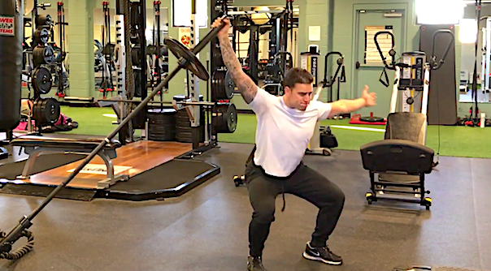
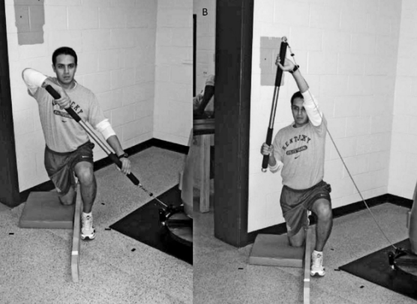
Application of Acute Training Variables
Rotational power • Squat to rotational press (Figure 9-22) • Rotational row (Figure 9-23) • Rotational push–pull • Rotational snatch • Explosive torso-and-hip rotation • Chop and lift
Strength • Single-leg squat • Mini band lateral walk

Slide 47
Application of Acute Training Variables

Slide 48
Application of Acute Training Variables

