Slide 1

Physical Activity and
Air Pollution Exposure
Semnan University
Mohsen Avandi

Slide 2
Objectives
Summarize health benefits of physical activity and public health recommendations
Discuss public health significance of air pollution exposure while being physically active

Slide 3
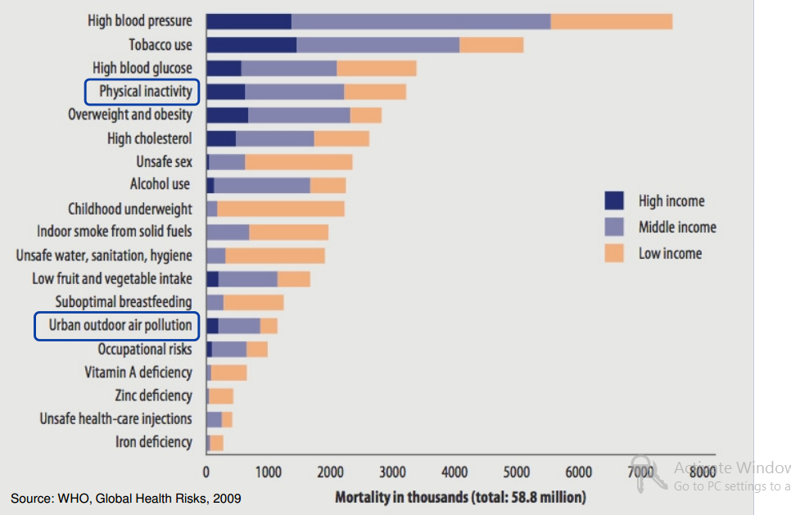
PHYSICAL ACTIVITY

Slide 4
Benefits of Physical Activity
In adults, physical activity lowers risk for:
Premature death
• Coronary heart disease
• Stroke
• Hypertension
• Type 2 diabetes
Colon cancer
Breast cancer
• Depression
• Unhealthy weight gain
• Injuries from falls

Slide 5
Benefits of Physical Activity
In children and adolescents, physical activity is associated with improved:
Cardiorespiratory fitness
• Bone health
• Cardiovascular biomarkers
• Metabolic health biomarkers
Academic achievement
Academic behaviors
• Cognitive skills

Slide 6
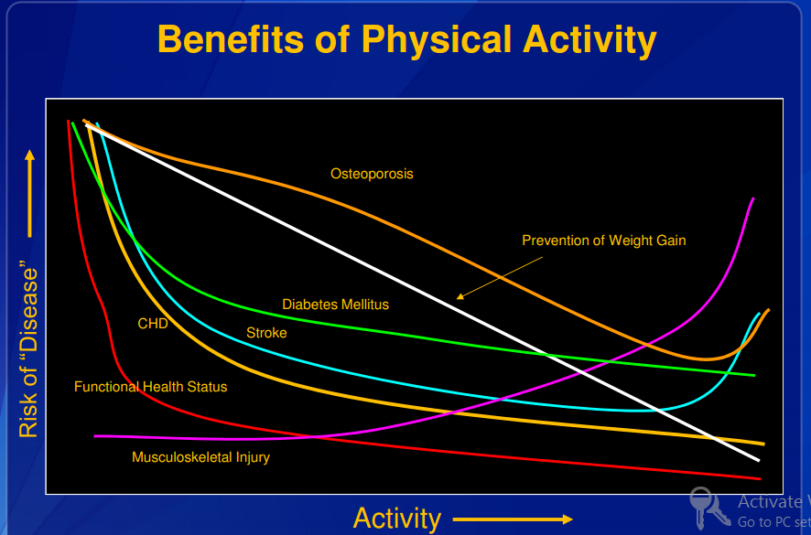
Benefits of Physical Activity

Slide 7
Public Health Impacts of Physical Inactivity
36% of adults report no leisure-time physical activity
82% of adults and 88% of adolescents do not meet current federal guidelines for aerobic activity and muscle strengthening
Estimated medical cost of physical inactivity = $75 billion per year

Slide 8
Physical Activity Guidelines
Exposure to air pollution is associated with several adverse health outcomes, including asthma attacks and abnormal heart rhythms.
People who can modify the location or time of exercise may wish to reduce these risks by exercising away from heavy traffic and industrial sites, especially during rush hour or times when pollution is known to be high.
However, current evidence indicates that the benefits of being active, even in polluted air, outweigh the risk of being inactive

Slide 9
AIR POLLUTION EXPOSURE WHILE BEING ACTIVE
How Physical Activity Affects Air Pollution Dose?
Concentration varies across microenvironments
- When and where activity occurs
Time spent in microenvironment
- Duration of activity (e.g., active travel vs. driving)
Ventilation rate correlates with intensity of activity
- Increased ventilation rate: more breaths/minute
- Increased velocity of breaths: forces air deeper into lungs and increases deposition fraction
- More mouth breathing: bypasses nasal filtration
Dose is dependent on age, sex, and body size

Slide 10
Air Pollution & Physical Activity Joint Health Effects
Mortality risks vs. benefits
Studies on increasing active travel consistently show that benefits (physical activity) > risks (air pollution and injury)
Modeled predictions of hypothetical scenarios using relative risk data from literature
Interaction effects are not well studied
Short-term exposure and acute health effects
Long-term exposure and chronic health effects
Built environment plays an important role in determining air pollution and physical activity levels

Slide 11
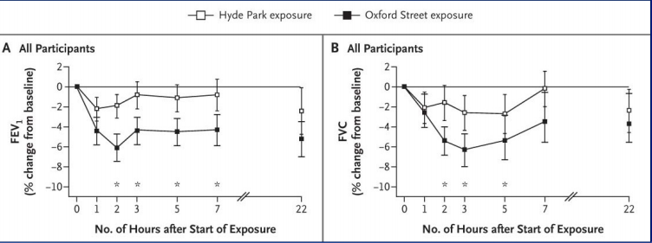
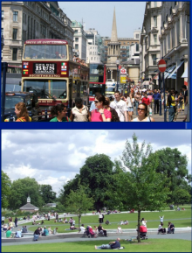
Short-term Exposure and Lung Function
60 adults with asthma walk for 2 hours along two different routes
Larger decline in lung function after walking more polluted route
Volume that has been exhaled at the end of the first second of forced expiration

Slide 12

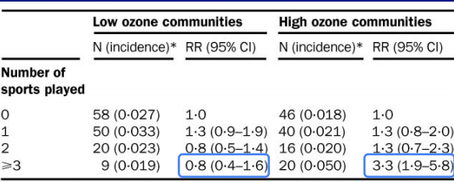
Long-term Exposure and Asthma Incidence
Cohort study of 3,535 children 9‒16 yrs Southern California, 1993‒1998
Playing ≥3 sports increased risk of asthma in high ozone communities, but not in low ozone communities.

Slide 13
Public Health Guidance
Promote physical activity while reducing risk from outdoor air pollution exposure
Outline factors that impact risk:
Individual susceptibility
Likelihood of exposure (when, where)
Level of physical activity (duration, intensity)
Type of pollutant
Consider unique communication needs of subpopulations
Improve air quality (primary prevention)

Slide 14
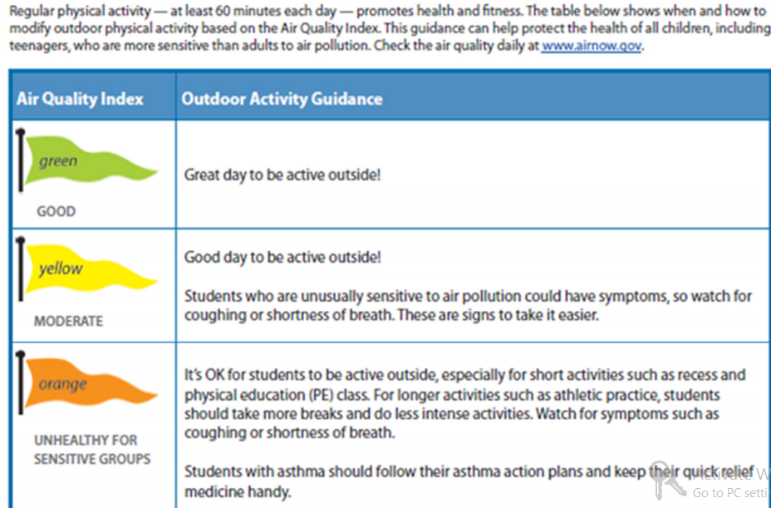
Guidance for Schools

Slide 15
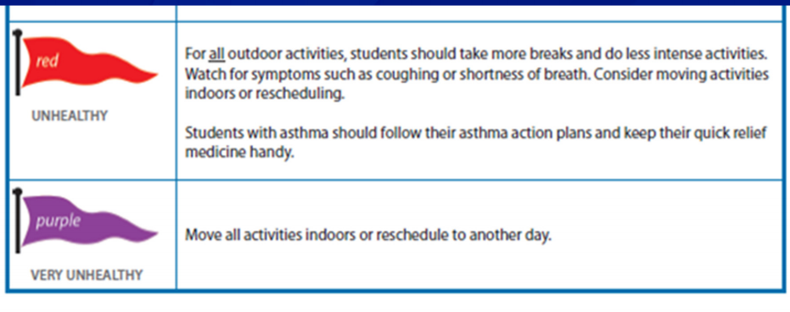
Guidance for Schools

Slide 16
Physical Activity and Air Pollution
Guidance – Messaging Issues
Make it applicable to all types of physical activity, not just “exercise”
Travel, household, occupational, and leisure-time
Address at-risk populations
Address microenvironments
Proximity to major roads, urban/rural settings
Time of day, seasonality
Encourage physical activity and time outdoors!

Slide 17
Ambient Air Quality and Athletic Performance
Jamie Mullins

Slide 18
Human performance
ambient Carbon Monoxide (CO), Nitrogen Dioxide (NO2), Ozone(O3), Particulate Matter (both PM10 and PM2:5), and Sulfur Dioxide (SO2).
Initial results suggest that low-level contemporaneous pollutant exposure impacts human performance through respiratory pathways.
significant effects of Ozone, and PM10 on performance in endurance events.
Because these events rely on respiration to fuel the aerobic processes involved in extended efforts, it is likely that these observed effects are acting through the respiratory pathways.

Slide 19
Human performance
both Ozone and PM have been shown to lead to inflammation of the respiratory track
do not find appreciable effects of Ozone exposure on either anaerobic or strength based events.
I do find smaller, but still significant effects of ambient PM10 concentrations on sprint events.

Slide 20
Carbon Monoxide (CO)
Carbon monoxide is emitted into the atmosphere directly as a result of incomplete combustion
internal combustion engines, to ovens, to tobacco smoke.
The large number and ubiquity of CO sources lead to highly variable ambient levels at a given place or time, and local concentrations are highly dependent on micro-environmental factors.

Slide 21
Carbon Monoxide (CO)
The detrimental impacts of CO exposure arise due to absorbed CO bonding with hemoglobin in the bloodstream (creating COHb or Carboxyhemoglobin, which is CO bonded with the hemoglobinbprotein) with an affinity approximately 200 times stronger than that of O2.

Slide 22
Carbon Monoxide (CO)
When a CO molecule takes one of the four potential bonding sites on a hemoglobin, there is less carrying capacity for O2 and the properties of the remaining three sites are altered such that bonded O2 is less readily released upon delivery.
As such, it has been shown that maximal O2 uptake during exercise (commonly referred to as VO2max) decreases linearly in blood concentrations of COHb

Slide 23
Carbon Monoxide (CO)
Additionally, Lebowitz et al. (1987) showed that typical ambient levels of CO were not elevated enough to be significantly associated with measurable lung function decrements in healthy individuals.

Slide 24
NO and NO2
NO itself appears to have negligible impacts on exposed individuals, even at concentrations far above those ever reached by ambient levels.
Although inhaled NO is almost fully absorbed into the bloodstream, and bonds with hemoglobin (taking the place of an O2 molecule, similarly to CO as described in the previous section)
As described further in the next section, NO2 is a necessary component (along with VOCs and sunlight) for the formation of Ozone, exposure to which is widely agreed to have negative effects on human health and performance.

Slide 25
NO and NO2
While direct exposure to high levels of NO2 can lead to both structural (thickening of the blood-air barrier) and biochemical (alteration of cell membranes) changes in the respiratory tract, exposures to concentrations typical of ambient levels have not been found to have measurable effects on healthy adults.

Slide 26
Ozone (O3)
Physiologically observable decrements in health are observable within a few hours of ozone exposure and may persist for hours or days after exposure, and a large proportion of O3 that is inhaled appears to stay in the body.
Effects of exposure include reductions in lung capacity, increases in flow resistance of respiration, changes in epithelial permeability, and increased reactivity of bronchi (the passage which conducts air into the lungs) to other challenges

Slide 27
Ozone (O3)
These reactions have been shown to impact lung and output performance among healthy adults undertaking a wide variety of physical activities including:
Running
Cycling
Hiking
showed that endurance athletes had a lower likelihood of completing a strenuous task when exposed to O3 levels as low as 120ppb, and demonstrated a significant decrease in the maximum exercise level of those exposed to 130ppb O3.

Slide 28
Ozone (O3)
also found that maximum exercise achieved by athletes decreased by 11% at an exposure level of 130ppb O3.
Particularly, it may be that co-exposure to NO2 and SO2 increase the absorption rate of ambient O3.
There is some evidence that women may be more susceptible to the negative effects of O3 exposure (Messineo and Adams, 1990), but (Seal Jr et al., 1993) found no evidence of reaction differences between blacks and whites.

Slide 29
Particulate Matter (PM )
Ambient particulate matter in the atmosphere is broadly categorized by size of particle as either fine (for particles with diameter ≤2:5um) or coarse (for larger particulates).
Fine particulates are emitted directly through various combustion processes and may also form in the atmosphere as by-products of a number of chemical reactions.
In contrast, coarse particulates tend to be created mechanically and consist largely of soil and mineral dust.

Slide 30
Particulate Matter (PM )
it has been shown that reductions in the high frequency component of heart rate variability (a bad thing) are closely associated with higher ambient levels of fine PM (Gold et al., 2000; Holguín et al., 2003), and numerous studies have linked longer term exposure to increased morbidity and mortality.
that exposure to concentrated ambient particulate matter (in North Carolina) can result in mild inflammation of the lower respiratory track and Lippmann et al. (2005) finds cardiac function decrements in mice exposed to high concentrations of ambient PM2:5

Slide 31
SO2
A multitude of studies have shown SO2 exposure to be associated with bronchoconstriction and higher rates of morbidity and mortality,
At normal breath-rates, essentially zero ambient SO2 reaches the lungs, as it is effectively filtered out in the upper respiratory track.
Short term effects of SO2 at ambient concentration levels tend to only be identified among asthmatics and others with sensitive airways, though bronchoconstriction can occur after as little as 2 minutes of exposure among these groups and can persist in some degree for many hours after .

Slide 32
Temperature
The human body is especially sensitive to high ambient temperatures during physical exertion.
Increased body temperature can contribute or lead to exercise-associated muscle cramps, heat syncope (dizziness), heat exhaustion, exertional heat stroke, and exertional hyponatremia (low salt levels in the blood).
Among others, Katsouyanni et al. (1993) found evidence for interactive effects of high temperatures and SO2 on health.
Conversely, cold, dry air can make breathing more difficult through increased bronchoconstriction, but precise thresholds for such effects are rarely discussed

Slide 33
Cardiovascular implications of exposure to traffic air pollution during exercise
SHARMAN

Slide 34
Components of automotive pollution
A diverse mixture of suspended particles and gases containing reactive free radical species is released into the atmosphere.
mixture of solids and liquids that are generally classified according to aerodynamic diameter, as coarse (<10mm; PM10), fine (<2.5mm; PM2.5) or ultrafine (<0.1 mm; PM0.1) particles.

Slide 35
Cardiovascular epidemiological evidence
Early epidemiological studies examining the relationship between chronic exposure to automotive pollution and disease found an unexpectedly increased incidence of cardiovascular mortality in workers exposed to high levels of pollution
PM<2.5 appears to be the most studied and may be of more risk to health, possibly due to these very small particles penetrating the lower regions of the lung and entering the circulation.
incidence of life-threatening myocardial infarctions
and cardiac arrhythmias
systemic inflammation,
as measured by C-reactive protein

Slide 36
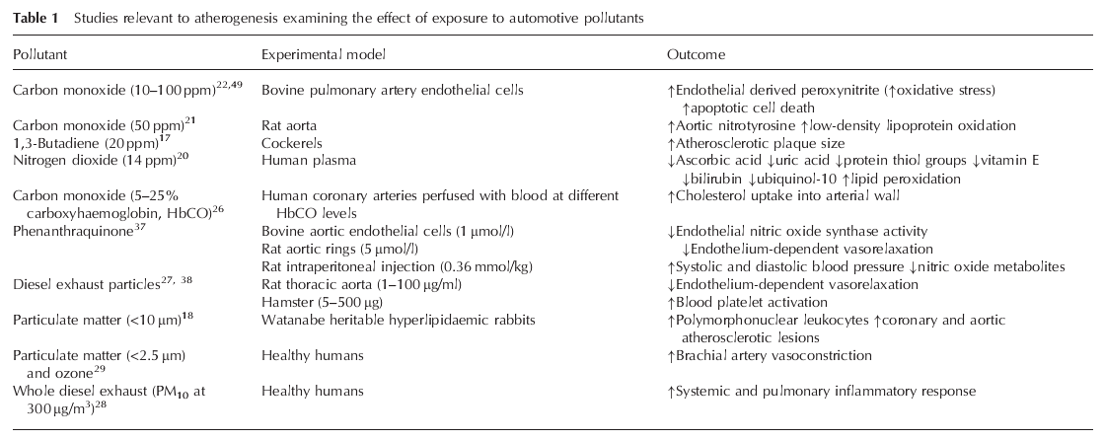

Slide 37
Cardiovascular mechanisms of action
The main pathway by which particulate air pollution contributes to increased risk is probably by direct augmentation of atherosclerosis
The etiology of atherosclerosis is multifactorial, but the process may be initiated and promoted by toxic insult to the endothelium, and is associated with chronic inflammation as well as high circulating concentrations of metabolites indicative of oxidative stress.
Several studies have reported diminished antioxidant defenses and increased markers of oxidative damage (e.g. malondialdehyde) in plasma and endothelial cells after expo-sure to components of automotive pollution such as CO and nitrogen dioxide (NO2)

Slide 38
Cardiovascular mechanisms of action
Additional cardiovascular risk may also arise from thrombotic complications as a consequence of increased platelet activation and an elevated inflammatory response caused by systemic infiltration of air pollution.
In humans, environmentally relevant concentrations of PM2.5 and O3 acutely augment brachial artery vasoconstriction.
Rats exposed to the same pollutants also show elevated concentrations of plasma endothelin-1, a powerful vasoconstrictor.
augmented vasomotor tone (vasoconstriction) has the potential to increase myocardial afterload and ischemia.

Slide 39
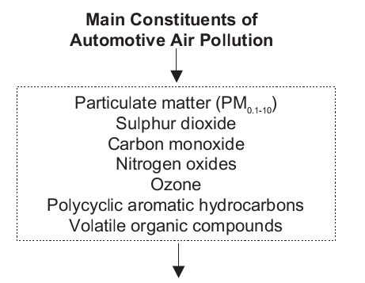
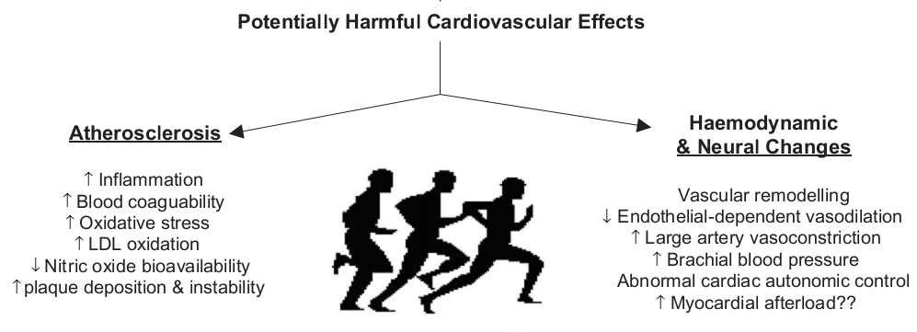

Slide 40
