Slide 1
Athlete Needs Analysis
1
William J. Kraemer, PhD, CSCS, FNSCA

Slide 2
Acute program variables
Choice of exercise
Order of exercise
Resistance used
Number of sets
Amount of rest between sets and exercises

Slide 3
Step 1: Needs Analysis
Needs analysis is a two-stage process that includes an evaluation of the requirements and characteristics of the sport and an assessment of the athlete.
Evaluation of the Sport
  movement analysis: Body and limb movement patterns and muscular involvement.
  physiological analysis: Strength, power, hypertrophy, and muscular endurance priorities.
  injury analysis: Common sites for joint and muscle injury and causative factors.

Slide 4
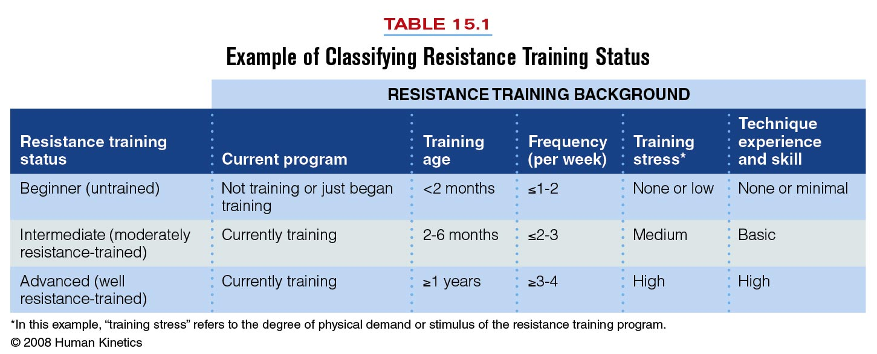
Assessment of the Athlete
  Training Status
    Type of training program
    Length of recent regular participation in previous training program(s)
    Level of intensity involved in previous training program(s)
    Degree of exercise technique experience

Slide 5
Step 1: Needs Analysis
Assessment of the Athlete
  Physical Testing and Evaluation
    Tests should relate to the athlete’s sport.
    Use the results of the movement analysis to select tests.
    After testing, compare results with normative or descriptive data to determine the athlete’s strengths and weaknesses.
  Primary Resistance Training Goal
    Typically to improve strength, power, hypertrophy, or muscular endurance.
    Concentrate on one training outcome per season.

Slide 6
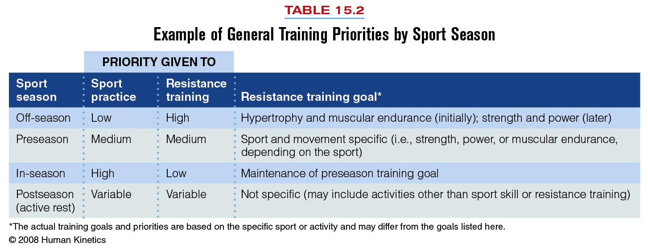
Table 15.2

Slide 7
Needs analysis
Allowing the exercise-prescription process
Informed choices for each of the acute program variables
A needs analysis answers three general questions:
1. What are the metabolic demands of the sport?
2. What are the biomechanical demands of the sport?
3. What are the common injuries observed in the sport profile?

Slide 8
Needs analysis
The needs analysis, initial testing data, and evaluations of athletes and the sport allow for intelligent program design.
examine athletes’ general fitness base
sport-specific fitness,
and injury history, as well as
the physiological and biomechanical demands of the sport and its potential risk for injury.

Slide 9
Metabolic Demands of the Sport
aerobic endurance and ultra endurance events (e.g., marathons or triathlons) are at one end of the spectrum, and very short-duration or explosive strength/power events (e.g., shot put, maximal clean and jerk) are at the other end.
anaerobic system when sprinting and then to the aerobic system during recovery (e.g., a soccer player sprinting down the field and then jogging back to position when the ball goes downfield).

Slide 10
Metabolic Demands of the Sport
it is important to carefully evaluate the actual metabolic demands of the sport prior to prescribing exercise.
One can estimate what the predominant metabolism will be for the primary muscles used, based on a time-motion analysis of the sport.
Thus, sport- specific conditioning should include attempts to train the same metabolic systems used in the sport .

Slide 11
Energy systems
Phosphagen (ATP-CP system): This system is typically utilized during short-duration, high-intensity physical activity
Glycolysis (lactic acid system): it is a less rapid source of ATP energy than the ATP-CP system
Krebs cycle or citric acid cycle (aerobic system)

Slide 12
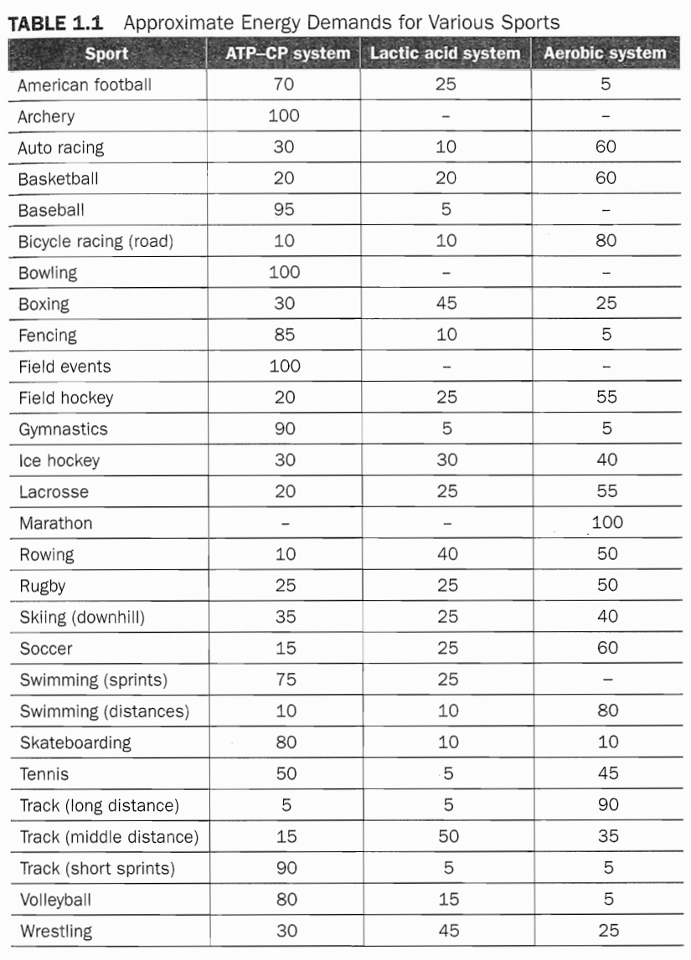

Slide 13
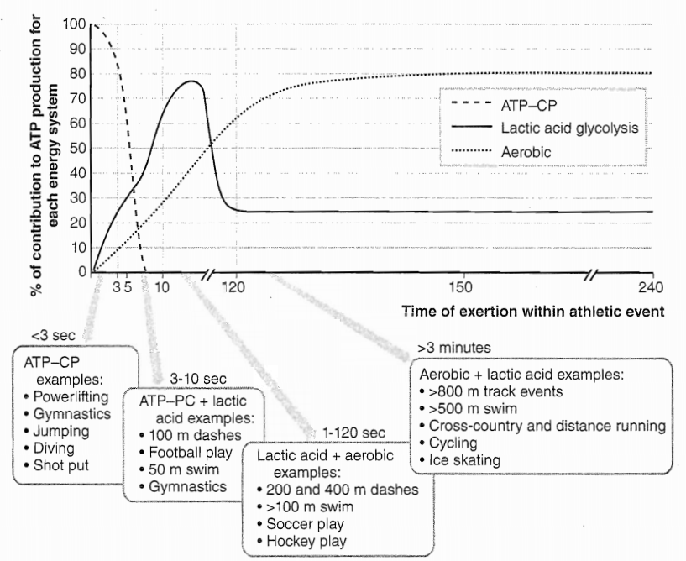

Slide 14
Energy systems
Generally, the ATP-CP cycle begins to fatigue and exhaust itself roughly 6 seconds after exercise is begun.
However, the glycolytic pathway is a short-lived energy system, lasting only a few minutes.
The conditioning program should be specific to the physiological analysis of each position.

Slide 15
Energy systems
Some workouts within a periodized training program should mimic the sport metabolism.
For example, wrestlers need to develop strength and power, but they also need to perform conditioning activities that utilize short rest periods in order to develop buffering capabilities so that they can express their maximal muscular strength and power under the metabolic conditions of the sport.

Slide 16
Energy systems
This is why an effective training program must incorporate a variety of workouts and why different athletes require different programs.

Slide 17
Biomechanical Demands of the Sport
body and limb movements
the speed of the athlete’s body
primary muscle actions
planes of motion
pattern of movement,
the joints involved during competition,
the pattern of muscle actions

Slide 18
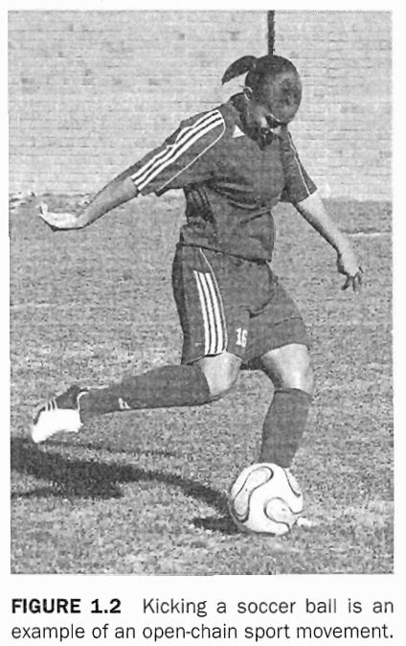
Describing Sport Movements
static or dynamic
Open or closed
isometric, concentric, and eccentric

Slide 19
Biomechanical Analysis in Practice
First, what are the patterns of movement (i.e., concentric, eccentric, or isometric), and in which planes do they take place?
Second, what joints are involved during the activity?
Third, what muscles are recruited, and what are the muscle actions?
Finally, what is the duration of time that the athlete will be actively engaged in the athletic event?

Slide 20
Biomechanical Analysis in Practice
The ultimate goal of analysis is to manipulate and match the acute variables that govern the program's design to match the metabolism and movements involved in the sport.

Slide 21
Video analysis
View a video of an athletic performance or activity.
Select a specific movement in the sport
To completely analyze the sport, several movements or skills may need to be examined. Look at the entire sequence of competition to get a feel for the demands of the sport.

Slide 22
Video analysis
Identify the joints around which the most intense muscular actions occur
Determine whether the movement is concentric, isometric, or eccentric
determine the range of angular motion
Estimate the velocity of movement in the early, middle, and late phases
Select exercises to match the limb's ranges of motion and angular velocities

Slide 23
Injury Risks of the Sport
In athletics, the majority of injuries affect the musculoskeletal system (bones, ligaments, muscles, and tendons), while additional injuries may include the neurological and cardiopulmonary systems (concussions, asthma, and heart attacks).
Musculoskeletal injuries can occur due to either mechanical overload or repetitive overuse of a joint, limb, or muscle group

Slide 24
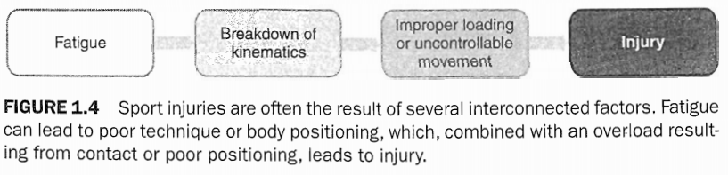
Mechanical overload injuries
Contact
Noncontact
First, injury occurrence increases when an athlete becomes fatigued. Second, the rate of injury increases when the athlete experiences tissue fatigue.

Slide 25
Needs Analysis for Injury Prevention
First, how likely is an injury to occur in the sport?
Second, what are the common injury sites and how are these injuries most likely to occur?
Third, which athletes are most prone to these risks for injury?
Fourth, how can an exercise program be developed that will diminish these risks?

Slide 26
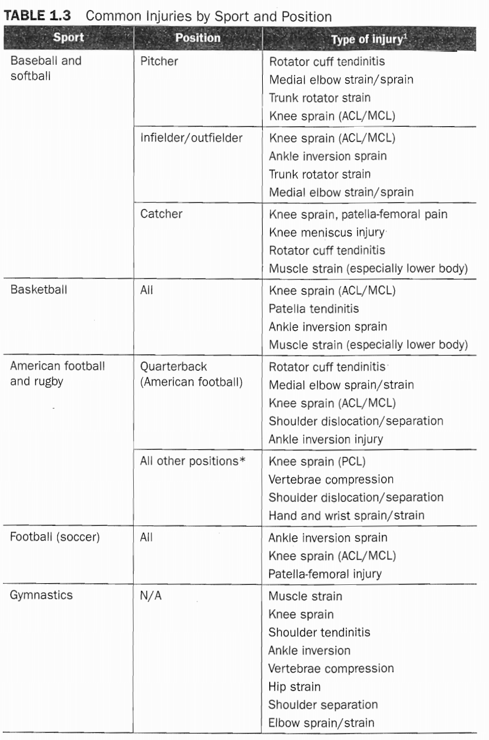

Slide 27
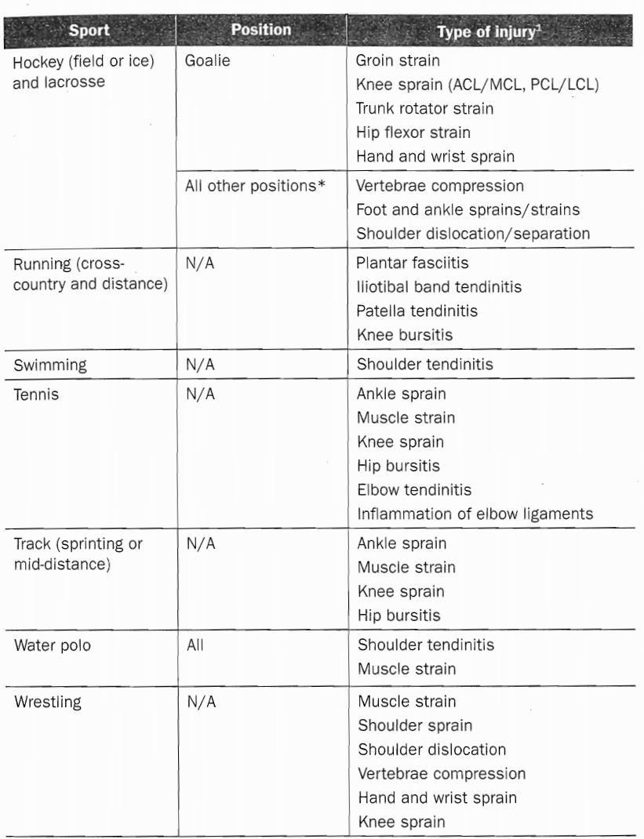

Slide 28
Integrating the Needs Analysis
athlete's training history
demands of the sport
position played on the team,
genetic and morphological differences,
and any previous injuries or medical conditions

Slide 29
Training history
their athletic history, their injury history, and any other questions that may seem pertinent to forming a comprehensive background profile.
Testing is also important to assess sport-fitness status, develop injury-prediction models, motivate athletes to improve or maintain a given fitness parameter, examine the effectiveness of a conditioning program, and to motivate athletes to take responsibility for their physical development in order to prevent injuries and improve their physical potential and performance.

Slide 30
Overreaching and Overtraining
By providing overload in the training program, strength and conditioning professionals ensure that the athlete will functionally overreach within the training program and progress as expected.
If manipulation of the training variables is not tailored correctly to the desired adaptations and specific training goals, the athlete will experience symptoms of nonfunctional overreach.

Slide 31
Overreaching and Overtraining
Performance will begin to suffer and some training adaptations may be lost.
If this process continues, the athlete can enter into an overtraining syndrome, and may need months to recover performance capabilities

Slide 32
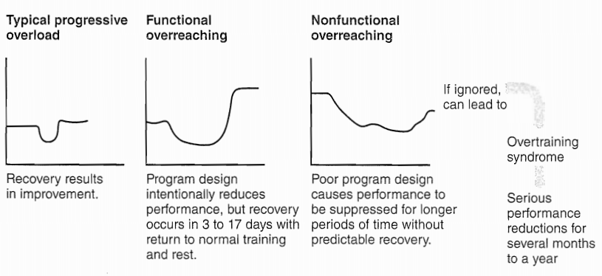
Overreaching and Overtraining

