Slide 1
Athlete Testing and Program Evaluation
2
Jay R. Hoffman, PhD, CSCS*D, FNSCA

Slide 2
Benefits of assessment
develop athletic performance profiles for specific sports (However, to understand the basic physical requirements of a sport, an athletic profile must be developed)
evaluate the effectiveness of specific training paradigms
athletes' potential for success in a specific sport or position
set training goals for both teams and individual athletes

Slide 3
Factors That Affect Performance Testing
Body Size. In general, strength is positively related to body size.
Absolute strength
Relative strength
Fiber Type Composition. The contractile properties of muscles play a significant role in their ability to generate power, sustain performance, and delay fatigue.

Slide 4
Factors That Affect Performance Testing
Although it may be possible to make a slow athlete faster, it is highly unlikely that strength and conditioning professional can make a slow athlete fast.
Training Status. the greater the training experience, the smaller the potential for achieving performance gains.

Slide 5
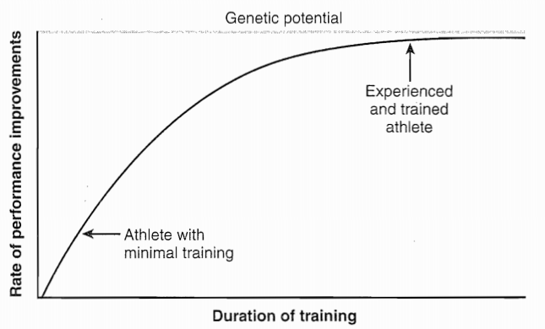
Theoretical training curves

Slide 6
Test Selection
Specificity and Relevance of the Test. For a performance test to be of significant value, it is imperative that each test used is specific to the athlete’s training program.
(e.g., machines versus free weights)
(e.g. squats versus leg press)

Slide 7
Test Selection
Validity and Reliability of the Test.
Validity refers to the degree that each test measures what it is intended to or claims to measure.
Reliability refers to the ability of each test to produce consistent and repeatable results.

Slide 8
Practical Considerations for Test Administration
Safety Considerations. All athletes, regardless of level of competition, should be medically cleared before participating in any health or performance assessment.
Timing of Assessment. the goal of each evaluation period may be different, focusing on determining training goals, assessing the effectiveness of the training program, or evaluating the readiness of athletes to compete.

Slide 9
Practical Considerations for Test Administration
The first testing session should be held before off-season (winter) work-outs begin in order to guide exercise prescription, establish training goals, and serve as a motivational tool for the athletes

Slide 10
Practical Considerations for Test Administration
This testing session helps strength and conditioning professionals evaluate the winter conditioning program, check the athletes' progress, and continue to motivate them.

Slide 11
Practical Considerations for Test Administration
Testing Sequence.
In general, the least fatiguing tests should be performed first. Tests that require high-skill movements, such as agility measurements, should be performed prior to any fatiguing tests.
Any performance test that fatigues the athlete will confound the results of any subsequent tests.

Slide 12
Strength
When assessing strength, strength and conditioning professionals must decide which type of exercise to use and whether to test maximal strength or predict it from submaximal assessment.
Strength testing can be performed with dynamic, constant-resistance exercises (i.e., free weights), isokinetic testing, or an isometric dynamometer.

Slide 13
Isokinetic Testing
recruits a smaller muscle mass or an isolated joint action
For example, comparing muscle groups from bilateral limbs (i.e., right-knee flexors with left-knee flexors) or agonist versus antagonist muscle groups (i.e., knee flexors versus knee extensors).
For athletes with strength imbalances greater than 15%, an incidence of muscle injury has been reported that is 2.6 times greater.

Slide 14
Dynamic Constant Resistance Testing
Repetition maximum (1RM). maximal strength testing is the potential risk for injury
or to predict maximal strength. the number of repetitions performed is 10 or fewer.
Formula

Slide 15
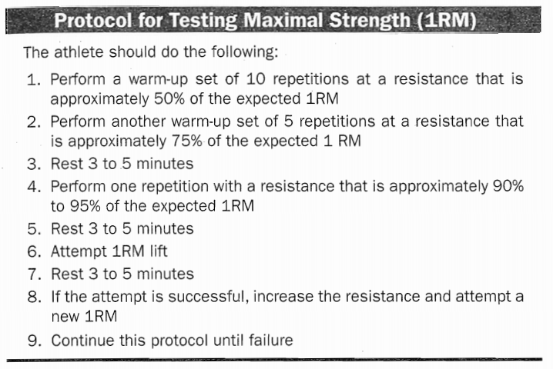
Repetition maximum (1RM)

Slide 16
Anaerobic Power and Anaerobic Fitness
Laboratory Tests.
Repeated jumps on a force plate or contact mat
Maximal-effort cycling tests
Nonmotorized treadmill
These tests assess peak power (highest power output attained during the test), mean power (average power output of entire test), or both, additionally, fatigue rate (the athlete's ability to maintain power output throughout the duration of the test)

Slide 17
Anaerobic Power and Anaerobic Fitness
Wingate anaerobic power test (WAnT)
30-second maximal-effort cycling
duration (10-20 s), or have performed a longer, 60-second test

Slide 18
Field Tests
Vertical Jump
Peak power (W) = 61.9 × jump height (cm) + 36 × body mass (kg) + 1.822
Mean power (W) = 21.2 × jump height (cm) + 23 × body mass (kg) − 1.393
300-Yard Shuttle Run. 25 yards (23 m) away and then returns to the starting line, A total of six round trips are performed (12 × 25 yards = 300 yards, or 273 m)
5-minute rest interval

Slide 19
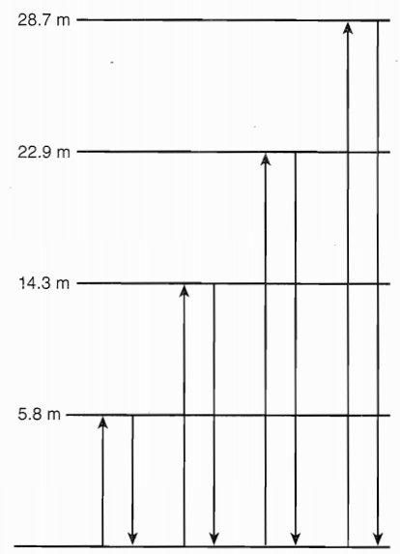
Field Tests
Line Drill
A total of three trials are often used, with a 2-minute rest period between each trial. All sprint times are recorded and the fastest time is reported. A fatigue index is generated by dividing the fastest score by the slowest score.

Slide 20
Aerobic Capacity and Aerobic Endurance
Direct Laboratory Measurement
1. The increase in oxygen uptake is no greater than 150 ml/min, despite an increase in exercise intensity (plateau criterion)
2. Attainment of age-predicted maximal heart rate (HRmax)
3. A respiratory exchange ratio (VCO2/VO2) greater than 1.10
4. A plasma-lactate concentration of at least 18 mmol/L Within 4 minutes of ending exercise

Slide 21
Field Tests
Cooper 12-minute run
and the 1.5-mile test for time

Slide 22
Speed
The 40-yard sprint is the most popular distance used in most speed assessments,

Slide 23
Agility
Agility refers to the ability to change direction rapidly.
T test,
Edgren side- step test,
the pro-agility (5-10-5) test,
and the Illinois test

Slide 24
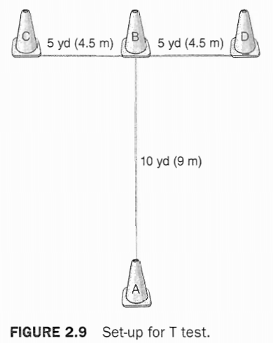
T test
warm-up
The athlete should face forward at all times and should not cross the feet. Crossing the feet or failing to touch a cone results in disqualification.

Slide 25
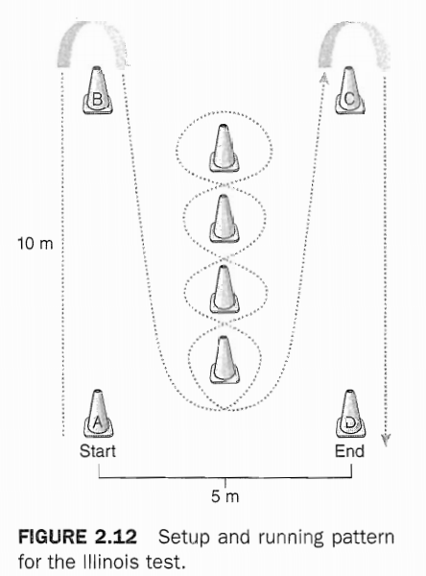
Illinois Test

Slide 26
Body Composition
Dual-Energy X-Ray Absorptiometry
Hydrostatic Weighing
Plethysmography
Skinfold Measurement
Bioelectrical Impedance

Slide 27
Skin fold sites

Slide 28
Skin fold sites

Slide 29
Skin fold sites

Slide 30
Skin fold sites

Slide 31
Skin fold sites

Slide 32
Skin fold sites

Slide 33
Skin fold sites

Slide 34
Skin fold sites

Slide 35
Skin fold sites
http://www.exrx.net/Calculators/BodyComp.html

