Slide 1
Dynamic Warm-Up
3
Avery D. Faigenbaum, EdD, CSCS*D, FNSCA, FACSM

Slide 2
A well-designed warm-up can:
increasing blood flow to active muscles,
raising core body temperature,
enhancing metabolic reactions, and
improving joint range of motion
reduce the risk of injury, and
lessen the potential for muscle soreness after exercise

Slide 3
A well-designed warm-up can
These effects can boost athletic performance by:
enhancing oxygen delivery,
increasing the speed of nerve-impulse transmissions,
improving rate of force development, and
maximizing strength and power

Slide 4
warming up and stretching
warming up and stretching are two different activities. A warm-up consists of preparatory activities and functionally based movements that are specifically designed to prepare the body for exercise or sport. In contrast, the primary goal of stretching is to enhance flexibility.

Slide 5
Dynamic Warm-up
Interest is growing in Warm-up procedures that involve dynamic activities and sport-specific movements that maximize active ranges of motion at different movement-specific speeds while preparing the body for the demands of sport training and competition.

Slide 6
Traditional warm-up
A usually consists of two components. The first is a general warm-up of 5 to 10 minutes of low- to moderate-intensity cardiorespiratory exercise, such as jogging or stationary cycling, followed by several minutes of static stretching.
The second is a specific warm-up that involves less intense movements similar to the sport or activity about to be performed.

Slide 7
General warm-up
A general warm-up of basic exercises for the major muscle groups increases heart rate, blood flow, muscle temperature, and core body temperature, as evidenced by the onset of sweating.
Static stretching exercises:
improve range of motion within joints,
enhance performance, and
reduce the risk of injury prior to activity

Slide 8
Static Stretching and Performance
Although static stretching enhances flexibility, which is a well-recognized component of health-related fitness, there is little scientific evidence to suggest that pre-event static stretching prevents activity-related injury or enhances athletic performance.

Slide 9
pre-event static stretching
A growing body of research evidence indicates that pre-event static stretching of the prime movers may actually have a negative effect on force production, power performance, strength endurance, reaction time, and running speed.
3% decrease in sprinting performance at 40 m following pre-event static stretching.
PNF, which involve both passive movements and active muscle actions, can also inhibit strength and reduce explosive power.

Slide 10
stretching-induced effect
This stretching-induced effect is thought to be related to a decrease in neural activation, reduced musculotendinous stiffness, or a combination of neural and muscular factors.
static stretching can result in muscle damage (as evidenced by elevated levels of creatine kinase in the blood).
Of note, the observed reductions in performance following static stretching may, in some cases, last up to one hour.

Slide 11
pre-event static stretching
pre-event static stretching may adversely affect athletic performance, particularly in sports that involve strength and power.
Consequently, most athletes should perform static stretching during the cool-down or as part of a separate training session. In some cases, however, athletes who participate in sports that require high levels of flexibility may benefit from pre-event static stretching.

Slide 12
Dynamic Warm-Up and Performance
This type of training typically includes movements of low, moderate, and high intensity that increase body temperature, enhance motor-unit excitability, develop kinesthetic awareness, and maximize active ranges of motion.
Prior to a Weightlifting workout, plyometrics jumps and explosive exercises with medicine balls could be used to prepare athletes for the upcoming training session.

Slide 13
Dynamic Warm-Up and Performance
some observers suggest that subsequent explosive performance may improve between 2% and 10%.

Slide 14
Postactivation Potentiation
In preparation for explosive sporting events, such as the long jump, pole vault, or high jump, a technique known as postactivation potentiation (PAP) may be used as part of the athletes’ dynamic warm-up.
A brief time of repetitive stimulation can result in an enhanced contractile response (potentiation), while continued stimulation can impair the contractile response (fatigue).

Slide 15
PAP
However, many factors need to be considered when applying the principles of PAP to athletic performance, Namely, training experience, individual power-strength ratio, intensity and volume of the pre-event activity, and the recovery period can influence the efficacy of any performance-enhancing stimulus.
time between the cessation of the PAP activity and the start of training or competition is within 4 to 12 minutes after the preload stimulus

Slide 16
Developing a Dynamic Warm-Up Protocol
prepares the body for the vigorous, random movements that can occur during sports training and competition.
an opportunity for younger athletes to gain confidence in their abilities to perform movement skills.
warm-up activities that are active, engaging, and somewhat challenging are far more enjoyable than traditional stretch-and-hold activities.

Slide 17
A well-designed warm-up can
the general idea is to (I) warm up, (2) activate, and (3) motivate. Warm up highlights the importance of increasing body temperature, activate refers to exciting or potentiating the neuromuscular system, and motivate draws attention to the need to psychologically prepare athletes for the demands of engaging, and diverse, performance during the practice session or game that follows may be enhanced.

Slide 18
A well-designed warm-up can
Instead of jogging around the playing field, a general warm-up of jumping rope, body-weight calisthenics, medicine ball exercises, footwork patterns with an agility ladder, or sport-specific actions, such as dribbling a soccer ball around cones, can contribute to movement skill development and make a valuable contribution to the overall conditioning process.

Slide 19
fundamental principle of a dynamic warm-up
perform large muscle group
similar to the movement patterns that will be performed during training
do not require equipment or a lot of space
prescribed number of repetitions (e.g., 8 to12) or cover a predetermined distance (e.g., 10 to 20 m).
athletes complete 5 to 12 different exercises that progress from relatively simple movements to more challenging

Slide 20
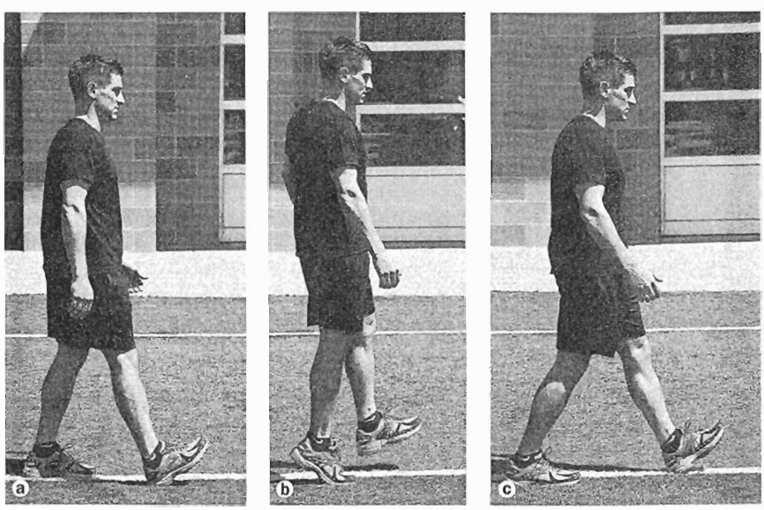
Dynamic Warm-Up Exercises

Slide 21
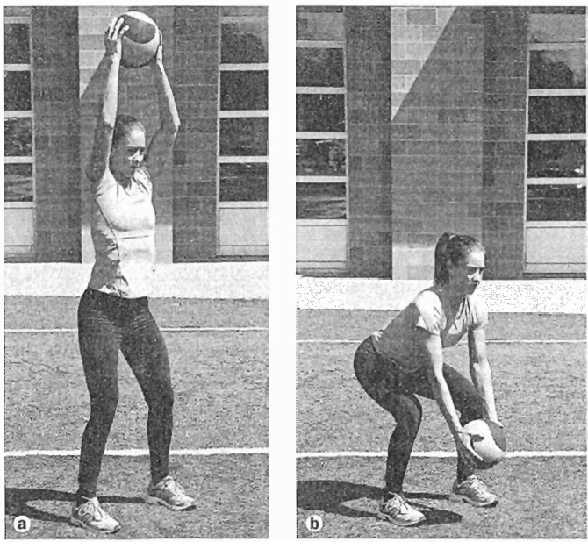
A well-designed warm-up can

Slide 22
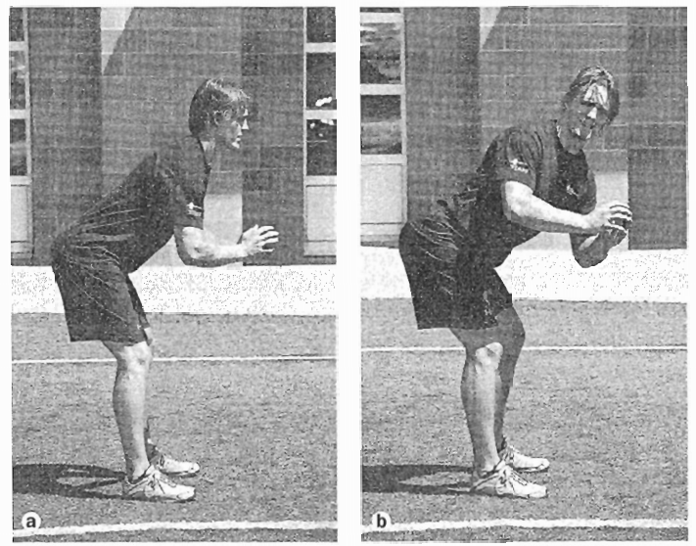
A well-designed warm-up can

Slide 23
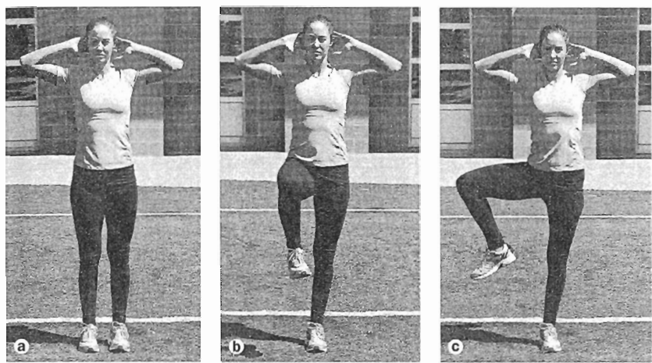
A well-designed warm-up can

Slide 24
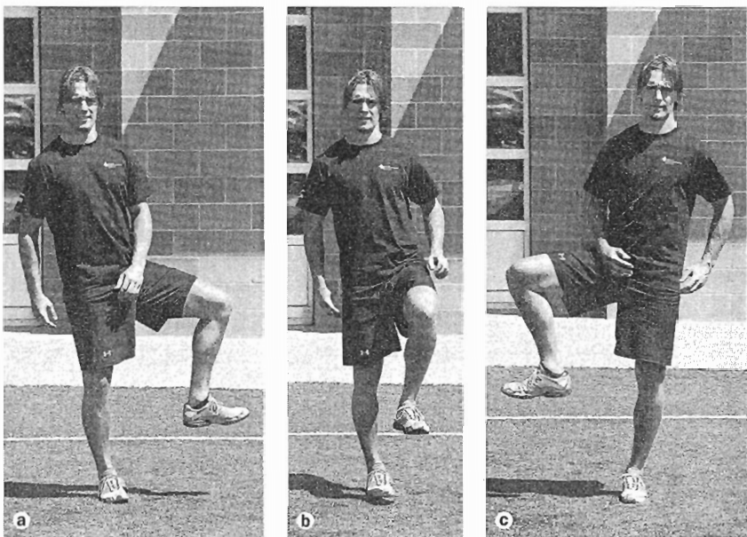
A well-designed warm-up can

Slide 25
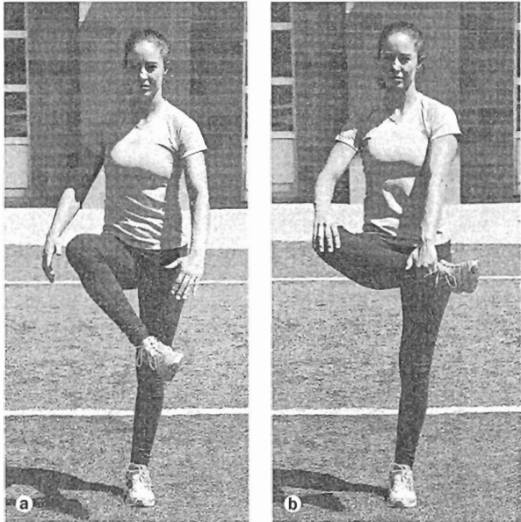
A well-designed warm-up can

Slide 26
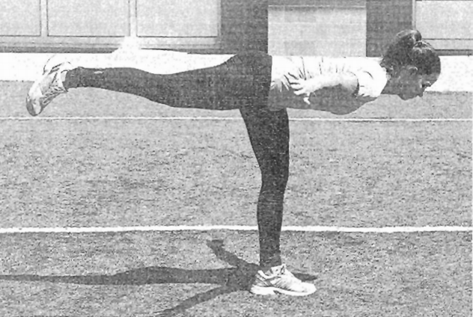
A well-designed warm-up can

Slide 27
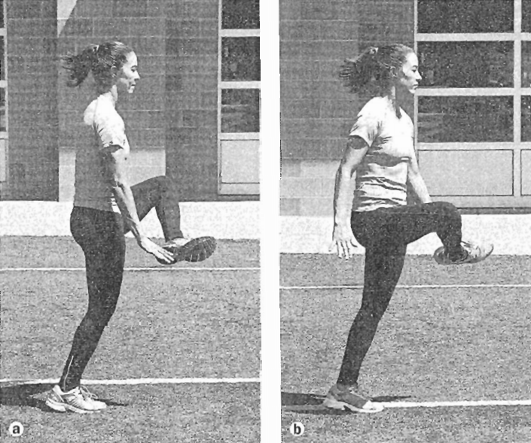
A well-designed warm-up can

