Slide 1
Resistance Training
4
Nicholas A. Ratamess, PhD, CSCS*D, FNSCA

Slide 2
Resistance training role
increasing muscular strength; power and speed, hypertrophy, muscular endurance, motor performance, balance, and coordination.
however, the critical element that dictates acute exercise response and chronic adaptation is the design of the resistance training program

Slide 3
Adaptations to Resistance Training
adaptations to:
Nervous systems
Muscular systems
Connective tissue systems
Cardiorespiratory systems
Endocrine systems

Slide 4
Nervous systems
recruit more muscle fibers and to preferentially use the muscle fibers most beneficial for strength and power activities.
some neural defense mechanisms may be desensitized, thereby allowing athletes to progressively train at a higher tolerance level.

Slide 5
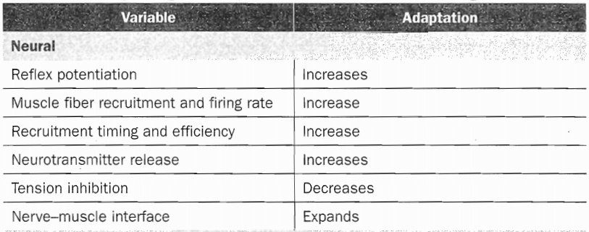
Nervous systems

Slide 6
Muscular systems
increases in size,
substrate concentrations and
enzyme activity,
fiber transitions
architectural changes, and
enhanced oxidative capacity (increased capillary and mitochondrial density)
Connective tissue hypertrophy

Slide 7
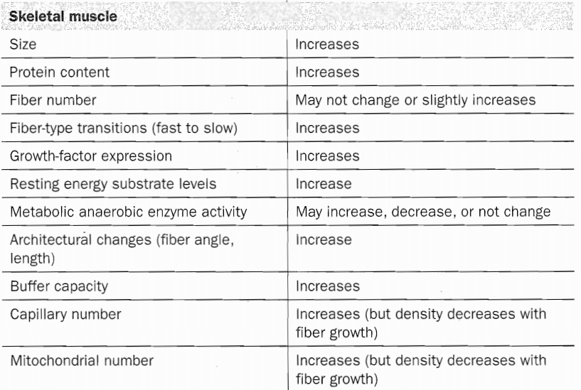
Muscular systems

Slide 8
CONNECTIVE TISSUE

Slide 9
Endocrine system

Slide 10
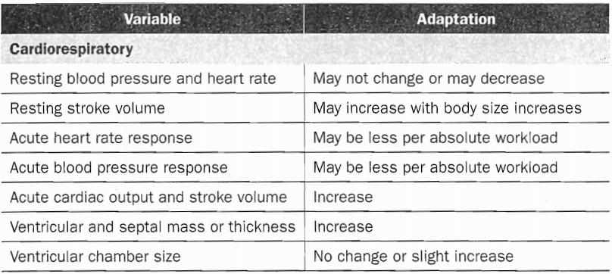
Cardiorespiratory system

Slide 11
Customizing Resistance Training Programs
Are health concerns or injuries present that may limit the exercises performed or the exercise intensity?
What type of equipment (e.g., free weights, machines, bands, tubing, medicine and stability balls, balances, and so an) is available?
What is the targeted frequency? Are there any time constraints that may affect workout duration?
What muscle groups need to be trained?
What are the targeted energy systems (e.g., aerobic or anaerobic)?
What types of muscle actions (e.g., concentric [CON], eccentric /ECC'], isometric [ISOM]) are needed?
If training for a sport or activity, what are the most common sites of injury?

Slide 12
Common goals of resistance training
injury rehabilitation
improvements in muscle size,
strength,
power,
speed,
local muscular endurance,
balance,
coordination,
flexibility,
percent body fat, and
general health

Slide 13
Example
gymnasts require great levels of strength and power but may experience decreases in performance as a result of excessive hypertrophy.
football linemen may benefit from additional lean body mass in addition to strength and power increases.

Slide 14
Resistance Training Program Variables
(1) exercise selection,
(2) exercise order and workout structure,
(3) intensity,
(4) training volume (total number of sets and repetitions),
(5) rest intervals,
(6) repetition velocity, and
(7) training frequency.

Slide 15
Exercise Selection
biomechanical perspective:
type of muscle contraction,
type of joint motion,
and whether they involve an open or closed kinetic chain.
practical concerns:
type of equipment will be used and whether exercises will be performed unilaterally or bilaterally.

Slide 16
Muscle contraction
All exercises consist of concentric (CON), eccentric (ECC), and isometric (ISOM) muscle actions.

Slide 17
ECC
Greater force per unit of muscle cross sectional area,
Involve less muscle-fiber activation per level of tension,
Require less energy expenditure per level of tension, and result in
Greater muscle damage
More conducive to muscle growth
Strength improvements are greatest when ECC actions are emphasized.

Slide 18
Sticking region
the weak point of the exercise range of motion that is evident during heavy sets or when significant fatigue is present.
is the limiting factor of the set, That is, the sticking region is the make-or-break point of the exercise.
weight selection ultimately depends on what weight can be lifted through the CON sticking region.
Consequently, other areas of the range of motion, including the ECC phase, may not receive the optimal training stimulus.

Slide 19
Sticking region
Heavy negatives and forced negatives from a partner are a couple of ways in which the ECC muscle action can be emphasized.
These provide great neuromuscular overload and a novel stimulus for enhancing strength and muscle size.
short four- to six-week training cycles for only a few sets per workout) to reduce excessive muscle damage and the risk of overtraining and injury.
Another form of heavy ECC training involves performing a bilateral exercise with low to moderate weight and then lowering it with only one limb.

Slide 20
ISOM
(1) from stabilizer muscles that provide reactive forces to maintain posture during an exercise,
(2) in between ECC and CON actions for the agonist muscles in an exercise,
(3) while gripping the weights, and
(4) as the primary action of the exercise in a specific area of the range of motion.

Slide 21
Functional isometrics
Functional isometrics:
lifting a barbell in a power rack a few inches until it is up against the rack’s pins,
The lifter then continues to maximally ISOM push or pull, maintaining for approximately 2 to 6 seconds.
they are effective when performed near the sticking region of the exercise.
Some exercises commonly targeted with functional isometrics are the bench press, deadlift, squat, and clean pull.

Slide 22
Joint Involvement
single joint
multiple joints
Single-joint exercises stress one joint or major muscle group, whereas multiple- joint exercises stress more than one joint or major muscle group.

Slide 23
Joint Involvement
Single-joint exercises :
effective for increasing muscular strength
used to target specific muscle groups
lesser risk of injury due to the reduced level of skill and technique involved.
Multiple-joint exercises :
more technically complex in terms of neural activation.
most effective for increasing muscular strength because they enable the athlete to lift a larger amount of weight.

Slide 24
Multiple-joint exercises
subclassified as:
Basic strength
Total body lifts
Basic strength exercises involve at least two or three major muscle groups, whereas total body lifts (e.g., Olympic lifts and variations) involve most major muscle groups.
most effective exercise for increasing muscle power because they require explosive force production and fast bodily movements

Slide 25
Multiple-joint exercises
Exercises that work large or multiple muscle groups produce a substantial acute metabolic and hormonal (testosterone and growth hormone) response.
it is thought that exercises that stress large muscle groups produce a greater anabolic hormone environment for the small muscle group exercises.

Slide 26
Type of Equipment
Alterations in body posture, grip, hand width, foot stance, and position change muscle activation to some degree, thus altering the exercise.
free Weights or machines.
Free weights consist of barbells, dumbbells, and associated equipment (i.e., plates, collars, benches).
Both free weights and machines are very effective for increasing muscle strength and performance, and both have advantages and disadvantages depending on the needs of the athlete.

Slide 27
Type of Equipment
Machines provide greater stability and control the path of movement. Free weights require the lifter to control all aspects of the exercise. Stabilizer muscles are stressed to a higher degree when free-weight exercises are performed.
machine exercises are safer and easier to learn initially, while free weights stress total muscular development to a larger degree.

Slide 28
Type of Equipment
When a neutral testing device is used, strength improvement from free weights and machines appear to produce similar results.
Free weight training appears more applicable to improving athletic performance.
decision to include free-weight or machine exercises may depend on other factors, such as equipment availability and cost.

Slide 29
unstable environments
(e.g., with stability balls, wobble boards, and BOSU balls)
increase the activity of trunk muscles and other stabilizer muscles (compared to stable environments)
since lighter weights must be lifted, the stimulus for maximal strength enhancement and force production is limited.

Slide 30
Unilateral and Bilateral Exercises
The level of muscle activation differs when an exercise is performed bilaterally versus unilaterally.
This term describes the fact that the maximal force produced by both limbs together is smaller than the sum of the limbs contracting unilaterally.

Slide 31
Kinetic Chain
closed chain kinetic exercises have higher transfer of training effects to specific sporting movements and activities of daily living.
Therefore, closed chain kinetic exercises should form the core foundation of athletic resistance training programs.

Slide 32
Workout Structure and Exercise Order
There are three basic workout structures to choose from:
(l) total body workouts,
(2) upper and lower body split workouts and
(3) muscle group split routines.

Slide 33
Total body workouts
Total body workouts involve exercises that work all major muscle groups (i.e., 1 or 2 exercises for each major muscle group).
They are very common among athletes and Olympic weightlifters.

Slide 34
Upper and lower body split
Upper and lower body split workouts involve performance of only upper body exercises during one workout and only lower body exercises during the next workout.
common among athletes, power lifters, and bodybuilders.
Muscle group split routines involve performance of exercises for specific muscle groups during a workout. These are characteristic of bodybuilding programs.

Slide 35
exercise order
The primary training goals should dictate the exercise order. Exercises performed early in the workout are completed with less fatigue, yielding greater rates of force development, higher repetition number, and greater amount of weights lifted.
Considering that these multiple-joint exercises are effective for increasing strength and power, prioritization is typically given to these core structural exercises (i.e., those extremely important to targeting program goals) early in a workout.

Slide 36
exercise order
When the goal of training is hypertrophy, training in a fatigued state does have a potent effect on the metabolic factors that induce muscle growth. In this case, the exercise order may vary to stress the metabolic factors involved in muscle hypertrophy.
For example, some bodybuilders have used a technique known as pre-exhaustion.
This technique improves hypertrophy and muscle endurance to a greater extent than maximal strength.

Slide 37
exercise order
For muscle endurance training, fatigue needs to be present for adaptations to take place.
For example, during a preseason conditioning phase, a basketball coach may choose to place the squat exercise later in the workout. This will force the athlete to perform the exercise in a fatigued state.

Slide 38
When training all major muscle groups in a workout:
Large muscle group exercises should be performed before smaller muscle group exercises.
Multiple joint exercises should be performed before single joint exercises.
For power training: Total body exercises (from most to least complex) should be performed before basic strength exercises.
Alternating between upper and lower body exercises or opposing (agonist-antagonist relationship) exercises can allow some muscles to rest while the opposite muscle groups are trained.

Slide 39
When training all major muscle groups in a workout:
Some exercises that target different muscle groups can be staggered between sets of other exercises to increase workout efficiency. For example, a trunk exercise can be performed between sets of the bench press. Because different muscle groups are stressed, no additional fatigue would be induced prior to performing the bench press. This is especially effective when long rest intervals are used.

Slide 40
Intensity
Intensity is the term often used to describe the amount of weight lifted during resistance training.
Low intensities of 45% to 50% of 1RM or less may increase muscle strength in untrained athletes. However, higher intensities (at least 80% to 85% of IRM) are needed to increase maximal strength as the athlete progresses to advanced levels of training.

Slide 41
Repetition Maximum Continuum
Loads corresponding to 1- to 6RM (repetition maximum), or >85% of 1RM, are most effective for increasing maximal strength.
Although significant strength increases occur when loads correspond to 6- to 12RM (67% to 85% of 1RM), this range may not be specific to increasing maximal strength in advanced athletes as compared to higher intensities.

Slide 42
Repetition Maximum Continuum
That is, a repetition range between 6- and 12RM may maximize the interaction between mechanical and metabolic growth factors, intensities lighter than this (12RM and lighter) have only a small effect on maximal strength, but they are very effective for increasing muscular endurance.
It is recommended that novice to intermediate lifters resistance train with loads corresponding to 67% to 85% of IRM for 6 to 12 repetitions. Advanced athletes should alternate this range with training loads of 80% to 100% of 1RM to maximize muscular strength.

Slide 43
Repetition Maximum Continuum
It is also important to note that intensity prescription is exercise dependent.
multiple-joint structural exercises
The intensity may not be as high for every exercise in a workout.
squats with a heavy load (4- to 6RM),
leg curls at a lower intensity (8- to 10RM).

Slide 44
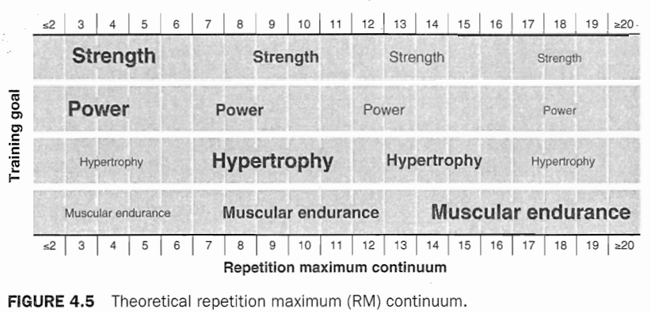
Repetition Maximum Continuum

Slide 45
Power Training
Power training requires two loading strategies
Therefore, both force and velocity components must be emphasized to maximize power.
Moderate to heavy loads are required to recruit the fast-twitch muscle fibers needed for maximal strength increases.
greater loading results in such a decrease in velocity that performing heavy resistance training increases force production, but does not optimize the velocity (or time) component.

Slide 46
Power Training
A second vital training strategy when training for power is to incorporate low to moderate intensities performed at an explosive lifting velocity (i.e.,, based on the impulse-momentum relationship).
Most studies have shown that peak power is attained in a range from 15% to 60% of IRM for ballistic exercises, such as the jump squat and bench press throw.

Slide 47
Power Training
Recent research indicates that perhaps even less resistance (e.g., body weight) can maximize power output during jumps.
The intensities at which peak power is attained during traditional repetitions are generally higher than those for ballistic exercises due to the variance in deceleration (e.g., 40% to 60% of IRM for the bench press, 50% to 70% for the squat).

Slide 48
Power Training
Although any intensity may enhance muscle power, specificity is needed to ensure that training encompasses a range of intensities, with emphasis placed on those that match the demands of the sport or activity.
Heavy loading (85% to 100% of IRM) is necessary for increasing strength, and light to moderate loading (30% to 60% of IRM for upper body exercises, 0% to 60% of IRM for lower body exercises) performed at an explosive velocity is necessary for increasing fast force production.

Slide 49
Increasing Intensity
(1) increasing relative percents of IRM,
(2) training within a repetition maximum (RM) zone, and
(3) increasing absolute amounts.

Slide 50
Increasing Intensity
relative percents of IRM
Olympic lifts and variations, squats, deadlift, and bench presses.
Percents can be used to vary intensity from set to set or to quantify a training cycle.
repetition maximum (RM)
Training within a RM zone requires an increase in repetitions with a current workload until a target number is reached.

Slide 51
Increasing Intensity
In a zone of 8- to 12RM, the athlete selects an 8RM load and performs 8 repetitions. During the next few workouts, the athlete performs additional repetitions with that load until 12 repetitions are completed on consecutive workouts. The training load is then increased, and the athlete subsequently performs 8 repetitions.

Slide 52
Increasing Intensity
absolute amounts
For example, the athlete completes six repetitions with I00 kg in the bench press. As strength increases, the athlete continues to perform six repetitions: however, he uses a greater load (e.g., 105 kg).

Slide 53
Supramaximal intensities
Remember that a concentric IRM can alternatively be defined as the maximal amount of weight lifted through the sticking region.
Techniques such as forced repetitions and heavy negatives, partial range-of motion training (in the strongest area of the range of motion), and overloads may be used to stimulate the nervous system and to perhaps enhance maximal strength.

Slide 54
Volume
Training volume is a summation of the total number of sets and repetitions performed during a workout.
Training volume can be manipulated by changing the number of exercises performed per session, the number of repetitions performed per set, or the number of sets per exercise.

Slide 55
Volume
There is also an inverse relationship between volume and intensity. That is, volume should be reduced if significant increases in intensity are prescribed.
Hypertrophy and muscular endurance training are associated with moderate to high intensity and volume. These programs, which are high in total work, tend to stimulate a potent endocrine and metabolic response.

Slide 56
Volume
Training volumes of athletes vary considerably and depend on other factors besides intensity (e.g., training status, number of muscle groups trained per workout, nutrition practices, practice and competition schedule).
Typically, two to six sets per exercise are most common during resistance training, but both greater and lesser amounts have also been used successfully.

Slide 57
Set Structures for Multiple-Set Programs
The first is a constant load/repetition system . The intensity and volume remain the same across all sets. This is very effective for increasing strength, power, hypertrophy, and muscular endurance.
A second system is to work from light to heavy. Weight is increased in each set, while repetitions remain the same or decrease. One popular example is the ascending pyramid.

Slide 58
Set Structures for Multiple-Set Programs
The third system is to work from heavy to light. One popular example of this is the descending pyramid.
Here, the weight is decreased with each sub- sequent set, while repetitions remain the same or increase.
However, critics of this system typically voice concerns about athletes being inadequately warmed-up when performing the heaviest set.

Slide 59
Rest Intervals
Rest interval length depends on training intensity, goals, fitness level, and use of the targeted energy system.
The amount of rest between sets and exercises significantly affects the metabolic, hormonal, and cardiorespiratory responses to an acute bout during resistance exercise, as well as performance of subsequent sets and training adaptations.

Slide 60
Rest Intervals
Acute force and power production are compromised with short rest intervals (30), although these short rest intervals are beneficial for hypertrophy and muscle endurance training.
Training to increase muscular endurance implies the athlete (1) performs high repetitions to enhance submaximal muscular endurance or (2) minimizes recovery between sets to enhance high-intensity (or strength) endurance, Thus, it is recommended that short rest intervals be used for muscular endurance training (e.g., ≤30 s).

Slide 61
Repetition Velocity
Lifting velocity affects the neural, hypertrophic, and metabolic responses to training.
Moderate to high velocities (1-2 s CON or less; l-2 s ECC) are most effective for enhanced muscular performance.
In addition, fast or explosive lifting velocities are recommended for maximizing increases in power.
The critical component to muscle endurance training is to prolong the duration of the set. Two recommended strategies for prolonging set duration are (1) moderate number of repetitions using an intentionally slow velocity and (2) high number of repetitions using moderate to fast velocities.

Slide 62
Frequency
The number of training sessions performed during a specific period of time may affect training adaptations.
It depends on several factors, such as volume, intensity, exercise selection, level of conditioning or training status, recovery ability, nutritional intake, and training goals.

