Slide 1
Anaerobic Conditioning
6
Jay R. Hoffman, PhD, CSCS*D, FNSCA

Slide 2
physiological adaptations
Physiological adaptations resulting from exercise are specific to the type of training program employed.
For athletes to achieve the desired physiological adaptations, they need to train the energy system that is predominantly recruited for their sport.

Slide 3
anaerobic energy system
These adaptations are necessary for athletes to maximize their ability to perform high-intensity activity with rapid recovery between each exercise bout (e.g., repeated sprint ability).
understand the physiological demands that the athlete experiences during competition.
American football, basketball, and ice hockey, and individual sporting events such as track and field, swimming, and cycling (specifically, the sprinting events).

Slide 4
anaerobic energy system
Other sports, such as soccer, field hockey, lacrosse, and team handball, rely on both the aerobic and anaerobic energy systems; however, the substitution patterns in those sports necessitate a greater reliance on the aerobic energy system to maintain prolonged activity.

Slide 5
Physiological Adaptations from Anaerobic Conditioning Programs
Increase in the transformation of 'type II fibers to a more glycolytic subtype
Significant elevations in glycolytic enzymes (phosphofructolcinase, phosphorylase, lactate dehydrogenase)
Increase in maximum blood-lactate concentrations
Reduced blood-lactate concentrations during submaximal exercise
Improved buffering capacity

Slide 6
Transformation of Muscle-Fiber Subtype
Fast-twitch fibers have high force capacity and a high speed of contraction, but fatigue quickly . In contrast, slow-twitch fibers have a slower contraction rate and a lower force capability, but are fatigue resistant. Thus, athletes who wish to excel in high-power sports, such as basketball, American football, or speed skating, would benefit from a higher percentage of fast-twitch fibers.

Slide 7
Transformation of Muscle-Fiber Subtype
The proportion of Type I (slow-twitch) to Type II muscle fibers appears to be genetically determined.
It is generally believed that training can only accomplish transformations within a fiber type.
Fiber subtypes become more glycolytic (anaerobic) or oxidative (aerobic), depending on the training stimulus that occurs.

Slide 8
Transformation of Muscle-Fiber Subtype
subtype IIx is more representative of a "couch potato.” This fiber subtype can be transformed quite rapidly into a more active subtype of the 'type II fiber subtype through an exercise program.
High-intensity exercise appears to be a potent stimulus for transforming the fiber subtype Type IIx to Type IIa.
Most of the population of Type IIx fibers has been reported to have converted to 'type IIa fibers following 20 weeks of training.

Slide 9
Transformation of Muscle-Fiber Subtype
Interestingly, subjects who were only performing endurance exercises also tended to increase the proportion of type IIa fibers, but they significantly elevated their 'type IIc fibers (the most oxidative of the Type II subtypes, and most conducive for enhancing prolonged exercise).
During periods of inactivity or detraining, fast-twitch fiber subtypes will transform from Type IIa back to Type IIx.

Slide 10
Metabolic Adaptations
All three energy systems are always activated, but the mode of exercise determines which of these energy systems is dominant.
To stress the anaerobic system, high-intensity activity should be focused on the specific energy system used during competition. For example, the sport of American football consists of repeated high intensity activity that averages 5 seconds per play, with approximately 25 to 30 seconds of rest between each play.

Slide 11
Phosphagen Energy System
To improve the functioning of the phosphagen energy system:
increase phosphagen concentrations within the muscle (ATP or CP).
enhance the recovery of this energy system between bouts of exercise

Slide 12
Phosphagen Energy System
Research has shown that short-duration (~5-6 s), high-intensity exercise causes little to no change in resting phosphagen (ATP or CP) concentrations, or in enzymes of the phosphagen energy system (i.e., creatine kinase).
Even during high-intensity exercise of longer duration (>10 s), the enzymatic changes in the phosphagen energy system are not consistent.

Slide 13
Phosphagen Energy System
During 30 seconds of continuous knee extensions significant elevations in both creatine kinase and myokinase were seen following seven weeks of training (1), while others were unable to find any significant change in the concentration of these enzymes following six weeks of training.
Differences among studies are likely related to training status, experience, duration of sprint, and length of training program.

Slide 14
Glycolytic System
Training studies using bouts of exercise between 15 and 30 seconds or longer have shown significant elevations in the glycolytic enzymes, such as phosphofructokinase, phosphorylase, and lactate dehydrogenase (6, 8, 14, and 16).
Parra and colleagues (16) have shown that these changes can occur within two weeks of training in previously untrained athletes.

Slide 15
Glycolytic System
evidence suggests that the intermittent nature of high-intensity activity with sufficient recovery provides a greater stimulus to glycolytic enzyme adaptations than continuous exercise does (4).
intermittent exercise, such as high-intensity interval training (10 sets of 10 s sprints with a 1:4 work-to-rest ratio for 15 weeks in competitive athletes) not only enhance anaerobic power to a greater extent than continuous exercise does, but may also enhance VO2max to the same magnitude that 20 to 25 minutes of continuous exercise does (22).

Slide 16
Oxidative Enzymes
The exercise stimulus causing an elevation in concentrations of glycolytic enzyme concentrations also appears to significantly increase mitochondrial enzyme activity (oxidative enzymes) (2, 23).
These changes enhance the efficiency of the mitochondria that may be responsible for slowing the use of muscle glycogen and reducing lactate production at a given intensity of exercise. This may have important implications for the anaerobic athlete by helping preserve muscle glycogen and potentially limiting fatigue. An increase in the concentration of these enzymes is more prevalent when the duration of high-intensity exercise exceeds 3 minutes (3).

Slide 17
Oxidative Enzymes
However, the implications of an increase in oxidative enzymes from anaerobic training programs suggest that anaerobic athletes may be able to generate some improvements in their aerobic capacity (13, 22, 24). This may have some important implications for enhancing exercise recovery.

Slide 18
Buffering Capacity
High-intensity exercise results in a lowering of muscle pH, contributing to the onset of muscle fatigue.
Training programs that stress the anaerobic energy system change the ability of the muscle to tolerate high concentrations of metabolic acidosis.
Buffers that are produced within the muscle, such as bicarbonate and muscle phosphates, help maintain the acid-base balance within the exercising muscle.

Slide 19
Buffering Capacity
During training (8 weeks), the buffering capacity within the muscle may increase 12% to 50% (17).
This depends on the conditioning level of the athlete and the design of the training program.

Slide 20
Developing Anaerobic Conditioning Programs
The primary movement patterns, duration of these movements, the number of movements, and the work-to-rest ratio are all critical variables that must be identified to prescribe appropriate exercises.
Each sport may be quite different. Even within a sport, variability of movements may exist among different positions.

Slide 21
Timing and Duration of the Program
When considering the time course of physiological adaptations that occur through training, strength and conditioning professionals can calculate the approximate time needed to begin preparing their athletes to reach peak anaerobic conditioning.
It is also imperative for strength and conditioning professionals to understand what their players have been doing in the off-season.

Slide 22
Team Sports
Matching the work and rest intervals of the sport is an important consideration in maximizing the effectiveness of an anaerobic conditioning program.
a work-to-rest ratio

Slide 23
Individual Sports
The development of a conditioning program for team sports, such as basketball, American football, or hockey, is quite different than the exercise prescription for athletes participating in an individual event, such as sprinting.
Unlike team-sport athletes, who perform various types of movements at variable intensities, sprinters are often required running a single sprint at maximum ability during a competition.

Slide 24
Individual Sports
The training program for sprinters is primarily focused on developing power, improving running technique and speed, and increasing speed endurance.
The goal of the sprinter is to reach peak running velocity as quickly as possible and to maintain running velocity throughout the length of the sprint. This is known as speed-endurance.

Slide 25
Individual Sports

Slide 26
Individual Sports
The anaerobic conditioning program for team-sport athletes is primarily concerned with preparing them for repeated bouts of high-intensity activity with limited rest intervals. In contrast, the sprinter’s training program is more concerned with the quality of each sprint than with improved fatigue rate.

Slide 27
Anaerobic Conditioning Exercises
Often, these types of drills are described as enhancing speed-endurance.
They were traditionally used to enhance or maintain speed during long-duration sprinting events. These drills have also been described as metabolic conditioning, which is a broader term for anaerobic conditioning or anaerobic endurance.
Swimmers who compete in sprinting events should focus on anaerobic conditioning in the water.

Slide 28
Interval Sprints
This is an excellent category of conditioning for developing anaerobic capacity; this drill can be performed on a 400 m track or on any measured course.
For example 100 m sprint, followed by a 100m jog
This combination is continued for the length of the workout. The length of the workout and the rest period (jog or walk) depends on both the conditioning and performance level of the athlete.

Slide 29
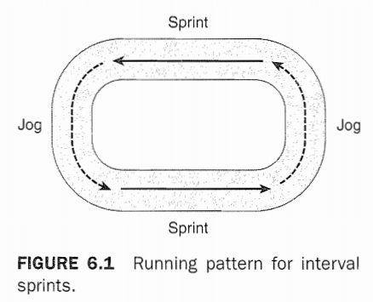
Interval Sprints
The distance for the intervals can also be varied. For instance, shorter intervals (e.g., 40 m) or longer intervals (e.g., 200 m) can be used as well.

Slide 30
Fartlek Training
This type of conditioning can be performed on either a track or a cross- country course. The athlete alternates short bursts of sprinting with jogging.
A major difference between Fartlek runs and intervals is that in the Fartlek runs, the sprints are of varying lengths. During interval training, the length of the sprint is consistent for the workout.

Slide 31
Repetition Sprints
For this drill, the athlete performs maximum sprints for a given distance. The distance can be either short (20-40 m sprints) or long (100-400 m sprints), Following a passive rest, the athlete repeats the sprint. The number of repetitions and the work-to-rest ratio depend on the athlete’s conditioning level.

Slide 32
Repetition Sprints from Flying Starts
This drill is similar to the previous one, except that the athlete begins each sprint from a running start, accelerates over 20 m, and then sprints the required distance. Again, the number of repetitions and the work-to-rest ratio depend on the athlete's conditioning level.

Slide 33
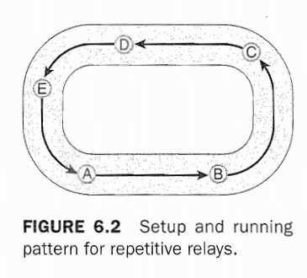
Repetitive Relays
This drill uses a group of athletes who form a relay team.
Athlete A sprints to and tags athlete B, who accelerates to athlete C. Athlete C sprints to athlete D, This process continues for the length of the track. Athletes will remain in the position of the person that they replaced.

Slide 34
Repetitive Relays
The work-to-rest ratio is controlled by the number of members of the relay team, For instance, assuming that each member of the relay team is similar in speed, and then a group of five relay members would result in a 1:4 work-to-rest ratio.

Slide 35
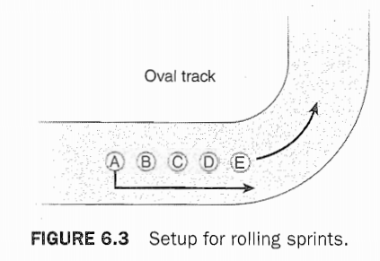
Rolling Sprints
This drill is performed with at least four athletes who are jogging or running slowly in a line around the track.
On the strength and conditioning professionals signal, the last athlete sprints to the front of the line. As that athlete reaches the front of the line, the strength and conditioning professional signals again.

Slide 36
Rolling Sprints
To increase the intensity of the run, the strength and conditioning professional can reduce the time between signals or add more runners to the group.

Slide 37
SUMMARY POINTS
Adaptations to anaerobic training programs include transformations of muscle-fiber subtype, metabolic adaptations to enzymes, and buffering capacity.
Although the number of Type I and Type II muscle fibers does not change through training, fibers within each category can change to a different subtype that is more aerobic or anaerobic, depending on the training stimulus.
Most metabolic adaptations to training affect the glycolytic energy system, which provides energy for intense activity lasting less than 3 minutes.
In team sports, such as American football, basketball, ice hockey, or soccer, athletes perform repeated bouts of high-intensity activity with limited rest periods between each bout. Thus, conditioning should be focused on preparing the athletes for these sport-specific demands.

Slide 38
SUMMARY POINTS
In contrast, sprinters focus more on speed-endurance in order to experience minimal fatigue toward the latter stages of the sprint.
One of the primary differences between the training programs of these athletes is that sprinters are interested in the quality of each individual sprint, while basketball and football players are primarily focused on the ability to maintain the quantity of high-intensity activity common to their sport.
Anaerobic conditioning exercises utilize varying intervals of intense effort and rest. The intervals should be determined by the conditioning level of the athlete and by the work-to-rest ratios observed in the sport.

