Slide 1
Endurance Training
7
Joel T. Cramer, PhD, CSCS*D, NSCA-CPT*D, FNSCA, FISSN
Abbie E. Smith, PhD, CSCS*D, CISSN

Slide 2
Endurance Training
Reaching performance goals in aerobic endurance sports requires an understanding of multiple factors, including the basic physiology behind endurance performance, exercise economy, principles of aerobic endurance training, performance psychology, and overall life-style.

Slide 3
Aerobic endurance adaptations
Aerobic metabolism refers to the production of energy from the break-down of carbohydrates and fats in the presence of oxygen.
Anaerobic metabolism refers to the production of energy from the breakdown of carbohydrates in the absence of oxygen.
Cardiovascular endurance refers to the response of the heart and vasculature to aerobic endurance training. As fitness improves, cardiac output increases to an increase in stroke volume (25).

Slide 4
Aerobic endurance adaptations
Maximal oxygen consumption (Vo2max) is related to cardiorespiratory fitness.
Lactate threshold is a fatigue threshold representing an abrupt increase in lactate above baseline concentration.

Slide 5
Factors in Aerobic Endurance Performance
exercise economy,
exercise prescription derived from scientifically based training principles,
psychological preparation that motivates the athlete, and a
lifestyle that leads to training success and adequate recovery.

Slide 6
Exercise Economy
Exercise economy refers to the metabolic demand of submaximal exercise (26). As athletes become more economical during tasks like running, cycling, or swimming, endurance performance also improves.
There are many ways to improve exercise economy, but specificity of the exercise modality should be the main focus.
This will allow more calories (energy) to be available during the race, delaying the fatigue process.

Slide 7
Exercise Economy
In addition to training the body to perform as efficiently as possible at a specific event, other factors can affect running economy, such as stride length (6), body weight (8), and air resistance (23).
A comfortable, natural stride length seems to be the most efficient for most runners.
Body weight should be kept at low but healthy levels based on athletes' body type and body composition. For example, excessive muscle mass may not allow for the optimal efficiency in aerobic exercise.

Slide 8
Exercise Economy
athletes can improve their economy by wearing tight-fitting clothing that does not catch the wind and by drafting behind other competitors, particularly during a race or time trial.

Slide 9
Training Principles for Aerobic Endurance Training
A variety of training techniques, when combined to form a structured training plan, can lead to optimal performance. An aerobic endurance training plan should include workouts of varying intensities and durations, each having specific benefits to overall endurance performance.

Slide 10
Training Principles for Aerobic Endurance Training
As mentioned previously, specificity of modality is very important. For example, if the athletic goal is a running competition, then the athlete should perform mostly running workouts.
In addition, supplemental activities, such as resistance training (28) and nutrient timing (20), can be important in reaching performance goals.

Slide 11
Performance Psychology
Anxiety is commonly experienced before a competition.
Although some may think that anxiety is detrimental, it may actually benefit performance (32).
Practicing techniques to reduce anxiety before a competition may actually be more harmful than helpful to performance.
However, substantial anxiety can have a negative effect on performance.

Slide 12
Performance Psychology
Mental state is also a factor during competition. Two strategies utilized during an endurance competition are association and dissociation (27).
Association consists of being very aware of the physiological sensations of exertion, such as muscular pain, muscular fatigue, and hydration, body temperature, and respiration. This technique seems to optimize efficiency and pace.

Slide 13
Performance Psychology
Dissociation is the opposite, consisting of the use of techniques to distract the athlete from the physical pain of the competition (27).
Dissociation is linked to an increase in the risk of injury and an increased likeliness of hitting the wall, or performing below expectations (36).

Slide 14
Lifestyle
Recovery is a very important part of aerobic endurance training. In fact, research shows that athletes with higher aerobic fitness levels can recover faster than people with lower aerobic capacities (17).
Adequate sleep and sufficient intake of high-quality nutrients are key components to recovery.

Slide 15
Aerobic Endurance Training Variables
Intensity
Duration
Volume
Mode of training

Slide 16
Intensity (Load)
Intensity measurement varies according to sport and mode of training. For instance, a runner may define intensity by a speed (i.e., miles per hour), while a cyclist may classify intensity with a load (i.e., watts).
The minimal training-intensity threshold to improve fitness is also the same for all activities, approximately 40% to 50% of VO2max or 55% to 65% of maximum heart rate (HRmax) (30). Additionally, physiological adaptations are specific to the intensity of training.

Slide 17
quantitative measure of intensity
Physiologically, heart rate is directly related to cardiorespiratory fitness (4). Therefore, it can be used to recommend intensity levels as a percent of an athlete’s maximal fitness level.
Predicted HRmax = 220 × age
Exercise pace can also be used to measure exercise intensity.
This technique uses the results of past competitions (e.g., average minute/mile pace) to establish training intensities.

Slide 18
quantitative measure of intensity
For example, when training at distances longer than competition lengths (e.g., long. slow distance, or LSD), the intensity should be less than the goal pace for competition. Similarly, when performing shorter tempo activities, the pace should be faster than competition pace.
Ratings of perceived exertion (RPE) are an additional valid tool for monitoring exercise intensity. The 15-point Borg scale has been shown to be correlated with blood lactate, heart rate, and VO2max responses to exercise (3, 30),

Slide 19
Duration and Volume
Exercise duration and volume are often inaccurately used interchangeably.
exercise duration refers to the length of time of a training session. It is influenced by intensity.
In contrast, training volume incorporates both intensity and duration of a training session.
For example, volume is often calculated in resistance training as the number of sets performed multiplied by the number of repetitions performed multiplied by the weight lifted (1). The same method is often applied to aerobic endurance training volume by multiplying the duration of exercise by (1) the distance traveled and (2) the exercise intensity (either the average pace or heart rate during a training session).

Slide 20
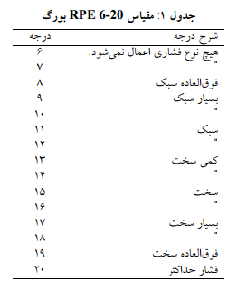
Borg scale

Slide 21
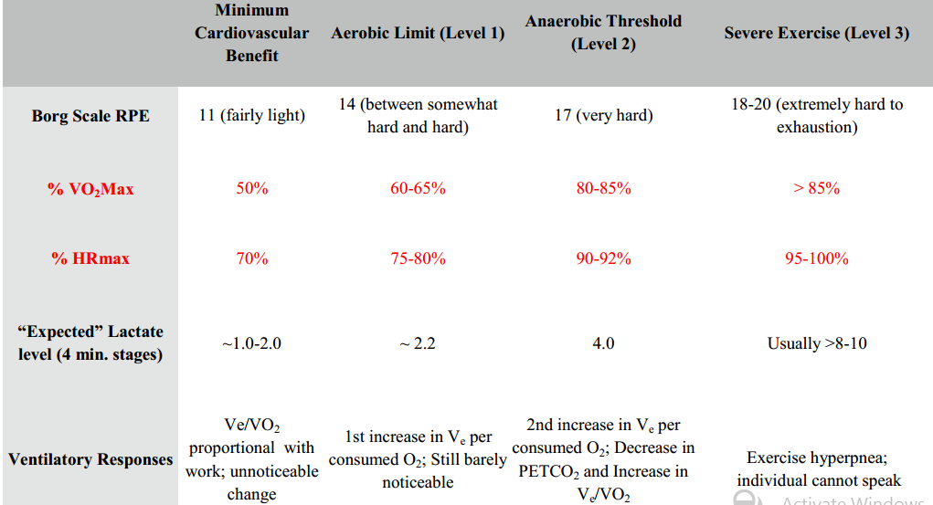
Relationship between Percent HR Max and Percent VO2 Max and RPE

Slide 22
Relationship between Percent HR Max and Percent VO2 Max
%VO2max = (%HRmax – 37)/.64
%HRmax = (0.64 x %VO2max) + 37

Slide 23
Duration and Volume
As with any training goal, the intensity and increase in volume should be based on the individual athlete and the specific sport. Aerobic endurance athletes are at the highest risk for staleness, overreaching, and overtraining. Manipulating and fluctuating training volume may help to avoid overuse injuries and overtraining.

Slide 24
Aerobic Endurance Training Strategies
The structure of any training program is instrumental for athletic success, injury prevention, and individual confidence.
However, it is essential that training programs be designed to be specific to the sport, season of competition, and the individual needs of the athlete.
This evidence suggests that combining traditional long-duration training with moderate-intensity training and short-duration, high-intensity training may yield the same (if not better) results in performance adaptations.

Slide 25
Long-Duration, Moderate-Intensity Training
The most common type of training identified with aerobic endurance sports, often referred to as long, slow distance (LSD) training, is characterized by moderate intensities (i.e., 60% to 70% of VO2max or HRmax) maintained for long periods of time.
Typically, the training distance is greater than the race distance by at least 30 minutes (9).
This is sometimes referred to as base training.

Slide 26
Long-Duration, Moderate-Intensity Training
It allows athletes to participate in a relatively large training volume without imposing a high level of stress on the musculoskeletal system.
base training helps enhance the basic cardiorespiratory and cardiovascular adaptations that are expected to occur with aerobic endurance exercise (7, 18).
Building a base level of aerobic capacity also improves the ability to recover between training sessions (17).

Slide 27
Long-Duration, Moderate-Intensity Training
Adaptations:
increase the rate of fat metabolism
increase in stroke volume
mitochondrial density
psychological benefits (long-duration activities equal to or greater than competition lengths).

Slide 28
Moderate-Duration, High-Intensity Training
at intensities higher than race pace
intensity at or slightly above the lactate threshold (An athlete's lactate threshold (LT) is associated with an exercise intensity at which lactate begins to accumulate and available aerobic energy sources can no longer keep up with the high rate of energy demand).
pace/tempo training
Pace/ tempo training is done at intensities near the LT. It lasts about 20 to 30 minutes, inducing both aerobic and anaerobic physiological adaptations (9).

Slide 29
Finding the right tempo
Heart Rate: 85 to 90 percent of your maximum heart rate.
Perceived Exertion: An 8 on a 1-to-10 scale (a comfortable effort would be a 5; racing would be close to a 10).
Talk Test: A question like "Pace okay?" should be possible, but conversation won't be.

Slide 30
Moderate-Duration, High-Intensity Training
interval training approach
Aerobic/ anaerobic interval training, which is commonly called Fartlek training (1), is primarily used to establish a sense of the race pace, increase the LT and augment the body's ability to maintain higher intensities for longer periods of time.
Fartlek training involves periods of moderate training (~70% VO2max) combined with A short, fast bouts (or hill running) at higher intensities (~85% to 90% VO2maX or HRmax).

Slide 31
Short-Duration, High-Intensity Training
Interval training has become very popular as a time-efficient training strategy for aerobic endurance athletes.
Interval training involves intensities at or above VO2max, typically lasting between 30 seconds and 5 minutes (10).
For an aerobic endurance athlete, the rest times between intervals are typically equal to or less than the work time itself, which keeps the work-to-rest ratio at 1:1 or 2:1.

Slide 32
Short-Duration, High-Intensity Training
A variety of work-rest combinations can be used throughout different points of an athlete's season.
improvements in cardiorespiratory and cardiovascular fitness, blood volume, LT, and muscle-buffering capacity (16).
Therefore, if similar adaptations in aerobic endurance performance can be achieved using interval training for 20 minutes versus LSD training for 45 to 60 minutes, then interval training is clearly more efficient. It also results in less stress on the body (34).

Slide 33
Resistance Training
Athletes and strength and conditioning professionals typically implement strength training as a method to alter body composition, rehabilitate injuries, and improve muscle balance, speed, and local muscular endurance (22).
Traditional resistance programs for aerobic endurance athletes have been designed using low-intensity exercises (<67% IRM), high repetitions (>12), short rest times (30-60 s) for two or three sets.

Slide 34
Resistance Training
recent evidence suggests explosive-strength training is a more effective method for improving running economy and performance (i.e., 5K/10K) (28).
Various aspects of resistance training, such as specific exercises chosen, workout structure, resistance used, volume (repetitions and sets), rest intervals between sets, and training frequency, can be manipulated to mold the strength training program to best meet the athlete's goals.

Slide 35
Periodization for Aerobic Endurance Training
Training programs should be designed to maximize performance and minimize fatigue and overtraining during high-volume training periods leading up to competition.
Dividing training into phases by systematically altering volume and intensity and providing for adequate regeneration and peak performance around the most important competitions is a common strategy referred to as periodization (2).

Slide 36
Periodization for Aerobic Endurance Training
the training season is divided into a monocyclic design, including a preparatory time (preseason), competitive segment (in-season), transition (postseason, or active rest), and an off-season (35).

Slide 37
Training Phases
Traditionally, training sessions are organized as a set of various cycles (i.e., micro, meso, and macro).
A microcycle refers to one training session or a group of training sessions. Mesocycles are groups of several microcycles centered on the competition phase. Macrocycles are a series of mesocycles planned in an annual or semiannual progression (24, 35).

Slide 38
Training Phases
The preparatory, or preseason, mesocycle centers on increasing training intensity and sustaining a moderate to high training volume.
Competitive, or in-season, training incorporates competition and important race days. developing a training plan that leaves the athlete rested at peak times.
The postseason transition phase allows for active recovery by decreasing the intensity and volume to eradicate any staleness or injury.

Slide 39
Training Phases
An off-season phase is implemented to establish a cardiorespiratory base, slowly increasing training intensity and duration as the athlete becomes fitter. Notably, a gradual increase in training duration (5% to 10% weekly) should be followed to prevent injury and overtraining (38).

Slide 40
Tapering Strategies
Tapering involves the alteration of training frequency, duration, and intensity, and the length of time within the reduced phase.
More recently, exercise intensity has become the key component in an effective taper; Athletes who maintain activities of moderate intensities (≤70% VO2maX) demonstrated a decrease in performance following a taper phase.

Slide 41
Tapering Strategies
reducing training duration but maintaining a high intensity (≥9O% VO2max) has proven to be effective in stimulating gains in performance (33).
between 7 and 16 days for an aerobic endurance athlete to achieve peak performance (35).

Slide 42
Recovery
Possibly the most overlooked aspect of aerobic endurance training is recovery. Due to the high-volume and sometimes high-intensity aspects of aerobic endurance training.
Overtraining is the result of too much stress, both physiological and psychological, and not enough rest (13).
It lasts at least two weeks and is determined by decreases in performance (5).

Slide 43
Recovery
Along with performance decrements, symptoms of overtraining include increased susceptibility to infections (5 ), weight loss, changes in sleep patterns, drowsiness, irritability, loss of appetite, loss of motivation, depression, anxiety, poor concentration, and high resting, recovery, and morning heart rates (11).
Overreaching can occur when an athlete increases intensity or volume of training to optimize training adaptations and performance. This is usually followed by a period of relative rest or tapering to allow for supercompensation (5).

Slide 44
Recovery
Recovery from overtraining may take up to five weeks of rest, during which detraining, or a decrease in fitness, will occur.
As a result, it is clear that recovery must be carefully planned into a training program, especially during an overreaching phase, to avoid prolonged periods of decreased training.
A simple way to help avoid overreaching and overtraining for novice athletes is to slowly build base levels of fitness (i.e., increase aerobic capacity). (LSD)

Slide 45
Recovery
In addition, for both novice and experienced athletes, a sound dietary strategy is also critical for glycogen repletion and muscle recovery (19).
consumption of both protein and carbohydrate is important for the replenishment of lost glycogen from the muscle, as well as for muscle repair and rebuilding (19).

