Slide 1
Speed Training
9
Robert U. Newton, PhD, CSCS*D, FNSCA

Slide 2
Introduction
Speed can be defined as the ability to run a specific distance in a particular time.
The most important factor influencing speed for athletes is:
genetic
Athletes with long limbs (biomechanical advantage)
and a high percentage of fast-twitch muscle fibers a physiological advantage
skill and technique
increase strength and power

Slide 3
Introduction
Speed training is an integral part of the preparation of athletes participating in sports (e.g., American football, baseball, basketball, lacrosse, and soccer).
Short-term SSC actions tend to enhance muscle performance, speed, acceleration, and power through elastic energy, whereas long-term adaptations reduce muscle stiffness and increase neuromuscular activation.
The SSC is often recognized as a link between power and speed that enables athletes to increase both performance variables .

Slide 4
Factors in Speed Performance
The ability to accelerate from the start may vary considerably among athletes.
The goal for all athletes is to reach peak velocity (which involves maximizing acceleration) as quickly as possible.
Running velocity is influenced by strength and power, which is why athletes who have set goals to become faster should be committed to both a resistance training program (see chapter 4) and targeted speed training.

Slide 5
Factors in Speed Performance
To maintain sprinting speed, athletes need to focus on improving their speed-endurance.
Speed-endurance is not a factor for short-distance sprints, such as the 40 m sprint, in which athletes should accelerate throughout the racing distance. However, this becomes very relevant for sprint distances of 100 m or greater. Here, speed-endurance becomes a factor for determining sprinting success.

Slide 6
Stride Rate and Stride Length
Speed is the interaction of stride rate and stride length.
Stride rate is the number of steps that are taken with each leg during the distance of a run.
If a sprinter in a 100 m run takes 25 foot strikes with his or her right leg and 24 foot strikes with his or her left leg, it equates to 49 strides. If the sprinter runs the 100m in 11.0 seconds, he or she would have a stride frequency of 4.45 strides per second. Elite sprinters have a stride rate of about 5 strides per second.

Slide 7
Stride Rate and Stride Length
As the stride rate increases, the amount of time spent on the ground (called the support phase) is decreased, while the time spent in the flight phase is increased.
If the stride rate of an athlete increases, but his or her stride length remains constant, his or her running speed will increase,
Similarly, if the athlete’s stride rate remains constant but his stride length is increased, his or her running speed will also increase

Slide 8
Stride Rate and Stride Length
initial change in speed is the result of an increase in running stride.
The stride length begins to increase as the sprinter accelerates.
The contribution of both stride rate and stride length to sprinting speed will change at different running velocities.
Stride rate appears to be more important in determining the runner's maximum velocity than stride length is.

Slide 9
Stride Rate and Stride Length
Stride length depends on an athlete’s height and leg length
Trained sprinters can achieve a greater stride rate than untrained runners can.
They reach their maximum velocity much earlier than untrained runners do

Slide 10
Muscle Fiber-Type Composition
muscle fiber-type composition has a critical role in determining running speed.
Each of these fibers has subtypes. Fiber subtypes have the basic characteristics of the fiber type (slow-twitch or fast-twitch), but can be altered based on the training stimulus or lack of stimulus.
However, athletes cannot change the fiber-type composition, so although Type I fibers may become more anaerobic or glycolytic through sprint or interval training, they will never acquire many of the characteristics generally associated with Type II fibers.

Slide 11
Muscle Fiber-Type Composition
Most people are born with an equal number of Type I and Type II fibers.
This is why it is not easy to develop elite athletes
They are generally born, not made!

Slide 12
Muscle Fiber-Type Composition
Muscle architecture
The combination of muscle thickness, fascicle length, and the resulting pennation angle has been suggested to influence speed performance
Muscle fibers that have a greater pennation angle generate more force, and muscle fibers with a smaller pennation angle have demonstrated a characteristic to shorten faster, thus helping athletes increase speed

Slide 13
Sprinting Mechanics and Technique
Technique training for sprinting can be divided into five areas:
starting,
acceleration,
drive phase,
recovery phase, and
deceleration

Slide 14
Starting
Athletes start from a variety of positions, including stationary or moving
Athletes in sports such as baseball and softball generally initiate all speed movements in a two-point stance from a stationary position.
(e.g., field hockey, soccer, basketball, and lacrosse) may also initiate movement in a two-point stance but from an active movement

Slide 15
speed movement from a two-point stance
the athlete should be in a comfortable position
with feet shoulder-width apart or slightly narrower, front leg bent at nearly 90
arms bent at 90° angles
hand on the lead-leg side next to the buttock and the other hand at the side of the face
rear foot should leave the ground first with a fast forward swing and the rear arm should propel forward

Slide 16
from a three-or four-point stationary stance
the athlete in a comfortable position.
The body weight should be evenly distributed between hands, feet, and knees
, the arms should be in a straight alignment shoulder-width apart
Prior to initiating the start, the athlete should align the center of gravity above the lead leg
bend the front leg to nearly a 90° angle and the rear leg at nearly 125°

Slide 17
from a three-or four-point stationary stance
move the hips shoulder-width apart or slightly wider
with the rear leg moving first with a forward swing
At the same time, the alternate arm should move actively

Slide 18
Acceleration
During the acceleration phase, the body gradually straightens and the strides lengthen
As the ball of the foot makes contact with the athletic surface, the foot should be in a dorsiflexed position
The athlete should look down and limit torso flexion at the waist

Slide 19
Acceleration
Acceleration differs from maximal velocity (drive and recovery phase) in the following ways
Stride length is increased over the acceleration period and front-side mechanics are stressed (e.g., leg action that occurs in front of the body)

Slide 20
Drive and Recovery Phases
The drive phase of each stride begins when the ball of the lead foot creates forceful contact with the surface and ends when the foot leaves the surface
The athlete’s center of gravity should be slightly behind the lead leg at the initial point of contact.

Slide 21
Drive and Recovery Phases
The forceful contact of the ball of the dorsiflexed lead foot is extenuated by extension of the hip, knee, and ankle
The short period of surface contact should continue until the athlete’s center of gravity passes over and in front of the lead foot.

Slide 22
The recovery phase
begins as the ball of the lead foot separates from the ground and continues until the foot returns back to the ground
Keeping the foot dorsiflexed
the athlete should flex the knee and pull the heel toward the hip rapidly
This allows for a faster swing of the recovery leg due to a mechanical advantage, since the leg is closer to the hip's axis of rotation.

Slide 23
The recovery phase
Once the heel reaches its maximum height, the athlete should drive it forward
As he or she begins to straighten the leg in preparation for ground contact, the athlete should focus keeping the foot in a dorsiflexed position and driving to the surface with powerful hip and knee extension

Slide 24
Deceleration
Successful deceleration and stopping in sports allows athletes to transition between acceleration and maximal velocity to change direction
The key to deceleration and changing direction without coming to a complete stop is to flex the ankles, hips, and knees as each foot contacts the ground

Slide 25
Surfaces and Footwear
Before beginning the training program, it is important to decide the facility to be used (i.e., indoor court, grass field, or track) and the type of shoes to be worn
surface similar to the one they compete on.
For instance, basketball players should perform their sprint training on a basketball court

Slide 26
Surfaces and Footwear
Athletes should also select footwear intended for speed training and competition
Surfaces should be flat and level with no obstacles (sports equipment, immovable natural objects, or grounds keeping equipment).

Slide 27
Speed Program Design
Speed Training Exercises
Fundamental speed drills assist the progression of proper form and technique in speed training
lead to improved acceleration, maximal velocity, and speed-endurance development
In addition, they should monitor athletes for proper form and technique during drill performance.
Ideally, the drills should be performed when athletes are fully recovered and not fatigued from other types of training or sport practice

Slide 28
example sprint training Workout

Slide 29
HEEL-ups
PURPOSE
Enhancement of foot speed
A 20-yard (18 m) course is marked out. The athlete should run the length of the course on the ball of the foot, pulling the heel of the lower leg up to touch the buttocks with each step
After a short recovery (30-45 s), the athlete repeats the exercises, moving back to the original starting position

Slide 30
The athlete should do the following:
As the leg bends, bring the knee up and forward
Keep the head in its normal alignment with the trunk
Keep the torso and shoulders steady and avoid rotation
Maintain a body angle between 80° and 85°
Relax the muscles of the head, neck, shoulders, and upper extremities
Begin arm swing with the lead arm bent to 70° and the hand beside the cheek on that side (opposite the trail leg)
End the arm swing with the rear arm bent to 130° and the hand slightly past the hip on that side (opposite the lead leg)

Slide 31
ARM ACTION (SEATED)
PURPDSE
Proper arm movement
The athlete should do the following:
Assume a long seated position with the knees locked
Begin with one arm bent in front of the face and the other arm back (a)
Swing the arms from the shoulder
Hammer the arm clown and back, just barely scraping the knuckles on the ground (b)
Keep a hand in from of the face at all times
Perform a hammering action down and back with the other hand

Slide 32
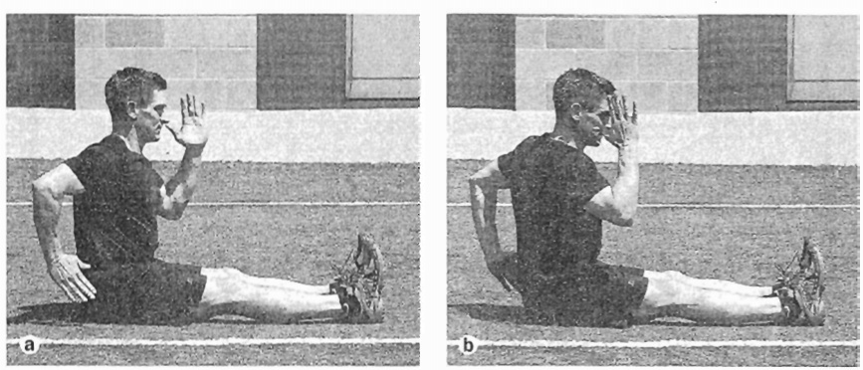
ARM ACTION (SEATED)
The drill is correct if the butt bounces off the ground.

Slide 33
ARM ACTION (STANDING EXCHANGE)
PURPOSE
Proper arm movement
The athlete should do the following:
Begin with one arm fiexed in front of the body with the thumb up
Hold the other arm behind the body with the elbow flexed and the thumb up
Exchange the position of the arms in a karate chopping action
Emphasize driving the arm down and back in a hammering action
Pause to accentuate the exchange

Slide 34
ARM ACTION (STANDING EXCHANGE)

Slide 35
LEAN AND FALL RUN
PURPOSE
First-step quickness and running position
The athlete should do the following:
Stand tall with the feet hip-width apart (not wider)
Balance body weight over the middle of the feet
Lean forward from the waist (a)
Keep the upper body quiet
Fall forward from the center

Slide 36
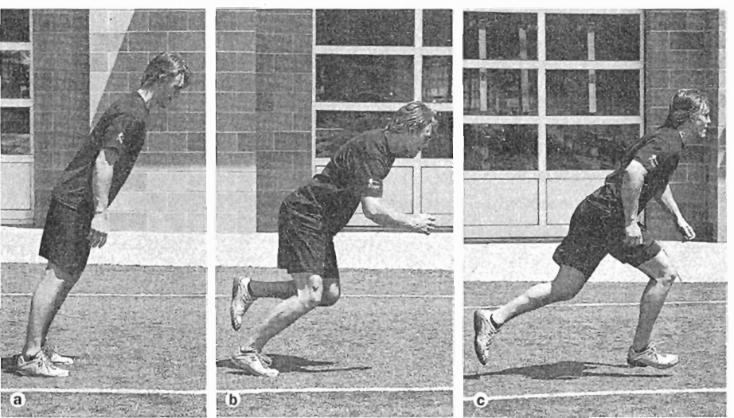
LEAN AND FALL RUN
Naturally let the foot take a step and come down under the hip (b)
Keep the first step short
Continue a running movement for about 10 to 20 yards (9-18 m) (5)
While moving into the sprint, push back against the ground to make each step progressively longer

Slide 37
DROP AND GO
PURPOSE
First-step quickness and position
Execute a lean and fall and allow the partner to Catch (a)
Hold that position for a one count, then let the partner step aside and release
Accelerate out of the forward lean (b)
Maintain posture and alignment
Be quick with the arms to put force into the ground

Slide 38
DROP AND GO

Slide 39
JUMP AND G0
PURPOSE
First-step quickness and position
MOVEMENT
The athlete should do the following:
Begin with feet shoulder-Width apart
Draw back the arms, then drive them upward and forward
Jump off with both feet
Land on a single foot
Drive off that leg and sprint

Slide 40
BOUND INTO RUN
PURPOSE
First-step quickness and position
Use a two-foot jump for takeoff (a)
Drive one leg forward and push the ground away as the lead leg comes into contact with the ground (b)
On landing, drive upward and forward with the opposite arm and leg (c)
Swing the trail leg through and reach for the ground
Execute four bounds into a sprint

Slide 41
BOUND INTO RUN

Slide 42
SCRAMBLE OUT
PURPOSE
First-step quickness and position
Lie face down with the hands at the sides in a push-up position (a)
Scramble out, emphasizing triple extension of the ankle, knee, and hip (b)
Maintain a powerful arm drive

Slide 43
SCRAMBLE OUT

Slide 44
TWO JUMPS AND GO
PURPOSE
First-step quickness and position
Begin with feet shoulder-width apart
Drop into a quick countermovement by flexing the ankles, knees, and hips
Draw the arms back at the beginning of the jump, and then drive them upward and forward
Jump of (with both feel using this technique and land on both feet
Jump off again with both feet but land on one leg
Drive off that leg and sprint for the remainder of the distance

Slide 45
PUSH-UP STARTS
PURPOSE
First-step quickness and position
Assume a push-up position (a)
On the command, move into a sprinting position with a four-point stance (b)
Start to sprint

Slide 46
PUSH-UP STARTS

Slide 47
Resisted Speed Training
Resisted speed training involves the athlete pulling a fellow athlete or implement that provides resistance
Resisted speed drills force athletes to recruit an increased number of muscle fibers, resulting in an augmented neural activation

Slide 48
Resisted Speed Training
Resistances used should not decrease the athletes’ standard speed by more than 10%. Greater resistance may actually damage running technique, negating any potential benefit from resisted running.
Recommendations for Resisted Running Drills
Recommended distance: 10-40 yd (9-36 m)
Sets and repetitions: 3-4 sets of 4-8 reps
Recovery: 90-120 s

Slide 49
LIGHT SLED PULLS
PURPOSE
Increase speed strength, power, and stride length
Attach a lightweight sled with an adjustable harness or waist strap
Utilize proper speed form and technique (as outlined in the speed technique section of this chapter)
Sprint for 10 to 40 yards (9-36 m) (a)

Slide 50
LIGHT SLED PULLS
When athletes perform this drill, strength and conditioning professional should observe their form, technique, and speed in covering the yardage
A tire, bag, or a partner (b) holding a cord can also be effective as a resistance device.
Recently, some nonmotorized treadmills have been marketed that provide controlled resistance

Slide 51
LIGHT SLED PULLS

Slide 52
HILL RUNNING
PURPOSE
Provide an effective overload to improve explosive power and running speed
The athlete sprints up a slight hill for a set distance, not to exceed 100 yards (91 m). The athlete should do the following:
Emphasize good running form with maximum knee drive and elbow pump
Begin at a short distance and increase distance over time
Choose a hill with a slope between 6° and 10° (Anything greater than this causes a reduction in stride length and compromises training results.)
Perform each sprint at 100% effort

Slide 53
Assisted Speed Training
Assisted speed training uses an implement (sport cord) or contrast to help athletes run faster than they normally would
By training with assisted speed, athletes can increase stride frequency and length more than is generally possible.

Slide 54
Assisted Speed Training
When incorporating assisted running into a speed training program, attention should be taken to ensure that athletes do not exceed 110% of their maximum running speed.
If not, stride length may be overextended, resulting in deceleration and a decrease in stride frequency .

Slide 55
THREE-PERSON TUBING ACCELERATION DRILL
To enhance stride frequency and length and quick leg recovery in first couple of steps for the one athlete being towed and to enhance starting power and stride length for the two athletes being resisted

Slide 56
THREE-PERSON TUBING ACCELERATION DRILL
Group three athletes of identical or nearly equal speed together. (The closer the athletes are to each other in speed, the more effective the drill will be.)
Attach the three athletes together with three adjustable waist belts and two 8-foot (2.4 m) elastic resistance cords.
Position the two athletes being resisted 4 yards (3, 6 m) in front of and 4 yards to the right and left of the athlete being towed, forming a V shape.
When the three athletes are lined up to begin the drill, connect each of the athletes being resisted to the athlete being towed with a sport cord,

Slide 57
THREE-PERSON TUBING ACCELERATION DRILL
To ensure that the athletes line up in the same position each time, place dome cones in a V shape at both ends of the field. (The front cones at each end should be separated by 25 yards, or 23 m.)
When arranging the cones, make certain that the cones at each end are directly in line with each other to ensure that the athletes run in a straight line,
Before beginning the drill, ensure that all three athletes are in a good running position and are ready to begin.
To begin the drill, give two consecutive commands by voice or whistle.

Slide 58
THREE-PERSON TUBING ACCELERATION DRILL

Slide 59
DOWNHILL RUNNING
Enhance acceleration through the use of overspeed training
The athlete sprints down a slope similar to that used for uphill running (6° to 10°)

Slide 60
CONE JUMPS AND SPRINT
Increase explosive power and acceleration
Stand facing a series of six consecutive cones that are 6, 12, or 15 inches high (15, 30, or Z6 cm) and are placed 3 to 6 feet (1-2 m) apart
On a verbal or whistled command, begin jumping forward over the cones (More advanced athletes may jump forward over two cones and backward over one until all six cones have been jumped.)
After jumping over the sixth cone, sprint 15 to 20 yards (14-18 m) forward to a cone directly in front
Loop the cone or touch it with the hand
Sprint back to the sixth cone

