Slide 1
Balance and Stability Training
Nejc Sarabon, PhD

Slide 2
sensorimotor training
sensorimotor training (also called Proprioceptive training, functional joint stability training, and balance training) can be a useful tool.
Its positive effects:
Improve joint stability during functional movements,
static and dynamic balance, and
Movement awareness, or kinesthesia
Injury prevention

Slide 3
Kinesthesia
On the other hand, improved kinesthesia is important for developing self-awareness, improving precision, and achieving more efficient movement at lower energy cost.
Sensorimotor training as we know it today was first introduced for the rehabilitation of diseases and injuries to the locomotors and central nervous systems.

Slide 4
Its goals of Sensorimotor
restoring neuromuscular function,
reestablishing functional joint stability, and
improving balance, based on automatic (reflex) corrective responses.

Slide 5
factors affect joint stability and balance
closely controlled reflex by the central nervous system
anatomical shape of joints that impose restraints on movements
the nature of the applied load, and
passive soft tissue structures, such as ligaments and the joint capsule

Slide 6
Balance and joint-stability training
Balance and joint-stability training have been proven to have positive effects on sensorimotor function in rehabilitation and sports (6).

Slide 7
Program Planning and Periodization
When planning training for balance should be provided based on the athlete’s goals:
Prevention of injury,
Development of athletic ability, and
Rehabilitation
In competitive sports, the role of balance and joint-stability training for preventing injury, especially later in the season, may be more relevant.

Slide 8
Program Planning and Periodization
These training modalities can also be used during the first part of the season, since they have a positive effect on injury prevention during all training periods.
Adaptations to training for balance and functional joint stabilization initially occur quickly.
Similar to other training modes, the rate of improvement is reduced as training progresses.

Slide 9
The following recommendations help athletes
Balance training programs should be at least four weeks in length. Athletes should continue training throughout the competitive season to maintain improvements,
To preserve the acquired level of the neuromuscular function, at least three workouts should be used per Week.

Slide 10
The following recommendations help athletes
At least one set of each exercise should be used, since this causes acute adaptations. Although it is recommended that athletes perform more than just one set, the upper limit is not reported in literature.
At least four repetitions are needed to achieve positive long-term adaptations.
One repetition should last at least 20 seconds.

Slide 11
The following recommendations help athletes
This is because the quantity of their usage is determined by fatigue, level of physical preparedness, complexity or intensity of the exercises, previous experience, and (in rehabilitation) state of injury.

Slide 12
Safe Progression for Balance Exercises
The major concern with balance and joint-stabilization exercises is to avoid potentially dangerous movements that depend on the preparedness of the athlete or patient and on the state of the healing tissue.
Slow progression should be followed toward extreme ranges of motion or movements
For the majority of joints, extreme ranges of motion are usually susceptible to injury, since both muscle force and neuromuscular control are diminished.

Slide 13
Safe Progression for Balance Exercises
For example, combined abduction and outer shoulder rotation or increased ankle inversion are positions in which the shoulder and ankle joints are relatively unstable and are susceptible to injury.
Another example is patellofemoral pain syndrome, where movements in 30° to 60° range of knee flexion should be avoided to avoid overstressing the articulation surface of the patella. Here, compressive force is at its highest, which stresses the patellar cartilage.

Slide 14
Safe Progression for Balance Exercises
The speed of movement should be increased slowly to enable good control over joint stability.
when the subject is still unaccustomed to the movement pattern, can cause diminished control of movement.
In programs for sport-injury prevention, rate of movement should slowly progress toward the speeds used in the sport, enabling joint stabilization during fast, sport-specific actions.

Slide 15
Safe Progression for Balance Exercises
In addition to a progressive increase in the speed of movement, athletes should work on eccentric and explosive strength, preparing the soft tissue of the joint and the musculoligamentous area to cope with increased stress.
For uninjured athletes, training for balance and functional joint stabilization should always be challenging.

Slide 16
Safe Progression for Balance Exercises
Progression from less to more demanding tasks is suggested. For example, a progression from monoaxial to multiaxial balance board is recommended.
Athletes should also progress from a bigger to a smaller support surface and incorporate longer work intervals, additional tasks, and a higher frequency of oscillation into their routines.

Slide 17
Safe Progression for Balance Exercises
the strength and conditioning professional should upgrade it or introduce a new, unfamiliar movement

Slide 18
Stability Training for Joint Systems
Torso and Core:
The human torso consists of the spine, pelvis, hips, abdomen, and the rib cage.
As such, it is a base for upper and lower limb movement and enables transfer of energy and force from the legs to the arms.
For example, in its final stage, the javelin throw demands a synchronized movement of the legs and torso to transfer additional power from the lower body to the shoulder girdle, arms, and, finally, to the javelin

Slide 19
Stability Training for Joint Systems
The muscles surrounding the abdominal cavity produce a corset that stabilizes the upper body, particularly the spine.
In popular literature torso stability has also been called core stability, stressing its central role in human movement.
Torso stability exercises should be used in rehabilitation.

Slide 20
Stability Training for Joint Systems
Stabilization of the spinal column involves the abdominal muscles, especially the transversus abdominis, part of the internal oblique, the diaphragm, and the pelvic floor muscles.
The combination of strength and balance training attempts to reestablish appropriate torso strength and stability.

Slide 21
Stability Training for Joint Systems
The primary issues associated with activation patterns of multiple trunk muscles among people suffering from back injury are as follows:
Decreased sense of position and repositioning of the torso
Delayed stabilizing muscle response
Diminished or even missing preactivation of torso muscles in rapid distal movements, causing lower back pain
Impaired recruitment of the torso musculature during fast and explosive movements
Increased body sway

Slide 22
Training Guidelines
athletes should apply limb movements that demand reflexive stabilization of the trunk muscles. These movements may be either anticipated or spontaneous.
applying anticipated perturbations, reflexive preparatory responses are trained.
On the other hand, unexpected perturbations demand reflexive, nonpreparatory trunk stabilization, which aids in the prevention of injury during unexpected impact from external forces

Slide 23
Training Guidelines
One system involves standing on an unstable platform, enabling the transfer of movements to the pelvis and trunk and demanding compensatory activity in order to effectively counterbalance the body.
On the other hand, perturbations can be transmitted to the torso through stiff upper limbs.

Slide 24
Training Guidelines
The arms should be almost totally extended to avoid active amortization of perturbing movements in the elbows.
A narrower foot placement slightly increases gluteal activity.
Pushing movements can slowly be introduced, demanding stability and strength at the same time. Sport-specific movements should be used to achieve the highest positive transfer of torso stability.

Slide 25
Exercises
Fundamentally, three basic concepts of trunk stability exercises can be used:
(1) from the legs toward the torso,
(2) from the hands towards the torso, and
(3) a combination of these two approaches

Slide 26
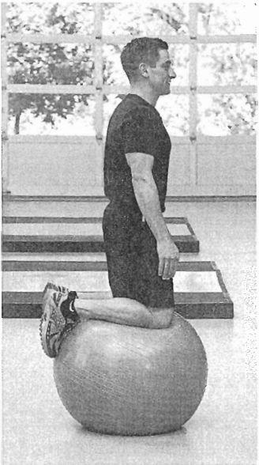
LEGS-T0-TORSO APPRROACH: KNEELING ON AN EXERCISE BALL
The athlete should maintain a straight back, push the hips forward.
For a variation, the arms may be placed akimbo (hands on hips with elbows bowed outward) or in abduction, depending on the athlete's ability to maintain balance.

Slide 27
HANDS-TO-TORSO APPROACH: PUSHING SIDEWAYS WITH AN EXERCISE BALL
legs positioned pelvis-width apart and with flexed knees to sustain a stable position, and then rotate the torso to push the ball against a wall.
Alter the ball contacts the Wall, the athlete should hold the elbows still, transferring the energy to the torso.

Slide 28
HANDS-TO-TORSO APPROACH: PUSHING SIDEWAYS WITH AN EXERCISE BALL

Slide 29
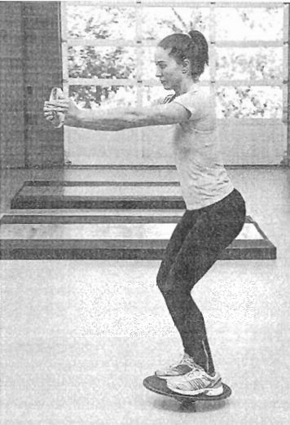
COMBINED APPROACH
The athlete assumes a two-leg stance on a balance board, extending the knees and holding Weights in extended hands.
The legs and hands should be straight, transferring disturbances to the torso

Slide 30
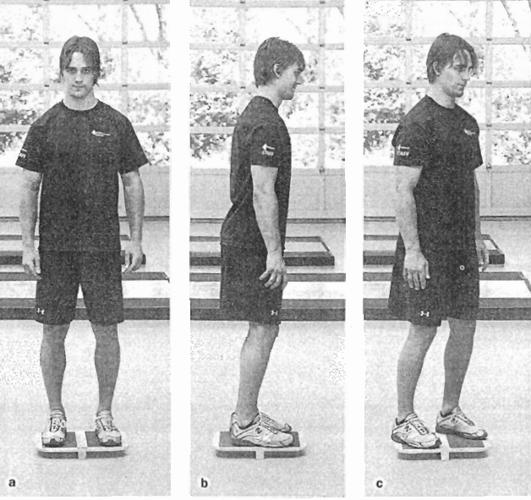
Knee
BALANCING ON A T-BOARD

Slide 31
SINGLE-LEG STANCE ON A BALANCE BOARD

Slide 32
SQUATTING ON A BOSU BALL

Slide 33
BALANCE PAD LUNGE

Slide 34
SINGLE-LEG LANDING ON A BALANCE PAD AFTER A FORWARD JUMP

Slide 35
WALK OR RUN OVER A POLYGON OF BALANCE PADS

Slide 36
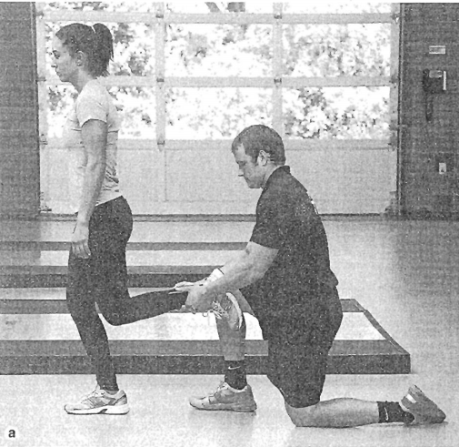
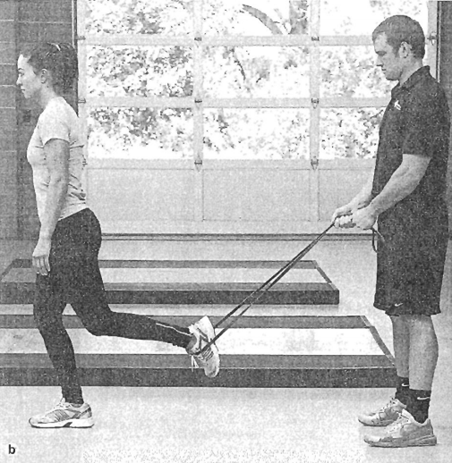
RHYTHMIC STABILIZATION

Slide 37
Ankle and Foot

Slide 38
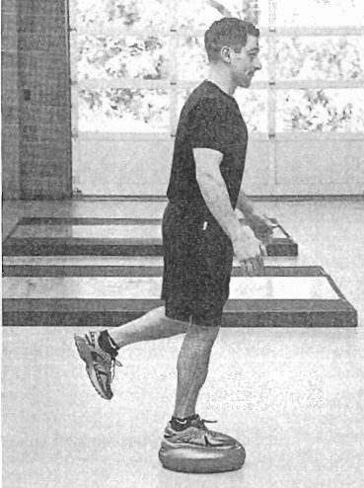
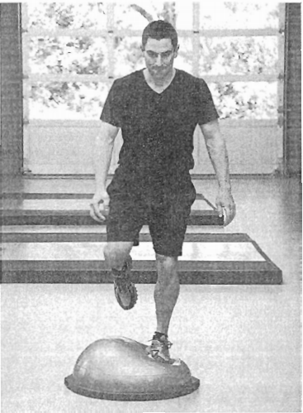
SINGLE-LEG STANCE ON A RUBBER HEMISPHERE

Slide 39
WEIGHT TRANSFER FROM HAND TD HAND

Slide 40
ELASTIC-BAR OSCILLATION

Slide 41
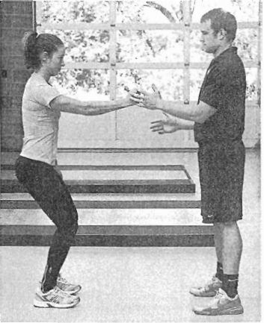
RHYTHMIC SHOULDER STABILIZATION WITH A PARTNER

