Slide 1
Training Integration and Periodization
G. Gregory Haff, PhD, ASCC
Erin E. Haff, MA

Slide 2
Periodization
Although periodization is widely accepted as a fundamental component of the training process, it is often misunderstood and misapplied.
misinterpretation of the classic literature on the topic
compartmentalizing the individual component of a training plan without considering how they are sequenced and integrated.
These issues are best illustrated in the contemporary literature on resistance training, where periodization is incorrectly defined as the manipulation of sets, repetitions, or resistance (18, 47).

Slide 3
Periodization
Nadori (57) and Nadori and Granek (58) suggest that periodization is the theoretical and methodological basis of training and planning. Here, predetermined training goals are accomplished through appropriate sequencing, integration, and Variation of training factors in order to produce very specific physiological and performance adaptations at appropriate times.

Slide 4
Periodization
Therefore, periodization should be defined as the logical, integrative, sequential manipulation of training factors (i.e., volume, intensity, training density, training frequency, training focus, and exercise selection) in order to optimize training outcomes at predetermined time points.

Slide 5
Several distinct goals are targeted by a periodized training plan
optimizing an athlete's performance at predetermined points
maintaining performance capacity for sports with a specific season
structuring precise training interventions to target the development of specific physiological and performance outcomes
managing the training stressors to reduce the potential for overtraining
promoting the athletes long-term development

Slide 6
General Principles of Periodization
periodization is a method for employing sequential or phasic alterations in the workload, training focus, and training tasks contained within the microcycle, mesocycle, and annual training plan.
In order for specific physiological responses and performance outcomes to develop, an appropriately sequenced and structured periodized training plan allows for the management of the recovery and adaptation processes

Slide 7
General Principles of Periodization
Since peak performance can only be maintained for brief periods of time (9, 45, 55), the actual sequential structure of the periodized training plan is an essential consideration.
For example, if the average intensity of all the training factors is high, the performance will elevate rapidly, but it will only be maintained for very brief periods

Slide 8
General Principles of Periodization
If, however, a more logical sequential modulation of training intensity is used, the period of peak performance can be extended. The magnitude of performance gain can also be significantly greater

Slide 9
Three basic mechanistic theories
General adaptive syndrome (GAS)
Stimulus-fatigue-recovery-adaptation theory
Fitness-fatigue theory

Slide 10
General Adaptive Syndrome
First conceptualized in 1956 by Hans Selye
the GAS describes the body's specific response to stress, either physical or emotional
These physiological responses appear to be similar regardless of what stimulates the stress

Slide 11
General Adaptive Syndrome
When a training stress is introduced, the initial response, or alarm phase, reduces performance capacity as a result of accumulated fatigue, soreness, stiffness, and a reduction in energy stores (78).
The alarm phase initiates the adaptive responses that are central to the resistance phase of the GAS, if the training stressors are not excessive and are planned appropriately, the adaptive responses will occur during the resistance phase.

Slide 12
Performance will be either returned to baseline or elevated to new higher levels (supercompensation).
Conversely, if the training stress is excessive, performance will be further reduced in response to the athlete's inability to adapt to the training stress, resulting in what is considered to be an overtraining response (20).

Slide 13
General Adaptive Syndrome
it is important to realize that all stressors are additive and that factors external to the training program (e.g., interpersonal relationships, nutrition, and career stress) can affect the athlete’s ability to adapt to the stressors introduced by the training program.

Slide 14
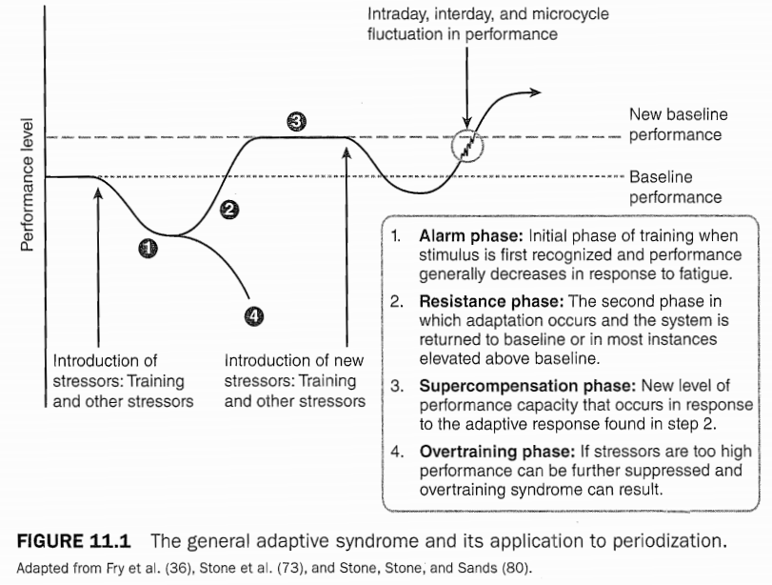
General Adaptive Syndrome

Slide 15
Stimulus-Fatigue-Recovery-Adaptation Theory
The initial response to a training stressor is an accumulation of fatigue, which results in a reduction in both preparedness and performance.
The amount of accumulated fatigue and the corresponding reduction in preparedness and performance is proportional to the magnitude and duration of the workload encountered

Slide 16
Stimulus-Fatigue-Recovery-Adaptation Theory
As fatigue is dissipated and the recovery process is initiated, both preparedness and performance increase.
If no new training stimulus is encountered after recovery and adaptation are completed, then preparedness and performance capacity will eventually decline

Slide 17
Stimulus-Fatigue-Recovery-Adaptation Theory
When closely examining the general response to a training stimulus, it appears that the magnitude of the stimulus plays an integral role in determining the time course of the recovery-adaptation portion of the process
For example, if the magnitude of the training load is substantial, a larger amount of fatigue will be generated, lengthening the time frame necessary for recovery and adaptation

Slide 18
Stimulus-Fatigue-Recovery-Adaptation Theory
Conversely, if the training load is reduced, less fatigue will accumulate and the recovery-adaptation process will occur at a more rapid rate
This phenomenon is often referred to as the delayed training effect, in which the magnitude and duration of loading dictate the length of time necessary for recovery and adaptation.

Slide 19
Stimulus-Fatigue-Recovery-Adaptation Theory

Slide 20
Stimulus-Fatigue-Recovery-Adaptation Theory
it is important to realize that the general pattern of response to a training stimulus can occur as a result of a single exercise, training session, training day, microcycle, mesocycle, or macrocycle. It is important to note that it is not necessary to have complete recovery prior to initiating a subsequent training stimulus (58).

Slide 21
Stimulus-Fatigue-Recovery-Adaptation Theory
In fact, it may be more prudent to modulate training intensities or workloads with the use of heavy or light days of training in order to facilitate recovery (19) while attempting to continue to develop fitness.

Slide 22
Stimulus-Fatigue-Recovery-Adaptation Theory
One sequential model that is largely based on the stimulus-fatigue recovery-adaptation theory is the concentrated loading.
In this scenario, a concentrated training load (64, 80), or accumulation load (43, 44, 88), is applied for a specific period of time (80).
After this application of intentionally high training loads, there is a significant reduction in the training load, and training is returned to normal levels.

Slide 23
Stimulus-Fatigue-Recovery-Adaptation Theory
This is often referred to as the transmutation phase, where preparedness and performance are elevated.
The final phase of this loading paradigm involves a further reduction in training load. This is sometimes referred to as a peak, taper, or realization phase (43, 44, 55, 84, 85, and 88).

Slide 24
Stimulus-Fatigue-Recovery-Adaptation Theory
During this phase, preparedness and performance generally supercompensate in response to the further reduction in fatigue that is stimulated by the reduction in training load (55).
If, however, this phase is extended for too long (>14 days), involution, or a reduction in preparedness or performance, will occur.

Slide 25
Stimulus-Fatigue-Recovery-Adaptation Theory
Through the manipulation of training variables, an appropriately sequenced and integrated periodized training plan allows for the management of the accumulated fatigue and the process of recovery and adaptation
If training loads are haphazardly applied and inappropriately sequenced, achieving performance goals becomes less likely as a result of the mismanagement of fatigue and or recovery.

Slide 26
Stimulus-Fatigue-Recovery-Adaptation Theory

Slide 27
Fitness-Fatigue Theory
The fitness-fatigue paradigm partially explains the relationships among fitness, fatigue, and preparedness.
In this paradigm, the two aftereffects of training, fatigue and fitness, summate and exert an influence on the preparedness of the athlete.
In reality, multiple fitness and fatigue aftereffects likely exist in response to training that are interdependent and exert a cumulative effect.

Slide 28
Fitness-Fatigue Theory

Slide 29
Fitness-Fatigue Theory

Slide 30
Fitness-Fatigue Theory
When the GAS, stimulus-fatigue-recovery-adaptation theory, and the fitness-fatigue theory are examined collectively, it is very clear that the ability to balance the development of various levels of fitness while facilitating the decay of fatigue is essential in modulating the adaptive responses to training plan.

Slide 31
Training Periods
(1) multiyear training plan,
(2) annual training plan,
(3) macrocycle,
(4) mesocycle,
(5) microcycle,
(6) training day, and
(7) training session

Slide 32
Training Periods

Slide 33
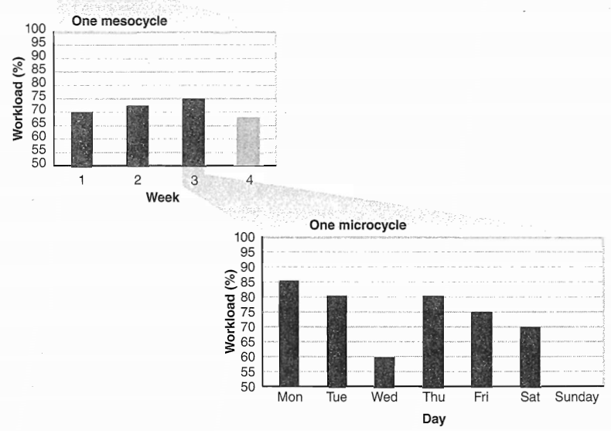

Slide 34
Multiyear Training Plan
The multiyear training plan is comprised of a series of annual training plans that are linked together to direct the athlete's training toward specific developmental and performance outcomes.
used by strength and conditioning professionals to develop training programs for athletes preparing for consecutive Olympic Games.
This type of training has also been suggested to be a useful method for the development of high school and collegiate athletes (46, 61)

Slide 35
Annual Training Plan
The annual training plan, sometimes called a macrocycle (12, 52), describes the overall training structures within a specific training year.
athlete's developmental status
training objectives
competitive schedule of the athlete or team

Slide 36
Annual Training Plan
In the classic literature, the annual training plan typically contains one macrocycle (52).
an alternative training approach is to break the training year into two or three macrocycles in order to address multiple competitive seasons or the needs of athletes who participate in multiple sports

Slide 37
Annual Training Plan
Regardless of the number of macrocycles in the annual training plan, the basic loading progression is from higher volumes of training toward higher intensity, lower volume training that is more technique oriented.
Additionally, as the training load changes across the annual plan, the focus of training will be altered

Slide 38
three major subdivisions contained within the annual training plan
(l) preparatory,
(2) competitive and
(3) transitional phases

Slide 39
Annual Training Plan

Slide 40
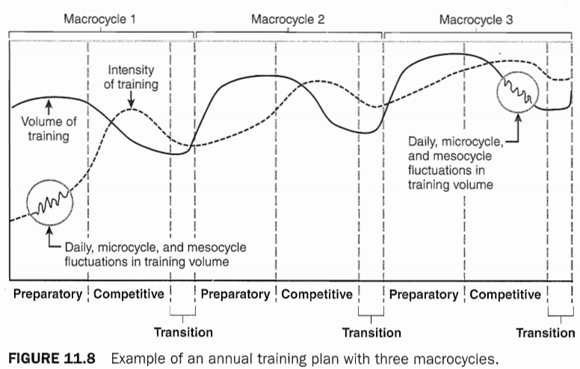
Annual Training Plan

Slide 41
Preparatory Phase
The preparatory phase of the annual training plan induces physiological, psychological, and technical adaptations that serve as a foundation for the competitive phase.
Depending on the athletes’ level of development and the individual sport's requirements, the amount of time spent in the preparatory phase will range between three and six months.

Slide 42
Preparatory Phase
Conceptually, younger or less developed athletes should spend more time engaged in the general preparatory phase.
while more advanced athletes can spend less time in this phase of training as a result of the training base already established.

Slide 43
Preparatory Phase
The total time spent in the preparatory phase will be divided among the macrocycles contained in the annual training plan. For example, in American football, a two-macrocycle annual training plan is generally used, with a three- to four-month preparatory phase in the early spring and a three-month preparatory phase before the fall season.

Slide 44
Subpreparatory categories
General preparatory phases
specific preparatory phases

Slide 45
General Preparatory Phase
typically contained in the early part of the preparatory phase
target the development of a general physical training base
high volumes of training; lower training intensities, and a large variety of training means that target the development of general motor abilities and skills

Slide 46
Specific Preparatory Phase
focuses on sport-specific motor and technical abilities in order to elevate sport performance preparedness
contains higher training loads coupled with bursts of high-intensity training.
this subphase strengthens the training base while preparing the athlete to transition into the competitive phase of the annual training plan.

Slide 47
Annual Training Plan

Slide 48
Competitive Phase
The primary goal of the competitive phase is to maintain or slightly improve the physiological and sport-specific skills acquired in the preparatory phase of development.
These goals can be met by focusing on sport-specific activities, such as skill-based conditioning exercises.
with a minor focus on general physical preparation activities.
The use of skill-based conditioning activities also allows for the continued development of both technical and tactical skill sets, which are necessary for competitive success.

Slide 49
Competitive Phase
Generally, the volume of training is decreased across the competitive phase, while the intensity is increased.
Classic periodization literature often suggests that the competitive phase be divided into the precompetitive and main competitive subphases.

Slide 50
Precompetitive Subphase
The precompetitive subphase should be considered a link between the preparatory and main competitive subphases
the scheduling of unofficial competitions
exhibition games
main objective of this phase is not to achieve the highest levels of performance, but to simply use competitions as training tools or as a means of preparation.

Slide 51
Main Competitive Subphase
The main emphasis of this subphase is maximizing the athlete's preparedness and optimizing performance
Generally, the primary competition is contained at the end of this subphase. A structured taper is employed for 8 to 14 days prior to this competition

Slide 52
Transitional Phase
an important bridge between either two annual training plans or two macrocycles
transitional phase should consist of a significantly reduced training load, with a primary focus on general training activities that are used to maintain fitness levels
should be a minimal emphasis on sport-specific skills in order to maintain technical proficiency
typically lasts between two and four weeks, but if the annual training plan is particularly stressful, it can be extended to six weeks

Slide 53
Transitional Phase
In some instances, a complete cessation of training during a portion of the transition phase may be warranted (i.e., if the athlete is recovering from an injury)
if training ceases for a significant time period, there will be a large reduction in the athlete's physical capacity.
Generally, the transition phase should be used to refresh the athlete both physically and mentally

Slide 54
Macrocycle
Traditionally, the macrocycle has been considered as a single season (69) or annual training plan.
However, it is likely that for many sports, multiple seasons will be contained within the annual training plan (i.e._, distance runners often compete in cross-country running, indoor track, and outdoor track) and multiple macrocycles (2 or 3) will be needed in order to direct the training activities

Slide 55
Macrocycle
Multiple macrocycle structures are typically seen, for example, in track and field, which has indoor and outdoor seasons, as well as in collegiate soccer, which has spring and fall seasons.
Theoretically, the macrocycle should be considered a training plan targeting specific training and competitive objectives

Slide 56
Macrocycle
These objectives are met by manipulating specific training activities at both the mesocycle and microcycle levels
The overall structure of the macrocycle is very similar to that of the annual training plan in that it contains preparatory, competitive, and transitional phases
It is important to note with each successive macrocycle, the intensity of training and the focus on technical, tactical, and sport-specific training will be elevated

Slide 57
Mesocycle
In the traditional Sense, the mesocycle is considered as a medium-duration training plan
is generally comprised of two to six interlinked microcycles
Typically, mesocycles are also considered to be blocks of training (43, 44), or summated microcycles

Slide 58
Mesocycle
mesocycles generally last around four weeks
It appears that after about four weeks of a specific mesocycle, asymptotic training effects (i.e., a reduction in the adaptive responses to the training stimulus) begin to occur
It appears that if the training stimulus is altered at about four weeks, these reductions in fitness or performance can be avoided, and continued progress toward the targeted goals can occur.

Slide 59
three basic blocks are designed
Accumulation,
Transmutation, and
Realization

Slide 60
Mesocycle

Slide 61
Mesocycle

Slide 62
Mesocycle

Slide 63
Accumulation Mesocycles
development of the athlete's overall conditioning
use of substantial workloads that target basic athletic abilities
such as muscular strength, anaerobic endurance, or aerobic endurance
two and four weeks and depends on the time necessary to attain the targeted training effect
Longer accumulation mesocycles result in longer training residuals (43, 44) and substantially greater delay of training effects

Slide 64
Transmutation Mesocycles
The central goal of this mesocycle is to elevate the athlete's overall level of preparedness by enhancing the abilities developed during the accumulation mesocycle
sport-specific training methods that focus on the competitive activity
utilize higher intensities that create a large amount of fatigue

Slide 65
Transmutation Mesocycles
maximization of muscular strength, based on the foundation set forth in the previous mesocycle.
two- to four-Week duration typically used in transmutation mesocycles
If the duration of this mesocycle is extended (>4 weeks), it is likely that the involution of residual training effects from the accumulation block will be maximized.

Slide 66
Realization Mesocycles
final structure before a major competition that maximizes the athlete’s level of preparedness
This mesocycle is very similar to the taper
between 8 and 14 days
reductions in training load that maximize preparedness and performance while decreasing accumulated fatigue
elevate preparedness, maximize specifically trained abilities, and create a situation that maximizes performance

Slide 67
Microcycle
smallest and most basic training structure
The basic length of a microcycle is largely dictated by the phase of the overall training plan
last from several days to two weeks
The actual structure of the microcycle is largely predicated by its place within the overall planning structures (mesocycle, macrocycle, and annual training plans), the specific requirements of the sport or athlete, the athlete's ability to tolerate training stress, and the time allotted for training activities

Slide 68
Microcycle
During the early portion of the preparatory phase use of what has been termed general preparatory microcycles
In the later stages of the preparatory phase, sport-specific preparatory microcycles will be used to develop sport-specific fitness and skills
These two microcycle types can be further subdivided into the ordinary, shock, pre- competitive, competitive, and recovery microcycles

Slide 69
Ordinary microcycles
lower training loads performed at submaximal intensities
the training load is gradually and uniformly increased with successive microcycles

Slide 70
Shock microcycles
A sudden increase in training load while maintaining a high volume of training is seen in a shock
Shock microcycles are widely used during both the preparatory and competitive phases of training by advanced athletes who have developed a substantial training base

Slide 71
Shock microcycles
the shock microcycle can be a very powerful tool for inducing significant physiological and performance adaptations
after a shock microcycle, ordinary or recovery microcycles are employed, depending on the training status of the athlete and the overall goals of the program
However, in very unique situations, some elite athletes may employ two sequential shock microcycles

Slide 72
Shock microcycles
This has been termed a double-shock microcycle
Shock microcycles are common-place in the training plans of elite athletes, but they should be avoided with beginner or novice athletes
an illogical application of a shock microcycle may increase the athlete’s injury risk and the potential for overtraining, and may induce traumatic maladaptive responses, such as rhabdomyolysis

Slide 73
Precompetitive microcycles
This microcycle may be considered an early portion of the precompetitive taper.
It is marked by reduced training volumes, but it also emphasizes sport-specific training activities that elevate performance

Slide 74
Competitive microcycle
The competitive microcycle occurs immediately prior to a competition.
It maximizes performance and preparedness
This microcycle should be considered an extension of the precompetitive microcycle
It contains the latter portion of the taper leading into the competition
immediate training preparation, travel to the competition, site preparation, warm-up, the actual competition, and the recovery activities undertaken after the competition

Slide 75
Recovery microcycle
contains a reduced training load in order to induce recovery by allowing the athlete to rest, heal, and prepare for upcoming training blocks

Slide 76
The basic microcycle structures
Depending on the targeted outcomes of the mesocycle, specific microcycle types can be selected and sequenced
realization mesocycle
Precompetitive microcycle (7 days) Competitive microcycle (7 days)
an accumulation mesocycle
Ordinary (7 days) Ordinary (7 days) Ordinary (7 days) Recovery (7 days)

Slide 77
The basic microcycle structures
mesocycle structure called for a concentrated
Shock (7 days) Ordinary (7 days) Ordinary (7 days) Recovery (7 days)
Ultimately, the various microcycle structures allow for various training sequences to be constructed, based on the needs of the athlete, the phase of training, and the goals of the mesocycle, macrocycle, and annual training plan.

Slide 78
Training Day
Typically, a training day contains one or more interconnected training sessions
in accordance with the objectives established by the microcycle plan
The density of training sessions in a training day largely depends on the athletes level of development, the time allotted for training, and the phase of training

Slide 79
Training Day
By placing smaller periods of training throughout the day, it is believed that greater physiological adaptations may occur, which ultimately result in greater performance gains.
studies have shown that greater neuromuscular and hypertrophic adaptations occur from training twice a day compared to a single training session, even when volume is held constant (36).

Slide 80
Training Session
A training session or workout (43, 88) is the basic structural unit in a periodized training plan
Typically, multiple training sessions are performed each day in order to target several training factors
Based on these organizational strategies, one training session is traditionally defined having any rest interval less than 40 minutes

Slide 81
Sequencing and Integration of the Training Process
In fact, this concept can be seen in Matveyev's (52) seminal text, where he states that there is “a definite sequence of different links of the training process” and "a rational order of the interaction of various aspects of an athlete’s training.“

Slide 82
Sequencing and Integration of the Training Process
This lack of sequencing and integration of training can be seen in training programs where many or all training factors are addressed or emphasized at one time.
This practice creates a scenario that generates high levels of fatigue and makes it virtually impossible to optimize performance at the appropriate times (30).

Slide 83
Sequencing and Integration of the Training Process
It is likely that these high levels of fatigue increase the risk of overtraining (75) and potential for injury (26).
appropriately periodized training plan minimizes both these risks by manipulating various training factors, including intensity, volume, density, and training focus, in a sequential and integrative fashion (76, 77),

Slide 84
Sequencing and Integration of the Training Process
When crafted correctly, these result in better management of training stressors and an increased ability to direct training toward specific performance goals.
As a result of the various levels of involution that exist for the various training factors, a sequential training approach can be crafted in which complimentary training factors (table 11.4) are emphasized at specific time points across multiple mesocycles. This maximizes specific physiological or performance outcomes.

Slide 85
Sequencing and Integration of the Training Process

Slide 86
Sequencing and Integration of the Training Process

Slide 87
Sequencing and Integration of the Training Process
The success of a sequenced training plan is related to ordering successive mesocycles in accordance with mechanical specificity (64, 69, 79, 83), metabolic specificity (63, 80), and the time course of the stability and involution of residual training effects.
Three of the more commonly used methods are the (1) traditional or classic model, (2) summated microcycle model, and (3) conjugated sequencing model

Slide 88
Traditional or Classic Model
contain relatively limited variations in training methods and means
create gradual wavelike increases in workload
In the initial stages of training, the load is increased primarily by elevating the volume of work, while only marginally increasing intensity
As training progresses, the intensity will increase and training volume will subsequently decrease.

Slide 89
Traditional or Classic Model
A central component of the classic model is a complex system that employs the parallel development of physical abilities
Early research on this model suggested that it results in a simultaneous development of divergent physiological functions that are necessary for a variety of sports
Therefore, it may not optimize the physiological and performance adaptations of intermediate and advanced athletes

Slide 90
several reasons of the classic model may not be advantageous for advanced athletes
Advanced athletes already have a high level of special physical preparedness
Conversely, with beginner or novice athletes, this model allows for stabilization of technical skills and other training factors
that requires the simultaneous development of several training factors, cannot produce the highly specific physical preparedness that advanced athletes need

Slide 91
several reasons of the classic model may not be advantageous for advanced athletes
The classic model relies on long periods of basic and sport-specific preparation (43, 44). These may be beneficial for novice athletes, but are considered a disadvantage for advanced athletes because of insufficient training variation
Developing technical competencies while simultaneously establishing special physical preparedness accumulates a large amount of fatigue
The modern athletic calendar often contains many competitions that the classic (traditional) periodization model cannot address

Slide 92
Summated Microcycle Model
The summated microcycle model increases training variation with an integrated, sequenced training structure
Typically utilized with intermediate to advanced athletes
training factors in a cyclical pattern that allows for a lower rate and magnitude of residual decay, or involution

Slide 93
Summated Microcycle Model
based on a four-Week block of training, or mesocycle that progresses from an extensive to an intensive workload, followed by a brief restitution period
The basic four-week structure is often selected because this duration is associated with the time point at which asymptotic training effects arise and the involution (decay) of training residuals begins to occur

Slide 94
Summated Microcycle Model
the summated microcycle model uses a whole block of training, or mesocycle, to emphasize a very specific training factor, while other complementary training factors receive a minimal emphasis
If crafted correctly, this type of sequential model can minimize overtraining potential and decrease the involution of training aftereffects

Slide 95
Summated Microcycle Model
Central to the effective application of the summated microcycle model is the loading pattern and training-factor integration that is contained within each of the four interlinked microcycles that comprise the mesocycle block
Another important point is how each block of training is interrelated and sequenced.

Slide 96
Summated Microcycle Model
From a loading perspective, the basic summated model utilizes a loading structure that progresses from extensive-to-intensive workloads across three successive microcycles, followed by a recovery microcycle
This general loading structure is traditionally referred to as a 3:1 loading paradigm

Slide 97
Summated Microcycle Model
Here, the first three microcycles increase in training volume, intensity, density, or some combination of each factor, followed by one recovery or unloading microcycle
It is important to note that at the end of the third microcycle, the highest levels of fatigue are developed and performance capacity can be significantly impaired

Slide 98
Summated Microcycle Model
Therefore, the recovery microcycle (where overall workload is reduced by manipulating training volume, intensity, or density) should be considered an extremely important component of the summated microcycle model because it reduces fatigue and potential for overtraining, elevates preparedness (31, 32), and facilitates the physiological adaptations necessary for the next block of training

Slide 99
Summated Microcycle Model
A second method of loading that is often used in conjunction with the summated microcycle model employs a concentrated loading (69, 84, 85), or planned overreaching, microcycle
During the first microcycle, fatigue will be significantly elevated, while preparedness and performance markers (muscular strength, power, and endurance) will be reduced

Slide 100
Summated Microcycle Model
Ultimately, the degree of the reduction in preparedness and performance stimulated by the concentrated loading microcycle is directly proportional to the magnitude of loading (69).
The dissipation of fatigue is accomplished in this model by sequencing the mesocycle so that after the concentrated loading microcycle ends, training workload is reduced to normal levels for two microcycles.

Slide 101
Summated Microcycle Model
Next, training loads are reduced further in a one-week recovery microcycle
The effectiveness of a summated microcycle model can be enhanced by employing intramicrocycle variation tactics.
For example, the intensity of training can be altered across the microcycle, allowing for heavy and light days to be performed in the context of the microcycle’s goal (80).

Slide 102
Summated Microcycle Model
An athlete may do resistance training on Monday and Friday, but the Workload on Friday should be 40% less of that utilized on Monday.
The inclusion of submaximal (light) days can exert a significant influence on the potential for positive adaptations, while minimizing the possibility of overtraining (19).

Slide 103
Summated Microcycle Model
Other intramicrocycle variations tactics, such as competitive-trial, interval, or repetition methods, may also be used to modulate the effectiveness of the summated microcycle (80),

Slide 104
Summated Microcycle Model

Slide 105
Conjugated Sequencing Model
The conjugated sequencing model, or coupled successive system, as it was originally termed (64, 83), is a system for sequencing and integrating training factors typically employed with advanced athletes
Central to this model is the sequencing of accumulation (64, 81, 84) (concentrated loading) (64, SO), transmutation (43, 44, 88), and realization (43, 44) or recovery (64, 80) mesocycles in order to take advantage of residual (delayed) training effects.

Slide 106
Conjugated Sequencing Model

Slide 107
Conjugated Sequencing Model
Theoretically, the annual training plan can be constructed by sequencing these three basic mesocycle structures and designing the training interventions in the context of the phases (i.e., preparatory or competitive) contained in the annual plan (figure 11- 12).

Slide 108
Conjugated Sequencing Model

Slide 109
Conjugated Sequencing Model
Central to the effectiveness of the conjugated sequencing model is the use of concentrated loading blacks, which are considered as the primary component of the accumulation block.
Typically, the accumulation block lasts between two and four weeks, during which either performance or preparedness is decreased in response to an elevated level of accumulative fatigue (64).

Slide 110
Conjugated Sequencing Model
Conceptually, the concentrated loading block saturates the system with one major training emphasis, while complimentary training factors are addressed with a smaller emphasis (figure l1.13).
For example, when sequencing training for speed development, the primary emphasis in the accumulation block would target maximal strength development, while the secondary emphasis would focus on muscular power, and the tertiary emphasis would be on speed and agility (6, 62).

Slide 111
Conjugated Sequencing Model
The selection of these training factors is based on the relationships among maximal strength, power development, and the expression of speed.
Typically, strength must he increased before power can be developed and then expressed as speed.
The reorientation of the training emphasis facilitates recovery and takes advantage of the delayed training effects (residuals) developed by the accumulation block.

Slide 112
Conjugated Sequencing Model
After completing two to four weeks of the transmutation block (43, 44), a realization or restitution block, which lasts between one and two weeks, will be performed (6).
The realization block of the sequential plan results in continued dissipation of fatigue and a significant increase in preparedness and performance, which occurs in response to changes in training focus and a reduction in training load

Slide 113
Conjugated Sequencing Model
For example, in figure 11.13, the realization block contains a primary emphasis on speed and agility, a secondary emphasis on muscle power, and a tertiary emphasis on maximal strength, while reducing workloads in order to maximize preparedness and performance.

Slide 114
Conjugated Sequencing Model

Slide 115
Conjugated Sequencing Model

Slide 116
