Slide 1
Sport injuries
Mohsen Avandi
Assistance professor of Semnan University

Slide 2
Fractures
A fracture is a break, usually in a bone.
Fractures commonly happen because of car accidents, falls or sports injuries. Other causes are low bone density and osteoporosis, which cause weakening of the bones. Overuse can cause stress fractures, which are very small cracks in the bone.

Slide 3
Fractures
Bones are rigid, but they do bend or "give" somewhat when an outside force is applied. However, if the force is too great, the bones will break, just as a plastic ruler breaks when it is bent too far.

Slide 4
Types of fractures
Stable fracture. The broken ends of the bone line up and are barely out of place.
Open, compound fracture. The skin may be pierced by the bone or by a blow that breaks the skin at the time of the fracture. The bone may or may not be visible in the wound.
Transverse fracture. This type of fracture has a horizontal fracture line.

Slide 5
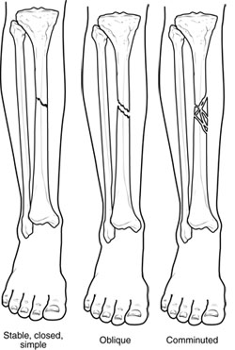
Types of fractures
Oblique fracture. This type of fracture has an angled pattern.
Comminuted fracture. In this type of fracture, the bone shatters into three or more pieces.

Slide 6
Cause
Trauma
Osteoporosis
Overuse
Repetitive motion can tire muscles and place more force on bone. This can result in stress fractures. Stress fractures are more common in athletes.

Slide 7
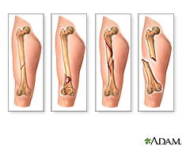
Symptoms
Out-of-place or misshapen limb or joint
Swelling, bruising or bleeding
Intense pain
Numbness and tingling
Limited mobility or inability to move a limb

Slide 8
Treatments
Cast Immobilization: A plaster or fiberglass cast is the most common type of fracture treatment.
Functional Cast or Brace: The cast or brace allows limited or "controlled" movement of nearby joints. This treatment is desirable for some, but not all, fractures.

Slide 9
Treatments
Traction: Traction is usually used to align a bone or bones by a gentle, steady pulling action.
External Fixation: In this type of operation, metal pins or screws are placed into the broken bone above and below the fracture site. The pins or screws are connected to a metal bar outside the skin.

Slide 10
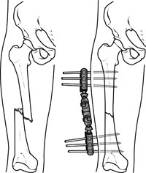
External Fixation

Slide 11
Treatments
Open Reduction and Internal Fixation
During this operation, the bone fragments are first repositioned (reduced) in their normal alignment, and then held together with special screws or by attaching metal plates to the outer surface of the bone. The fragments may also be held together by inserting rods down through the marrow space in the center of the bone.

Slide 12
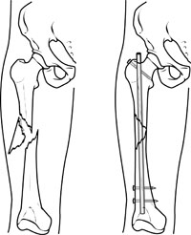
Open Reduction and Internal Fixation

Slide 13
Recovery
Fractures take several weeks to several months to heal, depending on the extent of the injury and how well you follow your doctor's advice. Pain usually stops long before the fracture is solid enough to handle the stresses of normal activity.
Specific exercises will help you restore normal muscle strength, joint motion, and flexibility.

Slide 14
Stress Fractures
A stress fracture is a small crack in a bone. Stress fractures often develop from overuse, such as from high-impact sports like distance running or basketball.
Most stress fractures occur in the weight-bearing bones of the foot and lower leg. Studies show that athletes participating in tennis, track and field, gymnastics, dance, and basketball are at high risk for stress fractures.

Slide 15
Stress Fractures
When muscles are overtired, they are no longer able to lessen the shock of repeated impacts. When this happens, the muscles transfer the stress to the bones. This can create small cracks or fractures.

Slide 16
Joint injuries
Chapter 2

Slide 17
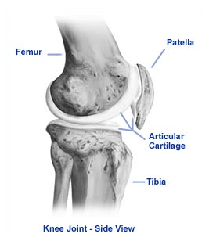
Introduction
Hyaline
Fibrocartilage

Slide 18
Osteochondritis dissecans
Osteochondritis dissecans (OCD) is a condition that develops in joints, most often in children and adolescents.
As a result, the small piece of bone and the cartilage covering it begin to crack and loosen.
The most common joints affected by osteochondritis dissecans are the knee, ankle and elbow, although it can also occur in other joints.

Slide 19
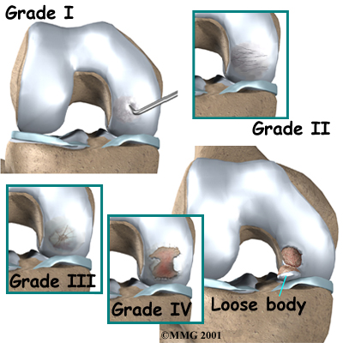
Osteochondritis dissecans

Slide 20
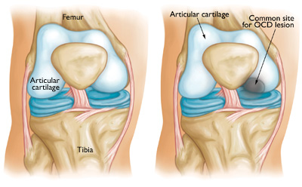
Cause
It is not known exactly what causes the disruption to the blood supply and the resulting OCD. Doctors think it probably involves repetitive trauma or stresses to the bone over time.

Slide 21
Symptoms
Pain and swelling of a joint — often brought on by sports or physical activity — are the most common initial symptoms of OCD. Advanced cases of OCD may cause joint catching or locking.

Slide 22
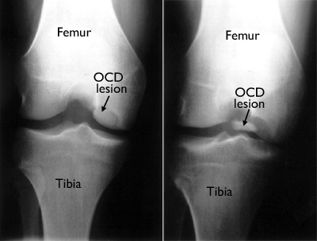
Examination
X-rays
Magnetic resonance imaging (MRI) and ultrasound

Slide 23
Treatment
Observation and Activity Changes
In most cases, OCD lesions in children and young teens will heal on their own, especially when the body still has a great deal of growing to do. Resting and avoiding vigorous sports until symptoms resolve will often relieve pain and swelling.
Nonsurgical Treatment
use of crutches, or splinting or casting the affected arm, leg or other joint for a short period of time.

Slide 24
Osteoarthritis
Osteoarthritis, also known as "wear and tear" arthritis, is a progressive disease of the joints.
With osteoarthritis, the articular cartilage that covers the ends of bones in the joints gradually wears away.
when the joint bent and straightened, there is now a frayed, rough surface. Joint motion along this exposed surface is painful.

Slide 25
Osteoarthritis
Osteoarthritis usually develops after many years of use. It affects people who are middle-aged or older. Other risk factors for osteoarthritis include obesity, previous injury to the affected joint, and family history of osteoarthritis.

Slide 26
Symptoms
A joint affected by osteoarthritis may be painful and inflamed. Without cartilage, bones rub directly against each other when the joint moves. This is what causes the pain and inflammation.
Pain may be worse in the morning and feel better with activity. Vigorous activity may cause pain to flare up.
The joint may stiffen and look swollen, enlarged or "out of joint." A bump may develop over the joint.
If bending the joint becomes difficult, motion may be limited.

Slide 27
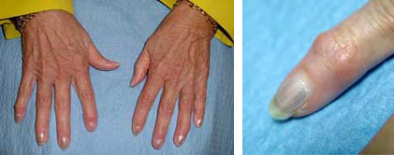
Symptoms

Slide 28
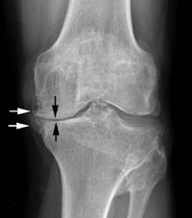
Diagnosis
A complete medical history, physical examination, X-rays, and possibly laboratory tests will be done.

Slide 29
Treatment
Nonsurgical Treatment
Lifestyle Modifications
The doctor may recommend rest or a change in activities to avoid provoking osteoarthritis pain. This may include modifications in work or sports activities. It may mean switching from high-impact activities (such as aerobics, running, jumping, or competitive sports) to low-impact exercises (such as stretching, walking, swimming, or cycling). A weight loss program may be recommended, if needed, particularly if osteoarthritis affects weight-bearing joints (such as the knee, hip, spine, or ankle)

Slide 30
Treatment
Medications
Non-steroidal anti-inflammatory drugs can help reduce inflammation.
Corticosteroids
Dietary supplements called glucosamine and chondroitin sulfate may help relieve pain from osteoarthritis.
Physical Therapy
A balanced fitness program, physical therapy, and/or occupational therapy may improve joint flexibility, increase range of motion, reduce pain, and strengthen muscle, bone, and cartilage tissues.

Slide 31
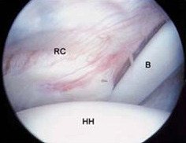
Treatment
Surgical Treatment
Arthroscopy
Osteotomy
Joint fusion
Joint replacement
Arthroscopy is a surgical procedure orthopaedic surgeons use to visualize, diagnose, and treat problems inside a joint.
The word arthroscopy comes from two Greek words, "arthro" (joint) and "skopein" (to look). The term literally means "to look within the joint."

Slide 32
Rheumatoid Arthritis
In rheumatoid arthritis, swells, invades surrounding tissues, and the joint lining produces chemical substances that attack and destroy the joint surface.
People of all ages may be affected. The disease usually begins in middle age.
Rheumatoid arthritis usually affects joints on both sides of the body in the hands and feet, as well as the hips, knees, and elbows. Without proper treatment, rheumatoid arthritis can become a chronic, disabling condition.

Slide 33
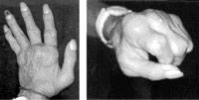
Cause
Ligaments and joint capsules become less effective supporting structures. Erosion of the articular cartilage, together with ligamentous changes, result in deformity and contractures. As the disease progresses, pain and deformity increase.

Slide 34
Symptoms
Swelling, pain, and stiffness in the joint, even when it is not being used
A feeling of warmth around the joint
Deformities and contractures of the joint
Symptoms throughout the body, such as fever, loss of appetite and decreased energy
Weakness due to a low red blood cell count (anemia)
Nodules, or lumps, particularly around the elbow
Foot pain, bunions, and hammer toes with long-standing disease

Slide 35
Treatment
Medication
Medications used to control rheumatoid arthritis fall into two categories: those that relieve symptoms and those that have the potential to modify the course of the disease. Often, they are used together. Aspirin and ibuprofen can help reduce the pain and inflammation of rheumatoid arthritis. Disease-modifying drugs include methotrexate and sulfasalazine and gold injections.

Slide 36
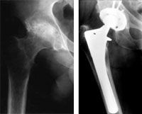
X-ray of hip with rheumatoid arthritis and total hip replacement

Slide 37
Gout
Gout develops when too much uric acid accumulates in your bloodstream. This dissolved uric acid then comes out of the bloodstream and forms microscopic spike-like crystals in joints or soft tissues.
Your body reacts to uric acid crystals as if they were a foreign body or bacteria. White blood cells and other infection fighting cells are sent into the area, which results in inflammation.

Slide 38
What Gout Affects
Joints. Gout frequently involves the joint of the big toe. However, it can affect small joints like those in the finger, as well as large joints, such as the knee and hip.
Bursae
Tendon sheaths. These tunnels protect and provide nutrition to tendons in the hands and feet.
Kidneys. High uric acid levels may cause kidney stones and, sometimes, damage the kidneys. About 15 people out of 100 with gout develop kidney stones.

Slide 39
Cause
Gout can develop when your body produces too much uric acid or when it does not eliminate enough of it. When the levels of uric acid in your blood are too high, it is called hyperuricemia.
The Role of Uric Acid
Uric acid is produced when your body breaks down purines, which are substances naturally found in your body, as well as in protein-rich foods.

Slide 40
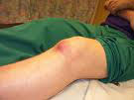
Symptoms
A gout attack can be sudden and severe. It may wake you up at night with intense pain in your big toe.
The joint that is affected is typically red and swollen. It may also feel hot.

Slide 41
Examination
Blood Test
Synovial Fluid Analysis

Slide 42
Treatment
Ice. Apply ice to the affected area to reduce swelling. Do not apply ice directly to the skin. Use an ice pack or wrap a towel around the ice. Apply ice for about 20 minutes at a time. Elevate. Frequently raise and keep the affected area above the level of the heart. Rest. Move the affected area as little as possible while symptoms are present.
Over-the-counter non-steroidal anti-inflammatory medicines.

Slide 43
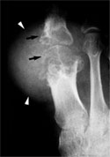
Surgical Treatment
Removal of tophi
Joint fusion
Joint replacement

Slide 44
Ligaments Injuries
Chapter 5

Slide 45
Sprains, Strains, and Other Soft-Tissue Injuries
Some of the soft-tissue injuries you are most likely to experience include:
sprains
strains
contusions
tendonitis
bursitis
stress injuries

Slide 46
Sprains
The joints of your body are supported by ligaments.
Ligaments are strong bands of connective tissue that connect one bone to another. A sprain is a simple stretch or tear of the ligaments.
The areas of your body that are most vulnerable to sprains are your ankles, knees, and wrists.

Slide 47
Sprains
Most mild sprains heal with "R.I.C.E." (rest, ice, compression, and elevation) and exercise. Moderate sprains may also require a period of bracing. The most severe sprains may require surgery to repair torn ligaments.

Slide 48
What causes sprains and strains?
A sprain is caused by direct or indirect trauma (a fall, a blow to the body, etc.) that knocks a joint out of position, and overstretches, and, in severe cases, ruptures the supporting ligaments. Typically, this injury occurs when an individual lands on an outstretched arm; slides into a base; jumps up and lands on the side of the foot; or runs on an uneven surface.

Slide 49
Strains
Chronic strains are the result of overuse (prolonged, repetitive movement) of muscles and tendons. Inadequate rest breaks during intensive training precipitates a strain. Acute strains are caused by a direct blow to the body, overstretching, or excessive muscle contraction.
People at risk for the injury have a history of sprains and strains, are overweight, and are in poor physical condition.

Slide 50
What are the signs of a sprain?
While the intensity varies, pain, bruising, swelling, and inflammation are common to all three categories of sprains:
mild,
moderate,
severe.

Slide 51
Grading sprains and strains
Grade one sprain – mild stretching of your ligament has taken place.
Grade two sprain – there has been a partial rupture (splitting) of your ligament but the joint it is associated with is still stable.
Grade three sprain – there has been a complete rupture of the ligament and the joint is unstable.

Slide 52
Treating a sprain
Most sprains and strains can usually be treated with self-care techniques, such as PRICE therapy – protection, rest, ice, compression and elevation.

Slide 53
Preventing sprains
using the correct footwear for activities
warming up properly before exercise
stretching or 'warming down' after exercise
doing regular strengthening and conditioning exercises

Slide 54
Treating sprains and strains
PRICE therapy
avoiding HARM

Slide 55
Protection
Protection – protect the injured area from further injury, by using a support or, in the case of an ankle injury, wearing shoes that enclose and support your feet, such as lace-ups.

Slide 56
Ice
Ice – for the first 48 to 72 hours after the injury, apply ice wrapped in a damp towel to the injured area for 15 to 20 minutes every two to three hours during the day. Do not leave the ice on while you are asleep, and do not allow the ice to touch your skin directly because it could cause a cold burn.

Slide 57
Compression
Compression – compress or bandage the injured area to limit any swelling and movement that could damage it further. You can use a crepe bandage or a simple elastic bandage available from a pharmacy. It should be wrapped snugly around the affected area but not so tightly that it restricts blood flow. Remove the bandage before you go to sleep.

Slide 58
Elevation
Elevation – keep the injured area raised and supported on a pillow to help reduce swelling. If your leg is injured, avoid having long periods of time where your leg is not raised.

Slide 59
HARM
For the first 72 hours after a sprain or muscle strain you should avoid:
Heat – such as hot baths, saunas or heat packs (applying a controlled amount of heat to affected joints)
Alcohol – drinking alcohol will increase bleeding and swelling and decrease healing
Running – or any other form of exercise that could cause more damage
Massage – which may increase bleeding and swelling

Slide 60
Treating pain
codeine, only available on prescription, may be required.
Oral non-steroidal anti-inflammatory drugs (NSAIDs), such as Ibuprofen can also help reduce swelling and inflammation. However, NSAIDs should only be considered 48 hours after the injury has occurred because they affect the healing process.

Slide 61
Muscle Cramp
Have you ever experienced a "charley horse"? If yes, you probably still remember the sudden, tight and intense pain caused by a muscle locked in spasm.
A charley horse is the common name for a muscle spasm. Muscle spasms can occur in any muscle in the body, but often happen in the leg.

Slide 62
Muscle Cramp
A cramp is an involuntary and forcibly contracted muscle that does not relax. Cramps can affect any muscle under your voluntary control (skeletal muscle). Muscles that span two joints are most prone to cramping. Cramps can involve part or all of a muscle, or several muscles in a group

Slide 63
Muscle Cramp
The most commonly affected muscle groups are:
Back of lower leg/calf (gastrocnemius)
Back of thigh (hamstrings)
Front of thigh (quadriceps)
Just about everyone will experience a muscle cramp sometime in life. It can happen while you play tennis or golf, bowl, swim, or do any exercise. It can also happen while you sit, walk, or even just sleep.

Slide 64
Muscle Cramp
Muscle cramps are very common among endurance athletes (i.e., marathon runners and triathletes) and older people who perform strenuous physical activities.
Athletes are more likely to get cramps in the preseason when the body is not conditioned and therefore more subject to fatigue. Cramps often develop near the end of intense or prolonged exercise, or 4-6 hours later.

Slide 65
Cause
Although the exact cause of muscle cramps is unknown (idiopathic), some researchers believe inadequate stretching and muscle fatigue leads to abnormalities in mechanisms that control muscle contraction.
Stretching and Muscle Fatigue
Heat, Dehydration, and Electrolyte Depletion

Slide 66
Cause
A regular program of stretching lengthens muscle fibers so they can contract and tighten more vigorously when you exercise. When your body is poorly conditioned, you are more likely to experience muscle fatigue,
Muscle cramps are more likely when you exercise in hot weather because sweat drains your body's fluids, salt and minerals (i.e., potassium, magnesium and calcium). Loss of these nutrients may also cause a muscle to spasm.

Slide 67
Symptoms
Muscle cramps range in intensity from a slight tic to agonizing pain. A cramping muscle may feel hard to the touch and/or appear visibly distorted or twitch beneath the skin. A cramp can last a few seconds to 15 minutes or longer. It might recur multiple times before it goes away.

Slide 68
Treatment
Cramps usually go away on their own without seeing a doctor.
Stop doing whatever activity triggered the cramp.
Gently stretch and massage the cramping muscle, holding it in stretched position until the cramp stops.
Apply heat to tense/tight muscles, or cold to sore/tender muscles.

Slide 69
Prevention
To avoid future cramps, work toward better overall fitness. Do regular flexibility exercises before and after you work out to stretch muscle groups most prone to cramping.
Warm Up
Calf Muscle Stretch
Hamstring Muscle Stretch
Quadriceps Muscle Stretch

Slide 70
Tendinitis
Tendinitis (also tendonitis), meaning inflammation of a tendon, is a type of tendinopathy often confused with the more common tendinosis, which has similar symptoms but requires different treatment.
Generally tendinitis is referred to by the body part involved, such as Achilles tendinitis (affecting the Achilles tendon), or patellar tendinitis

Slide 71
Types
Tendinitis injuries are common in the upper shoulder and lower section of the elbow (including the rotator cuff attachments), and are less common in the hips and torso.
rock climbers tend to develop tendinitis in their fingers or elbows, swimmers in their shoulders. Achilles tendinitis is a common injury, particularly in sports that involve lunging and jumping, while Patellar tendinitis is a common among basketball and volleyball players owing to the amount of jumping and landing

Slide 72
Diagnosis
Symptoms can vary from aches or pains and local joint stiffness, to a burning that surrounds the whole joint around the inflamed tendon.
In some cases, swelling occurs along with heat and redness, and there may be visible knots surrounding the joint.

Slide 73
Diagnosis
With this condition, the pain is usually worse during and after activity, and the tendon and joint area can become stiff the following day as muscles tighten from the movement of the tendon.
If the symptoms of tendinitis last for several months or longer it is probably tendinosis.

Slide 74
Treatment
Treatment of tendon injuries is largely conservative. Use of non-steroidal anti-inflammatory drugs (NSAIDs), rest, and gradual return to exercise is a common therapy.
Ice, compression and elevation are also frequently recommended. Physical therapy, Occupational therapy, orthotics or braces may also be useful.
Initial recovery is typically within 2 to 3 days and full recovery is within 3 to 6 months

Slide 75
Treatment
Tendinosis occurs as the acute phase of healing has ended (6–8 weeks) but has left the area insufficiently healed;
Steroid injections have not been shown to have long term benefits but have been shown to be more effective than NSAIDs in the short term.
In chronic tendinitis or tendonosis laser therapy has been found to be better than conservative treatment at reducing pain;

Slide 76
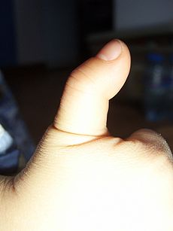
Tenosynovitis
Tenosynovitis is the inflammation of the fluid-filled sheath (called the synovium) that surrounds a tendon.
Symptoms of tenosynovitis include pain, swelling and difficulty moving the particular joint where the inflammation occurs.

Slide 77
Tenosynovitis
When the condition causes the finger to "stick" in a flexed position, this is called "stenosing" tenosynovitis, commonly known as "trigger finger".

Slide 78
Causes
Causes of tenosynovitis are unknown. Repeated use of hand tools can precede the condition, as well as arthritis or injury. Tenosynovitis sometimes runs in families and is generally seen more often in males than in females.

Slide 79
Diagnosis
A physical examination shows swelling over the involved tendon.
you move the muscle to which it is attached to see whether you experience pain

Slide 80
Treatment
Treatments for tenosynovitis depend on the severity of the inflammation and location. Mild tenosynovitis causing small scale swelling can be treated with non-steroidal anti-inflammatory drugs (NSAIDs) such as Naproxen, ibuprofen or diclofenac.
Resting the affected tendons is essential for recovery; a brace is often recommended.^{[2]} Physical or occupational therapy may also be beneficial in reducing symptoms

Slide 81
Treatment
More acute cases are treated with cortisone (steroid) injections, then a course of paracetamol and ibuprofen for pain. Outpatient surgery can be used to enlarge the synovium.

Slide 82
Bursitis
Bursitis is the inflammation of one or more bursae (small sacs) of synovial fluid in the body.
They are lined with a synovial membrane that secretes a lubricating synovial fluid.^{[1]} There are more than 150 bursae in the human body

Slide 83
Bursitis
When bursitis occurs, however, movement relying upon the inflamed bursa becomes difficult and painful. Moreover, movement of tendons and muscles over the inflamed bursa aggravates its inflammation, perpetuating the problem. Muscle can also be stiffened.

Slide 84
Signs and symptoms
Bursitis commonly affects superficial bursae. These include the subacromial, prepatellar, retrocalcaneal, and pes anserinusbursae.
Symptoms vary from localized warmth and erythema ^{[4]} to joint pain and stiffness

Slide 85
Cause
Trauma, auto-immune disorders, infection and iatrogenic etiologies can all cause bursitis.^{[5]} Bursitis is commonly caused by repetitive movement and excessive pressure. Shoulders, elbows and knees are the most commonly affected.
rheumatoid arthritis
scoliosis can cause bursitis of the shoulders

Slide 86
Treatment
It is important to differentiate between infected and non-infected bursitis.
People may have surrounding cellulitis and systemic symptoms include a fever. The bursa should be aspirated to rule out an infectious process
Bursae that are not infected can be treated symptomatically with rest, ice, elevation, physiotherapy, anti-inflammatory drugs and pain medication.

Slide 87
Treatment
Since bursitis is caused by increased friction from the adjacent structures, a compression bandage is not suggested because compression would create more friction around the joint. Chronic bursitis can be amenable to bursectomy and aspiration
Bursae that are infected require further investigation and antibiotic therapy. Steroid therapy may also be considered.

Slide 88
Calcific bursitis
Calcific bursitis refers to calcium deposits within the bursae. This most occurs in the shoulder area.
Signs and symptoms
Pain during rest
Tenderness on palpation
Stiffness (reducing joint range of motion)
Swelling

Slide 89
Diagnosis
X-ray
MRI scan
Treatment
Ice (in the acute stage)
Rest (immobilization of the affected limb in the acute phase)
Non steroidal anti-inflammatory drugs
Injections of steroid
Physical therapy
Surgical treatment

Slide 90
Training
ISOM
(1) from stabilizer muscles that provide reactive forces to maintain posture during an exercise,
(2) in between ECC and CON actions for the agonist muscles in an exercise,
(3) while gripping the weights, and
(4) as the primary action of the exercise in a specific area of the range of motion.

Slide 91
Dynamic training
Greater force per unit of muscle cross sectional area,
Involve less muscle-fiber activation per level of tension,
Require less energy expenditure per level of tension, and result in
Greater muscle damage
More conducive to muscle growth
Strength improvements are greatest when ECC actions are emphasized.

Slide 92
Isokinetic
recruits a smaller muscle mass or an isolated joint action
For example, comparing muscle groups from bilateral limbs (i.e., right-knee flexors with left-knee flexors) or agonist versus antagonist muscle groups (i.e., knee flexors versus knee extensors).
For athletes with strength imbalances greater than 15%, an incidence of muscle injury has been reported that is 2.6 times greater.

Slide 93
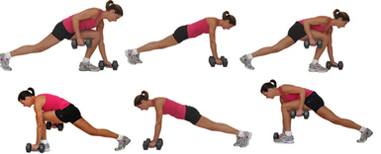
HICT
High Intensity Circuit Training (HICT) is a method of training that involves combining both cardio and resistance training in the same workout.

Slide 94
HICT
9-12 exercises that include a mix of cardio and body weight exercises. When choosing exercises, they looked for:
Whole body, compound exercises
Exercises that recruit the larger muscles of the body, such as the butt, chest and back
Moves that can be easily modified for different fitness levels (e.g., pushups on the knees rather than traditional pushups)

Slide 95
Plyometrics
Plyometrics are a training modality involving exercises in which athletes perform rapid SSC movements.
A great deal of exercises is classified as plyometric, including a range of unilateral and bilateral catch-throw, push-up, bounding, hopping, and jumping variations.
exercises are performed with little to no external resistance (i.e., body mass only or light medicine ball).

Slide 96
Plyometrics
Overload is applied by increasing the stretch rate (i.e., minimizing the duration of the SSC) or the stretch load (i.e., increasing height of drop during depth jumps).
Similar to ballistic movements, plyometrics are theorized to elicit specific adaptations in neural drive, activation patterns, and intermuscular control that improve RFD capacity.

Slide 97
Open and closed chain
Open
Close
Flexibility
Statics
Ballistics
Dynamics
PNF

Slide 98
روش های درمانی
Cryotherapy
Cryotherapy is a pain treatment that uses a method of localized freezing temperatures to deaden an irritated nerve.
Cryotherapy is also used as a method of treating localized areas of some cancers (called cryosurgery), such as prostate cancer and to treat abnormal skin cells by dermatologists.

Slide 99
Cryotherapy
While cryotherapy can reduce unwanted nerve irritation, it sometimes can leave the tissue affected with unusual sensations, such as numbness or tingling, or with redness and irritation of the skin. These effects are generally temporary.

Slide 100
روش های درمانی
گرما درمانی
آب درمانی
ابزارهای توانبخشی
موج کوتاه
فراصوت
لیزر
مادون قرمز
بانداژ
گچ گیری

Slide 101
موج کوتاه
استفاده درمانی دیاترمی موج کوتاه
1- اثربر فرایندهای التهابی
2- اثر بر عفونتهای باکتری
3- اثر بر آسیبهای تروماتیک
4- کاهش زمان بهبودی
5- تسکین درد
6- اثر برروی بافت ماهیچه ای

Slide 102
دیاترمی
محدودیتهای کاربردی جریان دیاترمی
1- خونریزی
2- لخته بستگی سیاهرگی (ترمبوز وریدی)
3- بیماری سرخرگی
4- بارداری
5- فلز در بافتها
6- فقدان حس پوستی
7-تومورها
8- رادیوتراپی
9- بیماران ویژه

Slide 103
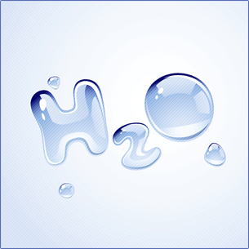
موارد کاربرد آب درمانی
7- ایجاد روحیه نشاط وشادابی
8- افزایش حجم تنفسی و کارکرد بهتر ریه ها
9- کاهش اسپاسم
10- افزایش حرکت روده ها و جلوگیری از یبوست
11- کارکرد بهتر کلیه ها
1- کاهش درد و گرفتگی عضلات
2- ریلاکسیشن
3- بازآموزی فعالیت عضلات فلج
4- تقویت عضلات
5- افزایش گردش خون وبهبود تغذیه بافتها
6- جلوگیری از تحلیل رفتن عضلات

Slide 104
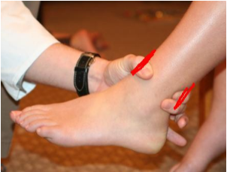
Ankle anterior drawer
Integrity of the anterior talofibular ligament and calcaneo-fibular ligament.
The patient sits on the examination table with their legs hanging freely over the end of the table.
The examiner places the left hand over the distal tibia to secure the leg

Slide 105
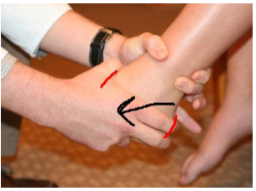
Ankle anterior drawer
The examiner's right hand grasps the hind foot (red lines, second figure). The index and long fingers should cup the patient's heel.
To administer the test, the examiner applies an anterior force to the heel while stabilizing the leg.

Slide 106
Ankle anterior drawer
The test should be repeated in plantarflexion (last figure) to isolate the anterior talo-fibular ligament.
Normally, anterior translation of the talus should not exceed a few mm, and there should be a firm endpoint to the anterior movement of the talus.

Slide 107
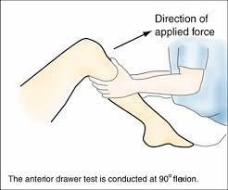
Anterior drawer test of the knee
Anterior cruciate ligament (ACL) of the knee
The patient should be supine, with the hips flexed to 45 degrees, the knees flexed to 90 degrees, and the feet flat on table. The examiner sits on the patient's feet and grasps the patient's tibia and pulls it forward.

Slide 108
Anterior drawer test of the knee
Excessive displacement of the tibia anteriorly indicates that the ACL is likely torn

