Slide 1
THERMOREGULATION and EXERCISE in COLD ENVIRONMENTS

Slide 2
Overview
General Physiological Responses
Hypothermia
Physiological Responses- Exercise
Acclimatization and Strategies

Slide 3
Thermoregulation Overview
Inputs Sensors Integrators Primary Secondary
Outputs Outputs
System maintains body temperature

Slide 4
Primary to Secondary Outputs
Primary
  Sympathetic
    Controllers
      Arterioles
      Sweat glands
      Adipose
  Motor
      Skeletal Muscle
  Hormonal
      Thyroxin
      Catecholes
      Leptin
  Q₁₀ effect
Secondary
  Sympathetic
    Effectors
      Vasoconstriction/dilation
      sweating
      BAT (UCP)
  Motor
      Preshivering/Shivering
  Hormonal
      Non-shivering Thermogenesis
      Non-shivering Thermogenesis
      Non-shivering Thermogenesis
  Q₁₀ effect

Slide 5
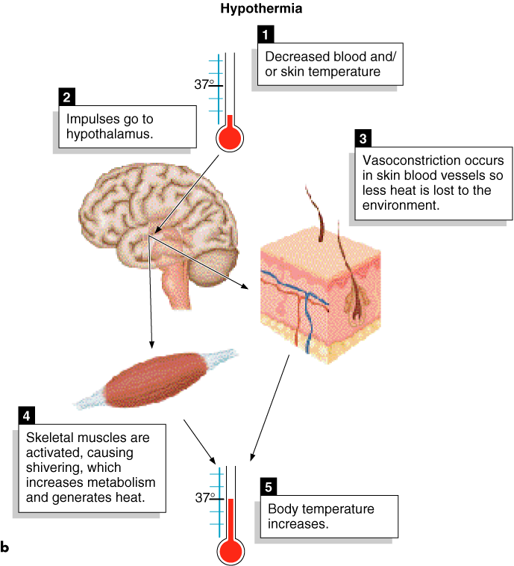
HYPOTHALAMUS AND HYPOTHERMIA
1. Hypothalamus integrates the input from skin and hypothalamic thermoreceptors comparing it with the “set point” then initiates warming mechanisms
2. Skin arterioles vasoconstrict under control of the sympathetic nerves, decreasing blood flow in the skin, thus cooling the skin and decreasing the difference in temperature between skin and air
Skeletal muscles are activated to shiver, thus increasing heat production
With prolonged exposure to the cold, thyroid hormone secretion increases, which also stimulates muscle metabolism

Slide 6
At 34.5º C (94º F) hypothalamus begins to lose ability to regulate temp
At 29.5º C (85.1º F) it is completely lost
Metabolic rates cut in half for every 10º C (18º F)

Slide 7
Vicious cycle of hypothermia/hypoglycemia
Hypothermia increases carbohydrate use
Chronic shivering will deplete glycogen
Hypoglycemia suppressing shivering
Reduced shivering accelerates the hypothermia
Reduced temperatures lower metabolic rate

Slide 8

How Does the Body Conserve Heat?
Shivering thermogensis—rapid involuntary cycle of contraction and relaxation of muscles
Nonshivering thermogenesis—stimulation of metabolism, e.g. through increased thyroid hormone release
Peripheral vasoconstriction—reduces blood flow to skin, so effectively increases the layer of insulation

Slide 9
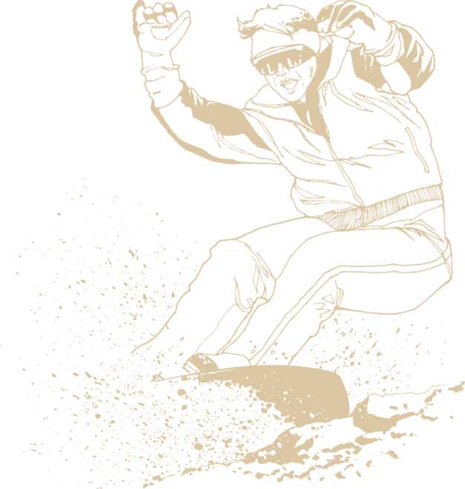
Factors That Affect Body Heat Loss
w Body size and composition
w Air temperature
w Wind chill
w Water immersion (3-5 x faster heat loss)

Slide 10
Body Weight, Height, Surface Area, and Surface Area/Mass Ratios for an Average-Sized Adult and Child
Surface Area/mass Person Weight(kg) Height (cm) area (cm²) ratio
Adult 85 183 210 2.47
Child 25 100 79 3.16
The higher the surface area to body mass ratio, the greater the rate of heat loss, i.e., the smaller the person, the fast he/she loses heat. Question: why does a shrew need to eat 16 times its body weight every day?

Slide 11
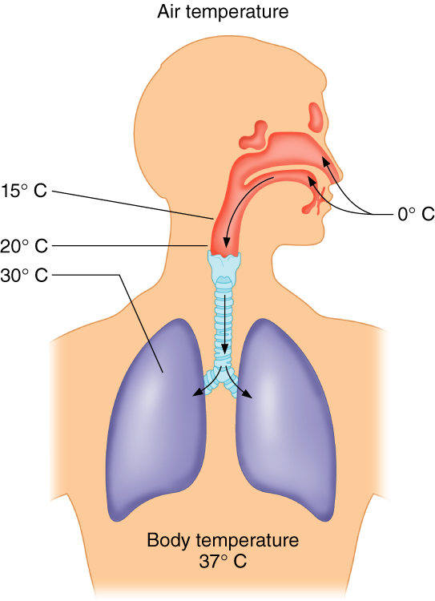
WARMING OF INSPIRED AIR

Slide 12
Hunting Reflex
Intermittent vasodilation in the hands and feet to maintain health of peripheral tissues by sending warm (nutrient rich) blood to them.
Gasping Reflex
Sudden disappearance syndrome following immersion in cold water
Inspiratory gasp, hyperventilation, tachycardia, hypertension

Slide 13
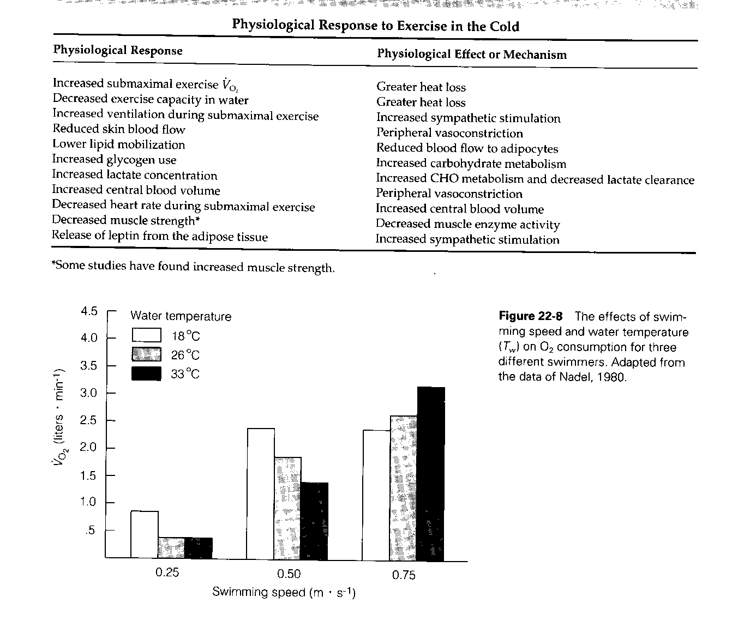
(also non shivering thermogenesis)
Cardiac arrhythmias are increased in the cold due to increased afferents to hypothalamus, Cardio control center, increased epi
Eventually central blood volume decreases due to plasma sequestration, inadequate fluid intake, cold diuresis

Slide 14
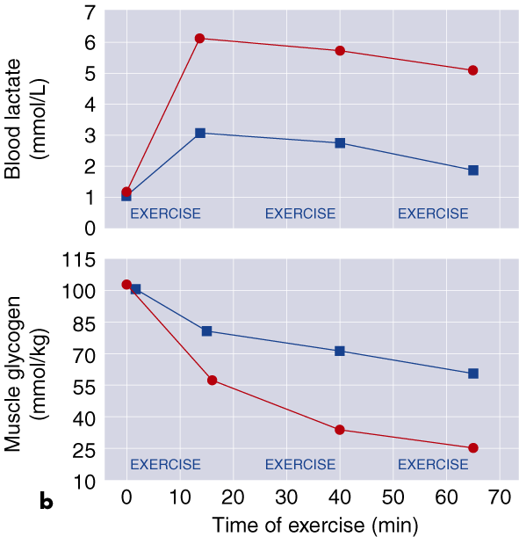
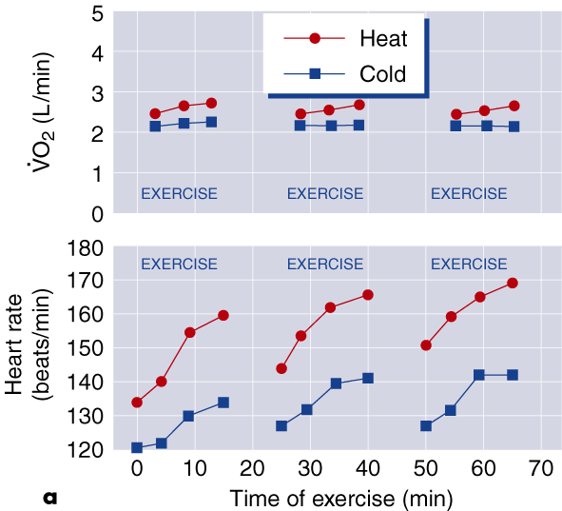
EXERCISE IN HEAT AND COLD

Slide 15
ی

Slide 16
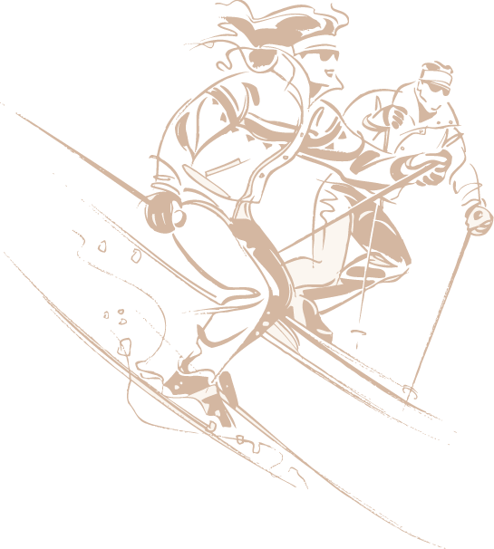
Responses to Exercise in the Cold
w Muscles weaken and fatigue occurs more rapidly
w Susceptibility to hypothermia increases
w Exercise-induced FFA mobilization is impaired due to vasoconstriction of subcutaneous blood vessels
w Shivering or Pre-shivering muscle tone may decrease
muscle efficiency, increase the metabolic cost of exercising

Slide 17

Health Risks of Exercise in the Cold
w Ability to regulate body temperature is lost if T_{body} drops below 34.5° C (94.1° F).
w Hypothermia causes heart rate to drop, which reduces cardiac output.
w Vasoconstriction in the skin reduces blood flow to skin, eventually causing frostbite.

Slide 18
Acclimatization
Delayed shivering in those exposed to several weeks of cold temps
  ↑Thyroid hormones
  ↑ Sensitivity to norepinephrine
  ↑ Uncoupled oxidative phosphorylation
  ↑ Leptin from adipose, ↑ SNS activation
  ↑ Skinfold thickness
  ↑ Foot/hand thermoregulation
  ↑ Ability to sleep
  Physical conditioning improves cold responses
Will cold adaptation occur if done while exercising?

Slide 19
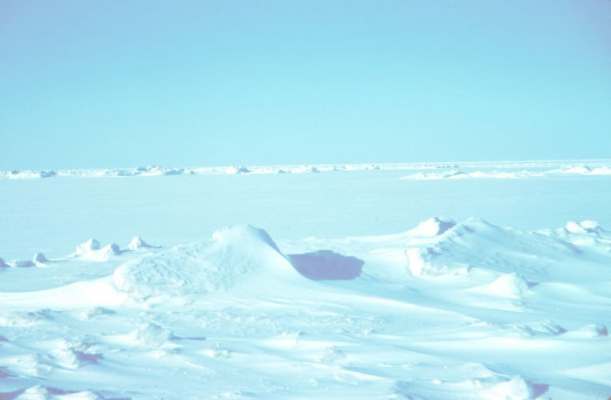
Exercise In Cold
cold core temperature during exercise is rare except when survival is at stake
  Protective clothing and high metabolism of exercise usually prevents drop in core temp
Work, however, has a lower metabolic output, long hours and may create an increased risk in cold environments
Movement in cold
  Numbing of exposed flesh
  Cumbersome protective clothing
Manipulation with hands difficult

Slide 20
Exercise In Cold
Clothing-layers and breath ability important
  Must balance insulation value with heat production of exercise
  Additional clothing after exercise important
  Metabolism drops, heat loss remains high
Shivering increases metabolic costs
  Increases perception of effort
  May also impair movement patterns
  Agonist and antagonist contract

Slide 21
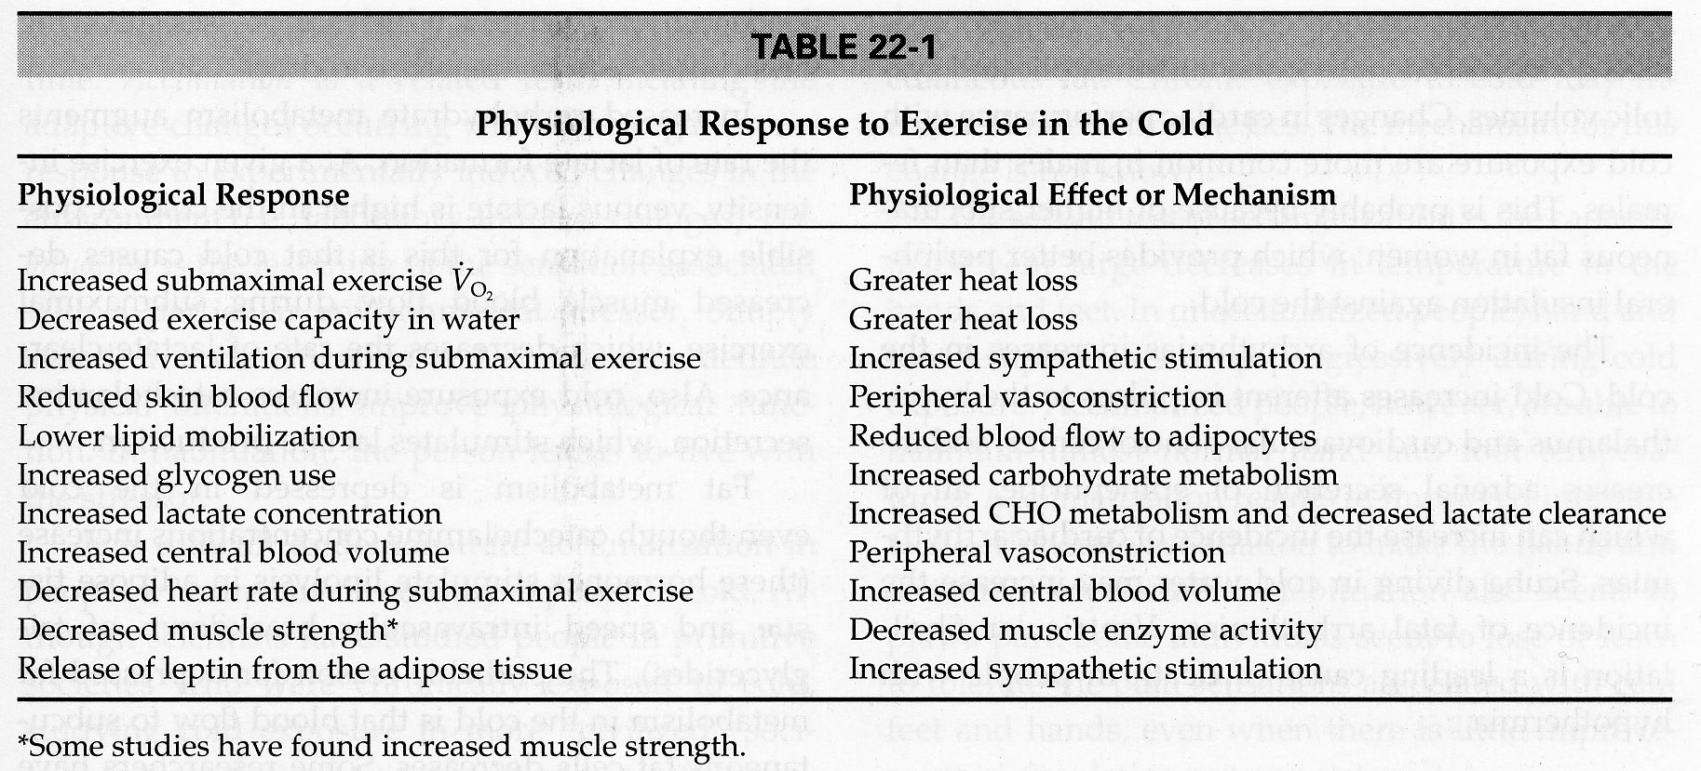
CV responses in Cold
O₂ consumption
  VO₂ max - unaffected by cold
Submax VO₂ increases at lower intensities (*work*)
  Due to higher heat loss
    Inc skin and ms blood flow during exercise in any temperature
    Greater thermal gradient in the cold results in greater heat loss
  Wet clothing in wind - 15-20% higher VO₂ requirements
Table 22-1 - exercise in cold

Slide 22
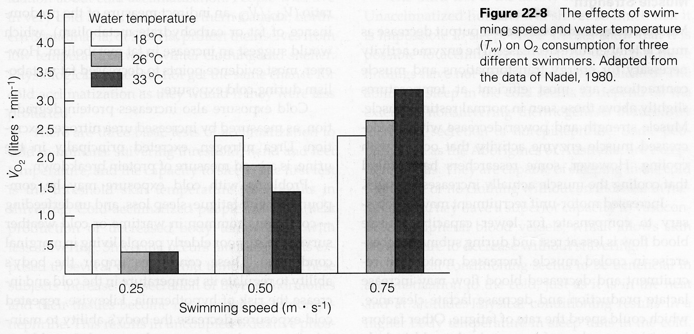
CV responses in Cold
Shivering - Inc VO₂ utilization
  May also be increase in non-shivering thermogenesis - due to inc catecholamines (stress) and leptin
Swimming in cold water
  Reduced VO₂ peak at higher intensities- fig 22-8

Slide 23
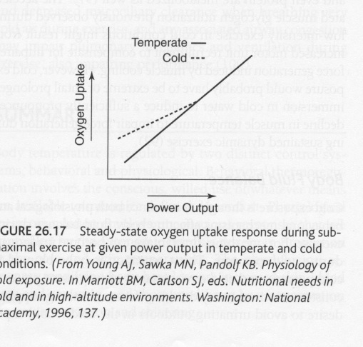
Exercise in Cold
Advanced Exercise Physiology, ACSM, 2006

Slide 24
Exercise in Cold
Exercise can partially replace heat production of shivering during cold
  Peripheral vasodilation with exercise - reduces insulation in body
  Exercise followed by cold exposure - higher threshold for vasoconstriction and shivering
Ventilation
  Inc ventilation - especially with sudden exposure - gasping reflex
  Hyperventilation, tachycardia, peripheral vasoconstriction, hypertension
  Reduced blood CO₂ - vasoconstriction in brain - confusion, unconsciousness

Slide 25
Exercise in Cold
Heart
  Cold - peripheral vasoconstriction - Inc central blood volume - inc BP
  Arrythmias - increase in cold
  Inc afferent impulses to hypothalamus and cardiovascular control center
  Increase adrenal epinephrine
  Ventricular fibrillation - leading cause of death in people with hypothermia

Slide 26
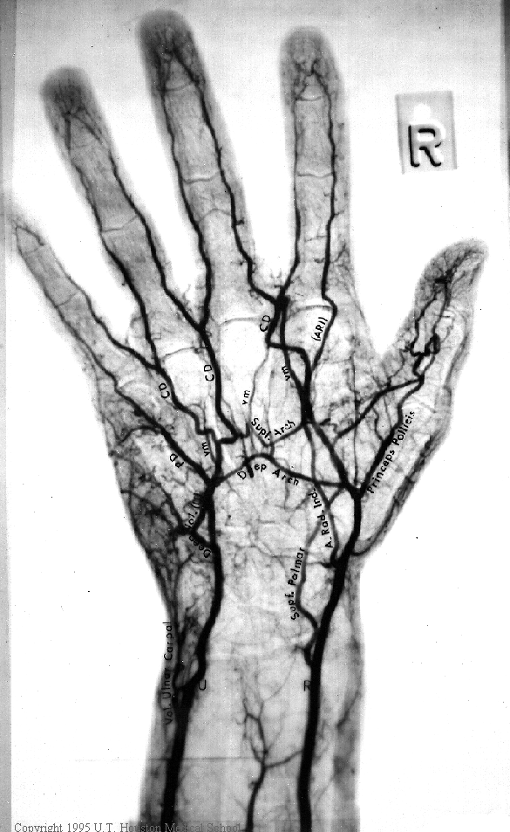
What happens to our hands in the cold
In the hand, blood flow is regulated by the AVA’s (Arteriovenous Anatomoses)
  Body is warm: AVA’s OPEN
  Blood flows in large quantities from the arteries through the AVA’a to the superficial veins
  Body cools: AVA’s CLOSE
  Blood flow is drastically reduced due to increased sympathetic activity
The remaining flow will return to the body core through deep veins, which are located close to the arteries

Slide 27
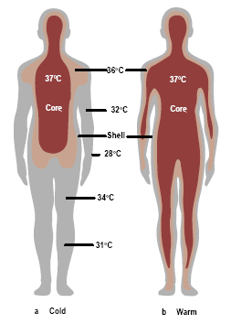
Physiological Amputation
Due to reduced blood flow, very little heat input to the hand remains
Essentially the same effect as occlusion

Slide 28
Cold Exposure
Muscle strength
Muscle strength and peak power decrease as muscle temp decreases - dec enzyme activity
  May require increase motor unit recruitment to compensate for reduced output
  May also see reduced muscle blood flow
  Combine to increase lactate production and reduce its clearance - early fatigue

Slide 29
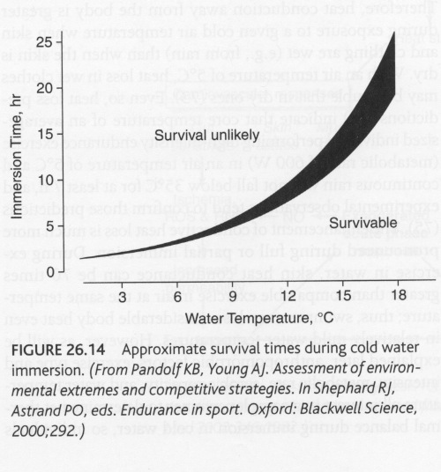
Cold Exposure
Advanced Exercise Physiology, ACSM, 2006

Slide 30
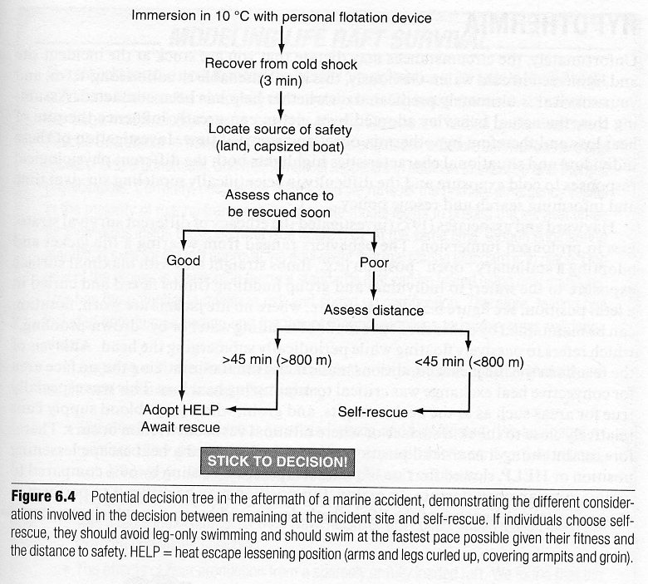
Cold Exposure
Advanced Environmental Exercise Physiology, Human Kinetics, 2010

Slide 31
Cold Exposure
Endurance work with the hands show the best performance at a muscle temp of 28 ºC - decrements below this temp
Max power and contraction speed requires an optimal temperature of 38 ºC
Manual dexterity
  Reduced with decreased temperature
  Dec nerve conduction velocity (afferents and efferents)
  joint stiffness - plays major role
  Observe decrease in manual dexterity below skin temp of 20 ºC (27 ºC intra-articular temperature
  Strong decrease below 15 ºC skin (24 ºC intra-articular temperature

Slide 32
Cold Exposure
Metabolic Changes
Increased use of carbohydrates during exercise in the cold
  Muscle glycogen reduced faster in light exercise - augments increase in lactate
  Prolonged exposure - hypoglycemia
    Suppresses shivering (threshold -.5 Celsius lower
    Accelerates hyopthermia
Fat metabolism depressed even with catecholamine rise
  may be due to reduced subcutaneous circulation
These problems are compounded by fatigue, sleeplessness and underfeeding

Slide 33
Acclimatization to cold
Shivering threshold
Maintain temperature without shivering, or with less shivering
  Experiment - three week exposure - inc thyroid hormone - tissues more sensitive to Nor epinephrine and Epinephrine
  Uncoupled ox phosphorylation
  Heat released without ATP formed
  Leptin - released from Adipose
  Stimulates Sympathetic NS
Sleeping Ability in the cold - Depends on non shivering thermogensis
  Aborigines (Australia) - vasoconstriction of periphery - sleep in cold without covering
Temperature of hands and Feet
  Unacclimatized - temperature decreases progressively
  Acclimatization - temperature maintained
  Intermittent vasodilation in periphery
    Hunting response - CIVD (cold induced vasodilation)
  Habituation as well, become more tolerant

Slide 34
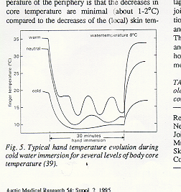
At a certain skin temperature, AVA’s in the hand open and blood flows through the hand increasing hand temperature. Once hand temperature increases, AVA’s close
- cyclic behaviour
Onset of CIVD at a skin temperature of approx. 20ºC
Warm core = greater levels of CIVD (cold induced vasodilation)
Cold core = eliminates effects of CIVD

Slide 35
Hypothermia
Core Temperatures
Mild - 32-35 ºC
Moderate - 28 - 32 ºC
Severe - below 28 ºC
Hypothalamus ceases to control body temp at extremely low temperatures (< 30 ºC)
  CNS depressed
  Lose ability to shiver
  Sleepiness - - -> coma
  Reduced metabolic rate --> dec temperature

Slide 36
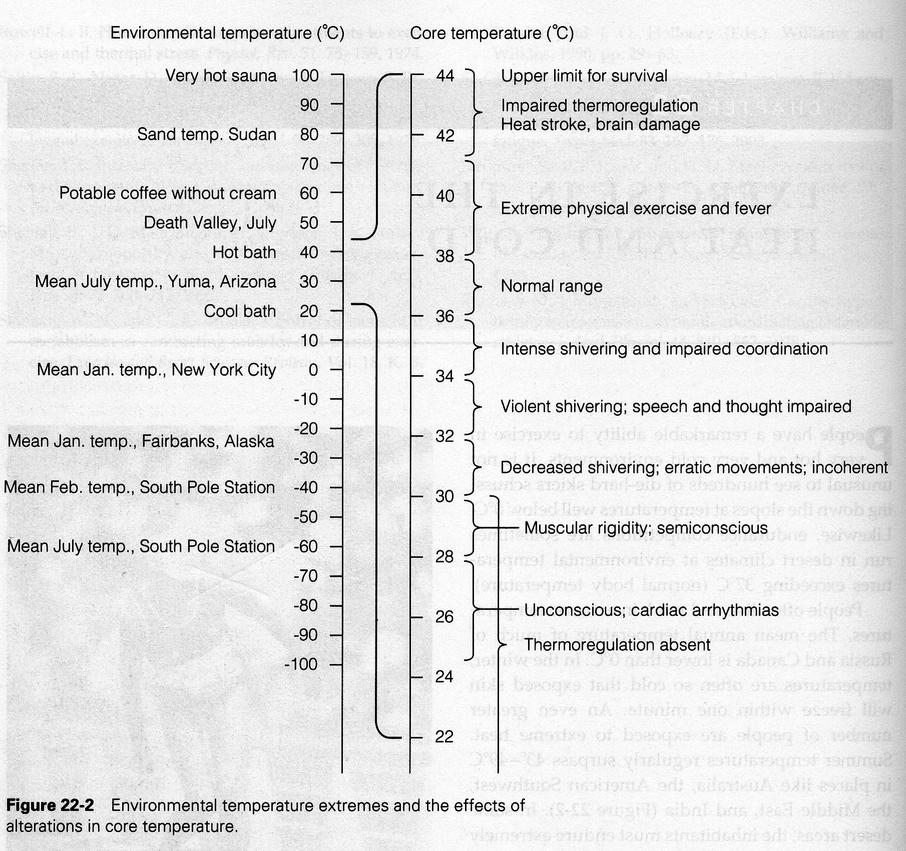

Slide 37
Hypothermia
Cardiovascular
  Central blood volume decrease
  Exacerbated by
    inadequate fluid intake
    Plasma sequestration
    Cold diuresis
Hypothermia is possible during endurance exercise events
  Heat loss greater than production
  Glycogen depletion - blood glucose declines, CNS functioning declines

