Slide 1
Managing jet lag: Some of the problems and possible new solutions
Josephine Arendt

Slide 2
jet lag
Jet lag is due to the misalignment of the internal circadian clock(s) with external time cues.
It is formally described as circadian desynchrony, or a mismatch between the timing of the internal circadian (circa24 h)clock(s) and the external environment.
After an abrupt shift in time cues such as after time zone change the circadian system adapts slowly to realign with the new schedule, approximately one day for each hour of time zone change, faster westwards, with different components of the system adapting at different rates (internal desynchrony).

Slide 3
Introduction
The perceived manifestations are variable from one individual to another, with number of time zones crossed, with direction and timing of flights and probably with seasons.
However, the major complaints are poor sleep, daytime fatigue and poor performance.
Travelling eastwards, short sleep and long sleep latency are common, travelling westward short sleep and early wake up are manifest.

Slide 4
Introduction
Poor alertness and fatigue during daytime are attributed partly to:
sleep deprivation
concomitant presence of night time rhythm physiology
metabolism and the peak of melatonin secretion
Olympic year of 2008 with many athletes travelling over large numbers of time zones
One of the earliest descriptions of the effects of jet lag on physical performance concerned American baseball players who performed significantly worse when playing away over an eastward time zone transition

Slide 5
Circadian timing system
human physiology and behavior are normally aligned with the 24 h day such that we are alert and active during the daylight hours and asleep during the dark phase of the day.
However, for most people jet lag symptoms resolve in time as the circadian system adapts to the new time cues, whereas rotating shift work schedules lead to frequent desynchrony with symptoms which persist, and also become worse with age.

Slide 6
Chronobiotic
A substance that adjusts the timing of internal biological rhythms, or more specifically a substance that adjusts the timing of the central biological clock.
Acrophase:
The time of the peak of a rhythm, usually the peak time of the best-fitting mathematical function approximating the data.
Biological circadian rhythms are internally generated and, in humans, have a period which is usually slightly longer than 24 h, other terms include circannual: about 1 year, ultradian or pulsatile: with a period shorter than 20 h.

Slide 7
Period
The duration of one complete cycle of a rhythmic variation, also known as tau.
On average human endogenous period (or tau) is about 24.2 h according to controlled experiments.
A short tau is associated with morning diurnal preference (larks) and a long tau with evening preference (owls) in a normally entrained environment.
every cell in the body possesses a self-sustaining oscillator(s) or clock(s), this symphony of oscillators is coordinated by the central circadian pacemaker situated in the supra-chiasmatic nuclei (SCN) of the hypothalamus.

Slide 8
Period
Removal of the SCN in mammals leads to the loss of virtually all circadian rhythms, and the SCN itself shows long term self-sustained oscillations of circa 24 h in metabolism and electrical activity in vitro.

Slide 9
Resetting human circadian rhythms
Because human tau is not exactly 24 h the circadian system has to be reset daily or at least frequently in order to maintain 24 h clock time.
The factors which synchronize/entrain or reset the clock are known as zeitgebers.
The most important by far is the alternation of light and darkness.
Blind people
Other zeitgebers include scheduled sleep and activity, hard exercise, meal timing, and some pharmacological treatments such as the hormone melatonin.

Slide 10
zeitgebers
All zeitgebers modify clock timing according to a phase response curve.
For example, light in the ‘biological’ early morning will advance the circadian system whereas light in the late biological evening will delay the circadian system.
‘Biological night’ is often defined as the time during which the hormone melatonin is secreted.

Slide 11
Melatonin and light

Slide 12
Individual variability when adapting to phase shift/time zone change
The faster the circadian system adapts to the new time zone the shorter the symptomatic period.
Light exposure during biological night will improve alertness and hasten adaptation if correctly timed.
Concomitant suppression of endogenous melatonin may contribute to the resetting effects of light.
It is of interest to note that possibly the most ancient advice given to time zone travelers was to time their behaviour, meals, etc., to be in synchrony with the new time zone as soon as possible.

Slide 13
Numerous attempts have been made to generate instructions as to timing of light exposure and (equally important) light avoidance after landing at destination.
See, for example, Midnight Sun. Likewise timed treatment with melatonin as a chronobiotic has received much attention.
American Academy of Sleep Medicine has recommended the use of melatonin for jet lag.

Slide 14
Recently the melatonin metabolite 6-sulphatox-ymelatonin has proved to be the best rhythm marker in field studies since it is less distorted by factors such as meals, exercise and sleep (less ‘masked’) than other markers.

Slide 15
Travel fatigue
Symptoms:
• General fatigue.
• Disorientation and increased likelihood of headache.
• Travel weariness.
Causes:
Disruption of sleep and normal routine, difficulties associated with travel (checking in, baggage claim, customs clearance), and
general dehydration.

Slide 16
Jet lag
Symptoms
Poor sleep during the new night-time, including delayed sleep onset (after eastward flights), early awakening (after westward flights), and fractionated sleep (after flights in either direction).
Poor performance during the new daytime at both physical and mental tasks.
Negative subjective changes. These include increased fatigue, frequency of headaches and irritability, and decreased ability to concentrate.
Gastrointestinal disturbances (indigestion, the frequency of defecation, and the consistency of the stools) and decreased interest in, and enjoyment of, meals.

Slide 17
Cause
Slow adjustment of the body clock to the new time zone, so that daily rhythms and the internal drive for sleep and wakefulness are out of synchrony with the new environment.
Travel fatigue is associated with any long journey; jet lag generally needs three or more time zones to be crossed rapidly.

Slide 18
Advice for coping with travel fatigue
Before the journey
Plan the journey well in advance.
Arrange for any stopover to be comfortable.
Arrange documentation, inoculations, visas, etc.
Make arrangements at the destination.
During the journey
Take some roughage (eg, apples) to eat.
Drink plenty of water or fruit juice (rather than tea, coffee, or
alcohol).

Slide 19
On reaching the destination
Relax and rehydrate with non-alcoholic drinks.
Take a shower.
Take a brief nap, if needed, but not enough to stop getting to sleep at night.

Slide 20
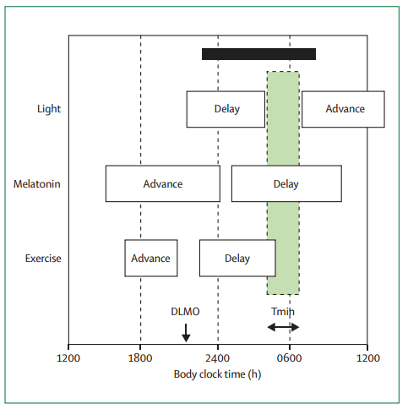
Phase shifts (advances and delays) of the body clock produced by light, melatonin ingestion, and exercise at different times during the day

Slide 21
The association between jet lag and its symptoms

Slide 22
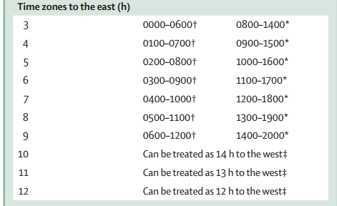
Recommendations for the use of bright light to adjust body clock after time-zone transitions

