Slide 1
Advanced Environmental Exercise Physiology
Mohsen Avandi

Slide 2
Introduction
increasing advocacy of the importance of physical activity
continuing advances in technology
equipment previously limited to specialized occupations such as commercial diving, piloting, and professional mountaineering is now within the reach of keen amateurs or available for recreational pursuits.(space tourists), (SCUBA)

Slide 3
INTERDISCIPLINARY DESIGN ISSUES
That is, scientists interested in the field must have a firm grounding in multiple physiological systems along with their interactions.
cardiovascular system, but also the muscular, bone, neurovestibular systems
nature of each environment
environmental physiology is in the close collaboration with engineers and ergonomists to develop better and safer equipment

Slide 4
COMMON TERMINOLOGY
Adaptation
it can be defined simply as changes to the human system induced by exposure to an environmental stressor.
both genotypic (changes in genetic factors) and phenotypic (changes in physiology) adaptations.

Slide 5
COMMON TERMINOLOGY
Habituation
refers to a reduction in the behavioral perception of a repeated stimulation.
A example is the reduced feeling of pain and discomfort with repeated cold immersion of the hand despite no change in actual finger temperatures.

Slide 6
COMMON TERMINOLOGY
Acclimation
An example is training for a competition in a hot environment by exercising inside a hot environmental chamber for an hour a day.

Slide 7
COMMON RESEARCH THEMES
Acute exposure
Chronic exposure or adaptation
Performance issues
Individual variability in response

Slide 8
Fundamentals of Temperature Regulation

Slide 9
Introduction
Humans have proven to be one of the most adaptable vertebrate species in the history of the planet
Using this combination of behavioral and physiological responses, humans are able to maintain a reasonably constant core body temperature

Slide 10
Introduction
Behaviorally:
alter the environment as necessary, by such means as the creation of clothing and shelter and the use of tools.
A challenge to the ability to maintain stable thermal balance is not just the stress imposed by the external environment but also the extreme variations in metabolic heat generation, as >70% of metabolic energy is converted to heat in the course of mechanical movement.

Slide 11
Thermoregulation
thermoregulation becomes an intricate balance between external and internal heat sources to ensure that the body does not become hyper- or hypothermic.
Heat exchange is typically quantified in watts, where 1 W = 1 joule per second.
This heat production can range from 70 to 100 W in resting adults and 280 to 350 W at mild walking pace to >1000 W during heavy exercise.

Slide 12
HEAT BALANCE EQUATION AND FACTORS AFFECTING HEAT EXCHANGE
S=M±W_{k} ±R±C±K-E (w/'m⁻²)
If is important to note that heat exchange can be either positive or negative for each individual component except for metabolism, depending on the gradient between the body and the environment.
The one exception is evaporation, which is defined as the change of water from liquid to vapor phase and can only be a source of heat dissipation in humans.

Slide 13
HEAT BALANCE EQUATION AND FACTORS AFFECTING HEAT EXCHANGE
M is the metabolic heat production. This is typically indirectly determined by the oxygen uptake.
W; is the external work performed by the individual and is typically subtracted from the total heat production.
R, the radiative heat exchange, refers to transfer of heat energy via electromagnetic waves between the environment and the human body.

Slide 14
HEAT BALANCE EQUATION AND FACTORS AFFECTING HEAT EXCHANGE
In addition, the radiation field surrounding an individual is dependent upon environmental conditions such as shade and cloud cover, time of day, and time of year, as well as altitude.
Furthermore, radiative heat exchange is dependent upon individual factors, such as posture and the surface area exposed to the heat source and the amount and reflectivity or absorbance of the clothing worn.

Slide 15
HEAT BALANCE EQUATION AND FACTORS AFFECTING HEAT EXCHANGE
C and K
Typically, conduction denotes direct contact with a solid surface such as ice or cold metal, while convection more commonly refers to contact with fluids or gases like water or air.
water having 27 times greater heat conductivity than air; this explains why 15 °C air temperature is comfortable but 15 °C water immersion is very cold and can quickly induce hypothermia.

Slide 16
HEAT BALANCE EQUATION AND FACTORS AFFECTING HEAT EXCHANGE
Similarly, direct contact of the bare hands with cold metal (high conductivity) can produce freeze burns due to high localized heat loss, while wood or rubber at the same temperature does not damage skin as rapidly.
An additional consideration with convective heat exchange is the speed of movement of the fluid against the body surface.

Slide 17
HEAT BALANCE EQUATION AND FACTORS AFFECTING HEAT EXCHANGE
We all know that convection ovens cook much more rapidly than conventional ovens, and that this is due to the addition of a fan that circulates the hot air in the oven and accelerates heat storage into the food.
water is in a river or is moving in a current, the warm water layer is rapidly removed and replaced with cold water, maintaining the high thermal gradient and accelerating heat loss.

Slide 18
HEAT BALANCE EQUATION AND FACTORS AFFECTING HEAT EXCHANGE
two general categories consisting of dry (radiative, conductive, convective) and wet (evaporative) pathways.
Dry heat exchange is dependent on the temperature gradients within the organism (e.g., core to periphery) and also between the organism and the environment.

Slide 19
HEAT BALANCE EQUATION AND FACTORS AFFECTING HEAT EXCHANGE
Unlike what happens with the other methods of heat exchange, the potential for evaporative heat loss is determined primarily by the water vapor pressure gradient between the body surface and the environment.
both air temperature and relative humidity need to be reported to accurately quantify water vapor pressure and environmental conditions in the heat.

Slide 20
Respiratory Heat Exchange
In addition to the skin, the respiratory system is a major avenue for conductive or convective and evaporative heat exchange, as the ventilation rate can exceed 150 L – min during exercise.

Slide 21
Effects of Clothing
The wearing of protective clothing can significantly alter evaporative heat transfer by impeding the movement of water vapor across the various layers, building a humid microenvironment and raising the water vapor pressure next to the skin.
The size and nature of this microenvironment depend on the amount of surface area coverage.

Slide 22
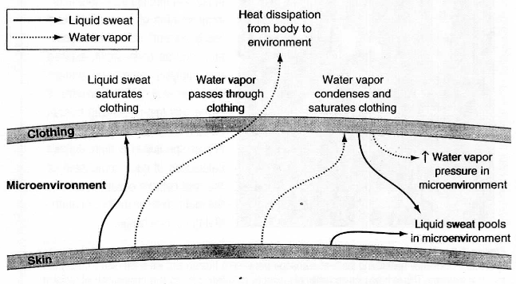
Effects of Clothing

Slide 23
Heat Stress

Slide 24
DIRECT EFFECTS OF HYPERTHERMIA
studies demonstrating that exercise tolerance is lower even in 20 °C compared to 10 °C temperatures. the actual mechanism or mechanisms by which impairment or exhaustion occurs remain unclear.

Slide 25
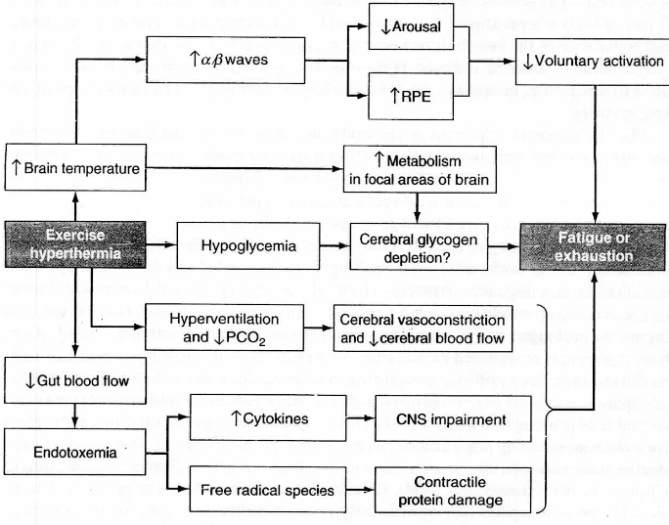

Slide 26
Neuromuscular Impairment
Overall, while mild muscle warming or warm ambient temperatures may facilitate force generation, studies eliciting high levels of hyperthermia (above approximately 38,5 °C Tom) via exercise in the heat have generally supported an impaired level of maximal force generation and muscle activation.

Slide 27
As seen in figure 3.2, both maximal voluntary contraction (MVC) and central activation of the knee extensors, a measure of voluntary recruitment of the muscles, progressively decreased with increasing rectal temperature.
The site of impairment along the neuromuscular pathway remains unclear, suggesting that it is beneath the level of the motor cortex.

Slide 28
Brain Arousal and Central Drive
A reduction in electroencephalographic (EEG) frequency has been reported in primates with passive heating, and evoked brain signals from soldiers after exercise in the heat also demonstrated a slowing of responses to stimuli.

Slide 29
Cerebral Blood Flow
While decreased mental arousal or activity may be an end result of hyperthermia, these changes in EEG activity may also be related to changes in blood flow dynamics within the brain.
Hyperthermia results in a decrease in the cerebral blood flow velocity during prolonged submaximal exercise in humans.

Slide 30
Heat Shock Protein Up regulation
one of the key immunological responses appears to be the production of various heat shock proteins (HSPS) with exposure to hyperthermia.
Heat shock proteins are a class of proteins found across a wide range of organisms, are classified according to their molecular weight (e.g., HSP 70, HSP 90), and appear to perform multiple functions in many physiological systems.

Slide 31
Heat Shock Protein Up regulation
their up regulation can be stimulated by many stressors apart from heat stress, including exercise, hypoxia, toxins, infections, and inflammations.
they play a significant role in heat adaptation.

Slide 32
Neurohumoral Factors
Disturbances in cerebral neurotransmitter levels, especially serotonergic activity, have long been implicated in central fatigue.
few researchers have examined whether hyperthermia alters serotonin levels in the brain.
If 5-HT levels increase, that could contribute to the elevated perceived effort, as well as to the reduction in work rate or exhaustion (or both) often observed during hyperthermia

Slide 33
Neurohumoral Factors
Dopamine is another neurotransmitter that is a candidate for modulating hyperthermic fatigue, since it plays a role in the control and initiation of movement and may also reduce 5-HT production.
Nybo and colleagues (2003) reported that dopamine levels were elevated in both arterial and jugular venous samples during hyperthermia

Slide 34
Endotoxemia
During severe exercise-induced hyperthermia above 40 °C, at levels associated with heat exhaustion or heatstroke, blood flow to the GI tract is markedly reduced, and this may compromise the integrity of the intestinal walls.
As a result, the leak-age of lipopolysaccharides (endotoxins) into the circulation can occur during severe exercise-induced hyperthermia.

Slide 35
endotoxemia
endotoxemia can trigger a cascade of detrimental physiological responses including a cytokine-mediated rise in hypothalamic set point, which can induce a fever-like situation and accelerate heat storage and heatstroke.
cytokines have been implicated as factors that influence fatigue at the level of the central nervous system in infections like the Epstein-Barr virus or in diseases such as chronic fatigue syndrome.

Slide 36
endotoxemia
Although few data have been reported, there is some evidence that contractile proteins are damaged by the endotoxemia-induced production of free radical species.

Slide 37
Postexercise Thermoregulation
during postexercise passive recovery in warm environments, core temperature remains elevated by 0.5 to 1 °C above baseline values for a sustained period, 60 min or longer.
In contrast, heat production, as measured by oxygen consumption, decreased rapidly (<l0 min) to baseline values. Furthermore, the primary conductive and evaporative heat dissipation avenues also rapidly returned to baseline; this included a drop in forearm blood flow, skin temperatures, and sweating rates.

Slide 38
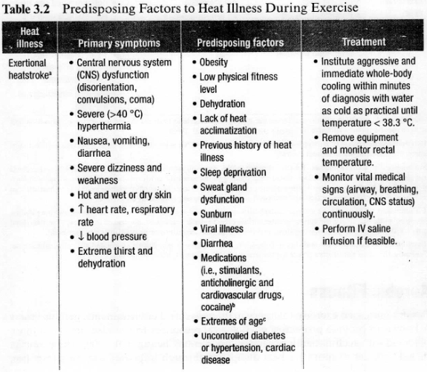

Slide 39
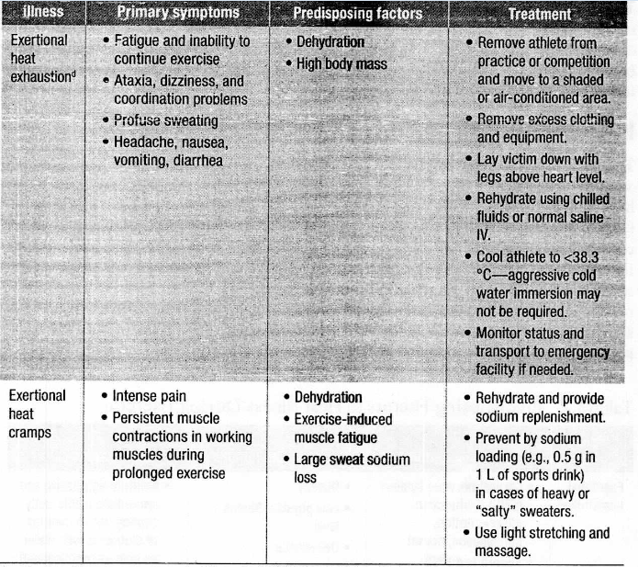

Slide 40
Heat Acclimation
heat acclimation generally elicits a lower resting core temperature, greater plasma volume, and an increased sweating rate.
In healthy adults, the primary stimulus for heat acclimation appears to be a sustained elevation in core temperature of 1 to 2 °C for 60 to 90 min over4 to 10 days.

Slide 41
Maturation
Maturation and age may influence an individual’s ability to thermoregulation during rest or exercise in the heat.
Children have a larger surface area-to volume ratio than adults.
While this is advantageous in temperate ambient environments by increasing the rate of radiative and conductive heat transfer, these benefits are negated with exposure to a hotter environment where the thermal gradient for exchange is smaller or toward positive heat gain by the body.

Slide 42
Maturation
evaporative heat dissipation is also attenuated in children, with sweating response and sweating rate gradually increasing from childhood through adolescence and into adulthood.

Slide 43
COOLING STRATEGIES
Precooling
Precooling using liquid cooling garments or cooling hoods, and the use of air conditioning, seem to attenuate symptoms and may improve some measures of muscle strength.
Especially interesting were our initial findings that head and neck precooling significantly decreased perceived fatigue and also increased distance covered during a 6 min walk test, suggesting that it may be a useful method of increasing exercise capacity and the abilities to perform activities of daily living in this population.

