Slide 1
EXERCISE FOR YOUTH
Mohsen avandi
Semnan University

Slide 2
EXERCISE FOR YOUTH
Research conﬁrms that adults who exercise regularly improve their overall health and reduce their risk for chronic conditions such as cardiovascular disease, diabetes, and stroke. A logical conclusion, therefore, is that regular physical activity can also improve the health status of children and adolescents and possibly prevent the development of chronic conditions.

Slide 3
EXERCISE FOR YOUTH
In fact, statistics show that one third of Americans under the age of 18 are physically unﬁt according to measurements of maximal oxygen uptake, or VO2max.
Moreover, boys tend to become ﬁtter as they get older; whereas, girls tend to become less ﬁt as they age.
Because risk factors tend to persist throughout life, children and adolescents who are at high risk tend to remain at risk as they age.

Slide 4
ANATOMICAL AND PHYSIOLOGICAL DIFFERENCES BETWEEN ADULTS AND YOUTH
GROWTH AND DEVELOPMENT:
The bones, muscles, and joints of children and adolescents are growing and developing at a rapid rate. Long bones grow in length because of the presence of the epiphyseal plate.
These growth spurts result in weight gain, height increases, and an altered center of balance that can interfere with biomechanical properties.
Ultimately, this can affect performance in physical activity and sports.

Slide 5
NEUROMUSCULAR CONTROL
A nerve cell called a motor neuron extends from the central nervous system to one or more muscle ﬁbers within a given muscle.
During growth and development, communication between motor neurons and their muscle ﬁbers gradually improves.
Impulses propagate more rapidly along the neuron as myelin sheath develops.

Slide 6
RESPONSE TO EXERCISE
Children and adolescents have a different physiological response to exercise than adults. For instance, they require 20% to 30% more oxygen per unit of body mass when running at a given pace.
energy expenditure and VO2max are higher during endurance activities such as running or walking.
Their less efﬁcient respiration is likely due to a shorter respiratory cycle caused by a higher respiratory frequency.
Though a child’s VO2max improves slightly with training, improvements are minimal.

Slide 7
RESPONSE TO EXERCISE
It might be because of the hormonal ﬂuctuations that occur at puberty.
children have a lower stroke volume both at rest and during exertion.
Furthermore, heart rate tends to be higher at rest and during exercise in this group; therefore, maximal heart rate cannot be accurately determined by subtracting age from 220 for anyone under the age of 16.
training heart rate for this group should reach 170 to 180 bpm to achieve even slight improvements in cardiorespiratory functioning.
Lastly, blood pressure at rest and during exertion is lower in children because of their smaller surface area.

Slide 8
REGULATION OF BODY TEMPERATURE
Sweat glands play a crucial role in maintaining body temperature.
Children produce more heat per kilogram of body weight during activity than adults; however, they do not sweat as efﬁciently.
They do have more sweat glands than adults, but their glands are underdeveloped and not as active as mature glands.
Additionally, their sweating mechanism is not activated until they reach a much higher core body temperature than adults.

Slide 9
REGULATION OF BODY TEMPERATURE
Children are generally more vulnerable to dehydration than adults are. When dehydrated, the body has difﬁculty eliminating body heat and is therefore prone to heat illness—especially during intermittent activity, the type of activity common in this population.
If children are exercising for a prolonged time period, ensure that they consume ﬂuids every 15 to 20 minutes to facilitate efﬁcient heat dissipation and better performance.

Slide 10
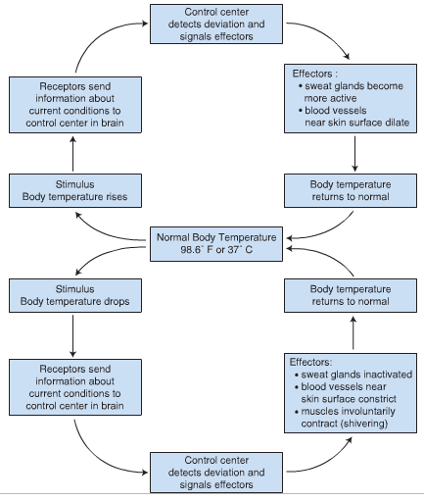
Homeostasis of body temperature through negative feedback

Slide 11
OVERWEIGHT AND OBESITY AMONG CHILDREN
According to the Centers for Disease Control, 16% of those between the ages of 6 and 19 are overweight or obese with an additional 15% dangerously close to meeting the criteria for overweight.
Additionally, the obesity rate for children between the ages of 2 and 5 and adolescents between the ages of 12 and 19 is twice as high as it was 30 years ago. It is nearly three times as high for those between the ages of 6 and 11.

Slide 12
Factors Contributing to Overweight and Obesity
Both genetics and environmental factors contribute to the prevalence of overweight and obesity in children and adolescents.
For example, genes determine the body’s metabolic rate. In other words, they inﬂuence how the body stores and uses fat for fuel.
If one parent is obese, the child has a 40% risk of becoming overweight. And if both parents are obese, the child has an 80% chance of becoming obese.

Slide 13
Factors Contributing to Overweight and Obesity
Environmental factors, such as sedentary lifestyle and excess energy consumption, probably have the greatest inﬂuence on the prevalence of overweight and obesity among school-aged children.
Children consume large quantities of high kilocalorie, high fat foods and fewer fruits and vegetables.

Slide 14
PRECAUTIONS DURING EXERCISE
INCREASED CORE TEMPERATURE
INCREASED RISK FOR MUSCULOSKELETAL INJURY
INCREASED RISK FOR HYPOTHERMIA:
Because children have a large surface area relative to body mass, they lose large amounts of heat when exercising in water.

Slide 15
BARRIERS TO EXERCISE
lack of time is the number one barrier to exercise, particularly for girls.
Students report spending 4 hours or more on some days doing homework. Many have part-time jobs that occupy them on weekends. Others have family obligations that ﬁll their schedules. These responsibilities often interfere with activity.

Slide 16
BARRIERS TO EXERCISE
Self-consciousness about physical attributes and competency in activity tend to be the primary barriers for boys. If boys feel that they are too young, too small, too over-weight, or lacking skills for a particular activity, they tend to avoid it, Some fear failure.
Many adolescents prefer to work on computers, talk on cell phones, or watch television rather than participate in activity. In fact, they are “playing” football, “riding” bicycles, or “hitting” tennis balls on a TV or computer screen.

Slide 17
BARRIERS TO EXERCISE
Teens like to be a part of a group, so if their friends are playing sports, they also play sports. However, if their friends are playing video games or going out to parties, they choose these other activities.
other barrier to exercise is inaccessibility or cost.

Slide 18
BENEFITS OF EXERCISE
DECREASED RISK FOR OBESITY
INCREASED MUSCULAR STRENGTH AND BONE DENSITY
IMPROVED CARDIORESPIRATORY PERFORMANCE
IMPROVED PSYCHOLOGICAL FACTORS
DECREASED RISK FOR CHRONIC DISEASE

Slide 19
RECOMMENDATIONS FOR EXERCISE
EXERCISE TESTING:
In most cases, basic adult exercise testing guidelines apply to healthy children and adolescents, but response to exercise differs.
When exercise testing is war-ranted, however, familiarize the child with the testing protocol ahead of time. This alleviates fears and helps ensure accurate measures.
The treadmill test is the most appropriate means of exercise testing for young children because of its simplicity and because it accommodates various body sizes.

Slide 20
RECOMMENDATIONS FOR EXERCISE
Most physical education classes in schools use simple ﬁeld tests to assess the ﬁtness status of students. For cardiorespiratory ﬁtness, they perform the 1-mi walk-run; for muscular ﬁtness, they use the curl-up test and the pull-up or push-up test; for ﬂexibility, they use the sit and reach test; and for body composition, they take skin fold measurements. Additionally, they calculate BMI as an indicator for overweight or obesity.

Slide 21
EXERCISE PRESCRIPTION
5 minutes of light activity such as walking, jumping jacks, and stretching prior to increasing intensity to prepare the body for activity.
5-minute cool-down
Groups such as the American Heart Association and ACSM suggest that all children over the age of two receive 60 minutes of moderate-to-vigorous intensity physical activity each day.
The activity should be enjoyable and varied but does not necessarily have to be continuous.
In fact, children under the age of 12 tend to perform better with intermittent activities that change from vigorous intensity to moderate intensity back to vigorous intensity, so encourage it.

Slide 22
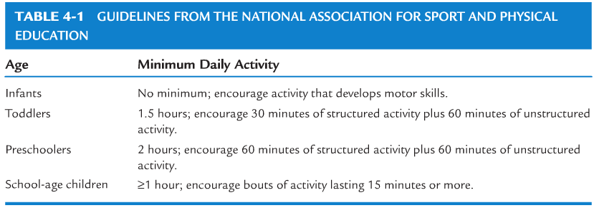
EXERCISE PRESCRIPTION
To ensure compliance, make the activities fun, nonthreatening, un embarrassing, and developmentally appropriate. Offer words of encouragement and support.

Slide 23
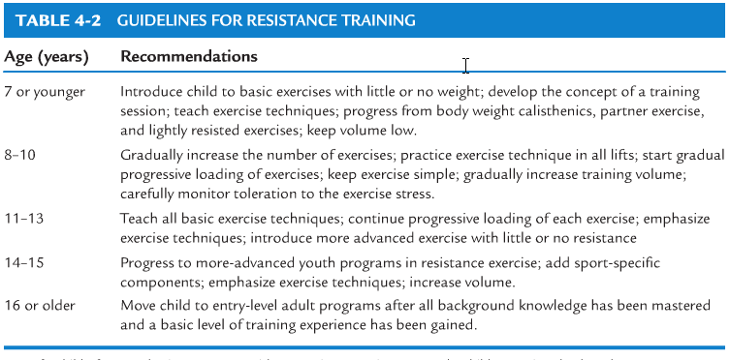
EXERCISE PRESCRIPTION

Slide 24
EXERCISE PRESCRIPTION
Encourage children to drink one to two 8-oz glasses of water before activity and provide them with water during activity to prevent dehydration.
Exercise in a cool environment.
Overweight children, however, might not initially be able to accumulate 60 minutes of daily activity.
Use light resistance with a greater number of repetitions. Have the child perform 8 to 15 repetitions to moderate fatigue and do not increase intensity until the child is able to perform the speciﬁed number of repetitions with proper form.

Slide 25
EXERCISE PRESCRIPTION
Emphasize activities that are enjoyable and not monotonous
Include both competitive and noncompetitive activities to meet the needs of different age groups and ability levels
Foster skills and abilities that develop conﬁdence
Promote interaction and coordination between the school and the community

Slide 26
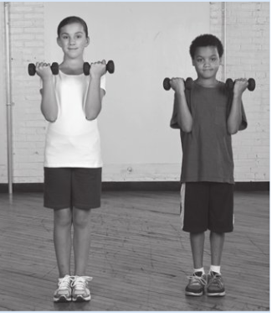
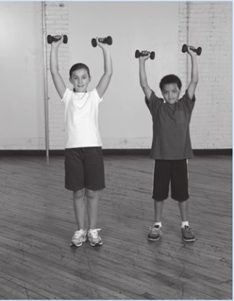

Slide 27
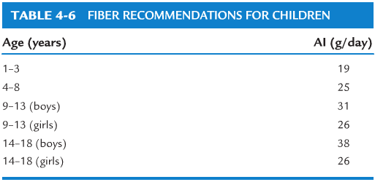

Slide 28
Thanks for Attention

