Slide 1
Growth and maturation
Chapter 1
Mohsen Avandi

Slide 2
INTRODUCTION
Paediatric exercise science examines the acute and chronic responses of the child and adolescent to exercise and/or physical activity.
Morphological parameters and physiological functions such as heart volume, lung function, aerobic power and muscular strength develop with increasing age and body size.

Slide 3
INTRODUCTION
Furthermore, physical fitness(e.g. muscular, motor and cardiorespiratory fitness) also changes with growth and maturation.
Therefore, variations in growth and maturation of a child can have profound effects upon aspects of physical activity, physical fitness and physical performance.

Slide 4
INTRODUCTION
The terms growth, biological maturation and development are often used synonymously in the paediatric literature.
Growth refers to changes in size of an individual, as a whole or in parts. As children grow, they become taller and heavier, they increase their lean and fat tissues, and their organs increase in size.

Slide 5
Changes in size are a result of three cellular processes
an increase in cell number, or hyperplasia,
an increase in cell size, or hypertrophy,
an increase in intercellular substances, or accretion.

Slide 6
Maturation
Maturation has been described as the process of being mature, or progress toward the mature state.
The process of maturing has two components, timing and tempo.
Maturation occurs in all biological systems in the body but at different rates.
Furthermore, the timing and tempo of maturity vary considerably among individuals, with children of the same chronological age differing dramatically in their degree of biological maturity.

Slide 7
Development
Here development refers to the processes of differentiation and specialization occurring during the prenatal life.
Life leading up to maturity is split into three stages:
the prenatal period,
childhood and
adolescence.

Slide 8
GROWTH
Different parts of the body grow at different rates and different times.
all tissues and systems follow four patterns of growth:
(1) neurological (e.g. brain and head),
(2) genital (e.g. reproductive organs),
(3) general (e.g. stature, heart size), and
(4) lymphoid (e.g. lymph glands, tonsils, appendix).

Slide 9
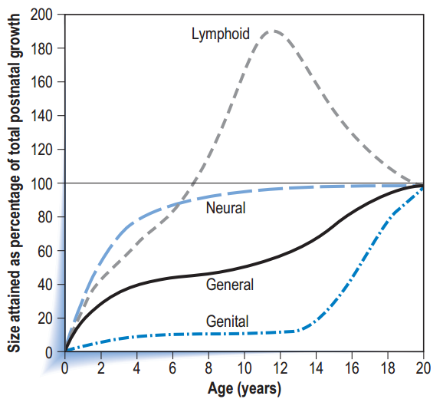
Scammon growth curves

Slide 10
Growth during childhood and adolescence
Growth during childhood and adolescence occurs distal to proximal. For example, the hands and feet experience accelerated growth first, followed by the calf and the forearm, the hips and the chest, and lastly the shoulders.
Most body dimensions, with the exception of subcutaneous adipose tissue and the dimensions of the head and face, follow a growth pattern similar to that of stature; however, there are wide variations in the timing of growth spurts.

Slide 11
Growth during childhood and adolescence
From childhood to adolescence, the lower extremities (legs) grow faster than the upper body (trunk). This results in sitting height contributing less to stature as age progresses.
Sex differences in leg length and sitting height are small during childhood.

Slide 12
Stature
Standing height or stature is a linear measurement of the distance from the floor, or standing surface, to the top of the skull and is the most widely used indicator of somatic growth because of its relative ease in measurement.
Stature is made up of sitting height (distance from the sitting surface to the top of the head) and leg length, or subischial length (distance between the hip joint and the floor).

Slide 13
Stature
The exact landmark of the hip joint is sometimes hard to locate so leg length is most often calculated by subtracting sitting height from standing height.
Stature varies during the course of the day, with readings being higher in the morning and decreasing throughout the day.
The diurnal variation may be as much as 1 cm or more

Slide 14
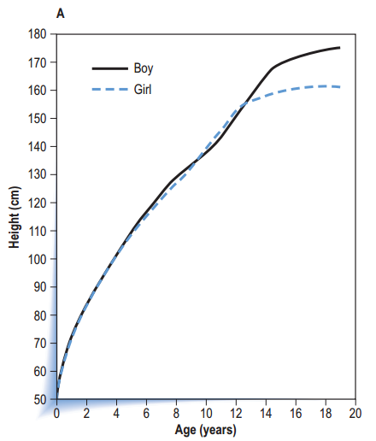
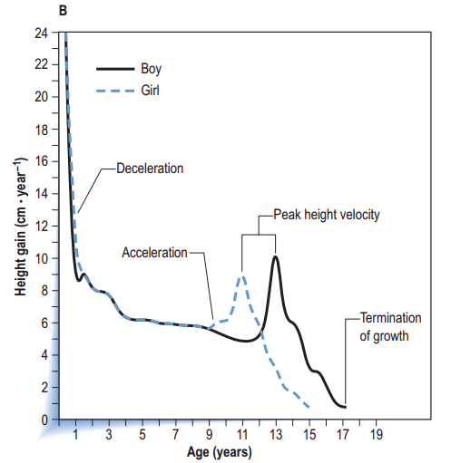
height distance curve

Slide 15
Stature
On average, males are usually 13 cm taller than females upon reaching their final adult height.
Peak height velocity refers to the maximum rate of growth in stature during the adolescent growth period.
Girls, on average, attain PHV approximately 2 years earlier than boys, with their onset of PHV occurring between 8.2 and 10.3 years. On average PHV is reached between 11.3 and 12.2 years.

Slide 16
Stature
Girls stop growing in stature by about 16 years of age and boys by about 18 or 19 years of age.

Slide 17
Body mass
Body mass is made up of a composite of tissues, including both fat and fat-free tissue, that accrue at different rates and times.
Changes in body mass can thus be a result of changes in fat or fat-free mass, but also changes in body water (dehydration or over hydration).
The relative proportions and distributions of fat and fat-free components depend on age, sex, and other environmental and genetic factors.

Slide 18
Body mass
It has been estimated that peak velocity in body mass normally occurs 0.2–0.4 years after PHV in boys and 0.3–0.9 years after PHV in girls (Armstrong &Welsman 1997).

Slide 19
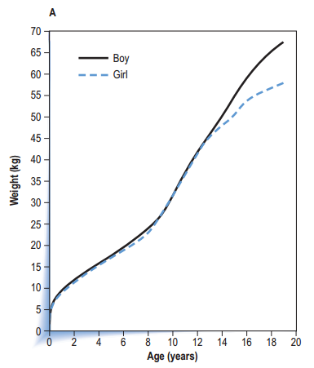
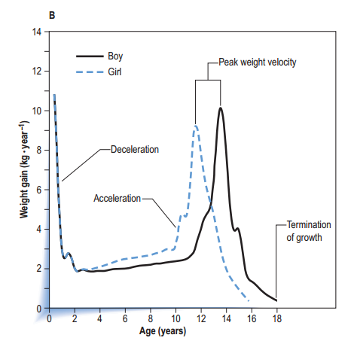
Body mass

Slide 20
Body proportions
During adolescence girls and boys experience very different changes in body shape.
Boys experience a broadening of the shoulders relative to the hips and girls experience a broadening of the hips relative to the shoulders.
During the adolescent growth spurt boys gain more in shoulder (biacromial) breadth (about 2.3 cm), whereas girls gain slightly more in hip (bicristal) breadth (about 1.2 cm).

Slide 21
Body proportions
The timing and speed of these changes in body dimensions may have a dramatic effect on several aspects of physical performance.
An increase in shoulder width can result in increased muscle mass in the upper body in boys.
This is one reason why sex differences in strength are much greater in the upper compared to the lower body.

Slide 22
Body proportions
Furthermore, this greater upper body muscle, combined with longer arms, could explain why older boys are better at throwing, racquet sports and rowing than girls.
Girls tend to have a lower centre of gravity, due to the relative broadening of the hips, which may contribute to their better sense of balance.

Slide 23
CONTROLLING FOR BIOLOGICAL MATURITY
Often within exercise physiology there is an interest in examining the trainability of the child, or the association between physical activity and health outcomes.
Unless body size and biological maturity indicators are considered, one cannot definitively identify the independent effects of physical activity or training on the outcome.

Slide 24
CONTROLLING FOR BIOLOGICAL MATURITY
When considering how to assess biological maturation it is first important to understand that 1 year of chronological time does not equal 1 year of maturational time.
Whilst every individual passes through the same stages of maturity they do so at differing rates, resulting in children of the same chronological age differing in their degree of maturity.
A second point to understand is that the size of an individual is not an accurate indicator of maturity.

Slide 25
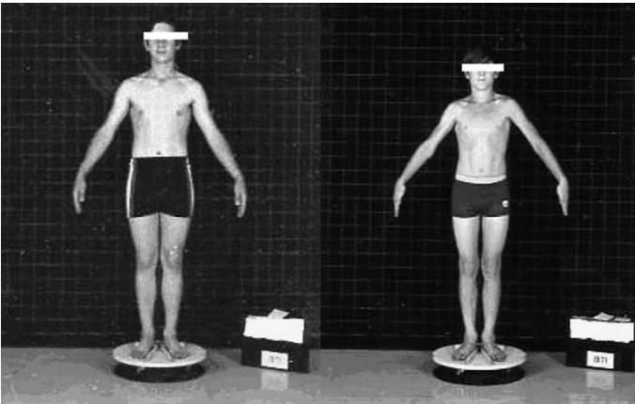
CONTROLLING FOR BIOLOGICAL MATURITY
Two boys photographed at the same chronological age (14 years). The boy on the left is an early maturer and the boy on the right is a late maturer.

Slide 26
CONTROLLING FOR BIOLOGICAL MATURITY
The most commonly used methods involve an assessment of skeletal age, secondary sex characteristics, menarcheal status and/or somatic characteristics.

Slide 27
Skeletal age
X-ray
usually of the hand and wrist or knee, and is the only method that spans the entire growth period, from birth to maturity.
Therefore, the assessment of skeletal maturity is based on the observation that an individual more advanced in maturity will have greater bone development and a smaller amount of cartilage than a less mature child.

Slide 28
Skeletal age
Skeletal age assessment involves estimating the level of skeletal maturity that a child has attained at a given point in time relative to reference data for healthy children.
Thus, an early maturing individual would have an older skeletal age compared to their chronological age.
Skeletal ages ranging from 9 to 16 years have been demonstrated in groups of 13- and 14-year-olds, thus illustrating the wide variation in skeletal age evident in children of a similar chronological age.

Slide 29
Age at peak height velocity
Landmarks on an individual’s height growth curve can be used as an indicator of maturity.
Girls usually reach PHV around 12 years and boys around 14 years of age. However, the timing of this event in relation to chronological age shows great variance.
Once APHV has been determined, individuals can be aligned by biological maturity age (years from APHV) rather than chronological age. For example, at APHV an individual has a biological maturity age equal to 0.0 years.

Slide 30
Age at peak height velocity
Early maturers are those whose APHV occurs greater than 1 year prior to the mean age, whilst late maturers are those whose APHV occurs more than 1 year after the mean age; the remainder are classified as average maturers.
To calculate an individual’s APHV it is necessary to have serial measures of height and the age of the individual when the measurement was taken.

Slide 31
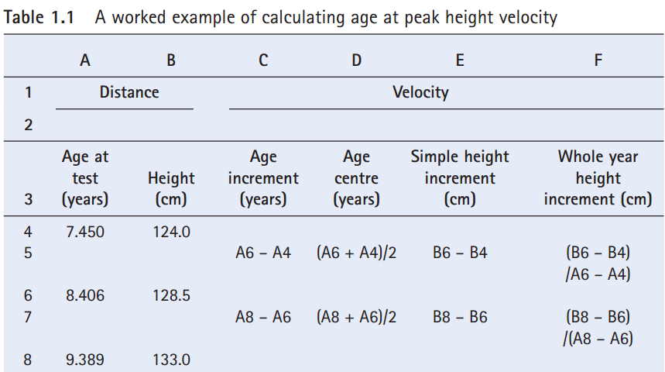
Age at peak height velocity

Slide 32
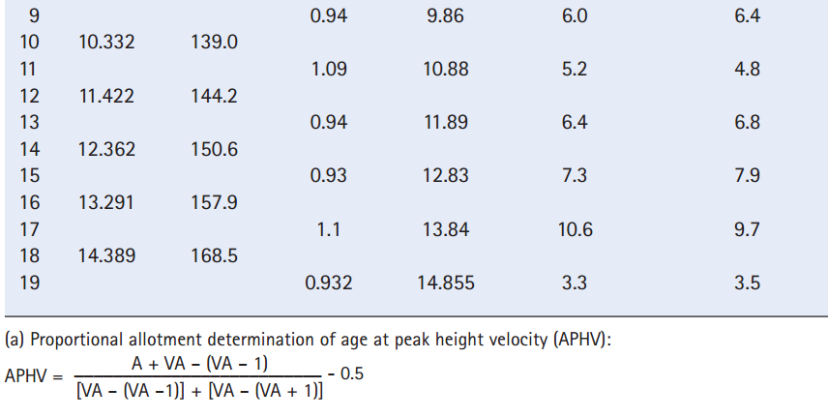
Age at peak height velocity

Slide 33
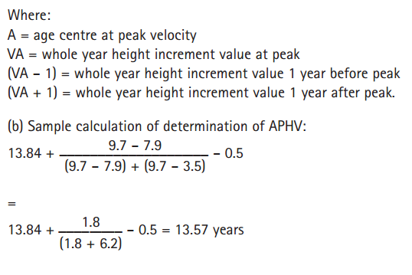
Age at peak height velocity

Slide 34
Age at peak height velocity
In the worked example the largest magnitude of height gain, or PHV, was 9.7 cm when age centre was 13.29 years.

Slide 35
Predicting age at peak height velocity
To obtain APHV, serial data are required and therefore this indicator of maturity has previously been limited to longitudinal studies.
The prediction equations require measures of stature, trunk length and leg length, as well as body mass and chronological age.
Using these growth indicators APHV can be predicted within ±1 year, in 95% of cases.
http://taurus.usask.ca/growthutility/index.cfm
This method of assessing maturity is quick, non-invasive, and inexpensive to administer and can be used in cross-sectional studies.

Slide 36
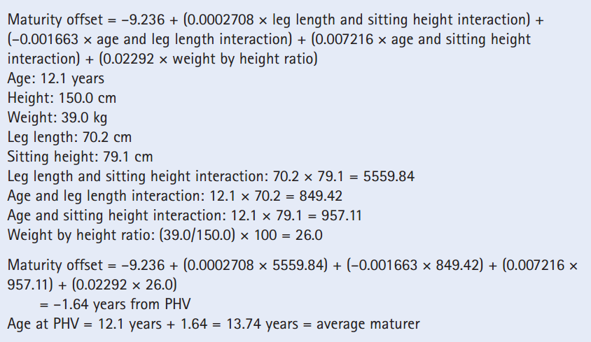
Predicting age at peak height velocity

Slide 37
Predictions based on morphological age
The height attained at any given chronological age can be compared to reference norms to assess maturity.
Since roughly 92% of adult stature is reached at PHV individuals could be classified into two maturity groups, pre- or post-PHV. Since the average age of PHV in boys is 14 years.

Slide 38
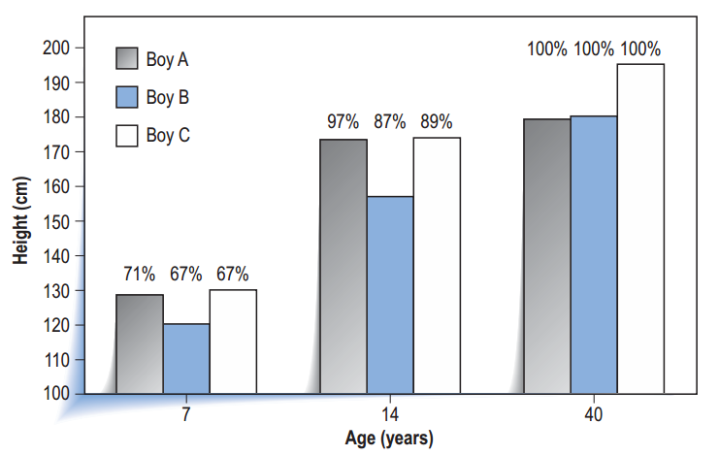
Predictions based on morphological age

Slide 39
Predictions based on morphological age
Some children have a rapid tempo of growth and attain adult stature at a relatively early age, while others have a slow tempo and finish growing relatively late.
Therefore, an accurate method of estimating adult height needs to incorporate an indicator of biological maturity for errors of prediction to be reduced.
These methods all include an assessment of skeletal age to account for maturity differences.

Slide 40
Predictions based on morphological age
Modified Roche–Wainer–Thissen method
Khamis–Roche method
These two methods estimate adult stature from current age, stature, body mass, and mid-parent stature (adjusted mean height of the parents).

Slide 41
Menarcheal status
Age at menarche (the first menstrual period) is the most commonly reported developmental milestone of female adolescence in both cross-sectional and longitudinal studies.
Although age at menarche is a widely used maturity indicator in female studies, its use is limited to later adolescence as menarche usually occurs after PHV.

Slide 42
Secondary sex characteristics
Sexual maturation is a continuous process that extends from sexual differentiation in the embryo through puberty to full sexual maturity.
Breast development in girls
pubic hair development in both sexes
Facial hair, axillary hair, voice change, body odour and body shape

Slide 43
Hormonal indicators of maturity
Secondary sexual development and somatic development reflects to a large extent the external manifestations of hormonal changes.
Confirmation studies have shown that salivary and serum levels of adrenal and gonadal hormones are closely related to the development of secondary sex characteristics.

Slide 44
REGULATION OF GROWTH AND MATURATION
The regulation of growth and maturation involves the complex and continuous interaction of genes, hormones, nutrients, and the physical environment.
A genotype is the group of genes making up an individual.
A child’s phenotype is the observed physical or physiological characteristics/ traits that are produced by the genotype in conjunction with the environment.

Slide 45
REGULATION OF GROWTH AND MATURATION
Hormones are essential for a child to reach their full genetic potential.
Physical activity is an environmental factor known to influence growth and maturation.

Slide 46
physical activity and growth and maturation
The first is that physical activity is viewed as exerting a favorable influence on growth and maturation because of its influence on the balance between energy intake from the diet and energy expenditure.
Thus, physical activity can be seen as essential in maintaining the development of healthy body weight.

Slide 47
physical activity and growth and maturation
A second point of interest is whether physical activity has a stimulatory or inhibitory influence on growth and maturation.
Additional environmental factors that are known to influence growth and maturation include illness, socioeconomic status of the family, family size, nutritional status, climate and others.

Slide 48
SUMMARY
Within the paediatric literature the term maturity ordinarily refers to the extent to which the individual has progressed to the mature state.
Girls, on average, experience the onset of puberty about 2 years in advance of boys, and for a shorter period are often taller and heavier than boys.
During adolescence, sex differences in physique increase greatly, which is due chiefly to the differential action of sex hormones.

Slide 49
Muscle strength
Mark B. A. De Ste Croix

Slide 50
INTRODUCTION
As strength is an essential component of most aspects of performance it is surprising that we know very little about the factors associated with strength development during childhood in comparison to other physiological variables.
As there are no physiological markers to indicate that a maximal effort has been given, the methodology and assessment tools are critical in studies of muscle strength during growth and maturation.

Slide 51
MUSCLE GROWTH
The origins of the diversity in muscularity in adults occur early in fetal development, at approximately the fifth week of gestation when some mesodermal cells differentiate into myoblasts.
Most of the myoblasts fuse to form myotubes containing multiple nuclei that attach to the developing skeleton to form primordial muscles. The primordia of most muscle groups are well defined by the end of the ninth week of gestation.

Slide 52
MUSCLE GROWTH
primordia of most muscle groups are well defined by the end of the ninth week of gestation.
The others stay as mononucleate cells that become the satellite cells of more mature muscle, responsible for muscle cell repair.
From 11 to 18 weeks hypertrophy of the muscles occurs due to both the multiplication of myofibrils and the addition of sarcomeres onto the ends of the muscle. By 23 weeks the nuclei of mature myotubes have moved to the edges of the muscle cell.

Slide 53
MUSCLE GROWTH
At about 10 weeks of gestation outgrowths from the spinal motor neurons begin to innervate the developing muscle fibers.
initially begins with multiple synapses ends up with only one neuromuscular junction, usually in the centre of the fiber.
The fibre type or the contractile and metabolic characteristics are determined at this early stage since muscle is a slave to its innervation or electrical frequency of stimulation.

Slide 54
MUSCLE GROWTH
Muscle fibre differentiation usually occurs after about 32 weeks of gestation but is not fully complete until a few months after birth.
The muscularity of an individual is reliant on the size and number of muscle fibres. The number of muscle fibres is due to the number of fetal myoblasts, with a significant genetic component.

Slide 55
MUSCLE GROWTH
The question of whether increases in muscle size during growth are due to hypertrophy or hyperplasia has been difficult to answer in situ due to the ethics of muscle biopsy and also to the limitations of non-invasive imaging techniques.
the average total number of fibres remains stable across age groups. Therefore in normal growth and development, increases in muscle cross-sectional area are generally agreed to be due to increased fibre size or hypertrophy rather than cellular hyperplasia.

Slide 56
DETERMINING MUSCLE SIZE
When measuring muscle cross-sectional area (mCSA) in children for research purposes the technique used should be non-invasive with no potential side effects.
Many studies with children have used anthropometric techniques to estimate mCSA because they are low cost, not labour intensive, equipment is portable and easily accessible, and measurement protocols take little time to complete.

Slide 57
DETERMINING MUSCLE SIZE
At the simplest level coaches have been known to take circumference measurements alone to estimate mCSA but circumference measurements ignore the fact that limb circumference is influenced by fat and bone cross-sections as well as muscle, such that a large circumference need not mean a large muscle.

Slide 58
DETERMINING MUSCLE SIZE
skinfold thickness. The technique described by Jones & Pearson (1969) is the most widely used anthropometric technique for estimating thigh muscle volume plus bone in children, although more recent equations by Housh et al (1995) for determining total mCSA plus bone have also become popular.
The main problem with both of these techniques is that the regression equations have been derived from adult data and therefore cannot be confidently applied to children.

Slide 59
DETERMINING MUSCLE SIZE
comparing the anthropometric technique to muscle volumes determined using magnetic resonance imaging (MRI), found that the anthropometric technique underestimates lean thigh volume by 31% (range 14–46%).
Therefore, while anthropometric estimates may be valid, they are not acceptable for monitoring changes over time, particularly in studies examining changes during growth and maturation (Housh et al 1995).

Slide 60
Radiography
estimates of mCSA
radiation exposure
ethical considerations
well-defined radiographs

Slide 61
CT
overcomes this problem by scanning thin slices of the body with a narrow X-ray beam which rotates around the body.
Unlike conventional radiography, CT can distinguish well between muscle, bone and fat. However, children are particularly sensitive to radiation; therefore this technique is contraindicated in children.

Slide 62
ultrasonography
Ikai & Fukunaga (1968) made the first measurement of strength per mCSA using ultrasonography with children.
One of the major issues of ultrasonography is the difficulty in distinguishing tissue boundaries and the difficulty in determining individual muscles/muscle groups.

Slide 63
Magnetic resonance imaging (MRI)
Magnetic resonance imaging (MRI) is an ethically acceptable technique that in recent years has offered exciting opportunities for the study of gross structure and metabolism of healthy and diseased muscle.
it is possible to differentiate individual muscle/muscle groups and identify both intramuscular fat and blood vessels.

Slide 64
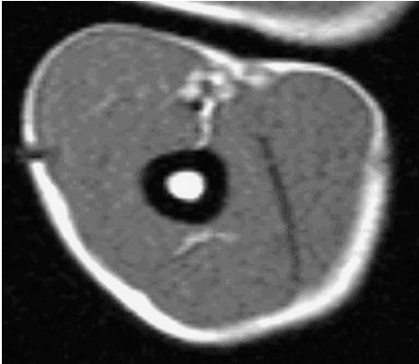
Magnetic resonance imaging (MRI)

Slide 65
Site of mCSA measurement
mCSA determination of mid-femur in the case of thigh muscles and mid-humerus in the case of elbow flexors and extensors.
Adult data suggest that for the knee extensors two-thirds femur height and for the knee flexors one-third femur height should be used as the site of maximal mCSA.

Slide 66
Site of mCSA measurement
maximal mCSA of each individual subject using MRI and found maximal thigh mCSA to occur between 51% and 69% of ascending femur length in 10- to 14-year-olds.
Deighan et al (2006) used MRI-determined thigh and arm mCSA in 9-year-olds, 16-year-olds and adults and demonstrated that there are age differences in the location of maximal mCSA of the elbow extensors.

Slide 67
AGE- AND SEX-ASSOCIATED DEVELOPMENT IN mCSA
The CSAs of muscle fibres reach their maximal adult size by 10 years of age in girls and 14 years of age in boys.
It has been suggested that the increase of tension on the muscle from bone growth will in turn provide a stimulus for the muscle fibre to increase in size.
MRI studies have also found no significant sex difference in knee and elbow mCSA up until 13/14 years.
The sex difference was magnified when the boys underwent their adolescent spurt at the age of approximately 13 years.

Slide 68
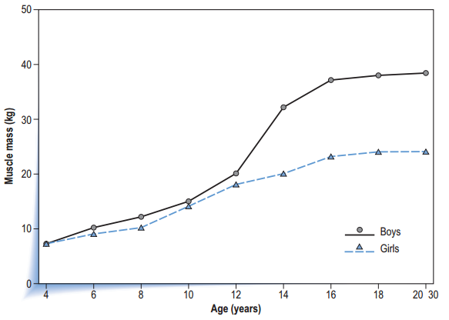
Changes in muscle mass with chronological age in relation to sex

Slide 69
DEFINING MUSCLE STRENGTH
There are various definitions of muscle strength, probably attributable to the numerous factors that interact to form the expression of strength.
the maximum force, torque or moment developed by a muscle or muscle groups during one maximal voluntary or evoked action of unlimited duration, at a specified velocity of movement.

Slide 70
Strength can be thought of in terms of a variety of muscle actions:
(1) maximal voluntary isometric,
(2) electrically evoked isometric twitch,
(3) electrically evoked isometric tetanus and
(4) maximal voluntary isokinetic muscle actions.

Slide 71
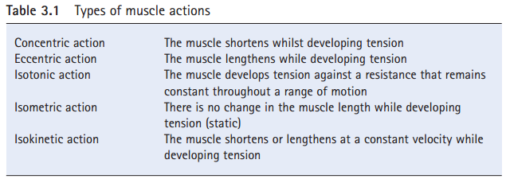
DEFINING MUSCLE STRENGTH
Given the significance of both concentric and eccentric actions in everyday life, investigations of age- and sex-associated strength development should consider concurrently the ability of the individual to perform both types of action.

Slide 72
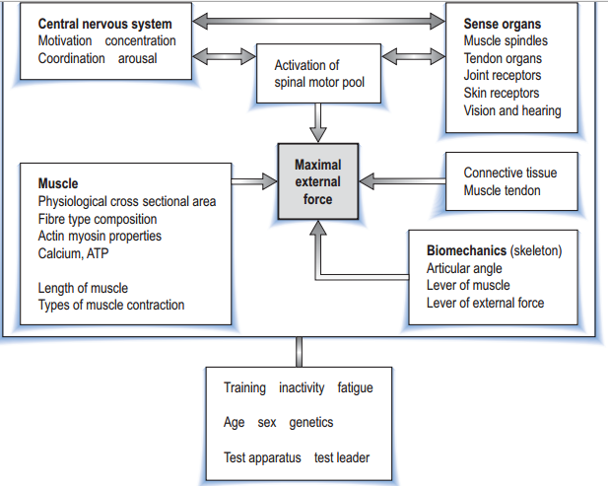
Factors that influence the generation of maximal external force

Slide 73
ASSESSMENT OF MUSCLE STRENGTH
Assessment of isotonic exercise has been popular in terms of the maximal amount lifted during one repetition (1 RM) and where the external load remains constant.
However, with children the unstable external loads may cause injury as well as the load not accommodating the full joint range of motion (ROM). For example, at the extremities of joint ROM the elastic component of muscle is inefficient at producing force.

Slide 74
ASSESSMENT OF MUSCLE STRENGTH
Most early strength development studies examined isometric forces generated from handgrip data.
Choice of testing protocol with children and adolescents may be influenced by subjects, test equipment availability, cost and specificity of testing.
Previous authors have suggested that the key issues relating to testing protocols should include the muscle group to be tested, joint angle, type of muscle action, velocity of muscle action and movement pattern.

Slide 75
factors associated with the development of muscle strength
Stature, mass and strength development
stature and mass are traditionally the size variables of choice because they can be quickly and easily measured.
isometric strength per body mass varied only slightly during childhood and through puberty in girls. In contrast, around the time of boys’ peak height velocity(PHV), i.e. age 14 years, there was an increase in strength per body mass in boys which was still continuing by age 18 years.

Slide 76
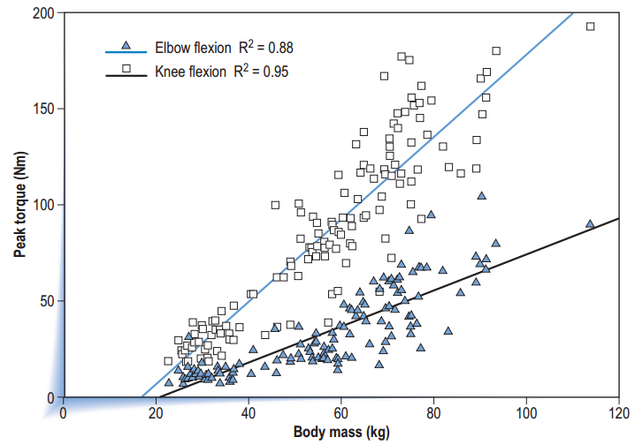
Stature, mass and strength development

Slide 77
Stature, mass and strength development
It is well recognized that peak strength velocity occurs about a year after PHV (11.4–12.2 years in girls and 13.4–14.4 years in boys).
Round et al (1999) reported that isometric knee extensor strength in girls increased in proportion to the increase in stature and mass in 8- to 13-year-olds.

Slide 78
Maturation and hormonal influences
An important consideration regarding the development of muscle function is the effect of endocrine adaptations typical of sexual maturation such as increased levels of testosterone and growth hormone (GH).
Testosterone levels accelerate from a modest fourfold increase during the early stages of puberty to a rapid 20-fold increase in mid–late puberty in boys.

Slide 79
Maturation and hormonal influences
It is not surprising that testosterone levels appear to coincide with the divergence of strength between boys and girls as circulating testosterone begins to rise 1 year before PHV, increasing steadily and reaching adult levels about 3 years after PHV.
Testosterone has been shown to stimulate anabolic processes in skeletal muscle and appears to be the principal hormone responsible for the development of strength.
This effect is mediated by androgen receptors in the myofibrils.

Slide 80
ways in which testosterone could augment strength include
increasing protein synthesis
promoting transition of type IIa motor units to a more glycolytic profile of type IIX motor units
increasing the production of insulin-like growth factor 1 (IGF-1)
amplitude of GH pulses
regulating neurotransmitter release thereby enhancing force

Slide 81
Detailed analysis of their data showed that there was an increase of 0.7% in isometric knee extension strength for every unit of circulating testosterone (nmol · L–1).
Jones & Round (2000) indicated that increasing levels of estrogen in girls causes inhibition of muscle growth as a result of a speedier skeletal maturation which removes the lengthening stimulus for muscle growth.

Slide 82
Fat-free mass and strength development
Typically, during childhood and puberty, strength increases coincide with changes in fat-free mass (FFM).

Slide 83
Age differences in strength per mCSA
Kanehisa et al (1995) suggested that isokinetic strength per mCSA, measured using ultrasonography, was greater in older age groups (18 years) than younger age groups (7 years) in every muscle group measured.
It is likely that the deficiency of strength per mCSA in the younger age groups might be related to a lack of the ability to mobilize the muscle voluntarily.

Slide 84
Age differences in strength per mCSA
Further investigation is required to establish whether these differences in torque per mCSA are due to biomechanical or neuromuscular factors.

Slide 85
Sex differences in strength per mCSA
Early work reported that absolute isometric strength differences between sexes disappeared when data were normalized to anthropometric muscle (plus bone) CSA in 9- to 12-year-olds.
Deighan et al (2002) recently reported significant sex differences in isokinetic elbow flexion per mCSA in 9- to 10-year-olds and 16- to 17-year-olds.

Slide 86
Sex differences in strength per mCSA
The majority of recent studies would lead us therefore to the conclusion that there is no significant sex difference in strength per mCSA irrespective of the muscle joint or action examined.

Slide 87
Neuromuscular factors and strength development
Both the level of voluntary neural drive or motor unit recruitment and the level of activation or frequency of stimulation govern %MUA.
The ideal way to measure the contractile capacity of a muscle is to record the force developed during supramaximal electrical stimulation of the nerve innervating the muscle.

Slide 88
Neuromuscular factors and strength development
The results of tetanic electrical stimulation may not be comparable to voluntary muscle actions, since in the former method synergistic muscles may not be excited and the procedure is very painful, leading to reduced compliance and, with child subjects, ethical concerns.

Slide 89
EXERCISE FOR YOUTH

Slide 90
EXERCISE FOR YOUTH
Research conﬁrms that adults who exercise regularly improve their overall health and reduce their risk for chronic conditions such as cardiovascular disease, diabetes, and stroke. A logical conclusion, therefore, is that regular physical activity can also improve the health status of children and adolescents and possibly prevent the development of chronic conditions.

Slide 91
EXERCISE FOR YOUTH
In fact, statistics show that one third of Americans under the age of 18 are physically unﬁt according to measurements of maximal oxygen uptake, or VO2max.
Moreover, boys tend to become ﬁtter as they get older; whereas, girls tend to become less ﬁt as they age.
Because risk factors tend to persist throughout life, children and adolescents who are at high risk tend to remain at risk as they age.

Slide 92
ANATOMICAL AND PHYSIOLOGICAL DIFFERENCES BETWEEN ADULTS AND YOUTH
GROWTH AND DEVELOPMENT:
The bones, muscles, and joints of children and adolescents are growing and developing at a rapid rate. Long bones grow in length because of the presence of the epiphyseal plate.
These growth spurts result in weight gain, height increases, and an altered center of balance that can interfere with biomechanical properties.
Ultimately, this can affect performance in physical activity and sports.

Slide 93
NEUROMUSCULAR CONTROL
A nerve cell called a motor neuron extends from the central nervous system to one or more muscle ﬁbers within a given muscle.
During growth and development, communication between motor neurons and their muscle ﬁbers gradually improves.
Impulses propagate more rapidly along the neuron as myelin sheath develops.

Slide 94
RESPONSE TO EXERCISE
Children and adolescents have a different physiological response to exercise than adults. For instance, they require 20% to 30% more oxygen per unit of body mass when running at a given pace.
energy expenditure and VO2max are higher during endurance activities such as running or walking.
Their less efﬁcient respiration is likely due to a shorter respiratory cycle caused by a higher respiratory frequency.
Though a child’s VO2max improves slightly with training, improvements are minimal.

Slide 95
RESPONSE TO EXERCISE
It might be because of the hormonal ﬂuctuations that occur at puberty.
children have a lower stroke volume both at rest and during exertion.
Furthermore, heart rate tends to be higher at rest and during exercise in this group; therefore, maximal heart rate cannot be accurately determined by subtracting age from 220 for anyone under the age of 16.
training heart rate for this group should reach 170 to 180 bpm to achieve even slight improvements in cardiorespiratory functioning.
Lastly, blood pressure at rest and during exertion is lower in children because of their smaller surface area.

Slide 96
REGULATION OF BODY TEMPERATURE
Sweat glands play a crucial role in maintaining body temperature.
Children produce more heat per kilogram of body weight during activity than adults; however, they do not sweat as efﬁciently.
They do have more sweat glands than adults, but their glands are underdeveloped and not as active as mature glands.
Additionally, their sweating mechanism is not activated until they reach a much higher core body temperature than adults.

Slide 97
REGULATION OF BODY TEMPERATURE
Children are generally more vulnerable to dehydration than adults are. When dehydrated, the body has difﬁculty eliminating body heat and is therefore prone to heat illness—especially during intermittent activity, the type of activity common in this population.
If children are exercising for a prolonged time period, ensure that they consume ﬂuids every 15 to 20 minutes to facilitate efﬁcient heat dissipation and better performance.

Slide 98
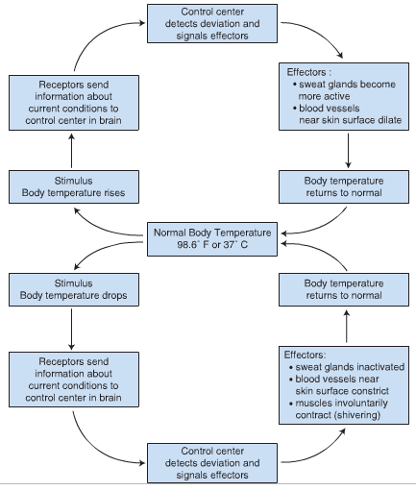
Homeostasis of body temperature through negative feedback

Slide 99
OVERWEIGHT AND OBESITY AMONG CHILDREN
According to the Centers for Disease Control, 16% of those between the ages of 6 and 19 are overweight or obese with an additional 15% dangerously close to meeting the criteria for overweight.
Additionally, the obesity rate for children between the ages of 2 and 5 and adolescents between the ages of 12 and 19 is twice as high as it was 30 years ago. It is nearly three times as high for those between the ages of 6 and 11.

Slide 100
Factors Contributing to Overweight and Obesity
Both genetics and environmental factors contribute to the prevalence of overweight and obesity in children and adolescents.
For example, genes determine the body’s metabolic rate. In other words, they inﬂuence how the body stores and uses fat for fuel.
If one parent is obese, the child has a 40% risk of becoming overweight. And if both parents are obese, the child has an 80% chance of becoming obese.

Slide 101
Factors Contributing to Overweight and Obesity
Environmental factors, such as sedentary lifestyle and excess energy consumption, probably have the greatest inﬂuence on the prevalence of overweight and obesity among school-aged children.
Children consume large quantities of high kilocalorie, high fat foods and fewer fruits and vegetables.

Slide 102
PRECAUTIONS DURING EXERCISE
INCREASED CORE TEMPERATURE
INCREASED RISK FOR MUSCULOSKELETAL INJURY
INCREASED RISK FOR HYPOTHERMIA:
Because children have a large surface area relative to body mass, they lose large amounts of heat when exercising in water.

Slide 103
BARRIERS TO EXERCISE
lack of time is the number one barrier to exercise, particularly for girls.
Students report spending 4 hours or more on some days doing homework. Many have part-time jobs that occupy them on weekends. Others have family obligations that ﬁll their schedules. These responsibilities often interfere with activity.

Slide 104
BARRIERS TO EXERCISE
Self-consciousness about physical attributes and competency in activity tend to be the primary barriers for boys. If boys feel that they are too young, too small, too over-weight, or lacking skills for a particular activity, they tend to avoid it, Some fear failure.
Many adolescents prefer to work on computers, talk on cell phones, or watch television rather than participate in activity. In fact, they are “playing” football, “riding” bicycles, or “hitting” tennis balls on a TV or computer screen.

Slide 105
BARRIERS TO EXERCISE
Teens like to be a part of a group, so if their friends are playing sports, they also play sports. However, if their friends are playing video games or going out to parties, they choose these other activities.
other barrier to exercise is inaccessibility or cost.

Slide 106
BENEFITS OF EXERCISE
DECREASED RISK FOR OBESITY
INCREASED MUSCULAR STRENGTH AND BONE DENSITY
IMPROVED CARDIORESPIRATORY PERFORMANCE
IMPROVED PSYCHOLOGICAL FACTORS
DECREASED RISK FOR CHRONIC DISEASE

Slide 107
RECOMMENDATIONS FOR EXERCISE
EXERCISE TESTING:
In most cases, basic adult exercise testing guidelines apply to healthy children and adolescents, but response to exercise differs.
When exercise testing is war-ranted, however, familiarize the child with the testing protocol ahead of time. This alleviates fears and helps ensure accurate measures.
The treadmill test is the most appropriate means of exercise testing for young children because of its simplicity and because it accommodates various body sizes.

Slide 108
RECOMMENDATIONS FOR EXERCISE
Most physical education classes in schools use simple ﬁeld tests to assess the ﬁtness status of students. For cardiorespiratory ﬁtness, they perform the 1-mi walk-run; for muscular ﬁtness, they use the curl-up test and the pull-up or push-up test; for ﬂexibility, they use the sit and reach test; and for body composition, they take skin fold measurements. Additionally, they calculate BMI as an indicator for overweight or obesity.

Slide 109
EXERCISE PRESCRIPTION
5 minutes of light activity such as walking, jumping jacks, and stretching prior to increasing intensity to prepare the body for activity.
5-minute cool-down
Groups such as the American Heart Association and ACSM suggest that all children over the age of two receive 60 minutes of moderate-to-vigorous intensity physical activity each day.
The activity should be enjoyable and varied but does not necessarily have to be continuous.
In fact, children under the age of 12 tend to perform better with intermittent activities that change from vigorous intensity to moderate intensity back to vigorous intensity, so encourage it.

Slide 110
EXERCISE PRESCRIPTION
To ensure compliance, make the activities fun, nonthreatening, un embarrassing, and developmentally appropriate. Offer words of encouragement and support.

Slide 111
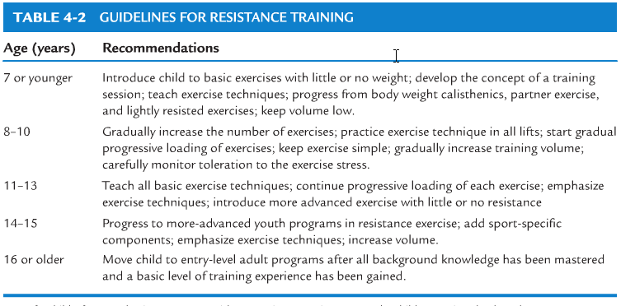
EXERCISE PRESCRIPTION

Slide 112
EXERCISE PRESCRIPTION
Encourage children to drink one to two 8-oz glasses of water before activity and provide them with water during activity to prevent dehydration.
Exercise in a cool environment.
Overweight children, however, might not initially be able to accumulate 60 minutes of daily activity.
Use light resistance with a greater number of repetitions. Have the child perform 8 to 15 repetitions to moderate fatigue and do not increase intensity until the child is able to perform the speciﬁed number of repetitions with proper form.

Slide 113
EXERCISE PRESCRIPTION
Emphasize activities that are enjoyable and not monotonous
Include both competitive and noncompetitive activities to meet the needs of different age groups and ability levels
Foster skills and abilities that develop conﬁdence
Promote interaction and coordination between the school and the community

Slide 114
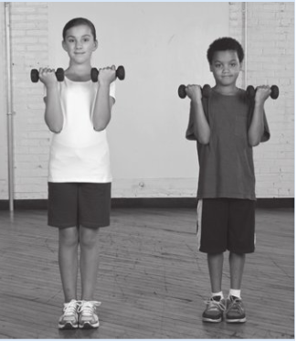
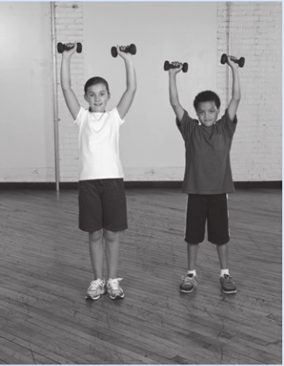

Slide 115
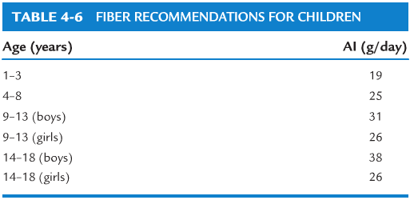

Slide 116
Maximal intensity exercise
Chapter 5

Slide 117
INTRODUCTION
Children and adolescents derive their energy for exercise from both aerobic and anaerobic metabolism.
less is known about anaerobic fitness than aerobic fitness of young people but there are merits in studying maximal intensity exercise.

Slide 118
Why less is known about anaerobic fitness than aerobic fitness
No gold standard for anaerobic fitness comparable to peak oxygen uptake for aerobic fitness
The association between aerobic fitness and health is more apparent
The contribution of aerobic fitness to sport performance is better understood
Measuring anaerobic fitness is more complex than assessing aerobic fitness
Maximal intensity exercise is more strenuous than exercise at peak oxygen uptake

Slide 119
Important of studying maximal intensity exercise
First, brief maximal intensity exercise has greater relevance and resemblance to the activity and play patterns of children and adolescents
second, maximal intensity tests are brief and the motivation and attention spans of young people might be better harnessed during assessment

Slide 120
continue
third, knowledge of the interplay between anaerobic and aerobic fitness during growth and maturation provides a composite picture of the exercising young person.

Slide 121
terms commonly and often indiscriminately used
Alactacid power, lactacid power, anaerobic power, anaerobic capacity, anaerobic work capacity, instantaneous power, peak power, mean power and short-term power are terms commonly and often indiscriminately used to describe non-identical aspects of maximal intensity exercise.

Slide 122
Maximal intensity exercise
Maximal intensity exercise should not be confused with 'maximal exercise’ as referred to in a peak VO2 test, since the mechanical power elicited during the former is two to four times that elicited during the latter when using cycle ergometry.

Slide 123
Maximal intensity exercise
Maximal intensity exercise refers to the accomplishment of all-out intensity exercise, where the predominant, though not necessarily exclusive, source of energy is from anaerobic metabolism.
Anaerobic fitness is defined as the capability to perform maximal intensity exercise.

Slide 124
Maximal intensity exercise
In essence, the competence to generate the highest mechanical power output over a few seconds (usually less than 5 s) and to sustain high power output over a short period of time (usually less than 60 s) are considered as indicators of anaerobic fitness.

Slide 125
determination of energy turnover during rest and exercise
Invasive procedures such as muscle biopsies
Non-invasive estimations of energy yield such as those using magnetic resonance spectroscopy. they are very expensive, not accessible to most researchers.
Cycle ergometers, treadmills and isokinetic dynamometers.
These tests usually last between 5 s and 60 s, and participants are verbally encouraged to give a maximal exercise effort throughout the duration of the test.

Slide 126
CYCLE ERGOMETER TESTS
Wingate anaerobic test
The Wingate anaerobic test (WAnT) is the most established and researched test of maximal intensity exercise and the versatility of the test is affirmed by the large base of WAnT data on children and adolescents who are untrained, trained, healthy and diseased

Slide 127
In healthy young people
at least two practice trials,
using an abbreviated WAnT (i.e. of 15 s duration) and
standardized warm-up routine are necessary to minimize any learning effects but the discretion of the
researcher is necessary in deciding the amount of test familiarization required before testing is commenced.

Slide 128
Three indicators of WAnT performance are usually reported
Peak power (PP) in watts (W) – the highest mechanical power output achieved during the test (usually within 5–6 s).
Mean mechanical power (MP) – the average mechanical power accomplished during the test (usually over 30 s), which can also be expressed as the total work done in joules (J).

Slide 129
continue
A measure of power decline or fatigue index (FI) in %, the difference between the PP and the final power output, expressed as a percentage of PP. The FI, which is less often reported than PP or MP, may be associated with the percentage of muscle fibre type distribution but in young people, this has not been established.

Slide 130
Test results are affected by the following factors:
The nature of the warm-up, the use of toe-clips and heel straps and whether the test is commenced from a stationary or rolling start.
The periods over which the PP and MP are averaged
Inclusion of the inertia of the flywheel and internal resistance in power computations

Slide 131
continue
The aerobic contribution to energy metabolism in performing maximal intensity exercise in the WAnT is greater in young people as oxygen uptake kinetics slow with age in response to high intensity exercise.
The use of a fixed applied force, normally 7.5% of body mass for sprint cycling, is not optimal for eliciting both PP and MP in one test throughout childhood and adolescence,

Slide 132
Force–velocity cycling test
Force–velocity cycle tests (FVT) were developed because of the need to optimize power outputs in maximal intensity cycle tests.
For example, the FVT protocol described by Santos et al (2002), involves a series of four to six maximal intensity cycle sprints against several applied forces with an initial applied force of 0.74 N · kg–1 body mass and subsequent applied forces selected randomly.

Slide 133
continue
Each completed sprint is followed by 60 s of active recovery (60 rpm with a minimal applied force) and another 4 min of passive rest before the next sprint is conducted.
Some FVT protocols commence from a stationary start rather than from a rolling start and these protocol differences confound comparisons of results across different studies

Slide 134
Isokinetic cycling test
Testing using isokinetic cycling is attractive because there is no need to consider the optimal applied resistance and the resultant power generated is not affected by the acceleration of the ergometer flywheel.

Slide 135
Accumulated oxygen deficit test
The accumulated oxygen deficit (AOD) test is used to estimate the anaerobic capacity of young people using mainly cycle ergometers, although treadmills have been used.
Accumulated oxygen deficit can be achieved in 60–90 s by using exercise intensities of 110%, 130% and 150% of peak VO2

Slide 136
continue
The predicted oxygen demand at 110%, 130% and 150% of peak V.O2 is obtained by using four to five exercise bouts that are below peak VO2 intensity (e.g. 50, 70, 80, 90, 100 W using cycle ergometry) for each subject, to establish a linear relationship between exercise intensity and VO2.

Slide 137
Summary of cycle ergometry methodology
affected by many protocol issues. These include:
the quality and quantity of practice trials
the nature of the pretest warm-up and whether the test uses a stationary or rolling start
the duration of the test
the applied force(s) used
the outcome variable(s) of choice (i.e. PP, PPopt, CCP, MP, FI or AOD)
the time period or pedal revolutions used to calculate power
whether the resultant power includes adjustment for flywheel inertia during
acceleration or deceleration during sprint cycling the generalizability of the results to non-cycling sports and exercise performances.

Slide 138
NON-MOTORIZED TREADMILL TEST
To measure horizontal sprinting power in the laboratory is difficult but several studies have used a non-motorized treadmill (NMT) with children and adolescents.
Some data but not all, show that PP and MP achieved in the 30 s NMT test are lower than those attained in the 30 s WAnT despite blood lactate concentration being higher after the NMT test than after the WAnT in the same group of young people

Slide 139
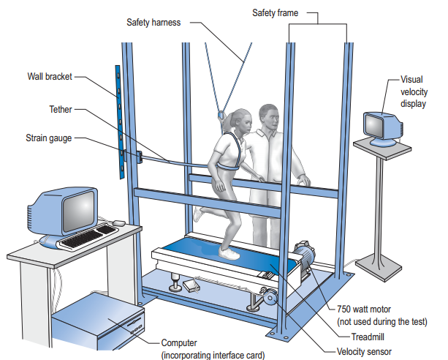
NON-MOTORIZED TREADMILL TEST

Slide 140
POST-EXERCISE BLOOD LACTATE CONCENTRATION
Post-exercise blood lactate is routinely sampled following maximal intensity exercise tests to provide an indication of the extent to which glycolysis has been stressed.
They observed the blood lactate concentration to rise, in boys, from a baseline value of 2.0 mmol · L to 3.2 mmol·L after 30 s, peak 2 min post-exercise at 3.6 mmol·L and then fall to 3.1 mmol · L after 3 min. The corresponding concentrations in girls were 1.6, 3.7, 4.9 and 4.7 mmol · L , respectively.

Slide 141
POST-EXERCISE BLOOD LACTATE CONCENTRATION
a single sample taken 2 min post-exercise can be assumed to reflect peak values in children but, in adults, peak values occur about 5 min post-exercise and this must be taken into account in child–adult comparisons.

Slide 142
continue
Following a maximal intensity exercise test, the peak blood lactate concentration is not just specific to the individual but also dependent on the mode of exercise and test protocol.
The length of the test is important as a cycling test lasting 60 s will produce greater post-exercise blood lactate accumulation than a standard 30 s WAnT due to the longer period of glycolytic stress.

Slide 143
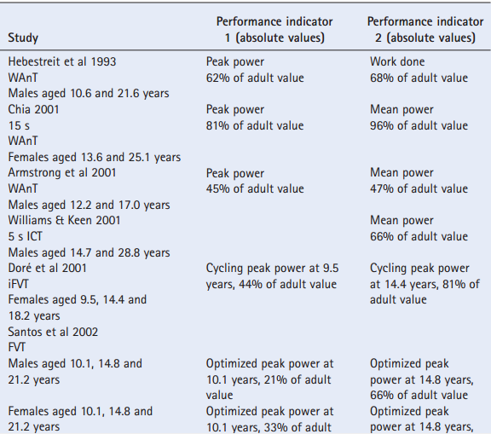
Anaerobic fitness of children and adolescents in comparison to adults

Slide 144
continue
The difference in anaerobic fitness between boys and men is greater than the difference in anaerobic fitness between girls and women but data on females are sparse.

Slide 145
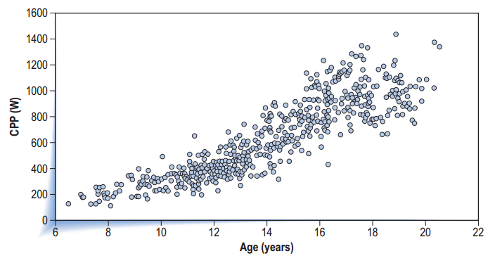
Relationship between cycling peak power (CPP) and age in male subjects

Slide 146
DETERMINANTS OF ANAEROBIC FITNESS
In males aged 5–18 years, muscle mass increases from 42% to 54% of body mass. This represents almost a fivefold increase in muscle mass from 7.5 to 37 kg.
The corresponding increase in females’ muscle mass over the same age range is 3.4 times from 7 to 24 kg or from 40% to 45% of body mass.

Slide 147
continue
Men attain peak muscle mass at about 30 years of age while women attain peak muscle mass before 20 years. Beyond 7 years of age, males have greater absolute and relative (kg muscle mass/kg body mass) muscle mass than females.
Changes in muscle size alter muscle pennation, which in turn influences force and power output.

Slide 148
continue
The nature–nurture debate on muscle fibre type distribution remains contentious because it is extremely difficult to apportion the genotype and phenotype effect on muscle fibre distribution.
There appears to be a greater prevalence of type IIa than type IIX fibres during childhood and adolescence but the evidence of a sex difference in fibre type distribution in childhood and adolescence is equivocal.

Slide 149
continue
There is speculation that hormonal factors, especially around the period of puberty, may account for some of the characteristic observations in maximal intensity exercise performance.
For example, concentrations of circulating growth hormone and testosterone in males and oestradiol in females are markedly increased during puberty.

Slide 150
continue
It is plausible that changes in neural factors during growth and maturation can influence the anaerobic fitness of young people.
age- and maturation-related differences in anaerobic fitness include increased myelination of nerve fibres (myelination increases the velocity of nerve transmission), improved coordination of muscle synergists and antagonists, and the increased ability to fully activate muscles during maximal intensity exercise.

Slide 151
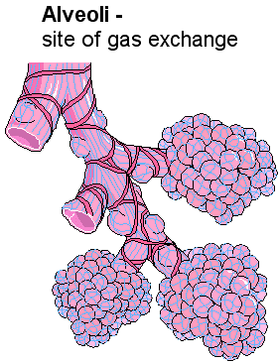
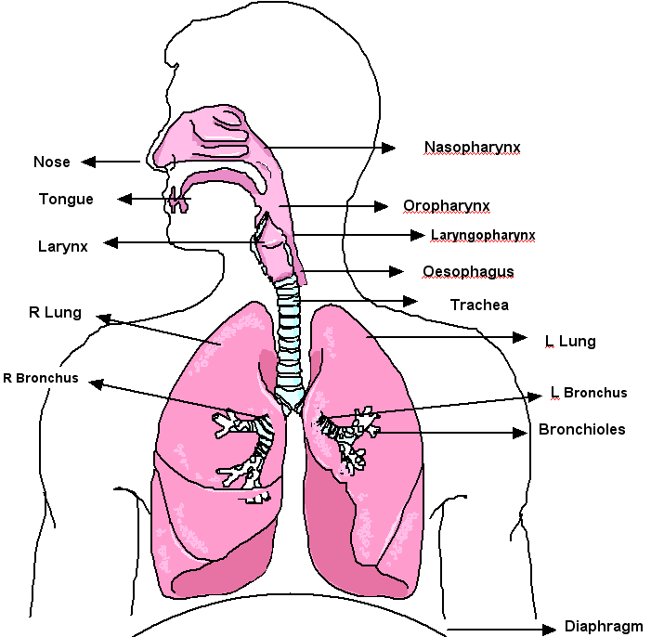
Pulmonary function
Chapter 6

Slide 152
INTRODUCTION
The pulmonary system provides the means to maintaining blood-gas homeostasis during resting and exercise conditions.
exchange of oxygen (O2) and carbon dioxide (CO2) between the ambient air and pulmonary blood.

Slide 153
STRUCTURE AND MECHANICS
The lung
The lung increases in both its length and width with age, following growth velocity curves similar in shape to those of both height and mass.
The age of peak velocity of lung width occurs at about 12.2 years and 13.8 years in girls and boys, respectively, and coincides closely with peak height velocity (PHV). some 6–8 months later (Simon et al 1972) and may coincide with the peak velocity of chest depth.

Slide 154
STRUCTURE AND MECHANICS
As the lung and thorax increase in size, so do total lung capacity (TLC) and the various subdivisions of lung volume and function.
In relation to height, TLC increases from approximately 2 L at 120 cm to 3 L at 140 cm and to 6 L at 180 cm.

Slide 155
Airways and alveoli
At birth the number and branching pattern of the bronchial system are finalized, but subsequently both the diameter and length of the airways increase with age.
Conversely, the number of alveoli in the lung only begin to noticeably increase after birth, multiplying exponentially from approximately 24 million to near maximal numbers by the 8th year (280 million).

Slide 156
Airways and alveoli
Concurrently alveolar surface area increases from 2.8 m2 at birth to 12.2 m2 at 13 months, 32 m2 at 8 years and 75 m2 in adulthood.

Slide 157
Respiratory system resistance, compliance and elasticity
Since resistance is increased by the power of four for any reduction in radius, these changes result in an absolute reduction in airway resistance with age whereby respiratory system resistance is closely related to height by an exponent of 1.7.

Slide 158
Compliance
Compliance infers distensibility (stretchiness) of the respiratory system. Essentially, respiratory compliance is the ability of the alveoli and lung tissue to expand on inspiration, i.e. the stiffer the lung, the less the compliance and the more pressure (work) that is required to inflate the lung.

Slide 159
compliance
During growth, lung volume and number and volume of alveoli increase and there is a reduction in the surface area-to-volume ratio and alveolar surface forces. As a result absolute compliance increases with age and is related to height by the exponent 1.76.

Slide 160
elasticity
The pathological neighbor to compliance is lung elasticity, which refers to the ability of the lung elastic tissues to recoil during expiration.
Coincident with the increased density of connective tissue, lung recoil pressure increases throughout childhood until the age of about 18 years

Slide 161
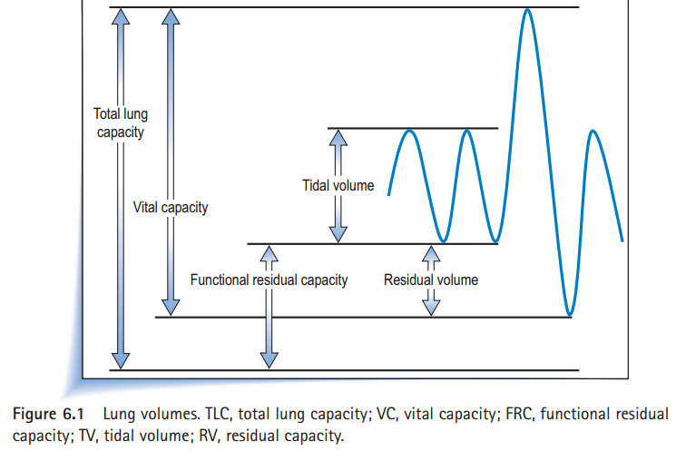
Lung volumes

Slide 162
Is pulmonary function limiting to exercise?
As stated earlier, the pulmonary system is generally able to maintain homeostasis of blood O2 content and acid–base status during both rest and exercise, and it has generally been accepted that, since V.Emax is not usually greater than 70% of MVV, pulmonary function is not limiting to exercise. However, more recently, it has been identified that some athletes display a form of impaired pulmonary gas exchange that leads to exercise-induced arterial hypoxaemia (EIAH). This phenomenon is evidenced by levels of alveolar PO2 (PAO2) and PaO2 saturation well below resting values and has been demonstrated to be limiting to V.O2max.

Slide 163
continue
Women, who have smaller lungs than height-matched males, are particularly susceptible to EIAH at lower exercise intensities compared with males, who tend to only demonstrate EIAH if highly trained and achieving high levels of V.O2 max.
This has led to the hypothesis that EIAH is in some way related to fitness level (in terms of V.O2 max) and lung size.

Slide 164
Adaptations with training
Some well-controlled longitudinal data do exist which suggest that training may enhance pulmonary function, at least in swimmers.
Longitudinal studies have also suggested that endurance training that enhances V.O2max appears to result in an increase in V.Emax, which is mostly due to increases in VT rather than fR.

