Slide 1
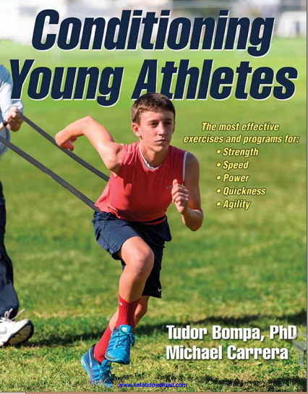
Conditioning Young Athletes
Mohsen Avandi
Semnan University

Slide 2
Training Guidelines for Young Athletes
Chapter 1

Slide 3
Reversing the Coin
child athletes who are doing too much, training excessively, and specifically training for one sport
on the other end of the spectrum are children who are overweight, overfed, undernourished, and detrimentally sedentary
Childhood obesity gradually increased in the 1980s through the 1990s
For these children, the program does not focus on what type or intensity of activity
emphasizes that any type of consistent activity, especially in the form of cardiovascular exercise such as walking, running, or cycling, can decrease health risks and improve health

Slide 4
Building the Foundation
it is essential that athletes take the time to rebuild the foundation of strength, power, endurance, speed, agility, and all the motor abilities that are important to their sport.
Skills such as running, jumping, skipping, and performing push-ups or chin-ups were not taught in multimillion-dollar gyms or athlete development centers but rather on the street corner, local park, or backyard.
Kids were once just kids and not aspiring professional athletes

Slide 5
Here are some benefits of organized sport
It promotes healthy living with an emphasis on building skills, strength, and endurance
It improves mental health and focus
It teaches important life skills, including self-respect and respect for others, in a safe environment. As the saying goes, there is no I in team
It teaches important life lessons about winning, losing, and striving to give one’s best effort
It emphasizes fitness and fun because each player gets equal playing time

Slide 6
Developing a Long-Term Training Program
For a long time, some coaches suggested that performing sport-specific exercises from an early age was the optimal way to train for a sport:
Stress the energy system that is dominant in a given sport
Follow motor skill specificity, meaning that athletes must select exercises that mimic the skill patterns used in the sport
laboratory research demonstrates that specificity training results in faster adaptation and leads to faster increments in performance
This is like trying to erect a high-rise building on a poor foundation

Slide 7
Problems performing sport-specific exercises from an early age
It can lead to unilateral, narrow development of the muscles and organ functions
It can disturb harmonious physical development and biological equilibrium, which are prerequisites of physical efficiency, athletic performance
it can result in overuse, overtraining, and even injuries
negative effect on the mental health of the children
It can interfere with children developing social relationships because of the many hours associated with intensive training
It can affect the motivation of children because the program can be too stressful, boring, and lacking in fun

Slide 8
Multilateral Development
It’s important for young children to develop a variety of fundamental skills
before they start training in a specific sport
develop fundamental skills such as running, jumping, throwing, catching, tumbling, and balancing
Most programs also have a swimming component, as swimming helps children develop aerobic capacities while minimizing the physical stresses placed on their joints.

Slide 9
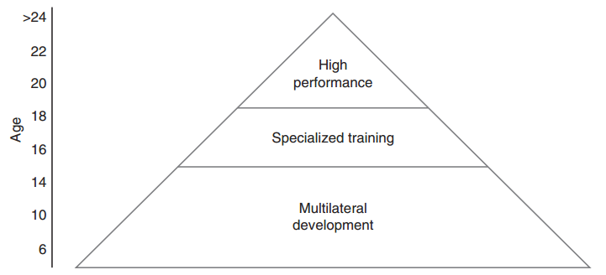
Long-Term Training Program

Slide 10
Multilateral Development
The purpose of multilateral development is to improve overall adaptation.
Athletes who are capable of swimming, cycling, and running can exercise their cardiorespiratory systems in a variety of ways and significantly reduce the chance of injuries
we tell our children to slow down and not be in a rush to grow up

Slide 11
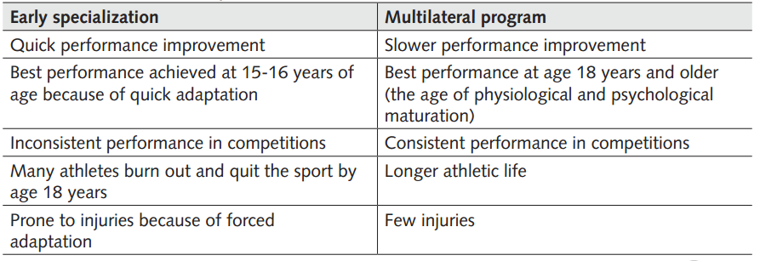
Early Specialization and Multilateral Development

Slide 12
vast majority of the best Soviet athletes had a strong multilateral foundation
Most athletes started to practice the sport at 7 or 8 years of age
During the first few years of activity, they all participated in various sports, such as soccer, cross-country skiing, running, skating, swimming, and cycling
Between the ages of 10 and 13 years the children also participated in team sports, gymnastics, rowing, and track and field
Specialized programs started at 15 to 17 years
The athletes who specialized at a much earlier age achieved their best performances at a junior age level

Slide 13
vast majority of the best Soviet athletes had a strong multilateral foundation
Only a minority of the athletes who specialized early on were able to improve performance at the senior age.
Many top-class Soviet athletes started to train in an organized environment at the junior age level (14 to 18 years). They had never been junior champions or held a national record. At the senior age, however, many achieved national- and international-class performances
Most athletes believed that their success was facilitated by the multilateral foundation
The study concluded that specialization should not start before the age of 15 or 16 years in most sports

Slide 14
early specialization lead to numerous practical and physiological implications
A decrease in motor skill development because focus shifts from general development to sport-specific programming
Increased risk of injury to the cardiovascular and musculoskeletal systems because of the intensity and volume of training
Improper recovery due to a lack of knowledge about nutrition and proper macro-and micronutrient ratios
Early burnout due to hours of dedication
Early injury due to overuse

Slide 15
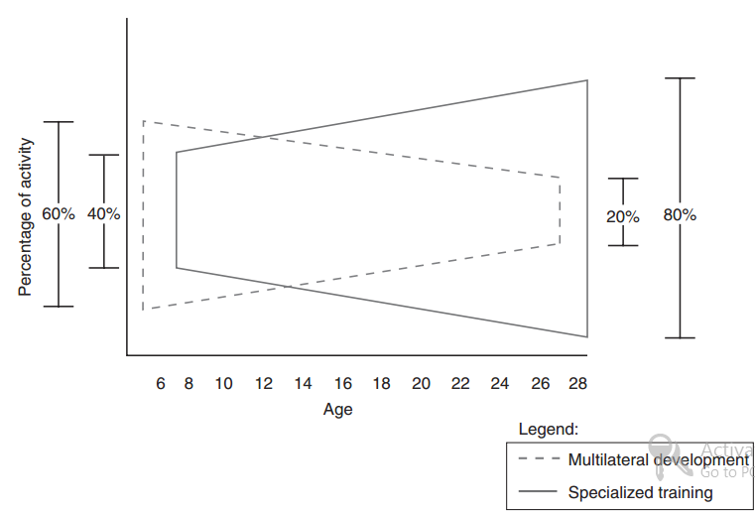
Ratio between multilateral development and specialized training for different ages

Slide 16
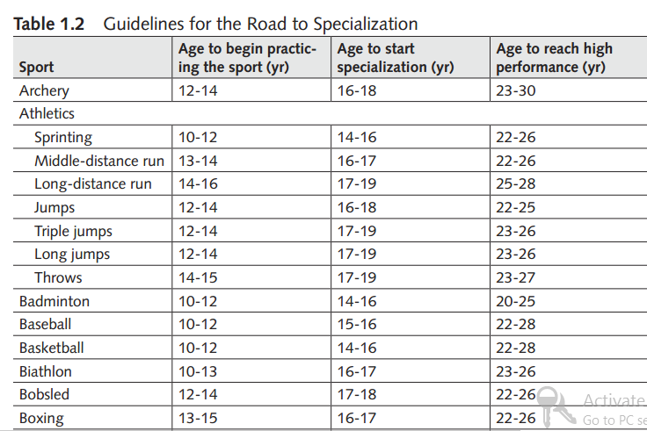
Guidelines for the Road to Specialization

Slide 17
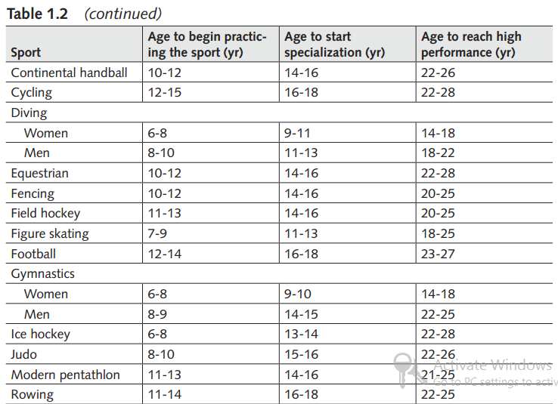
Guidelines for the Road to Specialization

Slide 18
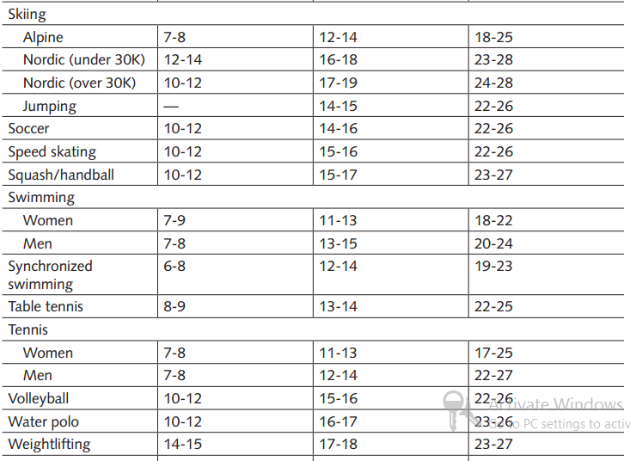
Guidelines for the Road to Specialization

Slide 19
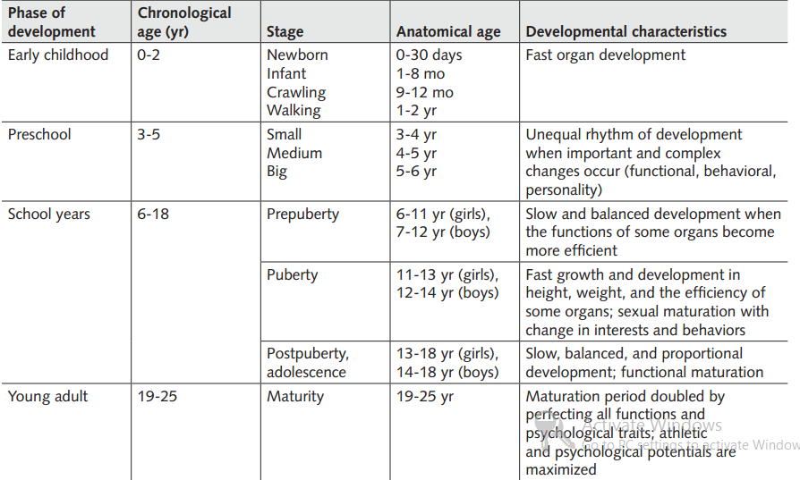
Stages of Anatomical Age

Slide 20
Stages of Athletic Development
Chapter 2

Slide 21
children evolve at different rates
The growth rates of children’s bones, muscles, organs, and nervous systems differ from stage to stage, and these developments largely dictate a child’s physiological and performance capabilities.
This is why a training program must consider individual differences and training potential.
for example, 14-year-old players, the differences between the players may be so great that some have the athletic potential of 16-year-olds (early developers), whereas others have only the physical capabilities of 12-year-olds (late developers).

Slide 22
children evolve at different rates
To neglect such large differences could mean that an early developer might be undertrained, whereas the late developer is overstressed
A gradual, progressive program with no abrupt increases in intensity greatly increases training efficiency and reduces the chance of frustration and injury. This process is called periodization of long-term training.
It is essential for anyone involved in children’s sports to incorporate periodization principles into each child’s training.
The athletic potential of a child is strictly dependent on his physical and mental development.

Slide 23
Multilateral phase
The primary purpose of the multilateral phase is to build the foundation upon which the athlete can effectively develop complex motor abilities, resulting in a smooth transition to the specialized phase.
There are two stages in the specialized phase: specialization and high performance.
It is also critical to understand that the rate at which children develop varies greatly, and you must consider the maturation differences of each athlete.

Slide 24
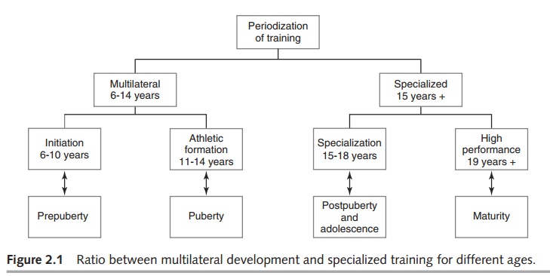
Ratio between multilateral development and specialized training for different ages

Slide 25
Setting the Foundation for Motor Skills Training
Motor skill development, which begins at infancy
Children develop both gross motor skills and fine motor skills concurrently
Gross motor skills involve large movements that rely on the coordination of the large muscles of the body
Movements such as running, jumping, climbing, and catching are all gross motor skills that children develop at an early age and continue to perfect as years pass.
Fine motor skills involve very small or more precise movements
These movements improve at the same time as gross motor skills and are often learned and practiced in a school.

Slide 26
Motor Skills Training
Motor skill development begins very early in life, becomes more pronounced during
the initiation stage (6-10 years of age),
is enhanced during the athletic formation stage (11-14 years of age), and is perfected during the specialization stage (15-18 years of age)
and into the high-performance stage.
The development of motor skills leads to advanced coordination of all fitness components, including strength, aerobic endurance, flexibility, and speed development.

Slide 27
Multilateral development—the exposure to a variety of skills and exercises—will result in visible coordination gains. The higher the coordination level, the easier it is to learn new and complicated technical and tactical skills. As a result, an athlete
will quickly and efficiently adjust to the unusual circumstances of athletic competition

Slide 28
Initiation Stage—6 to 10 Years of Age
participate in low-intensity training programs
emphasize fun
not capable of coping with the physical and psychological demands of high-intensity training or organized competitions.
athletes must focus on overall athletic development and not sport-specific performance.
cardiorespiratory system is developing and aerobic capacity is adequate for most activities.

Slide 29
Initiation Stage—6 to 10 Years of Age
Anaerobic capacities, however, are limited at this stage as children have low tolerance for lactic acid accumulation.
Body tissues are susceptible to injury.
Attention span is short at this age and children are action oriented; thus, they cannot sit and listen for long periods of time.
training at this stage to be varied and creative.

Slide 30
Guidelines
Emphasize multilateral development including running, jumping, catching, throwing, batting, balancing, and rolling.
Provide every child with enough time to adequately develop skills
Positively reinforce children
Encourage children to develop flexibility, coordination, and balance
Encourage children to develop various motor abilities in low-intensity environments
for example, swimming is a terrific environment for developing the cardiorespiratory system while minimizing the stresses on joints, ligaments, and connective tissues

Slide 31
Guidelines
Select a suitable number of repetitions for each skill, and encourage children to perform each technique correctly.
Modify the equipment and playing environment to a suitable level.
Design drills, games, and activities to maximize children’s opportunities for active Participation
Simplify or modify rules so children understand the game
Introduce modified games that emphasize basic tactics and strategies
Emphasize the importance of ethics and fair play
Provide opportunities for boys and girls to participate together
Make sure that sport is fun
Encourage participation in as many sports as possible

Slide 32
Initiation Stage—6 to 10 Years of Age
The initiation stage is the most important phase in developing coordination
At this developmental stage, children who are involved in a variety of activities make greater gains in coordination compared with those who participate in one sport that applies only sport-specific training.
During prepubescence, children develop basic skills and movements through play and games.

Slide 33
Athletic Formation—11 to 14 Years of Age
It is appropriate to moderately increase the intensity of training
During this stage, the cardiorespiratory system continues to develop
tolerance to lactic acid accumulation gradually improves
emphasize developing skills and motor abilities rather than performing and winning

Slide 34
Guidelines
Encourage participation in a variety of exercises from the specific sport and from other sports, which will help the athletes improve their multilateral base.
Progressively increase the volume and intensity of training
Design drills that introduce athletes to fundamental tactics and strategies and that reinforce skill development.
Help athletes refine and automate the basic skills
Emphasize improving flexibility, coordination, and balance
Emphasize ethics and fair play

Slide 35
Guidelines
provide all children with opportunities to participate at a challenging level
Introduce the athletes to exercises that develop general strength emphasize developing the core sections of the body—in particular the hips, lower back, and abdomen—as well as muscles at the extremities—shoulder joints, arms, and legs.
Most exercises should involve body weight and light equipment, such as medicine balls, resistance bands, and light dumbbells.
Continue developing aerobic capacity
Introduce athletes to moderate anaerobic training

Slide 36
Guidelines
They are usually better suited for short sprints of less than 80 meters, which involve the anaerobic alactic energy system, and endurance
events of longer distances (e.g., 800 meters and longer) at slower speeds, which test aerobic capacities.
Avoid competitions that place too much stress on the body.
To improve concentration, introduce athletes to more complex drills
Introduce athletes to a variety of fun competitive situations that allow them to apply various techniques and tactics.
Provide time for play and socializing with peers

Slide 37
Athletic Formation—11 to 14 Years of Age
The fast improvement in coordination that occurs during prepubescence sometimes slows or even slightly regresses during pubescence.
Growth spurts of up to four or five inches (10-12 cm) per year, specific to this stage of children’s development, normally occur with disturbances in coordination.
Girls tend to improve visual orientation and rhythm of motions better than boys because of sex differences and because girls have a more natural talent for dance and artistic sports.

Slide 38
Specialization—15 to 18 Years of Age
The most significant changes in training take place during this stage
now start performing more exercises and drills aimed specifically at high performance development in one sport.
Closely monitor the volume and intensity of training to ensure that athletes improve dramatically with little risk of injury.
stage the athletes should have no major technical problems. Thus, the coach can move from a teaching role to a coaching and training role.

Slide 39
Guidelines
Closely monitor the development of athletes during this stage
A coach who feels that an athlete needs more practice in a particular skill or dominant motor ability can suggest that the athlete practice a couple of extra hours per week.
Check for progressive improvements in the dominant motor abilities for the sport, such as power, anaerobic capacity, specific coordination, and dynamic flexibility.
Increase the training volume for specific exercises and drills to facilitate improvement in performance

Slide 40
Guidelines
Then, increase training intensity more rapidly than volume, although volume must still increase progressively.
Involve athletes in the decision-making process whenever possible
Continue to emphasize multilateral training, particularly during the preseason
Encourage athletes to become familiar with the theoretical aspects of training
Emphasize exercising the muscles that athletes primarily use when performing technical skills
Avoid maximum strength training, in which athletes perform fewer than four repetitions of an exercise, particularly for those who are still growing

Slide 41
Guidelines
Make developing aerobic capacity a high priority for all athletes, particularly those who participate in endurance or endurance-related sports
Progressively increase the volume and intensity of anaerobic training
Improve and perfect the techniques of the sport
Improve individual and team tactics
Increase the number of competitions progressively so that by the end of this stage the athletes are competing as frequently as senior-level competitors
Athletes should practice mental training

Slide 42
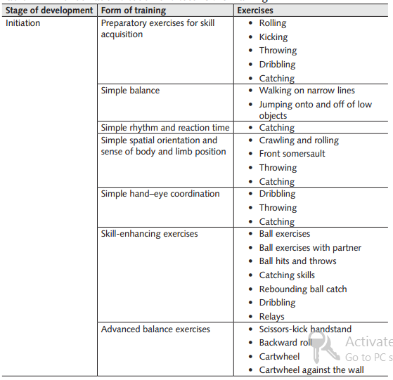
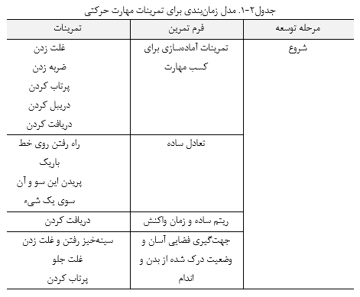
Periodization Model for Motor Skills Training

Slide 43
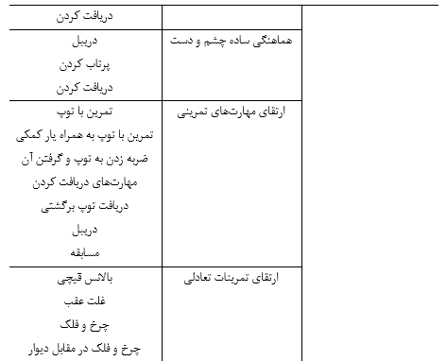
Periodization Model for Motor Skills Training

Slide 44
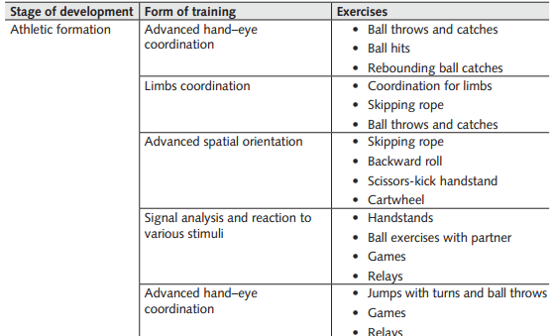
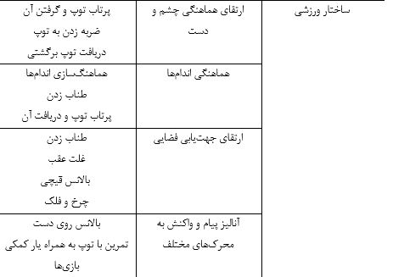
Periodization Model for Motor Skills Training

Slide 45
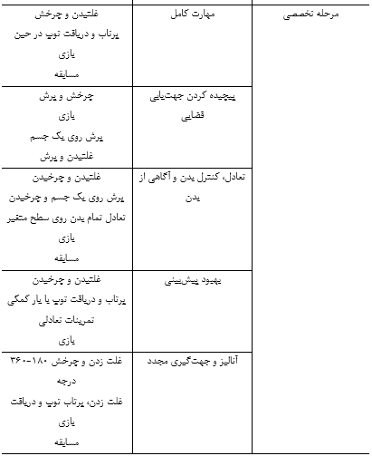
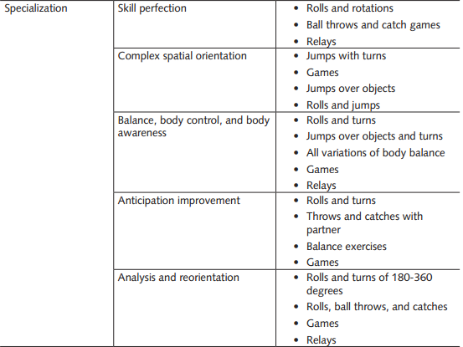
Periodization Model for Motor Skills Training

Slide 46
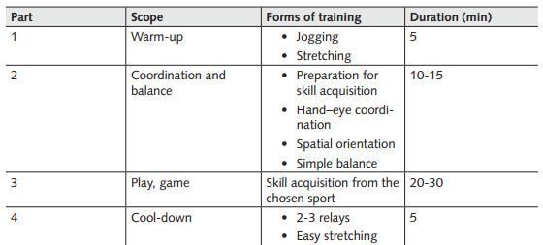
Sample Workout for Prepuberty

Slide 47
coordination exercises
All age groups should do 10 to 15 minutes of coordination, agility, and balance work at every workout.
It should be done in the early part of a training session, such as immediately after the warm-up, because children learn best when they are fresh.

Slide 48
Assessing the Young Athlete
Chapter 3

Slide 49
Heart Rate Chart
Heart rate is useful for monitoring the athlete’s reaction to the previous day’s training program.
base heart rate (BHR), which is the heart rate taken in the morning before stepping out of bed.
pulse beats for 10 seconds, then multiply this number by 6.
On the first day of each month, take a blank heart rate chart
The BHR also reacts to the intensity of the previous day’s training
When the BHR increases by six to eight beats per minute over the standard curve in one day, it could mean that the previous day’s training program was not well tolerated or that the athlete did not observe a normal athletic lifestyle

Slide 50
Heart Rate Chart
When the BHR decreases to its standard levels, the normal program can resume.
The BHR illustrates the athlete’s physiological state and reaction to training.
For example, athletes from endurance-dominant sports usually have lower BHR levels and thus the shape of the curve is lower than anaerobic dominant sports.

Slide 51
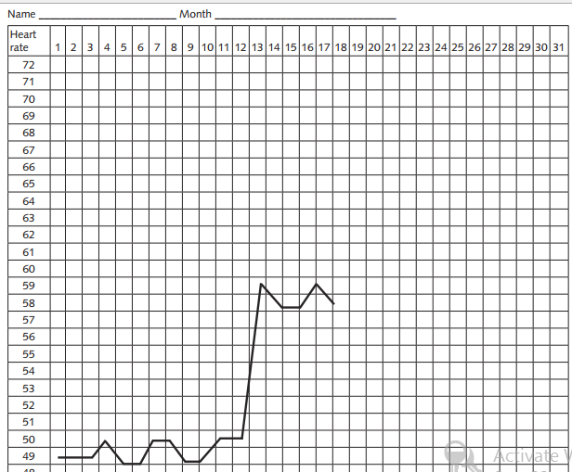
Heart Rate Chart

Slide 52
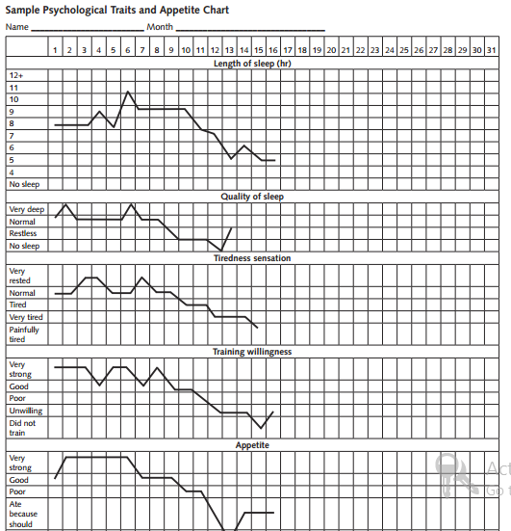
Psychological Traits and Appetite Chart

Slide 53
Assessment Tests for the Young Athlete
Both general and sport-specific testing is useful in all stages of athletic development.
Initiation stage (6-10 years of age)
Athletic formation stage (11-14 years of age)
Specialization stage (15-18 years of age)
High-performance stage (19+ years of age)
In the later stages—in particular, the late athletic formation stage and the specialization stage—fitness testing is especially important, both for monitoring improvements in overall strength, power, speed, and endurance and for collecting data that will help the coaches and trainers better devise a detailed training plan

Slide 54
Assessment Tests for the Young Athlete
Important Points Before Testing:
Administering a battery of tests to a group of 20 to 25 athletes can be time consuming and seem unproductive.
Begin by recording the athlete’s body weight and height

Slide 55
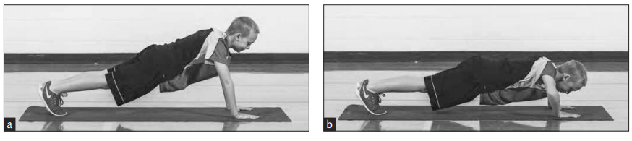
Test 1: Push-Up Test
Tests upper-body strength and endurance.
Record the total number of repetitions.
Stage
Appropriate for late initiation stage (10-year-olds can attempt the push-up technique) and all other stages of development.
bend the elbows until the arms are at a 90-degree angle

Slide 56
Tips
To improve an athlete’s technique, a teammate can place his fist on the floor directly below the athlete’s chest
To better challenge athletes, coaches can administer a weighted push-up test.
(Another athlete can hold the plate in place, if needed.) Test and retest with the same weight each time.
Incline push-ups, decline push-ups, and wide-grip push-ups are all great variations for challenging the athlete and improving upper-body and core strength.

Slide 57
Test 2: Pull-Up and Bent-Arm Hang Tests
Tests upper-body strength and endurance.
Record the total number of repetitions for pull-ups and the total time for the bent-arm hang
Stage
Athletes in the early athletic formation stage can attempt the bent-arm hang test.
Athletes in the late athletic formation, specialization, and high-performance stages can complete the pull-up test.

Slide 58
Position for the Pull-Up Test
Grab an overhead bar with an underhand grip
Extend the arms and place the hands approximately shoulder-width apart
Pull the body up until the chin clears the bar
The test is stopped when the athlete can no longer perform the test with proper technique.
The movement should be smooth and controlled—no jerking or swinging is allowed

Slide 59
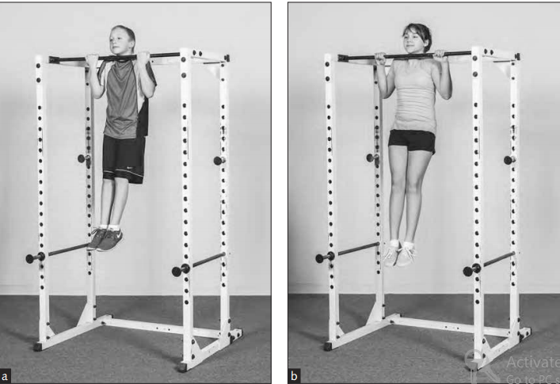
Position for the Pull-Up Test

Slide 60
Position for the Bent-Arm Hang Test
Instead of the standard pull-up test, female athletes can perform the bent arm hang test (see figure b).
Pull up, jump up, or step up to the pull-up bar until the chin is at the level of the bar. Use a reverse or forward grip. Make sure to use same grip for retest.
Hang and maintain this position for as long as possible. Stop the test when athlete can no longer maintain the chin at the level of the bar.
Male athletes can also perform this test to complement the pull-up test.

Slide 61
Some coaches use the horizontal bar of an in-ground goalpost to conduct the pull-up test.
Coaches can also purchase a portable pull-up or chin-up bar that can be attached to a door frame.
Use various grips (e.g., wide grip, short grip, reverse grip) for training variety

Slide 62
Test 3: Standing Long Jump and Three-Step Jump Tests
Tests power performance.
Measure the length of the jump using a measuring tape.
Stage
Great for all stages of athletic formation, including the initiation stage.
Position:
Stand with the feet shoulder-width apart
Perform a countermovement jump
Propel the body forward as far as possible
Measure the distance from the start line to the heel
Repeat the movement three times

Slide 63
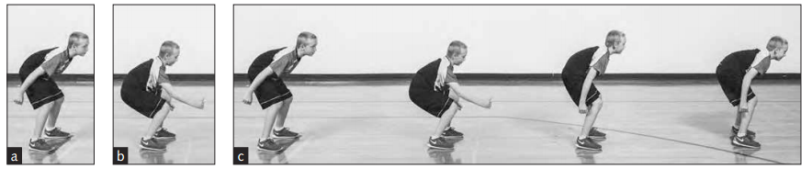
Test 3: Standing Long Jump and Three-Step Jump Tests
For the three-step jump (figure c), the athlete’s position is the same as that for the standing long jump. This time, instead of stopping after the first jump, the athlete quickly jumps again two more times for a total of three consecutive jumps

Slide 64
Test 4: 30-Meter and 60-Meter Sprints
Tests speed and power.
Use a stopwatch to record the fastest time
Stage
Use short distances, such as 15 to 20 meters, for athletes in the initiation stage and
increase to 30 meters for athletes in the in late initiation stage. Use the 30- and 60-meter sprints for athletes in other stages.

Slide 65
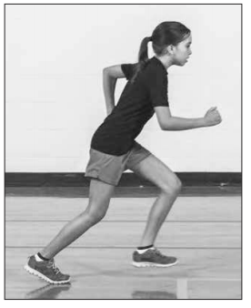
Test 4: 30-Meter and 60-Meter Sprints
Allow for proper recovery between sets, and
perform two or three sets of each sprint.
Take the best time

Slide 66
Test 5: Vertical Jump
Tests lower-body power.
Use chalk or sticky tape and a measuring tape to measure.
This test is great for all stages of development, regardless of sport. It is especially beneficial for athletes in the initiation and athletic formation stages because the vertical jump is an important indicator of leg strength and power; it can provide insight into possible weaknesses and help customize an athlete’s programming

Slide 67
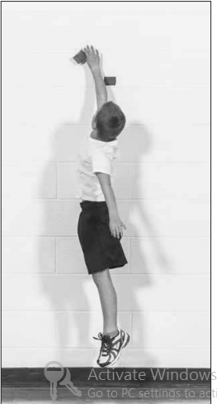
Test 5: Vertical Jump
Measure the difference (in centimeters)
between the starting position and the jump height tapes.

Slide 68
Test 6: Plank and Modified Plank Tests
Tests core strength (abdominals and lower back) and upper-body endurance.
Use a stopwatch to record the total length of time.
Athletes in the initiation stage can practice the modified plank test as a way to improve balance and coordination.
Athletes in the early athletic formation stage can use the modified plank test. Athletes in the late athletic formation and other stages of development can use the standard plank test of core strength

Slide 69
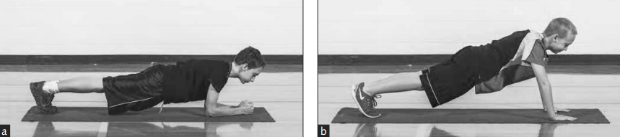
Test 6: Plank and Modified Plank Tests

Slide 70
Test 7: One-Mile (1500m) Aerobic Test
Tests cardiovascular fitness.
Use a stopwatch to measure time to completion
One mile is too great a distance for athletes in the initiation stage of development;
one-quarter or one-third of a mile are more appropriate distances for this age group. For athletes in other stages, the one-mile test is appropriate
Walk and run one mile. Time how long it takes to complete the distance.

Slide 71
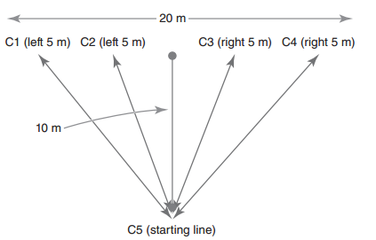
Test 8: Four-Cone Agility Test
Tests starting speed and speed in changing directions.
Use five cones, a measuring tape, and a stopwatch
This is a fun agility test for athletes in all stages of development
Athletes in the athletic formation, specialization, and high-performance stages can use agility tests of greater difficulty
The coach puts four cones
in a straight line, placing
cone 1 (C1) and cone 4 (C4)
20 meters apart. The coach
then places cone 5 (C5) 10
meters from the line and
between cone 2 (C2) and
cone 3 (C3). C5 is the starting point.

Slide 72
Speed Training
5
Avandi

Slide 73
Speed
Speed is one of the most important qualities necessary to excel in sports such as track and field and team sports performed on large fields (e.g., football, rugby, baseball).
In a few other team sports, such as basketball, handball, and lacrosse, athletes must run and move, react, or change direction quickly.
To have speed and agility, one needs to develop strength and power—an athlete can’t be fast or agile if she is not strong and powerful.

Slide 74
speed
The term speed incorporates three elements:
reaction time (the motor reaction to a signal),
movement time (the ability to move a limb quickly, as in martial arts, batting, or passing a ball), and
speed of running (including the frequency of arm and leg movement).
In team sports an athlete rarely performs action in a straight line, such as sprinting in track and field.
Players who can quickly change directions to receive a pass or deceive an opponent are highly regarded.
In this case, elements of speed—reaction time and speed of running in different directions—are combined.

Slide 75
speed
Many sport specialists believe that sprinters are born, not made, because speed depends on the athlete’s muscle-type composition.
Speed depends on the following:
Genetics. The higher the proportion of fast-twitch to slow-twitch muscle fibers, the faster the reaction and more powerful the muscle contraction.
Strength and power level of the athlete. Children cannot be expected to display a high level of speed before getting stronger.

Slide 76
physiological adaptation
Regardless of the physiological adaptation responsible for improving speed during prepuberty, children are encouraged to run, skip, and jump in many directions and at various levels of intensity.
The scientific literature shows that children who do not participate in activities that challenge the neuromuscular system and the development of motor skills early in life may not be able to approach activities in sport in the later years with vigor, determination, and physiological proficiency (Faigenbaum et al., 2013).
Even in the absence of traditional strength training, children are encouraged to play hard and give 100 percent effort in play.

Slide 77
Speed-Training Model for Initiation
The ability of prepubescent children to perform quick motions increases progressively in this early stage; both boys and girls develop speed in the later stage of athletic formation.
Some children, especially those who do not experience multilateral development, may have poor arm and leg coordination. Because arm drive directly influences leg frequency, a low level of coordinating arm and shoulder force impedes children’s ability to run fast.

Slide 78
Speed-Training Model for Initiation
The main reason for this is that boys start gaining strength during puberty due to an increase in hormones such as testosterone, whereas girls have very low, and therefore modest, gains.
The coordination of the arms and legs can be improved by repeating short distances (20-30 meters) with medium speed.
In such an exercise, learning limb coordination—not running fast—should be the objective.
Sex differences in running speed are not visible during early prepubescence.

Slide 79
Speed-Training Model for Initiation
These differences start to show as children approach puberty
with marked differences in speed development after the age of 15 years

Slide 80
Scope of Speed Training
One main goal of prepubescent sport activities is to develop play-specific speed.
Through exposure to play, games, and relays, children will learn how to coordinate their arms
They will learn how quickly to start moving parts of the body at a signal or in a play situation.
Prepubescent speed development is mainly the result of nervous system adaptation that children achieve through play and games

Slide 81
Scope of Speed Training
One way to challenge motor coordination and neural patterns of movement is to perform activities on difference surfaces. Because most school yards are paved in asphalt, which can be stressful on the joints,
children are also encouraged to play on softer surfaces such as grass
Variety in speed exercises is important because it improves motor experience
At the same time, children should not neglect the upper body. Simple throws using baseballs, tennis balls, or light medicine balls are useful for developing upper-body movement time

Slide 82
Scope of Speed Training
Unless children participate in sex-specific teams, most games, plays, and relays—especially in the school curriculum—should be coed because no visible differences between boys and girls exist at this developmental stage

Slide 83
Program Design
The duration of a drill or the distance to run should not be long
Children should not experience discomfort at this age. They should not run fast and continuously for longer than four to six seconds because longer distances require specific training.
If they pause for two or three minutes, then they can repeat the same action with enjoyment. Children do not have fun when they experience discomfort and pain
Young athletes, especially children who are approaching puberty, should increase distance progressively over years, from 20 meters or yards to 40 to 50 meters or yards.

Slide 84
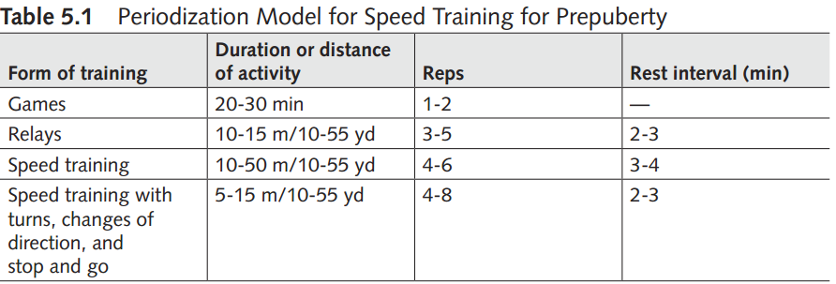
Program Design
In team-sport training or during games, the instructor can combine speed tasks with skill performance (e.g., throwing and kicking a ball).
For prepubertal children, the duration of a game does not have to be longer than 20 or 30 minutes.

Slide 85
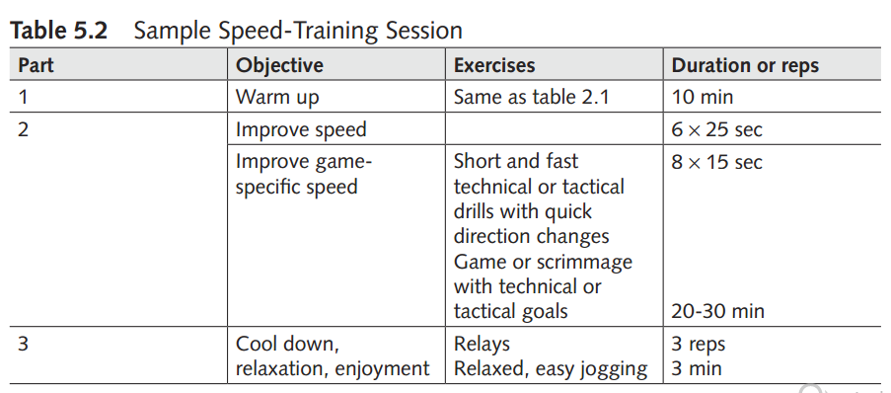
Program Design

Slide 86
Speed-Training Model for Athletic Formation
Speed development increases during puberty
Such improvement may relate to increases in body and muscle size
Strength gains positively influence speed development. From puberty on, the testosterone level in boys starts to increase dramatically, as does the ability to increase strength.
Although boys show clear improvements from the later stages of pubescence, girls seem to plateau in their rate of speed development

Slide 87
Program Design
As children approach postpubescence, they can increase the total amount of speed training.
distance run with high velocity from 20 to 50 or 60 meters or yards
Instructors can organize relays in ways that use many exercises, such as sprints, sprints with turns, runs around cones with direction changes, carrying or throwing medicine balls, or jumps over safe equipment at a low height
Instructors should also organize special exercises that improve reaction time

Slide 88
Program Design
Parallel with speed and movement time exercises, children should participate in simple exercises for power improvement
A critical element in speed training is the duration of the rest interval between repetitions. Because the ability to repeat high-quality exercises depends on the freshness of the neuromuscular system, the rest interval between repetitions must be as long as necessary to almost fully recover and restore the fuel needed to produce energy.

Slide 89
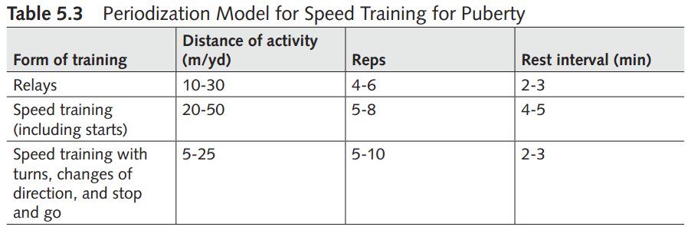
Program Design

Slide 90
Speed-Training Model for Specialization
Speed improvement comes with age. As children enter the postpuberty stage, gains in speed and movement time are more visible, especially for boys. Girls show the highest speed gains during late puberty and early postpuberty.
Boys maintain speed development throughout postpuberty. As they become stronger, they also become faster. The biggest difference between boys and girls is probably in the area of upper-body strength because from puberty on the upper-body strength of boys is constantly increasing.

Slide 91
Program Design
Speed. 60 to 70%, of the total time dedicated to speed
Training
Movement time.
Ability to overcome external resistance
Technique.
Concentration and willpower
Muscle elasticity

Slide 92
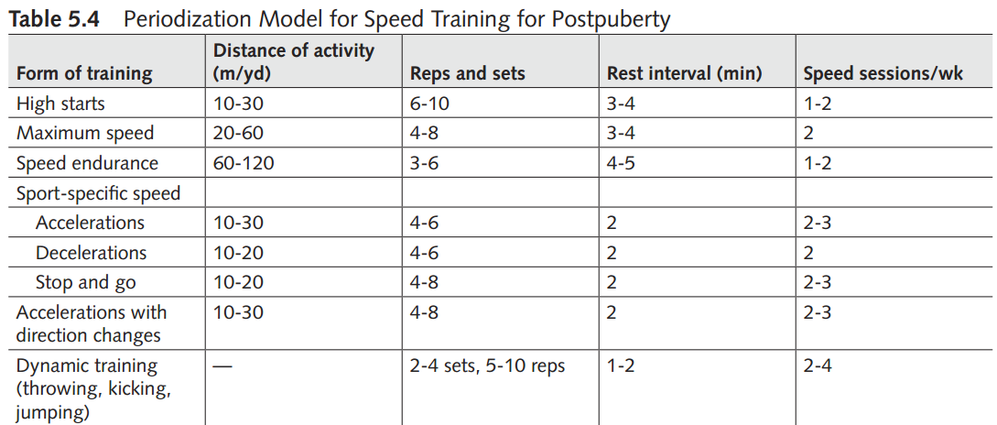
Program Design

Slide 93
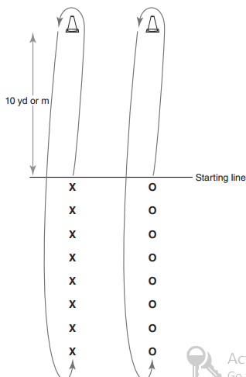
Exercises
File Relay

Slide 94
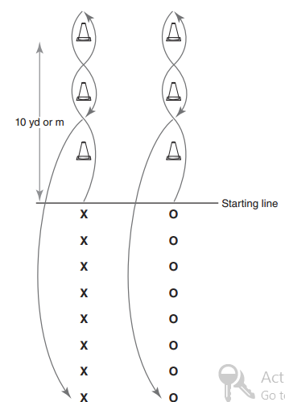
Slalom Relay

Slide 95
