Slide 1
The Warm-Up
Ian Jeffreys, PhD, ASCC, CSCS,*D,

Slide 2
CHAPTER 1
Why We Warm Up

Slide 3
Reasons for Warming Up
To maximize subsequent performance
To reduce the risk of injury

Slide 4
The Physiology of Warming Up
When the body is at rest, a range of physiological mechanisms remain at a level well below their optimal functioning level To reduce the risk of injury.
A body at rest is unprepared for activity and as we warm up, we are, in essence, preparing the body for a specific activity.
As activity increases, there will be a net increase in muscle temperature, and, eventually, the athlete’s core temperature.

Slide 5
The Physiology of Warming Up
Warm Up
increase in muscle temperature
quality of the neural activation
increased availability of calcium in the muscle sarcoplasmic reticulum
faster muscle contraction
increase the elasticity of muscle, allowing a greater range of motion
increase
in the force and power
Causing them to move more freely, efficiently, and effectively.
Treppe or staircase effect

Slide 6
The Physiology of Warming Up
Warm Up
production of carbon dioxide at the working muscles
increase in blood flow
oxygen delivery
Increase in the breathing rate and breathing depth
higher muscle temperatures
enhanced metabolic reactions
facilitate oxygen release from hemoglobin and myoglobin
Aerobic energy system will be progressively activated

Slide 7
Psychological Rationale for Warming Up
However, it could be argued that many of the methods used in traditional warm-ups such as extended aerobic activity and extensive static stretching do nothing to address the psychological requirements of the warm-up.
the warm-up needs to adequately address the technical requirements of the sport along with physical prerequisites for the training session.
needs to be a skill element to the warm-up, especially in precompetition warm-ups.

Slide 8
Psychological Rationale for Warming Up
In reality, the balance between physiological, psychological, and skill preparation will depend on the type of sport, the individual needs of the athlete, and the type of warm-up being undertaken.
flight-or-fight response
Therefore, careful control of the warm-up to optimize the athlete’s psychological state is important.

Slide 9
Net Potential Effects of Warming Up
Strength and power performance
Flexibility and mobility performance
Warm Up
Endurance performance
Skill performance
Psychological readiness for the subsequent activity
Speed and agility performance

Slide 10
The Warm-Up and Injury Risk Reduction
increase in muscle elasticity
increase in the strength and power potential
Warm Up
increasing functional range
of motion
reduce the risk of muscle injury
reduce the likelihood of a
muscle tear

Slide 11
Psychological Rationale for Warming Up
warm-up, the maximization of each will require distinctly different activities.
not optimize performance in the neural and
muscular systems
a general period of aerobic exercise
positively affect the body’s cardiovascular, respiratory, and metabolic systems
not address the skill
nature of activity
allowing optimal performance in endurance-based activities

Slide 12
CHAPTER 2
A New Way of Thinking About the Warm-Up

Slide 13
The Traditional General and Specific Warm-Up
The most common structure to design a warm-up is divided into two phases:
general warm-up followed by a
specific warm-up.
The general warm-up phase is mainly aimed: temperature-related benefits of a warm-up, plus those of diverted blood flow.
period of aerobic exercise starting at a low intensity and slowly building to an intensity 60 percent of V˙ O2max. such as jogging or riding a stationary bike.

Slide 14
The Traditional General and Specific Warm-Up
followed by a period of stretching, which has typically been static in nature, whereby the major muscle groups of the body are typically targeted with a top-down (starting at the head and moving to the ground) or a bottom-up (starting at the feet and moving to the head) approach.
A recent trend is to shift from static stretching to more dynamic stretching within the general warm-up structure.
specific warm-up, includes the performance of activities that resemble the upcoming requirements of the training session or competition.

Slide 15
The Traditional General and Specific Warm-Up
General Warm-Up typically fail to maximize subsequent athletic performance.
Because they fail to address many of the physiological mechanisms required for maximal performance.

Slide 16
Competition Versus Training Warm-Ups
For the competition warm-up, short-term performance will normally be the primary goal, especially at higher levels of competition.
This needs a focus on both physical and psychological preparedness.
Here, warm-ups need to be planned in a way that optimally prepares the athlete for competition yet does not induce fatigue.

Slide 17
Competition Versus Training Warm-Ups
While physical preparation will be important, perhaps of equal importance in competition warm-ups is the psychological preparation and skill-based preparation.
athletes tend to prefer familiarity and consistency.
the RAMP-based approach is a highly effective structure around which to build effective competition warmups.

Slide 18
Competition Versus Training Warm-Ups
Training warm-ups should be thought of as a part of the athlete’s athletic development program and as an integral part of the athlete’s training session.
Ideally, they should be intricately linked with the upcoming session, so that there is a seamless transition between the warm-up and the main training session itself.
If a warm-up is effectively planned, an athlete should be unable to differentiate between when the warm-up ends and the main training session starts.

Slide 19
The RAMP System of Warming Up
CHAPTER 3

Slide 20
RAMP protocol
The RAMP protocol itself considers the physiological, psychological, and skill basis of the warm-up process.
However, unlike traditional warm-ups, it also considers the medium- and longer-term development of the athlete.

Slide 21
Athleticism
Sport performance is dependent on a balance between four types of capacity: technical, tactical, physical, and psychological.
The main focus is typically on the technical and physical realms, because the other two realms require focused efforts best carried out in other parts of the session.
Technical performance is dependent on the development of a number of basic skill capacities.
For example, in soccer (European football) skills such as first-touch control, dribbling, passing, and shooting.

Slide 22
Athleticism
Given that the amount of deliberate practice appears to be the most important factor in the development of skill, integrating skill learning opportunities into a warm-up is a time-efficient method of increasing the quantity of skill practice.
Athleticism is the ability to perform sport-related tasks with a high degree of efficiency, control, and effectiveness.

Slide 23
The RAMP System
The term RAMP is based upon three distinct phases of the warm-up, each with a distinct focus:
R: Raise
AM: Activate and Mobilize
P: Potentiate
In this way, throughout a RAMP warm-up, all opportunities to enhance the quality of movement capacity and skill capacity are explored.

Slide 24
The Raise Phase
The first part of a warm-up therefore needs to focus on raising these key physiological parameters, namely blood flow, muscle temperature, core temperature, muscle elasticity, and the quality of neural activation and conduction.
This is achieved through the targeted use of low-intensity movements.
within the RAMP system these activities are carefully targeted and specific to the training goal of athletic development.
To achieve this, two types of Raise protocols are generally used, namely movement development protocols and skill development protocols.

Slide 25
Movement Protocols
In the main, movement-based Raise phase, protocols will focus on key locomotor patterns.
The Gamespeed System, outlines three major categories of movements based on their functions: initiation movements, actualization movements, and transition movements.
Initiation movements involve starting and changing the direction of movement.
actualization movements involve an athlete trying to maximize movement speed,
transition movements involve an athlete waiting to read and react to the evolving game and either initiate acceleration or perform a sport skill.

Slide 26
Movement Protocols

Slide 27
Skill-Based Protocols
Skill-based Raise patterns involve the use of key skills related to the sport to raise the key physiological parameters.
The skills chosen should link in with a major aim of the session. For example, a soccer session that works on maintaining possession can start with skills requiring the development of dribbling, passing, and first touch control capacities.
In contexts where multiple sports are practiced, or in general areas such as physical education classes more general skills. Here catching-, hitting-, kicking-, and throwing-based activities can be included which provide for multiple skill practice.

Slide 28
The Activation and Mobilization Phase
Many research papers have been published on the acute effects of static stretching on performance.
Largely, the results are equivocal, with some studies showing a reduction in subsequent performance on strength power speed and agility scores, but with others showing no reduction, unless the stretch is held for over 30 seconds.
One challenge of static stretching is that it is, by its very nature, static, and so many of the benefits of the Raise phase of the warm-up are lost as an athlete undertakes this static stretching routine.

Slide 29
The Activation and Mobilization Phase
Again, it is crucial to remember that one of the aims of the warm-up in the short term is preparation for performance in an efficient and effective manner and not as a means of increasing flexibility.
This is not to say that static stretching is not a useful modality for increasing flexibility; it will always be an important tool, but is best carried out as a separate session and not as part of a warm-up.

Slide 30
The Raise Phase
CHAPTER 4

Slide 31
Introduction
As outlined previously, the first phase of a warm-up should starts at a low intensity and gradually builds to a moderate intensity as it progresses.
The net effect is to induce the temperature and non-temperature-related benefits of the warm-up such as increased and diverted blood flow, increased muscle temperature, increased core temperature, increased oxygen delivery, and faster muscle contraction.

Slide 32
Introduction
This also helps activate the aerobic system while not overly inducing fatigue in the initial anaerobic systems.
In this way we now lose the term general and replace it with raise.

Slide 33
Activity Progression
During the Raise phase of the warm-up there will be progression in three ways:
1. Low intensity to moderate intensity
2. Simple movements to complex movements
3. Low cognitive challenge to high cognitive challenge
While the intensity is a relatively easy element to control.

Slide 34
Activity Progression
Movement complexity is generally increased by moving from single movements to combined movements.
So, for example, at the start of the warm-up, movements such as side shuffling, backpedaling, and linear running can be separated.
However, as the warm-up progresses, these can be combined, such as a move from side shuffling into backpedaling, or side shuffling into linear running.

Slide 35
Activity Progression
Cognitive challenge can be increased by the way in which practices by increasing the number of decisions an athlete needs to make during the performance of the movements.
practices are varied, and where their allocation is random, there is an increase in cognitive challenge and an associated increase in skill development.

Slide 36
Activity Progression
So, for example, with the backpedaling, side shuffling, and linear movement patterns listed earlier, these could be more randomly allocated within the warm-up.
Additionally, they can be varied in terms of their speed, their distance, their direction, and so on.

Slide 37
Activity Progression
Another key way of increasing the cognitive challenge is by increasing the degrees of freedom within a given exercise.
So, for example, a situation in which an athlete runs forward from cone A to cone B, before backpedaling to cone A, and then running forward again to cone B, is a relatively closed skill.
If the athlete is then asked to start the backpedal at a random point, a temporal or timing degree of freedom is added.

Slide 38
Activity Progression
In addition, if during the backpedal the athlete is then asked to accelerate forward in a direction dictated by a coach’s signal, this also adds a spatial degree of freedom.
It is also possible to incorporate game-type activities into the Raise phase.

Slide 39
Activity Progression
Within these variations, a wide variety of warm-up applications can be developed; they can start with developing fundamental movement patterns and progressively developing them into key movement combinations, sports generic movement patterns, and eventually sport-specific movement patterns.
The relative emphasis on basic or advanced skills will depend on the athlete.

Slide 40
Types of Raise Phases
the Raise phase of the warm-up can be divided into two types:
movement-based warm-ups
and skill-based warm-ups.

Slide 41
Movement-Based Raise Patterns
Movement-based warm-ups typically focus on developing the locomotor patterns that underpin sport performance.
The Raise phase is subsequently designed to develop and reinforce all of the key movement patterns that have been identified and provide athletes with the movement vocabulary to perform in practically all team and court sports.

Slide 42
Movement-Based Raise Patterns
Within this syllabus, emphasis essentially focuses on movement in three main dimensions: forward and back, side to side, and up and down, with combinations of these (such as diagonal work) also being addressed.

Slide 43
Key Movement-Based Raise Phase Setups and Patterns
The key setups and patterns commonly used for movement-based Raise phases include the following:
• Lines
• Staggered lines
• Bags
• Boxes
• Pitchforks
• Trellis

Slide 44
Lines
Set up two sets of three cones 5 yards (or 5 meters) apart to create a channel 10 yards (or 10 meters) in length (figure 4.1).
The working lane will be the area between the cones.
Athletes will line up in two lines, one behind the other.
Movement pattern work will be carried out within the working lane, moving from cone A to cone C.
Recovery jogging or walking will take place from cone C back to cone A outside the working lane.

Slide 45
Basic Pattern Example
1. Run from cone A to cone C using an acceleration, form-running technique.
2. Run from cone A to cone C using an acceleration, form-running technique; then decelerate to a square stance at cone C.
3. Start at cone A facing into the lane. Hip turn and run from cone A to cone C using an acceleration, form-running technique; then decelerate to a left-leading staggered stance at cone C.
4. Start at cone A facing away from the lane. Hip turn and run from cone A to cone C using an acceleration, form-running technique; then decelerate to a right-leading staggered stance at cone C.

Slide 46
Basic Pattern Example
5. Backpedal from cone A to cone C.
6. Side shuffle from cone A to cone C (facing into the middle of the lane).
7. Side shuffle from cone A to cone C (facing out of the lane).
8. Backtrack from cone A to cone C.
9. Cross-step run from cone A to cone C (facing into the middle of the
lane).
10. Cross-step run from cone A to cone C (facing out of the lane).

Slide 47
Combined Pattern Example
1. Run from cone A to cone B, and break into a faster run when running from cone B to cone C.
2. Run from cone A to cone B, break into a faster run at cone B, and decelerate to a square stance at cone C.
3. Side shuffle, facing into the lane, from cone A to cone B; at cone B hip turn and break into a run to cone C.
4. Side shuffle, facing away from the lane, from cone A to cone B; at cone B hip turn and break into a run to cone C.
5. Cross-step run, facing into the lane, from cone A to cone B; at cone B hip turn and break into a run to cone C.

Slide 48
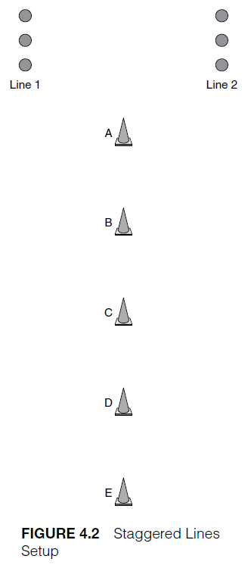
Staggered Lines
1. Place five cones 3 meters (or 3 yards) apart.
2. Athlete 1 starts at cone A and runs forward from cone A to cone B, decelerates at cone B with a plant step, backpedals to cone A, and then repeats the sequence to cones C, D, and E, back pedalling back to cone A each time. When finished, athlete 1 rests while athlete 2 takes a turn. Repeat three times.

Slide 49
Staggered Lines
4. Remove cones B, C, and D. Repeat the forward backpedal pattern, but this time the change of motion will occur on a coach’s signal. Repeat four times.
5. Repeat the forward side shuffle pattern, but this time the change of motion will occur on a coach’s signal.
6. Run forward from cone A to cone E. At cone E perform a cut in the direction of the coach’s signal.

Slide 50
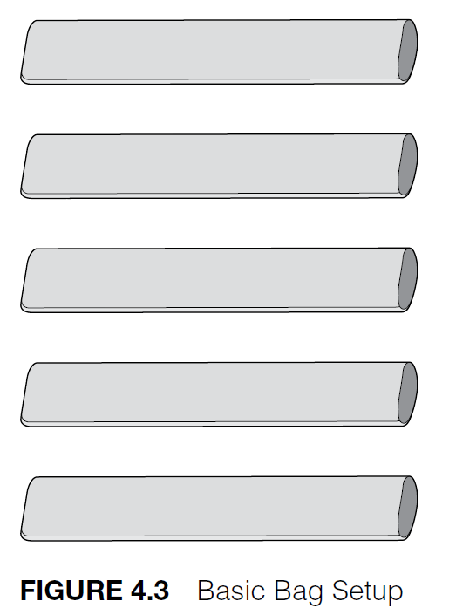
Bags
Larger bags allow for the focus to be placed on the individual movement patterns, and smaller bags place a larger focus on the ability to move effectively between the patterns being targeted.

Slide 51
Bags

Slide 52
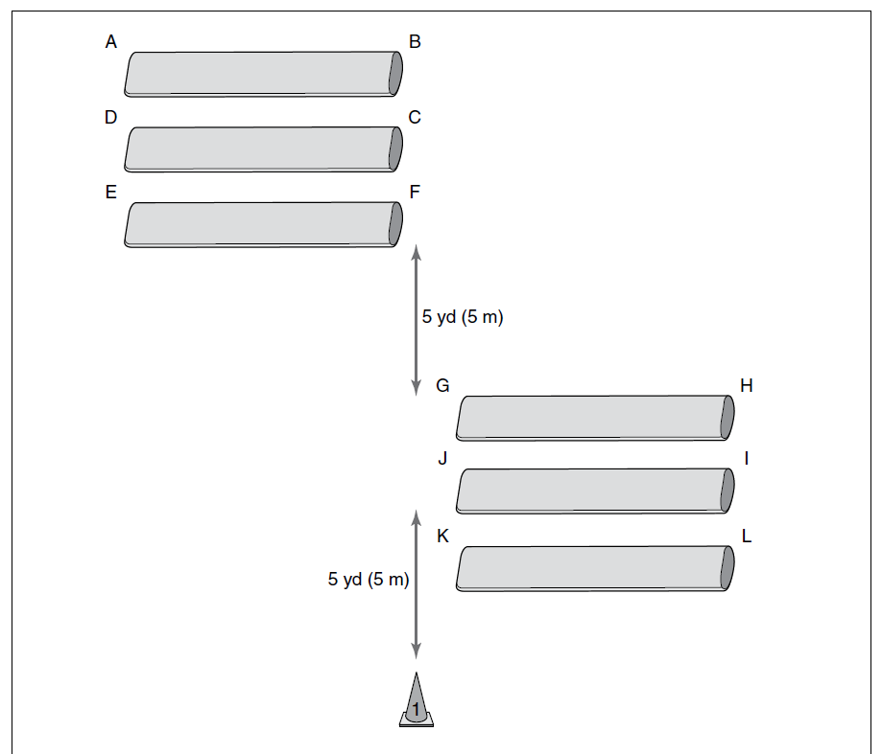
Bags
Start at point A, facing point D. Side shuffle to point B. Use a cut step to decelerate; then run forward to point C. Side shuffle to point D. Run forward to point E and side shuffle to point F. Use a cut step to stop lateral movement and run forward to point G. Decelerate to an athletic position, side shuffle to point H, use a cut step to decelerate, run forward to point I, and then side shuffle to point J. At point J, use a cut step to stop lateral movement and run forward to point K, and then side shuffle to point L. At point L, use a cut step to decelerate and run forward 2 yards to cone 1.

Slide 53
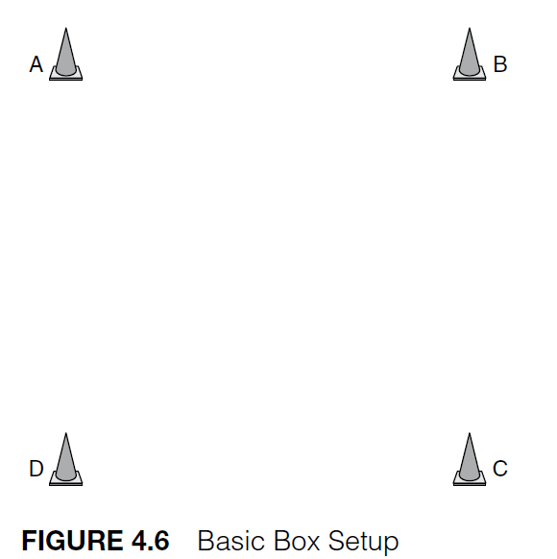
Boxes
The size of the box can be varied to change the emphasis and the challenge of the exercise.
Larger boxes allow for the focus to be placed on the individual movement patterns, and smaller boxes focus on the ability to combine the patterns being targeted and switch between movement patterns.

Slide 54
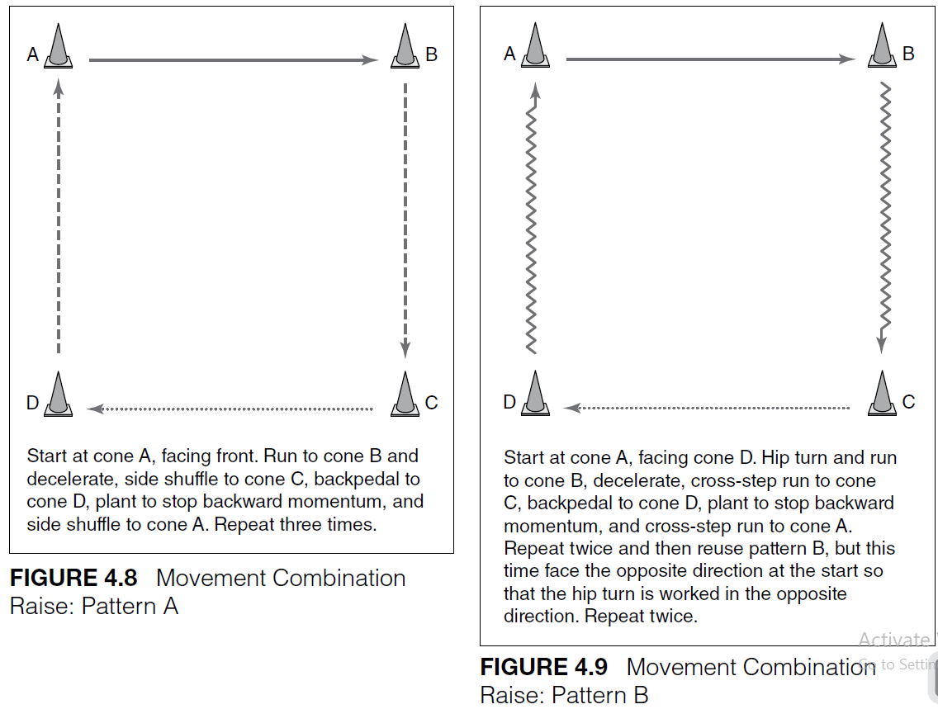
Boxes

Slide 55
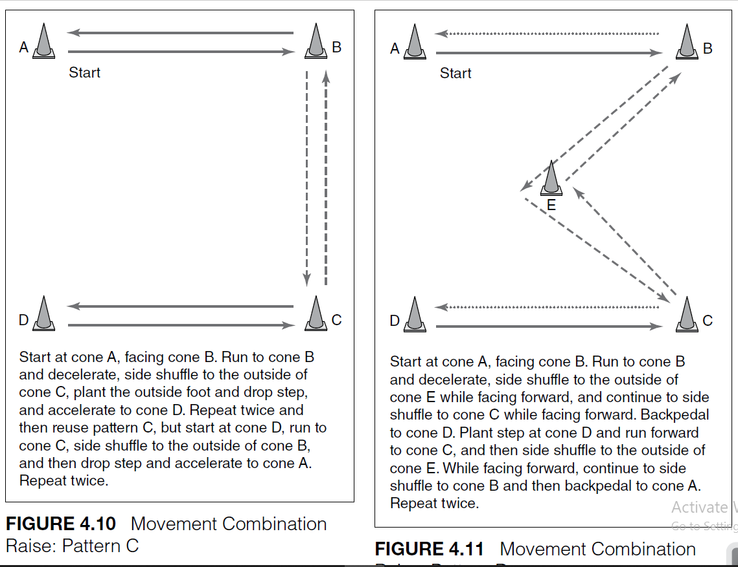
Boxes

Slide 56
Skill-Based Raise Patterns
The difference is that the emphasis is placed on the performance of sport-related skills as opposed to the development of movement.
The aim is to provide the athletes as many opportunities to perform key skills as possible.
start at a low intensity and provide for the appropriate movement
Activities such as basketball dribbling, soccer dribbling, and rugby passing provide ideal activities for this phase of the warm-up.
Subsequent activities can look to increase the complexity of the skills, the intensity of the movement, or both.

Slide 57
Skill-Based Raise Patterns
An increase in skill complexity can be achieved in a number of ways, such as requiring various variations on the dribbles and on the passes.
Similarly, cognitive challenges can be enhanced by adding variations in the application.

Slide 58
Key Skill-Based Raise Phase Setups and Patterns
• There-and-back lines
• Opposite lines
• Grids
• Crosses

Slide 59
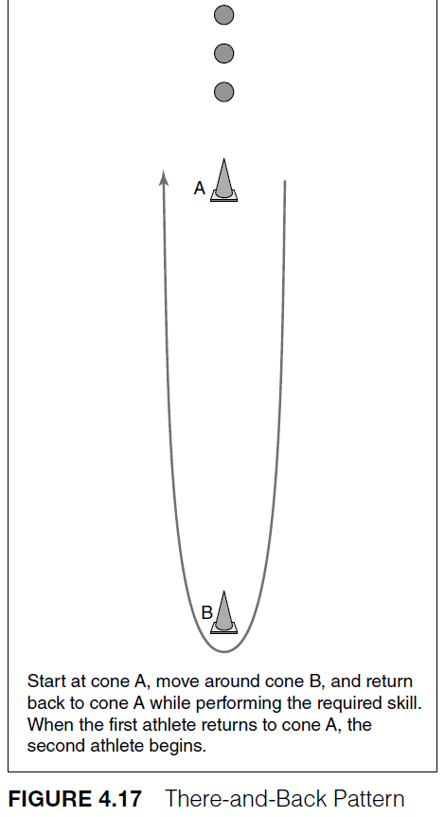
There-and-Back Lines
This is the simplest of all skill
patterns and it is often used at
the outset of skill development
to introduce skills such as dribbling
(figure 4.17).
Number of athletes in a group to three or four
Where large groups are involved, multiple lanes need to be set up. Distances can be varied depending on the skill or level of ability, but approximately 10 yards (or 10 meters) is generally an appropriate distance.

Slide 60
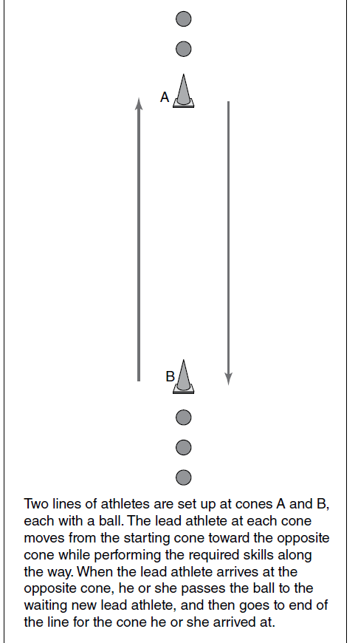
Opposite Lines
This setup has an advantage over the there-and-back pattern in that it greatly increases the amount of work carried out in a time period and also adds the need for greater communication between athletes.
Distances can be varied depending upon the skill or level of ability, but 10 yards (or 10 meters) is normally appropriate.

Slide 61
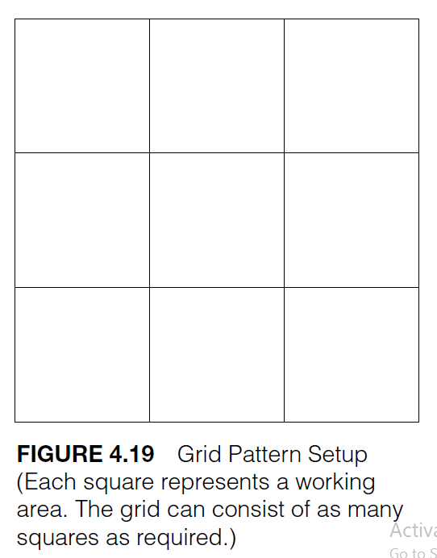
Grids
A very simple yet effective pattern for dribbling or control-based skills is a grid.
The confined area, combined with other athletes moving within this area, provides a challenge when performing even the most basic skills. Add variety and challenge by increasing the number of athletes in each square; the greater the number, the greater the interference effect.

Slide 62
Grids
A very simple yet effective pattern for dribbling or control-based skills is a grid.
The confined area, combined with other athletes moving within this area, provides a challenge when performing even the most basic skills. Add variety and challenge by increasing the number of athletes in each square; the greater the number, the greater the interference effect.

Slide 63
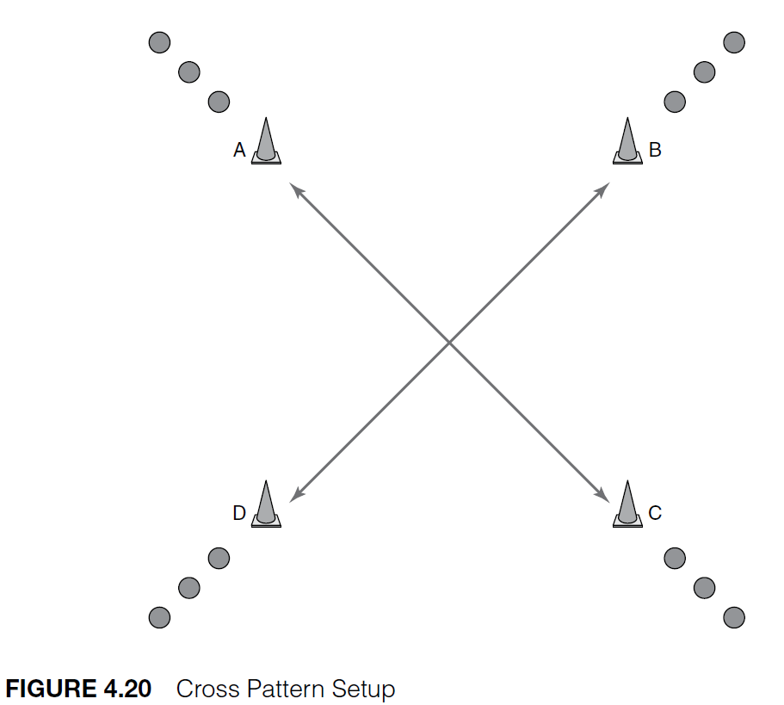
Crosses
Athletes performing the skill as they move between cones. The simplest setup is with a ball moving in each diagonal direction (e.g., at cone A and cone D). The full setup places a ball at all cones.
For example, linear running and deceleration in a soccer practice can be combined with passing, first touch drills, or both.

Slide 64
Organizing a Raise Phase
For maximum effectiveness, the activities in the Raise phase should be integrated with either the main training session aims or the development program of the athlete.
Planning of the warm-up should always consider the main aims of the session itself.
For example, if the main aim of the session is defensive movement, then movements included in the Raise phase should contribute to effective defensive movement, such as jockeying and backtracking.

Slide 65
Organizing a Raise Phase
However, this should not be the only consideration; we must always remember that the Raise phase provides opportunities to reinforce technical capacity in a wide range of skills and movement patterns, which may or may not be directly involved in the upcoming session.
Raise phase, which typically lasts 5 to 10 minutes.

Slide 66
Appropriate Challenge and Intensity
Activities selected need to have an initially low intensity to ensure that there is a gradual acclimation to the exercise load.
An important consideration is that the inclusion of a skill into a movement pattern normally increases the energy cost of that activity.
As the phase continues, intensity can be increased; but remember that the high-intensity activities will come in the Potentiation phase, so there is no need to reach high intensities at this stage.

Slide 67
Sequential Structure
Once the activities have been chosen, then their structural integration into the session should be considered.
Initial activities should be of a low intensity, but the coach or athlete should make progressions.
Importantly, the activities should be linked to the activities of the Potentiation phase to follow.

Slide 68
Appropriate Duration
The warm-up is always a balance between performance enhancement and fatigue.
Typically, this phase will take 5 to 10 minutes, with the duration depending on the type of activity undertaken, the athlete’s condition, and the environment.

Slide 69
The Activation and Mobilization Phase
CHAPTER 5

Slide 70
Long-Term Focus: Mobility
Mobility, or the ability to move effectively through a given movement pattern with effectiveness and efficiency, relies on much more than flexibility alone. Mobility requires a balance of flexibility, stability, and motor control.
The Role of Static Stretching
stretching during a warm-up has any effect on the reduction of injury risk.
whether static stretching has a negative effect on strength power and speed performance.
During this, much of the raising benefits of the Raise phase are lost.

Slide 71
Focusing on Mobility
mobility exercises within this phase need to be performed predominantly in a slow and controlled manner, with the athlete actively moving through the range of motion.
activation and mobilization happen together, with the athlete activating the correct movement pattern to achieve the required mobility.

Slide 72
Focusing on Movement
stretching element of a warm-up has been on stretching individual muscles with little attention placed on enhancing movement capacity.
However, the focus of the Activation and Mobilization phase is on the use of movement to enhance mobility and movement proficiency.
A shift to a movement focus involves examining major movement patterns undertaken by the human body rather than focusing on individual muscle actions.

Slide 73
Focusing on Movement
eight major categories:
• Jump or triple extension
• Squat
• Lunge or step
• Bend
• Brace
• Rotate
• Push
• Pull

Slide 74
Key Joints

Slide 75
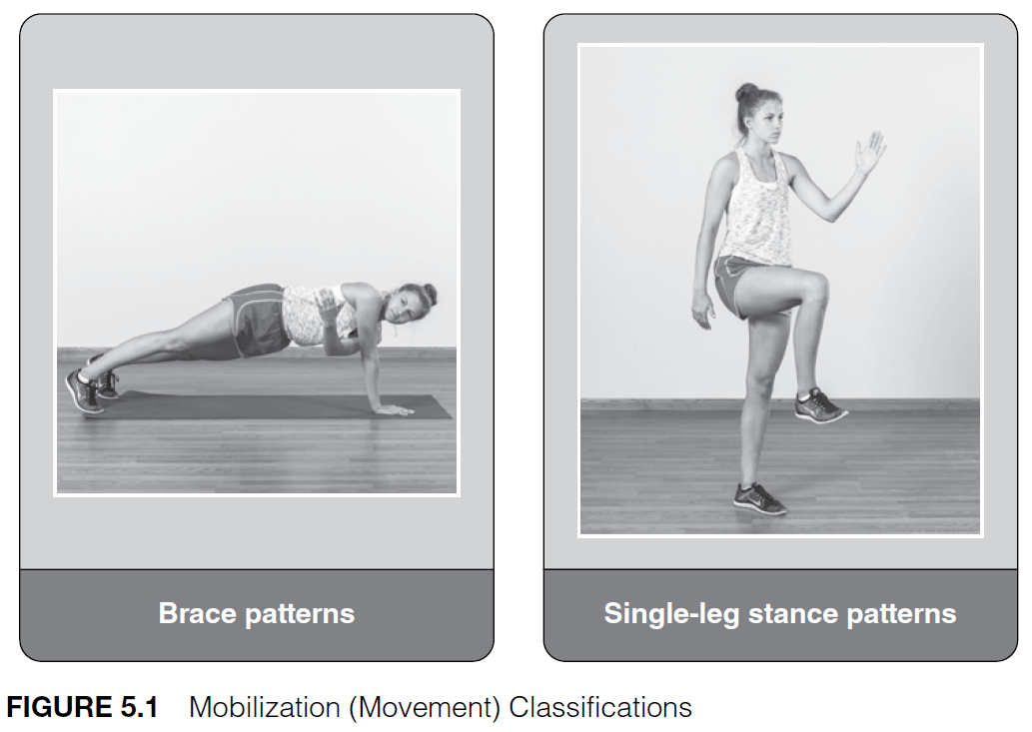
Mobilization

Slide 76
Initiating and Progressing the System
By selecting a movement from each fundamental movement pattern, an athlete’s mobility capacities can be systematically progressed, while ensuring that all of the major joints are appropriately mobilized.
These movement patterns will initially be isolated, allowing for focus to be placed on the appropriate technique for that movement pattern.
movements can also be effectively combined to provide movement challenges to the athletes that reflect the challenges they will face in the sport.
For example, a lunge pattern can be joined with a frontal plane rotation pattern.

Slide 77
Activation
Common challenges athletes may face include glute activation patterns (key to the optimal functioning of the hip), core activation patterns (essential for spinal stabilization and torso control), foot activation patterns, and activation patterns at the shoulder joint.
The ball and socket joint of the hip and shoulder allows for movement in multiple planes, a design that is both its strength and its weakness.
the Activation and Mobilization phase can be targeted at specific functional deficiencies, specific movements, or specific skills.

Slide 78
Activation
The focus on an Activation and Mobilization phase of each warm-up is an ideal opportunity to address any movement deficiencies and to ensure that all athletes have, and just as importantly maintain, effective fundamental movement capabilities.

Slide 79
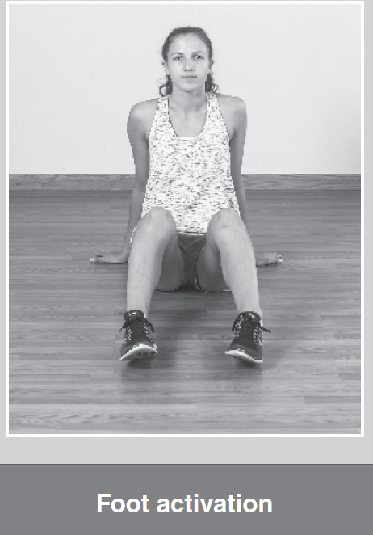
Activation

Slide 80
The Activation and Mobilization Process
1. Identify an athlete’s movement deficiencies or muscle activation patterns and select activities that address the deficiencies or challenges.
2. Identify the key movement patterns the athlete will need to perform (as well as the range of motion required) in the upcoming session.
3. Identify the key movement patterns the athlete will need for long term development.

Slide 81
Movement Deficiencies and Activation Patterns
This starts with an identification of any issues an athlete may have with motor programs, existing injuries, movement patterns, or activation patterns.
This analysis may often need to be carried out in conjunction with an athletic trainer or physiotherapist.
Importantly, this phase needs to be relatively short to ensure that the temperature-related elements of the previous phase are not lost, and so will consist of no more than three exercises that target specific capacities.

Slide 82
Movement Deficiencies and Activation Patterns
In many instances, athletes will not need this more corrective form of exercise analysis and thus the coach can move on to the second task, namely an identification of the key movement patterns required for the upcoming session.

Slide 83
Key Movements to be Performed in the Session
This analysis will look at the movement patterns to be performed in the upcoming session and ensure that the athlete is adequately prepared through the full range of movement required within these motions.
multiple joints allows for a time efficient and effective Activation and Mobilization phase to be designed.

Slide 84
Key Movements to be Performed in the Session
Here four to five exercises will normally suffice, each performed 8 to 12 times. This will normally take approximately 3 to 5 minutes to complete.
Athletes will simply move between two cones, typically for a distance of 10 yards or 10 meters.

Slide 85
Activation Exercises

Slide 86
Activation Exercises

Slide 87
External Rotation

Slide 88
Internal Rotation

Slide 89
Ys

Slide 90
Ts

Slide 91
Ls

Slide 92
Eversion, Inversion, Abduction, Adduction, Plantar Flexion, Dorsiflexion

Slide 93
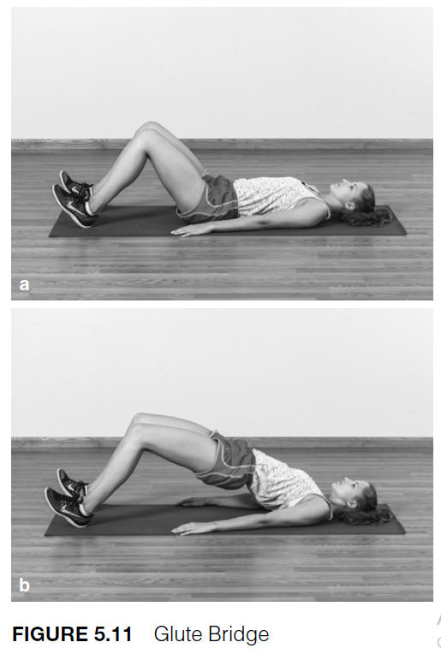
Prone Leg Raise

Slide 94
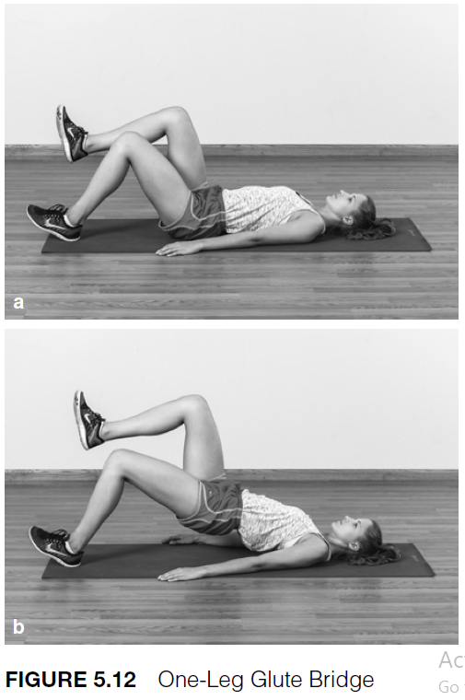
One-Leg Glute Bridge

Slide 95
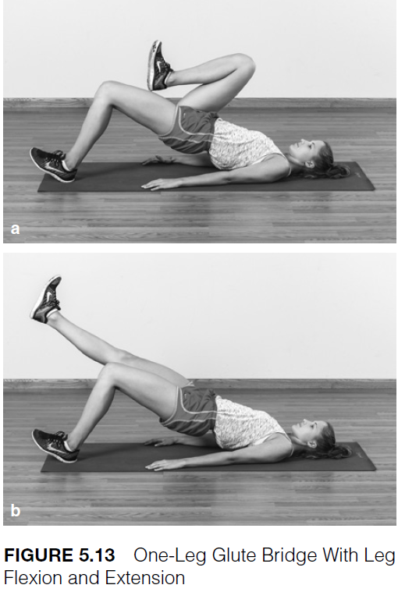
One-Leg Glute Bridge With Leg Flexion and Extension

Slide 96
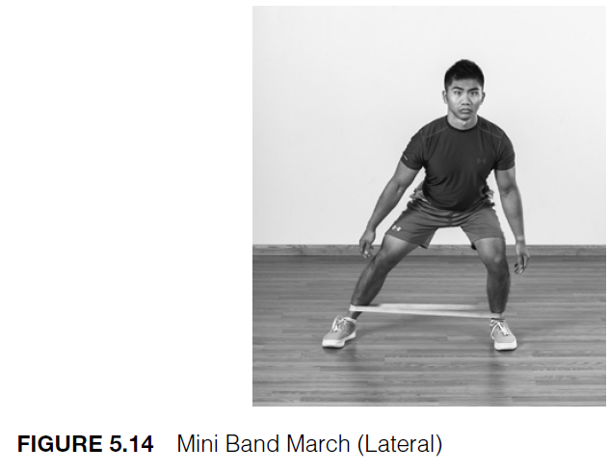
Mini Band March (Lateral)

Slide 97
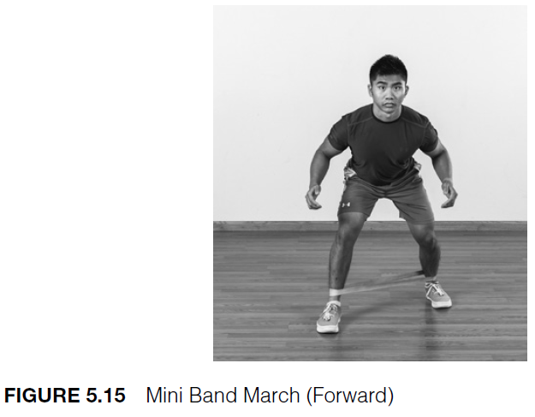
Mini Band March (Forward)

Slide 98
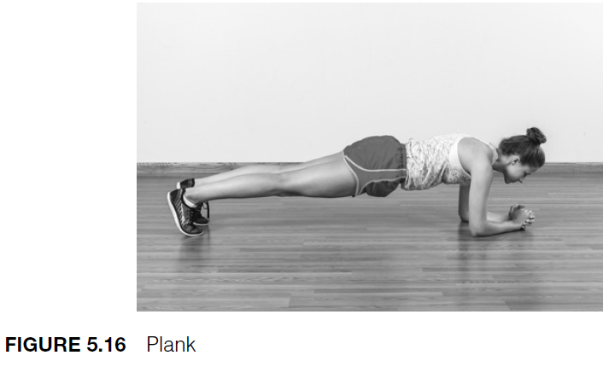
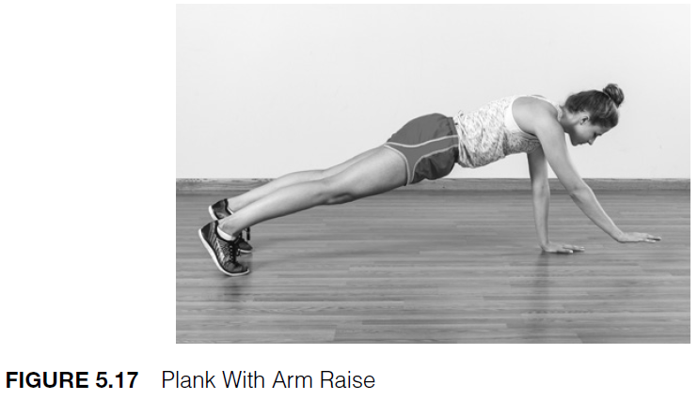
Plank

Slide 99
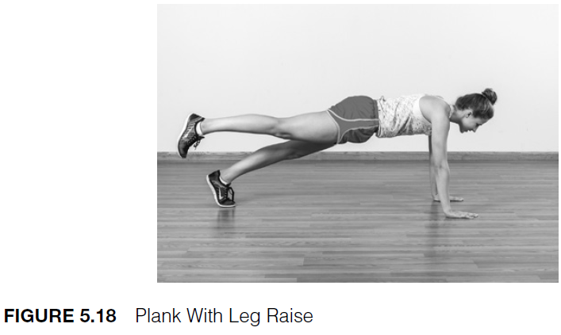
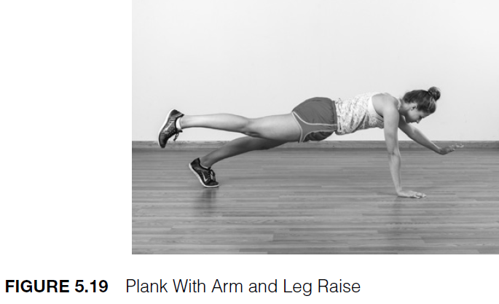
Plank

Slide 100
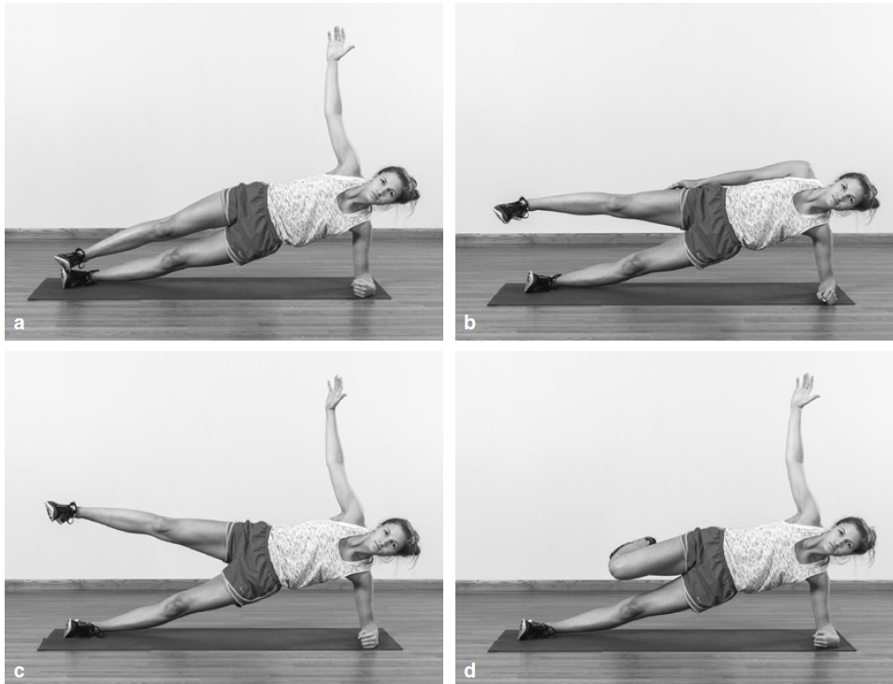
Plank

Slide 101
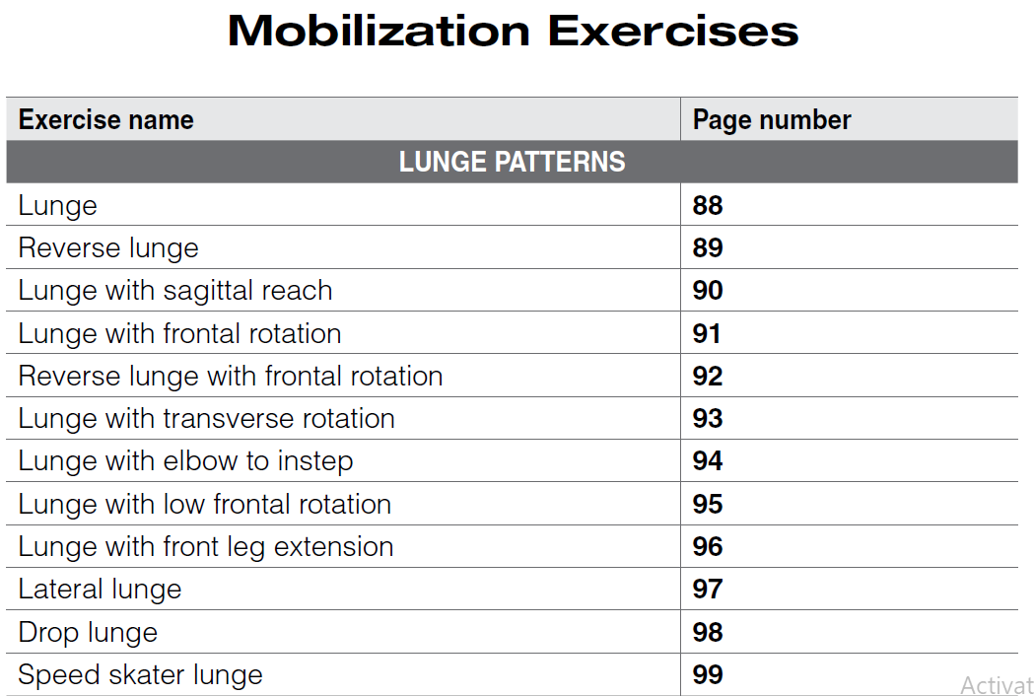
Plank

Slide 102
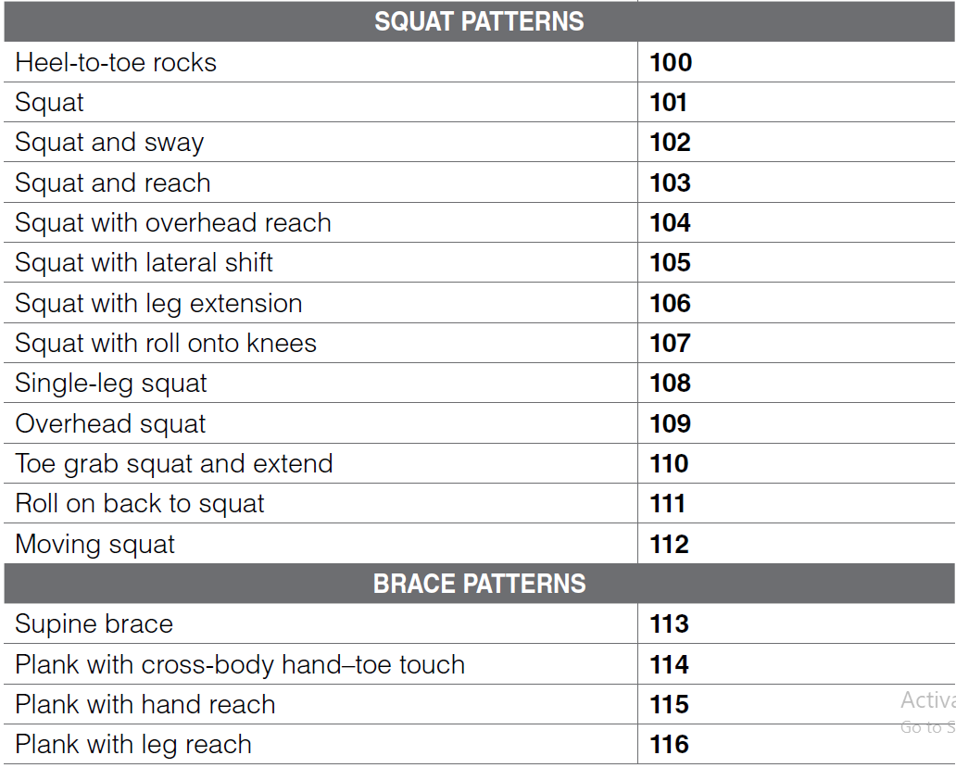
Plank

Slide 103
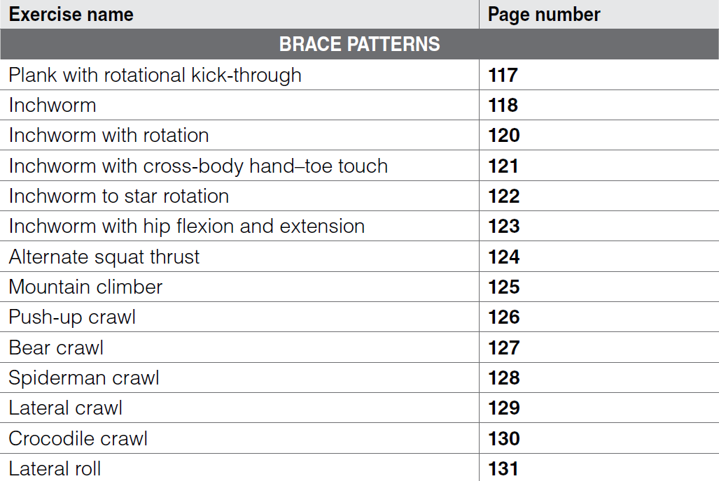
Plank

Slide 104
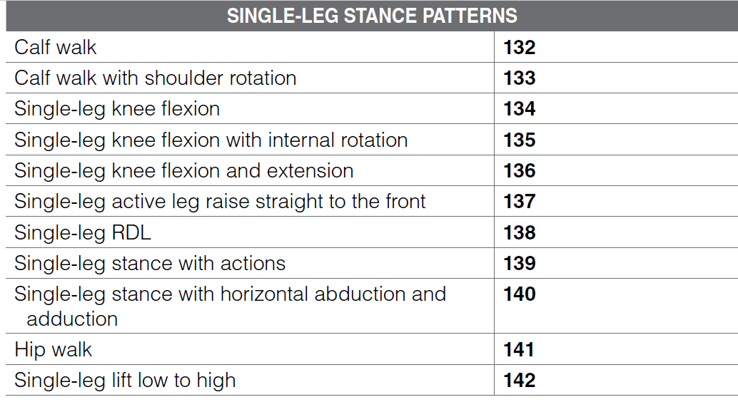
Plank

Slide 105
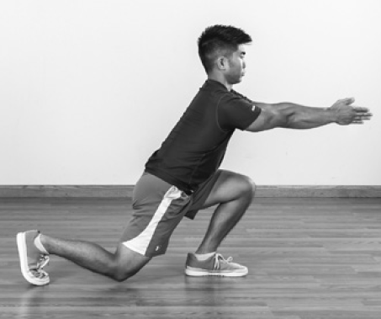
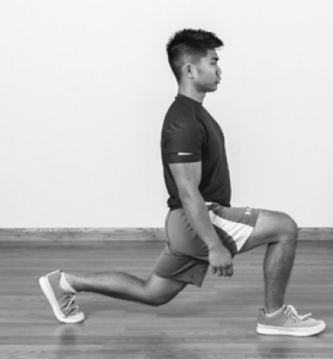
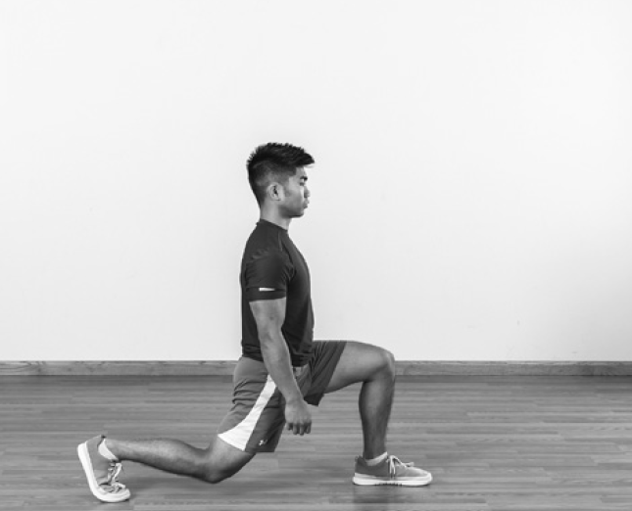
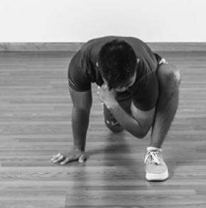
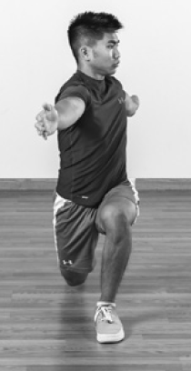
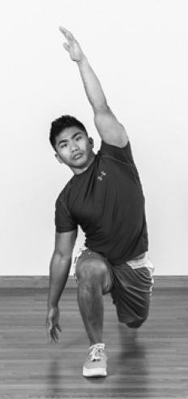
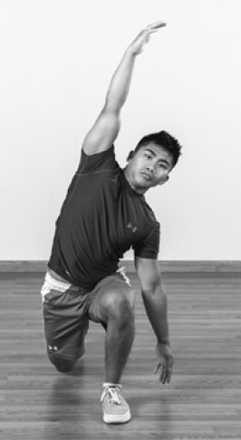
Lunge

Slide 106
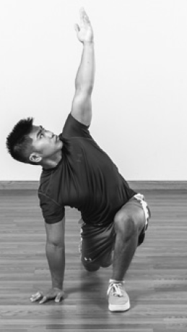
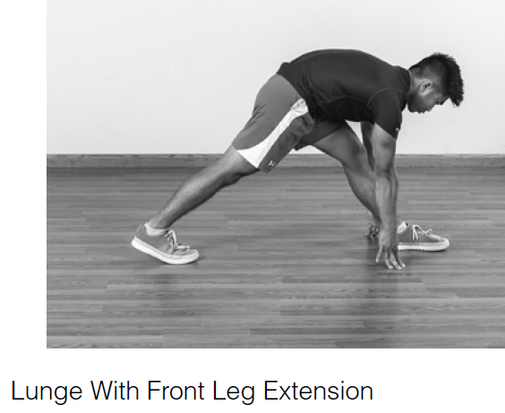
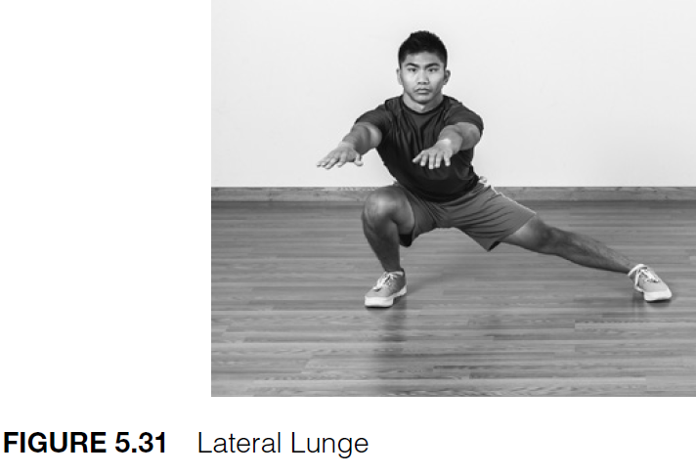
Lunge

Slide 107
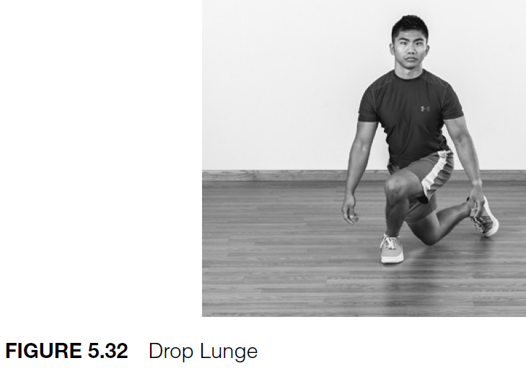
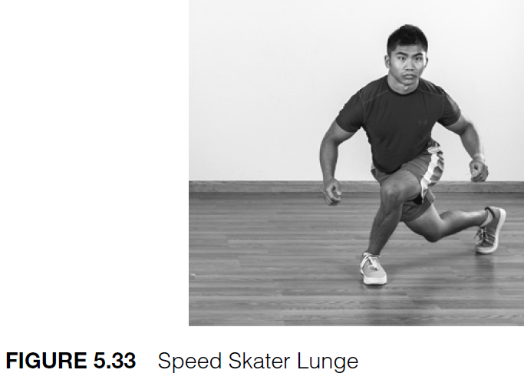
Lunge

Slide 108
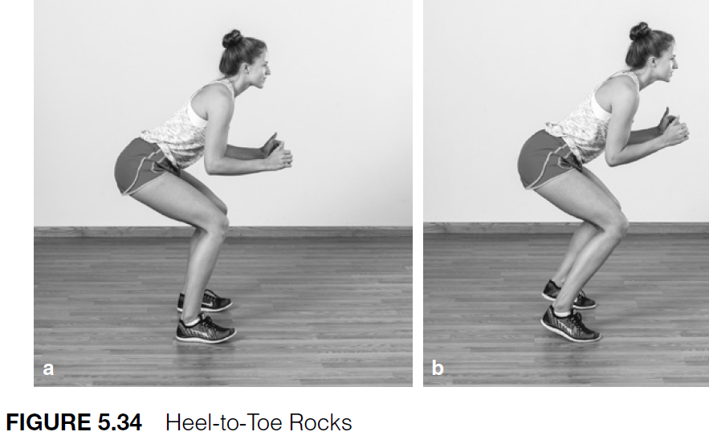
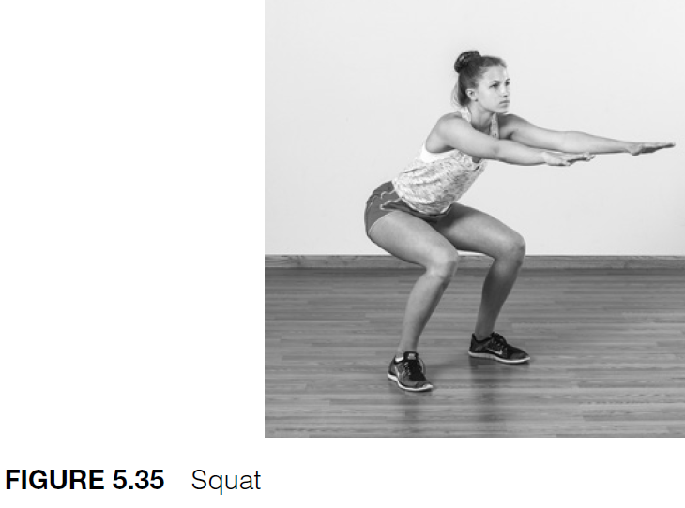
Lunge

Slide 109
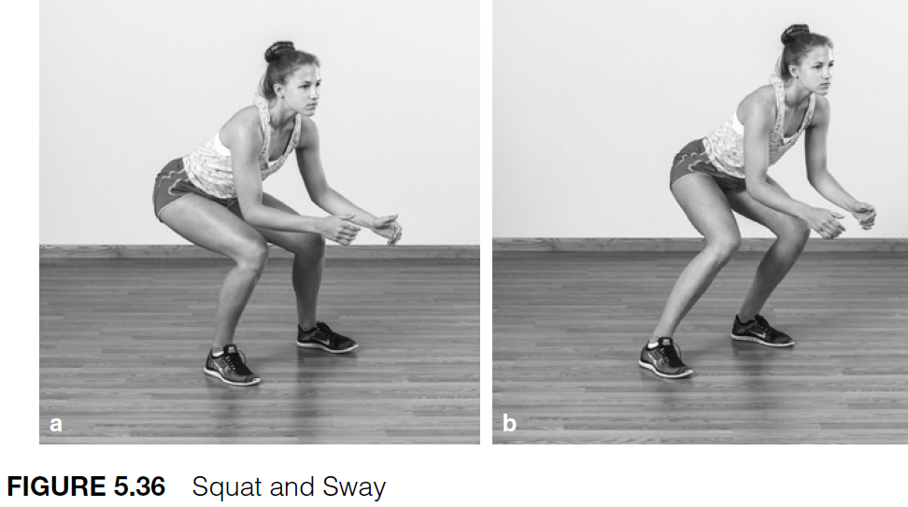
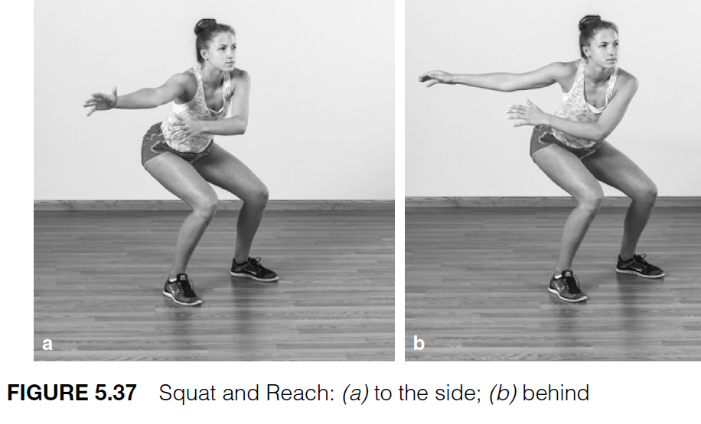
Lunge

Slide 110
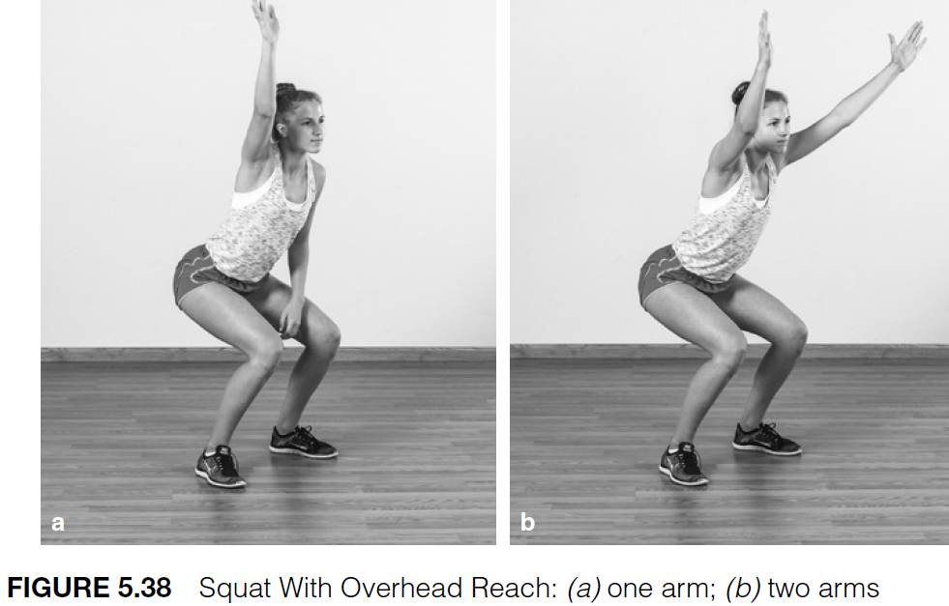
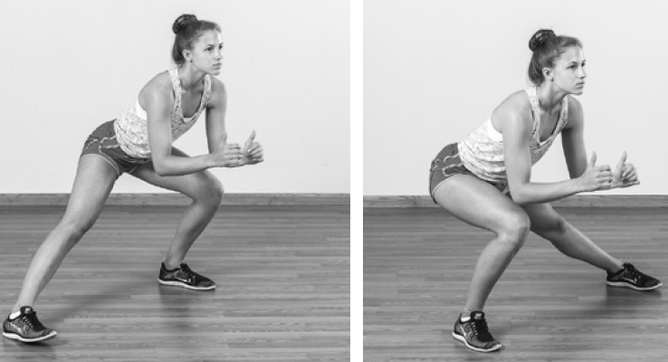
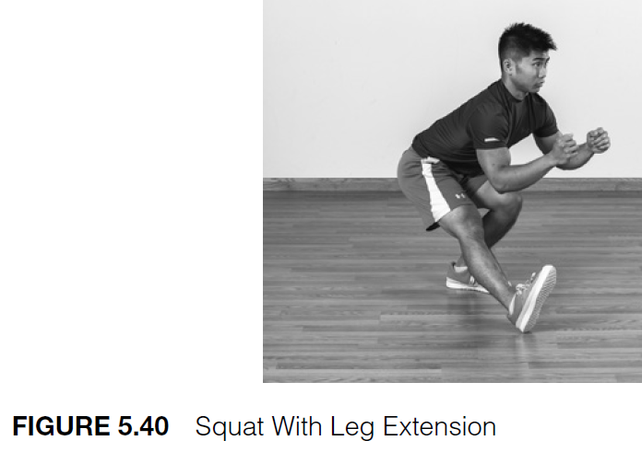

Slide 111
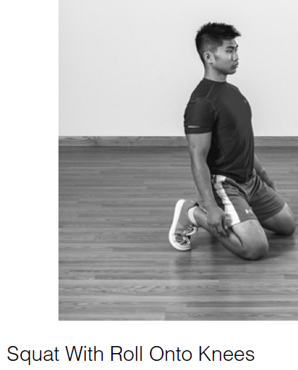
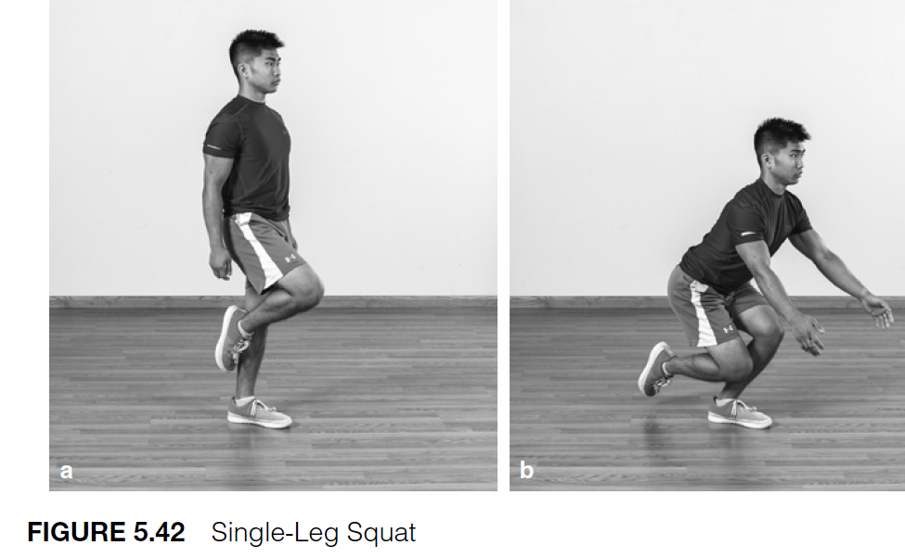

Slide 112
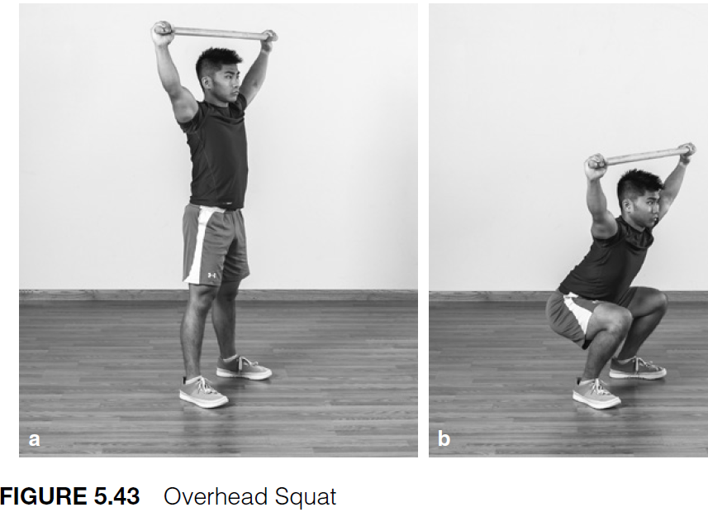
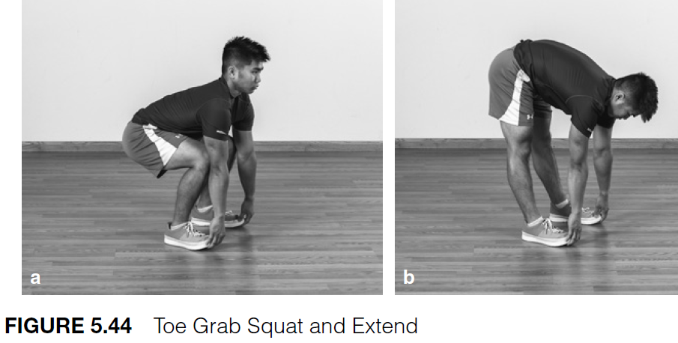

Slide 114
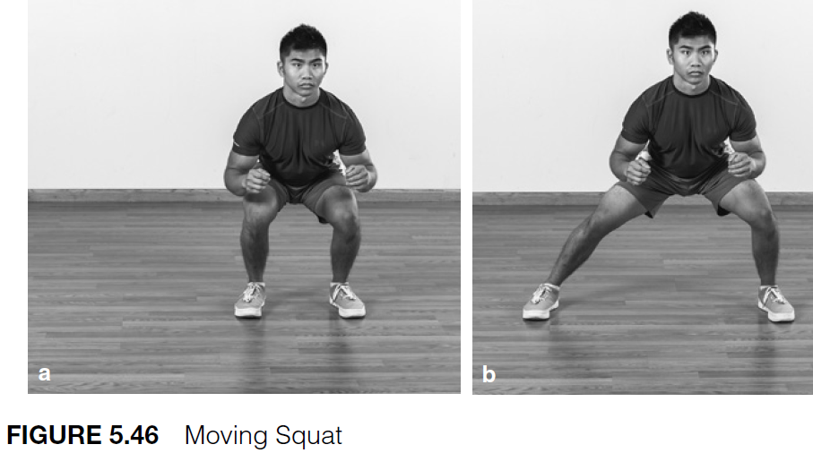

Slide 119
The Potentiation Phase

Slide 120
The Potentiation Phase
Essentially, the Potentiation phase is a transition between the Activation and Mobilization phase of the warm-up, where low intensity muscular actions have been performed, and the main training session itself.
It should provide a seamless transition for the athlete, focusing on the skills, movements, and physical capacities they will be required to perform in the subsequent training session or competition.

Slide 121
Focus of the Phase
Again the Potentiation phase can have a movement focus, a skill focus, or a combined focus.
Although planning to transition towards the main training session is a clear objective, it must not be the sole consideration. Again, training effectiveness and efficiency need to be considered.

Slide 122
Focus of the Phase
Here, an athlete can be both prepared for the upcoming training session but also work on key components of performance that may not be directly addressed within the main training session, but are still important elements of performance.

Slide 123
Duration of the Phase
Normally be 5 to 10 minutes
Athletes have always intuitively done this, for example, by performing progressively faster sprints or progressively increased lifting loads.
Additionally, for court and team sports, progression can be provided by increasing the cognitive challenge of the activity and by moving from general to specific scenarios.

