Slide 1
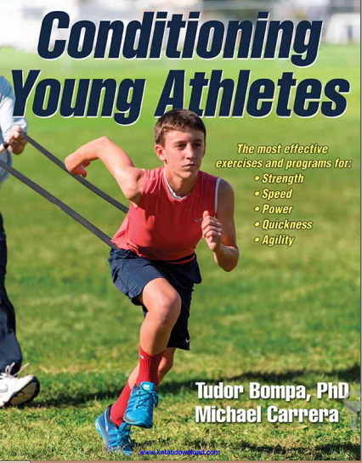
Conditioning Young Athletes
Mohsen Avandi
Semnan University

Slide 2
Speed Training
5
Avandi

Slide 3
Speed
Speed is one of the most important qualities necessary to excel in sports such as track and field and team sports performed on large fields (e.g., football, rugby, baseball).
In a few other team sports, such as basketball, handball, and lacrosse, athletes must run and move, react, or change direction quickly.
To have speed and agility, one needs to develop strength and power—an athlete can’t be fast or agile if she is not strong and powerful.

Slide 4
speed
The term speed incorporates three elements:
reaction time (the motor reaction to a signal),
movement time (the ability to move a limb quickly, as in martial arts, batting, or passing a ball), and
speed of running (including the frequency of arm and leg movement).
In team sports an athlete rarely performs action in a straight line, such as sprinting in track and field.
Players who can quickly change directions to receive a pass or deceive an opponent are highly regarded.
In this case, elements of speed—reaction time and speed of running in different directions—are combined.

Slide 5
speed
Many sport specialists believe that sprinters are born, not made, because speed depends on the athlete’s muscle-type composition.
Speed depends on the following:
Genetics. The higher the proportion of fast-twitch to slow-twitch muscle fibers, the faster the reaction and more powerful the muscle contraction.
Strength and power level of the athlete. Children cannot be expected to display a high level of speed before getting stronger.

Slide 6
physiological adaptation
Regardless of the physiological adaptation responsible for improving speed during prepuberty, children are encouraged to run, skip, and jump in many directions and at various levels of intensity.
The scientific literature shows that children who do not participate in activities that challenge the neuromuscular system and the development of motor skills early in life may not be able to approach activities in sport in the later years with vigor, determination, and physiological proficiency (Faigenbaum et al., 2013).
Even in the absence of traditional strength training, children are encouraged to play hard and give 100 percent effort in play.

Slide 7
Speed-Training Model for Initiation
The ability of prepubescent children to perform quick motions increases progressively in this early stage; both boys and girls develop speed in the later stage of athletic formation.
Some children, especially those who do not experience multilateral development, may have poor arm and leg coordination. Because arm drive directly influences leg frequency, a low level of coordinating arm and shoulder force impedes children’s ability to run fast.

Slide 8
Speed-Training Model for Initiation
The main reason for this is that boys start gaining strength during puberty due to an increase in hormones such as testosterone, whereas girls have very low, and therefore modest, gains.
The coordination of the arms and legs can be improved by repeating short distances (20-30 meters) with medium speed.
In such an exercise, learning limb coordination—not running fast—should be the objective.
Sex differences in running speed are not visible during early prepubescence.

Slide 9
Speed-Training Model for Initiation
These differences start to show as children approach puberty
with marked differences in speed development after the age of 15 years

Slide 10
Scope of Speed Training
One main goal of prepubescent sport activities is to develop play-specific speed.
Through exposure to play, games, and relays, children will learn how to coordinate their arms
They will learn how quickly to start moving parts of the body at a signal or in a play situation.
Prepubescent speed development is mainly the result of nervous system adaptation that children achieve through play and games

Slide 11
Scope of Speed Training
One way to challenge motor coordination and neural patterns of movement is to perform activities on difference surfaces. Because most school yards are paved in asphalt, which can be stressful on the joints,
children are also encouraged to play on softer surfaces such as grass
Variety in speed exercises is important because it improves motor experience
At the same time, children should not neglect the upper body. Simple throws using baseballs, tennis balls, or light medicine balls are useful for developing upper-body movement time

Slide 12
Scope of Speed Training
Unless children participate in sex-specific teams, most games, plays, and relays—especially in the school curriculum—should be coed because no visible differences between boys and girls exist at this developmental stage

Slide 13
Program Design
The duration of a drill or the distance to run should not be long
Children should not experience discomfort at this age. They should not run fast and continuously for longer than four to six seconds because longer distances require specific training.
If they pause for two or three minutes, then they can repeat the same action with enjoyment. Children do not have fun when they experience discomfort and pain
Young athletes, especially children who are approaching puberty, should increase distance progressively over years, from 20 meters or yards to 40 to 50 meters or yards.

Slide 14
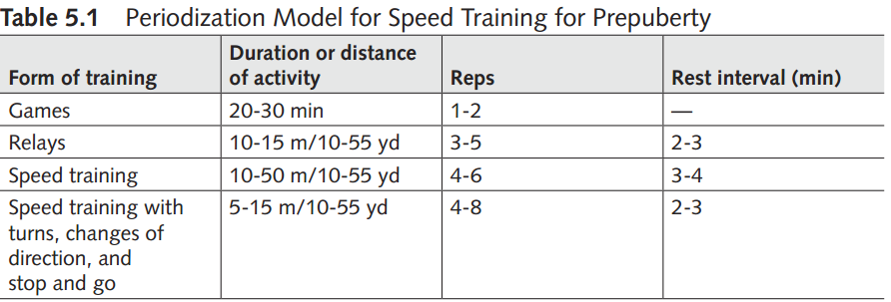
Program Design
In team-sport training or during games, the instructor can combine speed tasks with skill performance (e.g., throwing and kicking a ball).
For prepubertal children, the duration of a game does not have to be longer than 20 or 30 minutes.

Slide 15
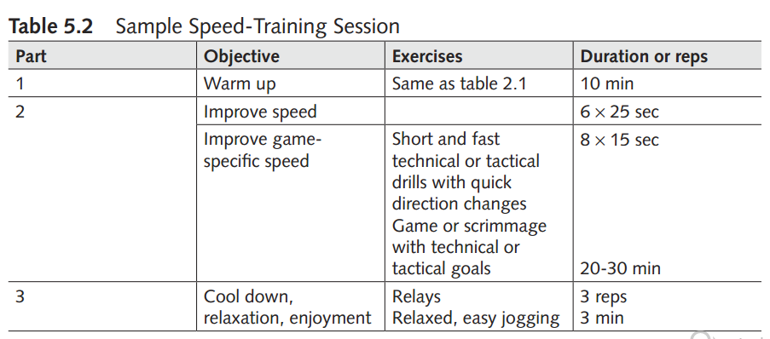
Program Design

Slide 16
Speed-Training Model for Athletic Formation
Speed development increases during puberty
Such improvement may relate to increases in body and muscle size
Strength gains positively influence speed development. From puberty on, the testosterone level in boys starts to increase dramatically, as does the ability to increase strength.
Although boys show clear improvements from the later stages of pubescence, girls seem to plateau in their rate of speed development

Slide 17
Program Design
As children approach postpubescence, they can increase the total amount of speed training.
distance run with high velocity from 20 to 50 or 60 meters or yards
Instructors can organize relays in ways that use many exercises, such as sprints, sprints with turns, runs around cones with direction changes, carrying or throwing medicine balls, or jumps over safe equipment at a low height
Instructors should also organize special exercises that improve reaction time

Slide 18
Program Design
Parallel with speed and movement time exercises, children should participate in simple exercises for power improvement
A critical element in speed training is the duration of the rest interval between repetitions. Because the ability to repeat high-quality exercises depends on the freshness of the neuromuscular system, the rest interval between repetitions must be as long as necessary to almost fully recover and restore the fuel needed to produce energy.

Slide 19
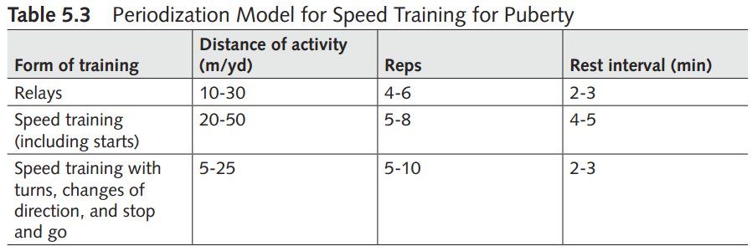
Program Design

Slide 20
Speed-Training Model for Specialization
Speed improvement comes with age. As children enter the postpuberty stage, gains in speed and movement time are more visible, especially for boys. Girls show the highest speed gains during late puberty and early postpuberty.
Boys maintain speed development throughout postpuberty. As they become stronger, they also become faster. The biggest difference between boys and girls is probably in the area of upper-body strength because from puberty on the upper-body strength of boys is constantly increasing.

Slide 21
Postpubescent speed training
Speed. High-velocity, high-frequency training at the highest intensity should be an important part, approximately 60 to 70%,Movement time.
Movement time: Training both speed and power will greatly improve the athlete’s ability to move a limb quickly.
Ability to overcome external resistance: To defeat such opposing forces, athletes have to improve their power. By increasing the force of muscular contraction, they can increase the acceleration of movements and the speed to complete a skill.

Slide 22
Postpubescent speed training
Technique. The speed and frequency of a movement and of movement time are often a function of technique. Acquiring an effective form facilitates performing a skill quickly, correctly, and efficiently.
Muscle elasticity: Muscle elasticity and the ability to relax the agonistic and antagonistic muscles alternately are important factors in achieving high frequency of movement and correct technique.

Slide 23
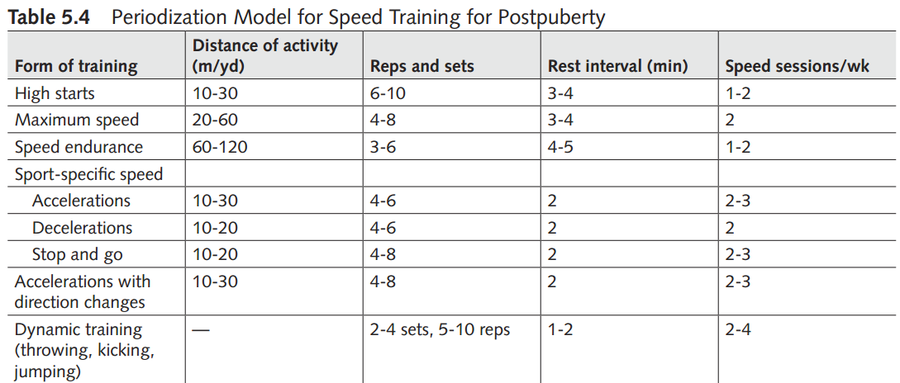
Program Design

Slide 24
Postpubescent speed training
High starts are important for all team sports in which players are constantly performing quick accelerations: soccer, football, baseball, hockey, lacrosse, and basketball. The athlete performs high starts standing, feet apart, in a ready position.
At the signal, the athlete accelerates as quickly as possible for 10 to 30 meters or yards, repeating the same action 6 to 10 times.
Acceleration training is a form of training that increases maximum acceleration to increase maximum speed for both sprinting and team sports. Athletes can perform acceleration training over 20 to 60 meters or yards four to eight times, with a rest interval of three or four minutes.

Slide 25
Postpubescent speed training
Speed endurance, on the other hand, is a form of training in which the scope is to maintain maximum velocity over a longer distance (60-120 meters or yards). Because this type of training is taxing physically and mentally, it is repeated three to six times but with a longer rest interval of four or five minutes.

Slide 26
Two important training considerations
First, athletes do not have to perform all forms of training in the same session.
Sprinters in track and field may perform starts and maximum speed in the same workout. However, because of its difficulty, speed endurance is trained in its own session, separate from any other type of training.
For most other team-sport athletes, the forms of training can be combined in the following way:
One to two days per week: high start sprints, maximum speed training, and acceleration with changes of direction
Two days per week: acceleration, deceleration, and stop-and-go sprints

Slide 27
Program

Slide 28
Program

Slide 29
Program

Slide 30
Program

Slide 31
Program

Slide 32
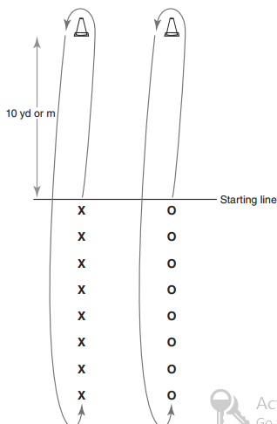
Exercises
File Relay

Slide 33
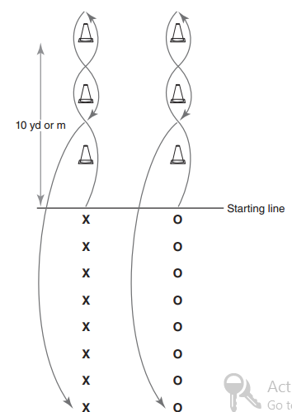
Slalom Relay

Slide 34
