Slide 1
Oxford Textbook of
Children’s Sport and Exercise
Medicine
Neil Armstrong
Willem van Mechelen

Slide 2
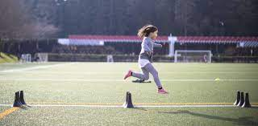
Speed and agility training
Jon L Oliver and Rhodri S Lloyd

Slide 3
Introduction
Natural play activities in children are characterized by fundamental movement skills that include agility and speed, which are also determinants of success in youth sport.
It has also been suggested that speed and agility may be important components of health- related fitness, with some limited evidence suggesting they may be an important marker of bone health.
Sprinting is a linear skill, with an individual propelling themselves forward as rapidly as possible.

Slide 4
Introduction
A sprint can be divided into four phases;
First step quickness,
Acceleration,
Maximal speed, and
Deceleration
Typically, measurements in youth have considered acceleration and speed.
Time taken to cover the first 10 m of a sprint is often used as a measure of acceleration, which incorporates first step quickness (0– 5 m).

Slide 5
Introduction
Speed is normally measured over longer distances of 30– 40 m.
In a large sample of 11- to 16- year- old boys it has been shown that maximal speed in a single stride occurs between 15 and 30 m.
More recently the definition of agility has been extended to incorporate that rapid changes of direction occur in response to a stimulus.
Consequently, agility has both a physical perspective reflecting change- of- direction- speed and a cognitive perspective reflecting perceptual and decision making skills.

Slide 6
Introduction
Given the difficulty of measuring perceptual skills in context- specific scenarios, most (if not all) of the literature about research in this area with regard to children and adolescents has assessed change- of- direction- speed rather than agility, per se.

Slide 7
Speed
Sprinting is considered a fundamental movement skill (FMS) that is important for both free- play activities and sport participation.
Consequently, talent identification in youth sports will often include measures of speed as key performance indicators.
This may be problematic; although speed is associated with sports performance it is influenced by age, maturation, and growth.

Slide 8
Speed
For instance, it has been suggested that peak rates of improvements in speed occur around the time of peak height velocity (PHV),19 and that these gains will be influenced by changes in body mass and lower limb length,20 as well as qualitative changes in muscle- tendon structure and function that accompany maturation.
It has also been suggested that these developmental processes may influence the responsiveness to speed training throughout childhood and adolescence.

Slide 9
Natural development of speed
it is surprising that relatively few studies describe the natural development of sprint speed during childhood and adolescence.
It has been suggested that both boys and girls exhibit similar sprint speed in the first decade of life,27,28 with both sexes experiencing more rapid natural gains in speed between the ages of 5–9 years; this phenomenon has been termed the ‘preadolescent spurt’.29
A second ‘adolescent spurt’ occurs with maturation, with peak gains coinciding with puberty and the timing of peak PHV.

Slide 10
Natural development of speed
With maturation, sex differences in speed become more apparent. From the age of 12 years the rate of progression of speed development is dramatically reduced in females when compared to males.
Natural speed development, on the other hand, continues into full maturity in males.29 This disparity between the sexes is attributed to maturational changes in circulating androgens, body dimensions, and body composition.
Girls demonstrate a more rapid rate of speed development up until the age of 12 years, whereas boys demonstrate a more rapid rate of speed development from the age of 12 years onwards.

Slide 11
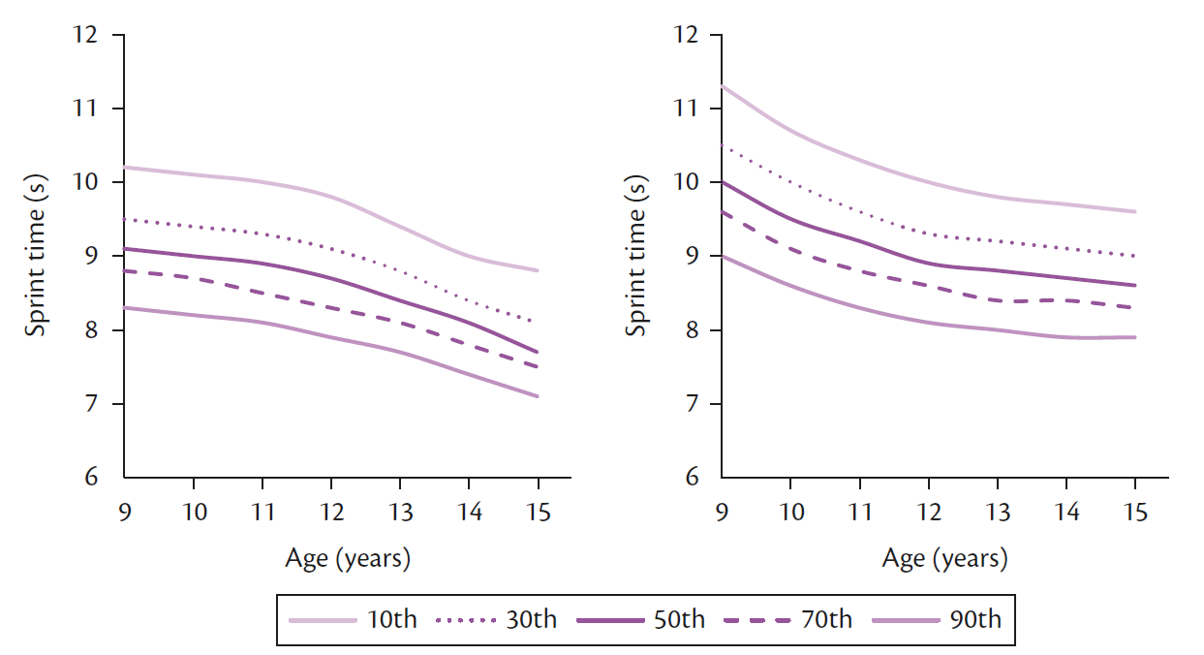
Fifty-metre sprint time percentiles in 9- to 15- year- old Australian boys and girls. Boys on the left and girls on the right

Slide 12
Natural development of speed
From cross- sectional examination of a large cohort of 11- to 16- year- old boys, data show that speed remains relatively stable from approximately 3 years to 1 year prior to PHV, with significant gains in speed observed from the timing of PHV onwards.
There is a suggested link between the observed preadolescent spurt in sprint speed and the development of the central nervous system and improved co- ordination.
This theory is supported by the rapid growth of the central nervous system during the first 7 years of life,28 the peak maturation of brain regions which control movement (at 7.5 years and 10 years of age in girls and boys, respectively),37

Slide 13
Development of speed
Changes in height, leg length, and muscle size during adolescence support a maturational influence on speed development.
Metabolic factors can influence maximal sprint speed.
Maturation of the glycolytic system
Maturation of muscle- tendon architecture
Ovalle41 reported marked increases in the surface area of the muscle- tendon junction from childhood into adulthood; this change was accompanied by a reduced number of Golgi organs in the mature state.

Slide 14
Development of speed
A tenfold increase in muscle- tendon stiffness has been observed in the first two decades of life.42 Changes in muscle stiffness will also be influenced by neural factors, with firing rates,31 twitch times.
Greater muscle- tendon and leg stiffness will theoretically enhance sprint performance by enabling the lower limbs to resist large vertical displacement of the centre of mass as well as increasing rate of force development during ground contact.
Leg stiffness has been shown to be a predictor of maximal sprint speed in adolescent boys.

Slide 15
Development of speed
When examining sprint speed on a non- motorized treadmill, Rumpf et al.49 noted that maximal speed, relative vertical stiffness, and relative leg stiffness all increased from pre- , to circa- , to post- PHV in boys;. These findings support a role of maturation and stiffness in the development of sprint speed.

Slide 16
Growth, maturation, and spatio- temporal determinants of speed
Running speed is a product of stride frequency and length.50
In an early study Schepens et al.26 examined the sprint mechanics of 2- to 16- year- old youths, concluding that step frequency changes little with age and that age- related changes in maximal speed are almost entirely due to proportional increases in stride length.
The authors reported significant decreases in stride frequency across boys classified from approximately 3- to 1- year prior to PHV; during this time, stride length significantly increased and there was no net change in speed. Stride frequency then stabilized in boys around PHV and 1 year post- PHV, while continued gains in stride length in these boys resulted in increased maximal speed.

Slide 17
Growth, maturation, and spatio- temporal determinants of speed
In comparison, pediatric data suggest that through adolescence children increase ground- contact times, which reduces stride frequency; however, this is more than compensated for by relatively larger increases in stride length.
Physical growth also influences speed development. Data suggest that increasing body mass as a result of maturation is related to increased contact times that reduce stride frequency. However, both greater relative levels of strength and increases in stature and leg length may compensate for this.

Slide 18
Speed training
There has been debate over recent years regarding how age and maturation interact with training responsiveness in children and adults. The ‘trigger hypothesis’56 suggests children do not respond to training until after the onset of puberty.
More recently, it has been suggested that training- induced gains in sprint speed can be made throughout childhood and adolescence, although the mechanisms that underpin those gains, as well as the types of training that are most effective, might differ with maturation.

Slide 19
Short- term speed training interventions
Sprint speed can be improved through a variety of training modes, including:
Sprint training,
Technical training,
Strength training, and
Plyometric training.

Slide 20
Short- term speed training interventions
Sprint training involves participants completing maximal sprint efforts, which can be modified to include various forms of both resisted (e.g. sled towing) and assisted (e.g. downhill) training.
Given that specificity is a key principle of training it is surprising that few studies have focused on the efficacy of free, resisted, or assisted sprint training to improve speed in youths.
Additionally, training- related gains in performance are generally greater than those that would be expected from growth and maturation.

Slide 21
Short- term speed training interventions

Slide 22
Short- term speed training interventions
In a systematic review of training studies, Rump et al.22 concluded that plyometric training and combined training are the most effective methods to improve speed for pre- and post- PHV boys.
boys who would be expected to be in a pre- PHV age range (<13 years old) respond to training that includes a plyometric stimulus, either in isolation or combined with other training.
Boys in a post- PHV age range respond most to interventions that include a strength stimulus (either in isolation or combined).

Slide 23
Short- term speed training interventions
While there are limited data available on boys who are circa- PHV, the evidence from Table 37.1 suggests that boys around the age of PHV (~13.5–14 years old) can make speed gains via a variety of training methods.
all studies included a reasonable and consistent dosage of two sessions per week, for either 12 or 16 weeks.
Table 37.1 and the work of Lloyd et al.80 suggest that combining strength and plyometric training is an effective way to promote speed development for youth of all ages and maturation.

