Slide 1
The Respiratory System and Its Regulation

Slide 2
Learning Objectives
Compare and discuss the various mechanisms that regulate pulmonary function.
Discuss the processes of pulmonary ventilation.
Describe the processes of pulmonary diffusion and the role of partial pressures of gasses.
Discuss the transportation of oxygen and carbon dioxide both in the muscle and the blood.

Slide 3
Respiratory System Introduction
Purpose: carry O₂ to and remove CO₂ from all body tissues
Carried out by four processes
  Pulmonary ventilation (external respiration)
  Pulmonary diffusion (external respiration)
  Transport of gases via blood
  Capillary diffusion (internal respiration)

Slide 4
Regulation of Pulmonary Ventilation
Body must maintain homeostatic balance between blood PO₂, PCO₂, pH
Requires coordination between respiratory and cardiovascular systems
Coordination occurs via involuntary regulation of pulmonary ventilation

Slide 5
Central Mechanisms of Regulation
Respiratory centers
  Inspiratory, expiratory centers
  Located in brain stem (medulla oblongata, pons)
  Establish rate, depth of breathing via signals to respiratory muscles
  Cortex overrides signals if necessary
Central chemoreceptors
  Stimulated by ⬆ CO₂ in cerebrospinal fluid
  – ⬆ Rate and depth of breathing, remove excess CO₂ from body

Slide 6
Peripheral Mechanisms of Regulation
Peripheral chemoreceptors
  In aortic bodies, carotid bodies
  Sensitive to blood PO₂, PCO₂, H⁺
Mechanoreceptors (stretch)
  In pleurae, bronchioles, alveoli
  Excessive stretch → reduced depth of breathing
  Hering-Breuer reflex

Slide 7
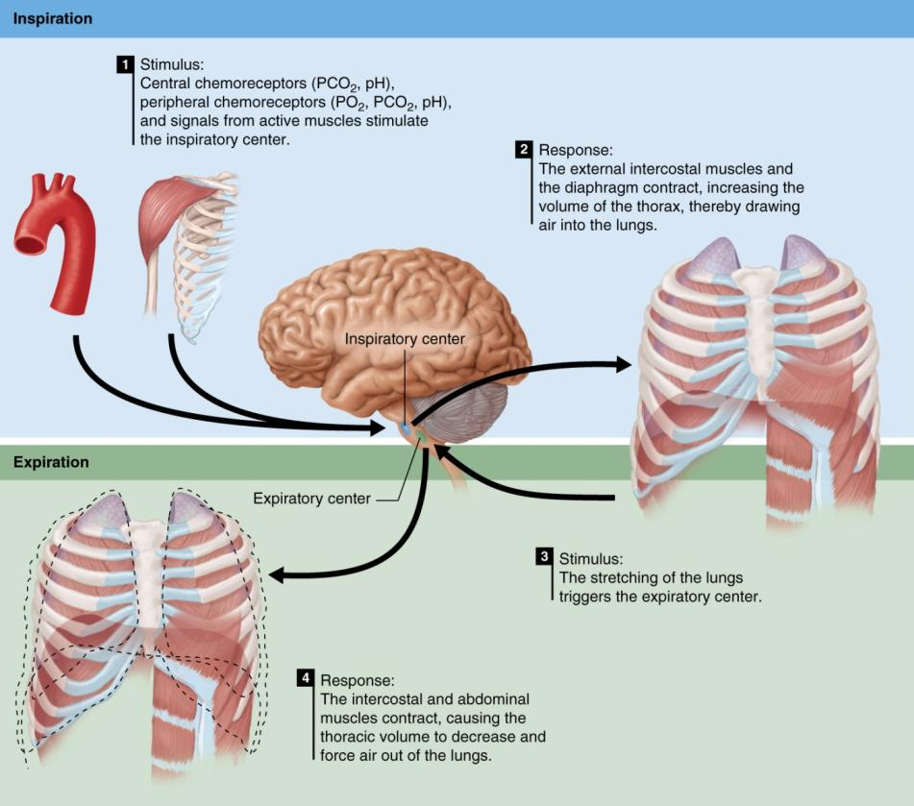
Figure 7.13

Slide 8
Pulmonary Ventilation
Process of moving air into and out of lungs
  Transport zone
  Exchange zone
Nose/mouth → nasal conchae → pharynx → larynx → trachea → bronchial tree → alveoli

Slide 9
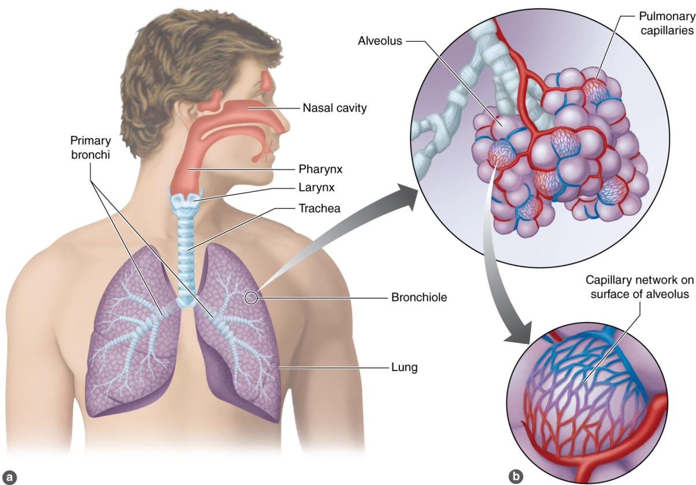
Figure 7.1

Slide 10
Pulmonary Ventilation
Lungs suspended by pleural sacs
  Parietal pleura lines thoracic wall
  Visceral (pulmonary) pleura attaches to lungs
  Lungs take size and shape of rib cage
Anatomy of lung, pleural sacs, diaphragm, and rib cage determines airflow into and out of lungs
  Inspiration
  Expiration

Slide 11
Pulmonary Ventilation: Inspiration
Active process
Involved muscles
  Diaphragm flattens
  External intercostals move rib cage and sternum up and out
Expands thoracic cavity in three dimensions
Expands volume inside thoracic cavity
Expands volume inside lungs

Slide 12
Pulmonary Ventilation: Inspiration
Lung volume ⬆, intrapulmonary pressure ⬇
  Boyle’s Law regarding pressure versus volume
  At constant temperature, pressure and volume inversely proportional
Air passively rushes in due to pressure difference
Forced breathing uses additional muscles
  Scalenes, sternocleidomastoid, pectorals
  Raise ribs even farther

Slide 13
Pulmonary Ventilation: Expiration
Usually passive process
  Inspiratory muscles relax
  Lung volume ⬇, intrapulmonary pressure ⬆
  Air forced out of lungs
Active process (forced breathing)
  Internal intercostals pull ribs down
  Also, latissimus dorsi, quadratus lumborum
  Abdominal muscles force diaphragm back up

Slide 14
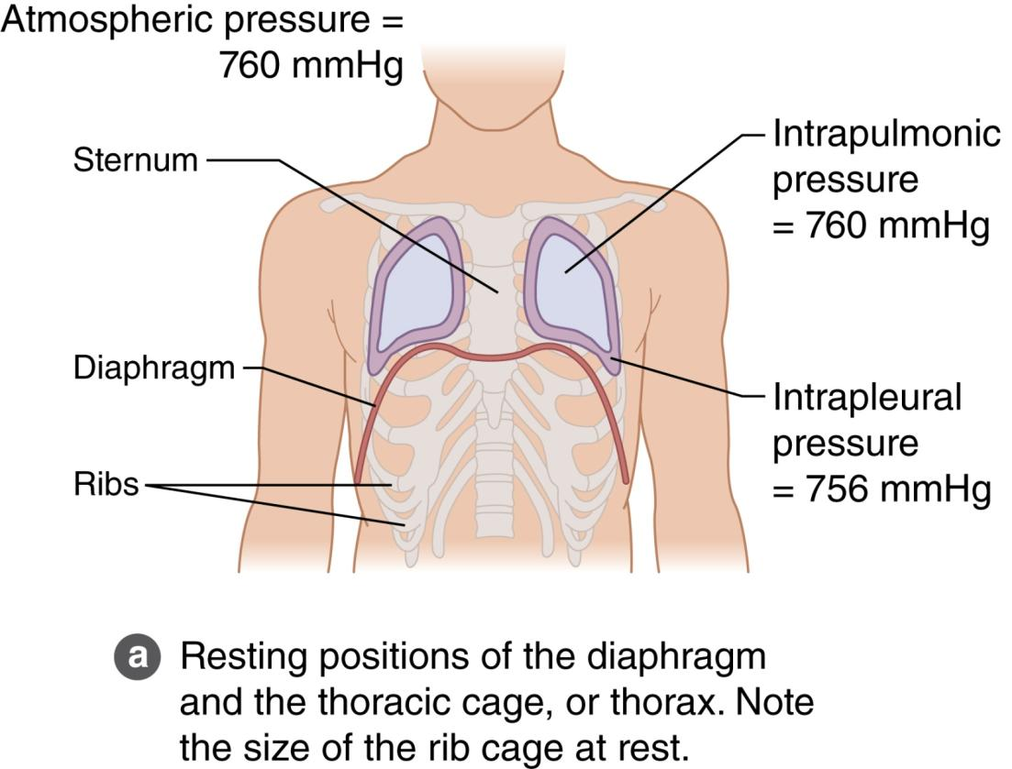
Figure 7.2a

Slide 15
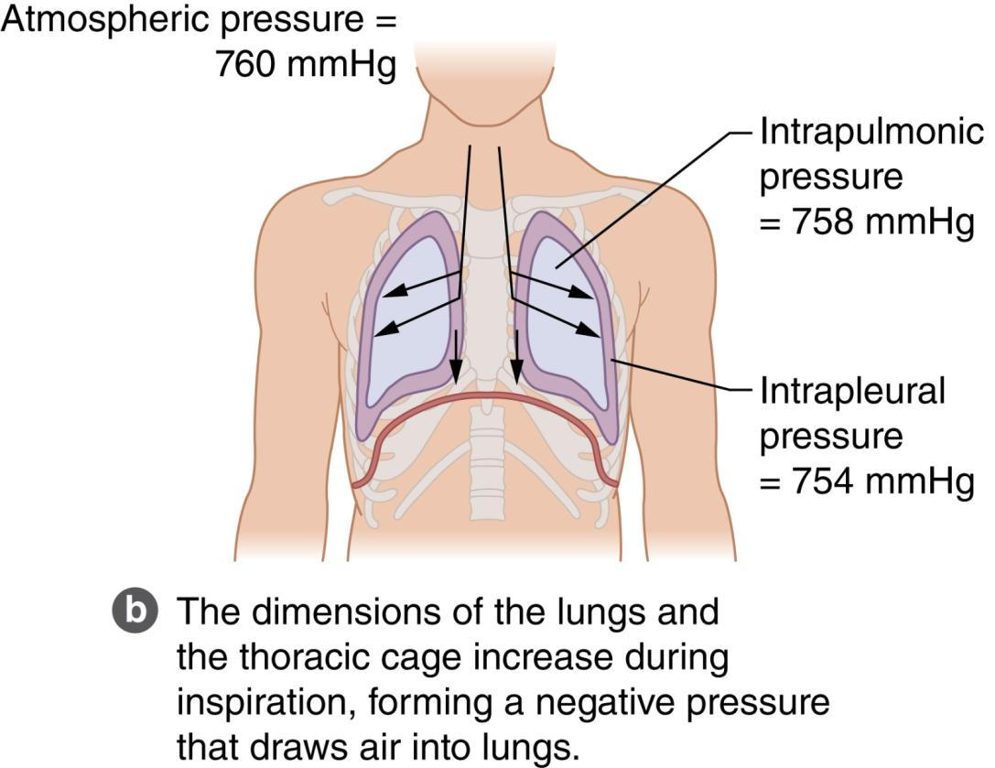
Figure 7.2b

Slide 16
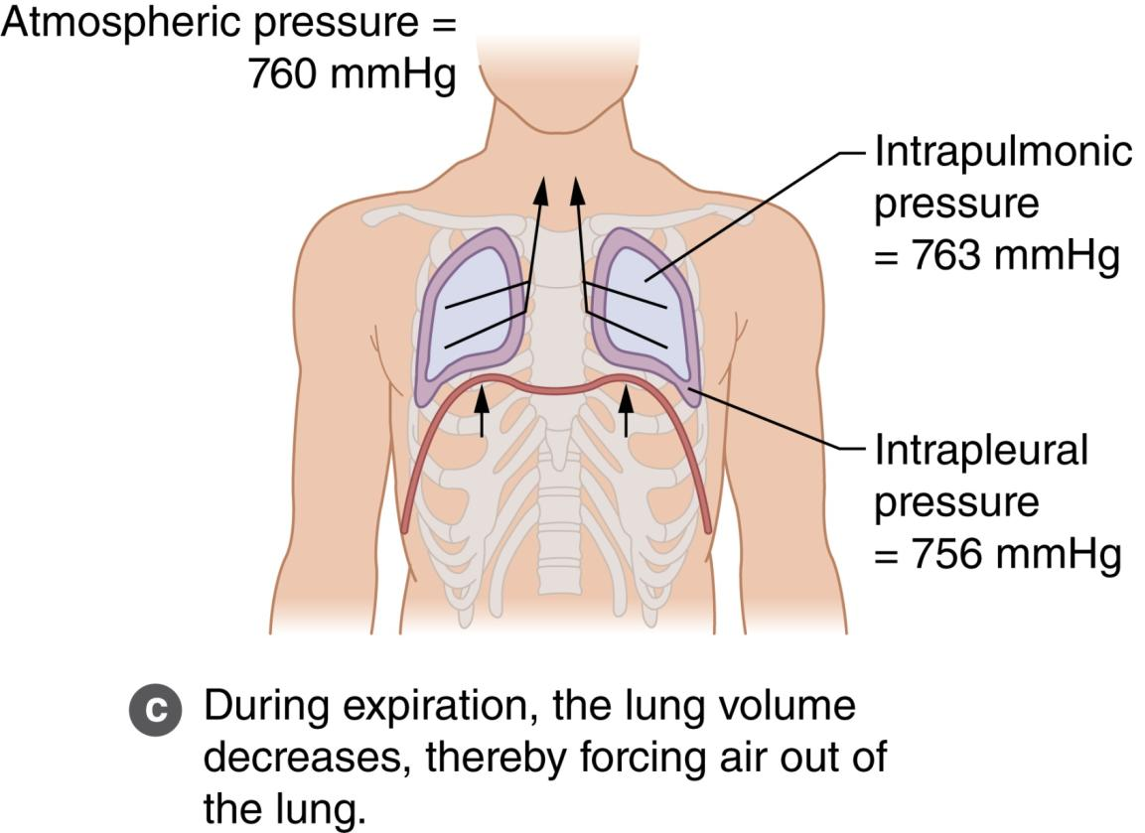
Figure 7.2c

Slide 17
Pulmonary Ventilation: Expiration
Respiratory pump
  Changes in intra-abdominal, intrathoracic pressure promote venous return to heart
  Pressure ⬆ → venous compression/squeezing
  Pressure ⬇ → venous filling
Milking action from changing pressures assists right atrial filling (respiratory pump)

Slide 18
Pulmonary Volumes
Measured using spirometry
  Lung volumes, capacities, flow rates
  Tidal volume
  Vital capacity (VC)
  Residual volume (RV)
  Total lung capacity (TLC)
Diagnostic tool for respiratory disease

Slide 19
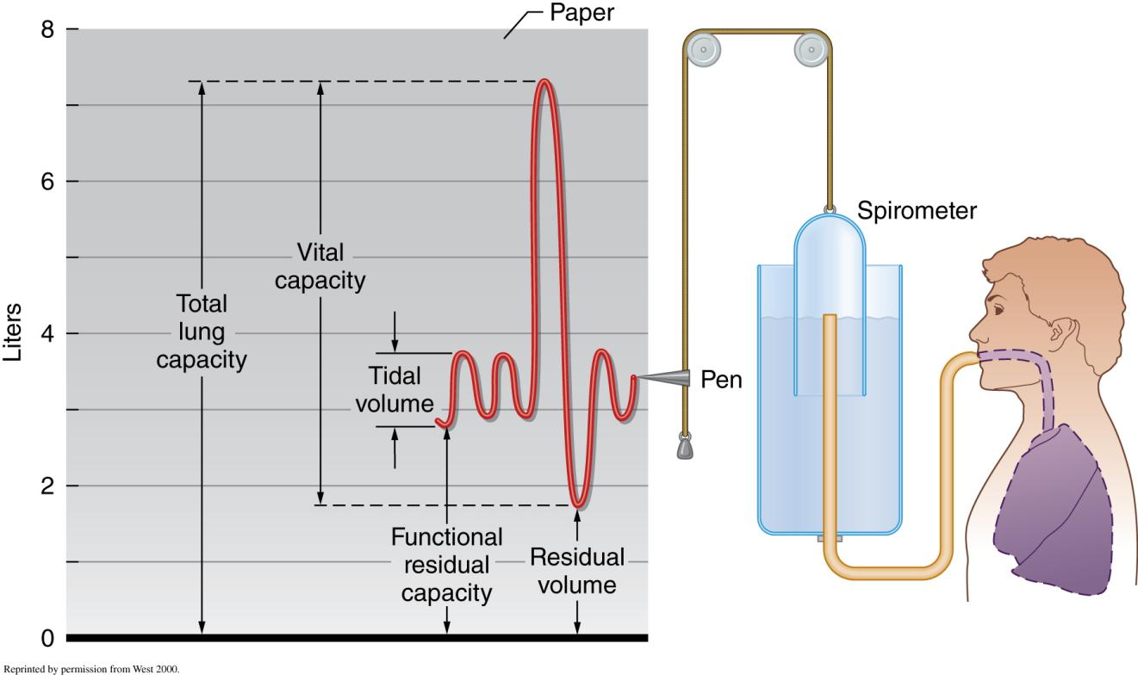
Figure 7.3

Slide 20
Pulmonary Diffusion
Gas exchange between alveoli and capillaries
  Inspired air path: bronchial tree → arrives at alveoli
  Blood path: right ventricle → pulmonary trunk → pulmonary arteries → pulmonary capillaries
  Capillaries surround alveoli
Serves two major functions
  Replenishes blood oxygen supply
  Removes carbon dioxide from blood

Slide 21
Pulmonary Diffusion:
Blood Flow to Lungs at Rest
At rest, lungs receive ~4 to 6 L blood/min
RV cardiac output = LV cardiac output
  Lung blood flow = systemic blood flow
Low pressure circulation
  Lung MAP = 15 mmHg versus aortic MAP = 95 mmHg
  Small pressure gradient (15 mmHg to 5 mmHg)
  Resistance much lower due to thinner vessel walls

Slide 22
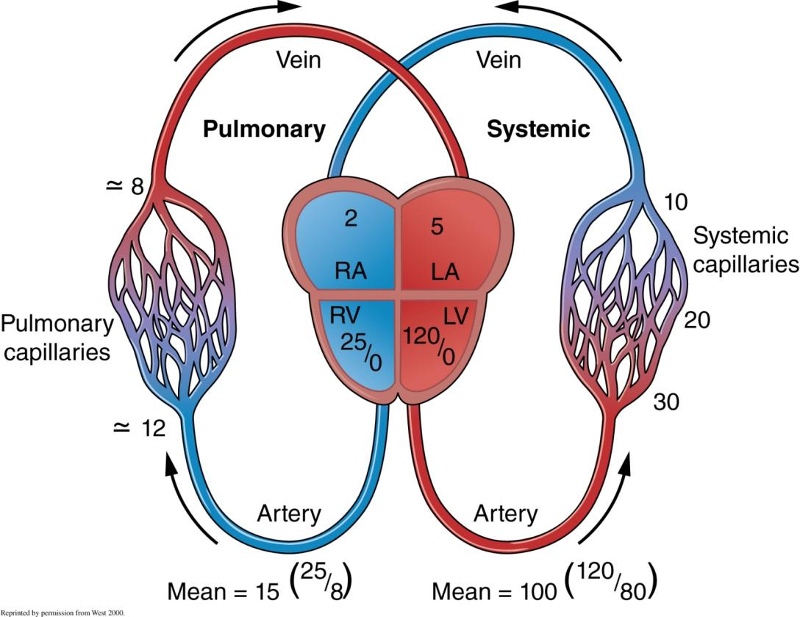
Figure 7.4

Slide 23
Pulmonary Diffusion:
Respiratory Membrane
Also called alveolar-capillary membrane
  Alveolar wall
  Capillary wall
  Respective basement membranes
Surface across which gases are exchanged
  Large surface area: 300 million alveoli
  Very thin: 0.5 to 4 μm
  Maximizes gas exchange

Slide 24
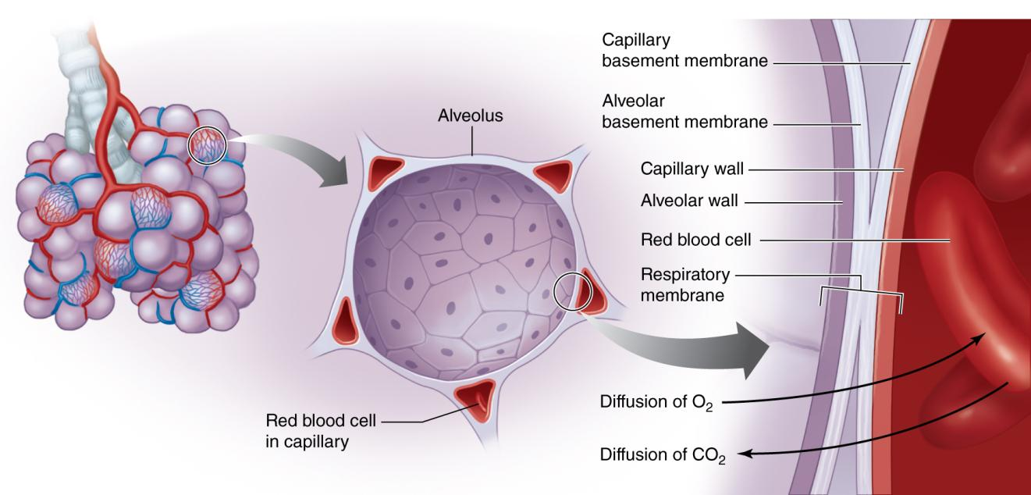
Figure 7.5

Slide 25
Pulmonary Diffusion:
Partial Pressures of Gases
Air = 79.04% N₂ + 20.93% O₂ + 0.03% CO₂
  Total air P: atmospheric pressure
  Individual P: partial pressures
Standard atmospheric P = 760 mmHg
  Dalton’s Law: total air P = PN₂ + PO₂ + PCO₂
  PN₂ = 760 x 79.04% = 600.7 mmHg
  PO₂ = 760 x 20.93% = 159.1 mmHg
  PCO₂ = 760 x 0.04% = 0.2 mmHg

Slide 26
Pulmonary Diffusion:
Partial Pressures of Gases
Henry’s Law: gases dissolve in liquids in proportion to partial P
  Also depends on specific fluid medium, temperature
  Solubility in blood constant at given temperature
Partial P gradient most important factor for determining gas exchange
  Partial P gradient drives gas diffusion
  Without gradient, gases in equilibrium, no diffusion

Slide 27
Gas Exchange in Alveoli:
Oxygen Exchange
Atmospheric PO₂ = 159 mmHg
Alveolar PO₂ = 105 mmHg
Pulmonary artery PO₂ = 40 mmHg
PO₂ gradient across respiratory membrane
  65 mmHg (105 mmHg – 40 mmHg)
  Results in pulmonary vein PO₂ ~100 mmHg

Slide 28
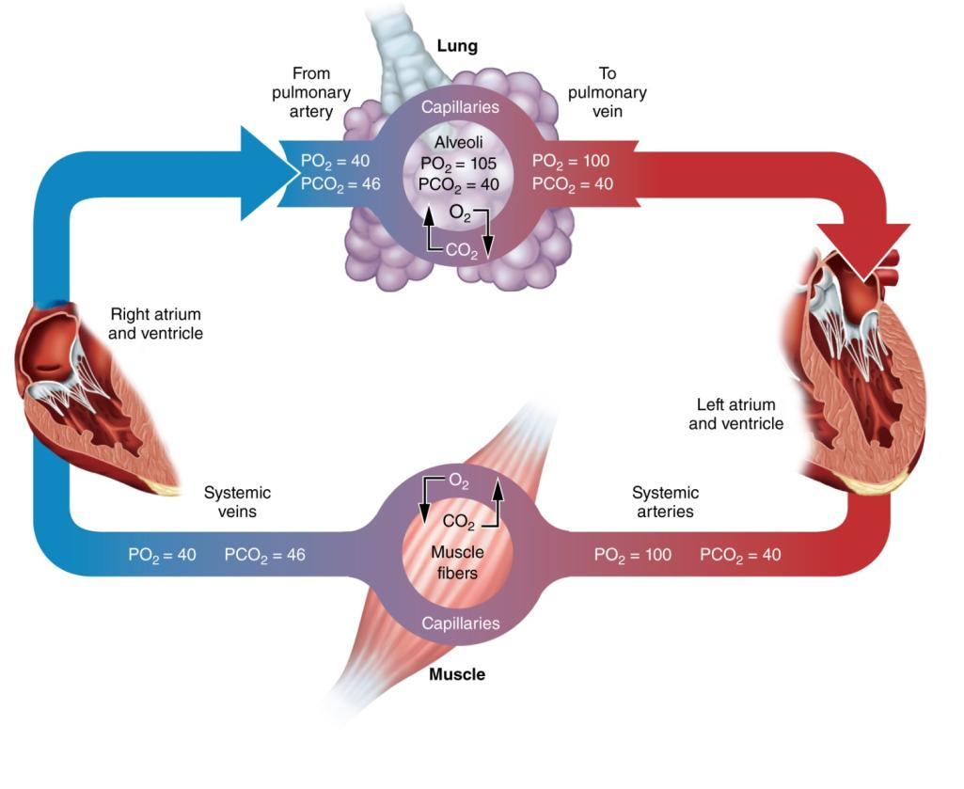
Figure 7.6

Slide 29
Gas Exchange in Alveoli:
Oxygen Exchange
Fick’s Law: rate of diffusion proportional to surface area and partial pressure gas gradient
  PO₂ gradient: 65 mmHg
  PCO₂ gradient: 6 mmHg
Diffusion constant influences diffusion rate
  Constant different for each gas
  CO₂ lower diffusion constant than O₂
  CO₂ diffuses easily despite lower gradient

Slide 30
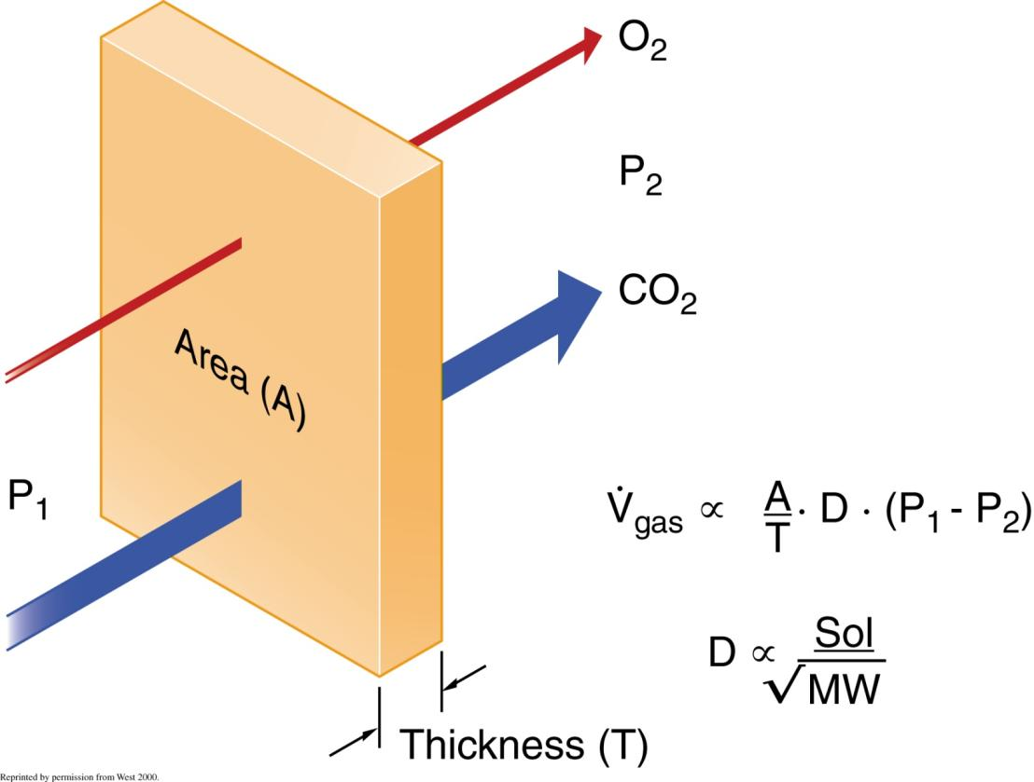
Figure 7.7

Slide 31
Gas Exchange in Alveoli:
Oxygen Exchange
O₂ diffusion capacity
  O₂ volume diffused per minute per 1 mmHg of gradient
  Note: gradient calculated from capillary mean PO₂,
  ≈11 mmHg
Resting O₂ diffusion capacity
  21 mL O₂/min/mmHg of gradient
  231 mL O₂/min for 11 mmHg gradient
Maximal exercise O₂ diffusion capacity
  Venous O₂ ⬇⬇ → PO₂ bigger gradient
  Diffusion capacity ⬆ by three times resting rate

Slide 32
Gas Exchange in Alveoli:
Oxygen Exchange
At rest, O₂ diffusion capacity limited due to incomplete lung perfusion
  Only bottom 1/3 of lung perfused with blood
  Top 2/3 lung surface area → poor gas exchange
During exercise, O₂ diffusion capacity ⬆ due to more even lung perfusion
  Systemic blood pressure ⬆ opens top 2/3 perfusion
  Gas exchange over full lung surface area

Slide 33
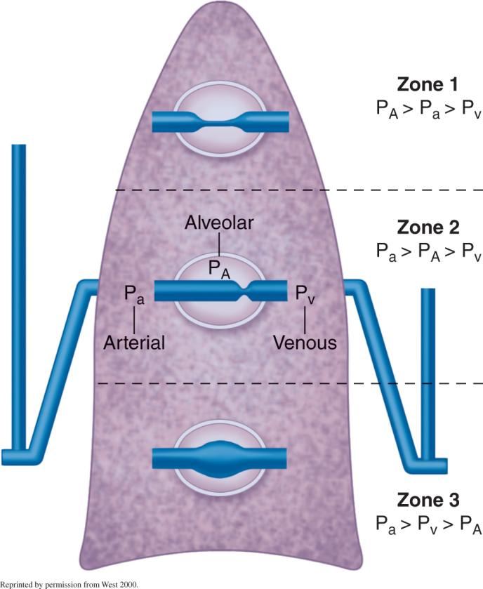
Figure 7.8

Slide 34
Gas Exchange in Alveoli:
Carbon Dioxide Exchange
Pulmonary artery PCO₂ ~46 mmHg
Alveolar PCO₂ ~40 mmHg
6 mmHg PCO₂ gradient permits diffusion
  CO₂ diffusion constant 20 times greater than O₂
  Allows diffusion despite lower gradient

Slide 35
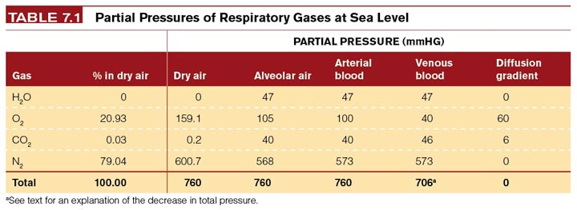
Table 7.1

Slide 36
Oxygen Transport in Blood
Can carry 20 mL O₂/100 mL blood
~1 L O₂/5 L blood
>98% bound to hemoglobin (Hb) in red blood cells
  O₂ + Hb: oxyhemoglobin
  Hb alone: deoxyhemoglobin
<2% dissolved in plasma

Slide 37
Transport of Oxygen in Blood:
Hemoglobin Saturation
Depends on PO₂ and affinity between O₂, Hb
High PO₂ (i.e., in lungs)
  Loading portion of O₂-Hb dissociation curve
  Small change in Hb saturation per mmHg change in PO₂
Low PO₂ (i.e., in body tissues)
  Unloading portion of O₂-Hb dissociation curve
  Large change in Hb saturation per mmHg change in PO₂

Slide 38
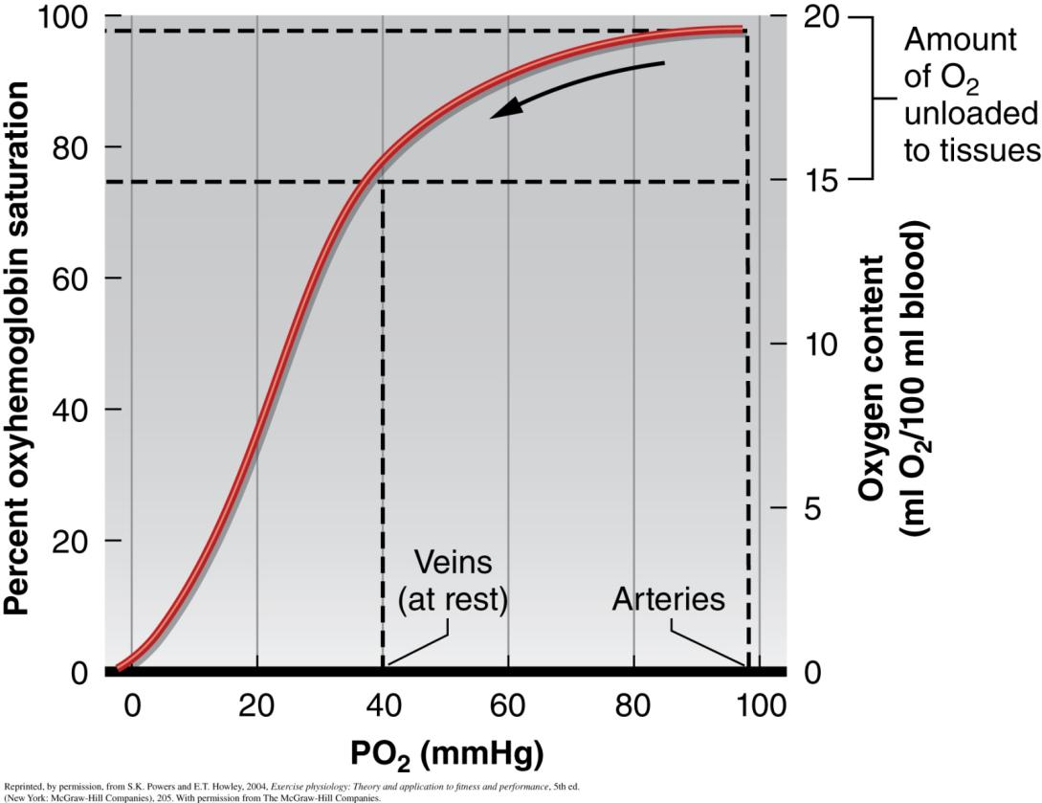
Oxyhemoglobin Disassociation Curve

Slide 39
Factors Affecting
Hemoglobin Saturation
Blood pH
  More acidic → O₂-Hb curve shifts to right
  Bohr effect
  More O₂ unloaded at acidic exercising muscle
Blood temperature
  Warmer → O₂-Hb curve shifts to right
  Promotes tissue O₂ unloading during exercise

Slide 40
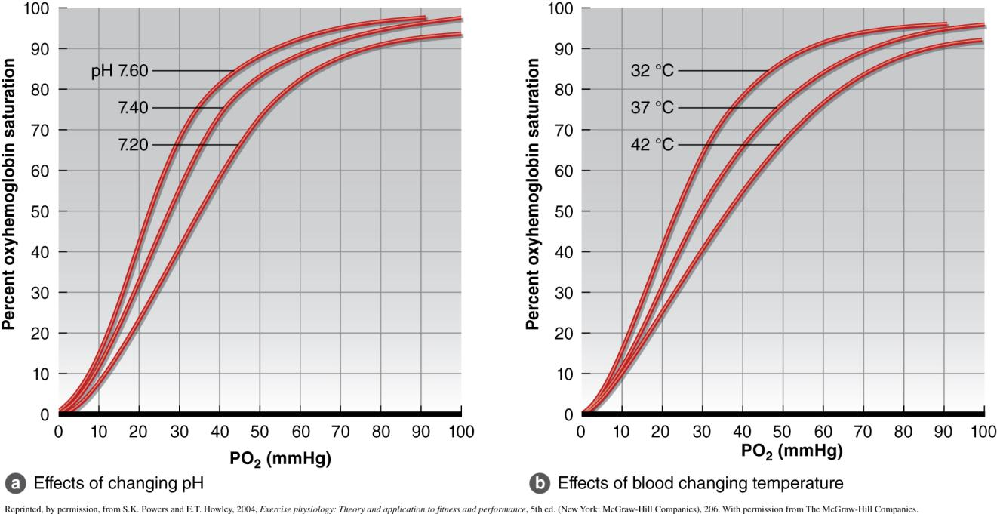
Shifts in hemoglobin saturation

Slide 41
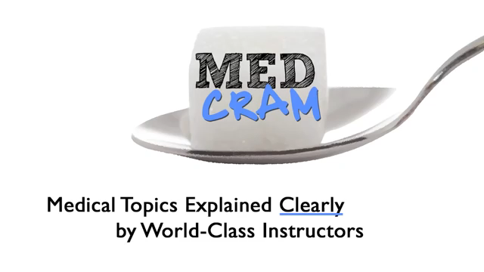
More oxyhemoglobin disassociation curve

Slide 42
Blood Oxygen-Carrying Capacity
Maximum amount of O₂ blood can carry
  Based on Hb content (12-18 g Hb/100 mL blood)
  Hb 98 to 99% saturated at rest (0.75 s transit time)
  Lower saturation with exercise (shorter transit time)
Depends on blood Hb content
  1 g Hb binds 1.34 mL O₂
  Blood capacity: 16 to 24 mL O₂/100 mL blood
  Anemia → ⬇ Hb content → ⬇ O₂ capacity

Slide 43
Carbon Dioxide Transport in Blood
Released as waste from cells
Carried in blood three ways
  As bicarbonate ions
  Dissolved in plasma
  Bound to Hb (carbaminohemoglobin)

Slide 44
Carbon Dioxide Transport:
Bicarbonate Ion
Transports 60 to 70% of CO₂ in blood to lungs
CO₂ + water form carbonic acid (H₂CO₃)
  Occurs in red blood cells
  Catalyzed by carbonic anhydrase
Carbonic acid dissociates into bicarbonate
  CO₂ + H₂O → H₂CO₃ → HCO₃⁻ + H⁺
  H⁺ binds to Hb (buffer), triggers Bohr effect
  Bicarbonate ion diffuses from red blood cells into plasma

Slide 45
Carbon Dioxide Transport:
Dissolved Carbon Dioxide
7 to 10% of CO₂ dissolved in plasma
When PCO₂ low (in lungs), CO₂ comes out of solution, diffuses out into alveoli

Slide 46
Carbon Dioxide Transport:
Carbaminohemoglobin
20 to 33% of CO₂ transported bound to Hb
Does not compete with O₂-Hb binding
  O₂ binds to heme portion of Hb
  CO₂ binds to protein (-globin) portion of Hb
Hb state, PCO₂ affect CO₂-Hb binding
  Deoxyhemoglobin binds CO₂ easier versus oxyhemoglobin
  – ⬆ PCO₂ → easier CO₂-Hb binding
  – ⬇ PCO₂ → easier CO₂-Hb dissociation

Slide 47
Gas Exchange at Muscles:
Arterial–Venous Oxygen Difference
Difference between arterial and venous O₂
  a-v O₂ difference
  Reflects tissue O₂ extraction
  As extraction ⬆, venous O₂ ⬇, a-v O₂ difference ⬆
Arterial O₂ content: 20 mL O₂/100 mL blood
Mixed venous O₂ content varies
  Rest: 15 to 16 mL O₂/100 mL blood
  Heavy exercise: 4 to 5 mL O₂/100 mL blood

Slide 48
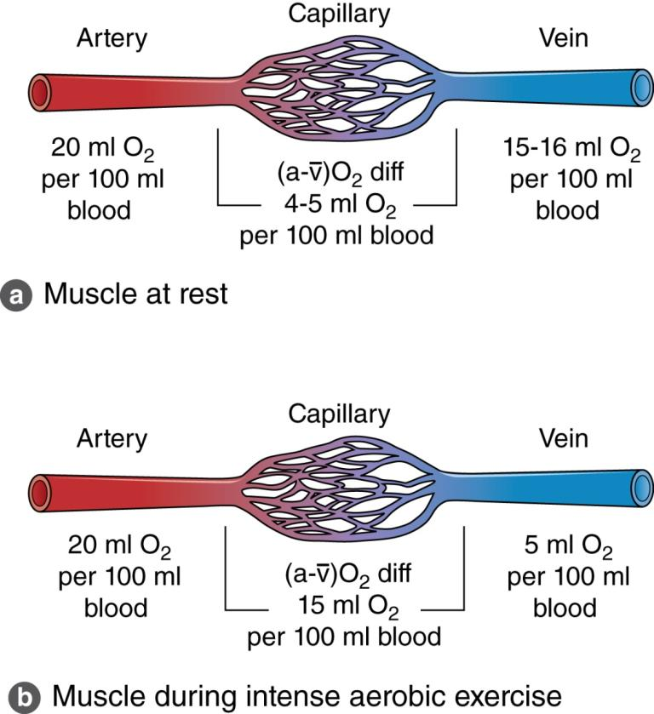
Figure 7.11

Slide 49
Gas Exchange at Muscles:
Oxygen Transport in Muscle
O₂ transported in muscle by myoglobin
  Similar structure to hemoglobin
  Higher affinity for O₂
O₂-myoglobin dissociation curve shaped differently
  At PO₂ 0 to 20 mmHg, slope very steep
  Loading portion at PO₂ = 20 mmHg
  Releasing portion at PO₂ = 1 to 2 mmHg

Slide 50
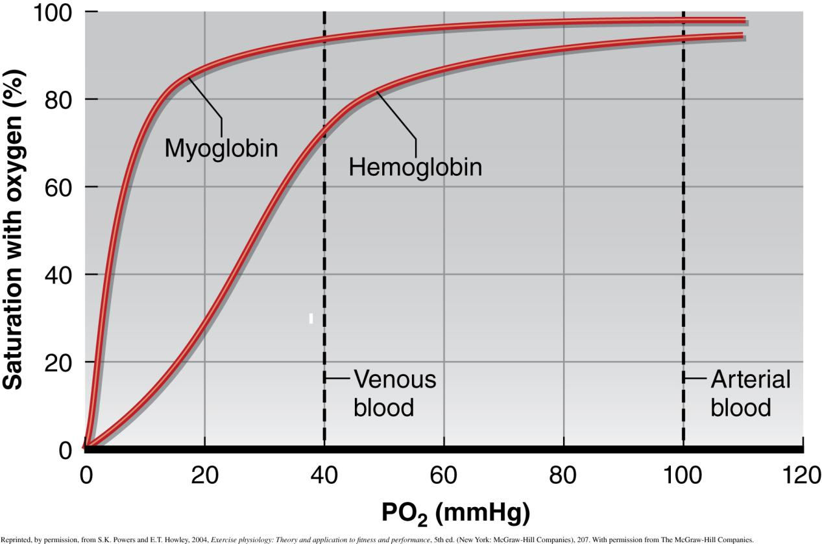
Figure 7.12

Slide 51
Factors Influencing Oxygen
Delivery and Uptake
O₂ content of blood
  Represented by PO₂, Hb percent saturation
  Creates arterial PO₂ gradient for tissue exchange
Blood flow
  – ⬇ Blood flow = ⬇ opportunity to deliver O₂ to tissue
  Exercise ⬆ blood flow to muscle
Local conditions (pH, temperature)
  Shift O₂-Hb dissociation curve
  – ⬇ pH, ⬆ temperature promote unloading in tissue

Slide 52
Gas Exchange at Muscles:
Carbon Dioxide Removal
CO₂ exits cells by simple diffusion
Driven by PCO₂ gradient
  Tissue (muscle) PCO₂ high
  Blood PCO₂ low

