Slide 1
Body Composition and Weight Management

Slide 2
Learning outcomes
Discuss the basic physiological concepts related to body composition
Compare and contrast laboratory and field methods to determine and interpret body composition
Discuss physiologic, environmental and behavioral factors that influence weight control
Creating and utilizing effective weight control strategies within selected populations

Slide 3
Body Composition Assessment
Body composition: body’s chemical and molecular composition
General models of body composition: 2-3-4 compartment models

Slide 4
Body Composition in Sport: “Ideal” body weight/fat

Slide 5
Body Composition Assessment
Provides more information
Height and weight not enough to know fitness status
Health vs sport performance
Body composition measured several ways
Densitometry/Hydrometry
DEXA
Air plethysmography
Skinfold
Bioelectric impedance

Slide 6
Body Composition Assessment
Densitometry: measures body density
Hydrostatic (underwater) weighing
Muscle heavier than water, fat lighter than water
Most valid and reliable method
Limitations of hydrostatic weighing
Lung air volume confounding
Conversion of body density to percent fat
Fat-free density varies among people

Slide 7
Hyrdostatic weighing

Slide 8
Body Composition Assessment
Hydrometry
Uses doubly labeled water (deuterium and ¹⁸O)
Labeled oxygen leaves the body as exhaled CO2 and in water loss
Deuterium leaves only as water
Predicts TEE and TBW
TBW used w/2-compartment models

Slide 9
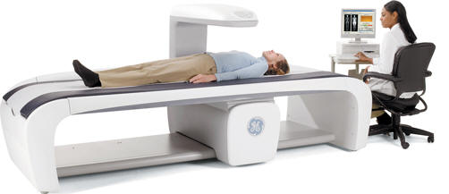
Body Composition Assessment
DEXA
Dual-energy X-ray absorptiometry
Quantifies bone and soft-tissue composition
Precise and reliable but expensive and technical
Air plethysmography
Another densitometry technique
Air displacement (instead of water)
Easy for subject, difficult for operator, expensive

Slide 10
Body Composition “Field” Assessments
Skinfold
Most widely used field technique
Measures thickness of 3-7 sites
Uses regression equations, reasonably accurate 3%
Limitation: Tester error
Bioelectric impedance
Electrodes on ankle, foot, wrist, hand
Current passes from proximal to distal sites
Fat-free mass good conductor, fat poor conductor
Reasonably accurate 3-5%
Limitation: TBW changes

Slide 11
Skinfold

Slide 12
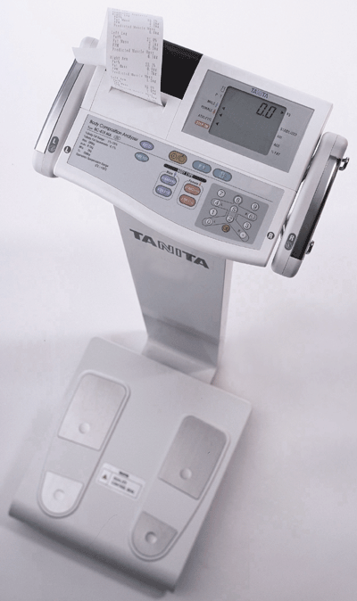
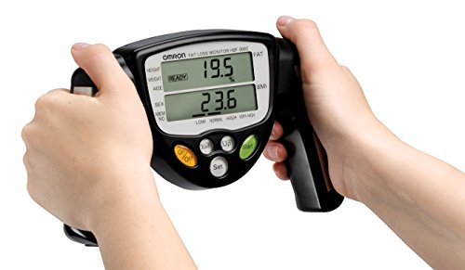
Bioelectrical Impedance

Slide 13
Body Composition “Field” Assessments
Anthropometric measurements
BMI (>25; >30)
WHR (m=<0.95; females=<0.85)
Waist circumference (high risk; males>40, females>35)
Developed through and useful in populations
Limitation: not true BC assessments

Slide 14
Optimal Weight Management: Determinants of Obesity
Genetics
FTO gene (Chromosome 16)
One of 40+ genes related to obesity
FTO gene ‘triggers’ other processes (lpha-ketoglutarate-dependent dioxygenase FTO)
Fat cell # and size
Set point theory
BMR
Weight cycling
Environment/Behavior
America is now “obesogenic”

Slide 15
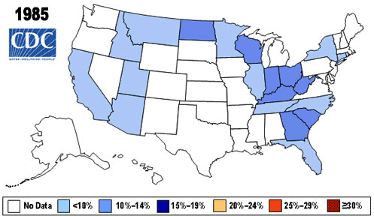
Obesogenic

Slide 16
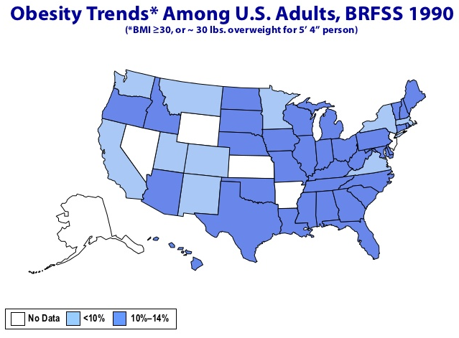
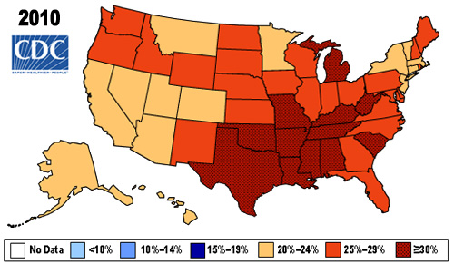
Obesogenic
Why the difference?
#ExPhysRules

Slide 17
Optimal Weight Management
Recommended macronutrient balance
Carbohydrate: 55 to 60% of daily kilocalories
Fat: <35% (<10% saturated)
Protein: 10 to 15%
Optimal for both performance and health

Slide 18
Figure 15.8

Slide 19
Figure 15.9

Slide 20
Nutrition and Sport: Classification of Nutrients—Fat
Fat essential for body function
Fuel substrate (triglycerides → FFAs + glycerol)
Component of cell membranes and nerve fibers
Required by steroid hormones and fat-soluble vitamins
Saturated versus unsaturated FFAs
Total fat <35% of total daily kilocalories (0 trans fat)
Saturated fat <10% total daily kilocalories
Cholesterol <300 mg/day

Slide 21
Nutrition and Sport: Classification of Nutrients—Fat
FFAs important fuel during exercise
Delay exhaustion after glycogen depletion
Body cannot metabolize triglycerides (dietary fat)
Must break down triglycerides into FFAs
High-fat versus high-CHO diets
High-fat intake → ⬆ circulating FFAs (good)
High-fat intake → ⬇ glycogen storage (bad)
High-fat intake linked to several chronic diseases

Slide 22
Nutrition and Sport: Classification of Nutrients—Protein
Protein essential for body function
Cell structure, growth, repair, and maintenance
Used to produce enzymes, hormones, antibodies, and as buffer
Controls plasma volume via oncotic pressure
Protein consumption
15% of total daily kilocalories
~0.80 g protein/kg body weight per day
Excessive protein intake → health risks
CHO + protein after exercise → improved glycogen and muscle protein synthesis

Slide 23
Effective Weight Management Plans
Minimum pre-program considerations
Goals (SMART)
Current physiological profile
Current behaviors
Environmental factors
Psychosocial factors
Recurring
Physiological profile
Recording actual behaviors
Include incentives
(keep in mind WHO we are helping)

Slide 24
Effective Wt Mgt Plans
Every plan should include
Physical Activity/Exercise
Negative Caloric Balance
Health-related Nutrition Recommendations
Tracking of successes and failures
www.health.gov
www.cnpp.usda.gov

Slide 25
Example
BOB: 55y/o, no hx of injury or chronic dz, former athlete in 1970’s, golfed in the 1980s/90s, sedentary since.
Goals: ‘shape up’
Phys Profile: 6’, 240lbs, BP 139/90, rhr 88
Log: minimum activity/ex; nutrition poor (38% fat; 25% protein; 37 carbohydrates)
Environment: urban residence, attorney, dines at restaurants 8+/wk
Social: divorced, 3 grown children, friends also attorneys

