Slide 1
Training for Sport

Slide 2
Chapter OBJECTIVES
Describe the model used to optimize training.
Compare and contrast the forms of training periodization. Discuss the advantages and disadvantages of each.
Discuss the differences in overreaching and overtraining
Define and describe the overtraining syndrome. Symptoms, physiological changes, predictors, and treatments
Describe the benefits of the tapering period
Discuss the alterations that occur during detraining

Slide 3
Training for Sport: Introduction
Positive stress: training that causes improvements in exercise performance
  Major training adaptations in 6 to 10 weeks
  Depends on volume and intensity of training
  Quantity training versus quality training
Rate of adaptation genetically limited
  Too much versus just right varies
  Too much training → ⬇ performance and ⬆ injury

Slide 4
Training for Sport: Introduction
Must balance volume and intensity
  Must include rest
  Correct balance enhances performance
Overtraining → performance decrements
  Chronic fatigue, illness
  Overuse injury, overtraining syndrome

Slide 5
Optimizing Training: A Model
Must include progressive overload
  Progressively ⬆ stimulus as body continually adapts
  Stimulates continuous improvements
Undertraining: insufficient stimulus
  Adaptations not fully realized
  Optimal performance not achieved
Overtraining: loss of benefits
  No additional improvements
  Performance decrements, injury

Slide 6
Optimizing Training: A Model
Undertraining: off-season
Acute overload: average training load
Overreaching: decrement, then benefit
Overtraining: maladaptations
  Performance decrements
  Overtraining syndrome, excessive training

Slide 7
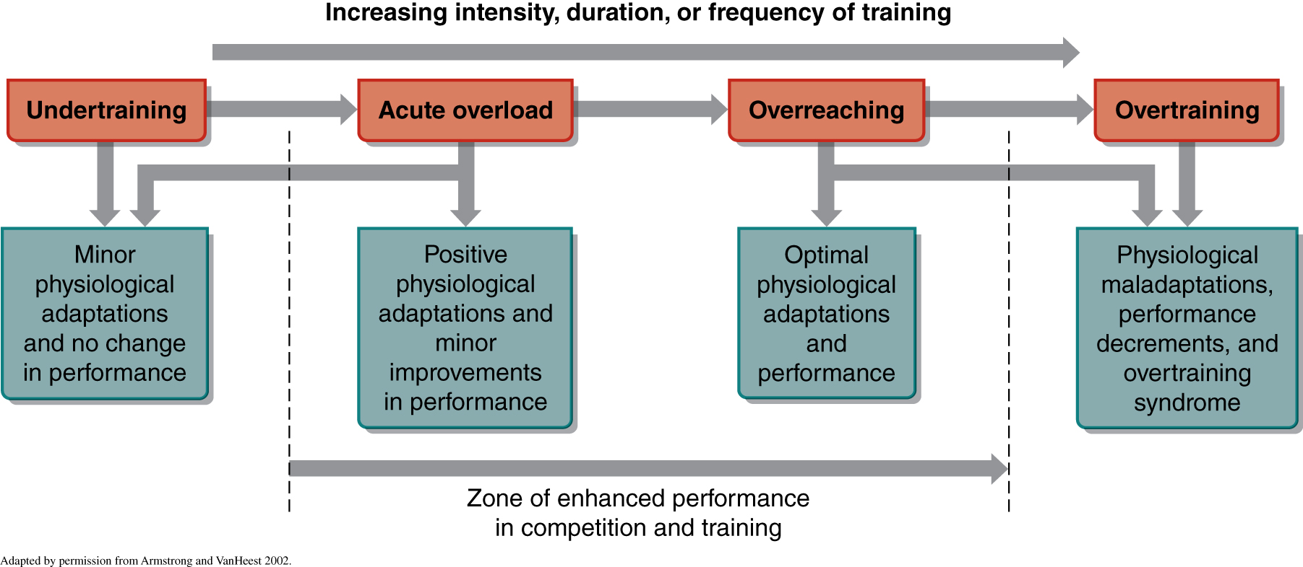
Figure 14.1

Slide 8
Overreaching
Systematic attempt in overstressing body for short period of training
  Allows body to adapt to stronger stimulus
  Not same as excessive training
  Caution: easy to cross into overtraining
Short performance decrement followed by improved performance and function

Slide 9
Excessive Training
Volume and/or intensity to an extreme
  For years, many athletes undertrained
  As intensity/volume ⬆, so did performance
  But more is better is not true after a point
Example: swim training 3 to 4 h/day no better than 1 to 1.5 h/day
Can lead to ⬇ strength, sprint performance

Slide 10
Excessive Training
Another swim study: single versus multiple daily training sessions
No evidence that more is better
  Similar heart rate and blood lactate improvements
  No additional improvements from 2 times/day

Slide 11
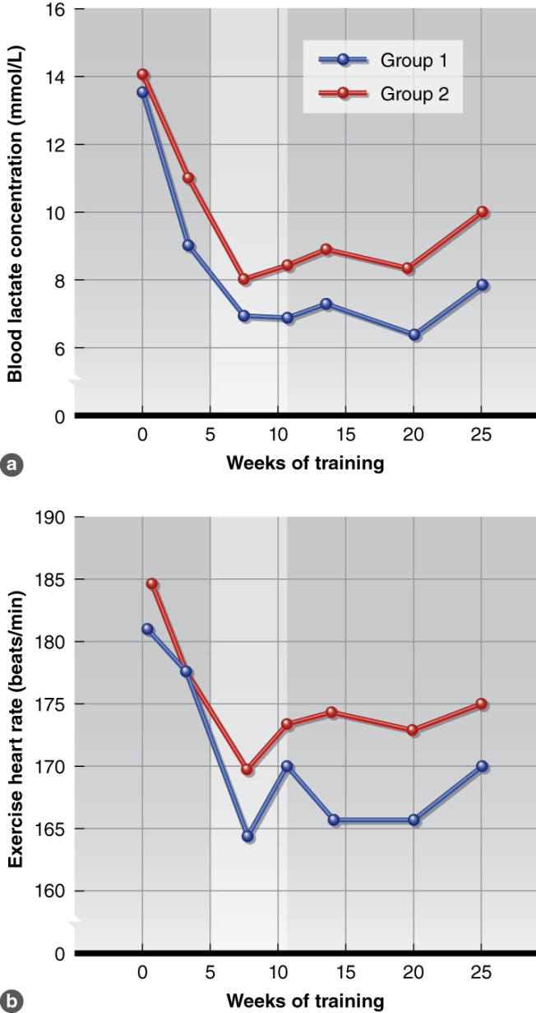
Figure 14.3

Slide 12
Excessive Training
Training volume should be sport specific
Value of high-volume training questionable
  In some sports, half the volume may maintain benefits and ⬇ risk
  Low intensity, high volume inappropriate for sprint-type performance

Slide 13
Excessive Training
Intensity and volume inversely related
  If volume ⬆, intensity should ⬇
  If intensity ⬆, volume should ⬇
  Different emphasis → different fitness results
  Applies to resistance, anaerobic, and aerobic training
• ⬆ Intensity + ⬆ volume → negative effects

Slide 14
Overtraining
  Unexplained ⬇ in performance, function for weeks, months, or years
  Cannot be remedied by short-term ⬇ training, rest
  Putative psychological and physiological causes
  Can occur with all forms of training: resistance, anaerobic, aerobic
Not all fatigue product of overtraining

Slide 15
Overtraining Syndrome
Highly individualized, subjective
Symptoms
  – ⬇ Strength, coordination, capacity
  Fatigue
  Change in appetite, weight loss
  Sleep and mood disturbances
  Lack of motivation, vigor, and/or concentration
  Depression

Slide 16
Overtraining Syndrome
Can be intensity or volume related
Psychological factors
  Emotional pressure of competition → stress
  Parallels with clinical depression
Physiological factors
  Autonomic, endocrine, and immune factors
  Not a clear cause-and-effect relationship but significant parallels

Slide 17
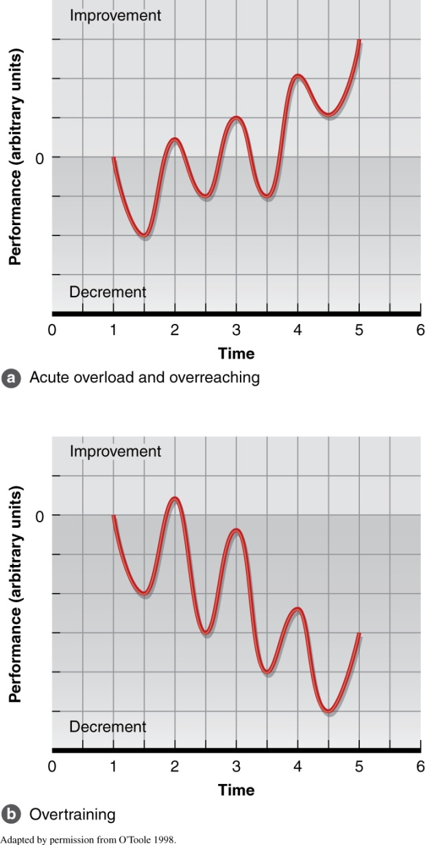
Figure 14.4

Slide 18
Overtraining Syndrome: Sympathetic Nervous System Responses
Increased BP
Loss of appetite
Weight loss
Sleep and emotional disturbances
Increased basal metabolic rate

Slide 19
Overtraining Syndrome: PNS Responses
More common with endurance athletes
Early fatigue
Decreased resting HR
Decreased resting BP
Rapid heart rate recovery

Slide 20
Overtraining Syndrome:
Endocrine Responses
Resting thyroxine, testosterone ⬇
Resting cortisol ⬆
Testosterone:cortisol ratio
  Indicator of anabolic recovery processes
  Altered ratio may indicate protein catabolism
  Possible cause of overtraining syndrome
Volume-related overtraining appears more likely to affect hormones

Slide 21
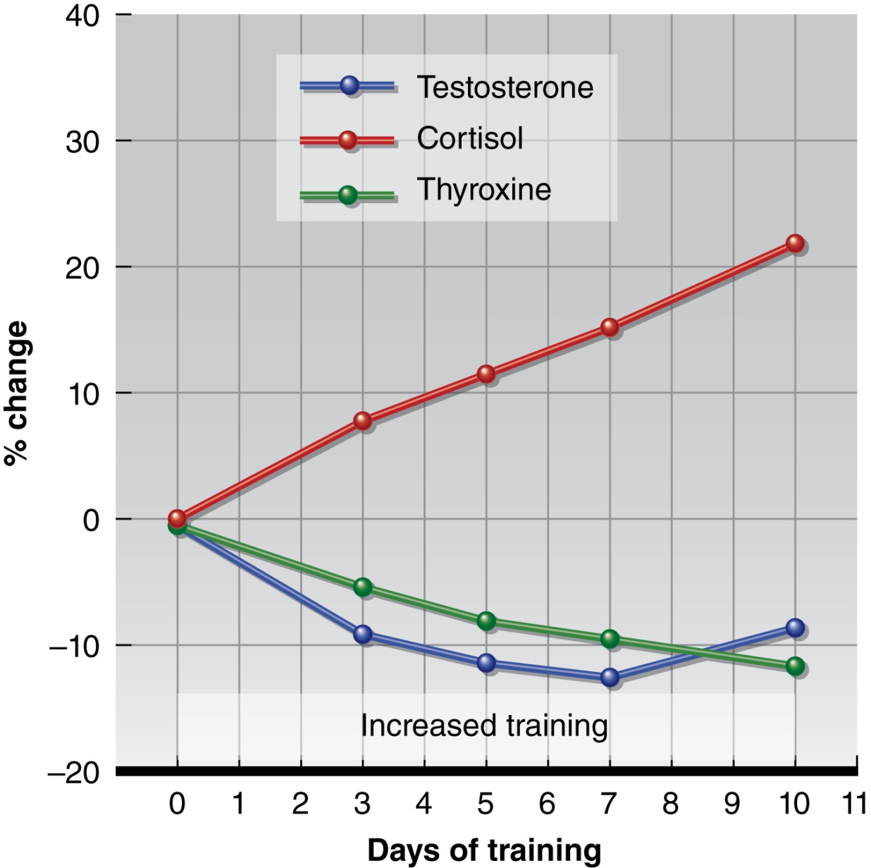
Figure 14.5

Slide 22
Overtraining Syndrome:
Endocrine Responses
• ⬆ Blood urea concentration
Resting catecholamines ⬆
Outside factors may influence values
  Overreaching may produce same trends
  Time between last training bout and resting blood sample critical
  Blood markers helpful but not definitive diagnostic tools

Slide 23
Overtraining Syndrome:
Neural and Endocrine Factors
Overtraining stressors may act primarily through hypothalamic signals
  Can lead to sympathetic neural activation
  Can lead to pituitary endocrine cascade
Hormonal axes involved
  Sympathetic-adrenal medullary (SAM) axis
  Hypothalamic-pituitary-adrenocortical (HPA) axis

Slide 24
Overtraining Syndrome:
Immune Responses
Circulating cytokines
  Mediate inflammatory response to infection and injury
  – ⬆ In response to muscle, bone, joint trauma
  – ⬆ Physical stress + ⬇ rest → systemic inflammation
Inflammation → ⬆ cytokines via monocytes
May act on brain and body functions, contribute to overtraining symptoms

Slide 25
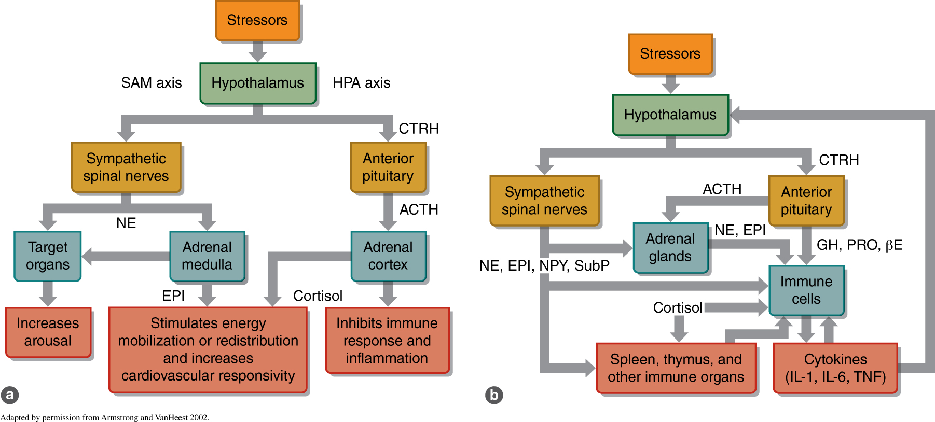
Figure 14.6

Slide 26
Overtraining Syndrome:
Immune Responses
Compromised immune function factor in onset of overtraining syndrome
Overtraining suppresses immune function
  Abnormally ⬇ lymphocytes, antibodies
  – ⬆ Incidence of illness after exhaustive exercise
  Exercise during illness → immune complications

Slide 27
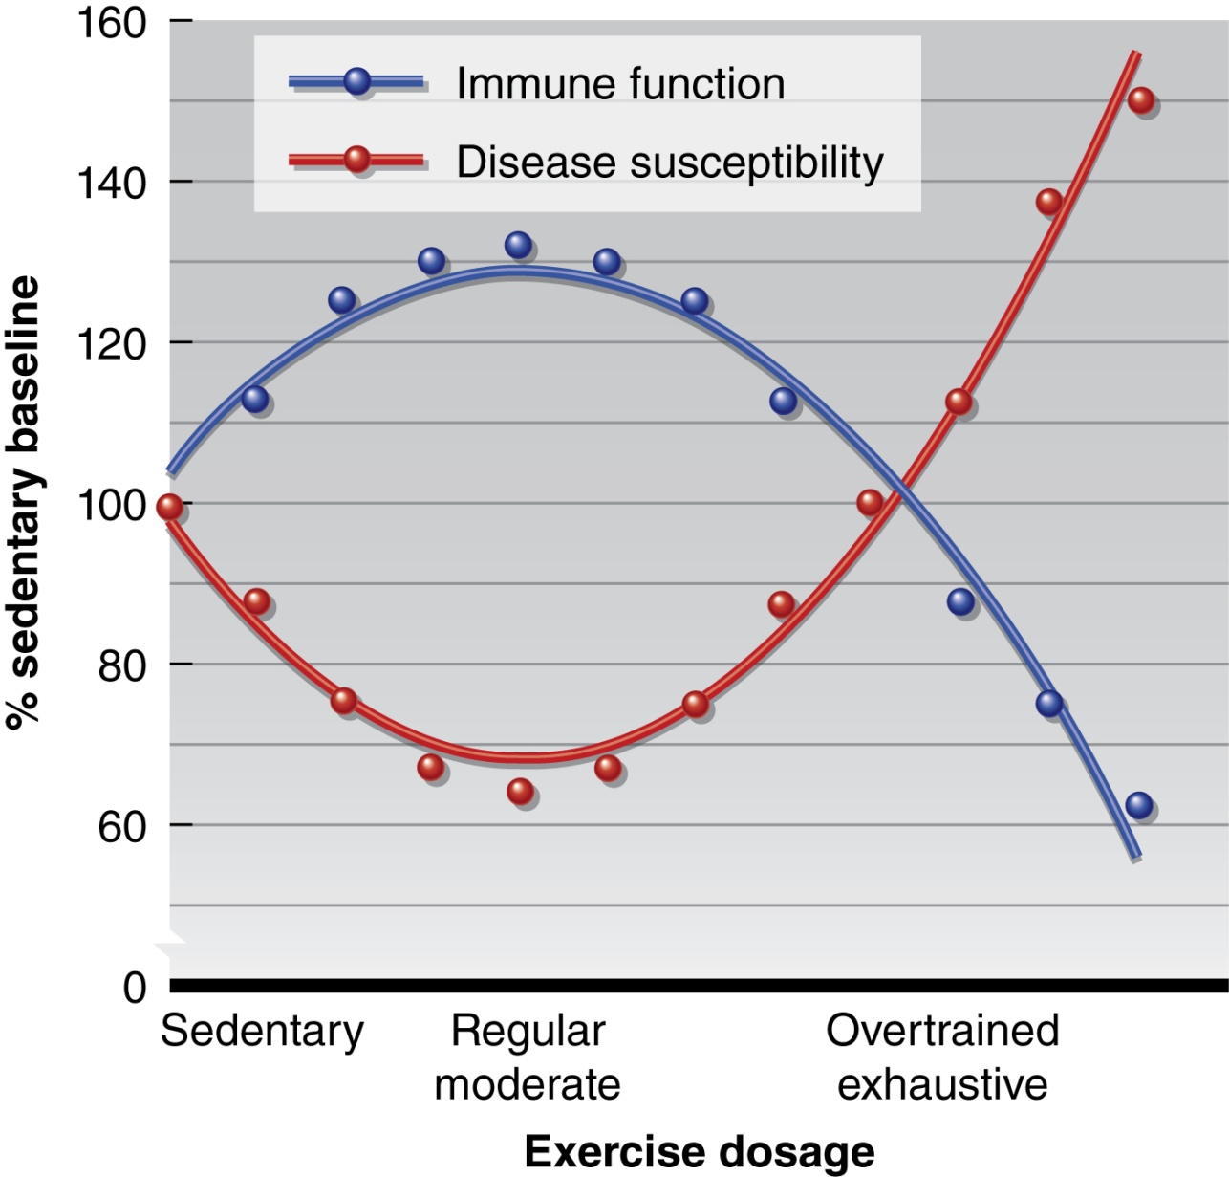
Figure 14.7

Slide 28
Overtraining Syndrome, Fibromyalgia, and Chronic Fatigue Syndrome
Three similar, overlapping syndromes
  Notoriously difficult to diagnose
  Causes remain unknown
Similar symptoms
  Fatigue
  Psychological distress
  Endocrine/HPA, neural, and immune dysfunction

Slide 29
Predicting Overtraining Syndrome
Causes unknown, diagnostics difficult
Threshold different for each athlete
Most coaches and trainers use (unreliable) intuition
No preliminary warning symptoms
  Coaches do not realize until too late
  Recovery takes days/weeks/months of rest
Biological markers have limited effectiveness

Slide 30
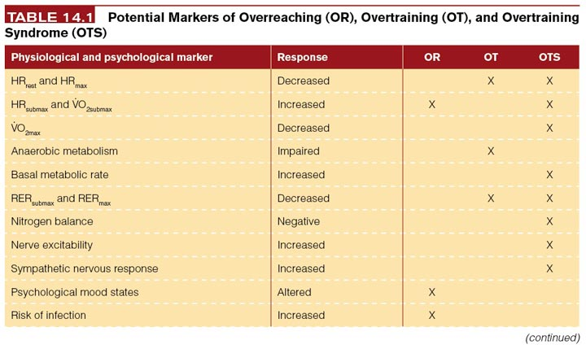
Table 14.1

Slide 31
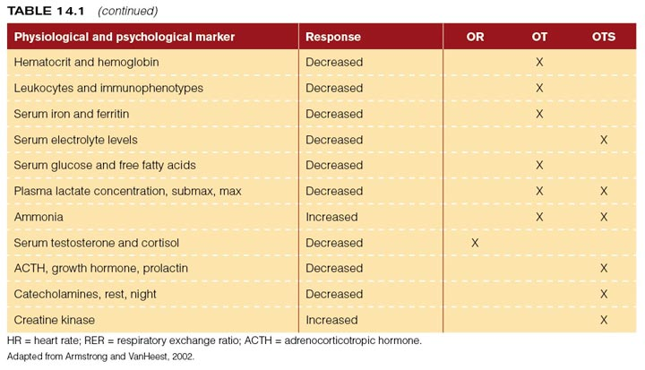
Table 14.1 (continued)

Slide 32
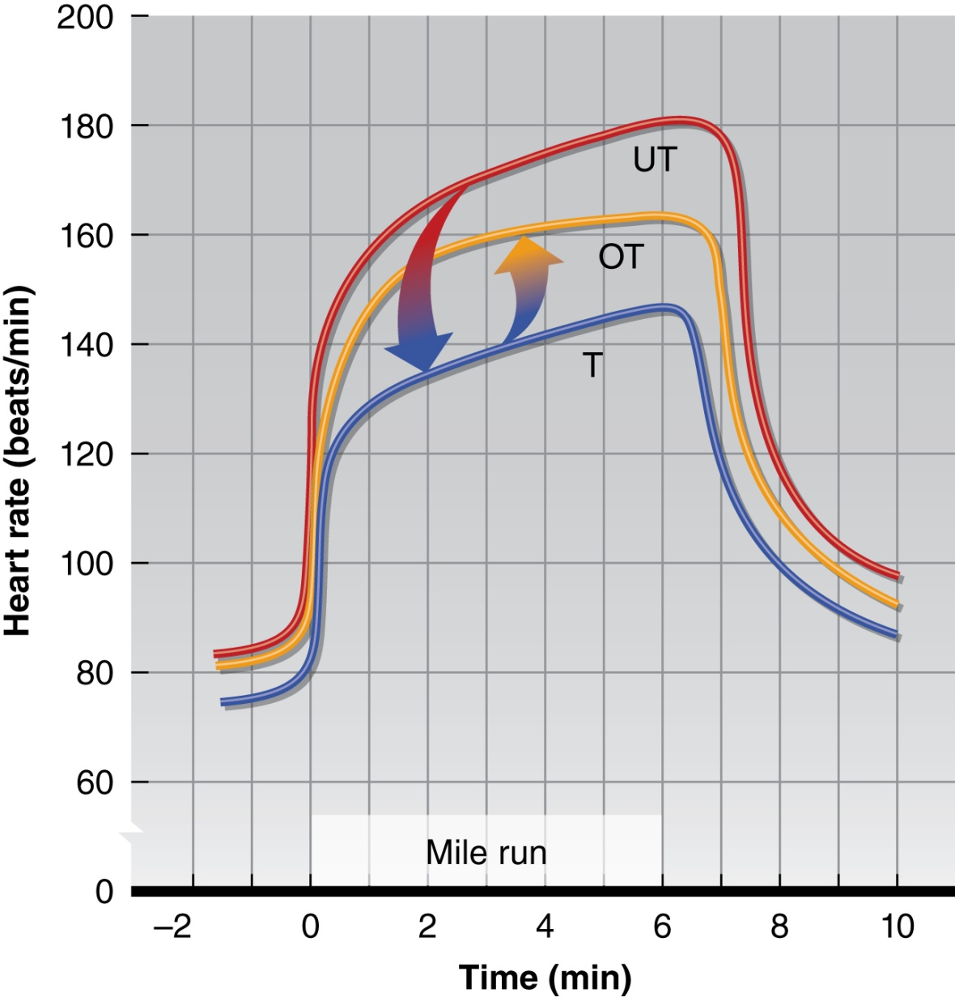
Figure 14.8

Slide 33
Overtraining Syndrome
Treatment
  Reduced intensity or rest (weeks, months)
  Counseling to deal with stress
Prevention
  Periodization training
  Adequate caloric (especially carbohydrate) intake

Slide 34
Overtraining:
Exertional Rhabdomyolysis
Acute (potentially lethal) condition
Breakdown of skeletal muscle fibers
  In response to unusually strenuous exercise
  Often similar to DOMS
  Severe cases cause renal failure (protein leakage)
  Exacerbated by statin drugs, alcohol, dehydration

Slide 35
Overtraining:
Exertional Rhabdomyolysis
Signs and symptoms
  Severe muscle aches (entire body)
  Muscle weakness
  Dark or cola-colored urine
Can reach clinical relevancy
  Rare, usually reported in case studies
  Requires hospitalization
  Precipitated by excessive eccentric exercise

Slide 36
Tapering for Peak Performance
Tapering = reduction in training volume/intensity
  Prior to major competition (recovery, healing)
  4 to 28 days (or longer)
  Most appropriate for infrequent competition
Results in increased muscular strength
  May be associated with contractile mechanisms
  Muscles repair, glycogen reserves replenished

Slide 37
Tapering for Peak Performance
Does not result in deconditioning
  Considerable training to reach VO_{2max}
  Can reduce training by 60% and maintain VO_{2max}
Leads to improved performance
  3% improved race time
  18 to 25% improved arm strength, power
  Effects unknown on team sports, marathons

Slide 38
Detraining
Loss of training-induced adaptations
  Can be partial or complete
  Due to training reduction or cessation
  Much more substantial change than tapering
Brief period = tapering
Longer period = detraining

Slide 39
Detraining
Immobilization
  Immediate loss of muscle mass, strength, power
Training cessation
  Rate of strength and power loss varies
Causes
  Atrophy (immobilization)
  Reduced ability to recruit muscle fibers
  Altered rates of protein synthesis versus degradation
Low-level exercise mitigates loss

Slide 40
Detraining
Muscle endurance ⬇ quickly
  Change seen after 2 weeks of inactivity
  Not clear whether the result of muscle or cardiovascular changes
Oxidative enzyme activity ⬇ by 40 to 60%

Slide 41
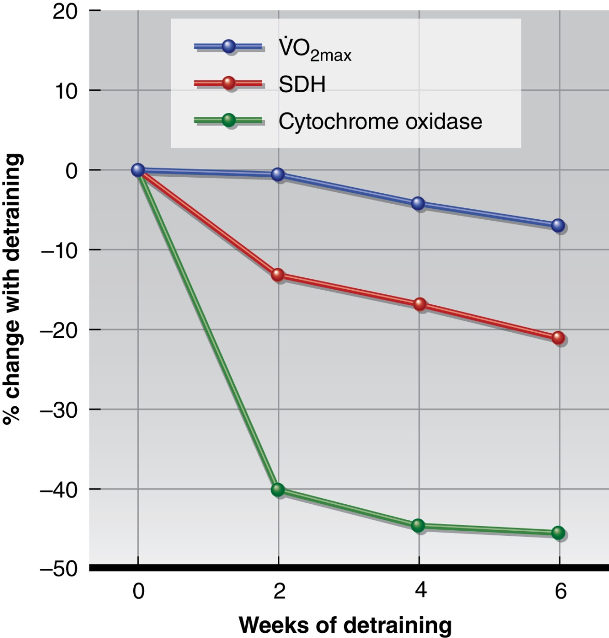
Figure 14.9

Slide 42
Detraining
Muscle glycogen stores ⬇ by 40%
Significant acid-balance imbalance. Exercise test once weekly during detraining showed
  Blood lactate accumulation ⬆
  Bicarbonate ⬇
  pH ⬇

Slide 43
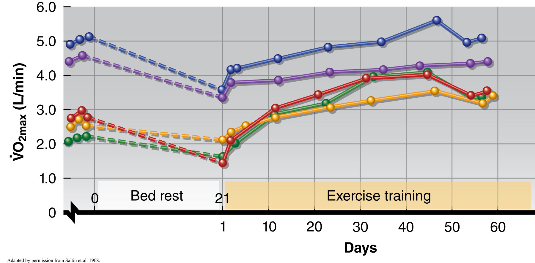
Figure 14.11

Slide 44
Detraining
How much activity is needed to prevent losses in physical conditioning?
Losses occur when frequency and duration decrease by 2/3 of regular training load
70% VO_{2max} training sufficient to maintain maximal aerobic capacity

