Slide 1
Exercise and Environment

Slide 2
CHAPTER LEARNING OUTCOMES
Describe the basic physiological responses to exercise in hot and cold environments.
Understand the specific elements of acclimatization to hot and cold environments.
Know the primary health-related risks of exercising in the heat and in the cold.
Be aware of the potential effects of exercising at high altitudes on health and performance.

Slide 3
Body Temperature Regulation
Stress of physical exertion complicated by environmental thermal conditions
Humans are homeothermic
Internal body temperature regulated, nearly constant despite environmental temperature changes
Thermoregulation: regulation of body temperature around a physiological set point
98.6F or 37C

Slide 4
Body Temperature Regulation: Metabolic Heat Production
Metabolic heat production (M)
<25% ATP breakdown → cellular work (W)
>75% ATP breakdown → metabolic heat
Transfer of heat between body and environment
Heat moves from body core to body shell via blood
When heat reaches skin, can be dissipated by conduction, convection, radiation, or evaporation

Slide 5
Body Temperature Regulation: Transfer of Body Heat
Conduction (K)
Heat transfer from one solid material to another through direct molecular contact (negligible)
Sitting on chilly (or hot) metal bleachers
Convection (C)
Heat transfer by movement of gas or liquid across a surface
– ↑ Movement across skin surface → ↑ heat exchange
Major daily thermoregulatory factor

Slide 6
Body Temperature Regulation: Transfer of Body Heat
Radiation (R)
Heat loss in form of infrared rays
Body can give off or receive radiant heat
Major daily thermoregulatory factor
C + K + R = avenues of dry heat exchange
Insulation (I): resistance to dry heat exchange
Still layer of air ideal insulator

Slide 7
Body Temperature Regulation: Transfer of Body Heat
Evaporation (E)
Heat loss via phase change from liquid to gas
Primary heat loss during exercise (~80%)
Clothing = resistance to E
Heat balance equation
M – W ± R ± C ± K – E = 0 → heat balance
If M – W ± R ± C ± K – E < 0 → heat loss
If M – W ± R ± C ± K – E > 0 → heat gain

Slide 8
Body Temperature Regulation: Transfer of Body Heat
Humidity and heat loss
Water vapor pressure (humidity) affects E
– ↑ Humidity → ↓ E, ↓ humidity → ↑ E
– Prolonged evaporation via sweat → dehydration
Cooling capacity of sweat
Air temperature can become ≥ skin temperature
C will not work, must depend on E
1.5 L sweat evaporated cools 400 W

Slide 9
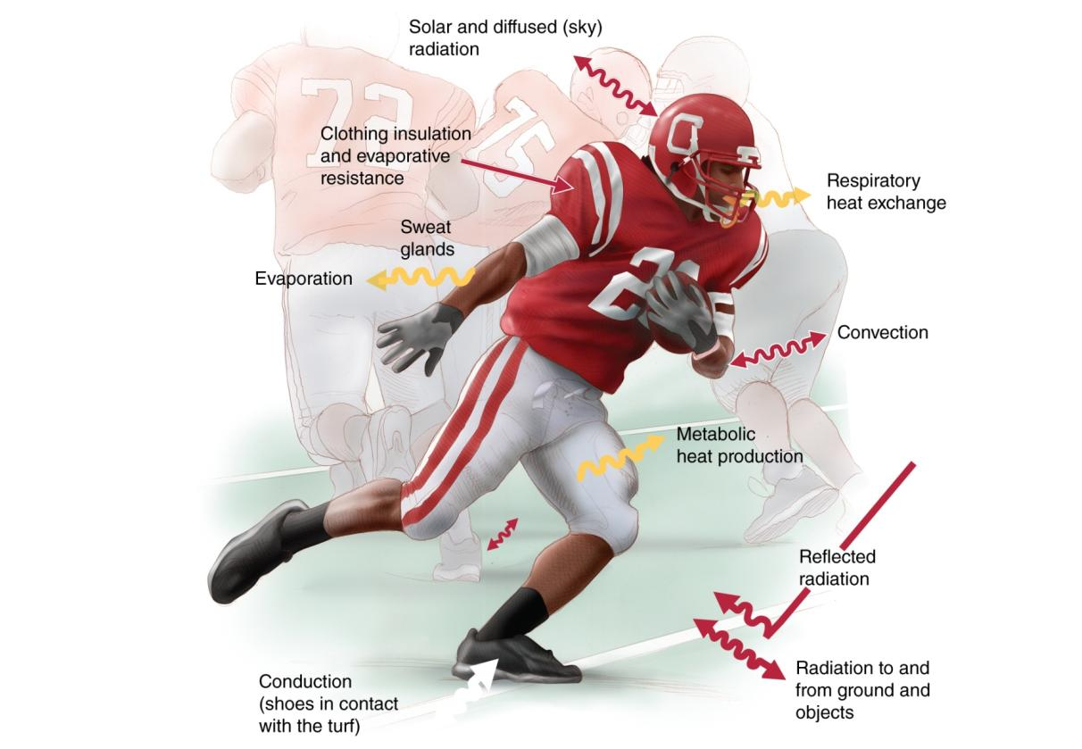
Figure 12.4

Slide 10
Body Temperature Regulation: Thermoregulatory Control
If C and E unlimited, can withstand 200 °C
Briefly withstand core temperatures <35 °C, >41 °C
For normal ranges of body and air temperature, thermoregulatory responses very effective
Core temperature regulated around 37 °C
Core temperature >40 °C inhibits physiological function
Thermoregulatory function controlled by POAH

Slide 11
Body Temperature Regulation: Thermoregulatory Control
Preoptic-anterior hypothalamus (POAH)
Body’s thermostat located in the brain
Receives input from sensory thermoreceptors
When body temperature deviates, POAH activates thermoregulatory mechanisms
Sensory receptors
Peripheral thermoreceptors in skin
Central thermoreceptors in brain, spinal cord

Slide 12
Body Temperature Regulation: Thermoregulatory Control
POAH signals sympathetic nervous system (SNS) effectors
Skin arteriole effectors
SNS vasoconstriction (VC) minimizes heat loss
SNS vasodilation (VD) enhances heat loss
Eccrine sweat gland effectors
SNS stimulation of sweating → E heat loss
Acetylcholine: sympathetic cholinergic stimulation
More responsive to changes in core temperature than skin temperature

Slide 13
Body Temperature Regulation: Thermoregulatory Control
Skeletal muscle effectors
Help generate additional heat via shivering
Involuntary cycle of contraction and relaxation
Only heat production, no useful work
Endocrine gland effectors
– ↑ Metabolism → ↑ heat production
Cooling → release of thyroxine, catecholamines
Hormonal stimulation of heat production

Slide 14
Body Temperature Regulation
Acclimation: short-term adaptation to environmental stressor (days/weeks)
Acclimatization: long-term adaptation to environmental stressor (months/years)
Conversion equations
C° = (F° – 32) / 1.8
F° = (C° x 1.8) + 32

Slide 15
Exercise in the Cold
Cold stress: any environmental condition causing loss of body heat
• ↓ Core or skin temperature triggers physiological + behavioral mechanisms
POAH triggers peripheral VC
POAH triggers nonshivering thermogenesis
POAH triggers skeletal muscle shivering
Cerebral cortex triggers behavioral adaptations

Slide 16
Exercise in the Cold
Cold habituation
Occurs after repeated cold exposures without significant heat loss
VC, shivering blunted; core temperature allowed to ↓ more
Metabolic acclimation
Occurs after repeated cold exposures with heat loss
Enhanced metabolic, shivering heat production
Insulative acclimation
When ↑ metabolism cannot prevent heat loss
Enhanced skin VC (↑ peripheral tissue insulation)

Slide 17
Exercise in the Cold
Dangerous (hypothermia-inducing) environmental conditions hard to define
Body composition affects heat loss
– ↑ Inactive peripheral muscle = ↑ insulation
– ↑ Subcutaneous fat = ↑ insulation
– ↓ Body surface area:mass ratio = ↓ heat loss
Child versus adult versus elderly
Men versus women

Slide 18
Exercise in the Cold
As with heat, air temperature alone not a valid index of heat loss
Windchill affects heat loss
Often misunderstood: air movement, not air temperature
Index based on cooling effect of wind
Increases C heat loss
Refers to cooling power of environment
– ↑ Windchill = ↑ risk of freezing tissues

Slide 19
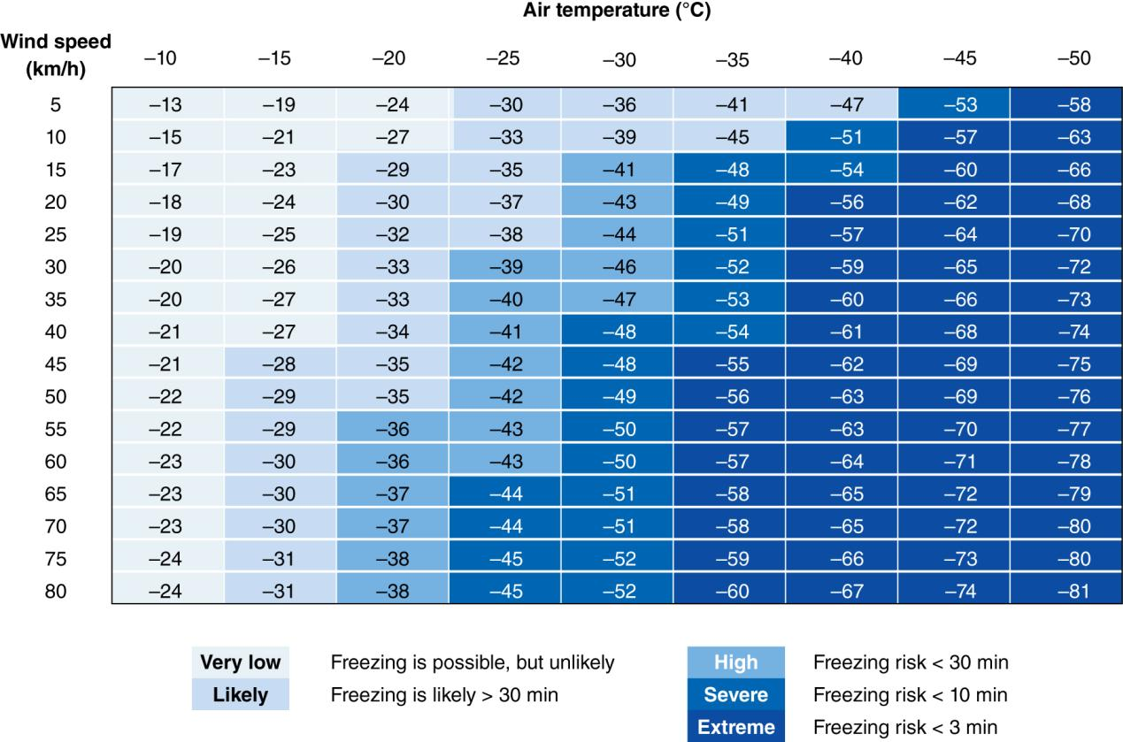
Figure 12.14

Slide 20
Exercise in the Cold
Water has thermal conductivity 26 times greater than air
Cold water versus air affects heat loss
When C + K + E + R is considered, heat loss 4 times faster in cold water versus cold air
Core temperature constant until water temp <32 °C
Core temperature ↓ 2.1 °C/h in 15 °C water
Heat loss ↑ in moving water, ↓ with exercise
Hypothermia from cold water occurs well above 0 °C

Slide 21
Physiological Responses to Exercise in the Cold
Muscle function ↓
Altered fiber recruitment → ↓ contractile force
Shortening velocity and power ↓
Affects superficial muscles (deep muscle spared)
As fatigue ↑, metabolic heat production ↓
Energy reserve depletion with endurance exercise → potential for hypothermia

Slide 22
Physiological Responses to Exercise in the Cold
FFA metabolic responses
Normally, ↑ catecholamines → ↑ FFA oxidation
Cold → ↑ catecholamine secretion but no ↑ FFA
VC in subcutaneous fat → ↓ FFA mobilization
Glucose metabolic responses
Blood glucose maintained well during cold exposure
Muscle glycogen utilization ↑
Hypoglycemia suppresses shivering

Slide 23
Health Risks During Exercise in the Cold
Hypothermia
Core temp 34.5 to 29.5 °C: POAH function compromised
Core temp <29.5 °C: POAH thermoregulation completely lost, metabolism slows, drowsiness, lethargy, coma
Cardiorespiratory effects of cold
Low core temperature → slow HR (SA node effects)
Cold air does not damage ventilatory tissues
Cold may ↓ ventilation (rate and volume)

Slide 24
Health Risks During Exercise in the Cold
Treatment for mild hypothermia
Remove individual from cold
Provide dry clothing, blankets, warm beverages
Treatment for severe hypothermia
Gentle handling to avoid arrhythmias
Gradual rewarming
May require hospital facilities, medical care

Slide 25
Health Risks During Exercise in the Cold
Frostbite
Peripheral tissue freezing (air temperature ~−29 °C)
Excess VC → lack of O₂, nutrients → tissue death
Untreated frostbite → gangrene, tissue loss
Gradually rewarm only when no risk of refreezing
Exercise-induced asthma
Affects up to 50% of winter-sport athletes
Excessive airway drying
Treated with β-agonists, steroid inhalers

Slide 26
Physiological Responses to Exercise in the Heat
Exercise → ↑ M heat load, disturbs thermal homeostasis in most environments
Effects on cardiovascular function
Skin arterioles VD to ↑ C heat loss, requires ↑ blood flow compared to exercise in the cold
POAH triggers SNS: cardiac output ↑ further via HR/contractility, ↑ VC to nonessential tissues
Blood volume ↓ (sweat), SV can’t ↑ (blood pooling), so HR ↑ further to compensate (cardiovascular drift)

Slide 27
Physiological Responses to Exercise in the Heat: Fluid Balance
Sweating
Hot environmental temperatures > skin, core temperatures
C, K, R → heat gain, E only avenue of heat loss
Eccrine sweat glands controlled by POAH
Sweat electrolyte content < plasma
Duct reabsorbs some Na⁺, Cl⁻
Light sweating: very dilute sweat
Heavy sweating: less dilute (more Na⁺, Cl⁻ loss)

Slide 28
Physiological Responses to Exercise in the Heat: Fluid Balance
Training affects sweat composition
More sensitive to aldosterone
Reabsorb (i.e., conserve) more Na⁺, Cl⁻
K⁺, Ca²⁺, Mg²⁺ losses unchanged
Sweat losses during exercise
Can lose 1.6 to 2.0 L (2.5-3.2% body weight) each hour
– ↑ Sweating → ↓ blood volume → ↓ cardiac output
Severe dehydration → onset of heat-related illness

Slide 29
Physiological Responses to Exercise in the Heat: Fluid Balance
Exercise and body water loss stimulate adrenal cortex and posterior pituitary gland
Hormonal control of fluid balance
Loss of water, electrolytes triggers release of aldosterone and antidiuretic hormone (ADH)
Aldosterone: retains Na⁺ at kidneys
ADH (vasopressin): retains water at kidneys
**ExPhysRules

Slide 30
Health Risks: Preventing Hyperthermia
No outdoor activities when WBGT >28 °C
Schedule practice early morning or evening
Never restrict fluid intake
Fluids readily available to replace sweat losses
Drink breaks every 15 to 30 min
Minimizes rise in HR, core temperature
Minimize clothing (especially football players)

Slide 31
Health Risks: Guidelines for Practicing and Competing in Heat
Events should not take place during hottest time of day, avoid WBGT >28 °C
Adequate supply of palatable fluids
Customize fluid intake based on fluid losses (1 L sweat loss = 1 kg weight loss)
Be aware of signs of heat illness
Organizers get final call on stopping events, excluding athletes who have heat illness

Slide 32
Acclimation to Exercise in the Heat
Repeated exercise in heat → rapid changes for better performance in hot conditions
Acclimation: short term (9-14 days)
Acclimatization: long term (months/years)
Effects of acclimation
Cardiovascular function optimized
Sweating rate, sweat distribution, and sweat content change
Results in a lower core temperature during exercise

Slide 33
Acclimation to Exercise in the Heat
Plasma volume ↑ due to ↑ oncotic P
Temporary (back to normal after 10 days)
Buys time for other adaptations to occur
• ↓ Heart rate, ↑ cardiac output
Supports ↑ skin blood flow
Greater heat loss, ↓ core temperature
Widespread sweating earlier, more dilute
Prevents dangerous Na⁺ loss
Optimized E heat loss

