Slide 1

Orthopedic Rehab of the Athlete
Bruce C. Reider
George J. Davies
Matthew T. Provencher

Slide 2
Part 1
Shoulder: Shoulder Instability

Slide 3
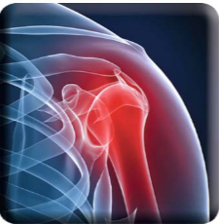
Anterior Shoulder Instability
Chapter 1

Slide 4
Epidemiology
8.2 occurrences per 100,000 person years¹ in the rural United States
24 occurrences per 100,000 person years in Scandinavian countries
The frequency of instability episodes in a military population over 1 year was calculated as 2.8%.
Age
Owens et al. reported that 80% of shoulder dislocations occur in younger patients.⁵ Forty seven percent of patients presenting to U.S. emergency departments with traumatic dislocations were between the age of 15 and 29.

Slide 5
Epidemiology
Gender:
Male collegiate athletes (0.15/1000 AE) were 2.7 times more likely to sustain a shoulder instability episode than female (0.06/ 1000 AE) collegiate athletes.
Sport:
In collegiate athletes, the rate of shoulder instability was greatest in Spring football at 0.40/1000 AE followed by wrestling (0.21/1000 AE), women’s ice hockey (0.18/1000 AE) and fall football (0.18/1000 AEs).⁴
However, female basketball players sustained more shoulder dislocations than male basketball players (proportion ratio = 2.7).^{9,10}

Slide 6
Pathophysiology: Intrinsic Factors
variations in the capsular and ligament insertion to the glenoid
Capsular redundancy
glenoid labrum is a static stabilizer of the joint and disruption of this structure yields a decrease in the stability of approximately 10% in all directions.
Generalized joint hypermobility (Figure 1-1), as measured by the Beighton scale, has been associated with a 2.5 times increased risk of having reported an episode of glenohumeral instability.¹⁴

Slide 7
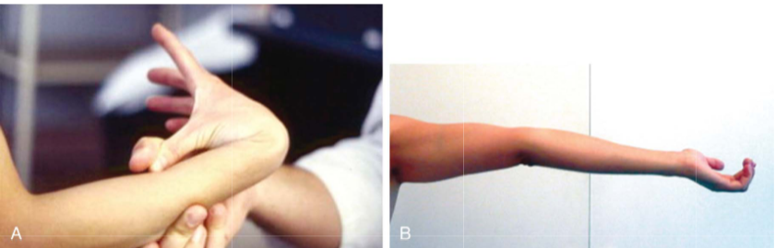
Hyperlaxity of the wrist (A) and elbow (B)

Slide 8
Pathophysiology: Intrinsic Factors
The loss of osseous integrity by altered inclination or version, as well as bone loss on the glenoid or humeral side of the joint may affect anterior and inferior joint stability.
There may be associated pathology that requires attention such as a superior labrum anterior to posterior (SLAP) lesion.
Dynamic stability of the shoulder is dependent on concavity-compression.¹⁶ This phenomenon is related to the centering forces produced by coordinated contraction of the rotator cuff musculature combined with proper position and stabilization of the scapula. ¹⁷

Slide 9
Pathophysiology: Extrinsic Factors
The initial incidence of shoulder dislocation was greater in those involved in sport.
Also, the frequency of recurrent dislocation was greater in athletes (> 80%) than the general population (33%).^{7,28}
Contact has been documented as the most common mechanism of shoulder dislocation.^{9,29}
In full to partial contact sports, contact with another participant
Another common mechanism for injury was player contact with equipment and playing surfaces.^{9,10}
In the general population, especially older women, falls on the outstretched arm.

Slide 10
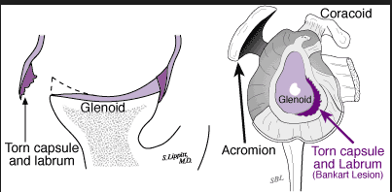
Traumatic Factors
Bankart described the mechanism for shoulder dislocation as a fall on the extended arm causing a forceful extension of the humerus resulting in anterior-inferior dislocation.³⁰

Slide 11
Clinical Presentation
History
often complain of pain after an initial episode of traumatic anterior instability
The pain and muscle spasm may accompany prolonged dislocation with a delay in reduction
The individual may report impaired sensation, loss of motion, and impaired strength.³⁷
Commonly, patients report feelings of apprehension and instability.³³

Slide 12
Clinical Presentation
Physical Examination
Abnormal Findings:
Positive anterior apprehension test (+/− relocation test) (Figure 1-5) is suggestive of anterior instability.³⁷
The athlete may complain of popping or clicking in the shoulder on movement.³⁸
Neurologic assessment including sensory and motor exam might demonstrate impaired sensation over the deltoid ³⁸

Slide 13
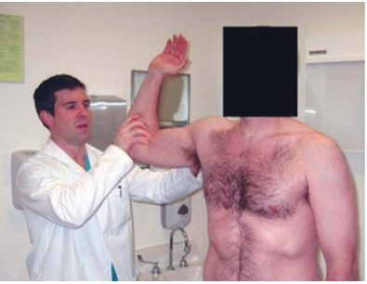
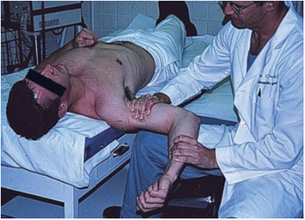
anterior apprehension test & anterior relocation test

Slide 14
Pertinent Normal Findings
The patient with anterior instability will demonstrate normal to near normal single plane range of motion after an initial recovery.
Strength will return after a brief period of recovery barring neurological involvement.
The patient will resume participation at a high level of play with the exception of overhead activities and activities requiring the arm to extend behind the body or adopt a position of abduction and external rotation

Slide 15
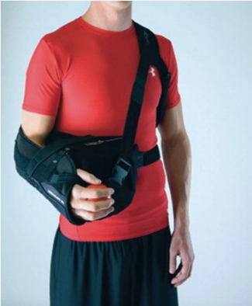
Treatment
Nonoperative Management
Bracing: Itoi et al. have shown that traumatic anterior instability can be placed in a sling (Figure 1-11) with pillow at 45° to 60° of external rotation (ER) and the injury heals.
A criterion-based, progressive exercise program is thought to be effective for short-term management of traumatic anterior shoulder instability coupled with bracing when the athlete returns to sport.

Slide 16
Guidelines for Choosing among Nonoperative Treatments
Patients with initial, unidirectional, capsular injuries may be appropriate for immediate bracing in slight abduction and ER.
A progressive rehabilitation program works well for many patients to ensure success.

Slide 17
Surgical Indications
Disability related to recurrent dislocations.
First-time dislocations with combinations of specific pathologies (e.g., an older patient with combined dislocation and rotator cuff tear).
Selected patients presenting with acute dislocation and combined bone loss (humeral and glenoid).

Slide 18
Aspects of History, Demographics, or Exam Findings That Affect Choice of Treatment
Number of dislocations³⁹
Severity of dislocation
Was anesthesia required?
Was it a “locked” dislocation?
Labral involvement
Bony avulsion
Percentage glenoid bone loss³⁹
Residual neurological or vascular symptoms
Rotator cuff involvement
Concomitant SLAP repair¹⁵

Slide 19
Nonoperative Rehabilitation Following Anterior Capsulolabral Injury
Charles A. Thigpen PhD, PT, ATC
Ellen Shanley PhD, PT, OCS
Richard J. Hawkins MD

Slide 20
Guiding Principles of Nonoperative Rehabilitation
Gradual, pain-free restoration of range of motion (ROM) avoiding the sensation of instability
Muscle guarding/spasm must first be resolved before dynamic stability can be restored
Correct application of manual techniques and therapeutic exercises to promote static balance in glenohumeral joint mobility and optimum dynamic stabilization from the rotator cuff and associated shoulder girdle muscles.
Return to sport is not appropriate until the athlete demonstrates dynamic stability in the functional ROM in which they are expected to participate.

Slide 21
Phase I
Goals
Educate the patient about restrictions, pain management, and activities of daily living (ADLs).
Protect the anterior shoulder by avoiding positions/movements that are likely to increase stress on the anterior/inferior capsulolabral structures.
Minimize shoulder pain to normalize muscle tone.
Gradually restore frontal plane elevation, abduction, and external rotation (ER) above 45°, as suggested in Table 1-1

Slide 22
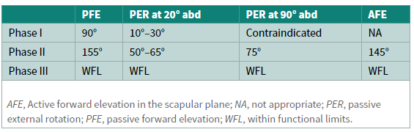
Staged Range of Motion Goals Following Arthroscopic Anterior Capsulolabral Injury

Slide 23
Protection
We recommend initial sling use for dislocations with gradual progression to no sling based on pain, available ROM, muscle performance, and activity level.
Management of Pain and Swelling
Oral pain medications as needed
Electrical stimulation
Intermittent cryotherapy for pain and inflammation reduction¹
Patient positioning: patients are encouraged to use pillows or bolsters to find a “position of comfort,” usually slightly abducted (20° to 30°) in a neutral or slight internal rotation (IR), especially at night.

Slide 24
Techniques for Progressive Increase in Range of Motion
The initial phase is resolving pain, decreasing swelling, and allowing the acute, postinjury shoulder to recover.
Supported Codman’s pendulum exercises for gentle motion and joint distraction, supported forward elevation (FE) (<90°), and ER to 0° at the side (<20° abduction) can be performed immediately to maintain joint mobility but should not reproduce symptoms.
We suggest all of these motions be performed with support to minimize rotator cuff activity due to incorrect technique.²⁻⁴

Slide 25
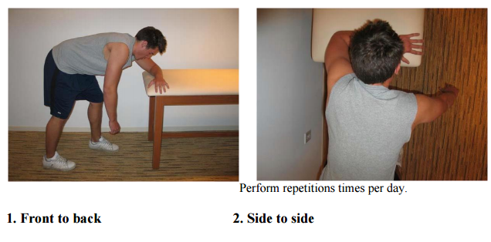
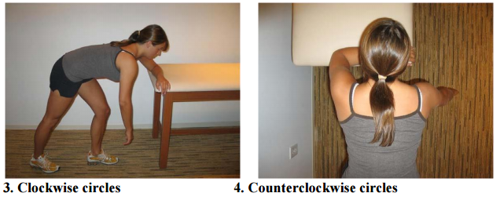
Codman’s (pendulum) Exercises
Bend forward at the waist, (back parallel to ground is ideal). Allow involved arm to hang down, perpendicular to the floor. Keep arm and shoulder muscles relaxed. Move arm slowly, increasing the arc as tolerated. This technique should cause only minimal pain.

Slide 26
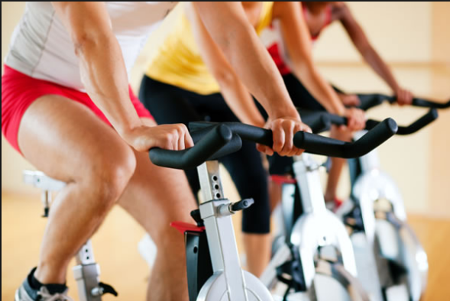
Stretching/Flexibility Techniques for the Musculo-Tendinous Unit
Stretching/flexibility exercises are not recommended at this time due the need to protect the repair.
Other Therapeutic Exercises
Lower extremity and cardiovascular exercises may begin immediately as long as there is no reproduction of instability symptoms.

Slide 27

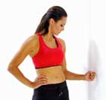
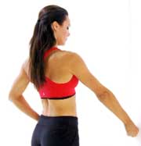
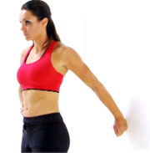
Activation of Primary Muscles Involved
Isometric exercises may begin day 1 as tolerated. We recommend performing these exercises in the “safe zone” of 20° to 30° abduction in the plane of the scapula in neutral rotation first with the elbow supported then gradually removing support.
Gradual progression to positional isometrics can begin day 1
Isometric extension
Isometric adduction
Isometric Abduction
External Rotation
Internal Rotation

Slide 28
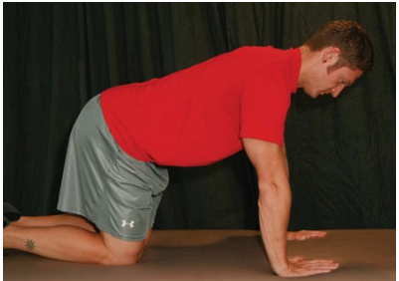
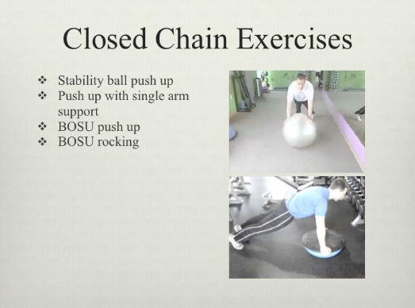
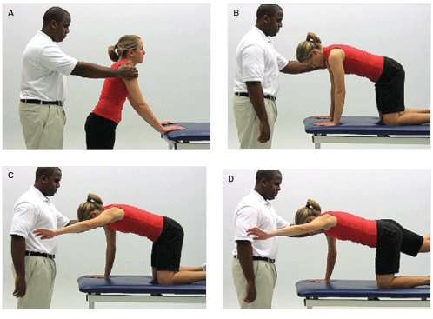
Open and Closed Kinetic Chain Exercises
Closed chain activities are often less painful and help to provide compression of the GH joint, thereby increasing the static stability of the joint

Slide 29
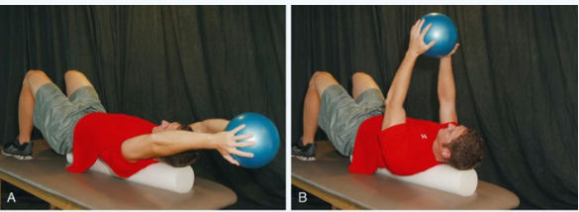
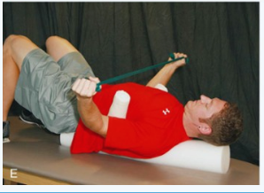
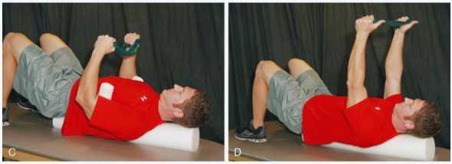
Neuromuscular Dynamic Stability Exercises
Exercises to emphasize rotator cuff balance and co-contraction should be emphasized during Phase I

Slide 30
Milestones for Progression to the Next Phase
Minimal to moderate pain (Numeric Pain Rating Scale [NPRS]: 2 to 4/10) with minimal pain at rest (2/10)
Stage I ROM goals achieved but not significantly exceeded

Slide 31
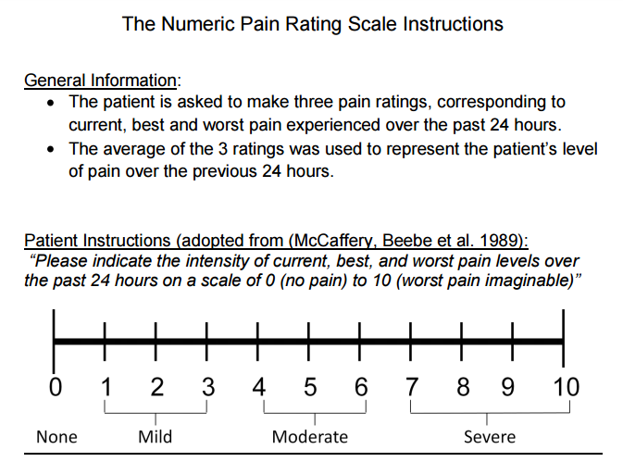
Numeric Pain Rating Scale

Slide 32
Phase II
Goals
Minimize shoulder pain (<2/10)
Achieve staged ROM goals to normalize passive ROM and active ROM.
Normalize rotator cuff guarding and neuromuscular control
Normalize scapular position and control

Slide 33
Clinical Pearls
Normalize subscapularis muscle function to provide dynamic stability for the anterior shoulder.
Avoid scapular protraction with coronal plane shoulder motion to limit stress on the anterior capsulolabral structures.^{6,7}
Follow up soft tissue work with proprioceptive neuromuscular facilitation (PNF), positional isometrics, and proprioceptive activities to maximize neuromuscular facilitation during early phases after injury.

Slide 34
Patient-Oriented Outcomes
We recommend two measures, a general measure of shoulder function that includes pain, function, and patient satisfaction similar to the American Shoulder and Elbow Surgeons’ (ASES), the Pennsylvania Shoulder Score (PSS) and a measure specifically for instability, such as the Western Ontario Instability Index (WOSI).¹⁰⁻¹⁴

Slide 35
Protection
Treatment for pain/analgesia oral pain medications
Electrical stimulation (TENS) is recommended to manage pain and muscle. TENS units at home are often helpful to control pain, especially shortly after surgery.
Intermittent cryotherapy for pain and inflammation reduction.¹
We recommend 20 minutes per hour for the first week following surgery.

Slide 36
Techniques for Progressive Increase in Range of Motion
Manual Therapy Techniques
Gentle joint distraction and grade I-III joint oscillations may be helpful before performing supervised PROM by the rehabilitation professional to decrease muscle guarding, restore capsular balance, and prepare the joint for ROM exercise.
We recommend these positions to be performed in the sca­pular plane in approximately 30° of elevation, and neutral rotation to limit the stress on the capsulolabral repair.⁵

Slide 37
Techniques for Progressive Increase in Range of Motion
Soft Tissue Techniques
Shortening, parallel techniques such as (Positional Release/Strain-Counterstrain) may be helpful to reduce protective guarding especially for the subscapularis, posterior rotator cuff, teres major, latissimus dorsi, and pectoralis major/minor.
Passive ROM and active assist ROM exercises may be initiated after POW 2 for ER and FE.

Slide 38
Stretching/Flexibility Techniques for the Musculo-Tendinous Unit
Should not be performed as these are end ROM exercises.
Other Therapeutic Exercises
Gradual introduction of total body strengthening (TBS), total leg strength (TLS), core stability, uninvolved total arm strength (TAS), and cardiovascular conditioning can be initiated with attention to the safety of the activity.

Slide 39
Activation of Primary Muscles Involved
Scapular retraction and proprioceptive neuromuscular facilitation (PNF) patterns should be emphasized and positions based on patient tolerance.
We recommend first achieving stability in a retracted position then progressing to scapular protraction to minimize increased stress on the anterior capsulolabral structures.^{6,7}
Although scapular elevation and retraction are safe we suggested limited resistance because of the load placed through the glenohumeral joint for most exercises.
Active ROM and rotator cuff strengthening within the staged ROM goals

Slide 40
Activation of Primary Muscles Involved
The recommended procedure is to begin with submaximal isometric strengthening of the shoulder and elbow with the arm adducted to the side in neutral rotation first, then to progressively increase the angle of arm elevation and ER.
As the patient demonstrates improved rotator cuff endurance and absence of pain or other symptoms it is recommended to progress to dynamic isometrics, then concentric/eccentric exercises, then AROM exercises within the ROM restrictions.

Slide 41
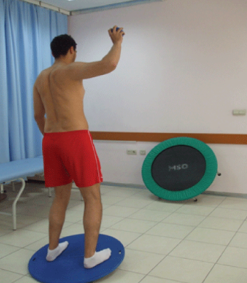
Sensorimotor Exercises
Angular reposition, rhythmic stabilization, and repeated contractions within staged ROM limits may be implemented during Phase II

Slide 42
Open and Closed Kinetic Chain Exercises
Closed kinetic chain (CKC) exercises may be implemented below 90° of elevation during Phase II
These exercises should begin in a modified weight-bearing position and progressed to full weight-bearing as tolerated.¹⁵

Slide 43
Milestones for Progression to the Next Phase
Appropriate healing of the surgical repair by adhering to the precautions and immobilization guidelines.
Staged ROM goals achieved but not significantly exceeded
Minimal to no pain (NPRS: 0—2/10) with ROM
PSS greater than 60% and WOSI less than 50%

Slide 44
Phase III
Goals
Achieve staged ROM goals to normalize passive ROM and active ROM. DO NOT significantly exceed especially for ER at 90° of abduction.
Minimize shoulder pain (0/10 at rest and <2/10 following exercises or activity)
Begin to increase strength and endurance

Slide 45
Phase III
Protection
No sling use
Avoid positions of max ER towards 90° of abduction, especially with a posteriorly directed load. (e.g., NO push-ups, bench press, pectoral flys)
Management of Pain and Swelling
Pain should not be a limiting factor at this point
Cryotherapy as needed
NSAIDS as needed.

Slide 46
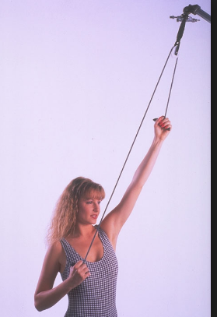
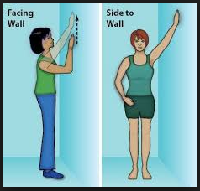
Phase III
Techniques for Progressive Increase in Range of Motion
FE should be progressed from active-assistive exercises (e.g., rope and pulley, wall walks), to active, to resistive upright exercises, then finally to prone exercises as per reported electomyography (EMG) activity of the shoulder.^{3,4}

Slide 47
Phase III
Soft Tissue Techniques
Deeper soft tissue techniques may be initiated during this phase.
More aggressive techniques such as Active Release® or other instrumented soft tissue mobilizations to normalize muscle tone and extensibility.
Particular attention should be paid to the subscapularis, latissimus, pectorals, teres major, and posterior rotator cuff.
these techniques often allow for gradual return consistent with the staged goals without aggressive joint mobilizations or excessive end range stretching.

Slide 48
Phase III
Active Release®
ART® is a patented, state of the art soft tissue system/movement based massage technique that treats problems with muscles, tendons, ligaments, fascia and nerves.
Headaches, back pain, carpal tunnel syndrome, shin splints, shoulder pain, sciatica, plantar fasciitis, knee problems, and tennis elbow are just a few of the many conditions that can be resolved quickly and permanently with ART

Slide 49
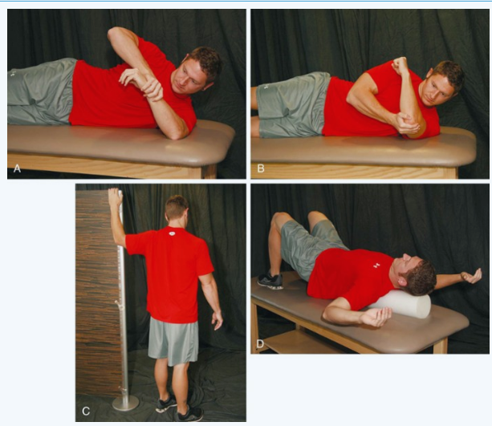
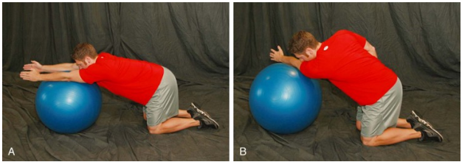
Phase III
Stretching/Flexibility Techniques for the Musculo-Tendinous Unit
Pectoralis minor
pectoralis major
Latissimus and posterior shoulder flexibility

Slide 50
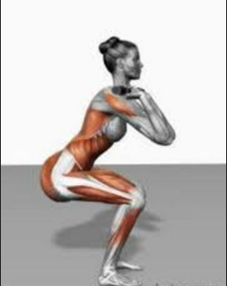
Phase III
Other Therapeutic Exercises
Address core stability deficits as needed beginning in the sagittal plane and progressing to frontal and transverse plane exercises.
Total leg strengthening exercises may be progressed as tolerated but high loads should be avoided on the shoulder in activities such as power clean, dead lifts, and back squats should be avoided.
Front squats during this phase are recommended to allow for safe positioning of the shoulder with large loads.
overhead squat, single leg squat

Slide 51
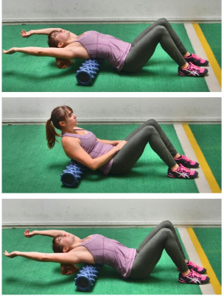
Phase III
Exercises and functional activities should be pain free and performed without substitutions or aberrant movement patterns (shrugging, thoracic extension)
Exercises should be progressive in terms of shoulder elevation (e.g., start with exercises performed at waist level progressing to shoulder level and finally overhead activities)

Slide 52
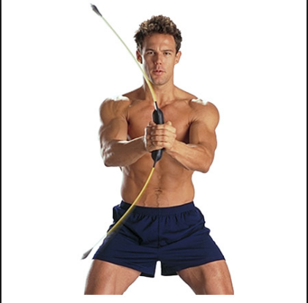
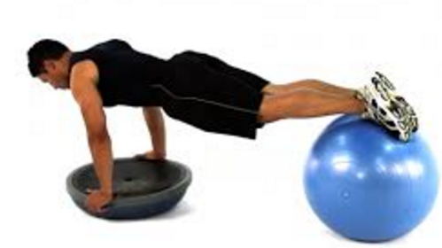
Phase III
Sensorimotor Exercises
Activities to improve neuromuscular control of the rotator cuff and shoulder girdle such as use of unstable surfaces, body blade, and manual resistance exercises in conjunction with auditory, visual, or tactile cues or biofeedback.
PNF patterns are particularly effective for restoring muscle balance and proper coordination patterns.

Slide 53
Phase III
Open and Closed Kinetic Chain Exercises
Strengthen scapular retractors and upward rotators.
Weight-bearing exercises with a fixed distal segment.

Slide 54
Phase III
Techniques to Increase Muscle Strength, Power, and Endurance
In general, increasing elevation increases deltoid and supraspinatus activity
Exercises should be progressive in terms of adding stress to the anterior capsule, gradually working towards a position of 90° of ER and 90° of abduction by 12 weeks.
Rehabilitation should include isolated and complex movement patterns progressing from isolated to complex movement patterns.

Slide 55
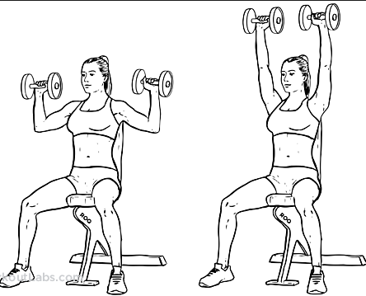
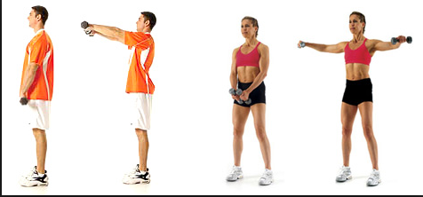
Phase III
The rotator cuff and scapula stabilizer strengthening program should emphasize high repetitions (typically 30 to 50 reps) and relatively low resistance (typically 1 to 2 kg) during this phase.
General shoulder strengthening exercises (front/side raises, shoulder presses) may be initiated as full AROM is achieved and rotator cuff and scapular stabilizer strength is adequate for normal movement patterns. This is usually a late Phase III exercise and should begin with 3 to 5 kg and similar reps (15 to 20 for 3 to 4 sets).

Slide 56
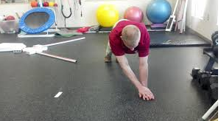
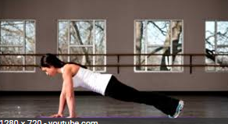
Phase III
Neuromuscular Dynamic Stability Exercises
CKC push up plus progression are important exercises as it promotes rotator cuff and scapular stabilizer co-contraction needed for dynamic stability.
Plyometrics
No heavy lifting or plyometrics should be performed during this stage

Slide 57
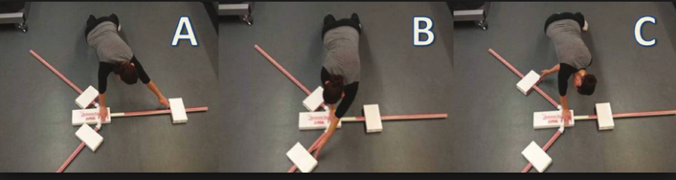
Milestones for Progression to the Next Phase
active ROM goals achieved with minimal to no pain (NPRS 0 to 2/10) and without substitution patterns
Strengthening activities completed with minimal to no pain (NPRS 0 to 2/10)
<20% deficit using isokinetic or hand held dynamometer for ER, IR, abduction, and elevation.
Able to complete 20 hand-taps during modified Davies CKC upper extremity (UE) test
Able to complete 30 reps of ER at <20° of abduction in 30 seconds (1 rep/sec).

Slide 58
Phase IV
The length of Phase IV will vary dependent upon sport participation. For noncontact sports it may be as simple as a gradual return to sport. For contact athletes it may require a more gradual return to activity in a braced condition.

Slide 59

Phase IV
Goals
No complaints of pain at rest and minimal to no pain (NPRS 0 to 2/10) following activities
No or minimal sensation of instability with activities
Normalize strength, endurance, neuromuscular control, and power as evidenced by:
<10% deficit using isokinetic or hand held dynameter for ER, IR, abduction, and elevation.
30 reps in 30 seconds with blue Thera-Band at 0° and 90° abduction

Slide 60
Phase IV
Able to complete 90 hand-taps during modified Davies CKC UE test in 60 seconds.³⁸
Gradual demonstration of confidence and performance in sports specific positions.
Functional improvement in ADLs and sport as evidenced by PSS > 90% and WOSI < 20%.
http://www.orthopaedicscore.com/scorepages/oxford_wosi_score.html

Slide 61
Phase IV
Management of Pain and Swelling
Pain should not be a limiting factor at this point.
Cryotherapy as needed
NSAIDS as needed
Open and Closed Kinetic Chain Exercises
Progression of OKC and CKC consistent with principles previously outlined

Slide 62
Phase IV
Techniques to Increase Muscle Strength, Power, and Endurance
During this phase the focus of exercises should progress from endurance to strength and power. This will require increasing loads, speed of movements, and type of contraction.
Loads—loads now may be increased appropriate to sport and body weight beginning with 3 to 5 sets of 10 and progressing to 3 to 5 sets of 4 to 6 reps over the next 8 to 10 weeks consistent with a traditional strength training program.

Slide 63
Phase IV
Speed of movement—concentric movements are challenged first beginning with IR, then ER, then punches and complex movements.
Type of contraction—eccentric loads can now be initiated beginning with ER (towards IR) and abduction (towards adduction) first then progressing to IR and abduction in preparation for plyometric exercises.
It is recommended to gradually progress to positions of high stress during this phase as needed. For example, to progress back to bench press begin with the athlete performing a dumbbell bench press on the floor, then barbell on the floor, then dumbbell.

Slide 64
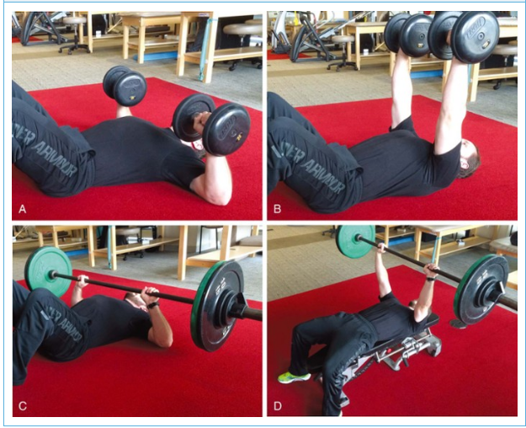
Phase IV

Slide 65
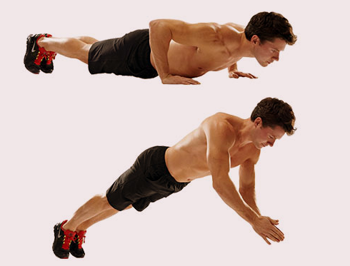
Phase IV
Neuromuscular Dynamic Stability Exercises
Integration of higher loads and greater perturbations are important in particular for athletes returning to sport.
For football players clap pushups on foam or Dynadisc
For throwers repeated ER yo-yos (with 1-kg weight on band)

Slide 66
Phase IV
Plyometrics
Because of the explosive nature of this type of exercise, emphasis of plyometric exercises should be on quality not quantity.
Perform two to three times/week and utilize moderate reps (e.g., 3 to 5 sets of 15 to 20 reps).
Begin with unweighted balls and progress to lightly weighted balls (Plyoballs).
Functional Exercises
Continue as per Phase III.

Slide 67
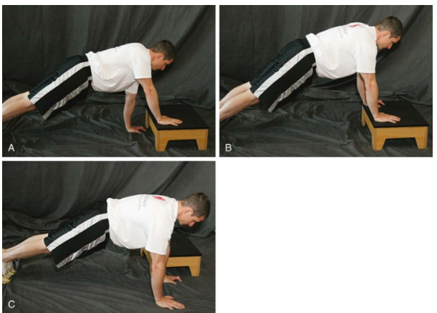
Phase IV
Sport-Specific Exercises
Med ball throws against a wall, for distance for OKC sports.
UE fitter/stepper in prone position for CKC sports
Dribbling on wall or rebounding with one hand

Slide 68
Phase V: Return to Sport Progression
Similar to Phase IV, the length will vary dependent upon sport participation.
As risk of reinjury increases, a more conservative approach in return to competition is recommended.

Slide 69
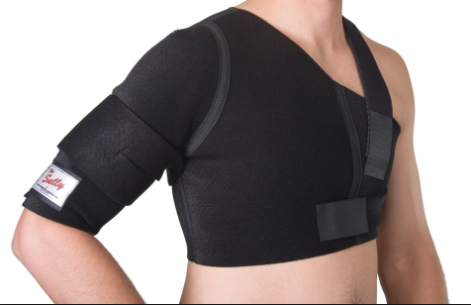
Phase V
Protection
Use of either a Sully or Donjoy (formerly SaWa) brace is recommended during initial return to sport, in particular for contact athletes
We prefer the SaWa brace-9 (lace up/strap brace) for contact athletes as it is the only brace demonstrated to limit ER and abd ROM.⁴²

Slide 70
Phase V
Techniques for Progressive Increase in Range of Motion
Manual Therapy Techniques
Soft Tissue Techniques
Stretching/Flexibility Techniques for the Musculo-Tendinous Unit
Regular assessment of ROM/flexibility during the return to sport progression and after return to sport is important for long-term shoulder function.
Open and Closed Kinetic Chain Exercises

Slide 71
Phase V
Techniques to Increase Muscle Strength, Power, and Endurance
Care should be taken to ensure that the athlete maintains shoulder-strengthening and dynamic strengthening exercises.
We recommend 3 days for 20 to 30 minutes of focused rotator cuff and scapular stabilizing exercises.
Plyometrics
Sport-Specific Exercises

Slide 72
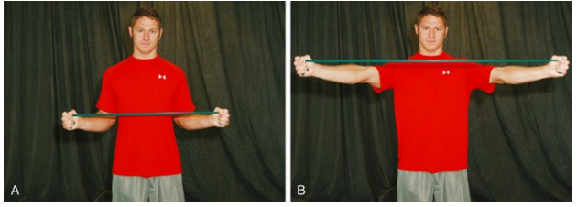
Criteria for Return to Sport
PSS > 95% and WOSI < 10%.
No complaints of pain at rest and minimal to no pain (NPRS 0 to 2/10) following activities.
No or minimal sensation of instability with activities.
Maintenance of sufficient ROM to perform desired activities.
<10% side-to-side deficit using isokinetic or hand held dynameter for ER, IR, abduction, and elevation.
<33% unilateral ER:IR ratio^{39,40}
30 repetitions in 30 seconds with blue Thera-Band at 0° and 90° abduction
Able to complete 90 hand-taps during modified Davies CKC UE test in 60 seconds.³⁸

Slide 73
Postoperative Rehabilitation after Arthroscopic Anterior Shoulder Stabilization
Charles A. Thigpen PhD, PT, ATC
Ellen Shanley PhD, PT, OCS
Richard J. Hawkins MD

Slide 74
Indications for Surgical Treatment
Disability related to recurrent shoulder instability.
Following first time dislocation selected patients combined with certain pathologies (e.g., full thickness rotator cuff tear following dislocation in older patient, large glenoid or humeral defect).

Slide 75
Guiding Principles of Postoperative Rehabilitation
Understanding of the surgical procedure and anatomic structures, which require protection.
Consideration of healing rates of the involved tissues while balancing the stresses needed for tissue proliferation/remodeling and protecting the repaired/reconstructed tissues.¹
Gradual restoration of PROM while protecting the anterior-inferior aspect of the glenohumeral joint through initial immobilization and the rate of ROM gain. Emphasizing PROM then AROM then resisted activities.
Correct application of manual techniques and therapeutic exercises

Slide 76
Phase I (0 to 14 days): Immediate Postoperative Period
Protection
Postoperative immobilization using a sling (with or without a pillow) is recommended for patient comfort and limits stress on the anterior/inferior structures for the first 2 weeks.
The sling is to be used at all times, including during sleep
We recommend gradual progression to no sling from weeks 4 to 6 based on pain, available ROM, muscle performance, and activity level.

Slide 77
Phase I (0 to 14 days): Immediate Postoperative Period
Management of Pain and Swelling
Interscalene pain pumps are often used during postoperative days 1 to 3 to control early postoperative pain.
Oral pain medications.
Electrical stimulation (Transcutaneous Electrical Neural Stimulation [TENS]) is recommended to manage pain and muscle guarding.
Intermittent cryotherapy for pain and inflammation reduction.⁸
Patient positioning: patients are encouraged to use pillows or bolsters to find a “position of comfort” which is usually slightly abducted (20° to 30°) in a neutral or slight internal rotation.

Slide 78
Phase I (0 to 14 days): Immediate Postoperative Period
Techniques for Progressive Increase in Range of Motion
The initial 2 weeks are essentially quiet with little or no ROM exercises required. The focus of this phase is resolving pain, decreasing swelling, and allowing the postsurgical shoulder to recover.
Codman’s pendulum exercises for gentle motion and joint distraction, supported FE (<90°), and ER to 0° at the side (<20° abd) can be performed 1 to 3 times/day to maintain joint mobility. We suggest all of these motions be performed with support to minimize rotator cuff activity due to incorrect technique.⁹⁻¹¹

Slide 79
Phase I (0 to 14 days): Immediate Postoperative Period
Soft tissue techniques—shortening, parallel techniques such as (Positional Release/Strain-Counter-strain) may be helpful to reduce protective guarding especially for the subscapularis, posterior rotator cuff, teres major, latissimus dorsi, and pectoralis major/minor.
Stretching/flexibility techniques for the musculo-tendinous unit are not recommended at this time.
Other Therapeutic Exercises
Although lower extremity and cardiovascular exercises may begin during the first 2 weeks while in the sling, in our experience patients do not tolerate these activities until after 14 days.

Slide 80
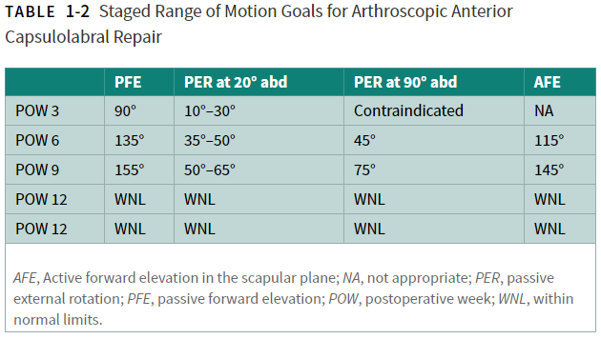
Phase I (0 to 14 days): Immediate Postoperative Period

Slide 81
Phase I (0 to 14 days): Immediate Postoperative Period
Activation of Primary Muscles Involved in Injury Area or Surgical Structures
Submaximal isometric exercises may begin POW 1 as tolerated. We recommend performing these exercises in the “safe zone” of 20° to 30° abduction.
Milestones for Progression to the Next Phase
Minimal to moderate pain (NPRS: 2 to 4/10) with minimal pain at rest (2/10)
Staged ROM goals achieved but not significantly exceeded

Slide 82
Phase II: Weeks 2 to 6 Postoperatively
Goals
Minimize shoulder pain (<2/10)
Achieve staged ROM goals to normalize passive ROM and active ROM. DO NOT significantly exceed
Normalize rotator cuff guarding and neuromuscular control
Normalize scapular position and control

Slide 83
Phase II: Weeks 2 to 6 Postoperatively
Protection
Treatment for pain/analgesia oral pain medications
Electrical stimulation (TENS) is recommended to manage pain and muscle guarding. TENS units at home are often helpful to control pain especially early following surgery.
Intermittent cryotherapy for pain and inflammation reduction.⁸ We recommend 20 minutes on/hour for the first week following surgery.

Slide 84
Phase II: Weeks 2 to 6 Postoperatively
Techniques for Progressive Increase in Range of Motion
Manual Therapy Techniques
Gentle joint distraction and grade I-III joint oscillations may be helpful before performing supervised PROM
Anterior-inferior or inferior glides should not be performed.
We recommend these positions to be performed in the scapular plane in approximately 30° of elevation, and neutral rotation to limit the stress on the capsulolabral repair.¹²

Slide 85
Phase II: Weeks 2 to 6 Postoperatively
Soft Tissue Techniques
Shortening, parallel techniques such as (positional release/strain-counterstrain) may be helpful to reduce protective guarding especially for the subscapularis, posterior rotator cuff, teres major, latissimus dorsi, and pectoralis major/minor.
Passive ROM and active assist ROM exercises may be initiated after POW 2 for ER and FE
Stretching/flexibility techniques for the musculo-tendinous unit should not be performed as these are end ROM exercises.

Slide 86
Phase II: Weeks 2 to 6 Postoperatively
Other Therapeutic Exercises
Gradual introduction of TBS, TLS, core stability, and uninvolved TAS beginning POW 2.
Additionally, cardiovascular conditioning can be initiated with attention to the safety of the activity.
All exercises should be performed with the patient in the sling until POW 5 to 6.

Slide 87
Phase II: Weeks 2 to 6 Postoperatively
Activation of Primary Muscles Involved in Injury Area or Surgical Structures
Scapular retraction and PNF patterns may begin POW 3 based on patient tolerance.
We recommend avoiding scapular protraction as this position has been shown to have high levels of subscapularis activity and increase stress on the anterior capsulolabral structures.^{13,14}
Although scapular elevation and retraction are safe we suggested limited resistance due to the load placed through the glenohumeral joint for most exercises.

Slide 88
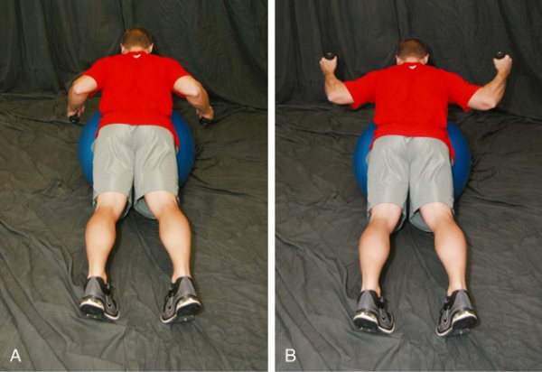
Phase II: Weeks 2 to 6 Postoperatively

Slide 89
Phase II: Weeks 2 to 6 Postoperatively
Active ROM and rotator cuff strengthening are purposefully de-emphasized until POW 6 because of the potentially detrimental effect to the healing tissues.^{22,23}
Although these exercises within the staged ROM goals would not likely result in excessive loading.
Therefore, we recommend beginning with sub-maximal isometric strengthening of the shoulder and elbow with the arm adducted to the side in neutral rotation.
As the patient demonstrates improved rotator cuff endurance and absence of pain or other symptoms we recommend progressing to dynamic isometrics then AROM exercises within the ROM restrictions.

Slide 90
Phase II: Weeks 2 to 6 Postoperatively
Sensorimotor Exercises
Angular reposition, rhythmic stabilization, and repeated contractions within staged ROM limits may be implemented beginning POW 2.
Open and Closed Kinetic Chain Exercises
CKC exercises may be implemented below 90° of elevation beginning POW 2. These exercises should begin in a modified weight-bearing position and progressed to full weight-bearing by POW 6.

Slide 91
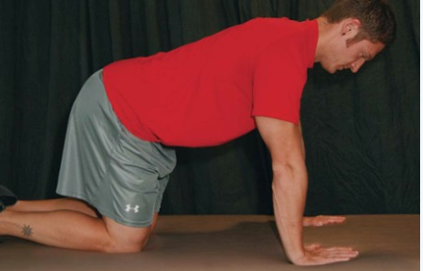
Phase II: Weeks 2 to 6 Postoperatively

Slide 92
Phase II: Weeks 2 to 6 Postoperatively
Milestones for Progression to the Next Phase
Staged ROM goals achieved but not significantly exceeded
Minimal to no pain (NPRS: 0 to 2/10) with ROM
PSS greater than 60% and WOSI less than 50%.

Slide 93
Phase III: Weeks 7 to 12 Postoperatively
Goals
Achieve staged ROM goals to normalize passive ROM and active ROM. DO NOT significantly exceed especially for ER at 90° of abduction.
Minimize shoulder pain (0/10 at rest and <2/10 following exercises or activity).
Begin to increase strength and endurance.
Increase functional activities as evidenced by PSS > 80% and WOSI < 30%.

Slide 94
Phase III: Weeks 7 to 12 Postoperatively
Protection
No sling use.
Avoid positions of max ER towards 90° of abduction, especially with a posteriorly directed load. (e.g., NO push-ups, bench press, pectoral flys).
Management of Pain and Swelling
Pain should not be a limiting factor at this point. If pain is limiting progression of activities rest and reevaluation of all aspects of the shoulder should be performed in consultation with the referring surgeon.
Cryotherapy as needed.
NSAIDS as needed.

Slide 95
Phase III: Weeks 7 to 12 Postoperatively
Techniques for Progressive Increase in Range of Motion
Forward elevation should be progressed from active-assistive exercises (e.g., rope and pulley, wall walks), to active, to resistive upright exercises, then finally to prone exercises.
Soft Tissue Techniques
Deeper soft tissue techniques may be initiated during this phase. More aggressive techniques such as Active Release®.
Particular attention should be paid to the subscapularis, latissimus, pectorals, teres major, and posterior rotator cuff.

Slide 96
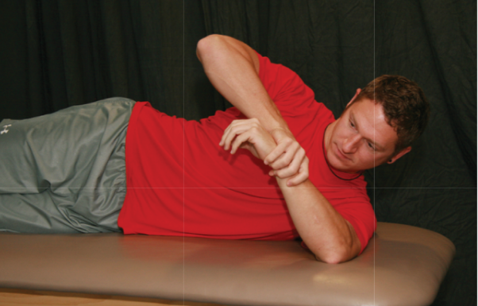
Phase III: Weeks 7 to 12 Postoperatively
Stretching/flexibility techniques for the musculo-tendinous unit.
End range flexibility exercises may begin in particular for posterior shoulder (horizontal adduction and sleeper stretch beginning at 60° to 70° of elevation on side.
Gradual introduction of latissimus, posterior shoulder, and FE stretches as needed.

Slide 97
Phase III: Weeks 7 to 12 Postoperatively
Other Therapeutic Exercises
Address core stability deficits PRN beginning in the sagittal plane and progressing to frontal and transverse plane exercises.
Total leg strengthening exercises may be progressed as tolerated but high loads should be avoided on the shoulder in activities such as power clean, dead lifts, and back squats should be avoided. We recommend front squats.

Slide 98
Phase III: Weeks 7 to 12 Postoperatively
Activation of Primary Muscles Involved in Injury Area or Surgical Structures
Elbow flexion/extension strengthening with elbow by the side can begin in this phase
Exercises and functional activities should be pain free and performed without substitutions or aberrant movement patterns (shrugging, thoracic extension).
Balanced rotator cuff strengthening to maintain the humeral head centered.

Slide 99
Phase III: Weeks 7 to 12 Postoperatively
Should be initially performed in a position of comfort with low stress to the glenohumeral joint such as less than 45° elevation in the plane of the scapula (e.g., elastic band or dumbbell external rotation, internal rotation, forward elevation).
Exercises should be progressive in terms of shoulder elevation

Slide 100
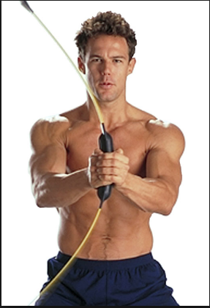
Phase III: Weeks 7 to 12 Postoperatively
Sensorimotor Exercises
Activities to improve neuromuscular control of the rotator cuff and shoulder girdle such as use of unstable surfaces, body blade, and manual resistance exercises in conjunction with auditory, visual, or tactile cues or biofeedback.
Proprioceptive Neuromuscular Facilitation (PNF) patterns are particularly effective for restoring muscle balance and proper coordination patterns.

Slide 101
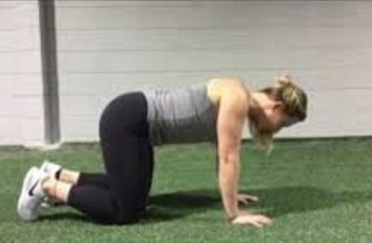
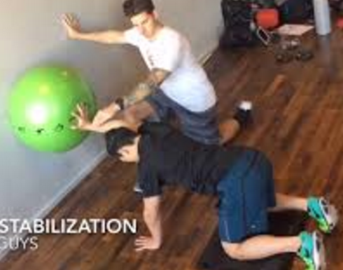
Phase III: Weeks 7 to 12 Postoperatively
Open and Closed Kinetic Chain Exercises
Strengthen scapular retractors and upward rotators
Weight-bearing exercises with a fixed distal segment. Examples: quadruped position while working to maintain proper position of the scapula, quadruped with scapula protraction, progressing from quadruped to tripod position, no push-ups.²⁸

Slide 102
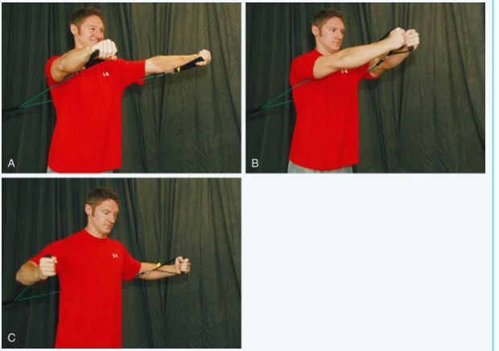
Phase III: Weeks 7 to 12 Postoperatively
Techniques to Increase Muscle Strength, Power, and Endurance

Slide 103
Phase III: Weeks 7 to 12 Postoperatively
Exercises should be progressive in terms of adding stress to the anterior capsule, gradually working towards a position of 90° of ER and 90° of abduction by 12 weeks.
Rehabilitation should include isolated and complex movement patterns progressing form isolated to complex movement patterns.
The rotator cuff and scapula stabilizer strengthening program should emphasize high repetitions (typically 30 to 50 reps) and relatively low resistance (typically 1 to 2 kg) during this phase.

Slide 104
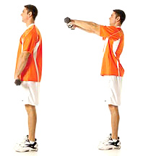
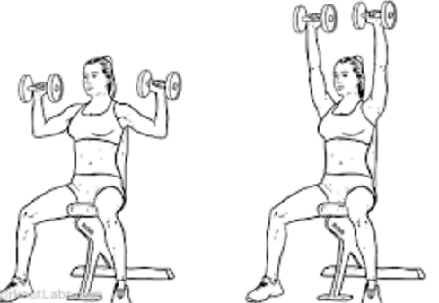
Phase III: Weeks 7 to 12 Postoperatively
General shoulder strengthening exercises (front/side raises, shoulder presses) may be initiated as full AROM is achieved and rotator cuff and scapular stabilizer strength is adequate for normal movement patterns. This is usually a late Phase III exercise and should begin with 3 to 5 kg and similar repetitions (15 to 20 for 3 to 4 sets).

Slide 105
Phase III: Weeks 7 to 12 Postoperatively
Neuromuscular Dynamic Stability Exercises
CKC pushup plus progression are important exercises as it promotes rotator cuff and scapular stabilizer co-contraction needed for dynamic stability.^{38,45}
Plyometrics
No heavy lifting or plyometrics should be performed during this stage.

Slide 106
Phase III: Weeks 7 to 12 Postoperatively
Milestones for Progression to the Next Phase
Staged active ROM goals achieved with minimal to no pain (NPRS 0 to 2/10) and without substitution patterns.
Strengthening activities completed with minimal to no pain (NPRS 0 to 2/10).
<20% deficit using isokinetic or hand held dynamometer for ER, IR, abduction, and elevation.
Able to complete 20 hand-taps during modified Davies CKC UE test.
We recommend modifying the Davies test by using biacromial width
Able to complete 30 reps of ER at <20° of abduction in 30 seconds (1 rep/sec).

Slide 107
Phase IV: Weeks 13 to 24 Postoperatively
The length of Phase IV will vary dependent upon sport participation.
For noncontact sports with less stress on the anterior shoulder and therefore reinjury risk return to sport progression may begin at 16 weeks.
For contact sports with high dislocation rates (football, wrestling) or high stress on the anterior shoulder (throwing sports) return to sport progression will begin between POW 20 to 24.

Slide 108
Phase IV: Weeks 13 to 24 Postoperatively
Goals
No complaints of pain at rest and minimal to no pain (NPRS 0 to 2/10) following activities.
No or minimal sensation of instability with activities.
Normalize strength, endurance, neuromuscular control, and power as evidenced by:
<10% deficit using isokinetic or hand held dynameter for ER, IR, abduction, and elevation.
30 repetitions in 30 seconds with blue Thera-Band at 0° and 90° abduction.
Able to complete 90 hand-taps during modified Davies CKC UE test in 60 seconds.⁴⁶
Gradual demonstration of confidence and performance in sports specific positions.
Functional improvement in ADLs and sport as evidenced by PSS > 90% and WOSI < 20%.

Slide 109
Phase IV: Weeks 13 to 24 Postoperatively
Management of Pain and Swelling
Pain should not be a limiting factor at this point
Cryotherapy as needed.
NSAIDS as needed

Slide 110
Phase IV: Weeks 13 to 24 Postoperatively
Other Therapeutic Exercises
Progressing from Phase III there are no limitations to TBS/TLS or TAS.
Open and Closed Kinetic Chain Exercises
Techniques to Increase Muscle Strength, Power, and Endurance
During this phase the focus of exercises should progress from endurance to strength and power.
Loads—loads now may be increased appropriate to sport and body weight beginning with 3 to 5 sets of 10 and progressing to 3 to 5 sets of 4 to 6 reps over the next 8 to 10 weeks

Slide 111
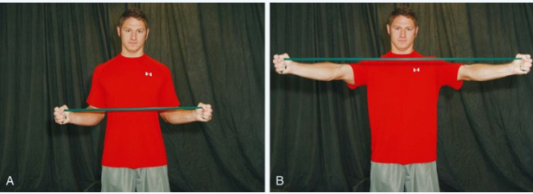
Phase IV: Weeks 13 to 24 Postoperatively

Slide 112
Phase IV: Weeks 13 to 24 Postoperatively
Plyometrics
Because of the explosive nature of this type of exercise, emphasis of plyometric exercises should be on quality not quantity.
Perform two to three times/week and utilize moderate repetitions (e.g., 3 to 5 sets of 15 to 20 repetitions)
Begin with unweighted balls and progress to lightly weighted balls (Plyoballs)

Slide 113
Phase IV: Weeks 13 to 24 Postoperatively
Sport-Specific Exercises
Med ball throws against a wall, for distance for OKC sports.
UE fitter/stepper in prone position for CKC sports.
Dribbling on wall or rebounding with one hand.

Slide 114
Phase V: >Weeks 16 to 24 Postoperatively—Return to Sport Progression
Similar to Phase IV the length will vary dependent upon sport participation.
Manual Therapy Techniques
Soft Tissue Techniques
Stretching/Flexibility Techniques for the Musculo-Tendinous Unit
Open and Closed Kinetic Chain Exercises
Techniques to Increase Muscle Strength, Power, and Endurance
Plyometrics
Sport-Specific Exercises

Slide 115
Phase V: >Weeks 16 to 24 Postoperatively—Return to Sport Progression
Criteria for Return to Sport
PSS > 95% and WOSI < 10%.
No complaints of pain at rest and minimal to no pain (NPRS 0 to 2/10) following activities.
No or minimal sensation of instability with activities.
Maintenance of sufficient ROM to perform desired activities.
A balance of posterior and anterior rotator cuff strength (ER:IR ratio) of 66% before beginning return to sport training.⁴⁷
30 repetitions in 30 seconds with blue Thera-Band at 0° and 90° abduction.
Able to complete 90 hand-taps during modified Davies CKC UE test in 60 seconds.

Slide 116

Epicondylitis
Chapter 9

Slide 117
Epidemiology
Age/ Sex:
35 to 50 years
Females and males
Sport:
Tennis
Golf
Occupations or hobbies with repetitive activities
1% to 3 % of population affected
Adults: 35 to 50 %
Elite: 11 to 13 %

Slide 118
Pathophysiology
Intrinsic Factors:
Proximal strength deficits at the scapula and GH joint
GH flexibility deficits
Poor weight shifting during backhand, late back swing
Increased wrist extension at ball impact
Poor general condition
Poor upper limb posture
Inadequate rest and recovery
Inadequate warm up

Slide 119



Pathophysiology
Extrinsic Factors:
Improper racquet grip size
How to Find Your Tennis Racquet Grip Size
Racquet string tension too high

Slide 120

Pathophysiology
Extrinsic Factors:
Strings not resilient or soft enough
Improper handle size of racquet
Traumatic factors:
Repetitive micro trauma
Vascular compromise
High ECC and CON stresses on extensor tendon

Slide 121
Clinical presentation
History:
درد تدریجی در محل اوریجن تاندون اکستنسور
غالبا با حرکات بک هند و به ویژه در ورزشکاران مبتدی و تفریحی تنیس شایع است
سایر موارد بروز آسیب شامل فعالیت های شغلی مکرر، فعالیت کامپیوتری و حمل کوله است.
نشانه ها عمدتا بعد از فعالیت ورزشی و حتی فعالیت های روزمره نمایان می گردد
آرنج در موقع خواب و بیداری همراه با درد می گردد

Slide 122


lateral and medial epicondyle of the elbow

Slide 123
Physical Examination
Abnormal Findings:
Loss of wrist flexion ROM
Tenderness to palpation of Extensor origin at lateral epicondyle
Localized edema
Grip weakness (both side, hand grip)
Pain with passive wrist flexion
Pain with resistive wrist extension

Slide 124

Physical Examination
Radiographs: tendinous calcific changes
MRI: tears of the extensor tendon, abnormal tendinous tissue

Slide 125



Differential Diagnosis
C6 to C7 nerve root compression
Posterior interosseous nerve syndrome
Lateral antebrachial cutaneous nerve irritation

Slide 126


Treatment
Nonoperative management
Activity modification
Corticosteroid injection
Nonsteroidal anti-inflammatory drugs

Slide 127




Nonoperative management
Bracing, wrist cockup splint
Shock-wave therapy
Physical therapy: strength, flexibility, ….
Cryotherapy, TENS, iontophoresis, ultrasound, low level laser
Improvement of sport mechanics
Plasma rich platelet injection

Slide 128
Surgical indications
Failure of injections
Associated intraarticular pathology
Failure of treatment for a 6 months

Slide 129
Phase I
Protection:
بریس مچ حتی در فعالیت های روزمره
اسپلینت مچ در موقع خواب برداشته شود. ممکن است باعث کوتاه شدن اکستنسورهای مچ گردد
تغییر فعالیت های روزمره
Pain and swelling management
Cryotherapy
Iontophoresis
TENS
Ultrasound
low level laser

Slide 130

Phase I
Techniques for Progressive Increase in Range of Motion
Manual therapy techniques
Mills manipulation: Mill’s manipulation is a small-amplitude, high-velocity thrust performed at the end of elbow extension while the
wrist and hand are held ﬂexed.
Soft tissue techniques
It is the authors’ opinion that deep-tissue massage often
exacerbates symptoms and has little therapeutic value

Slide 131

Phase I
Stretching/flexibility techniques for the musculo-tendinous unit
Wrist and fingers extensor
Pain free ROM

Slide 132
Phase I
Other therapeutic exercise
TAS
Scapula, deltoid, rotator cuff,
Biceps and triceps strength should be in a pain free, avoid full extension elbow
TLS without holding weights in hands
Open and Closed Kinetic Chain Exercises
This is contraindicated in phase I

Slide 133
Phase I
Milestones for Progression to the Next Phase
کاهش علائم حاد (درد، ادم و التهاب)
کسب ثبات و استابیلیتی در کمربند شانه ای و روتیتور کاف
کسب ROM طبیعی در فلکشن مچ

Slide 134
Phase II
Protection:
Counterforce bracing or wrist-cockup splint as needed
Pain and swelling management:
Cryotherapy
Iontophoresis
TENS
Ultrasound
low level laser

Slide 135
Phase II
Techniques for Progressive Increase in Range of Motion
Continue pain-free stretching of the wrist and finger
extensors. Begin to address any shoulder ﬂexibility
deficits.
Manual therapy techniques
Mills manipulation
Soft tissue techniques

Slide 136

Phase II
Stretching/flexibility techniques for the musculo-tendinous unit
Wrist and fingers extensor
Pain free ROM

Slide 137
Phase II
Other Therapeutic Exercises
Continue to progress general upper-extremity, multijoint exercises to normalize shoulder and scapula strength. For the tennis player, emphasize the scapula and posterior rotator cuff.
Continue biceps- and triceps-strengthening to include concentric and eccentric activity.
Initiate forearm-strengthening to include wrist ﬂexion.
Core and lower-extremity strengthening may be progressed, but the patient should still avoid holding heavy weights in the hands.

Slide 138


Phase II
Activation of Primary Muscles Involved
Wrist extension
Pronation
Supination

Slide 139

Phase II
Techniques to Increase Muscle Strength, Power, and Endurance
If proximal strength is adequate
Upper body ergometer

Slide 140


Phase II
Neuromuscular Dynamic Stability Exercises
Rhythmic stabilization
Functional exercise
PNF

Slide 141
Phase II
Milestones for Progression to the Next Phase
انعطاف پذیری طبیعی اندام فوقانی
قدرت طبیعی
حداقل درد در حین اکستنشن مچ

Slide 142
Phase III
Stretching/flexibility techniques for the musculo-tendinous unit
Wrist and fingers extensor
Overstretching of the wrist and finger extensors should be avoided.
Pain free ROM
Techniques to Increase Muscle Strength, Power, and Endurance
TLS, TAS, TAS
Sport specific exercise

Slide 143

Phase III
Activation of Primary Muscles Involved
ECC wrist extesion

Slide 144


Phase III
Neuromuscular Dynamic Stability Exercises
Rhythmic stabilization
Body blade

Slide 145




Phase III
Plyometrics
Two handed chest pass,
side to side wood chops,
over head soccer pass,
One handed external rotation
One handed backhand

Slide 146

Phase III
Sport specific exercise
Resistive forehand and backhand exercise using elastic band

Slide 147
Phase IV
Management of Pain and Swelling
Cryotherapy should be utilized throughout the return
Stretching and Flexibility Techniques for the Musculotendinous Unit
Continue full upper-extremity ﬂexibility program.
Avoid overstretching the extensor tendons.
Stretching should always be pain-free.

Slide 148
Phase IV
Other Therapeutic Exercises
Continue a full upper-extremity strengthening program to include the scapula, shoulder, elbow, forearm, and wrist
Continue core stability with emphasis on trunk rotation and posture.
Continue full lower-extremity strengthening program with emphasis on closed-chain activities

Slide 149
Techniques to Increase Muscle Strength,Power, and Endurance
Isokinetics for wrist ﬂexion–extension and pronation–supination once a strength base has been established.
sport-specifc speeds and train for endurance
Plyometrics
Sport-Specifc Exercises
An interval tennis program
The program should entail a progression of volume
and intensity.

Slide 150

Nonoperative Rehabilitation of Lateral Epicondylitis (Tennis Elbow)

Slide 151

Nonoperative Rehabilitation of Lateral Epicondylitis (Tennis Elbow)

Slide 152

Nonoperative Rehabilitation of Lateral Epicondylitis (Tennis Elbow)

Slide 153

Nonoperative Rehabilitation of Lateral Epicondylitis (Tennis Elbow)

Slide 154



Slide 155


Slide 156
BEYOND BASIC REHABILITATION: RETURN TO TENNIS AFTER TREATMENT FOR
LATERAL EPICONDYLITIS
Jamie Osmark

Slide 157
Aspects of Tennis that Require
Special Attention in Rehabilitation
Repetitive activities
Rapid development of muscular activity, short bursts,
and high intensity
Strength, speed, power, ﬂexibility, muscular endurance,
and muscular balance
Velocity, spin, and placement
Number of strokes
Anaerobic and aerobic activity

Slide 158
Phase I: Advanced Strength and
Conditioning Programs
Periodization
• Linear
• Macrocycles
• Mesocycles
• Microcycles

Slide 159
Program Design
Sport-Specific Concepts of Integrated Training
Training continuum
• Flexibility and joint mobility for joint stability
• Training with optimum posture
• Sensorimotor and balance training
• Core training
• Cardiorespiratory training
• Multiplanar training activities
• Training for optimum muscle balance
• Training for optimum muscle functional strength
• Training for optimum muscle functional power
• Neuromuscular dynamic stability exercises
• Training for speed, agility, and quickness (SAQ)
• Functional training

Slide 160


Olympic Lifts Used in the Training Program
Clean and jerk
Power clean

Slide 161
Training Principles Used in the Design of the Program
Principle of progression
• Principle of overload
• Principle of variation
• Principle of individualization
• Principles of specifcity: Specifc adaptation to imposed
demands (SAID)

Slide 162
Application of Acute Training Variables
When returning to tennis, a linear periodized program
consisting of endurance, hypertrophy, strength, and
power phases should be implemented for a safe, strong
return.
Repetitions
• Endurance phase: 12 to 20 repetitions
• Hypertrophy phase: 7 to 12 repetitions
• Strength phase: Four to six repetitions
• Power phase: Two to five repetitions

Slide 163
Application of Acute Training Variables
Sets
• Endurance phase: Two or three sets
• Hypertrophy phase: Three to six sets
• Strength phase: Three to five sets
• Power phase: Three five sets
Rest interval
• Endurance phase: 30 to 45 seconds
• Hypertrophy phase: 45 to 60 seconds
• Strength phase: 120 seconds
• Power phase: 120+ seconds

Slide 164
Application of Acute Training Variables
Intensity
• Endurance phase: <67% of 1RM
• Hypertrophy phase: 67% to 85% of 1RM
• Strength phase: >85% of 1RM
• Power phase: 75% to 85% of 1 RM
Repetition tempo
• Endurance: 2/1/2
• Hypertrophy: 2/0/2
• Strength: 2/0/1
• Power: 1/0/X

Slide 165
Application of Acute Training Variables
Training frequency
• 3 or 4 days
• Training duration
• 60 minutes per session
• 3 to 5 weeks per mesocycle
• Training volume
• Endurance: 12 to 60 repetitions per exercise
• Hypertrophy: 18 to 72 repetitions per exercise
• Strength: 12 to 30 repetitions per exercise
• Power: 6 to 25 repetitions per exercise

Slide 166





Application of Acute Training Variables
Specifc exercises used in the training
• Clean and jerk
• Clean
• Squat
• Dumbbell overhead press
• Dead lift
• Push press
• Row
• Lat pull-down
• Pushup
• Serratus punch
• Chest ﬂy
• Prone Y’s and T’s
• Plank
• Side plank
• Palloff press

Slide 167


Application of Acute Training Variables
Stability chop and lift
• Bridge
• Dead bug (Figure 9-19)
• Russian twist
• Wrist extension and ﬂexion
• Wrist pronation and supination
• Shoulder external rotation
• Shoulder internal rotation
• Quadruped thoracic rotation (Figure 9-20)
• Hip airplane
• Wall slide stretch
• Sleeper stretch

Slide 168
Application of Chronic Training Variables
The first phase, endurance, helps acclimate the player
back to strength training by preparing the muscles,
tendons, and overall joint stability for more volume
and intensity.
The second phase, hypertrophy, is aimed to build muscular size.
• The third phase, strength, focuses on gaining maximal
functional strength.
• The final phase, power, ties the prior phases together. Its focus is on the transfer and development of power through the legs, torso, and upper body.

Slide 169
Program Design and Performance
Training Program
Training continuum
• Flexibility and joint mobility for joint stability
Training with optimum posture
• Sensorimotor and balance training
• Core training
• Cardiorespiratory training
• Multiplanar training activities
• Training for optimum muscle balance
• Training for optimum muscle functional strength
• Training for optimum muscle functional power
• Neuromuscular dynamic stability exercises
• Training for SAQ
• Plyometric training
• Functional training
• Sport-specific training
• Power training
• Speed agility training

Slide 170
Application of Acute Training Variables
Repetitions
• Plyometric: 8 to 12 repetitions
• Rotational power: 3 to 12 repetitions
• Core strength: 1 to 12 repetitions
Sets
• Plyometric: Two or three sets
• Power: Three to five sets
• Strength: One or two sets
Rest interval
• Plyometric: 1 to 3 minutes
• Rotational power: 3 to 5 minutes
• Core strength: 1 to 2 minutes

Slide 171
Application of Acute Training Variables
Intensity
• Plyometrics: Body weight, medicine ball, dead ball,
near-maximal effort (>90% of maximal effort)
• Rotational power: 67% to 85% of 1RM
• Strength: Body weight and weighted vest
Repetition tempo
• Plyometrics: Maximal effort
• Rotational Power: Maximal effort
• Strength: Controlled 3/1/2
Training frequency
• Two or three times per week
Training duration
• 60 minutes
• 3 to 4 weeks

Slide 172
Application of Acute Training Variables
Training volume
• Plyometric: 16 to 36 repetitions per exercise
• Rotational power: 9 to 60 repetitions per exercise
• Strength: 1 to 24 repetitions per exercise
Specific exercises used in the training
• Plyometric
• Bounding
• 90°, 180° jumping exercise
• Lateral bounding with resistance

Slide 173

Application of Acute Training Variables

Slide 174



Application of Acute Training Variables
Lateral bounding progression
• Box jumps
• Medicine ball squat thrust
• Medicine ball slam
• Medicine ball rotational throw (Figure 9-21)
• 90°/90° wall plyometrics
• Straight-arm ball dribbling on wall
• Medicine ball squat to rotational chest pass
• Medicine ball sit-up overhead throw
• Reaction/response training

Slide 175



Application of Acute Training Variables
Rotational power
• Squat to rotational press (Figure 9-22)
• Rotational row (Figure 9-23)
• Rotational push–pull
• Rotational snatch
• Explosive torso-and-hip rotation
• Chop and lift
Strength
• Single-leg squat
• Mini band lateral walk

Slide 176

Application of Acute Training Variables

Slide 177

Application of Acute Training Variables

Slide 178
Application of Acute Training Variables
Single-leg Romanian dead lift
• Walking lunge with mini band rotation
• Triplanar lunge
• Pull-down
• Pushup
• Wrist extension and ﬂexion
• Wrist pronation and supination
• Plank
• Side plank
• Quadruped thoracic rotation
• Hip airplane
• Wall slide stretch

Slide 179
Application of Chronic Training Variables
During this phase of training, plyometrics are included
in order to utilize the stretch-shortening cycle so that
force production can be maximized. The typical focus
in tennis is the development and transfer of lower-body
power to upper-body rotational strength and stability.
In this training phase, emphasis is placed on development of rotary power.

Slide 180
Phase III: Sport-Specific Training
Principle of progression
• Principle of overload
• Principle of variation
• Principle of individualization
• Principles of specifcity: SAID

Slide 181
Application of Acute Training Variables
Repetitions
• Sport-specific agility: 8 to 20 repetitions
Sets
• Three or four sets
• Rest interval
• 1:4 work-to-rest ratio
Intensity
• Maximal effort
Training frequency
• Two or three times per week
Training duration
• 60 to 90 minutes
• 3 to 4 weeks

Slide 182
Application of Acute Training Variables
Training volume
• 24 to 80 repetitions per exercise
Specific exercises used in the training
• Medicine ball ground strokes
• Lateral intervals
• Linear intervals
• Multidirectional intervals
• Side shufﬂe
• Crossover
• Backpedal

Slide 183
Sports Performance Testing
Physiological assessments
• Lactate
• Before, during, and after training
• Heart rate
• Throughout training
• Rate of perceived exertion
• Immediately after interval training
Body composition tests: Body composition can be measured by using hydrostatic weighing, whole-body plethysmography (BOD POD), dual X-ray absorptiometry scan, or skin-fold measurements.
• Preseason
• End of preseason
• Periodically through competition

Slide 184
Sports Performance Testing
Functional Movement Screen (FMS): The FMS is a
great tool to use for looking at the athlete’s overall
movement strategy.
Single-leg squat
• Periodically through preseason
• Sport-specific testing

Slide 185

Meniscus Injuries
Frank R. Noyes, MD

Slide 186
Epidemiology
Meniscus tears are among the most common injuries treated by orthopedic surgeons.
Approximately 1 million meniscal surgeries are performed each year, with more than 50% done in patients 45 years of age or older.
It has been estimated that the incidence of meniscus tears in athletes is 61 in 100,000.
Although early studies reported a male-female ratio of this injury of 3:1.
Approximately 60% of meniscus tears occur in patients aged 20 to 49.
Common sports associated with meniscus tears are soccer, skiing, handball, basketball, wrestling, football, gymnastics, and tennis.

Slide 187

Meniscus tears

Slide 188

Pathophysiology
Intrinsic Factors
Acute ACL rupture: associated meniscus tears in approximately 60%.
Chronic ACL deficiency: increased shear forces, risk of giving-way.
Varus (medial meniscus) or valgus (lateral meniscus) malalignment.
Traumatic Factors
Common mechanisms include a sudden twist, changein direction, jumping, pivoting, or deep knee ﬂexion.
Commonly occurs with other knee injuries such as an
ACL rupture.

Slide 189

Classic Pathological Findings
Tibiofemoral joint line pain
Locking or clicking medial or lateral Tibiofemoral compartment
Posterior knee pain with ﬂexion greater than 90°
Knee effusion
Lack of pain-free extension

Slide 190
Clinical Presentation
History
Knee injury involving sudden twist, change in direction, jumping, pivoting, or deep knee ﬂexion
Frequently encountered in knees with ACL ruptures
Tibiofemoral joint line pain, swelling, locking, catching

Slide 191
Physical Examination
Abnormal Findings
Tibiofemoral joint line pain on palpation
Pain with full ﬂexion
Lack of pain-free full knee extension
Positive McMurray test: internal or external rotation knee ﬂexion produces pain, clicking, crepitus
Meniscal displacement during joint compression indicated by popping, clicking, catching
Tenderness on palpation at the posterolateral aspect of the joint at the anatomic site of the popliteomeniscal attachments

Slide 192
Pertinent Normal Findings
Symptoms: lack of pain with activities, rotational knee movements.
No joint line tenderness
Negative provocative meniscus tests (McMurray)
Full knee motion without pain
Imaging
Radiographs
Knees with Varus or valgus malalignment
MRI

Slide 193
Treatment
Nonoperative Management
Rest, activity modification
Oral nonsteroidal antiinﬂammatory medications
Physical therapy

Slide 194


Illustrations of the common complex and avascular meniscus tear patterns

Slide 195

Double-stacked vertical suture pattern used in the repair of longitudinal meniscus tears

Slide 196

Double-stacked repair technique for double longitudinal tears

Slide 197

Repair technique for radial meniscus tears

Slide 198

Repair technique for ﬂap tears

Slide 199
NONOPERATIVE REHABILITATION OF MENISCUS INJURIES
K. Donald Shelbourne

Slide 200
Introduction
Selecting an appropriate course of treatment for meniscus tears needs to be based on an understanding of the type and location of the meniscus tear as well as an assessment of concomitant impairments such as loss of range of motion (ROM), strength, and the presence of an effusion.
Even in the presence of a degenerative meniscus tear, a patient with a loss of ROM and/or a knee joint effusion may improve with a well-directed rehabilitation program designed to resolve these deficits.

Slide 201
Phase I
Goal
To eliminate effusion and restore normal, symmetric knee extension.
Protection
No protection required. Encourage the patient to fully weight bear on the affected leg and use the knee normally as soon as possible.
Provide gait training to restore normal gait pattern. By teaching the patient to stop favoring the leg, there will be less strength and range of motion loss owing to disuse.

Slide 202

Phase I
Management of Pain and Swelling
Over-the-counter nonsteroidal antiinﬂammatory medications and acetaminophen may be used as needed to help with swelling control and pain.
If additional pain control is needed to allow the patient to tolerate rehabilitation during the early phase, injected or oral steroids may be used.
If a moderate or severe effusion is present, significant relief may also be achieved by draining the knee.

Slide 203
Techniques for Progressive Increase in Range of Motion
First determine what amount of ROM is normal for the patient.
If the opposite knee is normal, use the ROM of that knee as a baseline for determining how much knee extension and ﬂexion is normal for that patient.
Most people have some degree of knee hyperextension, so the goal is not to achieve 0° of extension; rather, the goal is to restore normal knee extension, which may include hyperextension.
Measure knee extension by having the patient lie supine and prop both heels up on a bolster high enough to allow the knees to fall into hyperextension (Figure 30-10).

Slide 204

Patient positioning for measurement of knee extension

Slide 205
Techniques for Progressive Increase in Range of Motion
Perform a low-load, long duration stretch for knee extension/hyperextension three to five times per day.
Instruct the patient to perform a 10-minute heel prop with an ankle weight placed above and below the knee joint.
Use a passive knee extension device for 10 to 15 minutes (Figure 30-11).
Perform towel stretches into maximal extension. Hold for 5 seconds and perform ten repetitions.

Slide 206


Techniques for Progressive Increase in Range of Motion

Slide 207

Activation of Primary Muscles Involved
Ensure that good neuromuscular control of the quadriceps is achieved.
Perform active heel lifts. Have the patient sit with the leg extended, contract the quadriceps muscle group, and actively lift the heel up off of the table.
If the patient cannot achieve an active heel lift, add a short-arc quad exercise to help facilitate activation of the quadriceps muscle group.

Slide 208
Techniques to Reduce Effusion
Instruct patient in use of a cold-compression device
Advise patient to elevate the knee above the level of the heart while using the cold-compression.
Advise patient to avoid high impact activities such as running, jumping, and prolonged walking.

Slide 209
Functional Exercises
Teach the patient standing and sitting extension habits.
Stand with body weight shifted onto the involved leg and lock the knee out straight.
Sit with the heel propped and knee straight, allowing the knee to fall into hyperextension.
Milestones for Progression to the Next Phase
Little to no effusion present in the knee
Full, symmetric knee extension equal to the opposite normal knee

Slide 210
Phase II
Goals
To restore normal, symmetric knee ﬂexion and maintain symmetric knee extension.
Management of Pain and Swelling
Over-the-counter nonsteroidal antiinﬂammatory medications and acetaminophen may be used
Techniques for Progressive Increase in Range of Motion
First determine what amount of knee ﬂexion is normal for the patient.
If the opposite knee is normal, use the range of motion of that knee as a baseline for determining how much knee ﬂexion is normal for that patient.

Slide 211


Phase II
Measure knee ﬂexion by having the patient perform a heel slide. Ask the patient to slide the heel toward the buttocks, pulling the knee into as much ﬂexion as possible while in a long-sitting position.
Perform a heel slide exercise. Hold the stretch for 5 seconds, then pull the knee into slightly more ﬂexion and hold for an additional 5 seconds.
If knee ﬂexion is more severely limited, begin with a wall slide exercise.

Slide 212

Other Therapeutic Exercises
Perform towel stretches to monitor knee extension
If any loss of knee extension is detected, back off from ﬂexion exercises and return to focusing on knee extension.
Begin a low impact exercise program using a bike, elliptical, or stair climber. Begin with light resistance and gradually increase time from 5 minutes to 30 minutes. Then slowly increase the resistance.

Slide 213
Milestones for Progression to the Next Phase
Full, symmetric knee range of motion compared to the opposite, normal knee.
No effusion
Good neuromuscular control of the quadriceps muscle group

Slide 214
Phase III
Goals
To restore symmetric lower extremity strength
Management of Pain and Swelling
Although some activity-related soreness and swelling may occur, pain and swelling should mostly be under control during this phase.
Patients are advised to use a cold-compression device as needed for swelling and pain control.
Over-the-counter nonsteroidal antiinﬂammatory medications and acetaminophen may also be used

Slide 215
Techniques for Progressive Increase in Range of Motion
Range of motion should be maximized prior to the beginning of Phase III.
Monitor range of motion by performing towel stretch and heel slide and comparing with the opposite, normal knee.
If any loss of range of motion occurs as the strengthening program is underway, discontinue strengthening exercises and focus on Phase I and II exercises until symmetric range of motion is restored.

Slide 216
Other Therapeutic Exercises
Objectively measure strength of the quadriceps and hamstring muscle groups for both the involved and noninvolved legs (Cybex, Biodex, etc.).
If a side-to-side deficit is detected (greater than or equal to 10%), begin single-leg strengthening program 5 to 7 times per week.
Reevaluate strength testing on a regular basis and transition to bilateral strengthening exercises once full strength symmetry has been restored.
Single leg press
Single knee extension
Step-down
Continue to progress the low impact exercise program (bike, elliptical, or stair climber) by increasing resistance and/or increasing workout time.

Slide 217
Sport-Specific Exercises
Patients involved in low impact sports (nonrunning or jumping) activities may gradually return to these activities at this time.
Participation in sports requiring running or jumping should be delayed until full strength and range of motion symmetry has been regained.
Milestones for Progression to the Next Phase
Quadriceps and hamstring muscle group strength at least 90% (involved knee/non-involved knee)
Full, symmetric knee range of motion compared to the opposite, normal knee.
No effusion

Slide 218
Phase IV
Goal
Return to sports
Management of Pain and Swelling
Some soreness and swelling may occur during this phase as the patient’s activity level is increased and should be treated with use of a cold-compression device as needed.
Techniques for Progressive Increase in Range of Motion
Range of motion should be maximized prior to the beginning of Phase IV. Monitor range of motion by performing towel stretch and heel slide and comparing with the opposite, normal knee. If any loss of range of motion occurs during the return to sport phase, discontinue impact activities and focus on Phase I and II

Slide 219
Other Therapeutic Exercises
Continue with the low impact exercise program for cardiovascular conditioning and as a form of cross-training.
Once symmetric strength has been achieved, begin doing lower extremity strengthening program for both legs.
Functional Exercises
For patients returning to sports requiring change of direction, gradually progress through a functional progression to introduce jumping, planting, and pivoting.
Add increased speed and multidirectional components

Slide 220
Sport-Specific Exercises
When introducing impact activities (running, jumping, etc.) begin with an every-other-day schedule to allow the knee to adjust to the new level of activity.
Begin with structured drills to allow the patient to
work through each component skill of the sport
individually

Slide 221

Nonoperative Rehabilitation of Meniscus Injuries

Slide 222

Nonoperative Rehabilitation of Meniscus Injuries

Slide 223

Nonoperative Rehabilitation of Meniscus Injuries

Slide 224

Nonoperative Rehabilitation of Meniscus Injuries

Slide 225
POSTOPERATIVE REHABILITATION
AFTER MENISCUS REPAIR
Frank R. Noyes

Slide 226
Indications for Surgical Treatment
Meniscus tear with unresolved Tibiofemoral joint pain
Patient less than 50 years of age or in 50s and physically active
Meniscus tear classified at surgery according to location, type, size, integrity of tissue, and remaining meniscus bed
Peripheral single longitudinal tears (red-red, one plane)—repairable in all cases, high success rates
Middle third region (red-white or white-white—often repairable with reasonable success rates
Outer-third and middle-third regions (red-white, one plane) longitudinal, radial horizontal tears—decision on repair versus excision made at surgery

Slide 227
Phase I (days 0–14): Immediate
Postoperative Period
Goals
Range of motion (ROM) minimum: 0° to 90° first 2 weeks postop.
Weight bearing: toe-touch to half body weight (BW) for peripheral repairs; toe-touch to quarter BW for complex or all-inside repairs; none to toe-touch for radial repairs.
Pain, hemarthrosis controlled
Good patellar mobility
Adequate quadriceps contraction

Slide 228
Phase I (days 0–14): Immediate
Postoperative Period
Protection
Long-leg postoperative brace for complex or all-inside meniscus repairs.
Crutches. Toe-touch to half BW for peripheral repairs. Toe-touch to quarter BW for complex and all-inside repairs. None to toe-touch weight bearing for radial repairs.
Management of Pain and Swelling
Oral medications as required
Therapeutic modalities: electrical muscle stimulation, Cryotherapy
Elevate lower limb as frequently as possible

Slide 229
Phase I (days 0–14): Immediate
Postoperative Period
Techniques for Progressive Increase in Range of Motion
Begin first day postoperative
Passive knee ﬂexion and passive and active/active assisted knee extension exercises
Seated position, 0° to 90°, three to four times a day in 10-minute sessions
Active knee ﬂexion is limited to avoid hamstring strain to the posteromedial joint
Hyperextension avoided in anterior horn meniscus repairs
Hamstring and gastrocnemius-soleus ﬂexibility

Slide 230



Phase I (days 0–14): Immediate
Postoperative Period
If 0° to 90° not achieved by seventh day postoperative, begin overpressure exercises
Hanging weights for extension
Rolling stool, wall-sliding for ﬂexion

Slide 231

Phase I (days 0–14): Immediate
Postoperative Period
Activation of Primary Muscles Involved in Injury Area or Surgical Structures
Activation of the quadriceps, hamstrings, gastrocnemius soleus,
Electrical muscle stimulation and/or biofeedback may be used to enhance quadriceps contraction
Sensorimotor Exercises
Begin first week postoperative
Weight shifting side-to-side and front-to-back with crutch support
Cup walking to develop symmetry between limbs

Slide 232
Phase I (days 0–14): Immediate
Postoperative Period
Open and Closed Kinetic Chain Exercises
Begin first day postoperative
Quadriceps isometrics: one set × 10 repetitions every hour patient is awake
Straight leg raises, ﬂexion plane only initially: three sets × 10 repetitions
Add leg raises in extension, abduction, adduction planes when patient has sufficient quadriceps control to prevent an extensor lag during ﬂexion plane leg raises
Active-assisted knee extension 90° to 0°: three sets × 10 repetitions. Limit to 90° to 30° for anterior horn repairs

Slide 233
Phase II (weeks 3 to 6)
Goals
ROM 0° to 135°
Gradually resume full weight bearing with a normal gait pattern.
Begin closed-chain exercises.
Progress balance, proprioceptive training.
Progress lower extremity strength exercises

Slide 234
Phase II (weeks 3 to 6)
Protection
Brace discontinued week 6 for complex and all-inside meniscus repairs; 6 to 8 weeks for radial repairs
Crutches discontinued week 4 for peripheral repairs.
Half to full weight bearing for complex and all-inside repairs
Management of Pain and Swelling
Continue cryotherapy following all exercise sessions.
Oral medications if required

Slide 235
Phase II (weeks 3 to 6)
Techniques for Progressive Increase in Range of Motion
ROM is increased to 120° by weeks 3 to 4 and 135° by weeks 5 to 6.
Patients who fail to achieve these goals are placed into the overpressure program
Other Therapeutic Exercises
Upper body ergometer at 3 to 4 weeks if available
Activation of Primary Muscles Involved in Injury Area or Surgical Structures
Activation of the quadriceps, hamstrings, gastrocnemius soleus

Slide 236
Phase II (weeks 3 to 6)
Sensorimotor Exercises
Double-leg balance exercises
Walk on Styrofoam half rolls and whole rolls
Balance board
Open and Closed Kinetic Chain Exercises
Multiangle quadriceps isometrics (active), 0°, 30°, 60°, 90°: 1 set × 10 repetitions each
Straight leg raises in ﬂexion, extension, abduction, and adduction: 3 sets × 10 repetitions
Add ankle weights at 5 to 6 weeks of less than 10% of body weight

Slide 237



Phase II (weeks 3 to 6)
Knee extension (active/ active-assisted) 90 to 0°: three sets × 10 repetitions. Limit to 90° to 30° for anterior horn repairs
Toe raises: three sets × 20 repetitions
Heel raises begin at 5 to 6 weeks: three sets × 10 repetitions
Wall sits (above 60°) to fatigue: three sets
Minisquats: 3 sets

Slide 238


Phase II (weeks 3 to 6)
At 5 to 6 weeks, peripheral meniscus repairs, hamstring curls, 0° to 90°: three sets × 10 repetitions
At 5 to 6 weeks, peripheral meniscus repairs, leg press, 70 to 10°: three sets × 10 repetitions
At 5 to 6 weeks, all repairs, multi-hip machine (ﬂexion, extension, abduction, adduction): three sets × 10 repetitions
5 to 6 weeks, all repairs, knee extension (resisted), 90° to 30°: three sets × 10 repetitions

Slide 239
Phase III (weeks 7 to 12)
Goals
• Progress lower extremity strength
• Progress balance, proprioception
• Increase endurance
Protection
• Crutches discontinued weeks 8 to 12 for complex, allinside, and radial repairs
Management of Pain and Swelling
• Cryotherapy as required

Slide 240
Phase III (weeks 7 to 12)
Techniques for Progressive Increase in Range of Motion
Flexibility: hamstring, gastrocnemius-soleus, quadriceps, iliotibial band
Other Therapeutic Exercises
• Weeks 7 to 8: stationary bicycling, 15 minutes, one to two times a day
• Weeks 9 to 12 (select one activity a day for 15 minutes)
• Stationary bicycling
• Water walking
• Swimming with straight leg kicking
• Walking
• Stair climbing machine, low resistance, low stroke
• Ski machine, short stride, level, low resistance
• Elliptical cross-trainer

Slide 241
Phase III (weeks 7 to 12)
Sensorimotor Exercises
Balance board: two-legged, three times per day for 5 minutes
Lateral step-ups: 5- to 10-cm block, three times per day, three sets × 10 repetitions
Resisted gait training: resisted band marching and elastic band resistance to terminal single leg standing
balance

Slide 242
Phase III (weeks 7 to 12)
Open and Closed Kinetic Chain Exercises
Toe and heel raises: three sets × 10 repetitions
• Wall sits, to fatigue: three sets
• Minisquats: three sets
• Weeks 9 to 12: add rubber tubing, 0° to 40°: three sets × 20 repetitions
• Hamstring curls all meniscus repairs, active: three sets × 10 repetitions
• Knee extension, active, 90° to 30°: three sets × 10 repetitions
• Multichip: three sets × 10 repetitions
• Leg press, 70° to 10°: three sets × 10 repetitions Start weeks 9 to 12 for complex repairs

Slide 243
Phase IV (weeks 13 to 26)
Goals
• Increase strength and endurance.
• Peripheral repairs may begin running program 20 weeks postoperative if tolerated
Management of Pain and Swelling
• Cryotherapy as required

Slide 244

Phase IV (weeks 13 to 26)
Therapeutic Exercises
• Patients encouraged to perform upper body and core strengthening according to future desired activity level.
• Aerobic conditioning, three times a week for 20 minutes; select one activity per session
• Stationary bicycle
• Water walking
• Swimming, straight-leg kicking
• Walking
• Stair climbing machine

Slide 245
Phase IV (weeks 13 to 26)
Sensorimotor Exercises
Single-leg stance, unstable platform, three times a day
for 5 minutes
Perturbation training
Ball toss on plyoback, single-leg stance

Slide 246
Phase IV (weeks 13 to 26)
Open and Closed Kinetic Chain Exercises
• Straight leg raises with rubber tubing, high speed: three sets × 30 repetitions
• Minisquats, rubber tubing, 0° to 40°: three sets × 20 repetitions
• Hamstring curls, with resistance, 0° to 90°: three sets × 10 repetitions
• Knee extension, active with resistance, 90° to 30°: three sets × 10 repetitions
• Multi-hip: three sets × 10 repetitions
• Leg press, 70° to 10°: three sets × 10 repetitions

Slide 247
Phase IV (weeks 13 to 26)
Plyometrics
• Week 24 for peripheral meniscus repairs only. Must have completed running program.
• Level surface box hops on 4-square grid. Double-legged hops, land in knee ﬂexion. 4 levels.
• Single-leg hops
• Vertical box hops

Slide 248


Phase IV (weeks 13 to 26)
Functional Exercises
Week 16 to 20: peripheral meniscus repairs allowed to begin running program if tolerated. Patient must have less than 30% deficit in quadriceps and hamstrings peak torque on isometric
Week 24: peripheral meniscus repairs allowed to begin cutting, carioca, figure 8 agility, plyometric (box hops, level, double-leg) if tolerated. Must have less than 20% deficit for quadriceps/hamstrings

Slide 249
Phase IV (weeks 13 to 26)
Sport-Specifc Exercises
• Begin week 20 to 24 for peripheral meniscus repairs
After Return to Sport
Continuing Fitness or Rehabilitation Exercises
• Aerobic conditioning recommended according to
patient activity levels.
• Lower extremity strengthening to be advanced or
maintained as required.

Slide 250

Ankle Sprains, Fractures, and Chondral Injuries
Annunziato Amendola

Slide 251
Epidemiology
Under the age of 35 with a peak of incidence of 15 to 19 years of age
Slightly higher incidence of ankle sprain in males (1.04).
Sport
Ankle sprains are the most common injury in all sports involving running and pivoting; basketball is the most common sport,
football, soccer, running, volleyball, softball, baseball, and gymnastics.
Ice and water sports are less likely to cause an ankle sprain.
Position
Among soccer players, defenders and attackers have a higher risk of ankle injury as a result of contact with opponents.

Slide 252

Pathophysiology
Intrinsic Factors
Muscle strength imbalance: increased eversion-to inversion ratio and plantar ﬂexion-to-dorsiﬂexion
Increased BMI
Higher risk for dominant ankle in soccer
History of previous ankle sprains
Pes cavus or calcaneovarus alignment

Slide 253

Extrinsic Factors
Certain shoe wear may predispose to ankle injury: air heels, poor fit
Inadequate warm up with poor ﬂexibility
Artificial turf increases the risk of ankle injury

Slide 254

Classic Pathological Findings
Ankle sprains are usually lateral and involve the anterior tibiofbular ligament (ATFL) 100% of the time (grade I), whereas the calcaneofbular ligament (CFL) is involved in 50% to 75% of more severe sprains (grade II and III)
Clinical Presentation
For an ankle sprain, patients usually describe an inversion-type twist of the foot and ankle, or less frequently, eversion, followed by pain and swelling.
Swelling, ecchymosis, and tenderness laterally for lateral sprains and lateral malleolar fractures

Slide 255
Clinical Presentation
Decreased range of motion (ROM) with all injuries, more with fractures.
Deformity may be present with displaced fractures.
With sprains and osteochondral lesions (OCLs) it may be difficult to weight bear on the injured limb because of pain, but it is usually still possible to walk on the foot.
An osteochondral lesion or a loose body should be considered when persistent pain is present together with intermittent locking, stiffness, and limping

Slide 256

Arthroscopic view: chondral lesion following a severe ankle sprain

Slide 257
Physical Examination
Abnormal Findings
Pain and tenderness at the area of injury
Positive anterior drawer test and talar tilt test in the setting of a lateral ankle injury
Positive squeeze test, external rotation stress test, cotton test, fbula translation test, and crossed-leg test for an acute syndesmotic injury
Possible deformity and\or skin laceration in the presence of a fracture

Slide 258

Physical Examination

Slide 259
Differential Diagnosis
Tendinopathy: peroneal tendons most commonly, tibialis posterior, ﬂexor halluces longus
Stress fractures

Slide 260
Treatment
Nonoperative Management
Lateral ankle and mild syndesmotic sprains are usually treated with rest, ice, compression, and elevation (RICE)
nonsteroidal antiinﬂammatory drugs may be used for pain and swelling
short period (1 to 2 weeks) of immobilization or comparable rigid support for grade I and II ankle sprains.
Use of short leg cast or removable brace
Physical therapy aiming to regain ROM, strength, and proprioceptive function when appropriate for healing

Slide 261
Guidelines for Choosing among
Nonoperative Treatments
All lateral ankle sprains, nonoperative treatment is preferred
Grade I and grade II syndesmotic ligamentous injuries with a competent deltoid and posterior inferior tibiofbular ligament (PITFL) are generally treated using conservative measures.
Surgical Indications
Grade III injuries and fractures with syndesmotic instability
Weber A/supination-adduction (SA) 2 with associated vertical medial malleolar fracture
Osteochondral lesion
Failure of conservative measures resulting in chronic instability

Slide 262
NONOPERATIVE REHABILITATION OF LATERAL AND
SYNDESMOTIC SPRAINS
Paul J. Pursley

Slide 263

NONOPERATIVE REHABILITATION

Slide 264

Phase I (week 0 to 1)
Protection
Protected weight bearing with crutches (see Box 39-1: Ottawa Rules), immobilization boot for pain control
Management of Pain and Swelling
PRICE principles: Protection, Rest, Ice, Compression, Elevation

Slide 265

Phase I (week 0 to 1)

Slide 266
Phase I (week 0 to 1)
Techniques for Progressive Increase in Range of Motion
Manual Therapy Techniques
• Anterior to posterior fibular mobilization (lateral sprains)
Soft Tissue Techniques
Distal to proximal soft tissue mobilization/edema massage
Stretching and Flexibility Techniques for the Musculotendinous Unit
OKC ankle motion for all planes
Non weightbearing dorsiﬂexion stretch with UE assist

Slide 267
Phase I (week 0 to 1)
Other Therapeutic Exercises
TBS, core stability, contralateral TLS
Initiate isometrics progressing to isotonic with elastic band resist for inversion/eversion/DF/PF as tolerated by pain
Activation of Primary Muscles Involved
• Peroneus longus/brevis (lateral and syndesmotic)
• Tibialis anterior (syndesmotic)
• FHL/tibialis posterior/EHL
• Gastrosoleus

Slide 268
Phase I (week 0 to 1)
Sensorimotor Exercises
Intrinsic foot motion (toe extension with ankle PF/toe ﬂexion with ankle DF)
Seated circle board progressing to bilateral limb stance balance progression (as tolerated by pain)

Slide 269
Phase I (week 0 to 1)
Open and Closed Kinetic Chain Exercises
• Isometric ankle inversion/eversion
• Band-resisted inversion/eversion/PF/DF
Manual-resisted ankle motions with variable speed/pressure
CKC wall sits, partial squats
OKC ipsilateral hip/knee exercise

Slide 270

Phase I (week 0 to 1)
Techniques to Increase Muscle Strength, Power, and Endurance
• Biking
• Swimming with limited kicking
• Pool exercises in the deep end to limit weight bearing; focus on hip knee and ankle active ROM
Functional Exercises
• Functional stepping as tolerated by pain

Slide 271
Phase I (week 0 to 1)
Milestones for Progression to
the Next Phase
• Symmetrical and pain-free gait at self-selected pace on even surfaces
• Full AROM, minimal pain with passive overpressure
• Dorsiﬂexion/eversion (syndesmotic)
• Plantar ﬂexion/inversion (lateral)
• Full and symmetrical unilateral heel raise

Slide 272
Phase II (Lateral sprains: weeks 1 to 3; Syndesmotic sprains: weeks 2 to 4)
Protection
• Protective bracing
Management of Pain and Swelling
• Continued compression and icing/cooling as needed
Techniques for Progressive Increase in Range of Motion
Anterior to posterior talocrural mobilization to improve dorsiﬂexion
Soft Tissue Techniques
Distal to proximal soft tissue mobilization/edema massage; advance tissue mobilization depth as needed

Slide 273
Phase II (Lateral sprains: weeks 1 to 3; Syndesmotic sprains: weeks 2 to 4)
Stretching and Flexibility Techniques for the Musculotendinous Unit
Standing gastroc-soleus (G-s) stretching for lateral sprains
Other Therapeutic Exercises
Isotonic for involved ankle (band, cords, manual resistance by ATC/PT
Bilateral standing toe raises through full range (angle
board, stairs)
Nonimpact TLS for involved side
Leg press, machine based hips/quads/hamstrings

Slide 274
Phase II (Lateral sprains: weeks 1 to 3; Syndesmotic sprains: weeks 2 to 4)
Sensorimotor Exercises
Progression for bilateral to unilateral stance with sport-specific perturbation (chest pass/overhead pass, volleyball passing, hand fighting for football/ wrestling)
Bilateral stance on unstable surfaces, adding modifications such as active ankle motion, squats
Light intensity ladder drills, starting with A/P motion, progressing to diagonals and laterals and tolerated by pain and movement patterns
Star Excursion Balance Test (SEBT). Initiate with posterior reaching to reduce pain associated with dorsiﬂexion

Slide 275

Phase II (Lateral sprains: weeks 1 to 3; Syndesmotic sprains: weeks 2 to 4)

Slide 276
Phase II (Lateral sprains: weeks 1 to 3; Syndesmotic sprains: weeks 2 to 4)
Open and Closed Kinetic Chain Exercises
Progress OKC isotonic w/band or manual resist
CKC squats, lunges, lateral lunges, step-ups
Techniques to Increase Muscle Strength, Power, and Endurance
Elliptical
Walk to jog on treadmill or level surfaces
Swimming with full kicking
Pool-based running

Slide 277
Phase II (Lateral sprains: weeks 1 to 3; Syndesmotic sprains: weeks 2 to 4)
Plyometric
Bilateral partial anterior jumping
Pool-based jumping bilateral to unilateral as tolerated by pain
functional Exercises
Step-ups/step-downs with free weight resistance
Sport-Specific Exercises
Ball-based activity (passing/catching/fielding)
Ground-based stick work (field and ice hockey)

Slide 278
Phase II (Lateral sprains: weeks 1 to 3; Syndesmotic sprains: weeks 2 to 4)
Milestones for Progression to the Next Phase
• Minimal to no effusion/edema
• Symmetrical running gait
• No reports of pain or instability with bilateral anterior
hopping
• Full, pain-free AROM. Full PROM with minimal pain
(<2/10 per VAS)

Slide 279
Phase III (Lateral sprains: weeks 3 to 6; Syndesmotic sprains: weeks 4 to 6)
Protection
• Soft bracing as needed for stability and injury prevention
Management of Pain and Swelling
• Icing as needed
Techniques for Progressive Increase in Range of Motion
Continued AP talocrural mobilization for dorsiﬂexion
Soft Tissue Techniques
Deep soft tissue mobilization at peroneus longus/brevis as needed for tissue release

Slide 280
Phase III (Lateral sprains: weeks 3 to 6; Syndesmotic sprains: weeks 4 to 6)
Other Therapeutic Exercises
Return to previous global strengthening program
Sensorimotor Exercises
• Unilateral stance on unstable surfaces (See Figure 39-10A,B)
• Unilateral stance with perturbation on stable/unstable surfaces
• Full speed planned movement drills
• Ladder drills
• Cone drills
• Unilateral jumps to unstable surfaces (foam pad/BOSU)

Slide 281

Phase III (Lateral sprains: weeks 3 to 6; Syndesmotic sprains: weeks 4 to 6)

Slide 282
Phase III (Lateral sprains: weeks 3 to 6; Syndesmotic sprains: weeks 4 to 6)
Open and Closed Kinetic Chain Exercises
Weighted squats/lunges/lateral lunges/step-ups
Olympic lifts with cuing for good technique
Techniques to Increase Muscle Strength, Power, and Endurance
• Treadmill running levels and inclines
• Sport cord resisted sprint intervals anterior/posterior/lateral
• Cord resisted lateral slide board
• Cord resisted skate sprints (as applicable per sport and facilities)

Slide 283


Phase III (Lateral sprains: weeks 3 to 6; Syndesmotic sprains: weeks 4 to 6)

Slide 284



Phase III (Lateral sprains: weeks 3 to 6; Syndesmotic sprains: weeks 4 to 6)
Plyometric
• Box jumps
• Bounding
• Hurdle drills bilateral to unilateral
• Split jumps
Directional jumping
• Planned
• Reaction based on command

Slide 285
Phase III (Lateral sprains: weeks 3 to 6; Syndesmotic sprains: weeks 4 to 6)
Sport-Specific Exercises
Sport-specific multidirectional movement progressing from planned to reactive drills
Milestones for Progression to the Next Phase
• Symmetrical and pain-free sprints
• Unilateral hopping <90% of contralateral LE
• Full passive range without pain
• SEBT <95% contralateral LE

Slide 286

Phase IV (weeks 6 to 18)
Protection
• Prophylactic soft bracing
Stretching and Flexibility Techniques for the Musculotendinous Unit
Stretch program/ maintenance
Sensorimotor Exercises
• Unilateral balance activities for injury prevention
Sport-Specific Exercises
Return to full competitive sport/ prophylactic soft
bracing or taping

Slide 287


Slide 288


Slide 289


Slide 290


Slide 291
POSTOPERATIVE REHABILITATION AFTER LATERAL ANKLE LIGAMENT REPAIR/RECONSTRUCTION
Scot A. Youngblood

Slide 292
Indications for Surgical Treatment
• Recurrent lateral ankle instability despite an appropriate course of nonoperative care: rehabilitative exercises and ankle supportive (lace-up) bracing

Slide 293

Phase I: Immediate Postoperative
Period (days 0 to 14)
Protection
Non weight bearing in a posterior splint secured with elastic bandage.
Crutch ambulation
Management of Pain and Swelling
• Oral analgesic medication and ice
• Rest, ice, compression, and elevation

Slide 294
Phase I: Immediate Postoperative
Period (days 0 to 14)
Other Therapeutic Exercises
Upper body ergometry to maintain cardiovascular fitness
Milestones for Progression to the Next Phase
• Healing of the surgical incision with reduction of postoperative swelling.

Slide 295


Phase II (weeks 2 to 6)
Protection
• WBAT with the use of a cam walker
• A standard cam walker can be used
Management of Pain and Swelling
• Acetaminophen and/or NSAIDs as needed
• Ice and elevation following physical therapy and other periods of prolonged standing and/or walking

Slide 296
Phase II (weeks 2 to 6)
Upper body ergometry to maintain cardiovascular fitness
Upper body strengthening activities as tolerated (preferably in a seated or supine position)
Activation of Primary Muscles Involved in Injury Area or Surgical Structures
Isometric activation of the peroneus longus, brevis and tertius
Isotonic dorsiﬂexion and plantar ﬂexion through a protected range of motion (10° of dorsiﬂexion and 30° of plantarﬂexion)

Slide 297

Phase II (weeks 2 to 6)
Sensorimotor Exercises
Seated active plantar ﬂexion to 30° and dorsiﬂexion to 10° using a rockerboard (see Figure 39-11)

Slide 298
Phase II (weeks 2 to 6)
Milestones for Progression to the Next Phase
Resolution of postoperative swelling
No pain with full weight bearing and ambulation in cam walker
Active range of motion to at least 10° of dorsiﬂexion and 30° of plantar ﬂexion
• 3+/5 strength in the involved peroneus longus, brevis and tertius; gastrocnemius/soleus complex and tibialis anterior and posterior

Slide 299


Phase III: Immediate Postoperative
Period (weeks 6 to 12)
Protection
• Lace-up figure-8 ankle brace
Management of Pain and Swelling
• Oral analgesic medication or NSAIDs as needed.
• Ice and elevation following physical therapy and other periods of prolonged standing and/or walking
Soft Tissue Techniques
• Scar mobilization as needed

Slide 300
Phase III: Immediate Postoperative
Period (weeks 6 to 12)
Other Therapeutic Exercises
• Stationary cycling
• Upper body strengthening activities as tolerated (preferably in a seated or supine position)
Activation of Primary Muscles Involved in Injury Area or Surgical Structures
• Peroneus longus, brevis and tertius

Slide 301

Phase III: Immediate Postoperative
Period (weeks 6 to 12)
Sensorimotor Exercises
• Standing Biomechanical Ankle Platform System (BAPS) exercise

Slide 302

Phase III: Immediate Postoperative
Period (weeks 6 to 12)

Slide 303

Phase III: Immediate Postoperative
Period (weeks 6 to 12)

Slide 304
Phase III: Immediate Postoperative
Period (weeks 6 to 12)
Techniques to Increase Muscle Strength, Power, and Endurance
• Treadmill walking
Functional Exercises
• Wall squats
• Single-limb stepping (4″ step)

Slide 305

Phase IV (weeks 12 to 16)

Slide 306
Phase IV (weeks 12 to 16)
Protection
• Use of lace-up figure-8 ankle brace as needed
Management of Pain and Swelling
• OTC analgesics or NSAIDs as needed
• Ice as needed following rehabilitation activities
Other Therapeutic Exercises
• Double-limb and single-limb leg press
• Shallow and deep water exercise or swimming
Upper body strengthening activities as tolerated
• Stationary cycling

Slide 307


Phase IV (weeks 12 to 16)
Sensorimotor Exercises

Slide 308


Phase IV (weeks 12 to 16)
Open and Closed Kinetic Chain Exercises

Slide 309
Phase IV (weeks 12 to 16)
Functional Exercises
• Single-limb step

Slide 310
Phase V (weeks 16 to 24)
Protection
• Lace-up fgure-8 ankle brace for sports and activities
that require rapid stops/starts and/or changes in direction (i.e., cutting)
Management of Pain and Swelling
• OTC analgesic medication or NSAIDs as needed
• Ice as needed

Slide 311
Phase V (weeks 16 to 24)
Other Therapeutic Exercises
• Double-limb and single-limb leg press
• Shallow and deep water exercise or swimming
Upper body strengthening activities as tolerated
• Stationary cycling
• Use of the elliptical trainer for cross training

Slide 312

Phase V (weeks 16 to 24)
Sensorimotor Exercises
Single-limb standing balance on foam mat with perturbation such as multi-directional reaching

Slide 313
Phase V (weeks 16 to 24)
Techniques to Increase Muscle Strength,
Power, and Endurance
• Straight-line sprints
• Shuttle run
• Crossover and cutting drills

Slide 314

Phase V (weeks 16 to 24)
Neuromuscular Dynamic Stability Exercises

Slide 315

Phase V (weeks 16 to 24)

Slide 316
Phase V (weeks 16 to 24)
Plyometric
• Shuttle® System
• Box jumps
• Two-leg ankle hops: in place
• Two-leg ankle hops: forward/backward
• Two-leg ankle hops: side to side
• Unilateral ankle hops: in place
• Unilateral ankle hops: forward/backward
• Unilateral ankle hops: side to side
• Unilateral broad jump
Functional Exercises
• Single-limb stepping (6″ step)
• Running

Slide 317
Criteria for Return to Sport
Full active range of motion in the operative ankle
• Normal (5/5) strength in the musculature in the operative ankle
• Straight-line running at full speed without limitations
• Full speed cutting and crossover drills
• No limitations in jumping or landing activities
After Return to Sport
Continuing Fitness or Rehabilitation Exercises
• Continue to maximize lower extremity strength with particular attention on the peroneals
• Continue to maximize balance and proprioception with ongoing perturbation training

