Slide 1
آزمون های آسیب شناسی
سید محسن آوندی
دانشگاه سمنان

Slide 2
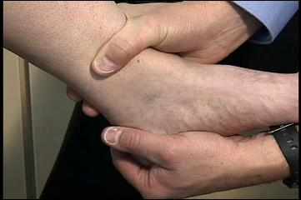
Anterior drawer test of ankle

Slide 3
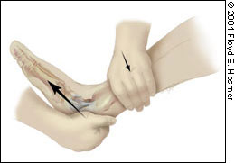
Purpose
To test for ligamentous laxity or instability in the ankle. This test primarily assesses the strength of the Anterior Talofibular Ligament.
Test Position: Supine or Sitting.

Slide 4
Performing the Test:
The examiner stabilizes the anterior distal leg with one hand & grasps the patient's calcareous and rear foot with their second hand. The examiner then places the patient's foot into 10-15 degrees of plantar flexion and translates the rear foot anteriorly.
A positive test results if the talus translates forward. Positive test results are often graded on a "0 to 3 scale", with 0 indicating no laxity & 3 indicating gross laxity.

Slide 5
Importance of Test:
The anterior drawer test is a beneficial test to perform in a patient following an inversion ankle sprain (injury to the lateral collateral ligaments).
The 3 main components of the Lateral Collateral Ligaments of the ankle include the anterior talofibular ligament (ATFL), calcaneofibular ligament, and posterior talofibular ligament.
The ATFL courses from the anterior aspect of the lateral malleolus to the anterior medial aspect of the neck of the talus. The function of the ATFL is to resist anterior translation of the ankle and prevent internal rotation of the talus on the tibia.

Slide 6
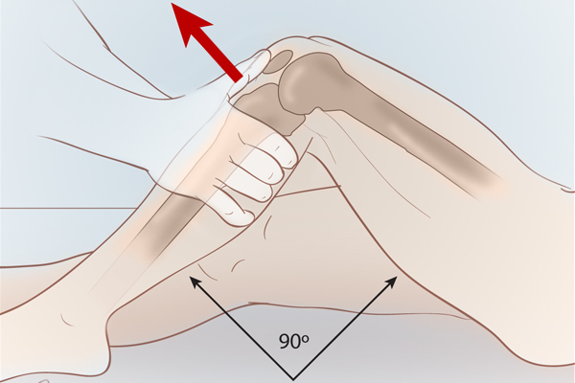
Anterior drawer test of knee
Purpose: To assess for the integrity of the ACL.
Test Position: Supine.

Slide 7
Performing the Test:
Have the patient's tested leg bent to about 90 degrees of flexion. The examiner should sit on the foot of the patient's leg. Place a hand along each side of the patient's knee, while palpating the joint line. Apply a posterior-to anteriorly directed force through the superior tibia. Compare the involved side to the non-involved side. A positive test includes the lack of an end-feel or excessive translation.

Slide 8
Importance of Test:
In the acute stage, this test does not adequately assess the integrity of the ligament due to 3 hypotheses:
a) swelling following ACL rupture prohibits the test position of 90 degrees of knee flexion
b) hamstring protective spasms following injury restricts anterior translation of the tibia
c) the posterior horn of the medial meniscus may become blocked by the medial femoral condyle, again blocking anterior translation of the tibia.

Slide 9
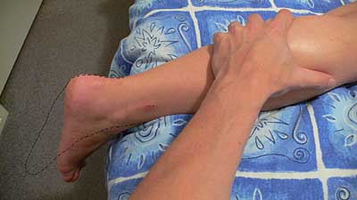
Calf Squeeze Test
Purpose: To detect a rupture of the achilles tendon.
Test Position: Prone.

Slide 10
Performing the Test:
The examiner gently squeezes the calf. A positive test is considered when the ankle remains still or there is significantly less plantar flexion than the contralateral side.

Slide 11
Importance of Test:
The achilles tendon is the largest tendon in the human body. Due to the amount of stress placed on the tendon each day, it is also one of the most commonly injured tendons. The tendon serves as the attachment point of the gastrocnemius, soleus, and plantaris muscles to the calcaneus.
During an achilles tendon rupture, the passive tension in the ankle is altered, and significantly less plantar flexion will be seen during a calf squeeze.

Slide 12
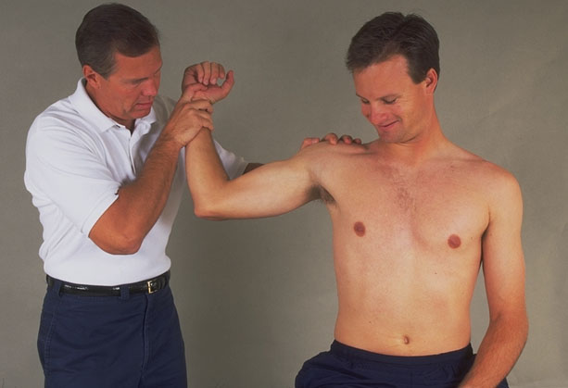
Apprehension test
Purpose of Test: To assess for anterior instability of the glenohumeral joint capsule.
Test Position: Supine

Slide 13
Performing the Test:
The examiner flexes the patient’s elbow to 90 degrees and abducts their shoulder to 90 degrees. The examiner then slowly externally rotates the patient’s shoulder. The test is considered positive if the patient demonstrates apprehension during shoulder external rotation.

Slide 14
Apprehension-Relocation method:
The examiner flexes the patient’s elbow to 90 degrees and abducts their shoulder to 90 degrees. The examiner then slowly externally rotates the patient’s shoulder. If the patient experiences apprehension during external rotation, the examiners places a firm hand over the anterior shoulder, increasing shoulder stability. The examiner again applies an external rotation force to the shoulder. If the patient has apprehension during the first external rotation and no apprehension during the second external rotation, it is considered a positive test.

Slide 15
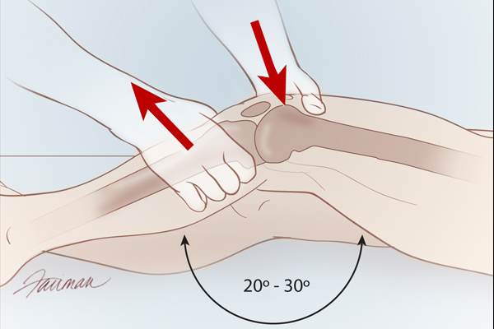
Lachman Test
Purpose: To assess the integrity of the ACL.
Test Position: Supine.

Slide 16
Performing the Test:
The patient should be relaxed for this test, especially the tested extremity.
The examiner places the tested leg into about 20 degrees of flexion, by placing the examiner's knee under the patient's thigh.
Use one hand to stabilize the distal femur near the joint line on the anterior side, while palpating the joint line.

Slide 17
Performing the Test:
Place the thumb of the other hand on the anterior side of the tibia and the fingers grasping the posterior side of the tibia near the joint line.
Apply quick posterior-to-anteriorly directed forces through the tibia.
It is important that the correct joint angle is used for this test

Slide 18
Importance of Test:
The position of 20 degrees of knee flexion is a less painful position than the 90 degrees required for the Anterior Drawer Test; thus, there is a lower chance of protective spasms from the hamstrings. Also, in 20 degrees of flexion, the ACL is more maximally stressed and can be assessed more accurately, because other tissues due not limit anterior translation of the tibia.

Slide 19
Importance of Test:
It should be noted that patients with a torn PCL may test positive with a Lachman test.
This means PCL integrity should be assessed prior to looking at ACL integrity. Often with ACL injuries, other tissues and structures can be injured as well.

Slide 20
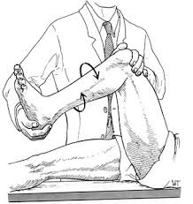
McMurray Test
Purpose: To assess for a lesion in the meniscus.
Test Position: Supine.

Slide 21
Performing the Test:
Place the patient's tested leg in maximal hip and knee flexion.
While palpating the joint line, apply a valgus force to the knee, while simultaneously externally rotating and extending the knee completely.
Place the tested leg back in maximal hip and knee flexion.
While palpating the joint line, apply a varus force to the knee, while simultaneously internally rotating and extending the knee completely.

Slide 22
A positive test occurs when pain or clicking/thudding is produced.
When the tibia is externally rotated, the medial meniscus is primarily being assessed, while the posterior portion of the lateral meniscus may be assessed as well. When the tibia is internally rotated, the lateral meniscus is being tested.

Slide 23
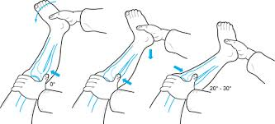
Pivot-Shift Test
Purpose: To assess the integrity of the MCL and ACL (rotary instability).
Test Position: Supine.

Slide 24
Performing the Test:
The examiner should lift the tested leg off the table with the knee fully extended. Place the heel of one hand behind the fibular head of the patient.
Use the other hand to grasp the tibia, while palpating the medial joint line.
While maintaining a valgus force and internal rotation of the tibia throughout the test, slowly flex the patient's knee.

Slide 25
A positive test occurs when the lateral tibial plateau begins anteriorly subluxed and returns to neutral as you flex the knee to around 30 degrees.

Slide 26
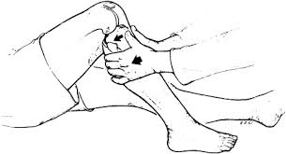
Posterior Drawer Test
Purpose: To assess the integrity of the PCL.
Test Position: Supine.

Slide 27
Performing the Test:
Have the patient's affected hip and knee in a flexed position. The examiner should be seated on the patient's foot of the involved limb.
Apply an anterior-to-posteriorly directed force through the proximal tibia. Be sure to return to the tibia to neutral before assessing the movement. The absence of an end-feel or excessive translation compared to the non-involved side is a positive test.

Slide 28
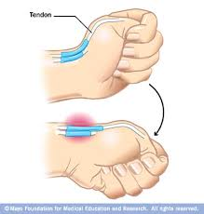
Finkelstein Test
Purpose: To assess for the presence of DeQuevain's disease.
Test Position: Sitting or standing.

Slide 29
Performing the Test:
The patient actively (or active assistive) flexes thumb maximally and wraps fingers over thumb, making a fist. The patient then ulnarly deviates his/her wrist to stretch the muscles of the 1st extensor compartment. The test is positive if the patient complains of pain over the 1st extensor compartment of the wrist.

Slide 30
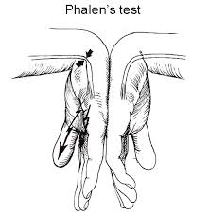
Phalen's Test
Purpose: To assess for carpal tunnel syndrome (CTS).
Test Position: Sitting or standing.

Slide 31
Performing the Test:
The examiner passively flexed the patient's wrist maximally (but not overpressure), while maintaining the shoulder in neutral and elbow in extension.
This position is held for 60 seconds or until symptoms are reproduced. A positive test occurs with numbness and tingling on the palmar aspect of the 1st, 2nd, 3rd, and radial half of the 4th digit within 60 seconds of assuming the position.

