Slide 1
Biological basis of maximal power production
5
Prue Cormie

Slide 2
Power
Empirical evidence supported by pre-vious research has shown that superior ability to generate maximal power typically results in enhanced athletic performance.

Slide 3
Muscle Mechanics
Force-Velocity Relationship
length-Tension Relationship
Type of Muscle Action

Slide 4
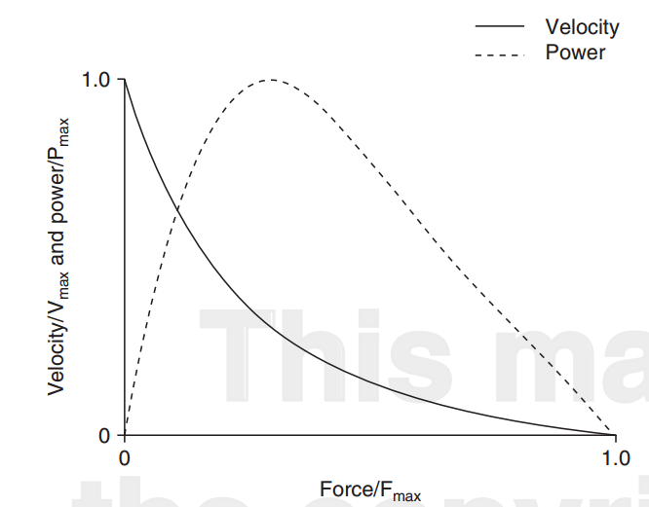
Force-Velocity Relationship
inverse relationship between the force and velocity during concentric muscle contraction

Slide 5
Force-Velocity Relationship
actin-myosin cross-bridge cycling
Specifically, because it takes a fixed amount of time for cross-bridges to attach and detach.
total number of cross-bridges attached decreases with increasing velocity of muscle shortening.

Slide 6
Force-Velocity Relationship
Due to the fact that the amount of force generated by a muscle depends on the number of attached cross- bridges, force production decreases as the velocity of the contraction increases and power, therefore, is maximized at a combination of submaximal force and velocity values.

Slide 7
Force-Velocity Relationship
Maximal muscular power is therefore determined by the parameters of the force-velocity relationship:
maximal isometric force (Fmax),
maximal velocity of shortening (Vmax) and
the degree of curvature (defined by a/Fmax or b/Vmax).

Slide 8
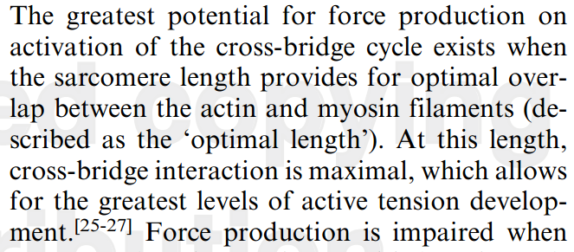
Length-Tension Relationship
The ability of skeletal muscle to generate force is critically dependent on sarcomere length.

Slide 9
Length-Tension Relationship
Stretching a sarcomere beyond the optimal length also reduces the force production capacity. At longer lengths, cross-bridge interaction is decreased as a result of less overlap between actin and myosin filaments.
therefore, muscular force may be increased with a slight stretch prior to activation.

Slide 10
Type of Muscle Action
The ability of muscle to generate maximal power is influenced by the type of action involved; eccentric or concentric contractions as well as actions involving the combination of eccentric, isometric and/or concentric contractions.
the mechanisms responsible for improved performance during SSC movements are an issue of debate amongst researchers.

Slide 11
SSC
SSC compared with concentric-only movements is based on the fact that it takes time for muscle to generate force (due to time constraints imposed by stimulation, excitation and contraction dynamics.
have enhanced power generation capability due to the greater distance over which force can be developed compared with concentric-only movements (i.e. based on the work-energy relationship)

Slide 12
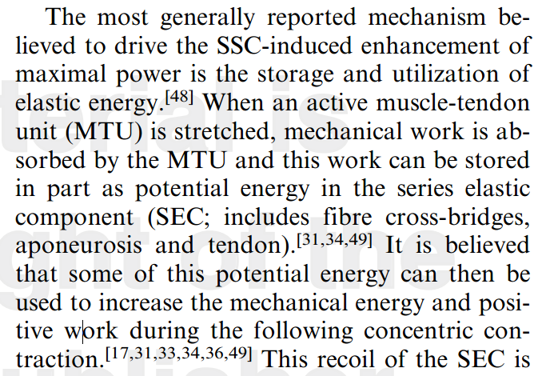
SSC
Storage and Utilization of Elastic Energy

Slide 13
SSC
The stretch reflex subsequently increases muscle stimulation, resulting in increased contraction force during the concentric phase and ultimately contributes to enhanced maximal power output

