Slide 1
Oxford Textbook of
Children’s Sport and Exercise
Medicine
Neil Armstrong
Willem van Mechelen

Slide 2
CHAPTER 1
Assessment of biological maturation
Robert M Malina

Slide 3
Introduction
Maturation refers to progress towards the biologically mature state, which varies among tissues, organs, and systems of the body.
Tempo or rate of maturation varies considerably among systems of the body and among and within individuals.
It is difficult to separate maturation from growth.
Growth refers to the increase in the size of the body as a whole and of its parts as the child progresses from birth to adulthood.

Slide 4
Chronological age and age groups
Chronological age (CA) is the basic reference in studies of growth and maturation.
Chronological age is calculated as the difference between date of measurement and date of birth.
Children and adolescents are commonly sorted into single year CA groups, which vary depending on the method of grouping. For example, 9 years can include children between 9.0 through 9.99 years, so that the midpoint of the age group is 9.5 years.

Slide 5
Growth status
Growth status refers to the size attained at the date of observation.
Height and weight are the primary indicators of growth status.
Height, or more appropriately standing height, is the distance from the standing surface to the top of the skull (vertex).
Sitting height, the distance from the flat sitting surface to the top of the skull, is often measured and provides information on upper body segment length.
Standing height minus sitting height provides an estimate of leg or lower body length.

Slide 6
Growth status
The ratio of sitting height to height provides an indication of relative body proportions, i.e. relative trunk or relative leg length.
Weight is a measure of body mass which is heterogeneous in composition. Body mass is often partitioned into fat- free mass (FFM) and its two major components, lean tissue mass (LTM) and bone mineral content (BMC), and fat mass (FM).
Dual energy X- ray absorptiometry (DEXA) and bioelectrical impedance analysis (BIA) are often used in pediatric sports medicine and science.

Slide 7
Growth status
Height and weight increase gradually through childhood, increase at an accelerated rate during adolescence (growth spurt), and then slowly increase into late adolescence.
Growth in height stops in the late teens or early twenties, whereas weight often continues to increase.
Fat free mass, LTM, and BMC have a growth pattern like height and weight and each has an adolescent spurt, while FM increases more gradually with CA.

Slide 8
Growth status
Relative fatness (% fat) increases during childhood but declines during adolescence in males and continues to increase at a slower pace in females during adolescence. The decline in % fat in males is due to the rapid growth in FFM.

Slide 9
Growth rate
The increment in height or other dimensions between two observations provides an estimate of growth rate, or tempo of growth.
Increments are influenced by technical errors of measurement at each observation, and, in the case of estimated leg length, are influenced by measurement error in both height and sitting height.
Growth rates decline with increasing CA during childhood, reach a nadir at the onset of the spurt (take- off), increase to a maximum (peak height velocity, PHV) and then decline until growth ceases.

Slide 10
Assessment of maturity status
Maturity status refers to the level or state of maturation at the CA of observation. Indicators of skeletal and pubertal maturation are used most often.
Skeletal age
Skeletal maturation is estimated as skeletal age (SA) derived from evaluation of the bones of the hand and wrist viewed on a standard radiograph.
Three methods are commonly used to estimate SA of the hand wrist.

Slide 11
Skeletal age
Greulich- Pyle method
It is sometimes called the atlas method and was developed on well- off American white children from Cleveland, Ohio.
Tanner- Whitehouse method
The Tanner- Whitehouse (TW) method was developed on British children.
The method specifies criteria and associated maturity scores for 20 bones: the radius, ulna, metacarpals and phalanges of the first, third, and fifth digits (long bones), and for the carpals except the pisiform.

Slide 12
Skeletal age
Ages at attaining skeletal maturity with the RUS protocol were lowered from 18.2 to 16.5 years in boys and from 16.0 to 15.0 years in girls.
Fels method
The method specifies criteria for the radius, ulna, carpals, and metacarpals and phalanges of the first, third, and fifth rays.

Slide 13
Skeletal age
Skeletal maturation is estimated as skeletal age (SA) derived from evaluation of the bones of the hand and wrist viewed on a standard radiograph.
Other parts of the skeleton, e.g. knee and foot and ankle, have also been used to derive estimates of SA.
Three methods are commonly used to estimate SA of the hand wrist:
Greulich- Pyle method
Tanner- Whitehouse method
Fels method

Slide 14
Greulich- Pyle method
The Greulich- Pyle method (GP) is an extension of the method initially described by Todd.
It is sometimes called the atlas method and was developed on well- off American white children from Cleveland, Ohio.
An SA is assigned to each bone and the median of the SAs is the estimate of SA for the child.

Slide 15
Tanner- Whitehouse method
The Tanner- Whitehouse (TW) method was developed on British children.
The method specifies criteria and associated maturity scores for 20 bones: the radius, ulna, metacarpals and phalanges of the first, third, and fifth digits (long bones), and for the carpals except the pisiform.
The scores for the 20 bones are summed into a skeletal maturity score; the 7 carpals and 13 long bones each contribute 50% to the skeletal maturity score.
The first revision of the TW method (TW2) did not change the criteria for maturity indicators and scores, and provided SAs based on 20 bones (TW2 20 Bone SA), for the carpals (TW2 Carpal SA), and for the radius, ulna, and short bones (TW2 RUS SA).

Slide 16
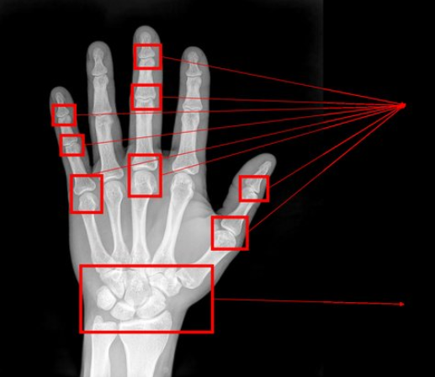
Tanner- Whitehouse method
The most recent version, TW3, eliminated the 20 Bone SA and retained the RUS (TW3 RUS) and Carpal (TW3 Carpal) SAs.
Ages at attaining skeletal maturity with the RUS protocol were lowered from 18.2 to 16.5 years in boys and from 16.0 to 15.0 years in girls.

Slide 17
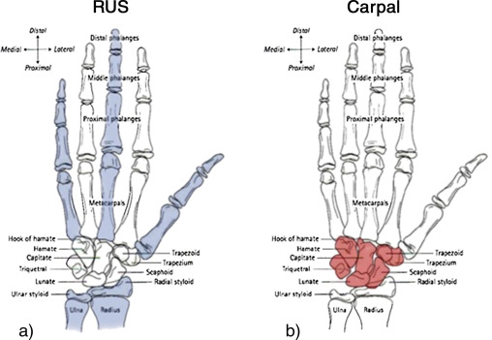
Tanner- Whitehouse method

Slide 18
Fels method
The Fels method was based on participants in the Fels Longitudinal Growth Study of children from middle- class families in southcentral Ohio.
The method specifies criteria for the radius, ulna, carpals, and metacarpals and phalanges of the first, third, and fifth rays. Grades are assigned to each bone depending on CA and sex.
presence (ossification) or absence of the pisiform and adductor sesamoid is noted.

Slide 19
Skeletal age
Skeletal maturation varies considerably among individuals of the same CA and fluctuates above and below 1 year.
The difference between SA and CA (SA minus CA) is often used to classify youth into contrasting maturity groups using a band of ± 1.0 year which approximates standard deviations for SAs within specific CA groups.

Slide 20
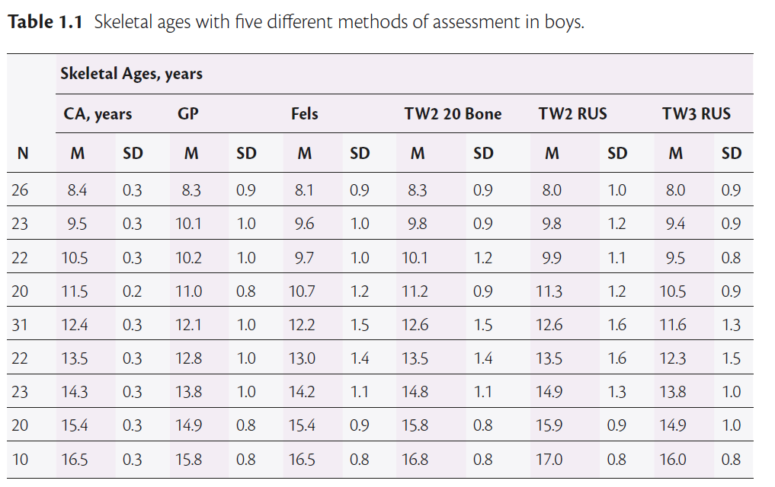
Skeletal age

Slide 21
Overview of skeletal age
Skeletal age can be used throughout the postnatal maturation period in contrast to other maturity assessment methods, which are limited to puberty and adolescence.
The use of SA is often criticized because specific training is required to learn the protocol(s).
Major limitations of SA are expenses associated with the radiographs per se, the need for qualified individuals to take them, and radiation exposure.
With modern technology, exposure to radiation presents minimal risk, 0.001 millisievert, which is less than natural background radiation and radiation exposure associated with the equivalent of 3 h · day–1 television viewing.

Slide 22
Overview of skeletal age
The lack of qualified individuals knowledgeable of the different assessment protocols and interpretations is a major limitation in the sport sciences.
It is relevant to note that ethnic identification of youth in some countries is not permitted.
Other protocols:
Skeletal age based on ultrasound assessment of the maturity status of the distal radius and ulna.
DEXA scans of the hand- wrist for the assessment of SA.
The ‘intrinsic’ bone ages.

Slide 23
Secondary sex characteristics
Secondary sex characteristics are limited to the pubertal years.
Characteristics in males include pubic hair (PH), genitalia (G, penis, scrotum, testes), testicular volume, voice change, and facial and axillary hair.
Characteristics in females include PH, breasts (B), axillary hair, and menarche.
Facial hair and voice change in boys and axillary hair in both sexes generally develop late during puberty and are not widely used.

Slide 24
Pubertal stages
The five stages of PH, G, and B described by Tanner are commonly used to assess pubertal status.
Stages are labelled PH1 through PH5, B1 through B5, and G1 through G5.
Stage 1 of each characteristic indicates the prepubertal state— absence of overt development.
Stage 2 marks the overt development of each characteristic; B2 and G2 are typically the first overt sign of the transition into puberty.
Stages 3 and 4 mark progress in pubertal maturation; the respective stages are sometimes labelled as mid- and late- puberty.
Stage 5 indicates the mature state.

Slide 25
Pubertal stages
The stages are specific to the respective characteristics in each sex and are not equivalent, i.e. B3 ≠ PH3, G3 ≠ PH3, B3 ≠ G3, PH3.
A youngster is either in a stage or not in a stage at the time of assessment; there are no intermediate stages.
Stage at time of assessment provides no information on when the youngster entered the stage (timing) or how long he/ she has been in the stage.
Maturation of the neuroendocrine system involving the hypothalamic- pituitary- gonadal- adrenal axes drives the overt development of the characteristics.

Slide 26
Pubertal stages
Self- assessments are often used in nonclinical settings; they require privacy, good quality photographs of the stages, simplified descriptions, and a mirror to assist in process.
Some self- assessment scales include pictures or drawings of the stages, and questions regarding facial and axillary hair in males and axillary hair and menarcheal status in girls.

Slide 27
Testicular volume
Testicular volume provides a more direct estimate of genital maturity in boys.
The method requires palpation of the testes in order to match their size with a series of models of known volume (Prader orchidometer).
The ellipsoid models have the shape of the testes and range from 1 to 25 mL; a volume above 4 mL marks the beginning of puberty.
The method is used primarily in the clinical setting.
Sonography can also be used to estimate testicular volume.

Slide 28
Menarcheal Status
Although age at menarche is an indicator of maturity timing, menarcheal status (pre or post) is an indicator of maturity status.
It is specifically useful in single year CA groups.

Slide 29
Assessment of maturity timing
The two most commonly used indicators of timing are age at PHV and age at menarche.
Age at peak height velocity:
Age at PHV is the estimated CA at the maximum rate of growth in height during the adolescent spurt.
Onset of the spurt occurs when growth velocity in height reaches its minimum in late childhood (age at take- off), followed by acceleration to a maximum rate (PHV), and then by deceleration until growth in height terminates in the late teens/ early twenties.

Slide 30
Assessment of maturity timing
Age at PHV is ordinarily estimated from serial height measurements of individuals taken annually or semi- annually from late childhood through adolescence.
ages at PHV ranged from 9.0– 15.0 years in individual girls and 11.1– 17.3 years in individual boys.
Age at menarche:
Age at menarche refers to the timing of the first menstrual flow.
longitudinal studies of American and Polish girls ranged from 10.77– 15.25 years and 10.49–16.30 years, respectively.
In a nationally representative sample of American girls, 90% attained menarche by 13.75 years, but 10% of girls attained menarche after this age.

Slide 31
Tempo of maturation
Tempo refers to the rate at which maturation progresses.
mean single year velocities for TW2 20 Bone SAs varied between 0.66– 1.14 years per year and standard deviations varied between 0.33– 0.52; corresponding mean single year velocities for boys varied between 0.75– 1.27 years per year and standard deviations ranged from 0.32– 0.60 years.

Slide 32
Percentage of predicted adult height
Percentage of predicted adult height at a given age provides an estimate of maturity status.
based on the average of the heights of both parents.
The protocol has a large associated error of ~9 cm.
Percentage of predicted adult height based upon the Khamis-Roche equations has been used as an indicator of maturity status in studies of physical activity and of youth athletes.

Slide 33
Summary
The processes of growth and maturation occur concurrently and are related.
Growth status— size attained at the time (chronological age [CA]) of observation, and growth rate— increment between observations, are basic to the assessment of growth.
Maturity timing refers to the CA at which specific maturational events occur. Chronological age at peak height velocity (PHV) and CA at menarche are used most often.
Skeletal age is the only maturity indicator that spans childhood through adolescence; other indicators (pubertal status, CA at PHV, CA at menarche) are limited to the interval of puberty and the growth spurt.

Slide 34

CHAPTER 2
Growth and maturation
Adam DG Baxter- Jones

Slide 35
Introduction
The concepts of a child’s growth and maturation are central to all studies related to paediatric exercise science.
Morphological parameters and physiological functions such as heart volume, lung function, aerobic power, and muscular strength develop with increasing age and body size.
Furthermore, physical fitness parameters (e.g. muscular, motor, and cardiorespiratory) also change with growth and maturation.
Thus the effects of growth and maturation may mask or be greater than both the exercise and PA effects under investigation.

Slide 36
Introduction
At the beginning of the 20th century D’arcy Thompson wrote his classic treatise On Growth and Form, and suggested that exercise was a direct stimulus to growth.
In 1964, James Tanner published The Physique of the Olympic Athlete, in which he concluded that ‘the basic body structure must be present for the possibility of being an athlete to arise.
However, a number of studies have suggested that when heavy training regimens are started at a young age, especially with aesthetic sports like gymnastics, the growth and maturation of the child may be adversely effected.
Thus the nature versus nurture debate continues.

Slide 37
Introduction
Concern about a child’s size does not just pertain to childhood; the importance of size and measuring growth itself begins much earlier, even before birth.
It has now been shown that both the size of a foetus and the child’s growth in the first year after birth can determine their lifelong health status.
It should be emphasized that regular exercise for the pregnant mother and pre- school child is only one of many factors that may influence an individual’s growth and maturation.
Growth and maturation are maintained primarily by genes, hormones, energy, and nutrients which not only interact among themselves but also with the environment in which the individual lives, both inter- and intra- uterine.

Slide 38
Introduction
it is important to realize that the same genes will be expressed differently when exposed to different environmental conditions.
To fully understand the potential of exercise or PA on a child’s growth, a sound understanding of the general principles of human growth and maturation, i.e. auxology, are required.
Auxology is the science of somatic growth and development.
Growth refers to changes in size of an individual, as a whole or in parts.
As children grow, they become taller and heavier, they increase their lean and fat tissues, and their organs increase in size.

Slide 39
Introduction
Changes in size are a result of three cellular processes:
i) an increase in cell numbers, i.e. hyperplasia,
ii) an increase in cell size, i.e. hypertrophy, and
iii) an increase in inter- cellular substances, i.e. accretion.
Maturation is the progressive achievement of adult status and comprises a subset of developmental changes that include morphology, function, and complexity.
Size and morphological changes can also be scaled relative to achievement of adult status and can be used as a continuous scale of maturation; e.g. percentage of adult height attained.

Slide 40
Introduction
The major distinction between size per se and maturation is that all children eventually achieve the same adult maturity, whereas adult size and body dimensions vary considerably.
It is therefore important to remember that growth and maturation occur simultaneously and interact, although they may not follow the same time line.
The process of maturing has two components: timing and tempo.

Slide 41
Introduction
The former refers to when specific maturational events occur (e.g. age when menarche is attained, age at the beginning of breast development, age at the appearance of pubic hair, or age at maximum growth in height during the adolescent growth spurt, known as peak height velocity, or PHV).
Tempo refers to the rate at which maturation progresses (i.e. how quickly or slowly an individual passes from the initial stages of sexual maturation to the mature state).
Maturation occurs in all biological systems in the body but at different rates.

Slide 42
Introduction
In the growth and maturity literature, life leading up to maturity is split into three stages:
the prenatal period,
childhood, and
adolescence.

Slide 43
Prenatal to postnatal growth
The period of prenatal life is vitally important to the child’s wellbeing, as is the transition from prenatal to postnatal life.
There is now compelling evidence that the origins of many chronic diseases occur prenatally and are related to the trajectory of a child’s growth.
Growth in uterine is particularly important.
This hypothesis suggests that undernutrition, and thus restricted growth, during foetal life causes long- term changes to the structure and function of the body, and that these changes predispose it to the development of many chronic diseases in later life.

Slide 44
Prenatal to postnatal growth
As already indicated, growth is defined as the increase or decrease in some measurable quantity of tissue.
Infants triple in weight during their first year, with the most notable change occurring during the first month of life.
The most overt signs of growth are the changes in somatic growth, which are measured by the techniques of anthropometry.
However, the most common dimensions of child growth cluster along the longitudinal axis of the body.

Slide 45
Prenatal to postnatal growth
Size is often measured in terms of body breadth. Two of the most frequently used are the biacromal breadth of the shoulders and the bicristal breadth of the hip.
These measures reflect the complex internal changes in architecture of the shoulder and hip regions, including associated development of musculature and adipose tissue.
However, the most commonly taken measure of somatic growth is stature.
Other dimensions, for example sitting height, are of equal importance.

Slide 46
Prenatal to postnatal growth
It is important to remember that humans generally grow proportionately and it is the interrelationships between various measurements that provide important information about the growth process.
the ratio of sitting height to stature assists in diagnosing particular types of growth failure.
Body size and composition at birth reflect foetal growth.
Postnatal growth velocities are highest immediately after birth, falling off sharply by 12 months.
During the same time period, hip and shoulder breadths increase by about 55%.

Slide 47
Prenatal to postnatal growth
At birth skinfold thickness at the triceps and subscapular vary considerably and reflect the roles of prenatal growth and gestation. After birth these skinfold thicknesses rise markedly, peak at around 6–9 months before starting to decline.
As the newborn infant makes the transition from growth controlled by maternal influences to their own influences, growth becomes more regularized and predictive of future growth; this is called canalization.
Canalization reflects the adherence of individuals to specific patterns of growth.
At PHV an individual is 92% of their final adult height.

Slide 48
Statural growth
One of the most famous records of human statural growth is that of a boy known simply as De Montbeillard’s son.
Between 1759 and 1770, Count Philibert Gueneau De Montbeillard successively measured his son at approximately 6- month intervals.
The pattern of the growth curve, to a large extent, is related to the frequency of data collection. If only two data points had been collected, e.g. birth and 18 years of age, the line between these two points would be linear.
However, in this case, data were collected approximately every 6 months, and it clearly illustrates that growth is not a linear process, i.e. individuals do not gain the same amount of height during each calendar year.

Slide 49
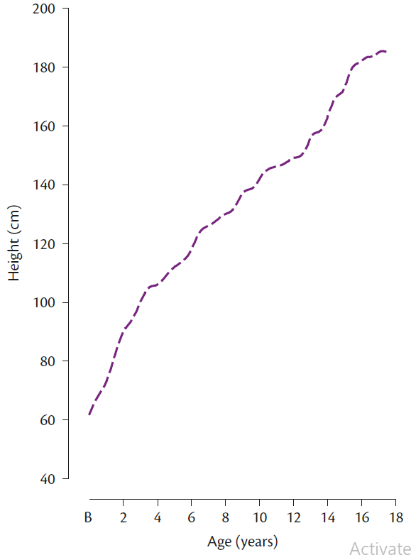
The growth in height

Slide 50
Statural growth
Relatively rapid growth is observed in infancy, which gradually declines by 5 years of age, and thereafter, the slope of the line decreases.
Steady growth in childhood (between 5 and 10 years of age) and then rapid growth during adolescence (between 10 and 16 years of age) is then observed.
During adolescence an S- shaped, or sigmoid curve, is observed. Finally, very slow growth is observed as the individual approaches an asymptote at 18 years of age.
Velocity of growth is a better reflection of the child’s state at any particular time than the distance achieved.

Slide 51
Statural growth
The curve in Figure 2.2 shows that, following birth, two distinct increases in growth rates occur.
The first of these is the juvenile or mid- growth spurt which occurs between 6 and 8 years of age.
The second increase, which is more dramatic, occurs between 11 and 18 years and is called the adolescent growth spurt.
The adolescent growth spurt, however, varies in both magnitude and timing within and between the genders.
Males enter their adolescent growth spurt almost 2 years later than females and have a slightly greater magnitude of height gain.

Slide 52
Statural growth
The extra 2 years of growth prior to adolescence, in combination with a greater magnitude of growth during adolescence, explains in part the increased final adult height observed in males.
At the same time other skeletal changes occur that result in gender differences in adulthood, such as wider shoulders in males and wider hips in females.
Males also demonstrate rapid increases in muscle mass while females accumulate greater amounts of fat, and therefore, as a result of natural biological development, by the end of adolescence males are stronger.
The increase in size also results in other physiological advantages in males over females, such as increased lung capacity.

Slide 53
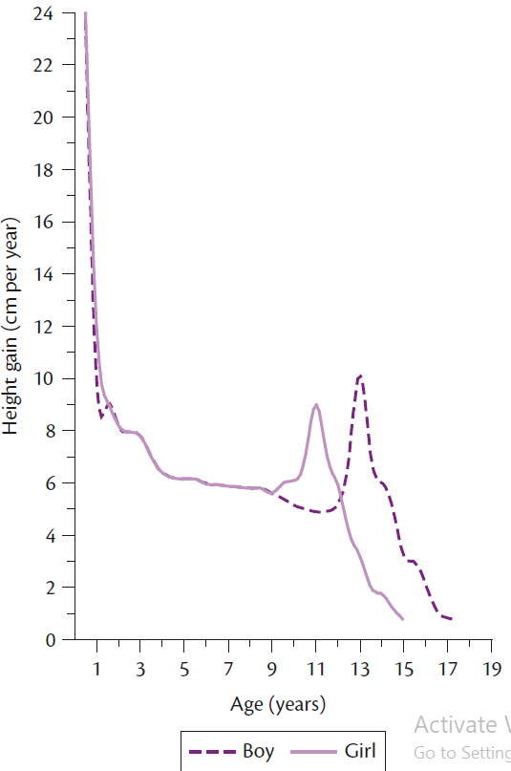
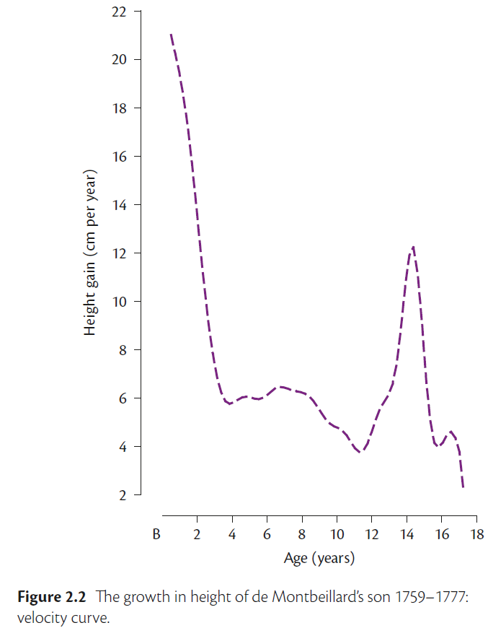

Slide 54
Types of growth data
a single individual’s data (longitudinal data) and curves of yearly averages derived from different children measured only once (cross- sectional data), as each of these curves will have a different shape.
The mixed- longitudinal design consists of a number of relatively short longitudinal studies that interlock and cover a whole age range (e.g. 8–10 years, 9–11 years, 10–13 years, etc.).
The advantage of longitudinal over cross- sectional designs is that in longitudinal design, individual variance can be obtained and therefore the timing and tempo of an individual’s pattern of growth can be identified.
Most knowledge in paediatric exercise science is based on cross- sectional research.

Slide 55
Growth in stature
Stature is made up of sitting height (distance from the sitting surface to the top of the head) and leg length, or subischial length (distance between the hip joint and the floor).
It can be difficult to locate the exact landmark of the hip joint, so leg length is most often calculated by subtracting sitting height from standing height.
Stature varies during the course of the day.
Intervertebral disks become compressed due to weight bearing.
During the first year of life, infants grow quickly at approximately 25 cm year–1, and during the first 6 months of life the velocity may be even faster at around 30 cm ・ year–1.

Slide 56
Growth in stature
During the second year of life there is growth of another 12– 13 cm in stature.
This accelerated growth means that by 2 years of age boys have attained approximately 50% of their adult stature.
Girls, even at birth, are always closer to their mature status than boys, and reach 50% of their final adult stature by 18 months of age.
Deceleration in growth, dropping to a rate of about 5–6 cm・ year–1 before the initiation of the adolescent growth spurt.
Between 6.5 and 8.5 years, there is a small but distinct increase in growth rate, known as the juvenile or mid- growth spurt.

Slide 57
Growth in stature
On average, boys experience about 2 years more of preadolescent growth—approximately 5 cm ・ year–1— than girls. This is roughly 10 cm of growth that girls do not experience.
Girls stop growing in stature by ~16 years of age and boys by ~18 or 19 years of age.

Slide 58
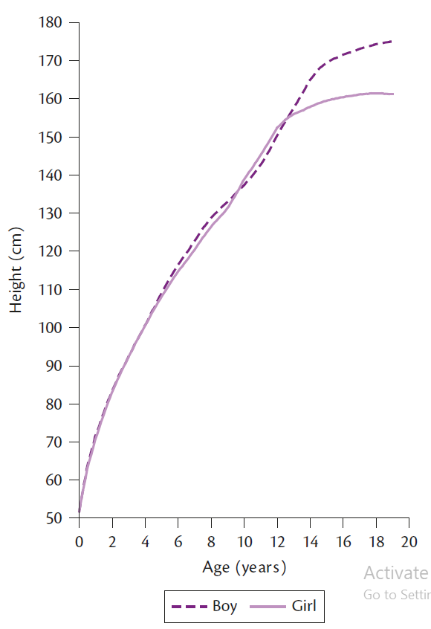
Growth in stature

Slide 59
Patterns of growth
Different parts of the body grow at different rates and at different times.
Neurological (e.g. brain and head),
Reproductive (e.g. reproductive organs),
lymphoid (e.g. lymph glands, tonsils, and appendix) and
General (e.g. stature and heart size).
Brain and head growth (neural tissue) exhibit the most rapid early growth. At birth a child’s head is roughly half its adult size.
From birth there is steady growth until 7 years of age, and by 8 years of age neural tissue growth is almost complete.

Slide 60
Patterns of growth
Reproductive tissue until 12– 14 years of age.
The reproductive curve includes primary sex characteristics (e.g. uterus, vagina, fallopian tubes in females; prostate and seminal vesicles in males) and secondary sex characteristics (e.g. breasts in females, facial hair in males, and axillary and pubic hair in both genders).
By 10–12 years of age reproductive organs are only 10% of their adult size. During adolescence (puberty) there is a rapid growth in genital tissues.

Slide 61
Patterns of growth
The lymphoid tissues, which act as a circulatory system for tissue fluid, are involved with the immunological capacities of the child and show a different growth curve.
There is a remarkable increase in size of lymphoid tissue until the early adolescent years (~11– 13 years).
The relative size of lymphoid tissue then steeply declines during puberty, probably as a result of the up- regulation of sex hormones during this period.

Slide 62
Patterns of growth
The general curve of growth also includes skeletal tissue, the respiratory system, and the digestive system.
The general curve follows a sigmoid curve of growth and reflects a rapid growth during infancy and early childhood, steady growth during mid- childhood, rapid growth during early adolescence, and asymptotes in late adolescence.

Slide 63
Growth in body mass
Body mass is made up of a composite of tissues, including fat, lean, and bone tissue, that accrue at different rates and times.
Changes in body mass are a result of changes in fat or fat- free mass as well as changes in body water concentrations (dehydration or over- hydration).
Furthermore, body mass, like stature, also shows diurnal variation.
Voiding the bladder
Diet and PA
Phase of the menstrual cycle can also affect body mass

Slide 64
Growth in body mass
body mass follows a four- phase growth pattern:
Rapid growth in infancy and early childhood,
Rather steady gain during mid- childhood,
Rapid gain during adolescence,
And usually a slower increase into adulthood.
The water content of the foetus is high and represents about 75% of body weight at birth. Much of this weight is lost during the first few days of life, declining to 45%.
By puberty, water represents approximately 19% of total body weight. Additionally, at birth the brain represents 13% of body weight, compared to 2% in adulthood.

Slide 65
Growth in body mass
During the first year of life body mass doubles and by the end of the second year it has quadrupled.
Most children show the lowest annual increment in body mass around 2–3 years of age; from this point to the onset of adolescence body mass increases, but at a slower rate.
It has been estimated that peak velocity in body mass normally occurs 0.2– 0.4 years after PHV in boys and 0.3– 0.9 years after PHV in girls.
In boys, the growth spurt in body mass is primarily due to gains in muscle mass and skeletal tissue; fat mass remains fairly stable.
However, girls experience a less dramatic rise in muscle mass and skeletal tissue but experience a continuous rise in fat mass during adolescence.

Slide 66
Growth in body mass
consequence of this growth pattern is that by young adulthood males have 50% more lean body mass than females. Although sex differences in skeletal tissue may be present during infancy and childhood, they become far more pronounced during adolescence.
After age 14, boys have approximately 10% more bone mineralization.
by birth, fat represents 15% of total body weight, 25% at 6 months, and 30% at 1 year of age.

Slide 67
Development of shape
the concept of change in shape reflects the changes in proportionality of body segments from infancy to adulthood.
As discussed, head size increases twofold from birth to maturity, although other segments show different patterns. The trunk increases threefold, the arms fourfold, and the legs at maturity are five times their birth length.
In early foetal growth the head grows fastest, in infancy trunk growth accelerates, and in childhood leg growth accelerates.
During childhood and adolescence, limb growth occurs distal to proximal. Thus, during childhood there may be a period where children appear to have large hands and feet in relation to the rest of their body.

Slide 68
Development of shape
The longer period of preadolescent growth in boys is largely responsible for the fact that mens’ legs are longer than womens’ in relation to trunk length.
Other gender shape differences also occur during adolescence. Where boys experience a broadening of the shoulders relative to the hips, girls experience a broadening of the hips. These differences are evident during childhood but become accentuated during adolescence.
The timing and speed of these changes in body dimensions may have a dramatic effect on several aspects of physical performance.

Slide 69
Development of shape
An increase in shoulder width can result in increased muscle mass in the upper body in boys. This is one reason why sex differences in strength are much greater in the upper compared to the lower body.
Furthermore, this greater upper body muscle, combined with longer arms, may explain why older boys are better at throwing, racquet sports, and rowing than older girls.
Girls tend to have a lower center of gravity, due to the relative broadening of the hips, which may contribute to their better sense of balance.

Slide 70
Adolescence and puberty
As discussed, maturation is the progressive achievement of adult status.
Some authors refer to adolescence when talking about psychosocial changes and puberty when talking about the physical changes. However, most of the literature uses these terms interchangeably.
Adolescence is a dramatic period involving rapid transformation of anatomy, physiology, and behavior.
The progressive acquisition of secondary sexual characteristics are common examples of maturation during adolescence.
In 1930, Boas coined the expression tempo of growth drawing an analogy with classical music: some children are marked allegro (fast), others lento (slow).

Slide 71
Regulation of growth and maturation
The regulation of growth and maturation involves the complex and continuous interaction of genes, hormones, nutrients, and the physical environment.
A genotype is the group of genes making up an individual.
Whether a child achieves that potential, however, depends on the conditions (i.e. environment) into which the child is born and subsequently raised.
An individual’s phenotype is the observed physical or physiological characteristics and traits that are produced by the genotype in conjunction with the environment.
Adequate levels of several hormones are essential to normal growth and development. Hormones are therefore essential for a child to reach full genetic potential.

Slide 72
Regulation of growth and maturation
Some of the most prominent hormones involved in the regulation of growth and maturation include testosterone (primarily from the leydig cells of the testes and also the adrenal cortex), oestrogen (primarily from the ovarian follicle and also the adrenal cortex), thyroxine (from the thyroid gland), cortisol and adrenal androgens (from the adrenal cortex), insulin (from the β- cells of the Islets of Langerhans of the pancreas), and a series of hormones from the pituitary glands.
The pituitary hormones include but are not limited to adrenocoticotrophin (ACTH), follicle- stimulating hormones (FSH), growth hormone (GH) (or somatotrophin), leutenizing hormone (LH), and thyrotrophin (TSH).

Slide 73
Regulation of growth and maturation
Postnatal growth is a result of GH secretion and the final component of post- natal growth, i.e. puberty, when GH interacts with gonadal steroids.
Growth hormone and thyroid hormones are the primary hormones for growth prepubertally.
Growth hormone is regulated by growth hormone- releasing hormone, which causes release and synthesis of GH, and somatostatin, which inhibits GH release.
In humans there is a dose- dependent relationship between the amount of GH secreted over a 24- h period and the growth rate of an individual.

Slide 74
Regulation of growth and maturation
Although GH has direct effects on some cells, many of its effects are mediated by the local generation of insulin- like growth factor I (IGF- I).
Prepubertal growth is therefore largely dependent on the thyroid hormones and the GH/ IGF–1 axis.
Insulin- like growth factor- I plays an important role in:
muscle tissue growth through the stimulation of glycogen accumulation and the transfer of amino acids into cells for protein synthesis.
Insulin- like growth factor-I also promotes connective tissue, cartilage, and bone growth through the stimulation of cartilage growth and the formation of collagen.

Slide 75
Regulation of growth and maturation
During the final component of post- natal growth, i.e. pubertal, sex steroids modulate growth.
The central feature of puberty is the maturation of the primary reproductive endocrine axis.
This is comprised of the hypothalamus, pituitary gland, and gonads. This three- part system is known as the hypothalamic- pituitary- gonadal (HPG) axis.
The hypothalamus serves as the main enabling centre, and its primary signal is a hormone known as gonadotropin releasing hormone (GnRH) or luteinizing- hormone- releasing hormone (LHRH) that is released in a pulsatile fashion.

Slide 76
Regulation of growth and maturation
The effect of GnRH release is to simulate production and release of two gonadotropins from the pituitary, FSH and LH.
In the ovary LH stimulates testosterone production and FSH stimulates the conversion of testosterone to oestradiol. At the same time, inhibin is secreted which has a suppressive effect on FSH.
After ovulation, progesterone is secreted.
In the testis, LH stimulates testosterone production and FSH inhibin secretion, which act as feedback controls on the pituitary. Gonadal function is also regulated by a number of metabolites including insulin, cortisol, GH, and IGF- I.

Slide 77
Regulation of growth and maturation
Circulating levels of FSH are much higher in girls compared to boys during infancy, whereas no sex differences are noted in LH.
Thus, one of the first detectable signs of biological maturity, related to a change in HPG axis activity, is the appearance of sleep- associated increased LH pulse amplitude.
On average LH concentrations will rise first in girls at about 8–9 years of age, reflecting their earlier onset of puberty, and then in boys 1–2 years later.
The resultant rising testosterone levels stimulate a host of other pubertal changes, including the appearance of pubic, axillary, and facial hair, voice changes, accelerated linear growth, and increase in muscle mass.

Slide 78
Regulation of growth and maturation
In girls, increased LH stimulation leads to increases in ovarian steroid production with oestradiol levels approaching those characteristic of women in the follicular phase.
In late puberty, the secretion of FSH and LH becomes cyclic in females.
In boys LH stimulates testosterone production and FSH stimulates growth of tubules and sperm production.
In contrast to the cyclic secretion of FSH and LH in females with the attainment of sexual maturity, in males FSH and LH secretions remain constant.

Slide 79
Regulation of growth and maturation
Estradiol is produced in the ovaries and is the most potent estrogen in females. Testosterone is also present in females, but in smaller amounts than in boys.
In males testosterone is synthesized in the testes. Although testosterone is the most abundant androgen in males, the most potent androgen is dihydrotestosterone, which is derived from testosterone.
During infancy boys demonstrate higher levels of testosterone than girls. Compared to infancy, levels of testosterone and estradiol are reduced during childhood, with no marked sex differences.
Both estradiol and testosterone affect GH production by augmenting GH pulse amplitude.

Slide 80
Regulation of growth and maturation
Thus, the somatotropic axis and the HPG axis function synergistically in promoting the adolescent growth spurt.
During puberty, males experience a dramatic growth spurt in muscle and fat- free mass, primarily due to the rise in circulating levels of testosterone. The more modest gain of muscle mass during puberty in females is primarily caused by the lower levels of adrenal androgens produced.
As discussed, androgens and oestrogens also promote bone growth and skeletal maturation. Androgens stimulate longitudinal growth and increased thickness of bones.

Slide 81
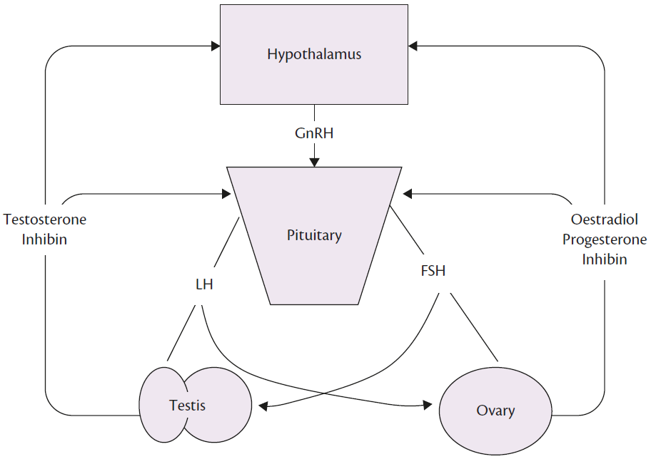
The hypothalamic- pituitary- gonadal axis and its principal hormones

Slide 82
Biological maturity
When considering how to assess biological maturation it is important to understand that 1 year of chronological time does not equal 1 year of maturational time.
The maturity indicator chosen should be any definable and sequential change in any part of the body that is characteristic of the progression of the body from immaturity to maturity.
The most commonly used methods to assess maturity or pubertal events are: skeletal maturity, sexual maturity, biochemical and hormonal maturity, somatic or morphological maturity, and dental maturity.
However, the timing of pubertal events varies between individuals of the same sex.

Slide 83
Biological maturity
Furthermore, although sexual maturation and skeletal development are associated, an individual in one stage of secondary sexual development cannot be assumed to be in a set stage of skeletal development.

Slide 84
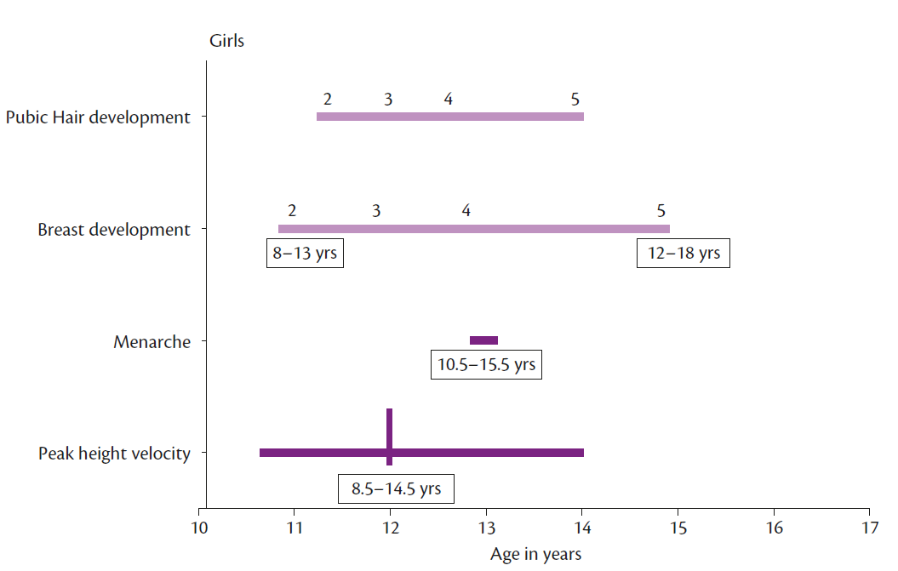
Biological maturity

Slide 85
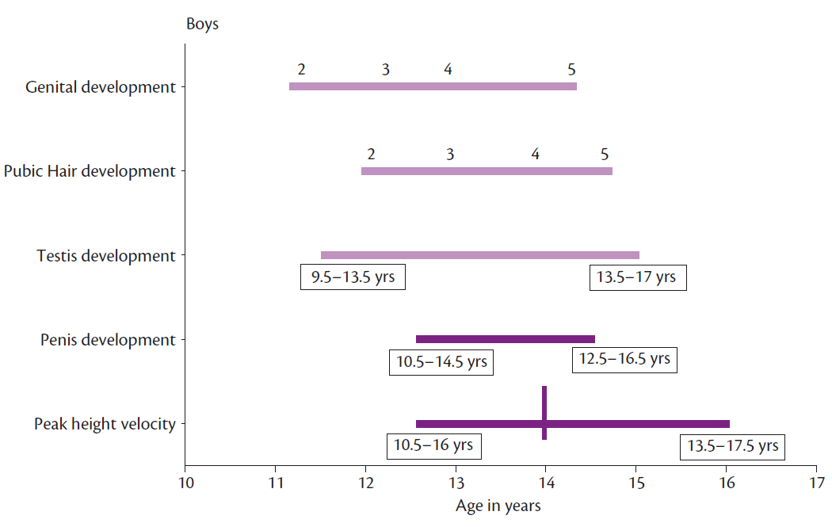
Biological maturity

Slide 86
Relationship of maturity to body size and function
It is clear that a child’s maturity status will influence measures of growth and performance.
Early maturing individuals of both sexes are taller and heavier than those of the same chronological age who mature at an average or late rate.
Studies have repeatedly shown little or no correlation between the timing of the adolescent growth spurt (i.e. maturity status) and adult stature, suggesting that early, average, and late maturing children reach, on average, the same adult height.
This is not the same for weight. Early maturing individuals have, on average, greater body weights as young adults.

Slide 87
Relationship of maturity to body size and function
Early maturing individuals and late maturing individuals also vary in body shape.
Late maturers tend to have relatively longer legs (i.e. legs account for a greater percentage of adult stature) than early maturers.
Furthermore, early maturing girls and boys tend to have relatively wider hips and relatively narrower shoulders.
In contrast, late maturing individuals tend to have relatively narrower hips and relatively wider shoulders.
In both sexes early maturing youngsters have, on average, larger measurements of muscle and fat.

Slide 88
Relationship of maturity to body size and function
In summary, at any given chronological age during adolescence, early maturing boys and girls are on average taller, heavier, have greater fat- free mass (especially in boys), total body fat, and percent body fat (especially in girls) than their less mature peers.
The maturity- associated differences in body size and body composition are especially marked during adolescence and influence strength and aerobic power.
Studies have shown that early maturing boys are stronger than late maturing boys during adolescence. Early maturing girls tend to be slightly stronger than late maturing girls early in adolescence (11 through 13 years of age), but as adolescence continues the difference between maturity groups disappears.

Slide 89
Relationship of maturity to body size and function
It has been shown that early maturing individuals, when compared to late maturing individuals of the same chronological age, have a higher absolute maximal oxygen uptake (VO2 max).
This difference in VO2 max between contrasting maturity groups is more pronounced in males than in females, which may be due to males developing greater muscle mass, red blood cells, haemoglobin, lung capacity, pulmonary ventilation, and oxygen uptake than females during adolescence.

Slide 90

CHAPTER 4
Motor development
David Sugden and Helen Soucie

Slide 91
Introduction
Movement is probably the most observable trait that we note from infancy through to adulthood.
Movement usually progresses, and this progression is known as motor development.
In the early twentieth century, most observational studies investigated the ages and stages children went through from birth to maturity.

Slide 92
General description of change
The first 2 years of life see dramatic changes, followed by periods of stability, with further major changes occurring during the pubertal period.
For example, locomotion is not present at birth, but during the first year of life the child gains postural control, develops turning over and changing positions, creeping and crawling, and finally at around 12 months of age, walking is accomplished.
By age two, the child is performing rudimentary jumps and attempting running. By the time a typically developing child is 6 or 7 years of age, all the fundamental gross motor skills (running, jumping, hopping, skipping, climbing, throwing, catching, and galloping) are observable, albeit in a rudimentary manner.

Slide 93
General description of change
After age seven, gross motor skills are further honed by using them in more challenging environments, refining them, modifying them, and using them in a series of other activities like playing games, recreation, and leisure activities.
A similar pattern is seen in manual skills.
The newborn and young infant has crude but goal- directed manual skills involving manipulation, reaching, and grasping.
The very young infant grasps an object using the palm and ulna side of the hands.
During the first year of life this changes to the more radial and distal location, and eventually the grasp becomes a combination of the thumb and index finger in true opposition.

Slide 94
General description of change
As the child develops, more complex manual skills are evident in activities like writing and drawing.
At 18 months the first random scribbling is evident and between the ages of 3 to 5 years, the child acquires drawing of lines and circles, copying a square, and sometimes a triangle.
Again, by age six or seven, the child is competent in performing most manuals skills.

Slide 95
Traditional maturational explanations
four- stage progression from reflexive to voluntary behaviour. As an example she used the development of palmar grasp:
Reflex from pressure on the palm.
At 3–4 months inhibition of palm pressure producing extension of fingers and thumb.
Palmar grasp occurs without palmar pressure when, for example, reaching to grasp an object.
Flexibility in producing a variety of grasps to accommodate the environmental context.

Slide 96
Information processing and cognitive explanations
With development, children react and move faster, have improved memory use, and are more effective at using different types of feedback.

Slide 97
Early movement development
The time from birth to 24 months represents a significant period in a baby’s life with a transition from a state of minimal control of their arms, legs, and posture, to one of good postural control, walking, and to a certain degree, the ability to reach, grasp, and manipulate a variety of objects.

Slide 98
Spontaneous movements and reflexes
Prechtl reported on a series of studies looking at movements in utero and for 30 weeks post- term.
He describes three classes of movements: writhing movements, fidgety movements, and voluntary movements, all developing from the tenth week in utero to the 20th week post- term.
He notes that these observations of movements are good predictors of neurological dysfunction in young children.
After extensive observations of infants in the first year of life she reported a total of 47 different stereotypies, identifying 11 as the most frequent.

Slide 99
Spontaneous movements and reflexes
These spontaneous movements were not considered reflexes or involuntary movements, but instead were viewed as possible precursors to later voluntary actions.
the spontaneous kicking movements was noted to resemble the spatial and temporal components of mature walking patterns.
The early reflexes found in babies are related to infant survival and are nourishment- seeking as well as protective actions.
The stepping reflex occurs when a young infant is held upright with their feet on a support surface and they perform alternating step like movements.

Slide 100
Spontaneous movements and reflexes
Thus as the stepping reflex disappears, infants simultaneously experience a rapid gain in mass, most of which is subcutaneous fat rather than muscle tissue.

Slide 101
Vision and visual perception development
How information is taken into the system has a profound effect on future actions and movements.
While most human senses affect the resulting actions, the primary source for action early in life, and the best understood, is vision.
Vision specifies the context in which the body moves, it controls movements through the use of feedback, it helps with preplanning movement, and it provides information about the results of the movement.
Vision also provides spatial information in the form of location, distance, and size, and provides temporal information about moving things, both alive and inanimate, in relation to the self.

Slide 102
Vision and visual perception development
At birth the visual structures are present but immature.
Myelinization has occurred to a certain extent, but the optic nerve develops rapidly up to around 4 months.
Newborn acuity is lower than that at maturity, but by 2 months of age, vision has developed enough for the infant to recognize faces.
Infants at around 4 months of age are relatively accurate in reaching and contacting slow- moving objects;
In other words, the infants explore limb movements using proprioceptive and haptic feedback, followed by a ‘mapping’ via the visual tracking of reaching and grasping.

Slide 103
Motor development 2–7 years of age
At 2 years of age, children are capable of a number of basic skills, including walking, running, climbing, releasing objects, a bit of scribbling, some self- care, and, in general, using motor skills to independently enjoy and explore their environment.
variables in the walking process:
These variables included neural maturation and various morphological measures such as height, weight, and leg length, plus practice calculated from the number of days from a child’s first step.

Slide 104
Motor development in later childhood
Between age 6 years and puberty, a number of developmental changes take place in the child.

