Slide 1
Oxford Textbook of
Children’s Sport and Exercise
Medicine
Neil Armstrong
Willem van Mechelen

Slide 2
Resistance training
Avery D Faigenbaum and Rhodri S Lloyd

Slide 3
Effectiveness of youth resistance training
Well- designed youth exercise program grounded in resistance training may help fill the critical need for children and adolescents to maximize long- term physical development while minimizing the risk of activity- related injury.
It can be expected that active children and adolescents will show noticeable gains in height, weight, and measures of physical fitness during the developmental years, even without participation in a structured resistance- training program.

Slide 4
Effectiveness of youth resistance training
However, a child or adolescent who participates in a resistance training program will have better strength performance at any age when compared to an age- matched peer who does not participate in this type of training.

Slide 5
Effectiveness of youth resistance training
Data from several research studies indicate that neuromuscular adaptations:
(i.e. a trend towards increased motor unit activation and changes in motor unit coordination, recruitment, and firing)
and possibly intrinsic muscle adaptations (as evidenced by increases in twitch torque) appear to be primarily responsible for training induced strength gains during preadolescence.

Slide 6
Effectiveness of youth resistance training
Gains in motor- skill performance and the coordination of the involved muscle groups may also play a significant role because both neural and mechanical factors influence force production in children.
Improvements in movement coordination are likely a more important contributor to training- induced gains if the exercises include complex movements (e.g. weightlifting exercises) rather than isolated muscle actions.

Slide 7
Effectiveness of youth resistance training
Muscle hypertrophy is more common following resistance training in adolescent males because testosterone and other hormonal influences on muscle hypertrophy would be operant.
Children appear to experience more difficulty increasing their muscle mass in response to a training program due to inadequate levels of circulating androgens.

Slide 8
Detraining and persistence of training- induced gains
The temporary or permanent reduction of the training stimulus is referred to as detraining.
Most children and adolescents will undergo periods of reduced training because of program design factors, travel plans, examination schedules, school vacations, or decreased motivation.
The concept of detraining in youth is relatively complex, because any loss in strength and power due to a reduction in training may be masked by the growth- related increase in muscle performance that will occur during the detraining period.

Slide 9
Detraining and persistence of training- induced gains
strength gains regressed towards untrained control group values during the detraining period at a rate of 3% per week.
It was speculated that changes in neuromuscular functioning and possibly a loss of motor coordination could be at least partly responsible for the detraining response.
Following 8 weeks of detraining, researchers reported the greatest loss of strength and power in the pre- peak height velocity (PHV) group as compared to the mid- and post- PHV groups.

Slide 10
Detraining and persistence of training- induced gains
A 1 day week− 1 maintenance program was just as effective as a 2 day week− 1 maintenance program in retaining the strength gains made after 12 weeks of resistance training in a group of pubescent male athletes.

Slide 11
Risks and concerns
Despite a compelling body of supportive evidence, resistance training was not always recommended for children and adolescents due to the presumed high risk of injury associated with this type of training as well as the alleged lack of training- induced benefit.
A common misperception was that this type of training would be injurious to the epiphysis or growth plate in a young lifter’s body.
training program where qualified supervision, safe equipment, and adherence to developmentally appropriate training guidelines.

Slide 12
Risks and concerns
no evidence to suggest that resistance training will negatively impact growth during childhood and adolescence.
Of note, most of the forces that youth are exposed to in various sports (e.g. gymnastics) and recreational activities (e.g. tag games) are likely to be far greater, both in exposure time and magnitude, than resistance exercise.69 For example, jumping and landing activities during competitive sports and play have been found to induce ground reaction forces greater than twice body mass depending upon age and jumping technique.

Slide 13
Maximum strength testing
one repetition maximum (1RM) strength and power testing has been found to be a safe and reliable testing procedure for children and adolescents.
Researchers assessed 1 RM performance on the chest press and leg press weight machine exercises in 96 children (6 to 12 years of age) and no adverse consequences or complaints of muscle soreness were reported.

Slide 14
Maximum strength testing
In order to reduce the risk of accidents and injury, participants should receive safety instructions on appropriate starting eights, correct exercise technique, and the proper handling of barbells, dumbbells, and plates.

Slide 15
Maximum strength testing

Slide 16
Potential benefits of youth resistance training
Bone health:
Since youth with low muscle strength are at an increased risk of fracture,99 weight- bearing activities, particularly resistance training and jumping exercises, may be most beneficial during the growing years.
the mechanical stress from this type of training may act synergistically with growth- related increases in bone mass.
levels of bone mineral density and bone mineral content well above values of age- matched controls.

Slide 17
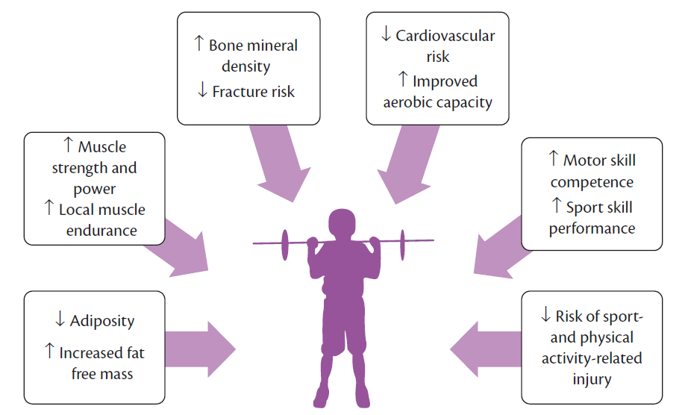
Potential benefits of youth resistance training

Slide 18
Youth resistance- training guidelines
An ‘overdose’ of training can result in non- functional overreaching, overtraining, or injury.
Consequently, the systematic progression of different training variables, along with individual monitoring of stress tolerance, will determine the long- term training- induced adaptations that take place.
A medical examination prior to participation in a resistance- training program is not mandatory for healthy youth, although caution should be used for children and adolescents with a pre- existing medical condition.

Slide 19
Youth resistance- training guidelines
Choice and order of exercises:
select exercises that are appropriate for a participant’s body size,
fitness level, and
resistance training skill competency.
body weight exercises, free weights (barbells and dumbbells), weight machines, elastic bands, and medicine balls.
It is reasonable to start with relatively simple movements and gradually progress to more advanced exercises as confidence and competence improve.

Slide 20
Youth resistance- training guidelines
Choice and order of exercises:
For most youth, multiple exposures to total body workouts over the course of a week will provide an adequate stimulus.
In general, multi- joint exercises should be performed before single- joint exercises.
more challenging exercises earlier

Slide 21
Youth resistance- training guidelines
Training intensity and volume:
training intensity is one of the more important factors in the design of a resistance- training program.
Of note, a significant positive correlation was found between gains in motor performance skills and the mean intensity (% 1RM) of the youth resistance- training program.
meta- analytical data suggest that the average resistance training program consists of two to three sets of 8–15 repetitions with loads between 60% and 80% of the 1 RM on six to eight exercises.

Slide 22
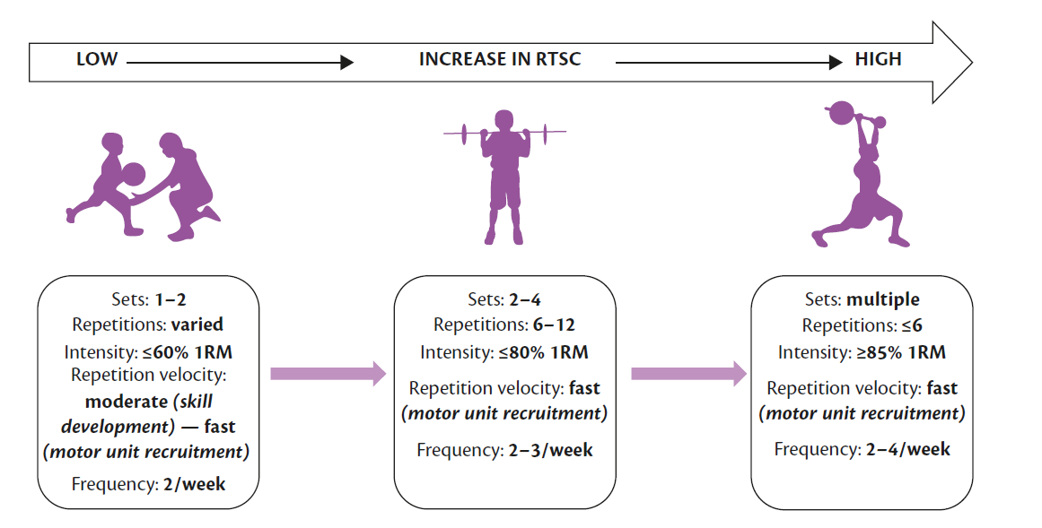
Youth resistance- training guidelines

Slide 23
Youth resistance- training guidelines
Rest interval between sets and exercises:
the researchers found that adults may need rest intervals of at least 3 min between sets, adolescents may require rest intervals of 2 min, while children may only require rest intervals of 1 min to minimize loading reductions and attain the highest lifting performance.
Consequently, a shorter rest interval (e.g. 1– 2 min) between sets and exercises may suffice in children and adolescents when performing moderate- intensity resistance training.

Slide 24
Youth resistance- training guidelines
Repetition velocity:
untrained youth initially perform resistance exercises with a light to moderate load in a controlled manner maintaining a relatively low to moderate velocity.
However, different training cadences may be used depending on the choice of exercise and program goals.

Slide 25
Youth resistance- training guidelines
Training frequency:
A training frequency of two to three times ・ week− 1 on non- consecutive days is recommended for most children and adolescents.
Factors such as the weekly training volume, nutritional intake, and sleep habits should also be considered.

Slide 28
Summary
youth resistance- training program offers observable health and fitness benefits to children and adolescents.
Neuromuscular adaptations and possibly intrinsic muscle adaptations appear to be primarily responsible for training- induced strength gains during preadolescence.
In addition to gains in muscular fitness, regular resistance training can increase bone mineral density, improve cardiovascular risk factors, enhance psychosocial well-being, and prepare youth for the demands of competitive sport.

