Slide 1
Fatigue in Sport and Exercise
Shaun Phillips

Slide 2
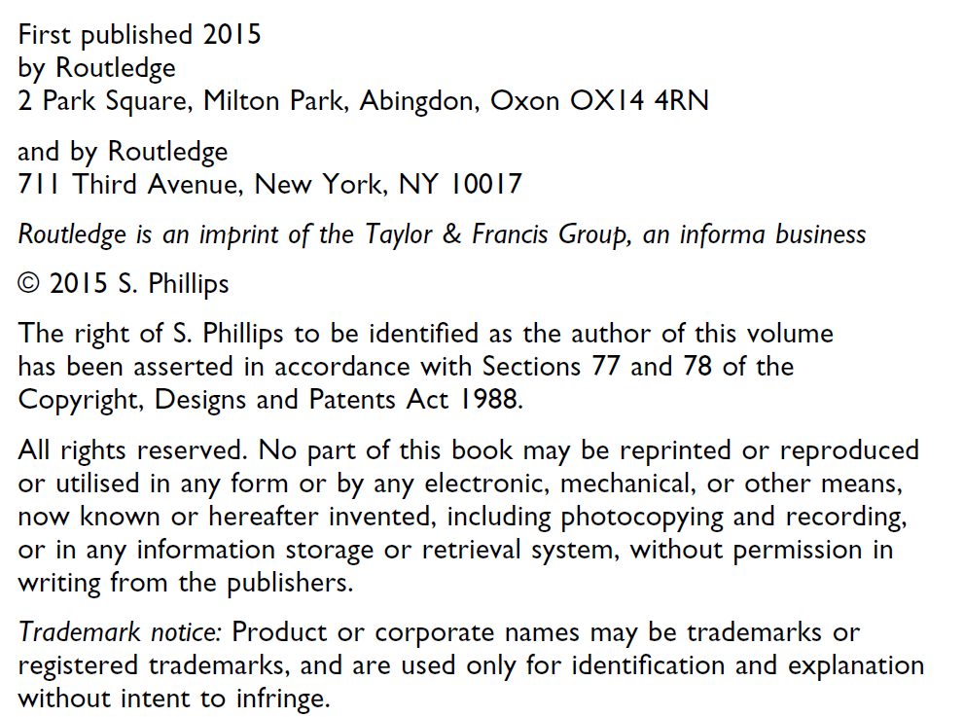

Slide 3


Slide 4


Slide 5
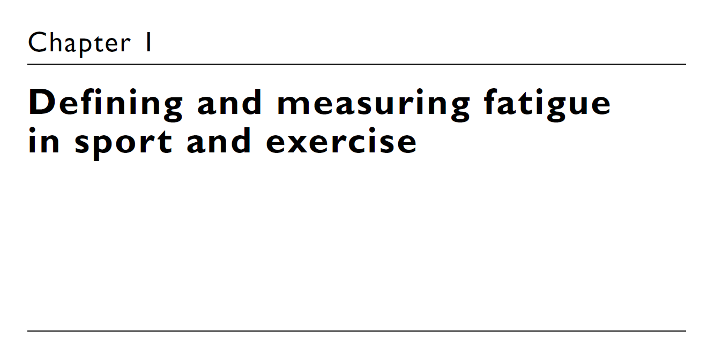

Slide 6
Part 1 – Defining fatigue

Slide 7
Introduction
The study of fatigue in humans has been a source of interest for over a century.
Since the early work of Mosso and Hill, the how and why of human fatigue has been subjected to debate and speculation.
The first [phenomenon characterizing fatigue] is the diminution of the muscle force.
The second is fatigue as a sensation.
Quantitatively the phenomena of exhaustion may be widely different; qualitatively they are the same, in our athlete, in your normal man, in your dyspnoeic patient.

Slide 8
Introduction
[The limit of exercise] has often been associated with the heart alone, but the facts as a whole indicate that the sum of the changes taking place throughout the body brings about the final cessation of effort.
Fatigue of brain reduces the strength of the muscles.
In addition, the exercise intensity, amount of muscle mass involved, and the type and duration of exercise can all influence fatigue mechanisms.
Another source of confusion is that researchers often use the terms ‘fatigue’ and ‘exhaustion’ interchangeably.

Slide 9
Introduction
A participant who is no longer able to maintain a given power output during a time to exhaustion test will often be classified as having reached ‘exhaustion’. However, they may still be fully capable of continuing exercise at a lower intensity.
Therefore, the concepts of fatigue and exhaustion are different constructs that should not be confused.
It is important to remember that in this book fatigue is the focus of discussion, not exhaustion.

Slide 10
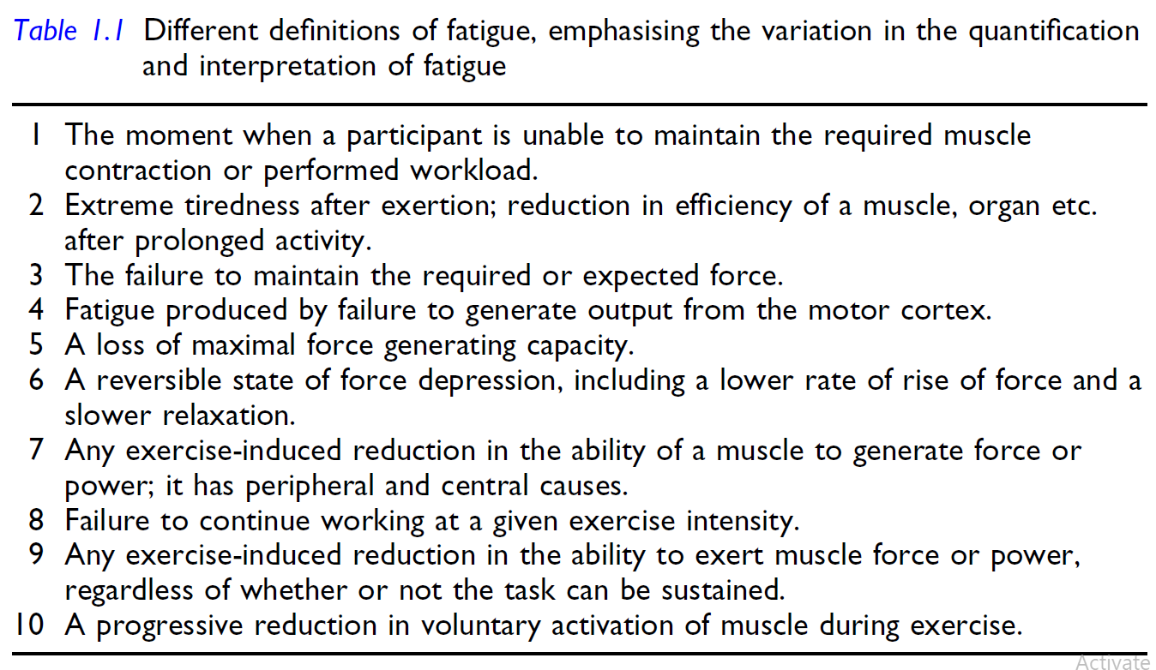
Introduction

Slide 11
Introduction
A participant who is no longer able to maintain a given power output during a time to exhaustion test will often be classified as having reached ‘exhaustion’. However, they may still be fully capable of continuing exercise at a lower intensity.
Therefore, the concepts of fatigue and exhaustion are different constructs that should not be confused.
It is important to remember that in this book fatigue is the focus of discussion, not exhaustion.

Slide 12
Prevalent fatigue theories: peripheral and central fatigue
Fatigue can be broadly categorized into two types: peripheral fatigue and central fatigue.

Slide 13
Peripheral fatigue

Slide 14
Peripheral fatigue

Slide 15
Central fatigue

Slide 16
Peripheral fatigue
Peripheral fatigue states that the sites of fatigue sit outside of the central nervous system (CNS).
More specifically, peripheral fatigue is associated with an attenuation of muscle force production caused by a process or processes distal to the neuromuscular junction.
Early work of AV Hill and colleagues in the 1920s.
Hill conducted, immediately before termination of exercise, the oxygen requirements of the exercising muscles exceed the capacity of the heart to supply that oxygen.
This develops an anaerobiosis within the working muscles, causing lactic acid accumulation.

Slide 17
Peripheral fatigue
Because of this change in the intramuscular environment, continued contraction becomes impossible and the muscle reaches a state of failure.
Hill interpreted, that fatigue is caused by increased intramuscular lactic acid concentrations.
Hill and colleagues concluded that the primary limiting factor in exercise tolerance was the heart’s capacity to pump blood to the active muscles.

Slide 18
Peripheral fatigue
This theory, termed the cardiovascular/anaerobic/catastrophic model of human exercise performance (‘catastrophic’ due to the predicted failure of homeostatic cardiac function), became the dominant theory within exercise science teaching and research.
Indeed, if exercise is limited purely by attainment of a maximal cardiac output, as Hill suggested, then psychological aspects such as motivation, focus, and confidence have no role to play in exercise performance.

Slide 19
Peripheral fatigue
The cardiovascular/anaerobic/catastrophic model of exercise performance does not satisfactorily explain many of the definitions of fatigue stated in this chapter, or many of the real-world observations and sensations experienced when a person reaches ‘fatigue’.

Slide 20
Peripheral fatigue

Slide 21
Central fatigue
Whereas peripheral fatigue occurs via processes outside of the CNS, unsurprisingly central fatigue proposes that the origin of fatigue is located within the CNS, with a loss of muscle force occurring through processes proximal to the neuromuscular junction.
Specifically, this refers to locations within the brain, spinal nerves and motor neurons.

Slide 22
Several definitions of central fatigue
A negative central influence that exists despite the subject’s full motivation.
A force generated by voluntary muscular effort that is less than that produced by electrical stimulation.
The loss of contractile force or power caused by processes proximal to the neuromuscular junction.
However, the definitions are all similar in that they provide only vague definitions of central fatigue, with no specific information about locations or mechanisms of impairment.

Slide 23
Several definitions of central fatigue
On an examination of what takes place in fatigue, two series of phenomena demand our attention. The first is the diminution of the muscle force. The second is fatigue as a sensation.
There appear, however, to be two types of fatigue, one arising entirely within the central nervous system, the other in which fatigue of the muscles.
The two quotes above were made in 1915 and 1931, respectively, indicating that an awareness of the potential for both peripheral and central fatigue process has existed for at least a century.

Slide 24
Several definitions of central fatigue
However, the idea of a central component to the fatigue process did not immediately become popular from a research perspective.
Central fatigue as a hypothesis may not have gained traction due to the publication of research findings that appeared to support the theory of peripheral muscle fatigue.
However, it may also have been due to limitations in the ability to measure central fatigue.

Slide 25
Several definitions of central fatigue
Maintaining a maximal CNS ‘drive’ is difficult and even unpleasant, and requires a well-familiarised and motivated participant to achieve it.
Even if a participant is well motivated, it is not always possible to maintain maximal CNS drive to some muscles.
It is more difficult to maximally recruit all motor units during repeated maximal concentric contractions compared with eccentric contractions.
Therefore, the reported impact of central fatigue on exercise performance may be influenced by the specific exercise protocols used in different research studies.

Slide 26
Several definitions of central fatigue
These issues help to highlight some of the problems associated with measuring central fatigue.

Slide 27
Measuring fatigue
Direct methods of fatigue assessment
Maximal voluntary force generation/electrical stimulation
Accurate measurement of the force generating capacity of muscle is crucial for the reliable assessment of muscle fatigue.
The maximal isometric force production (MVC for maximal voluntary contraction) is often used for this purpose.
does not enable dynamic contraction of the muscle.
Strong verbal encouragement is provided by the investigator in an effort to assist the participant in reaching a true maximal contraction.

Slide 28
Measuring fatigue
Direct methods of fatigue assessment
Maximal voluntary force generation/electrical stimulation
For example, Nybo and Nielsen investigated the influence of hyperthermia on fatigue following exercise at 60% VO2max until exhaustion in temperatures of 40°C and 18°C.
Indicating a negative effect of hyperthermia on force production and, hence, greater central fatigue.

Slide 29
Measuring fatigue
Concerns with the use of MVC for assessing fatigue
Force production can be limited by the voluntary effort/motivation of the participant.
Not even strong encouragement and feedback may be sufficient to enable someone to achieve a true maximal contraction.
In addition, MVC can be limited by factors present within the CNS or in the periphery.
Therefore, it is not possible to clearly determine potential mechanisms for reduced MVC.

Slide 30
Measuring fatigue
Concerns with the use of MVC for assessing fatigue
Where MVC is the maximal voluntary contraction force and ES is the force generated by electrical stimulation, superimposed onto the MVC (referred to as total muscle force).
MVC / MVC + ES
Currently, MVC and ES are the most direct methods of assessing muscle fatigue.

Slide 31
Measuring fatigue

Slide 32
Low-frequency fatigue
Low-frequency fatigue (LFF) is characterized by a proportionately greater loss of force during low-frequency compared with high-frequency muscle stimulation.
This form of fatigue can take hours or even days to dissipate, and may play a key role in the decline in muscle force production.
Low frequency fatigue is typically interpreted by measuring torque responses to different frequencies of electrical stimulation and examining changes in the ratio of force production at a given frequency (usually 20 Hz) to that at a standardized frequency (usually 50 or 80 Hz).
Decreases in this ratio are interpreted as LFF.

Slide 33
Low-frequency fatigue
Low-frequency fatigue may increase the requirement for greater CNS activation to elicit a given muscle force.
Consequently, this could cause an increase in effort perception for a given force production, potentially contributing to the development of central fatigue.
Low-frequency fatigue has been reported during high-intensity and submaximal exercise, and therefore has the potential to be used as a fatigue measure during a variety of exercise scenarios.

Slide 34
Low-frequency fatigue
Assessment of LFF is of course limited in its applicability by the requirement to use laboratory-based ES on a small amount of muscle mass during exercise that is not representative of most sporting situations.
Many of the techniques commonly used to measure fatigue during exercise are limited in their ability to measure fatigue during real-world sport-specific activities.

Slide 35
Indirect methods of fatigue assessment
Endurance time (‘time to exhaustion’)
Many research studies have utilized an endurance test, commonly known as a time to exhaustion test, to assess and/or quantify fatigue, particularly the influence of an intervention on the development of fatigue.
Use of these tests is partly based on the assumption that there is a relationship between the force generating capacity of muscles and the time to exhaustion.

Slide 36
Indirect methods of fatigue assessment
Endurance time (‘time to exhaustion’)
Also, gross time to exhaustion tests (e.g. a cycle to exhaustion at 80% VO2max) exhibit large coefficients of variation (up to ~35%), suggesting that time to exhaustion tests should not be the only measure used to determine the influence of a treatment on performance/fatigue.
However, the runs in the Hinckson and Hopkins study only lasted between ~2 and 8 minutes.
Most other research into the reliability of time to exhaustion tests has used longer duration exercise, which may be less reliable than shorter exercise due to the multitude of factors that can influence a person’s decision of whether or not to continue, such as motivation and boredom.

Slide 37
Indirect methods of fatigue assessment
Endurance time (‘time to exhaustion’)
Therefore, the ability of converted time to exhaustion scores to detect small changes in performance or fatigue is unknown.

Slide 38
Indirect methods of fatigue assessment
Electromyography
Electromyography (EMG) is the analysis of the electrical activity of muscle tissue.
The two common forms of EMG are surface EMG (non-invasive) and needle EMG (invasive). For ethical reasons, surface EMG is most prevalent in the sports science literature.
The amplitude of the signal is related to the number and size of action potentials (electrical signals transmitted down motor neurons into the muscle).

Slide 39
Indirect methods of fatigue assessment
Electromyography
Changes in the frequency of these action potentials or in the number of muscle fibers activated can be detected, however EMG cannot distinguish between these two occurrences.
Electromyography amplitude falls progressively during repeated maximal isometric contractions, likely due to a reduction in the activity of motor units and, hence, a reduction in muscle force production.
However, this does not automatically mean that EMG is a good indicator of muscle fatigue, as the cause and effect relationship between EMG amplitude and fatigue is still under debate.

Slide 40
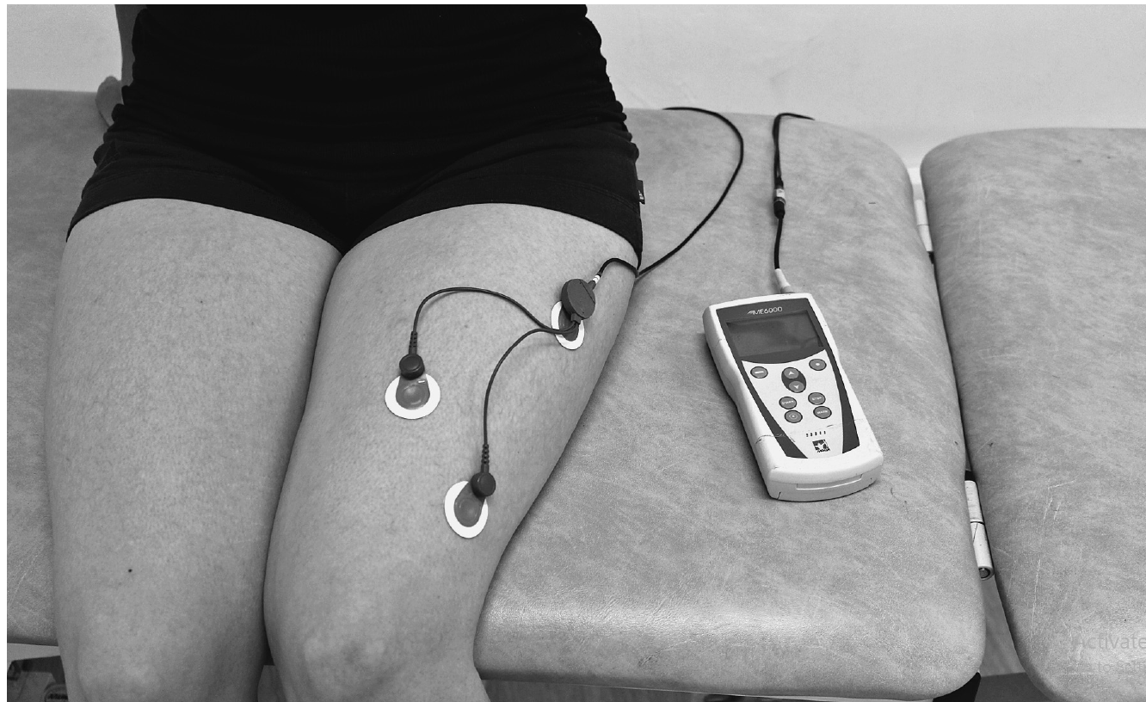
Indirect methods of fatigue assessment
Electromyography

Slide 41
Indirect methods of fatigue assessment
Electromyography
During repeated or sustained submaximal contractions a rise in EMG activity is seen in the presence of a reduction in muscle force production (i.e. muscle electrical activity is increasing yet force is reducing).
This is probably due to the progressive requirement for more muscle fibre recruitment as contractions progress and existing muscle fibres begin to fatigue.
However, during repeated submaximal contractions there is a large inter-participant variability in EMG response.

Slide 42
Indirect methods of fatigue assessment
Electromyography
Finally, EMG can only be used with any form of validity during isometric contractions, as changes in muscle length alter the relation -ship between EMG and neuromuscular activation.
This indicates that EMG may not be a particularly useful or appropriate index of fatigue during many sport-specific muscle actions.

Slide 43
Indirect methods of fatigue assessment
Muscle biopsies
In a muscle biopsy, a small piece of muscle tissue is removed from an intact human muscle for examination.
In sport and exercise science research, the needle biopsy is most common.
Here, local anesthetic is applied to the area after which a needle is inserted into the muscle (commonly the vastus lateralis of the quadriceps).

Slide 44
Indirect methods of fatigue assessment
Muscle biopsies
Muscle biopsies can be used for quantifying muscle fiber composition, muscle energy content, and the concentration and activity of a multitude of enzymes involved in energy production.
A potential limitation is that a biopsy sample may not be representative of the entire muscle from which it is drawn.
In this situation, results extrapolated from a biopsy sample to the full muscle would be inaccurate.

Slide 45
Indirect methods of fatigue assessment
Muscle biopsies
In addition, if repeated biopsy samples are required, variations in the sampling site may affect the validity and/or reliability of the data.

Slide 46
Indirect methods of fatigue assessment
Blood sampling
Methods of sampling vary, from simple fingertip or earlobe capillary sampling (Figure 1.5) to arterial and venous sampling and cannulation.
The frequency and method of blood sampling will depend on the aims of the research, the aims of the sampling (what blood variables will be measured and what they will be used for), and ethical and consensual restrictions.
A classic example is the testing of blood lactate.

Slide 47
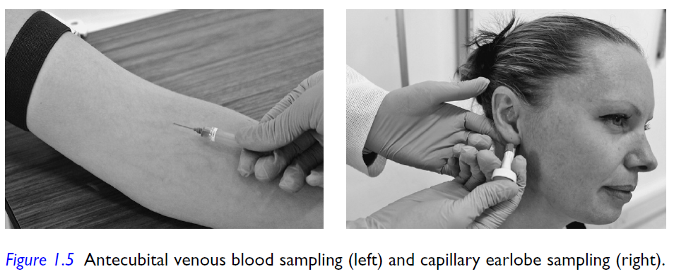
Indirect methods of fatigue assessment
Blood sampling

Slide 48
Indirect methods of fatigue assessment
Blood sampling
However, blood lactate concentration is not a valid measure of muscle lactate concentration during exercise as it only reflects activities undertaken a few minutes prior to sampling, and the balance between lactate movement into and out of the blood.

Slide 49
Indirect methods of fatigue assessment
Perceptual measurements
Numerous rating scales have been developed which attempt to quantify an individual’s psychological, perceptual, and motivational responses to exercise.
measure varied aspects such as sensation of effort, motivation, pain, enjoyment, concentration, attention, lethargy, and many more.

Slide 50
Indirect methods of fatigue assessment
Ratings of perceived exertion
The most commonly used perceptual scale is the Borg rating of perceived exertion (RPE) scale (also referred to as the Borg 6–20 scale).
1970 by Gunnar Borg.
The seemingly arbitrary 6–20 range of the original Borg scale was developed due to the observed correlation between heart rate and RPE ratings, such that the given score on the scale can be multiplied by 10 and provide a close approximation of the exercising person’s heart rate (e.g. an RPE of 12 approximates a heart rate of 120 bpm).

Slide 51
Indirect methods of fatigue assessment
Ratings of perceived exertion
however its use in young children is inappropriate or limited due to inabilities to cognitively rate perceived exertion (0–3 years of age) or provide a cohesive RPE score (4–7 years); little is known about the ability of adolescents to provide accurate RPE scores.
Furthermore, interventions can be made that alter the relationship between exercise intensity (usually measured by heart rate) and RPE, such as the use of music, altered sensory perception strategies.

Slide 52
Indirect methods of fatigue assessment
Task effort awareness scale
The scale is designed to quantify the magnitude of the psychological/ psychic sensations of effort and the extent to which a person is consciously aware of this effort.
Magnetic resonance imaging
The development of magnetic resonance imaging (MRI) techniques in medical and health settings has opened a new window into the workings of the body during exercise.

Slide 53
What causes (and what does not cause) fatigue in sport and exercise?
Part II

Slide 54

Energy depletion
Energy metabolism during exercise
Adenosine triphosphate has three components:
adenine, ribose, and three phosphates.
The energy in these bonds is released when ATP is broken down in a hydrolysis reaction, and this energy is used by the cell for various functions such as muscle contraction.

Slide 55
Energy depletion
Energy metabolism during exercise
Only a small amount of ATP is stored in the body at any time (enough to fuel approximately 2 seconds of maximal intensity muscle contraction).
three primary metabolic pathways:
the phosphocreatine (PCr) pathway,
the anaerobic pathway,
and the aerobic pathway.

Slide 56
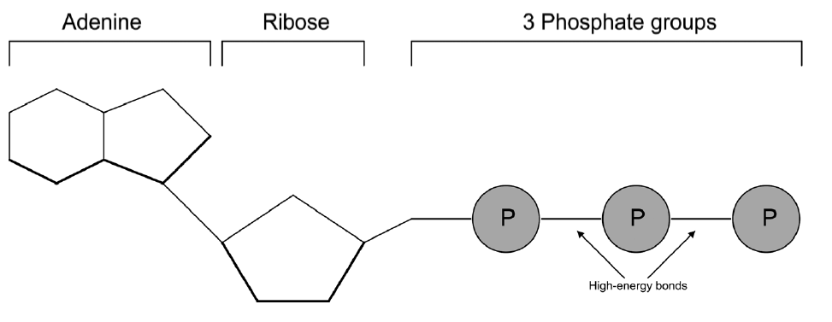
Energy depletion
Energy metabolism during exercise

Slide 57
Energy depletion
Energy metabolism and fatigue during exercise
ATP depletion
In exercising humans, intramuscular ATP concentrations do not fall below about 60% of resting levels, regardless of the intensity or duration of exercise. However, the ATP concentration of single fibres can drop to very low levels.
The occurrence of ATP depletion and its role in exercise-induced fatigue is open to debate, and more research is required.
ATP levels in individual muscle fibers can fall to as low as 20% of resting values following maximal exercise, particularly in type II muscle fibers.

Slide 58
Energy depletion
Energy metabolism and fatigue during exercise
ATP depletion
Given the conflicting observations regarding ATP depletion at the whole muscle and individual fibre levels, the exact occurrence and influence of ATP depletion on exercise fatigue is still open to debate.
However, an important message to take from this discussion is that ATP depletion is far from an accepted cause of exercise-induced fatigue, and in fact is strongly argued against in some of the literature.

Slide 59

Phosphocreatine depletion
Energy metabolism and fatigue during exercise
Phosphocreatine is a phosphorylated creatine molecule that is particularly important in resynthesizing ATP during explosive, high-intensity exercise.
In theory, this is sufficient for approximately 10-seconds of maximal work before PCr stores become depleted.

Slide 60
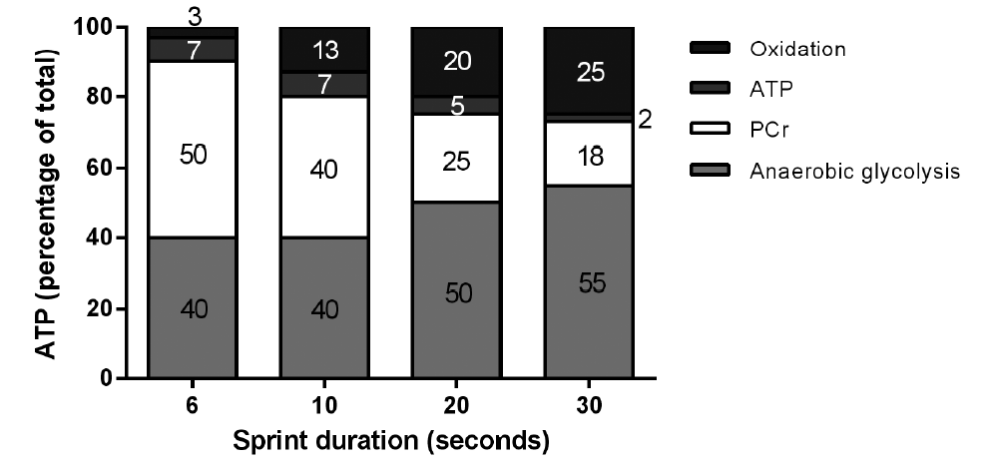
Phosphocreatine depletion

Slide 61
Phosphocreatine depletion
Energy metabolism and fatigue during exercise
The reduction in power output may be partially due to PCr depletion, which would reduce the rate of ATP resynthesize and necessitate a reduction in power output to prevent critical reductions in ATP concentration.
Phosphocreatine levels are not fully depleted during single sprints lasting 5–30 seconds. Therefore, it does not appear that PCr depletion is the sole cause of fatigue during short duration maximal exercise.

Slide 62
Glycogen depletion
Energy metabolism and fatigue during exercise
Carbohydrate, in the form of muscle and liver glycogen and blood glucose, is the primary fuel during exercise.
Carbohydrate is metabolized in glycolysis (anaerobic) and the Krebs cycle (aerobic).
Therefore, it is a fuel that can be metabolized to generate ATP across a wide range of exercise demands.
glycogen depletion causes fatigue, and more recent perceptions of the role of carbohydrate in exercise fatigue.

Slide 63
Glycogen depletion
Potential carbohydrate-related causes of fatigue during exercise
glycogen is an important fuel source during exercise – we only have a limited amount of it stored in our body – when it runs out we can no longer exercise at the same intensity – the end result: fatigue. Problem solved?
The three primary glycogen clusters are sub-sarcolemmal
glycogen (located just under the sarcolemma, or muscle fibre membrane), inter myofibrillar glycogen (located between myofibrils), and intra myofibrillar glycogen (located within the myofibrils, near the muscle z-line).

Slide 64
Glycogen depletion
Potential carbohydrate-related causes of fatigue during exercise
The major glycogen cluster is the inter myofibrillar one (approximately 75% of total glycogen stores), but the exact distributions are dependent on factors such as muscle fibre type, training status, fibre use, and the type of exercise performed.
Localized ATP depletion has been linked with fatigue via alterations in calcium (Ca2+) release from the sarcoplasmic reticulum.
The intra myofibrillar glycogen cluster is preferentially depleted during most forms of exercise. Most intra myofibrillar glycogen is stored close to the triads (a t-tubule surrounded on both sides by an enlarged area of the sarcoplasmic reticulum, termed terminal cisternae.

Slide 65
Glycogen depletion
Potential carbohydrate-related causes of fatigue during exercise
This glycogen cluster is thought to generate ATP for the triads so that they are able to perform their important role in the excitation-contraction coupling process, namely the release of Ca2+ from the sarcoplasmic reticulum.
This is supported by research that shows impaired sarcoplasmic reticulum function and Ca2+ kinetics following exercise, and an association between muscle glycogen depletion and this impaired function.
These findings appear to support a metabolic energy deficiency theory of muscle glycogen depletion.

Slide 66
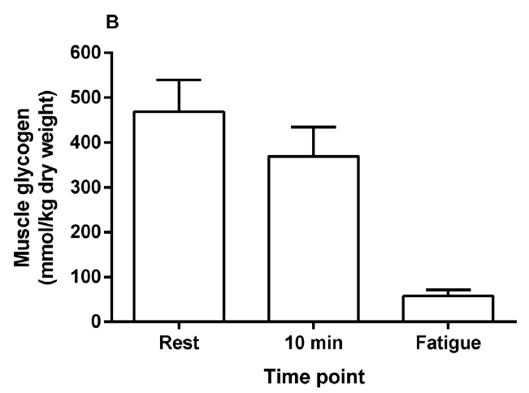
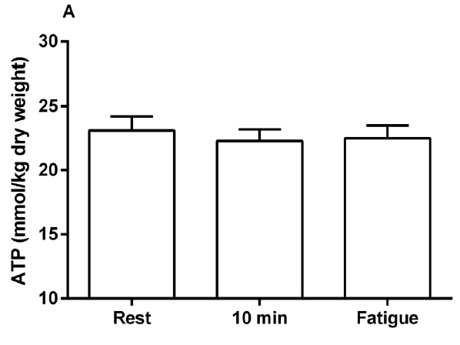
Glycogen depletion

Slide 67
Glycogen depletion
Potential carbohydrate-related causes of fatigue during exercise
GLYCOGEN DEPLETION CAUSES HYPOGLYCAEMIA, WHICH LEADS TO FATIGUE
The pattern of use of the four primary fuel sources (muscle glycogen, muscle triglycerides, blood glucose, free fatty acids) during exercise will depend on:
exercise mode, intensity, and duration, the training status, metabolic makeup, and pre-exercise fuel status of the athlete, and environnemental conditions, particularly ambient température.

Slide 68
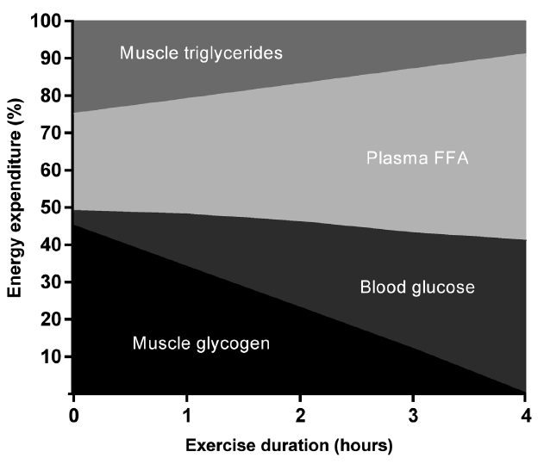
Glycogen depletion

Slide 69
Glycogen depletion
Potential carbohydrate-related causes of fatigue during exercise
GLYCOGEN DEPLETION CAUSES HYPOGLYCAEMIA, WHICH LEADS TO FATIGUE
Intramuscular fuel sources (glycogen and triglycerides) are predominant for approximately the first 90 minutes of exercise.
During prolonged exercise, blood glucose is an important fuel for working muscles and the central nervous system (CNS). Brain glucose stores are limited; therefore, the uptake of blood glucose is crucial for the brain.

Slide 70
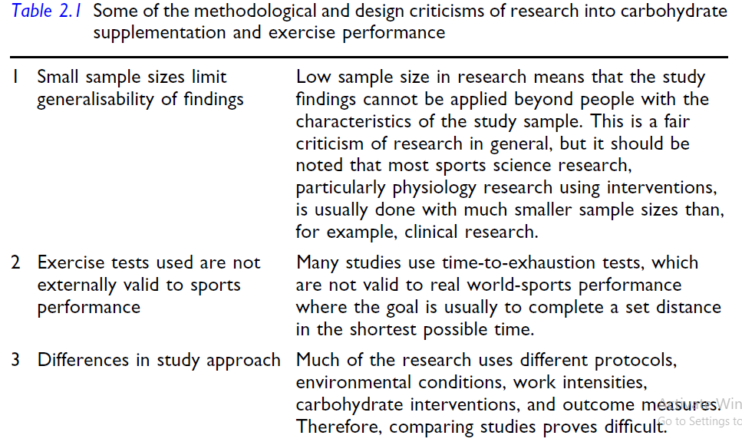
Glycogen depletion

Slide 71
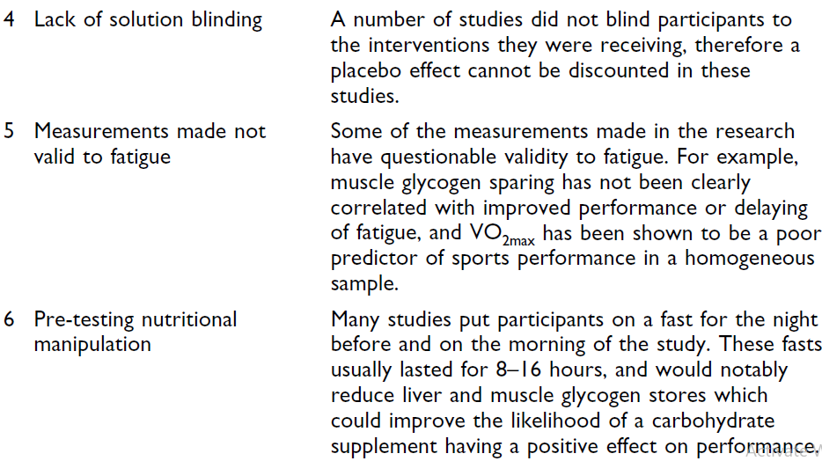
Glycogen depletion

Slide 72
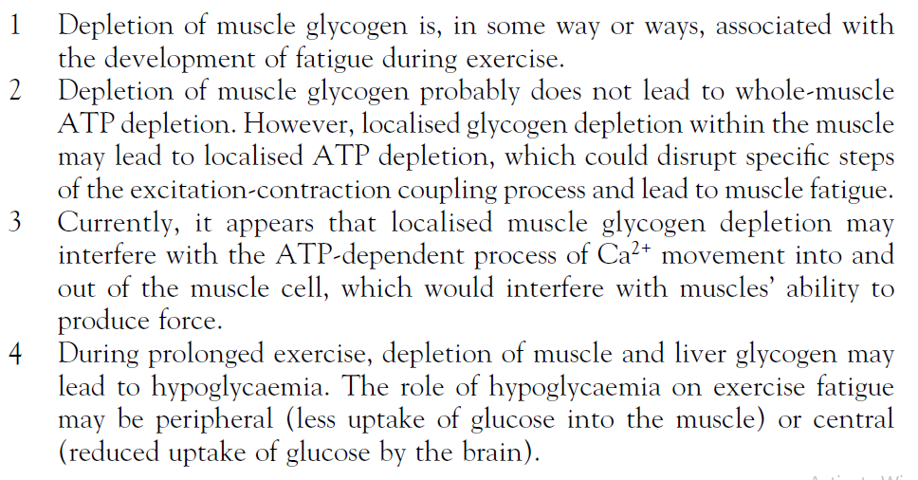
Glycogen depletion

Slide 73
Free-fatty acids
Training while fasted also results in lower blood insulin and greater blood epinephrine concentrations, which facilitates greater lipolysis and opportunity for fatty acid oxidation. Therefore, training in a fasted state may enable athletes to alter their metabolic responses to exercise and, perhaps, delay fatigue.
Approximately 90% of fat stores are in the form of triglycerides in adipose cells located at various sites around the body.
Development of a metabolic profile where fatty acid oxidation could delay muscle glycogen depletion may delay fatigue, particularly during prolonged exercise.
Training in a fasted state may enable metabolic adaptations that allow the muscle to better oxidize fat for energy, potentially sparing muscle glycogen and delaying fatigue. However, to date this has not been conclusively shown.

Slide 74


Slide 75
Introduction
Although our knowledge of the processes involved in metabolic acidosis has developed significantly, the exact causes of metabolic acidosis, and its role in fatigue during exercise, are still keenly debated.
back to research carried out in the early 1900s.
lactic acid concentrations were lowest in muscles that were exposed to oxygen.
it was concluded that increases in lactic acid were greatest under anaerobic conditions.

Slide 76
Introduction
the conclusion was made that during intense work muscles contract in the absence of an adequate oxygen supply (in ‘anaerobiosis’), thereby producing lactic acid which causes muscle acidosis that leads to fatigue.
In the 1970s, a linear relationship was found between lactate accumulation and loss of muscle force in frogs and later, in human thigh muscle.
Simply put, while acidosis and fatigue may correlate, it cannot be said that acidosis causes fatigue. Indeed, much of the research that showed a correlation between lactic acid and fatigue also showed relationships between other metabolic measures and fatigue.

Slide 77
How might lactic acid cause fatigue?
First, a reduced muscle pH, caused by lactic acid production, may impair muscle contraction via a decline in isometric muscle force production and muscle shortening velocity.
Intramuscular acidosis was thought to do this by reducing sarcoplasmic reticulum calcium (Ca2+) release and calcium sensitivity.
Second, intramuscular acidosis could cause fatigue by inhibiting glycolysis.
reduced activity of key enzymes that regulate glycolysis during exercise that causes notable reductions in muscle pH.
Potential causes of lactic acid-induced fatigue include impaired isometric muscle force and contraction velocity, and inhibition of glycolysis due to a reduction in intramuscular pH.

Slide 78
Metabolic acidosis and exercise fatigue: the counter-view
An important question to answer when discussing the biochemistry of lactic acid is ‘What does the body produce during exercise – lactic acid or lactate’?
Reading lay articles, or even scientific papers on the subject, you will often see that the terms lactic acid and lactate are used interchangeably as though they mean the same thing.
Lactic acid is, as the name suggests, an acidic compound that has the potential to release a proton (hydrogen ion, H+) into a solution, thereby making that solution more acidic.
Conversely, lactate does not release H+;

Slide 79
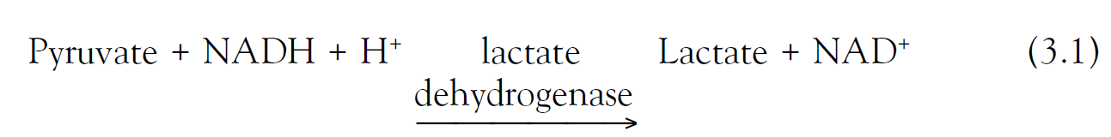
Metabolic acidosis and exercise fatigue: the counter-view
During exercise, ATP is resynthesized via anaerobic glycolysis (Figure 3.2) and oxidative phosphorylation via β-oxidation of fatty acids and breakdown of pyruvate in the Krebs cycle and electron transport chain.
To prevent pyruvate accumulation, which would inhibit glycolysis and thereby impair both anaerobic and oxidative ATP resynthesize, pyruvate can be converted, via the lactate dehydrogenase reaction, to lactate.

Slide 80
Metabolic acidosis and exercise fatigue: the counter-view
Simply put, the production of lactate via the lactate dehydrogenase reaction is alkalinizing to the cell, not acidifying.
Lactate may also facilitate H+ removal from the cell via monocarboxylate (MCT) transporters present in cell membranes.
These transporters also serve to remove H+ from the cell, meaning that the removal of lactate also removes H+ from the muscle.

Slide 81
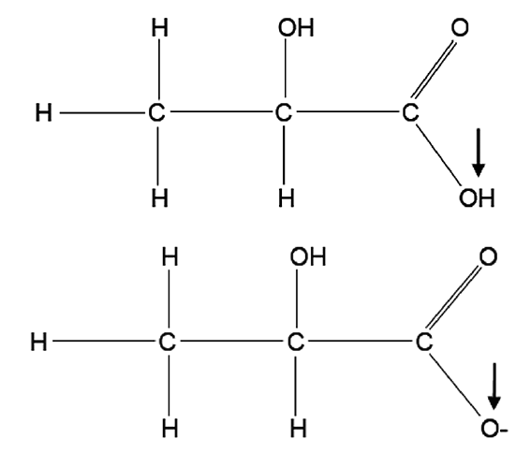
Metabolic acidosis and exercise fatigue: the counter-view
The chemical structure of lactic acid (top) and lactate (bottom). Lactic acid contains hydrogen that dissociates and moves into the surrounding solution
as a hydrogen ion (H+), increasing its acidity.

Slide 82
Metabolic acidosis and exercise fatigue: the counter-view
As stated above and shown in Figure 3.2, lactate, not lactic acid, is produced in glycolysis.
This means that any lactic acid present in the body would dissociate to lactate and H+.

Slide 83
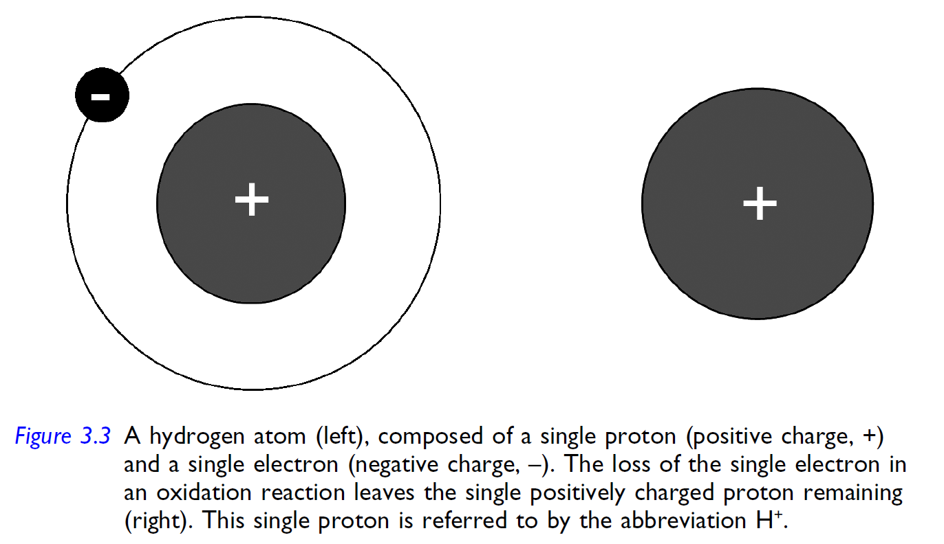
Metabolic acidosis and exercise fatigue: the counter-view

Slide 84
Metabolic acidosis and exercise fatigue: the counter-view
As stated above and shown in Figure 3.2, lactate, not lactic acid, is produced in glycolysis.
This means that any lactic acid present in the body would dissociate to lactate and H+.
The production of lactate does not produce H+, and therefore does not directly make its environment more acidic. However, lactate production may alter the behaviour of intracellular water, thereby indirectly causing H+ production.

Slide 85
The impact of hydrogen production on muscle function
Sarcoplasmic reticulum Ca2+ release and Ca2+ binding to troponin C
Originally, it was thought that metabolic acidosis caused a reduction in muscle force by reducing the rate of Ca2+ release from the sarcoplasmic reticulum.
The release of Ca2+ is crucial for muscle contraction, and if insufficient Ca2+ is released the muscle may contract with less force.

Slide 86
The impact of hydrogen production on muscle function
Sarcoplasmic reticulum Ca2+ release and Ca2+ binding to troponin C
However, it appears that the normal processes of Ca2+ release from the sarcoplasmic reticulum are not impaired, even when muscle pH levels are as low as 6.2 (from a normal resting pH of ~7.1).
It therefore appears that the influence of acidosis on Ca2+ movement from its intramuscular storage site is minimal.
Hydrogen competes with Ca2+ to bind to troponin C, and for this reason it was thought that intramuscular H+ accumulation would reduce muscle force.

Slide 87
The impact of hydrogen production on muscle function
Sarcoplasmic reticulum Ca2+ release and Ca2+ binding to troponin C
However, increased intramuscular acidity also causes a reduction in the binding of Ca2+ to other locations in the muscle fibre, such as the sarcoplasmic reticulum Ca2+ pump.
Intramuscular acidosis causes changes to Ca2+ kinetics, but these changes have, at most, only a small effect on muscle force production. In fact, some of these changes may actually favour an increase in muscle force development under acidic conditions.

Slide 88
The impact of hydrogen production on muscle function
Muscle membrane excitability
Research into the effect of H+ on the excitability of skeletal muscle (the ability of the electrical signal to move across the muscle membrane and into the muscle to stimulate Ca2+ release) is a good example of how H+ can exert positive effects on muscle function.

Slide 89
The impact of hydrogen production on muscle function
The rate of glycolysis
The suggestion that acidosis inhibits glycolytic enzymes and therefore slows the rate of glycolysis is controversial, with some research demonstrating no associations between muscle pH and muscle force production or high intensity exercise performance.

Slide 90
The impact of hydrogen production on muscle function
The cross-bridge cycle
Hydrogen production can impair cross-bridge force production, thereby reducing muscle force. Hydrogen production may also reduce the maximum velocity of muscle contraction, although this is dependent on the extent of acidosis, muscle temperature, and Ca2+ kinetics. The potential influence of H+ on muscle force and velocity indicates that it may also impair muscle power output.

Slide 91
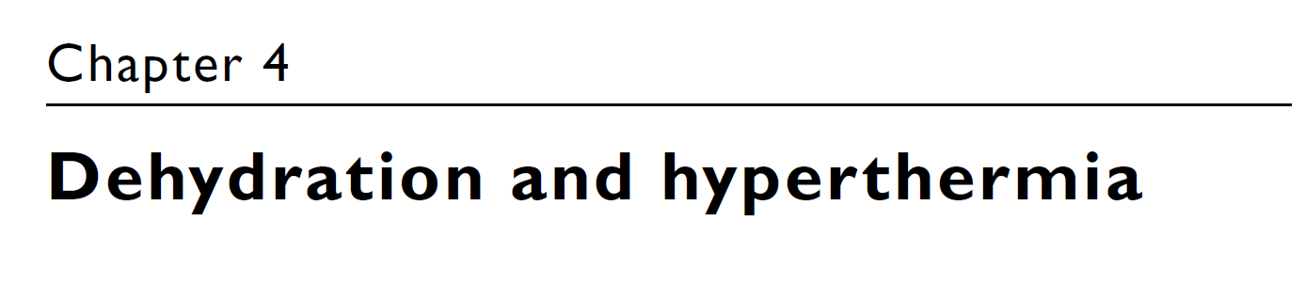

Slide 92
Dehydration and exercise fatigue
Hydration or euhydration refers to a normal (or, more accurately, appropriate) body water content for an individual.
Hyperhydration refers to a state of excess body water content.
The dynamic process of losing body water is termed dehydration.
Dehydration and hypohydration are closely related, but do not mean the same thing.
Dehydration is the process of body water loss; hypohydration is the end result of this loss.

Slide 93
The importance of water in the body
A person can survive for several weeks without consuming food, and can survive losses of up to 40% of their BM in fat, carbohydrate, and protein.
However, a matter of days without water, or a water loss of only 9–12% of BM, can be fatal.
Approximately two thirds of body water content is contained inside our cells (intracellular fluid), with the other third outside the cells (extracellular fluid).

Slide 94
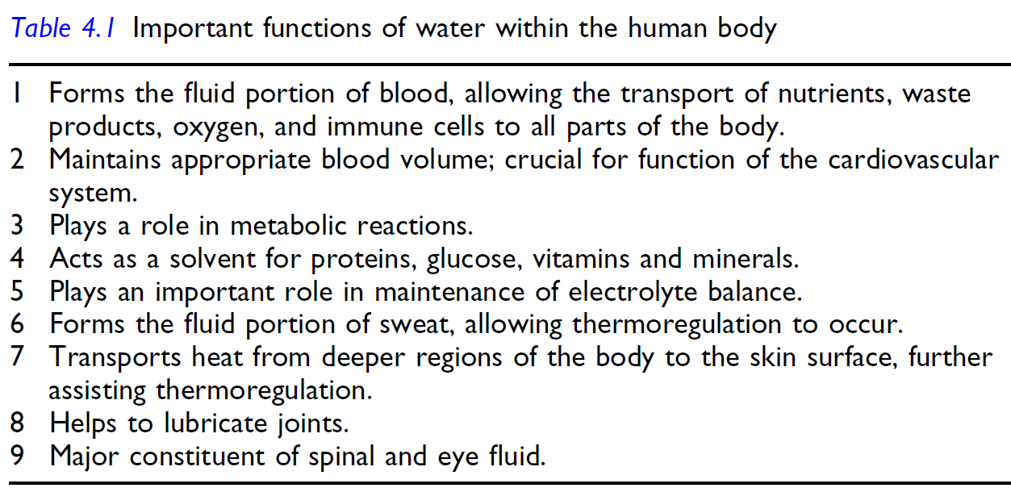
The importance of water in the body

Slide 95
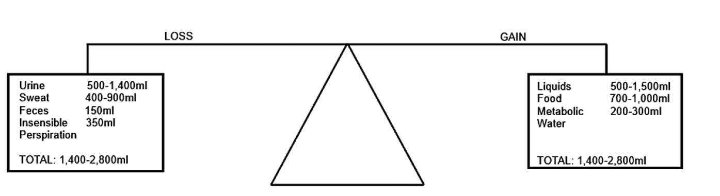
The importance of water in the body

Slide 96
The importance of water in the body
It is recommended that normal adults should consume 1–1.5 ml of water for every Kcal expended, and athletes should consume 1.5 ml of water for every Kcal expended.
Body water balance is influenced by factors that vary greatly between people. As a result, water requirements can vary significantly from person to person.

Slide 97
Classical mechanism of dehydration-induced performance decrement
During exercise, sweat rate greatly increases. Sweating is the main way that the body dissipates heat produced from the increase in energy metabolism during exercise.
The fluid portion of sweat comes from blood plasma, muscle tissue, skin and other internal organs.
The loss of fluid from blood plasma causes a decrease in plasma volume.
reduction in stroke volume
and reduction cardiac output

Slide 98
Classical mechanism of dehydration-induced performance decrement
This reduction in cardiac efficiency may in itself lead to impaired exercise performance, with an approximate increase in exercising heart rate of 3–5 beats per minute for every 1% loss of BM due to dehydration.
However, if water loss and exercise continue, the reduced plasma volume may lead to competition for blood flow between core organs and tissues and the skin.
Therefore, according to the classical theory, dehydration may impair performance directly through alterations in cardiac efficiency, and indirectly by contributing to the development of hyperthermia.

Slide 99
Classical mechanism of dehydration-induced performance decrement

Slide 100
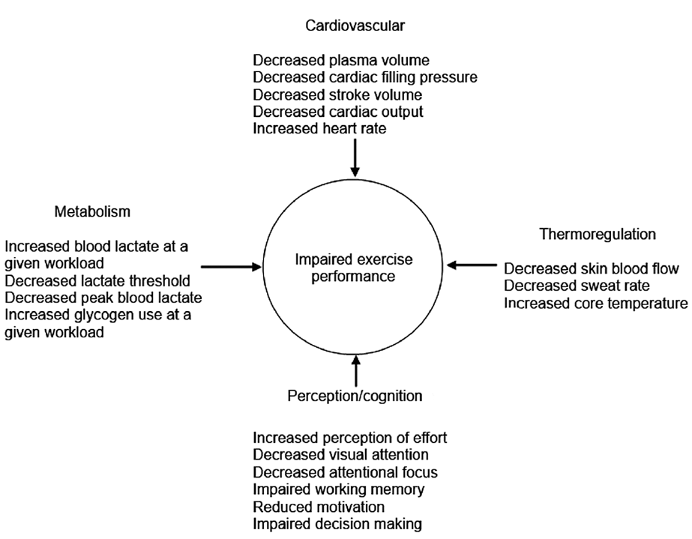
Classical mechanism of dehydration-induced performance decrement

Slide 101
Classical mechanism of dehydration-induced performance decrement
Early research established an apparent ‘threshold’ hypohydration level of 2% body mass, above which aerobic exercise performance is impaired.
This threshold has become established as a cornerstone of fluid intake recommendations and guidelines.
Marino et al. These authors found that ingesting no fluid during 60 minutes of self-paced high-intensity cycling in moderate (hypohydration 1.7% BM) or warm (hypohydration 2.1% BM) conditions did not impair performance compared with consuming enough fluid to maintain BM.
Interestingly, the authors provided evidence to suggest that the neuromuscular system altered muscle recruitment in response to different hydration levels, thereby enabling a similar performance level despite differences in hydration status.

Slide 102
Classical mechanism of dehydration-induced performance decrement
Nolte et al. This study was a little different to some of the other hydration research, as it investigated the relationship between fluid intake and time to complete a 14.5 km march in soldiers. Interestingly, no relationship between fluid intake and exercise time, or BM loss and exercise time, was found.
Furthermore, the soldiers’ hydration status was maintained despite BM losses of around 2%.

Slide 103
Classical mechanism of dehydration-induced performance decrement
Zouhal et al. This study investigated the relationship between BM change (as an indicator of hydration) and marathon finishing time. The authors found that the greater the BM loss, the faster the marathon finishing time. Put another way, the people who lost more weight, and therefore were, perhaps, more hypohydrated, tended to perform better than those who maintained a stable hydration status or who drank more fluid than they lost during the run.

Slide 104
Classical mechanism of dehydration-induced performance decrement
Overall summary: The research studies discussed above, and others that have found either no effect or a minimal effect of dehydration on exercise performance.
Studies using self-paced exercise demonstrate that fluid loss does not impair exercise performance. A review of the literature further states that dehydration only impairs exercise performance during fixed workload exercise.
Reduced body mass during exercise does not necessarily mean that a person’s hydration status has been negatively affected. Body mass loss does not necessarily equate with fluid loss.

Slide 105
Classical mechanism of dehydration-induced performance decrement
Only people with specific characteristics may show improved exercise performance with high levels of body mass loss. Therefore, intentional body mass loss should not be recommended as a general strategy for improving performance.
Hypohydration during exercise by an average of about 2.2% BM does not impair exercise performance, and in fact may cause a performance improvement.
There is no relationship between percentage change in BM and percentage change in power output during exercise.

Slide 106
Classical mechanism of dehydration-induced performance decrement
Both exercise duration and intensity are more important determinants of performance than dehydration.
There is no significant difference in performance between exercise that results in a BM loss of less than 2% or a BM loss of more than 2%.

Slide 107
Hyperhydration during exercise
Hypervolaemia is an abnormal increase in blood plasma volume which can be caused by overdrinking.
Hyponatraemia is an abnormally low blood sodium level, caused by overdrinking and/or large sweat sodium losses.
Increased body water content can occur for many reasons:
Protein breakdown, which increases both plasma proteins and plasma volume.
Increased plasma volume due to increased plasma sodium concentration
Retention of sodium due to increased activity of aldosterone
Increased plasma volume due to increased activity of vasopressin
Impairment of renal function due to dehydration

Slide 108
Hyperhydration during exercise
Features of hyponatraemia can range from no or minimal symptoms such as weakness, dizziness, headache, nausea, and vomiting, to serious symptoms including fluid accumulation in the brain (cerebral oedema) leading to brain swelling, altered mental function, seizures, fluid accumulation in the lungs (pulmonary oedema), coma, and death.
The primary cause of exercise-associated hyponatraemia is overdrinking during exercise. High sweat sodium concentrations can also increase the risk of hyponatraemia, as less fluid intake is required to dilute blood sodium to dangerous levels.

Slide 109
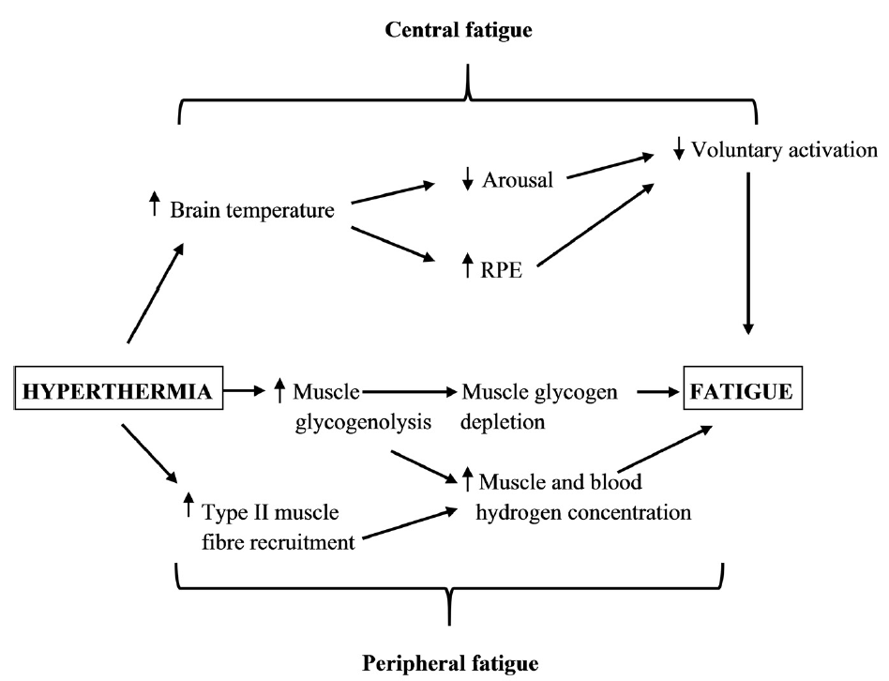
hyperthermia-induced fatigue during exercise

Slide 110
Central fatigue associated with hyperthermia
There is good evidence to show that hyperthermia reduces the ability to produce muscle force despite no change in the ability of the muscle itself to produce force. This suggests that central factors may be more important than peripheral factors in hyperthermia-induced fatigue.
During exercise in hyperthermia, brain metabolic rate increases but both blood flow to the brain and brain electrical activity decrease. These changes are associated with a progressive increase in the perception of exercise effort, demonstrating a link between brain blood flow and function, and exercise performance.

Slide 111
Central fatigue associated with hyperthermia
The ‘critical’ core temperature of approximately 40°C is much lower than the temperature required to cause cellular damage. Therefore, the relevance of this temperature as a limiting factor in exercise performance should be questioned.
Elevated skin temperature increases skin blood flow requirements, potentially impairing cardiovascular responses to exercise. High skin temperature may also reduce brain blood flow and oxygen delivery.

